Slide 1
Culture Organizing and Developement
Syd Beane
Senior Community Development Specialist
Center for Community Change
160 Sansome Street, 7th Floor
San Francisco, CA 94104
Tel: 415 - 982-0346 Fax: 415-956-688-

Slide 2
Paradigm Shift
In living systems, what is healthy is a dynamic balance, what is unhealthy is imbalance - over emphasis of one tendency or neglect of the other.
We should not replace any one view of the world with another but establish a better balance between them.

Slide 3
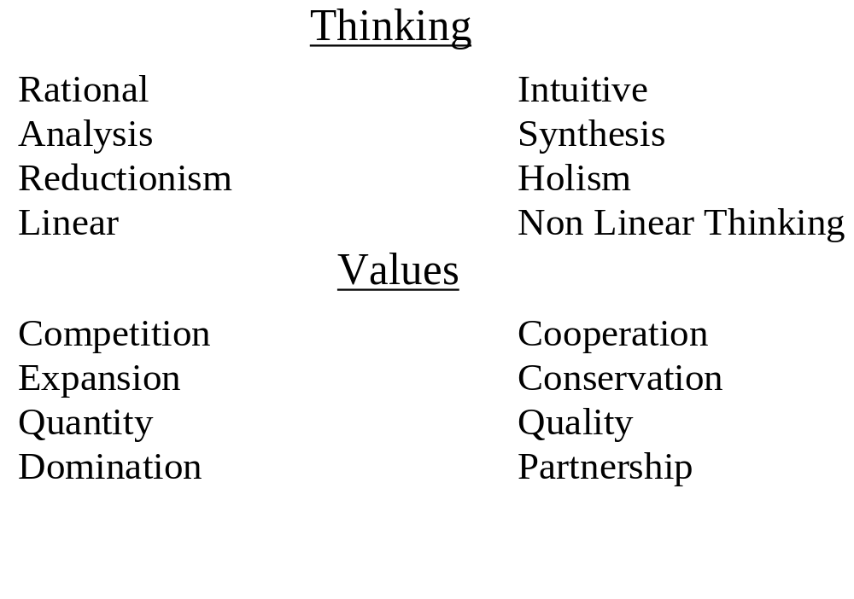
Old Paradigm New Paradigm

Slide 4
Indian Center, Inc.
Organizing and Development Model
Strategic Planning
Lincoln Community Development Partnership
State Housing Commission
Nebraska Equity Fund
Ritual and Ceremonies
Community Based Org
Community Needs Assessment
Long Range Strategic Planning
Ritual and Ceremonies
Public Policy
Organizing
CDC Development
Affordable Housing Development
Economic Development
Ritual and Ceremonies
Task Force Organizing
Tenant Organizing
Coalition Organizing
Rituals and Ceremonies
Development

Slide 5
Organize
Organize Community Support for Development
Develop Financing and Project
Organize Community Visioning Meetings
Identify Development Needs
Development
Development
Organize Development Corporation
Select Development Team
Organize Development Committee
Complete Development Concept Plan
Organize

Slide 6
Culture and Organizing
Culture is a system of feeling, values, and beliefs which determine how we think and act.
Communities will share certain values and differ in others.
Those in power sometimes deliberately manipulate values to suit their own purposes.
When people do not understand the real values of their group, they are likely to accept the myths that are created for them.

Slide 7
The myths created by people in power maintain the status quo cut people off from their real history and culture of individual pride and collective action.
Rediscovering our own history and vulture helps us to restore the real value of our communities.
A priority of our organizing activities must be to elp the different member of our organization rediscover their own histories and cultures

Slide 8
Organizing strategies and tactics will not be effective unless they are acceptable to the culture in which we are organizing.
Organizers should become familiar with their own history and cultural values before organizing with people of other cultures.

Slide 9
Culture as an Organizing Context
Organizing with people is not only about building an organization. It is reestablishing peoples culture.
The organization is creating a shared sense of history and beliefs which provide a cultural context for developing strategies and tactics.
The organization and organizer in the process of helping people rediscover their historical values develops a vehicle for creating a new system of feelings, values, and beliefs.

Slide 10
Building Culture into Daily Organizing
Personalize and communicate cultural values during on-to ones and through organization materials.
Build culture into meetings.
Actions should include activities which preserve the history of the organization and its events.
Through the creation and re-creation of symbols.

Slide 11
Ceremonies and Rituals
Ceremonies and rituals are the residue of culture which allows us to give expressions to personal experiences and beliefs while connecting with community and all things.
Rituals and symbols help us to rediscover things we may need to see differently.
Ceremonies link and mental expressions and allow us to act out our feelings and beliefs.

Slide 12
Major Components of Ceremony
- Story
- Symbol
- Action
Other Elements of A Ceremony
- Personal Preparation
- Involves the Senses
- Encourage Group Participation
- Physical Object
- Sacred Place
- Reinforcement of beliefs at all levels; body, mind and spirit
- Language Use
- Music

Slide 13
Sustainable Development
Sustainability is meeting current economic social and cultural needs without compromising the ability of future generations to meet their needs.
And underlying premise of sustainability is that economic development, social equity and environmental quality are inextricably linked.

Slide 14
Sustainable development Principles:
Develop land in harmony with natural ecosystems
Use water, energy, lumber and other resources efficiently
Conserve plants, animals endangered species and natural habitats
create development opportunities which are equitable for all community partners

Slide 15
Focus investment to preserve and revitalize communities
integrate space-based community economic development with sector-based high growth business development
Integrate the development of community businesses, housing and schools

