Slide 1

Comments
Joseph R. Mason
Drexel University, the Wharton School, and FDIC

Slide 2
Managing DI Through the Cycle
DI is different from other types of insurance.
  Katrina: Property insurance.
  Auto: my car
DI gives claimants $, but takes assets.
Liquidates and recovers over time: time consistency problem.
How does DI reserve for losses?
  First, observe that gross losses_{t} > net losses_{t+m}

Slide 3
Managing DI Through the Cycle
Reserve Savings
t
Financing

Slide 4
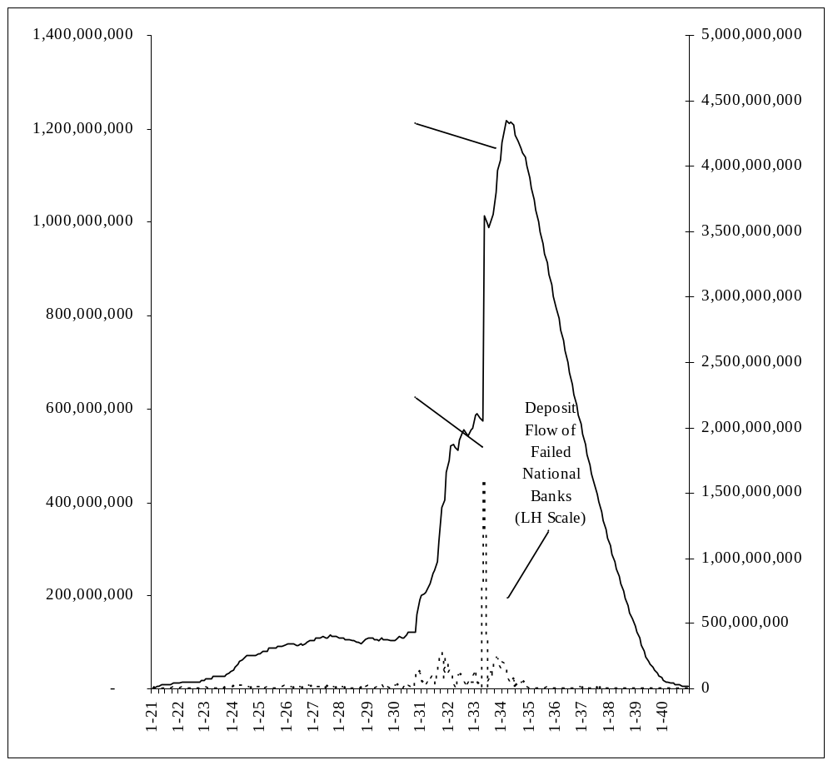
Managing DI Through the Cycle

Slide 5
Managing DI Through the Cycle
DI manages liquidation as AMC to achieve reserve savings.
  monitoring, capital , liquidity
Three important questions:
  What makes banks fail?
  What determines resolution strategy?
  What effect do failures and their resolution have on economic performance?

Slide 6
Rajkamal Iyer and Jose L. Peydro-Alcalde, “Interbank Contagion: Evidence from Real Transactions.”
Directly models contagion via interbank exposure data among large Indian banking institutions at the time of the failure of the Madhavan Mercantile Cooperative Bank (MMCB) March 10-12, 2001 due to fraud.
Institutional Environment: Much like U.S. Credit Union system.
Data:
  3/31/01 (public) and 12/31/01 (CB) deposit data.
  3/31/01 balance sheet data.
  3/31/01 MMCB deposit exposure (source?).
  3/31/01 interbank exposure.
Findings:
  1. Exposure to MMCB (-) related to deposit growth.
  2. Test individual bank:
    media coverage;
    release (by bank) of exposure information regarding MMCB;
    importance of government mandate in general vs. MMCB exposure in particular.

Slide 7
Greg Caldwell, “An Analysis of Closure Policy under Alternative Regulatory Structures.”
Theoretical adaptation of Repullo (JMCB 2001) and Kahn and Santos (2001).
Examines bank choice of risk given institutional AMC design.
Looks at welfare Implications of resolving failure where:
W=ƒ(υ, A₀, μ, A, A_{M}, φ, λ, A_{C}, θ, ω, R)
Key to theory is assumption of difference between:
  benevolent supervisory agency ;
  self serving deposit insurer.
General idea is that “ benevolent supervisory agency” is more likely to resolve through merger to preserve desirable social investment.
  Vulture capitalist vs. AMC
  LCR vs. EPOR
Merger facilitated by capital infusion (forbearance)?

Slide 8
Managing DI Through the Cycle
Reserve Savings
t
Financing

Slide 9
Carlos Ramirez and Philip Shively, “Do Bank Failures Affect Real Economic Activity?”
Empirical Application: follow on CM (2003) and AKM (JMCB 2005) using state-level data to identify real effects of bank failures.
  Bank Fails → Business Fails?
  Business Fails → Bank Fails?
  Impulse vs. Propagation
Use 48 state-level VARs. Find
Bank Fails → Business Fails
NOT Business Fails → Bank Fails
Then seeks to identify why Bank Fails → Business Fails. Answers:
    ↑ deposits ser capita
    ↑ loans per capita
    ↓ branching dummy
    ↓ DI dummy

Slide 10
Managing DI Through the Cycle
Reserve Savings
t
Financing
What makes banks fail?
What determines resolution strategy?
What effect do failures and their resolution have on economic performance?

Slide 11
Managing DI Through the Cycle

