Slide 1
Bandelier’s Animal and Plant ABC Coloring Book

Slide 2
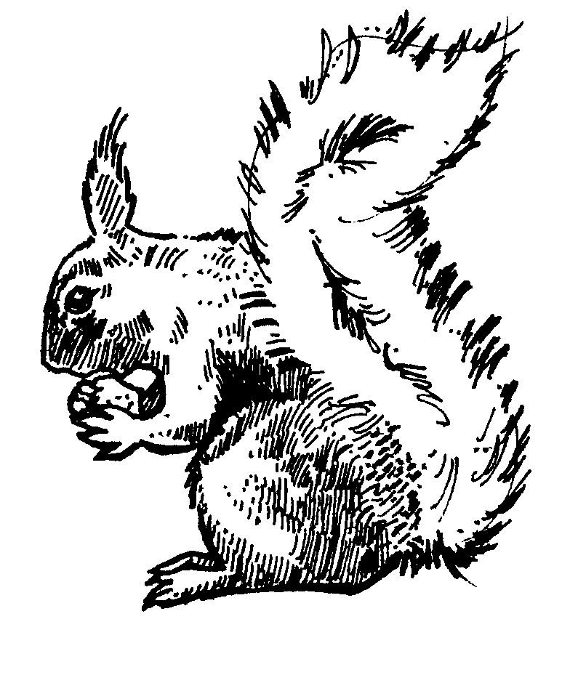
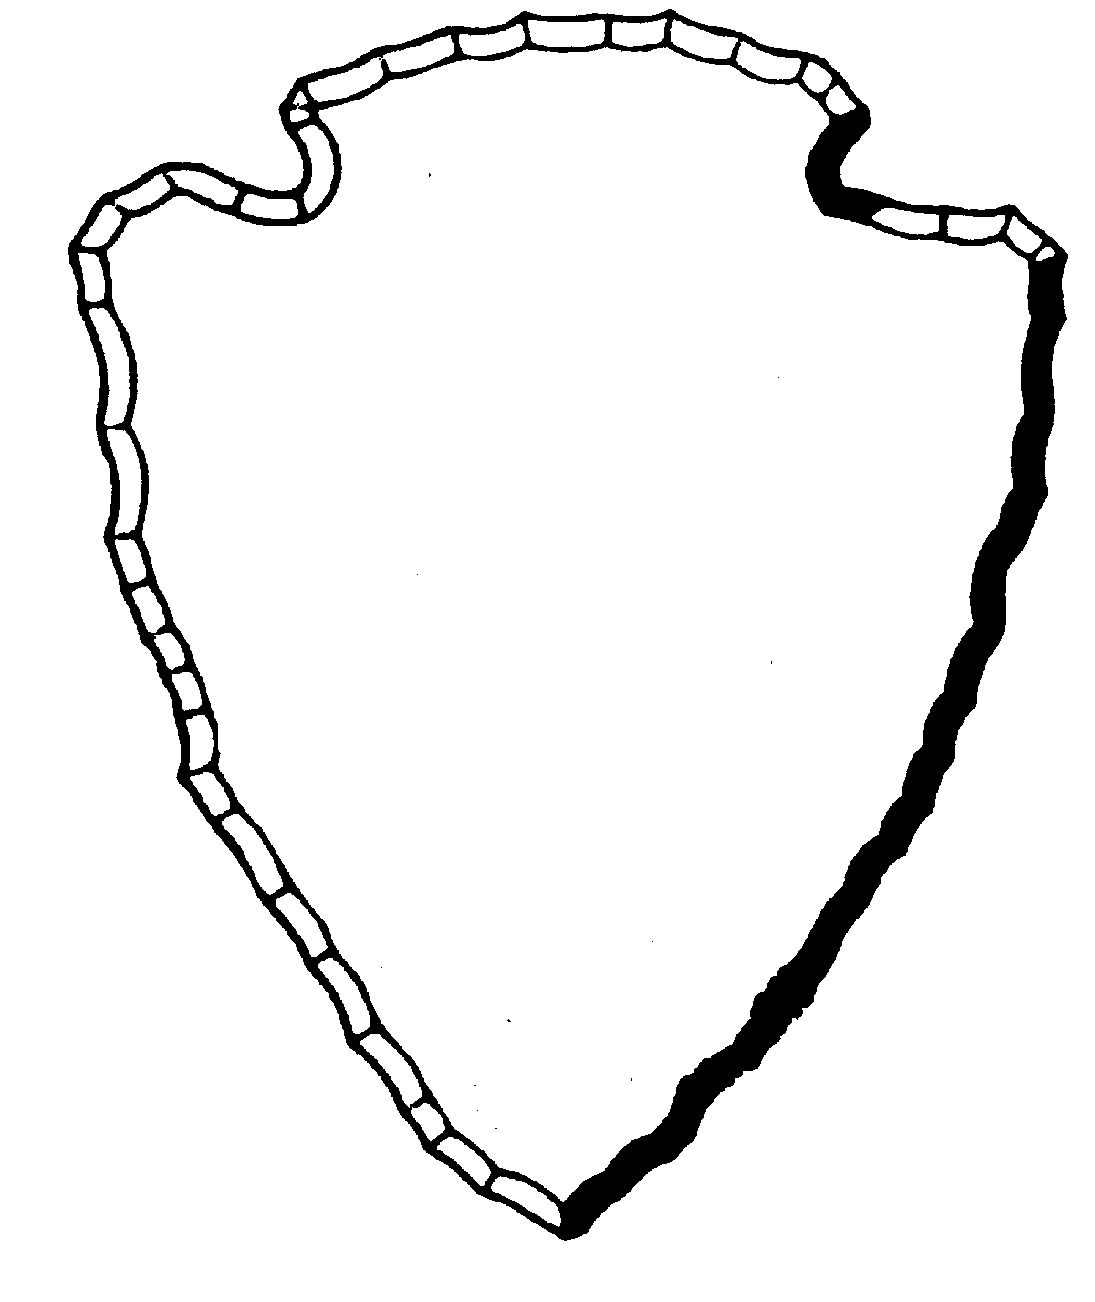
Abert’s Squirrel
Aa
All Abert’s squirrels almost always eat seeds.
1

Slide 3
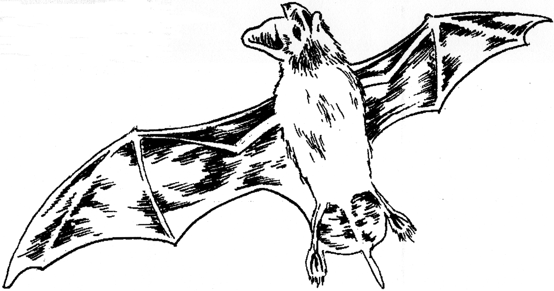
Bat
Bb
Brown bats eat black bugs.
2

Slide 4
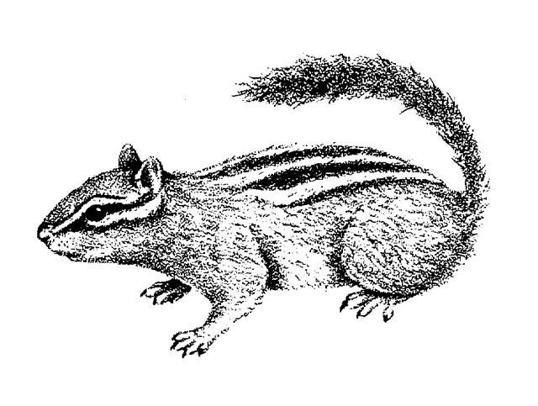
Chipmunk
Cc
Chipmunks can carry nuts.
3

Slide 5
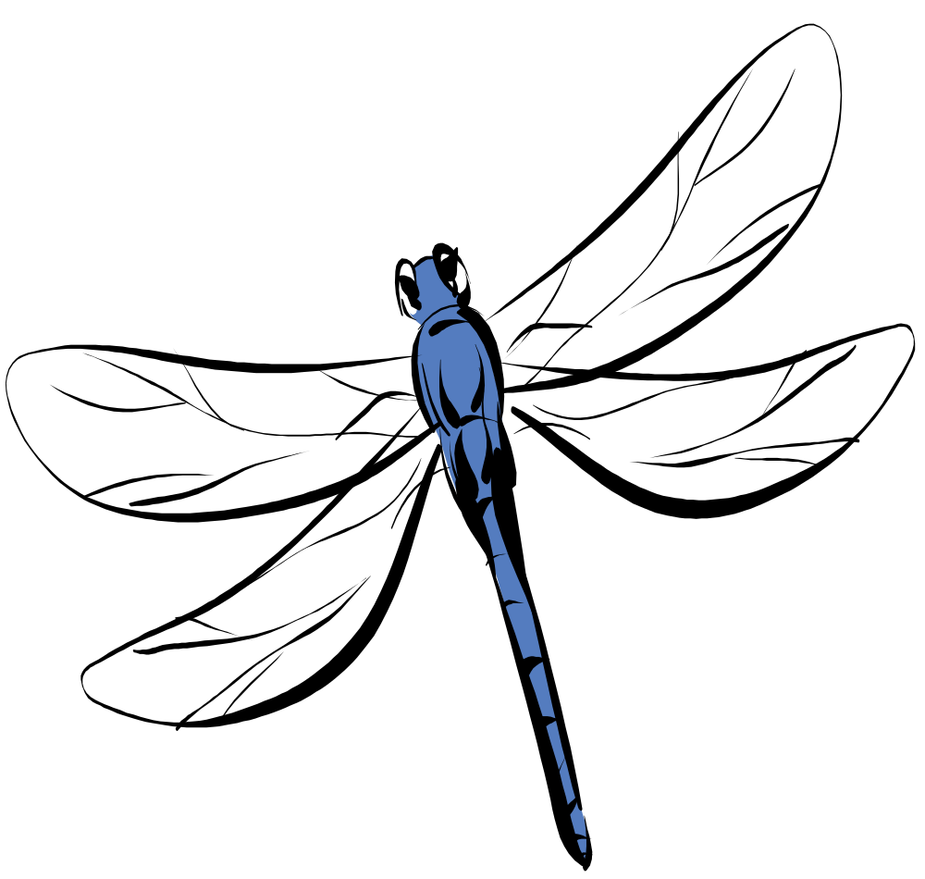
Dragonfly
Dd
Dragonflies dart and dip.
4

Slide 6
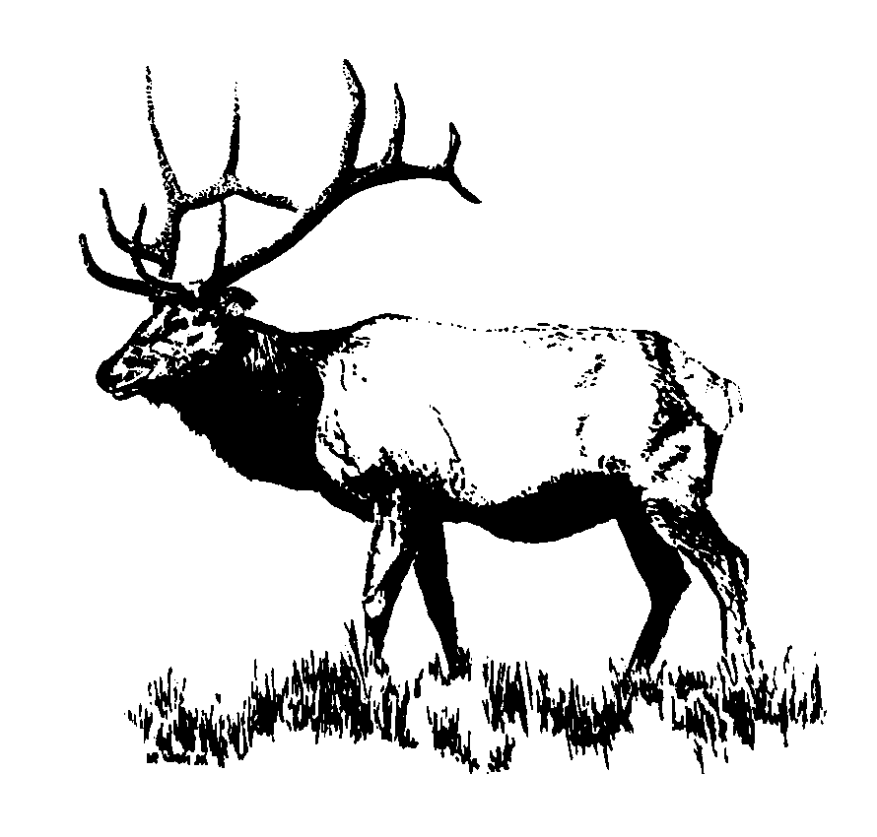
Elk
Ee
Every elk eats grass and plants.
5

Slide 7
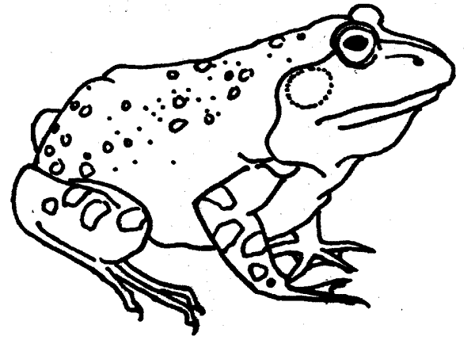
Frog
Ff
Four frogs catch five flies.
6

Slide 8
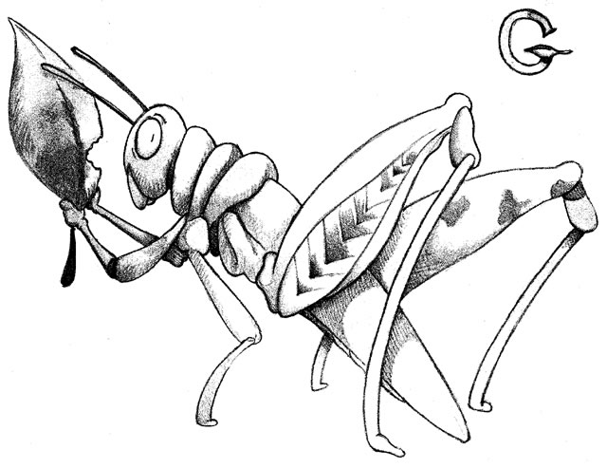
Grasshopper
Gg
Green grasshoppers go high.
7

Slide 9
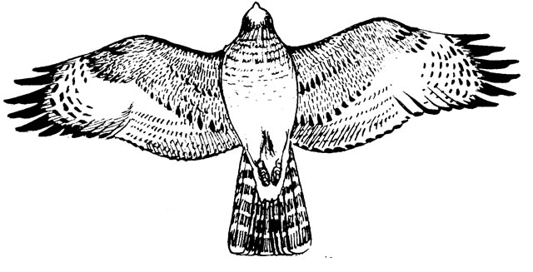
Hawk
Hh
A hawk holds a high branch.
8

Slide 10

Indian Paintbrush
Ii
Insects like Indian paintbrush.
9

Slide 11
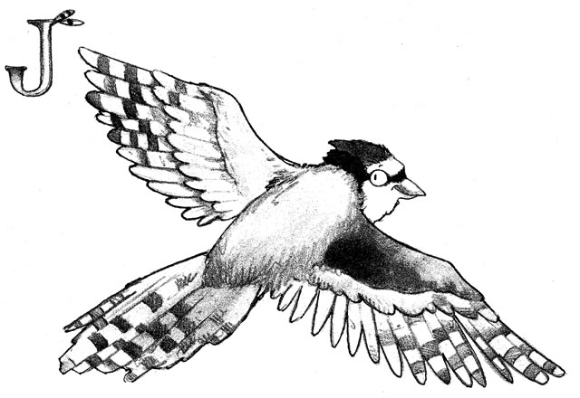
Stellar Jay
Jj
Jays jabber with joy.
10

Slide 12
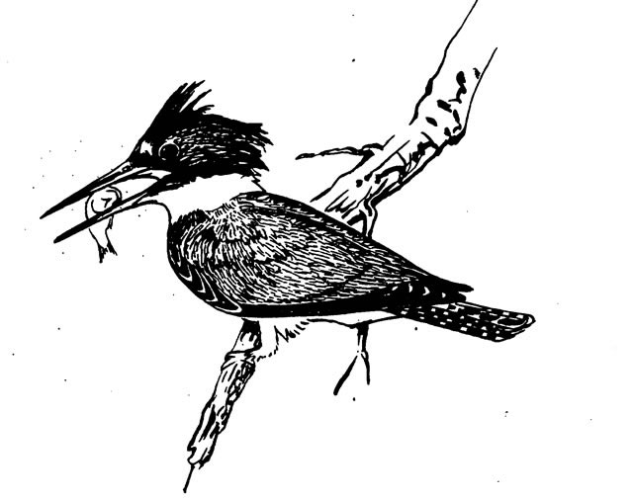
Kingfisher
Kk
A kingfisher has a keen beak.
11

Slide 13
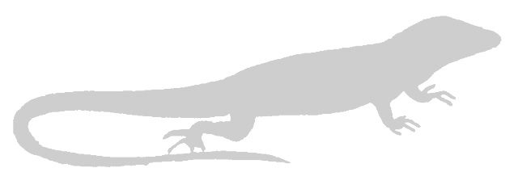
Lizard
Ll
Lazy lizards like to lie on rocks.
12

Slide 14
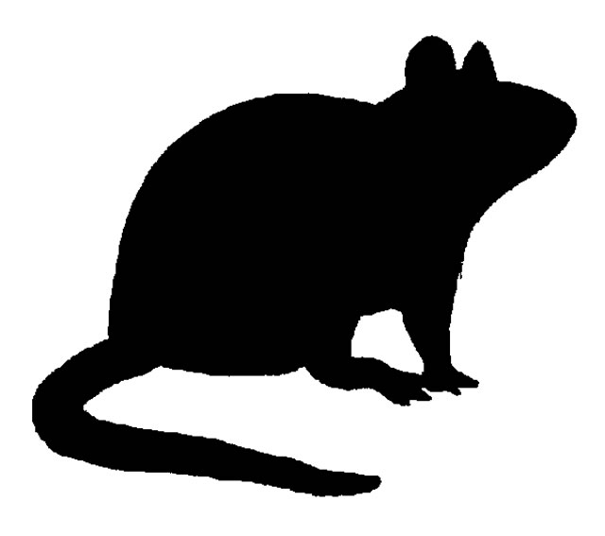
Mouse
Mm
A mouse may run many miles.
13

Slide 15

National Park
Nn
National Parks need nice visitors.
14

Slide 16
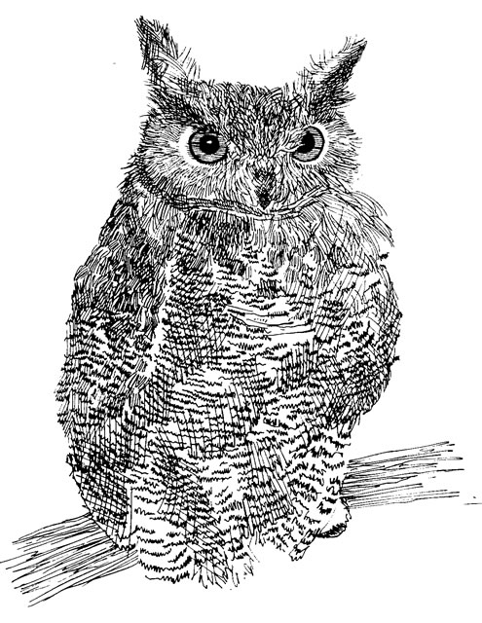
Great Horned Owl
Oo
Owls come out at night.
15

Slide 17
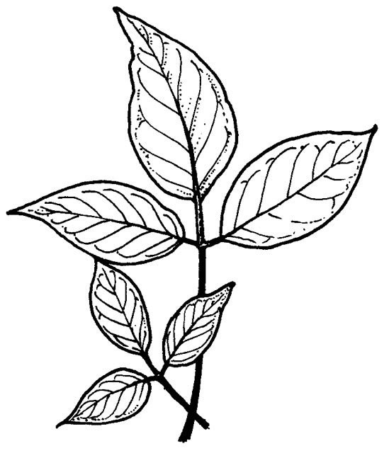
Poison Ivy
Pp
Poison ivy can poise a problem.
16

Slide 18
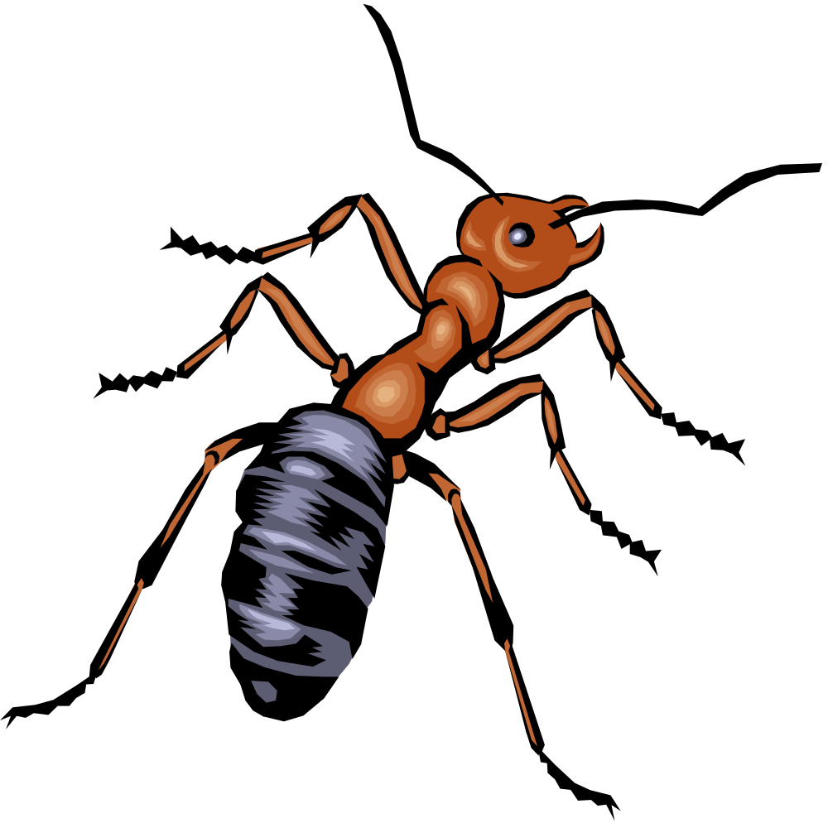
Queen Ant
Qq
Queen ants are quick and quiet.
17

Slide 19
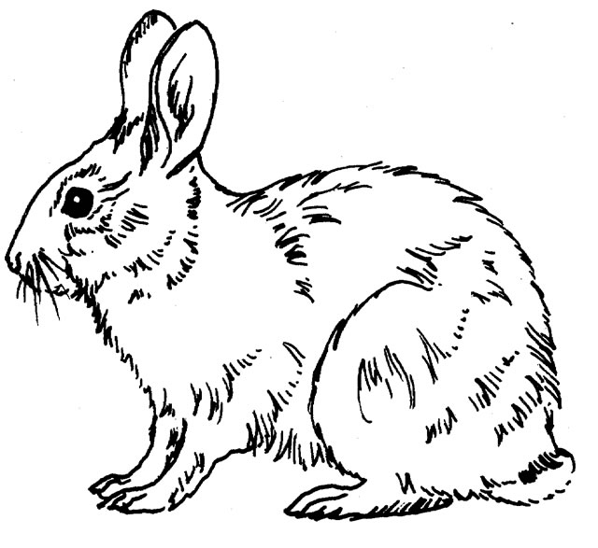
Rabbit
Rr
Rabbits really run fast.
18

Slide 20
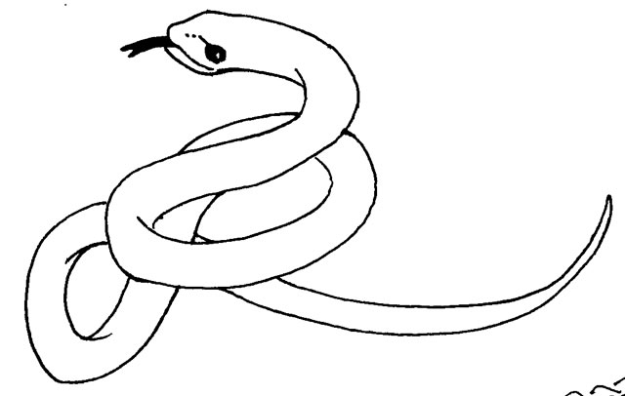
Snake
Ss
Seven snakes slither.
19

Slide 21

Tarantula
Tt
Tarantulas take their time.
20

Slide 22

Underground Homes
Uu
Underground homes are safe.
21

Slide 23
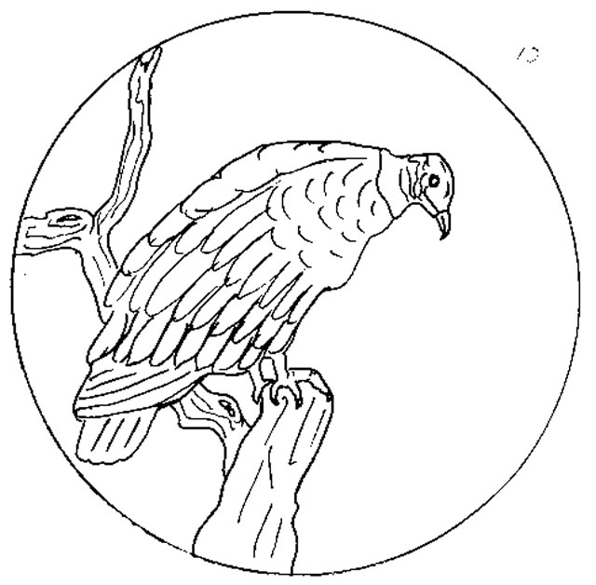
Vulture
Vv
Vultures have a very high view.
22

Slide 24
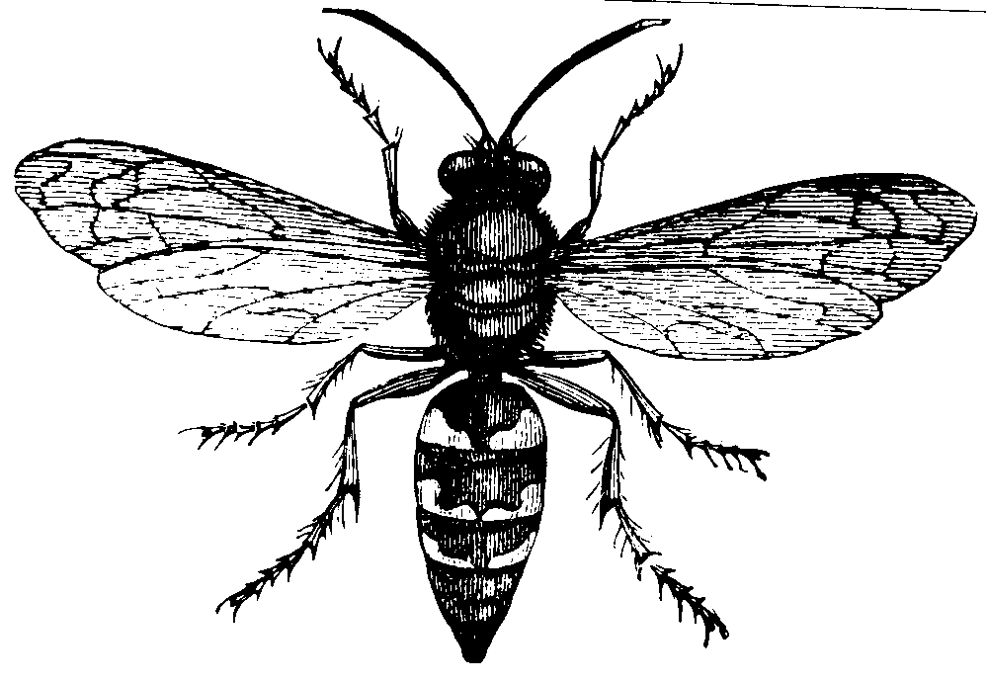
Wasp
Ww
Wasps will want nice nests.
23

Slide 25
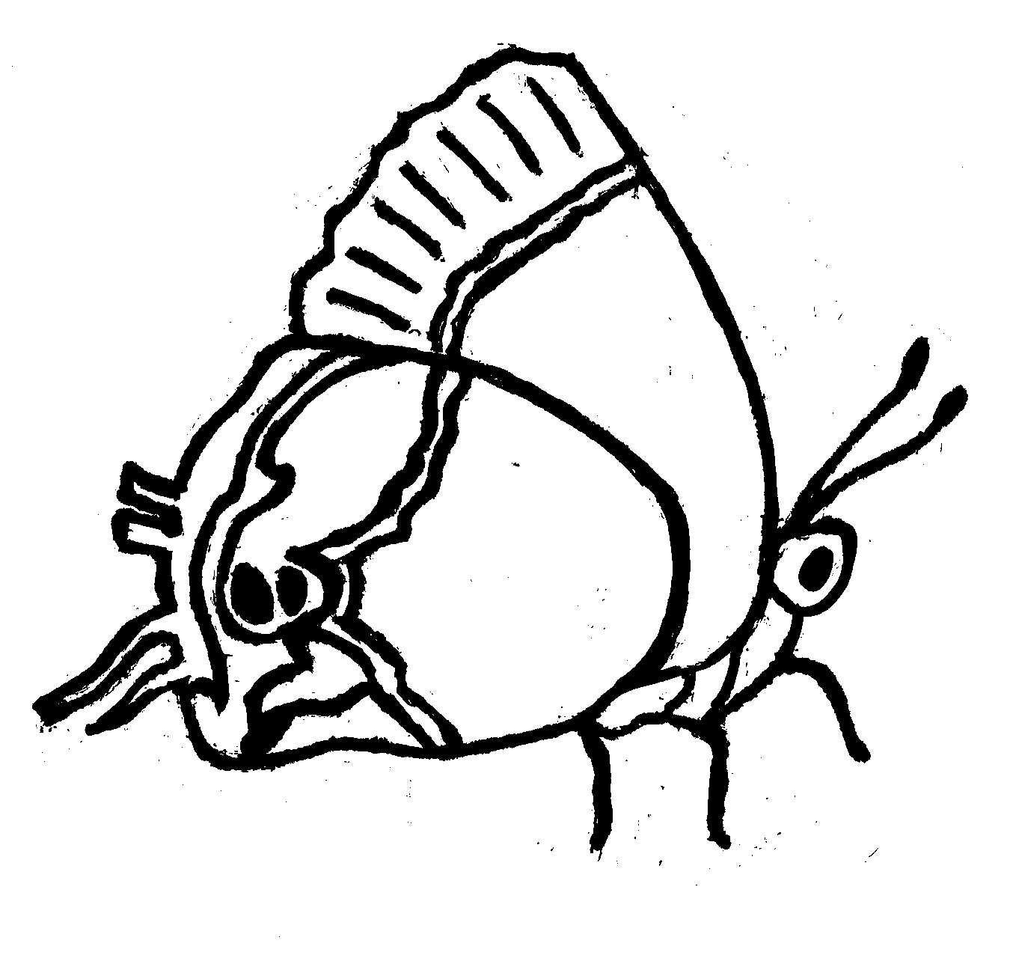
Xami Hairstreak Butterfly
Xx
Xami Hairstreak butterflies fly to the flowers.
24

Slide 26

Yucca
Yy
Young yuccas have yellow fruit flowers.
25

Slide 27
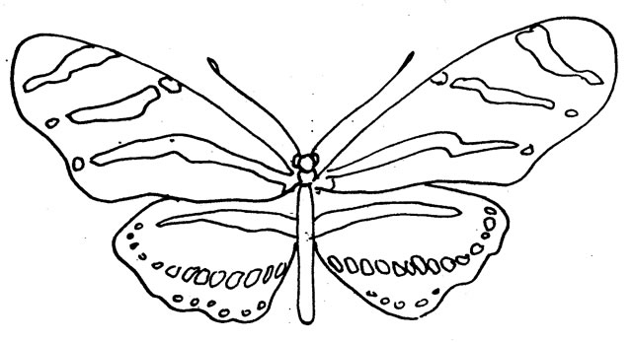
Zebra Butterfly
Zz
Zebra butterflies fly zig zag patterns.
26

