Slide 1


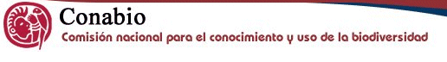
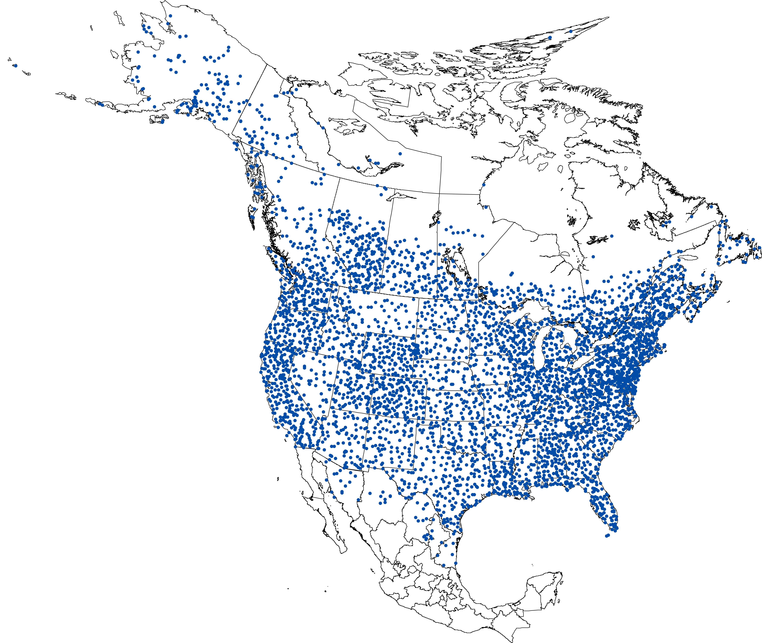
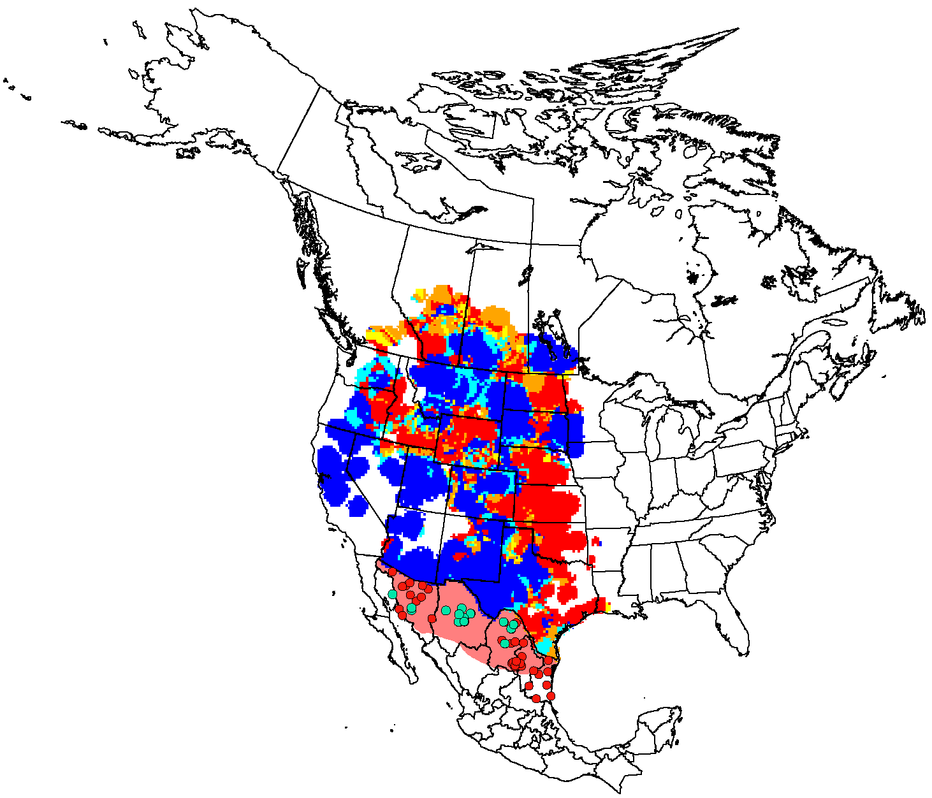
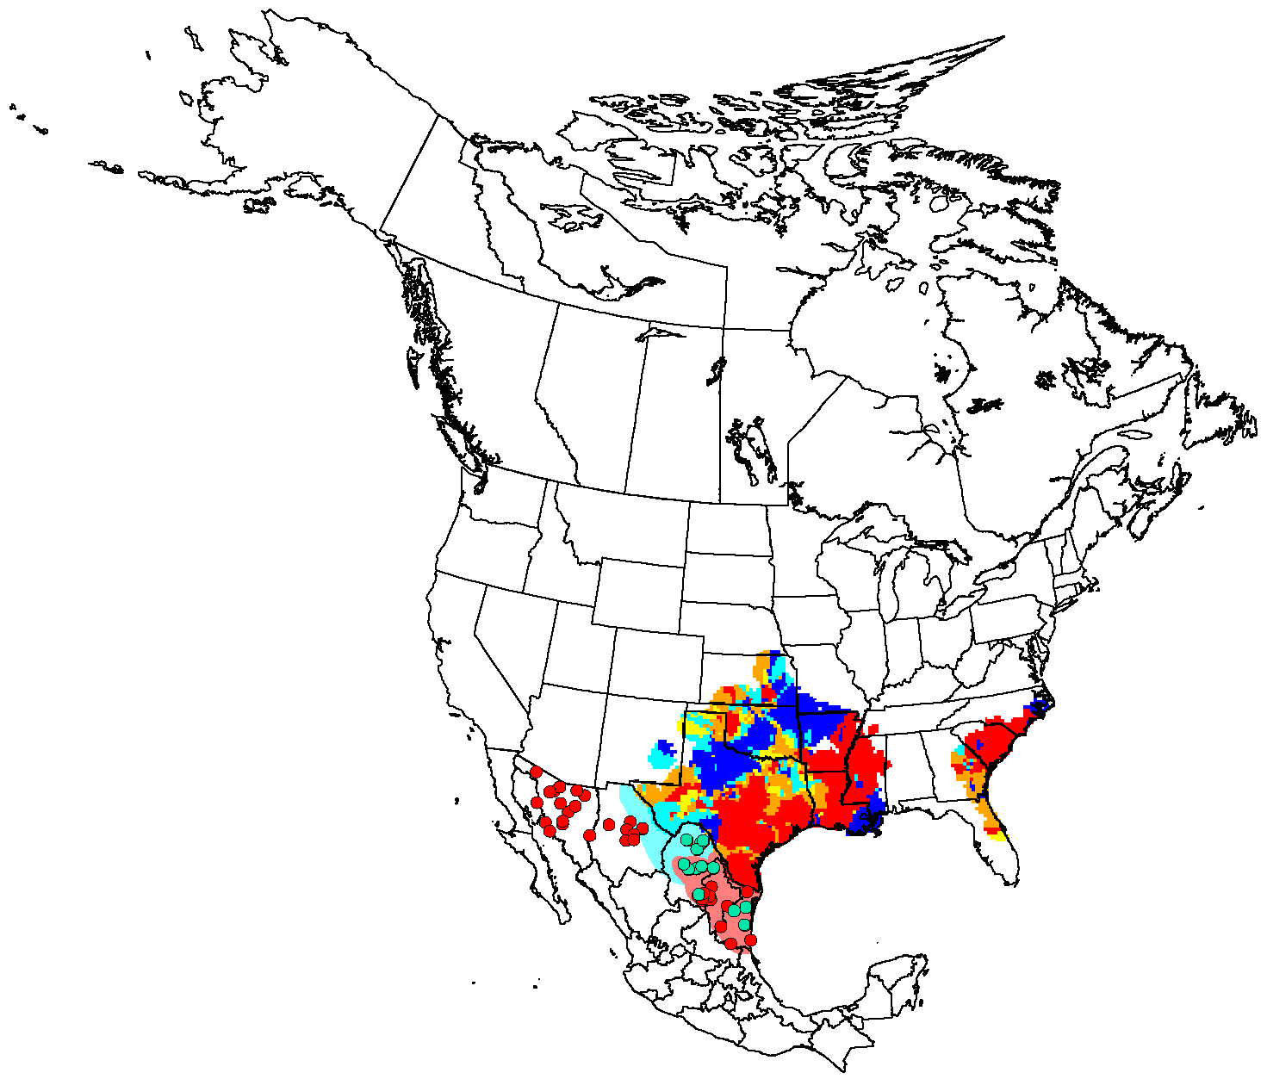
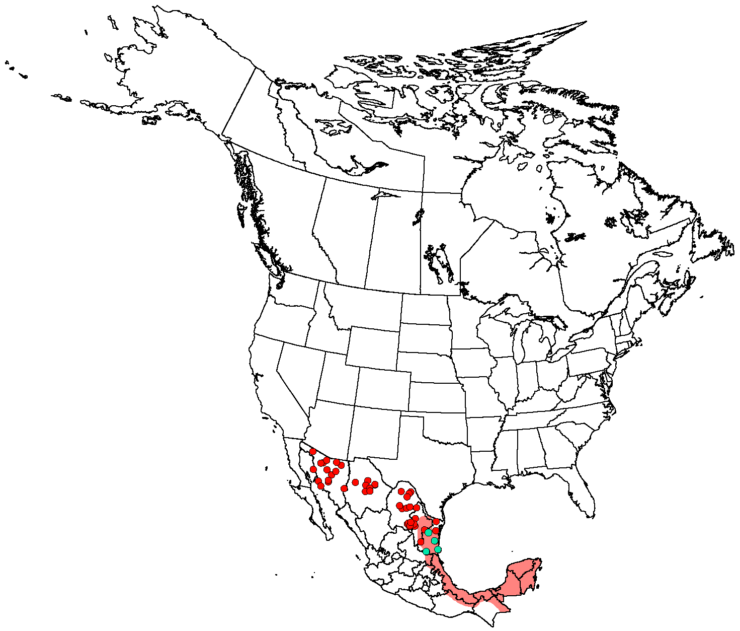


Establishing a Mexican Breeding Bird Survey (BBS) Program
Keith L. Pardieck¹, Humberto A. Berlanga², Connie M. Downes³, Bruce G. Peterjohn¹, David J. Ziolkowski, Jr.¹, and Brian Collins³
¹USGS Patuxent Wildlife Research Center, 12100 Beech Forest Road, Laurel, MD 20708-4038 U.S.A.
²Comisión Nacional Para el Conocimiento y Uso de la Biodiversidad, Liga Periférico-Insurgentes Sur No.4903, Col. Parques del Pedregal, Delegacion Tlalpan, C.P. 14010 México, DF, México.
³Canadian Wildlife Service, 1125 Colonel By Drive, Ottawa, ON K1A 0H3 Canada
BBS is an Important Conservation Tool
The North American Breeding Bird Survey (BBS) forms the foundation of non-game, land bird conservation in the U.S. and Canada, providing large-scale, long-term population data for > 400 species. Established in 1966, the (BBS) is a long-term, avian monitoring program with the purpose of providing scientifically credible measures of status and trends of North American bird populations at continental and regional scales to inform biologically sound conservation and management actions. These data, along with other indicators, are used by the U.S. Fish and Wildlife Service, Canadian Wildlife Service, state agencies, Partners in Flight and many others to assess avian population trends and set national and regional conservation priorities. Analogous population trend data are largely unavailable for most of Mexico’s breeding bird species, severely limiting bird conservation planning efforts there.
  • Currently, the BBS is a joint effort by the U.S. Geological Survey and Canadian Wildlife Service.
  • BBS consists of over 4100 roadside routes (Fig. 1) randomly placed throughout the continental U.S. and Canada of which approximately 3000 routes are sampled annually.
  • BBS data provide an index of avian population abundance that are used to estimate population trends and relative abundances across various geographic scales.
BBS Methodology
  • 24.5-mile (39.2 km) long routes containing 50 stops spaced at 0.5-mile (800-m) intervals are randomly dispersed using a stratified random design.
  • Routes are sampled once per year during the height of the breeding season (June for most routes).
  • Observers (75% are volunteers) skilled in avian identification collect the data.
  • A 3-minute point count is conducted at each stop.
  • All birds seen within 0.25-mile (400-m) radius, or heard, are recorded by the observer.
  • Sampling begins 30 minutes before local sunrise and takes approximately 4.5 hours to complete.
  • Data are either submitted electronically via the Internet, or via the postal service to be scanned by the national BBS office.
Why Establish a Mexican BBS?
The avian conservation community in Mexico has grown substantially in the last decade mirroring their increasing need for better trend assessment of breeding bird populations. Dunn et al. (2005) report that a Mexican BBS program could provide adequate population trend estimates for over 80 species of northern Mexican birds. Although the results of the 3-year pilot project reported here suggest this total is likely to be much higher, especially as the BBS becomes established throughout Mexico.
In addition to providing vital avian population data for Mexico’s conservation efforts, a Mexican BBS would also complete the continental picture for many species whose breeding populations are shared between nations. For example, BBS population trend information for most North American species extends only to the U.S. and Mexican border as depicted by the USGS trend maps for Swainson’s Hawk (Figure 2) and Painted Bunting (Figure 3). However with the inclusion of data from a Mexican BBS, as simulated by data from the ’93-’95 pilot project, a more complete range-wide population picture for these species becomes apparent and available (Figures 2, 3 and 4).
Mexican BBS Background
Efforts to expand the BBS to a truly comprehensive North American program began in earnest in the early 1990s, when the U.S. Fish and Wildlife Service and numerous Mexican and U.S. citizens initiated a 3-year pilot project to examine the feasibility of expanding the BBS into northern Mexico using established BBS methodology. Between 1993 – 1995, 87 routes were sampled in five northern Mexican states by 34 participants:
  ● 1993 – 26 routes surveyed in four Mexican states: Chihuahua, Coahuila, Nuevo Leon, and Tamaulipas.
  ● 1994 – 28 routes surveyed including eight in Sonora.
  ● 1995 – 33 routes surveyed between the five states.
A total of 218 species was detected (Table 1), including 29 ranked of continental importance in the Partners in Flight’s Southwest Avifaunal Biome (Rich et al. 2004; species in blue).
Lessons Learned:
  ► Existing BBS methodology feasible for sampling bird populations in northern Mexico.
  ► At that time, operational infrastructure and skilled volunteer base lacking to sustain program.
  ► Research needed to further evaluate/optimize for sub-tropical habitats of southern Mexico.
Fig. 1. BBS route location figure including locations of 1993-1995 Mexican pilot project routes
Future Directions
Mexico’s National Commission for the Knowledge and Use of Biodiversity has partnered with the U.S. Geological Survey and Canadian Wildlife Survey in developing a Mexican Breeding Bird Survey program to be implemented by 2010. Current efforts include:
  • Conducting a workshop at 4th NAOC to form partnerships and identify participants, outline implementation plan, and identify program needs and time line.
  • Evaluating an optimal BBS methodology for Mexico.
  • Developing training courses.
  • Establishing randomized BBS routes.
To learn more about, or assist with, the Mexican BBS program please contact:
Humberto Berlanga, CONABIO (hberlang@xolo.conabio.gob.mx; 55-5004-5000)
Keith Pardieck, USGS (kpardieck@usgs.gov; 301-497-5843)
Connie Downes, CWS (connie.downes@ec.gc.ca; 613-998-0490)
Acknowledgments
Kinard Boone assisted with graphical design; Allison Sussman and Mark Wimer provided route location figure; John Sauer, Jim Hines and Jane Fallon provided USGS trend maps.
Mexican Pilot Project Participants: Miguel Angel Cruz, Guadalupe Avila, Alejandra Carrera, Carlos Castillo, Mario Cirett-Galan, Enrique Cisneros, Liliana Coronado, Leonardo Corral, Marco Corti, Ernesto Enkerlin, Jorge Franco, Daniel Garza, Aldequndo Garza, Eduardo Gomez, Carmen Gonzalez, Antonio Guerra, Martin Haro, Guillermo Herrera, Benito Leal, Gabriela Leon, Arturo Lerma, Bonnie Mckinney, Cristina Melendez, Cesar Mendez, Guadalupe Morales, Arnulfo Moreno-Valdez, Rafaela Paredes, Elvira Rogero, Teresa Solis, Mario Trevino, Jose Trevino, Julian Trevino-Villarr., Andros Villarreal, and Ruperto Zapien.
References
Dunn, E. H., B. L. Altman, J. Bart, C. J. Beardmore, H. Berlanga, P. J. Blancher, G. S. Butcher, D.W. Demarest, R. Dettmers, W. C. Hunter, E. E. Iñigo-Elias, A. O. Panjabi, D. N. Pashley, C. J. Ralph, T. D. Rich, K. V. Rosenberg, C. M. Rustay, J. M. Ruth, and T. C. Will. 2005. High priority needs for range-wide monitoring of North American landbirds. Partners in Flight Technical Series No. 2. Partners in Flight website: http://www.partnersinflight.org/pubs/ts/02-MonitoringNeeds.pdf.
Strategic Plan for North American Breeding Bird Survey: 2006-2010. in press. U.S. Geological Survey, Biological Resources Discipline, Circular.
Fig.2. Swainson’s Hawk trend map 1966-2003, with Mexican trend simulated from pilot project
Within an extensive breeding range stretching from northern Mexico to southern Canada, Swainson’s Hawk populations have experienced declines of 2% per year or more since 1980 in portions of the US and Canada. That appraisal prompted Partners in Flight to include the species on its Watch List and has since spurred more intensive investigations into prey availabilities, habitat degradation, and pesticide exposure. Exploratory data from the 3-year pilot project suggest that Swainson’s Hawk populations in northern Mexico declined 93.2% (N=10, P=0.01) between 1993 and 1995. This period corresponds with widely reported large-scale poisonings of wintering birds in Argentina and illustrates the value of Mexican BBS routes in both local and continental scale conservation planning.
Fig. 3. Painted Bunting trend map 1966-2003, with Mexican trend simulated from pilot project
Another Partners in Flight Watchlist species, Painted Bunting has experienced a steady population decline in the southern United States over the survey’s 40 year history (-1.6% per year; P = 0.01, N = 359). Range-wide culprits include habitat degradation and loss, but an active pet trade in Mexico further impacts the species’ welfare there. Long-term population data from Mexico is needed to identify the particularities of local demographics as well as frame a more comprehensive conservation assessment of the species.
Fig. 4. Brown Jay simulated trend map 1993-1995
Dunn et al. (2005) estimated that a Mexican BBS program could provide adequate population trend estimates for > 80 bird species found in northern Mexico. The results of the 3-year pilot project indicate that the number is likely to be much higher, somewhere in the order of 150+, especially once the program is well established. The Brown Jay is an example of one of those species and, in being largely restricted to Mexico in the program, also serves as a good example of the results that local and regional planners can expect to see in the future.
Percent Change per Year
= detections, 1993 - 1995
= > 1 detection, 1993 - 1995
Less than -1.5
-1.5 to -0.25
>-0.25 to 0.25
>0.25 to +1.5
Greater than +1.5
English Name | Scientific Name | Total Ind. | Routes
Thicket Tinamou | Crypturellus cinnamomeus | 41 | 3
Black-bellied Whistling-Duck | Dendrocygna autumnalis | 117 | 5
Fulvous Whistling-Duck | Dendrocygna bicolor | 2 | 1
Muscovy Duck | Cairina moschata | 7 | 2
Mexican Duck | Anas platyrhynchos | 21 | 6
Ruddy Duck | Oxyura jamaicensis | 13 | 1
Plain Chachalaca | Ortalis vetula | 369 | 5
Crested Guan | Penelope purpurascens | 1 | 1
Wild Turkey | Meleagris gallopavo | 43 | 10
Scaled Quail | Callipepla squamata | 440 | 26
Elegant Quail | Callipepla douglasii | 6 | 1
Gambel's Quail | Callipepla gambelii | 720 | 13
Northern Bobwhite | Colinus virginianus | 311 | 13
Montezuma Quail | Cyrtonyx montezumae | 12 | 3
Brown Pelican | Pelecanus occidentalis | 4 | 1
Neotropic Cormorant | Phalacrocorax brasilianus | 7 | 2
Double-crested Cormorant | Phalacrocorax auritus | 3 | 1
Great Blue Heron | Ardea herodias | 14 | 8
Great Egret | Ardea alba | 9 | 2
Snowy Egret | Egretta thula | 38 | 4
Little Blue Heron | Egretta caerulea | 1 | 1
Tricolored Heron | Egretta tricolor | 1 | 1
Cattle Egret | Bubulcus ibis | 53 | 8
Green Heron | Butorides virescens | 9 | 6
White Ibis | Eudocimus albus | 3 | 1
White-faced Ibis | Plegadis chihi | 6 | 2
Black Vulture | Coragyps atratus | 985 | 24
Turkey Vulture | Cathartes aura | 1317 | 41
Osprey | Pandion haliaetus | 6 | 3
White-tailed Kite | Elanus leucurus | 5 | 3
Northern Harrier | Circus cyaneus | 1 | 1
Cooper's Hawk | Accipiter cooperii | 2 | 2
Gray Hawk | Asturina nitida | 4 | 2
Common Black-Hawk | Buteogallus anthracinus | 1 | 1
Harris's Hawk | Parabuteo unicinctus | 110 | 25
Roadside Hawk | Buteo magnirostris | 6 | 3
Swainson's Hawk | Buteo swainsoni | 55 | 14
White-tailed Hawk | Buteo albicaudatus | 4 | 3
Red-tailed Hawk | Buteo jamaicensis | 127 | 33
Golden Eagle | Aquila chrysaetos | 3 | 3
English Name | Scientific Name | Total Ind. | Routes
Collared Forest-Falcon | Micrastur semitorquatus | 1 | 1
Crested Caracara | Caracara plancus | 37 | 8
American Kestrel | Falco sparverius | 79 | 22
Bat Falcon | Falco rufigularis | 1 | 1
Peregrine Falcon | Falco peregrinus | 2 | 2
Prairie Falcon | Falco mexicanus | 3 | 3
American Coot | Fulica americana | 13 | 2
Killdeer | Charadrius vociferus | 41 | 12
Black-necked Stilt | Himantopus mexicanus | 2 | 1
Laughing Gull | Larus atricilla | 2 | 2
unid. Tern | Sternid sp | 2 | 1
Rock Pigeon | Columba livia | 54 | 7
Red-billed Pigeon | Patagioenas flavirostris | 95 | 4
Band-tailed Pigeon | Patagioenas fasciata | 1 | 1
White-winged Dove | Zenaida asiatica | 1507 | 42
Mourning Dove | Zenaida macroura | 2625 | 46
Inca Dove | Columbina inca | 236 | 19
Common Ground-Dove | Columbina passerina | 100 | 15
Ruddy Ground-Dove | Columbina talpacoti | 2 | 2
White-tipped Dove | Leptotila verreauxi | 113 | 5
Green Parakeet | Aratinga holochlora | 23 | 2
Maroon-fronted Parrot | Rhynchopsitta terrisi | 40 | 2
Red-crowned Parrot | Amazona viridigenalis | 28 | 2
Red-lored Parrot | Amazona autumnalis | 24 | 1
Yellow-headed Parrot | Amazona oratrix | 29 | 2
Yellow-billed Cuckoo | Coccyzus americanus | 11 | 4
Greater Roadrunner | Geococcyx californianus | 109 | 35
Groove-billed Ani | Crotophaga sulcirostris | 180 | 6
Eastern Screech-Owl | Megascops asio | 4 | 2
Great Horned Owl | Bubo virginianus | 9 | 4
Ferruginous Pygmy-Owl | Glaucidium brasilianum | 8 | 3
Elf Owl | Micrathene whitneyi | 1 | 1
Burrowing Owl | Athene cunicularia | 17 | 4
Mottled Owl | Ciccaba virgata | 1 | 1
Lesser Nighthawk | Chordeiles acutipennis | 50 | 11
Common Nighthawk | Chordeiles minor | 102 | 13
Common Pauraque | Nyctidromus albicollis | 14 | 3
Tawny-collared Nightjar | Caprimulgus salvini | 2 | 1
Whip-poor-will | Caprimulgus vociferus | 11 | 2
White-throated Swift | Aeronautes saxatalis | 3 | 1
Table 1. Species detected during Mexican Pilot Project 1993-1995
(blue = PIF Watchlist species)
English Name | Scientific Name | Total Ind. | Routes
Cactus Wren | Campylorhynchus brunneicapillus | 824 | 28
Rock Wren | Salpinctes obsoletus | 10 | 2
Canyon Wren | Catherpes mexicanus | 60 | 10
Carolina Wren | Thryothorus ludovicianus | 18 | 5
Bewick's Wren | Thryomanes bewickii | 27 | 5
House Wren | Troglodytes aedon | 37 | 7
Blue-gray Gnatcatcher | Polioptila caerulea | 34 | 7
Black-tailed Gnatcatcher | Polioptila melanura | 394 | 20
Eastern Bluebird | Sialia sialis | 26 | 4
Western Bluebird | Sialia mexicana | 41 | 6
Brown-backed Solitaire | Myadestes occidentalis | 8 | 1
Clay-colored Robin | Turdus grayi | 42 | 3
American Robin | Turdus migratorius | 45 | 6
Northern Mockingbird | Mimus polyglottos | 1276 | 39
Long-billed Thrasher | Toxostoma longirostre | 52 | 8
Curve-billed Thrasher | Toxostoma curvirostre | 408 | 33
European Starling | Sturnus vulgaris | 2 | 2
Phainopepla | Phainopepla nitens | 123 | 9
Tropical Parula | Parula pitiayumi | 35 | 2
Yellow Warbler | Dendroica petechia | 6 | 3
Gray-crowned Yellowthroat | Geothlypis poliocephala | 33 | 2
Painted Redstart | Myioborus pictus | 14 | 2
Yellow-breasted Chat | Icteria virens | 159 | 6
Hepatic Tanager | Piranga flava | 4 | 1
Summer Tanager | Piranga rubra | 5 | 4
White-Collared Seedeater | Sporophila torqueola | 15 | 2
Yellow-faced Grassquit | Tiaris olivacea | 12 | 1
Olive Sparrow | Arremonops rufivirgatus | 250 | 7
Eastern Towhee | Pipilo erythrophthalmus | 40 | 3
Canyon Towhee | Pipilo fuscus | 65 | 13
Cassin's Sparrow | Aimophila cassinii | 140 | 5
Rufous-crowned Sparrow | Aimophila ruficeps | 63 | 9
Chipping Sparrow | Spizella passerina | 5 | 3
Black-chinned Sparrow | Spizella atrogularis | 2 | 2
Lark Sparrow | Chondestes grammacus | 134 | 12
English Name | Scientific Name | Total Ind. | Routes
Black-throated Sparrow | Amphispiza bilineata | 811 | 27
Savannah Sparrow | Passerculus sandwichensis | 1 | 1
Grasshopper Sparrow | Ammodramus savannarum | 2 | 1
Song Sparrow | Melospiza melodia | 40 | 5
Yellow-eyed Junco | Junco phaeonotus | 66 | 4
Grayish Saltator | Saltator coerulescens | 1 | 1
Northern Cardinal | Cardinalis cardinalis | 430 | 29
Pyrrhuloxia | Cardinalis sinuatus | 598 | 29
Black-headed Grosbeak | Pheucticus melanocephalus | 45 | 5
Blue Grosbeak | Guiraca caerulea | 250 | 29
Lazuli Bunting | Passerina amoena | 11 | 2
Indigo Bunting | Passerina cyanea | 1 | 1
Varied Bunting | Passerina versicolor | 34 | 9
Painted Bunting | Passerina ciris | 319 | 13
Dickcissel | Spiza americana | 12 | 1
Red-winged Blackbird | Agelaius phoeniceus | 486 | 16
Eastern Meadowlark | Sturnella magna | 486 | 14
Western Meadowlark | Sturnella neglecta | 376 | 15
Melodius Blackbird | Dives dives | 24 | 2
Great-tailed Grackle | Quiscalus mexicanus | 1922 | 38
Bronzed Cowbird | Molothrus aeneus | 340 | 26
Brown-headed Cowbird | Molothrus ater | 422 | 26
Orchard Oriole | Icterus spurius | 12 | 3
Hooded Oriole | Icterus cucullatus | 115 | 16
Bullock's Oriole | Icterus bullockii | 3 | 2
Altamira Oriole | Icterus gularis | 110 | 7
Audubon's Oriole | Icterus graduacauda | 69 | 6
Scott's Oriole | Icterus parisorum | 77 | 15
House Finch | Carpodacus mexicanus | 253 | 25
Red Crossbill | Loxia curvirostra | 1 | 1
Pine Siskin | Carduelis pinus | 1 | 1
Lesser Goldfinch | Carduelis psaltria | 41 | 5
House Sparrow | Passer domesticus | 704 | 31
English Name | Scientific Name | Total Ind. | Routes
Broad-Billed Hummingbird | Cynanthus latirostris | 2 | 2
Buff-bellied Hummingbird | Amazilia yucatanensis | 4 | 3
Magnificent Hummingbird | Eugenes fulgens | 9 | 4
Lucifer Hummingbird | Calothorax lucifer | 7 | 3
Black-chinned Hummingbird | Archilochus alexandri | 8 | 3
Costa's Hummingbird | Calypte costae | 3 | 1
Broad-tailed Hummingbird | Selasphorus platycercus | 19 | 1
unid. Hummingbird | Trochilid sp | 7 | 4
Elegant Trogon | Trogon elegans | 151 | 5
Blue-crowned Motmot | Momotus momota | 8 | 1
Ringed Kingfisher | Ceryle torquatus | 1 | 1
Green Kingfisher | Chloroceryle americana | 1 | 1
Acorn Woodpecker | Melanerpes formicivorus | 244 | 7
Gila Woodpecker | Melanerpes uropygialis | 522 | 14
Golden-fronted Woodpecker | Melanerpes aurifrons | 264 | 19
Ladder-backed Woodpecker | Picoides scalaris | 116 | 21
Hairy Woodpecker | Picoides villosus | 3 | 2
Red-shafted Flicker | Colaptes auratus | 19 | 5
Gilded Flicker | Colaptes chrysoides | 20 | 5
Northern Flicker | Colaptes auratus ssp. | 10 | 3
Lineated Woodpecker | Dryocopus lineatus | 6 | 2
Pale-billed Woodpecker | Campephilus guatemalensis | 2 | 2
unid. Woodcreeper | Dendrocolaptid sp | 4 | 2
Northern Beardless-Tyrannulet | Camptostoma imberbe | 3 | 1
Greater Pewee | Contopus pertinax | 2 | 2
Western Wood-Pewee | Contopus sordidulus | 10 | 2
unid. Empidonax | Empidonax sp | 3 | 2
Black Phoebe | Sayornis nigricans | 22 | 6
Eastern Phoebe | Sayornis phoebe | 19 | 4
Say's Phoebe | Sayornis saya | 43 | 15
Vermilion Flycatcher | Pyrocephalus rubinus | 25 | 12
Ash-throated Flycatcher | Myiarchus cinerascens | 331 | 23
Brown-crested Flycatcher | Myiarchus tyrannulus | 126 | 15
Great Kiskadee | Pitangus sulphuratus | 28 | 4
Social Flycatcher | Myiozetetes similis | 5 | 2
English Name | Scientific Name | Total Ind. | Routes
Couch's Kingbird | Tyrannus couchii | 145 | 9
Cassin's Kingbird | Tyrannus vociferans | 82 | 16
Thick-billed Kingbird | Tyrannus crassirostris | 1 | 1
Western Kingbird | Tyrannus verticalis | 5 | 4
Scissor-tailed Flycatcher | Tyrannus forficatus | 151 | 16
Rose-throated Becard | Pachyramphus aglaiae | 7 | 2
Masked Tityra | Tityra semifasciata | 4 | 1
Loggerhead Shrike | Lanius ludovicianus | 102 | 21
White-eyed Vireo | Vireo griseus | 2 | 1
Bell's Vireo | Vireo bellii | 169 | 9
Blue-headed Vireo | Vireo solitarius | 1 | 1
Warbling Vireo | Vireo gilvus | 2 | 1
Yellow-green Vireo | Vireo flavoviridis | 7 | 2
Steller's Jay | Cyanocitta stelleri | 41 | 4
Green Jay | Cyanocorax yncas | 46 | 5
Brown Jay | Cyanocorax morio | 184 | 4
Western Scrub-Jay | Aphelocoma californica | 29 | 2
Mexican Jay | Aphelocoma ultramarina | 412 | 12
Tamaulipas Crow | Corvus imparatus | 252 | 4
Sinaloa Crow | Corvus sinaloae | 2 | 1
Chihuahuan Raven | Corvus cryptoleucus | 550 | 28
Common Raven | Corvus corax | 635 | 34
Horned Lark | Eremophila alpestris | 63 | 4
Purple Martin | Progne subis | 35 | 6
Northern Rough-winged Swallow | Stelgidopteryx serripennis | 66 | 9
Cliff Swallow | Petrochelidon pyrrhonota | 22 | 1
Cave Swallow | Petrochelidon fulva | 84 | 5
Barn Swallow | Hirundo rustica | 584 | 33
Mexican Chickadee | Poecile sclateri | 18 | 3
Bridled Titmouse | Baeolophus wollweberi | 75 | 2
Black-crested Titmouse | Baeolophus atricristatus | 56 | 7
Verdin | Auriparus flaviceps | 234 | 12
Bushtit | Psaltriparus minimus | 20 | 2
White-breasted Nuthatch | Sitta carolinensis | 1 | 1
Brown Creeper | Certhia americana | 13 | 1

