Slide 1
Saving Energy While Using Electronics
Katharine Kaplan Osdoba
ENERGY STAR Program
U.S. Environmental Protection Agency
osdoba.katharine@epa.gov

Slide 2
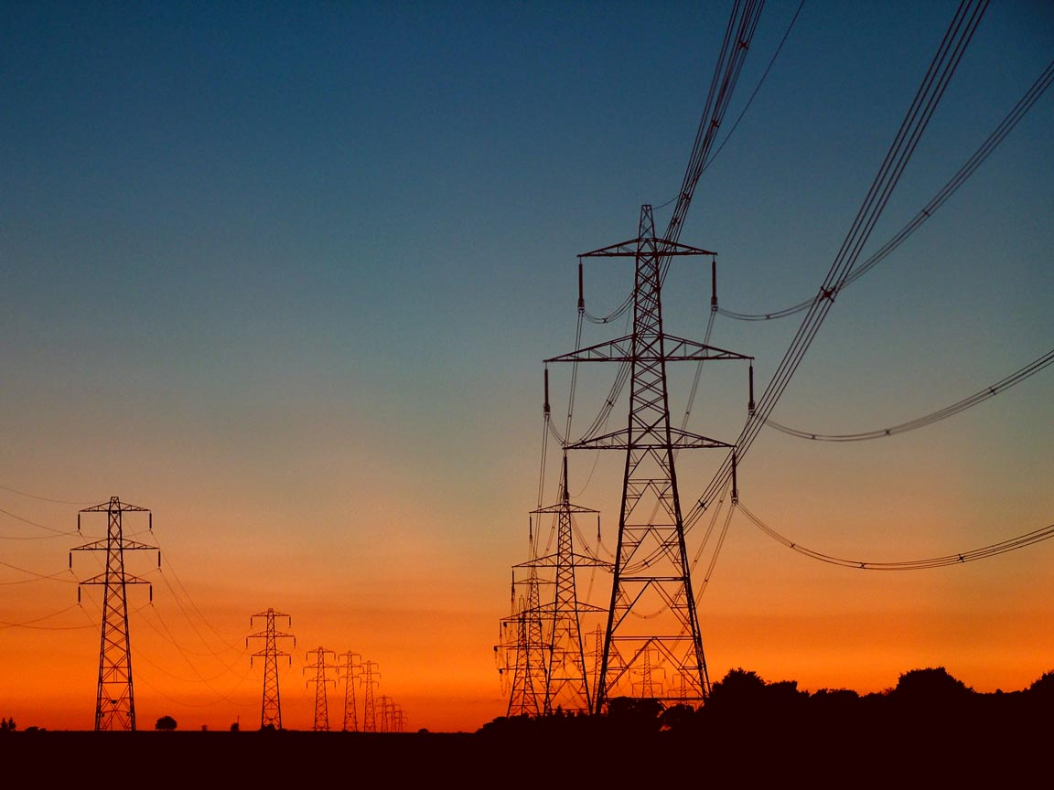

Benefits of Reducing Electricity Consumption
Improve air quality
  Less smog, acid rain
Help mitigate climate change
  Fewer greenhouse gas emissions
Improve reliability of electricity grid
  Fewer power outages
Lower energy bills
  Consumers, businesses, and governments save
National security
  Less dependence on foreign oil
  Reduced price volatility

Slide 3
What is ENERGY STAR?
ENERGY STAR is a voluntary government/industry partnership that helps businesses and consumers make energy-efficient choices, making it easy to save energy, money and protect the environment.
ENERGY STAR helps consumers make energy-efficient choices that
can save about a third on their energy bills without sacrificing features,
style or comfort

Slide 4
How Does ENERGY STAR Work?
Guiding Principles for selecting products and setting specifications:
  Cost-effective efficiency
  Performance maintained or enhanced
  Significant energy savings potential
  Efficiency achievable with non-proprietary technology
  Product differentiation and testing feasible
  Labeling effective in the market

Slide 5
Topics To Be Covered
Saving energy today by activating power management settings on our PCs through network tools
New ENERGY STAR office equipment specifications and their potential savings
Federal and State initiatives requiring ENERGY STAR products
Role federal purchasers can play in saving energy by specifying ENERGY STAR qualified office equipment

Slide 6
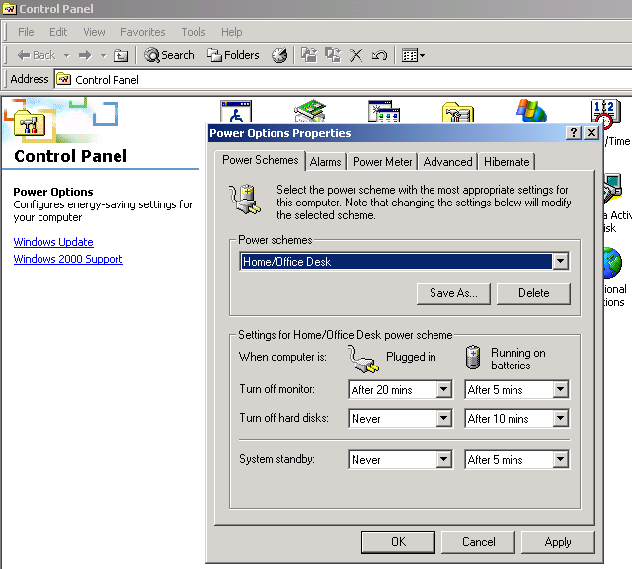
What is Power Management?
Already exists in Windows 95,98, ME, 2000 and XP.
Just needs to be activated.

Slide 7
Why Power Management?
Roughly 100 million office computers and monitors use more than 1% of the nation’s electricity
More than half of electricity used to power PCs is wasted
  60% of PCs are left on at night
  30% to 45% of monitors are not enabled for power management
  90+% of computers are not enabled for power management

Slide 8
How Much Can I Save?
Monitor power management (MPM) can save $10 to $30 per monitor annually by placing your inactive monitors into a low-power sleep mode.
Computer power management (CPM) places inactive computers (CPU, hard drive, etc.) into a low-power sleep mode, which can save $15 to $45 per desktop computer annually.

Slide 9
Monitor Power Management – A No-Brainer
MPM is stable -- problems associated with MPM are exceptionally rare
Fortune 500 IT departments require less than a day to implement MPM features
Many federal agencies have activated MPM
Comment most often overheard: “this really is a no-brainer”

Slide 10
EPA Provides Technical Resources To Activate MPM
Network Tools
  From EPA: EZ Save*, EZ GPO*
  Commercially Available: Altiris Energy Saver Toolkit; Apple’s Remote Desktop 2; CA’s Unicenter; IE’s NightWatchman; Desktop Standard’s Policy Maker; Verdiem’s Surveyor Network Energy Manager
Consultation* regarding use of existing network options such as:
  Replication of image during rollout to W2000 or XP
  3rd party desktop management tool
Learn about options at: www.energystar.gov/powermanagement
*free of charge

Slide 11



MPM – Large and Small Federal Agency Involvement
DOD Office of the Secretary of Defense activated MPM on 700 computers to save $7000/year.*
Defense Information Systems Agency implemented MPM, as part of a migration to Windows 2000, on 6000 machines to save $60,000/year.
Navy confirmed that MPM will be set to 15 minutes on 410,000 PCs to save over $4 million/year.
*These savings assume $10/computer savings conservatively.

Slide 12
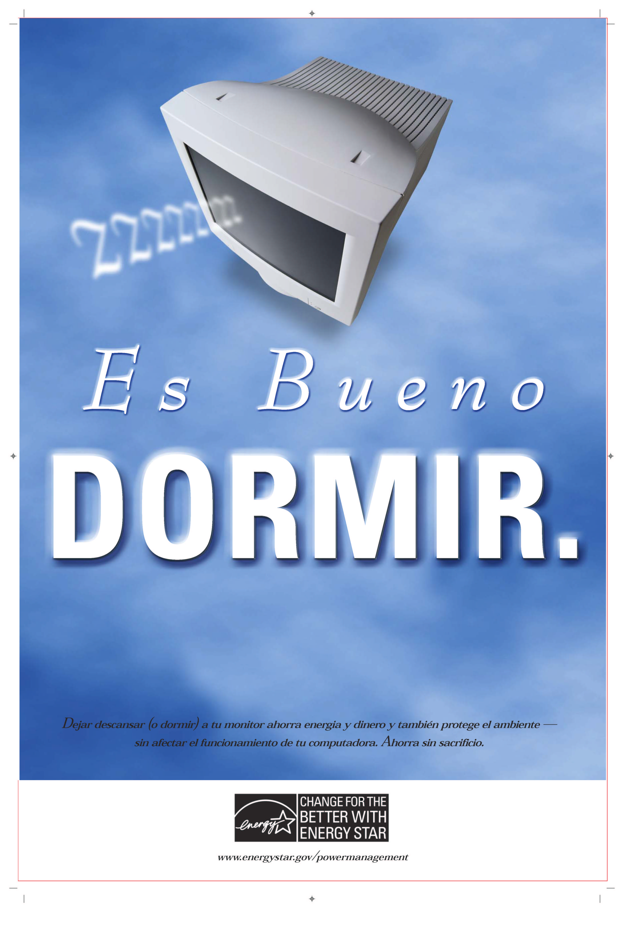
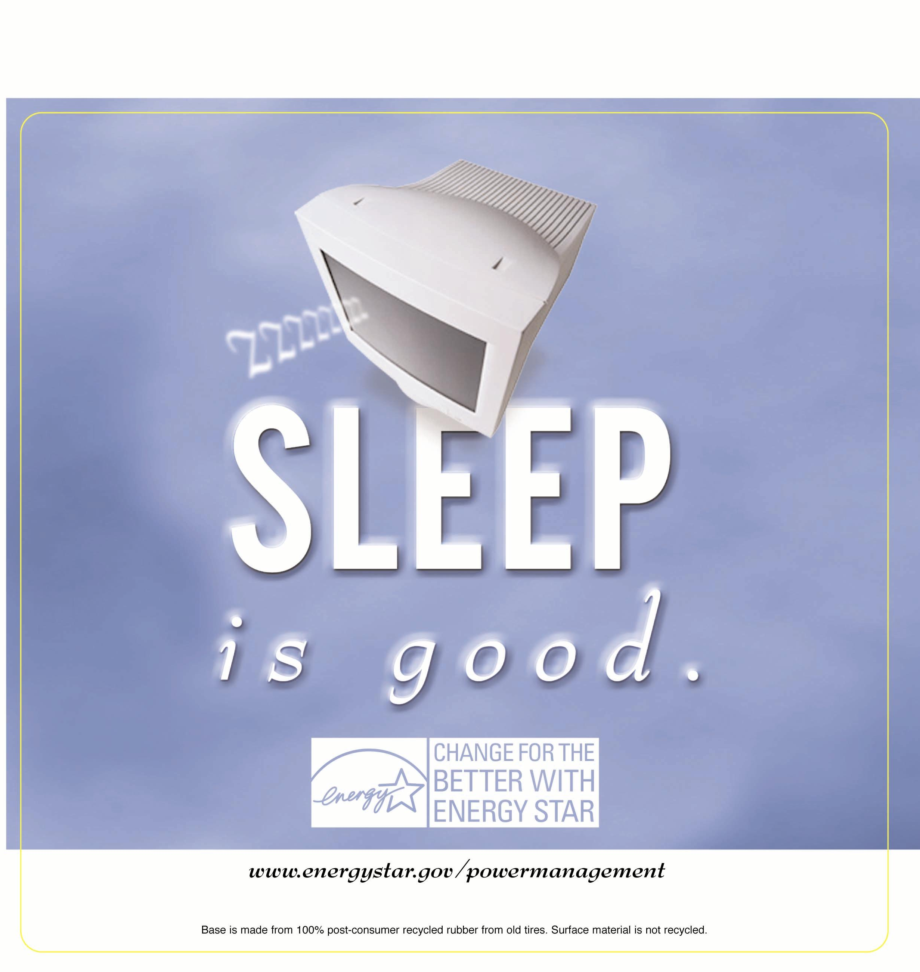
Educational Material Available fro MPM: Mouse Pad and Poster

Slide 13
PR Effort Linked to MPM: Secured Article Placements
National Public Radio Broadcast
Energy Professionals: Buildings, Building Operating Management
High Tech: Government Computer News, PC World, Computer World, InfoWorld, Yahoo News, Smart Computing
Upper Management: CIO, CFO, AOL Money Newsletter
Education: Chronicle of Higher Education, Education Dealer, School Planning and Management

Slide 14
Million Monitor Drive Campaign
Organizations pledge to “contribute” to the goal of addressing a million monitors annually.
Helps secure high priority for MPM within organization.
Many federal Agencies have joined
Honored Top Contributors to MMD at ENERGY STAR Awards ceremony in April 2003 and April 2004.
In total, 10 million monitors have been addressed by the MMD

Slide 15
Computer Power Management – On the Upswing
Originally designed to conserve battery life on standalone laptops
Increasingly deployed to save electricity on desktops
However, activation in networked environments is not as straightforward as MPM
  A few barriers have held back wide-spread enterprise implementation
System standby (S3)
  saves 40+ watts
  wakes up in 5-10 seconds
  does not save work in event of a power loss
Hard disk spin down
  only saves a few watts
Hibernate (S4)
  same energy savings as system standby
  wakes up in 20+ seconds
  saves work in the event of a power loss
Notes:
53,293 knowledge worker machines represent a $3.23 million savings opportunity
However, 21,007 WinNT PCs are slightly more challenging than WinX or WinXP PCs (39.4%)

Slide 16
CPM: Challenges
Challenges:
  If patches are pushed out at night, may need extra step to awaken computers at night
  May be some compatibility issues with old drivers and software that would prevent sleep state
Like MPM, numerous tools to activate CPM:
  EPA’s EZ GPO*; Apple’s Remote Desktop 2; IE’s NightWatchman; Desktop Standard’s Policy Maker; Verdiem’s Surveyor Network Energy Manager
PR Efforts - just beginning as focus has been on technical issues
* Free of Charge
Notes:
PM cannot currently be centrally managed with standard group policy objects in Microsoft Windows Active Directory
The “Wake-on-LAN” feature must be enabled in order for PCs in standby mode to “wake up” for administrative tasks such as push updates and remote desktop logins
Network administrators don't have an easy way to enable and manage the Wake-on-LAN features of the NIC remotely, making it difficult for installed bases of PCs to begin using Wake-on-LAN
As a result, when a user logs off of a computer, the PM status of the computer is hard to predict and not easily controlled.

Slide 17




Federal CPM Implementations: Small But Building
Defense Logistics Agency activated CPM on 600 laptops using the EZ GPO tool in February 2006.
US EPA’s offices in Arlington, VA activated CPM on 800 PCs, set to sleep after 10 minutes of inactivity, in December 2005.
NASA’s Kennedy Space Center activated CPM on 2,400 computers in September 2005.
US Army contractor used EZ GPO to activate CPM on 5,000 laptops in Iraq in August 2005.

Slide 18
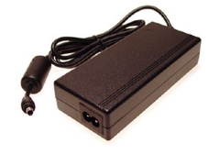
New 2007 Office Equipment Specs
Two new specifications are coming in 2007 that cover all office equipment
  Computer Specification covers desktops, notebooks, workstations, desktop derived servers
  Imaging Equipment Specification covers copiers, fax machines, mailing machines, multifunction devices, printers, scanners
New specifications shift focus to overall energy use and not only standby power
Both require that external power adapters are ENERGY STAR qualified as well

Slide 19
New Office Equipment Specifications - Timeline
Product Category | Status | Effective Date
External Power Supplies | Finalized | January 1, 2005
Monitors* | Finalized | January 1, 2006
Imaging Equipment | Under Development | April 1, 2007
Computers | Under Development | July 1, 2007
* Tier 1 has been in effect since January 1, 2005. The Tier 2 monitors specification will take effect on January 1, 2006. EPA also may revise the specification in the near future to require ENERGY STAR EPSs on monitors with EPSs.

Slide 20
Save Close to $50/Per Office Worker With ENERGY STAR!
By 2007, an office with new ENERGY STAR qualified products (PCs and imaging equipment) will save roughly $48 and 680 kWh/ office worker.
A 200-person office will save about $10,000 annually and prevent the emission of 100 tons of CO2, equivalent to:
  Planting 26 acres of trees
  Preventing the emissions of 17 cars

Slide 21
Meet Federal and State Requirements
EPAct requires that the federal government purchase ENERGY STAR qualified and FEMP-designated products.
Executive Order 13221asks federal agencies to purchase products that with low standby power levels met by ENERGY STAR qualified products.
Many states require purchase of ENERGY STAR qualified products.
California
Hawaii
Indiana
Maryland
Massachusetts
Minnesota
Nevada
New York State
North Carolina
Utah
Vermont
Virginia
Wisconsin

Slide 22
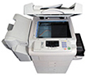
New Imaging Equipment Spec
Two Approaches:
  Typical Electricity Consumption (TEC)
    Looks at full duty cycle for standard-sized EP copiers, multifunction devices, and printers
    Metric is typical weekly electricity a product might use in all modes
  Operational Mode (OM)
    Focuses energy consumption in various low-power modes (i.e., sleep and standby) for products such as ink jets and large format devices
Notes:
Draft 1 was released on August 10, so spec is still being developed.
TEC looks at the full duty cycle of products such as standard-sized EP (electrophotographic or “laser”) copiers, MFDs and printers. The result of the newly-developed TEC test procedure is a figure for the typical weekly electricity a product might use (in ALL modes).
Some products (such as ink jets or large format devices) continue to be treated under the existing operational mode approach, which only looks at sleep modes.
EPA is considering breaking out power allowances for ink jet products based on functionality/features (wireless interfaces, memory/storage, paper handling options). The data submitted by partners over the past few years does not show a correlation between power needed in sleep mode and speed, so differentiating by feature is a promising option.
EPA plans to closely monitor, but not specify, the recovery time of products. This will allow manufacturers design flexibility, while providing EPA with data to determine if future specifications should address recovery time.
Reference to other specs – products with EPSs must use qualified EPSs. Same with additional handsets on fax machines, and digital front ends (or computers) sold with printers.
EPA explained that partners may mark a product as ENERGY STAR qualified in an international market where it meets a specification, even if the product cannot meet ENERGY STAR in ALL markets.

Slide 23
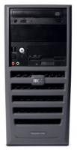
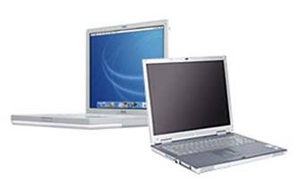
New Computer Specification
Tier I Hardware & Operational Mode Requirements:
  More aggressive sleep modes
  New standby power requirements
  New idle test procedure and power levels
  New external and internal power supply requirements
Tier II: Performance Benchmark
  Use a software benchmark to measure the performance of the computer while simultaneously measuring the energy required to create that performance
Notes:
Why revise computer specification:
Current specification only considers sleep mode, does not address “active mode”
Largest opportunities for energy savings are when computers are turned on, which occurs during peak demand times
Current label has about 98% market penetration, offering little differentiation for innovative, energy-efficient models
Address low enabling rates

Slide 24
What Can Federal Agencies Do Now?
Broker a call between your IT manager and EPA about activating power management.
Check with your suppliers and discuss their plans to meet the new requirements:
http://www.energystar.gov/index.cfm?c=revisions.revisions_specs
Learn more about EPAact at:
http://www.eere.energy.gov/femp/about/legislation_epact_05.cfm
Contact EPA for more information:
  Katharine Kaplan Osdoba, U.S. EPA ENERGY STAR Program, Osdoba.katharine@epa.gov, (202) 343-9120

