Slide 1
Presentation at the
Aspen Meeting of the PAC
John Womersley
On behalf of the DØ Collaboration
June 2003

Slide 2
Question 1
What is currently your best understanding of how the performance of the silicon detector will diminish with increasing integrated luminosity? What is the impact of this degradation in performance on the most important physics analyses? Which physics topics suffer the most from this effect and which least?
Radiation damage lifetime estimated from
  locations and types of detectors installed in DØ
  measurement-based knowledge of the phenomenology of radiation damage
  actual measured doses received
  expect the lifetime will be limited by micro-discharge breakdown of the junction in the Micron detectors in the inner barrels.
    begins to occur at bias of ~ 150 V; all channels fail at ~200 V
  will start to lose significant numbers of channels at an integrated luminosity of 3.6 ± 1.8 fb⁻¹
  all of the channels on the inner layer will be dead by 4.9 ± 2.5 fb⁻¹.
    These uncertainties reflect how well we can estimate the micro-discharge formation and dose accumulation.

Slide 3
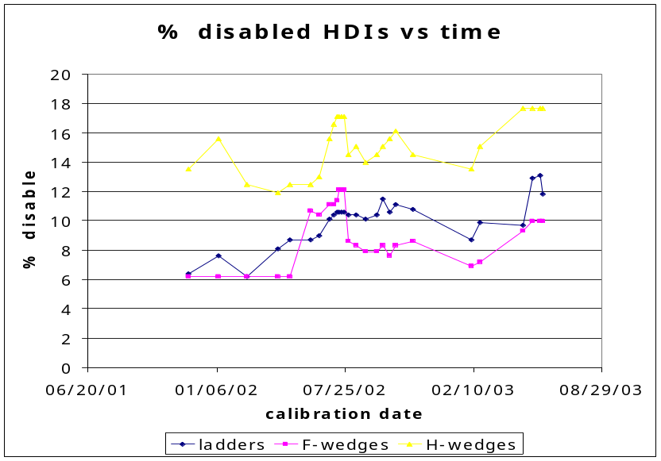
Longevity of the detector
  Fraction of disabled ladders was 6% in 2001 and is ~ 12% now
  No reason to believe this is anything to do with radiation damage
  We have no idea how to extrapolate this to the future
% ladders
disabled

Slide 4
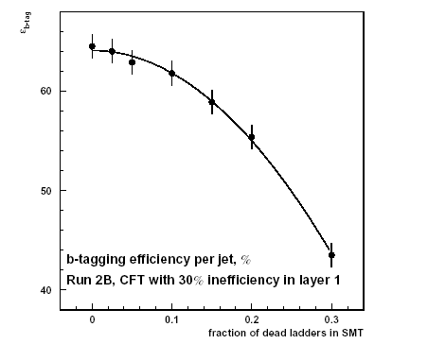
Impact of degradation
We know that loss of silicon layers will impact b-tagging:
  Lower efficiencies
Also degrades precise tracking and primary vertex identification capability
  Hence worse missing E_{T} and jet resolution
Run IIb detector

Slide 5
Physics affected
Physics which requires multiple b-tags is affected most:
  Top quark physics, including precision mass measurements
  Standard Model Higgs Searches
  Supersymmetry searches involving light stop and sbottom
  Supersymmetry searches involving cascade decays of squarks or gluinos to heavy flavor
  Supersymmetric Higgs searches in 4b and bbττ modes
  Technicolor searches
  The entire B-physics program
    Flagship physics of the Tevatron

Slide 6
The silicon detector is an integral part of the DØ tracking system
  Needed for pattern recognition and track sagitta measurements
Almost all physics is affected by loss of precision tracking and primary vertex identification:
  W mass and electroweak physics
  Supersymmetry searches in trileptons
  Supersymmetry searches with taus
  Extra dimensions
  Jets and missing E_{T}

Slide 7
Question 2
How much time is needed to install and commission the new silicon detectors?
We have put together a fully resource loaded plan for
  Opening the detector
  Removal of the old silicon
  Installation of the new silicon
    4.5 months
  Cabling and Technical commissioning
    10 weeks (1.5 shifts, 2 teams of 2 people per shift)
  Online software (downloads, calibrations, unpacking, monitoring…)
    1.5 months (in parallel with above)

Slide 8
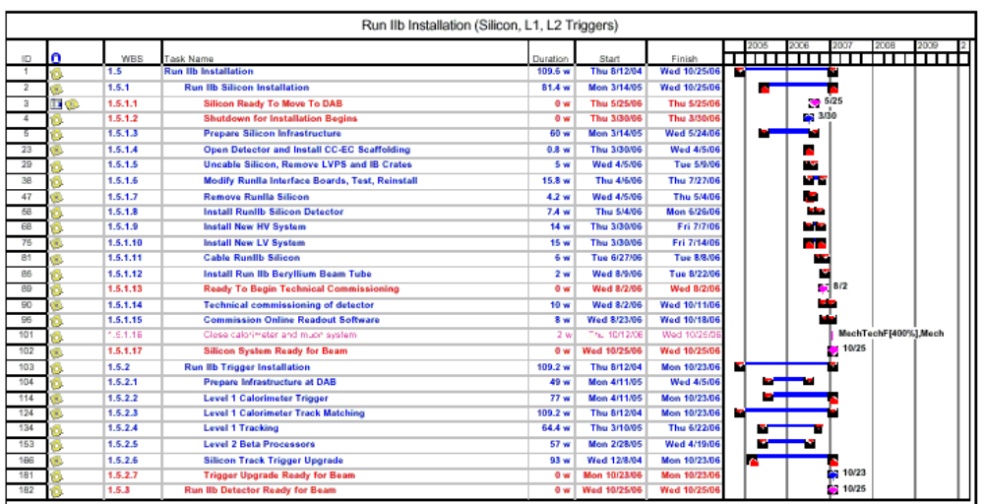
The plan also integrates the installation of the trigger upgrades
Total shutdown duration is 7 months
  Experts feel this is conservative

Slide 9
Question 3
At what time after the end of the shutdown period would the full experiment be able to record physics-quality data with good efficiency?
We know we have to come up quickly
We are putting a detailed beam commissioning plan together
Silicon
  In Run II we had problems with
    LV power supplies – now moved outside the hall
    Downstream electronics – now fixed, will not change
    Interface boards – hence heavy emphasis on technical commissioning before close-up
  Successful as-built alignment procedure allowed physics quality data to be taken rapidly in Run IIa

Slide 10
Trigger
  Will use splitter cards to allow parasitic commissioning of calorimeter trigger before the long shutdown
  Calorimeter trigger calibration requires ~ 1 week of beam time + 4 weeks analysis after shutdown
For the silicon and trigger upgrades together, we estimate that 3 months of commissioning time with beam will be needed

Slide 11
Question 4
What strategy would the collaboration prefer for the detector upgrades and what are the most important drivers of this position? What should be the conditions for beginning the extended shutdown to install the silicon detector upgrades? What is the minimum time of operation after the shutdown needed to justify installing the silicon detector?
I shall defer answering the first part until the end of this presentation

Slide 12
Conditions to begin shutdown
We cannot state hard-and-fast conditions for beginning the silicon installation shutdown.
The decision will be a complicated optimization exercise including a good measure of gut feeling.
We will need to consider:
  The state of readiness of the detector upgrades (both DØ and CDF)
  The performance of the existing tracking system including
    radiation damage (if any)
    further component losses (if any)
    pattern recognition performance in the high occupancy environment
  Accelerator performance up to that date and projections for the following two years
  The state of the LHC accelerator and detectors at that time
  Any discoveries or hints of new physics in the Run II data.

Slide 13
How long to run?
It is important to note that the upgraded DØ silicon detector offers increased performance over the current device.
  six layers rather than four
    better pattern recognition at high occupancy
  inner layers are closer to the beampipe
    Significantly improved b-tagging
  It is not a spare part, it is a higher performance detector.
  A very rough figure of merit is that the double b-tagging efficiency with the new detector is 1.7 times higher than the existing device, even in the absence of radiation damage to the latter
    Full GEANT simulation of ZH + 7.5 minbias events
We believe that, after roughly a year of downtime, a physics running period also of a year or so at high luminosity would justify installing the new detector.

Slide 14
Question 5
Please review the motivation for each of the non-silicon detector upgrades and comment on any substantial changes that might occur due to the new luminosity profiles.
For DO, the non-silicon upgrades are:
  Level 1 trigger
    Calorimeter clustering at level 1
    Calorimeter-track matching
    Fiber tracker trigger upgrade
  Level 2 trigger
    Silicon Track Trigger upgrade
    Beta processors
  Level 3
    Processor upgrades

Slide 15
These upgrades were designed to handle luminosity of 2×10³² cm⁻²s⁻¹ with a bunch spacing of 396 ns, maintaining enough headroom to handle peak luminosities up to 4×10³² cm⁻²s⁻¹.
  The motivation is to keep the L1 accept rate under control and to maintain rejection at L2 and L3
The upper curve of the new luminosity profile corresponds to instantaneous luminosity reaching 2×10³² cm⁻²s⁻¹ some time in FY06, and approaching 3×10³² cm⁻²s⁻¹ in FY08.
The lower curve exceeds 1×10³²cm⁻²s⁻¹ in FY07, and eventually reaches about 1.7×10³²cm⁻²s⁻¹.
    All of the non-silicon upgrades are still required*
  * Part of the STT upgrade is still needed even without the silicon upgrade

Slide 16
Ancillary Questions

Slide 17
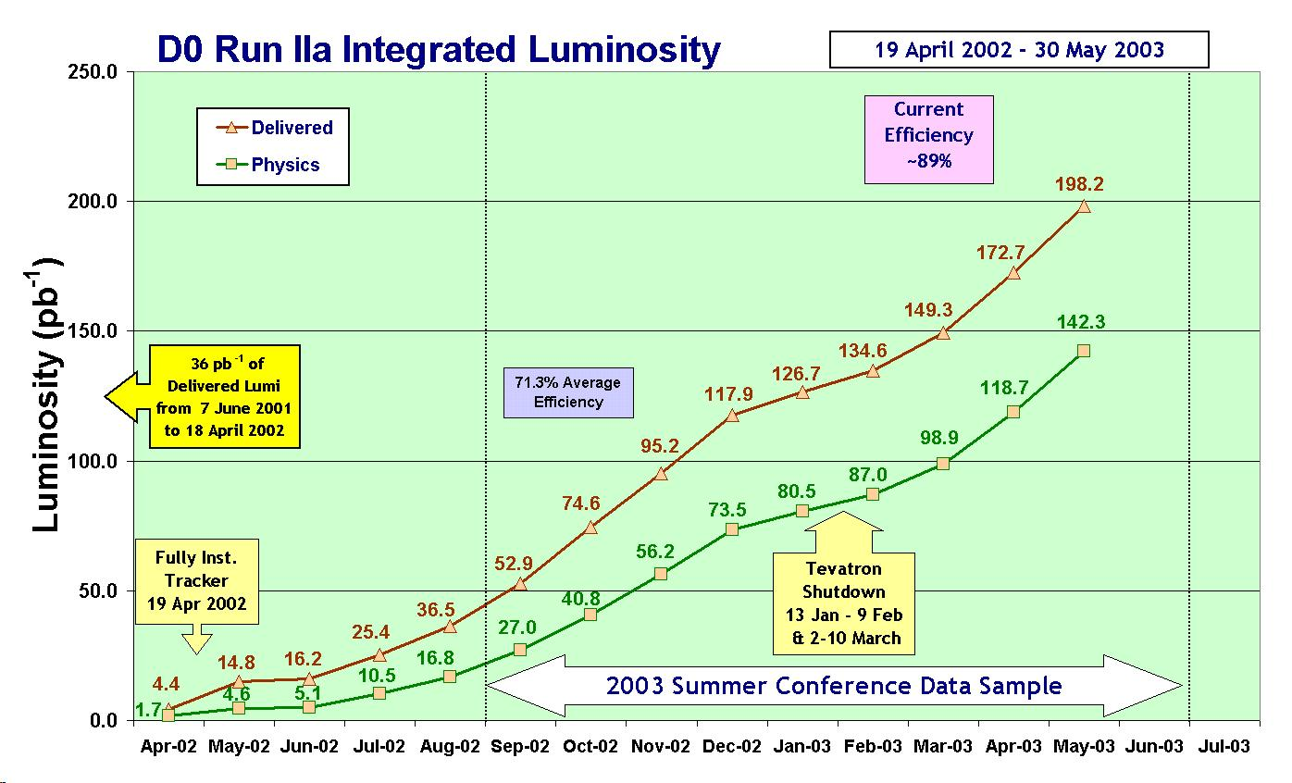

Slide 18
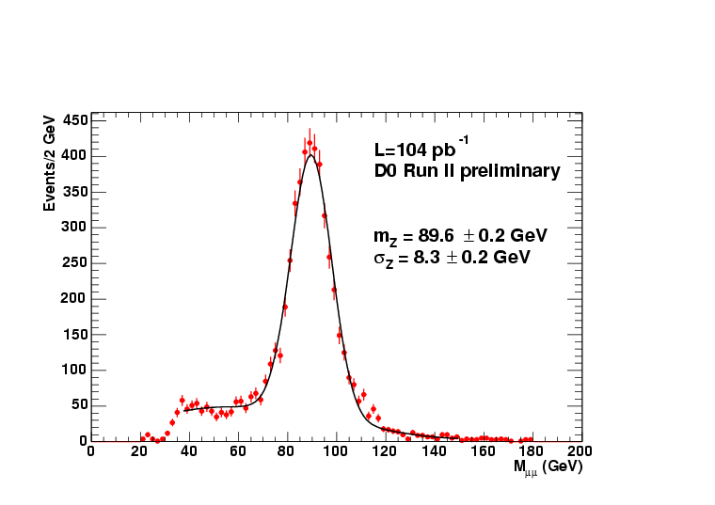
Z → μ⁺μ⁻ with 104pb⁻¹ of 2002-2003 data

Slide 19
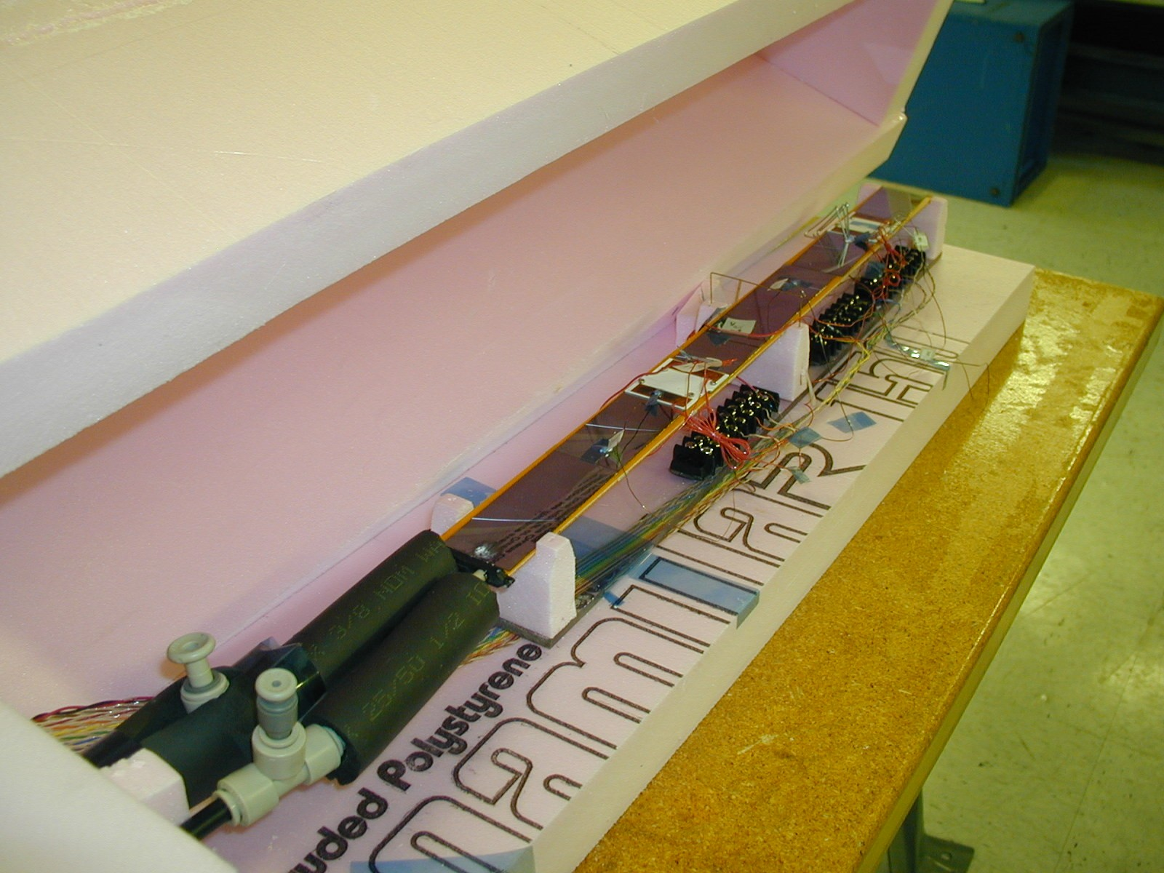
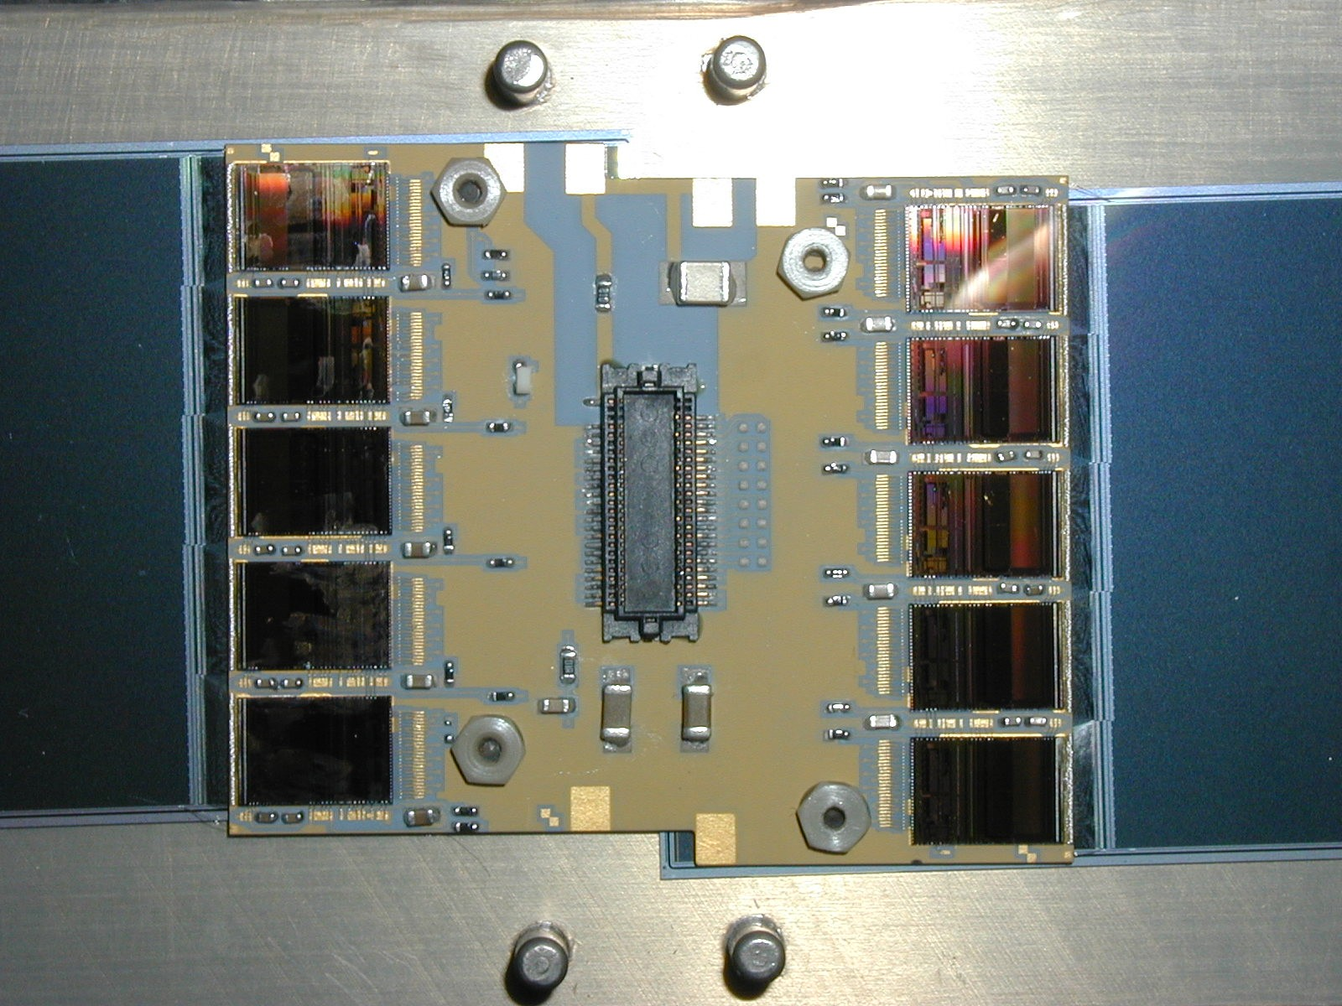
Upgrade Status
The detector upgrades are proceeding well
  Latest version of the SVX4 chip looks good
  We have prototyped all components
  No major technical problems remain
  We have started to place the final production orders for various components
  Roughly $8M has been obligated so far of $28.6M TPC (45% cont)
    $2.5M “in kind” including $2M from NSF
  Available contingency can take us to roughly January 04

Slide 20
The collaboration
We are continuing to add members
  At next week’s Institutional Board Meeting we will consider applications from Clermont-Ferrand and from Simon Fraser University
  We have expressions of interest from two more institutions
For the Upgrade Lehman Review, we obtained MOU’s from 75 of 76 institutions
  All are committed to Run IIb or are developing proposals for continued participation.
  We have commitments of sufficient physicist effort for the Run IIb detector projects.
  Summed person-years meet or exceed requirements extracted from the resource-loaded schedule for both silicon tracker and trigger/DAQ/Online projects.
For the operations phase, we understand that we need to transition to a “LEP-like” mode of running
  Preliminary estimate: we need ~ 80 FTE’s to operate the experiment, its software and computing

Slide 21
Physics issues beyond the Higgs
One Experiment | 2 fb⁻¹ | 5 fb⁻¹ | 10 fb⁻¹
# high p_{T} jets > 400 GeV | 1300 | 3300 | 6600
Gluino mass | 400 GeV | ~ 450 GeV? | ~ 500 GeV?
Trileptons m_{1/2} reach tan β = 5, m₀ small tan β = 5, m₀ large tan β = 35, m₀ large | m_{1/2} ~ 220 GeV -- m_{1/2} ~ 120 GeV | m_{1/2} ~ 235 GeV m_{1/2} ~ 140 GeV m_{1/2} ~ 145 GeV | m_{1/2} ~ 250 GeV m_{1/2} ~ 160 GeV m_{1/2} ~ 170 GeV
GMSB γγ + ME_{T} chargino mass | 325 GeV | 345 GeV | 370 GeV
SUSY Higgs + bb reach in tan β for m_{A} = 150 GeV | tan β > 45 | tan β > 35 | tan β > 27
Topcolor Z′→ tt | mass < 580 GeV | 640 GeV | 720 GeV
Z′→ dijets | mass < 560 GeV | 610 GeV | 650 GeV
Z′→ dileptons | mass < 1 TeV | 1.15 TeV | 1.3 TeV
And don’t forget SUSY searches/exclusion using the h

Slide 22
One experiment | 2 fb⁻¹ | 5 fb⁻¹ | 10 fb⁻¹
# top events ≥3 jets + 1b-tag ≥4 jets + 2b-tags | 1000 240 | 2500 600 | 5000 1200
Top mass: Lepton + jets Dileptons | 2.7 GeV 2.8 GeV | 2.2 GeV 2.2 GeV | 1.6 GeV 1.6 GeV
Single top cross section (s / t) |V_{tb}| (s / t channel) | 21% / 12% 12% / 10% | 13% / 8% 8% / 9% | 9% / 5% 6% / 8%
Top spin ½ vs. Spin 0 | 2σ | 3σ | 4.5σ
Rare decays t → cγ t → cZ | < 7.5 × 10⁻³ < 4 × 10⁻² | < 3 × 10⁻³ < 1.5 × 10⁻² | < 1.5 × 10⁻³ < 7.5 × 10⁻³
W mass: transverse mass W/Z ratio method | 27 MeV 44 MeV | 22 MeV 28 MeV | 19 MeV 20 MeV
W width (direct) | 32 MeV | 24 MeV | 18 MeV
sin²θ_{W}^{eff} (from A_{FB} ) | 0.0007 | 0.00042 | 0.00028
What counts for all of the above is luminosity × efficiency

Slide 23
Higgs sensitivity study
CDF and DØ agreed to revisit the “famous” SM Higgs reach plot
  CDF focus on WH channel
  DØ focus on ZH channel
No combined results yet
What I have seen so far is rather encouraging
  see next slide
Goal is to show to Ray Orbach on June 24

Slide 24
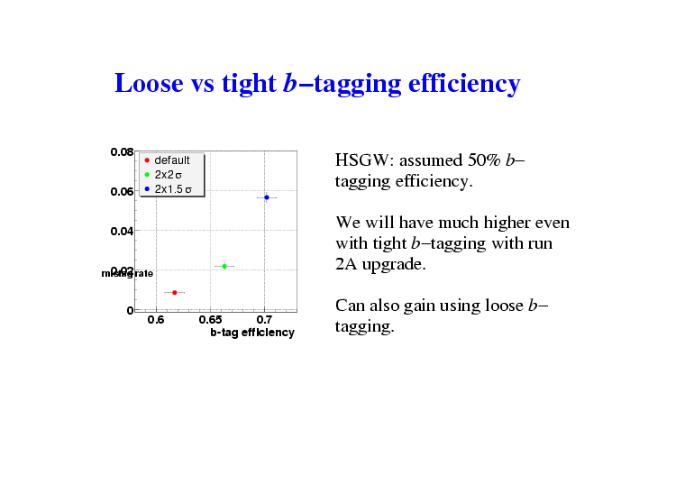
M. Narain, A. Khanov, F. Rizatdinova
B
b-tagging studied with full GEANT simulation and pattern recognition

Slide 25
Question 4:
What strategy would the collaboration prefer?

Slide 26
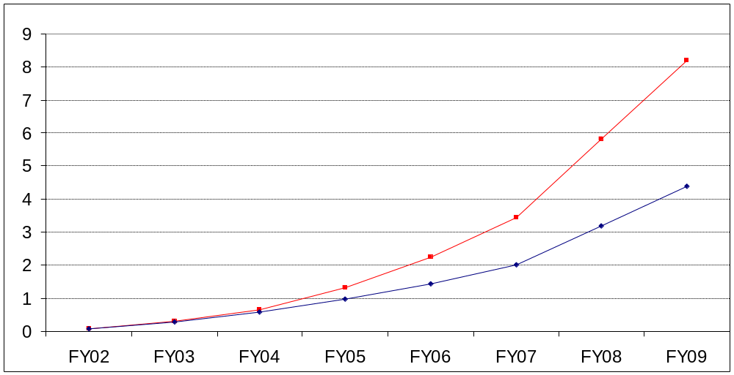
Why are we here?
Fermilab has submitted to DOE an accelerator plan
There exists the implication that we should rethink the need for the Run IIb detector upgrades in light of this plan

Slide 27
What you expect me to say
You might expect that I will stand up and say “we must still build the detector upgrades no matter what”
I am not going to do that
I know at least some members of the community, and of this committee too, wonder whether upgrading makes sense
I am not going to argue what the right thing to do will eventually turn out to be
I am going to argue that now is not the time, and this is not the way, to reach such a conclusion
  In fact “should we build the upgrades?” is not the right question to ask at all

Slide 28
The “spiral of death”
Suppose we conclude something like this right now
  “In light of the presented accelerator plan, and the high technical risk of achieving the upper goals, we feel it is no longer prudent to invest in the detector upgrades”
The message we send is
  “We do not really believe the accelerator luminosity upgrades will pay off. Maybe not at all (base profile), maybe not in time to be useful”
Why would anyone continue to invest in such accelerator upgrades?
  They won’t.
  What future does this leave for the collider?
Why would anyone then invest in any new accelerator facility at Fermilab?
  “After all, they can’t make things work”
Why would anyone then invest in any new accelerator facility in the USA, or want the USA as a technical partner?
We must not let this happen

Slide 29
Broader impact
This is a big, visible, important question, not just for DØ or for Fermilab, but also for the future vitality of US accelerator-based HEP
Potential loss of trust in our commitments, reliability and capabilities
  International impact
Potential loss of resources
  One is starting to hear senior people saying semi-openly that they want to take resources away from Fermilab in light of the Run II outlook
    I believe it is naïve to imagine that any such resources can simply be redirected
    The perception of failure in a major HEP project will hurt us all
      it certainly won’t increase the likelihood of any other major HEP project being supported
    Shooting inwards will hurt us all
      How many times do we have to learn this lesson?
      At this point we simply must help one another succeed.
University groups have even been told that their CDF/DØ work is hard to support when the program “seems to be failing”

Slide 30
What do we have to do
The real problem here is our accelerator performance and the level of credibility attached to our projections, planning, and management
This is what must be addressed to get us out of the spiral
  “Addressed” means dealing with both the perception – the public image of how we are doing – and the reality
  Descoping our goals may be part of this process, but by itself does not constitute this process
  If we do descope our goals we’d better be able to explain in a watertight way that it is because of unavoidable things like Maxwell’s equations and maybe the old age of the machine (perhaps even insufficient funds?)
  If human factors (our competence, management or lack-of-will)
  end up being blamed, then we are still in the spiral
  Consider a stand-down from running the Tevatron, if necessary?
How can we help?

Slide 31
The detector upgrades
Sacrificing the upgrades now will do nothing to
  Enhance the credibility of the accelerator plan
  Restore confidence in Fermilab’s ability to focus on and address problems
If indeed it does end up being the right thing to do, then it has to be because
  We are really and visibly getting our act together
  And as part of that process, we (as a community) have in the end convinced ourselves that
    there are unavoidable limitations to accelerator performance
    an overall optimization of resources is appropriate
    doing so will help secure the future of the field
  None of these conditions is now true.
It should not be done now, not in a rush because of a review, not this way, not based on this plan, and what little we know now.

Slide 32
Risk
We always knew these upgrades were a gamble; we proceeded because the physics payoff was so significant.
  It still is.
Investors will tell you that if you want to make real money, you have to be prepared to make risky investments.

Slide 33
What we advocate
We wish to see a wholehearted effort to get the most physics out of the Tevatron — a broad program — while it remains a unique facility in the world.
This means that we should not back down from ambitious luminosity goals, but should work to put them on a firmer basis with a robust effort to address the technical and human issues that currently call them into question.
The schedule is such that we cannot ask the detector upgrades to take a holiday while this happens. We have to keep going full pace.
We should plan for success in the accelerator and we should not do anything that precludes taking full advantage of that success.
We should proceed with the upgrades while we get our arms round the accelerator situation
  We have to be sure we get this right, for the future
  of Fermilab and for the field as a whole…

