Slide 1


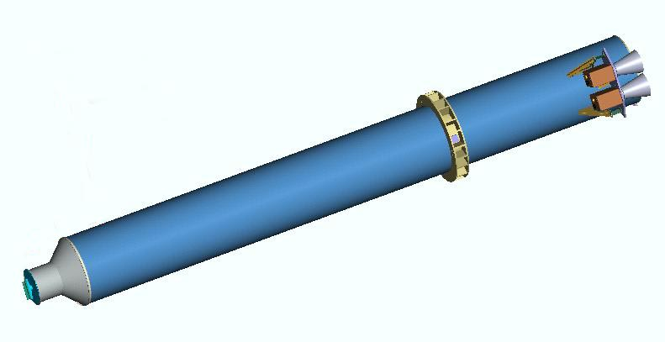



Swift X-ray Telescope Status & Observations of the Afterglow of GRB 041223
David Burrows - PSU
University Partners:
PSU UL OAB

Slide 2
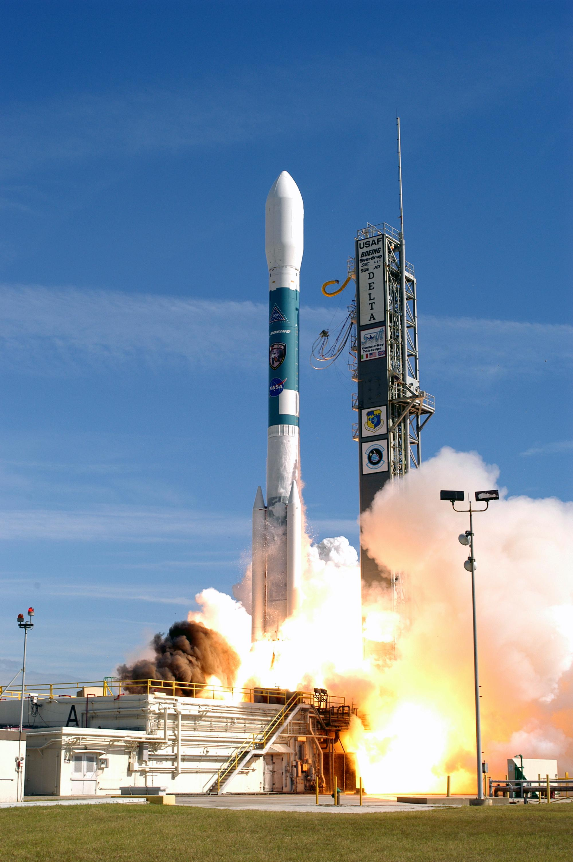
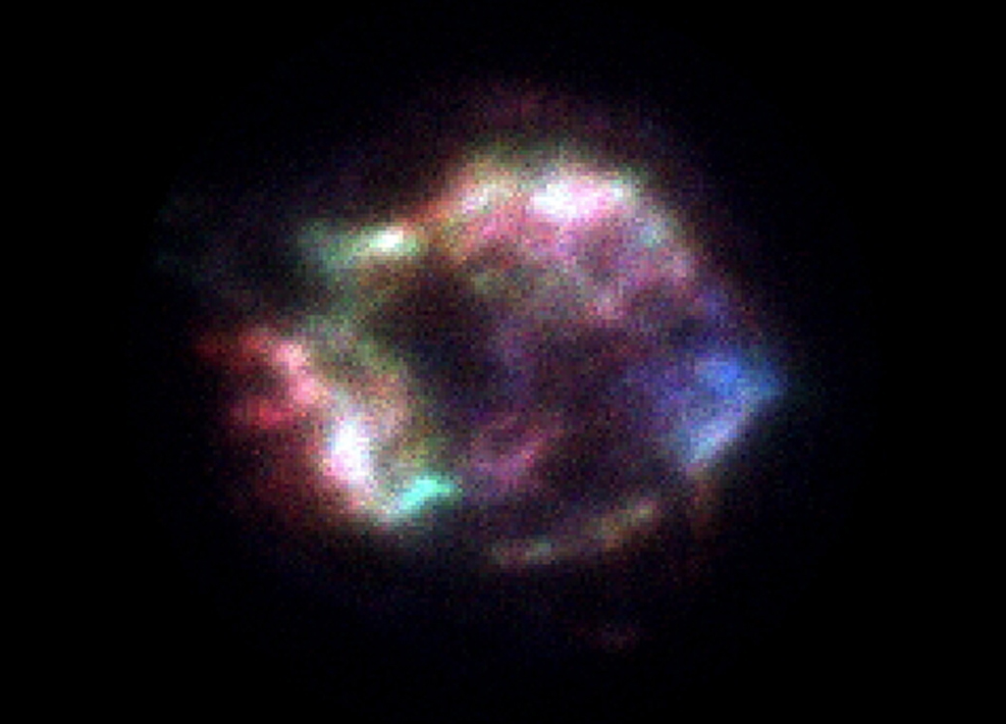
The Swift Observatory
Launched: 20 November 2004
XRT turned on: 23 November 2004
XRT First Light: 11 December 2004
First BAT Burst: 17 December 2004
First XRT Afterglow: 23 December 2004
XRT First Light: Cas A

Slide 3
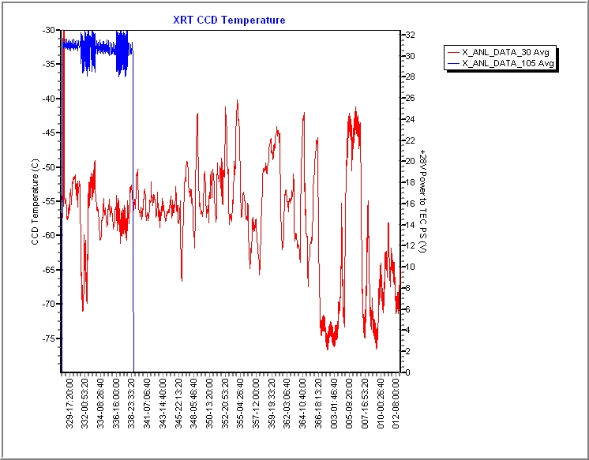
XRT
Thermal
Tests
UVOT
Activation
TEC Power
Heating
CCD
Beginning XRT
Thermal Control

Slide 4
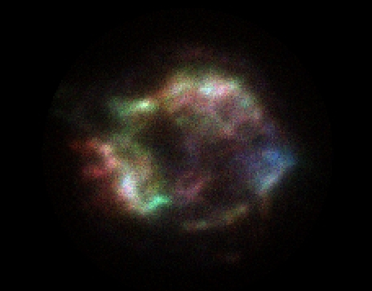
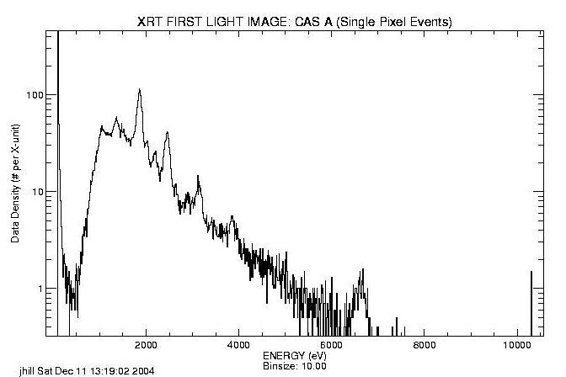
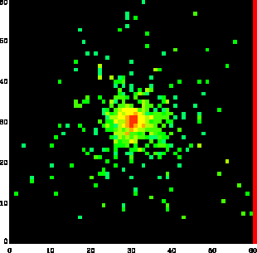
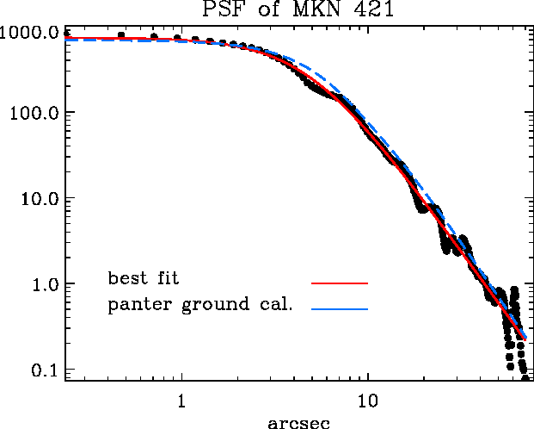
XRT First Light Observations
2% shift in gain
Cas A:
(13 ks)
J. Hill, PSU
M. Goad, UL
Focus is perfect!!
Mkn 421:
A. Moretti, OAB

Slide 5
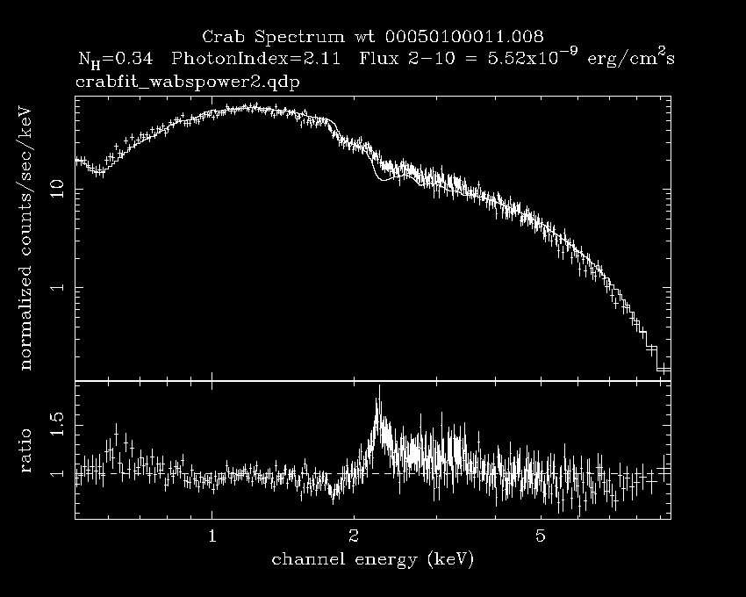
Preliminary Crab spectral fit
N_{H} = 0.35 ± 0.04
Γ = 2.10 ± 0.01

Slide 6
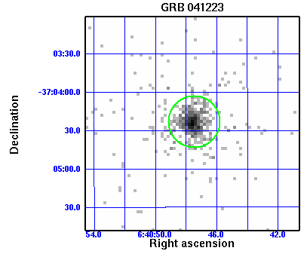
GRB 041223
Discovered by BAT at 14:06:18 on 23 December 2004
XRT was in midst of thermal tests, taking data in PC mode
Slewed to GRB 4.6 hrs after burst as ToO
Observed on 3 consecutive orbits for total of about one hour on-target
XRT position:
RA(J2000) = 06:40:47.5
Dec (J2000) = -37:04:22.5
SWIFT J064047.5-370423
Offset from optical transient:
2.1 arcseconds
Offset from BAT position:
50 arcseconds

Slide 7
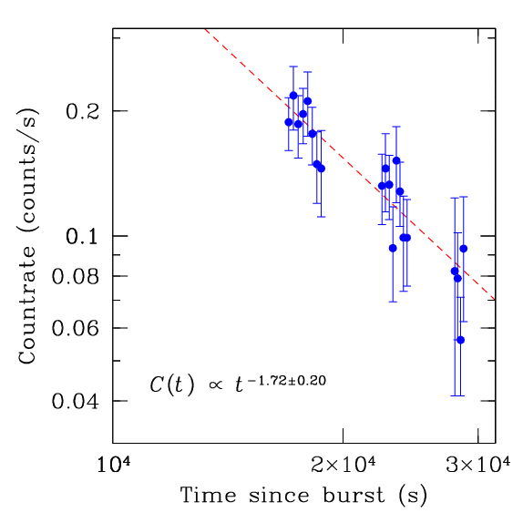
Lightcurve
X-ray source was uncatalogued.
X-ray source faded rapidly.
Data extracted with ximage from 20” radius circle. Background extracted from 47” radius circle.
Only used times when pointing was stable and background was low.
520 counts in 3504 seconds.

Slide 8
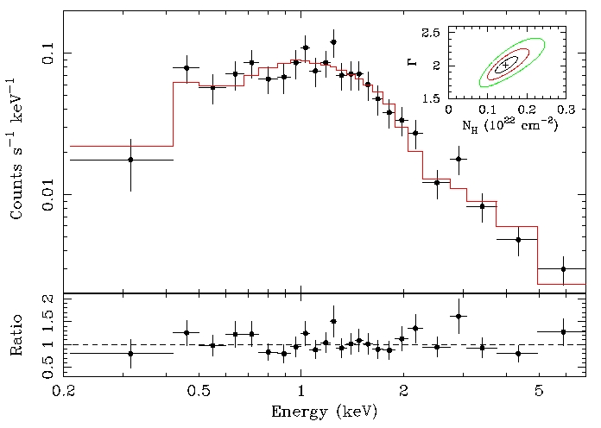
Spectrum
N_{H} = (1.5 ± 0.5) x 10²¹
Γ = 2.02 ± 0.21 (90%)
χ² / ν = 15.4 / 22
F_{x} = 6.5 x 10⁻¹² (0.5-10 keV)

Slide 9
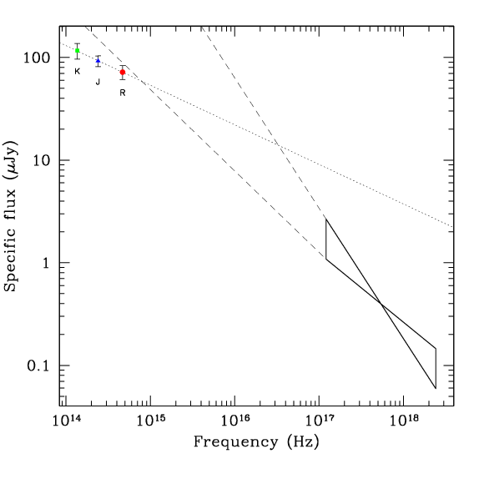
Broad-band SED
For F_{ν}(t) = t ^{-α} and F(ν) = ν ^{-β}
Band | α_{ν} | β_{ν} | t – t₀
J | 1.14 ± 0.08 | 0.40 ± 0.03 | 16 – 87
0.5-10 keV | 1.72 ± 0.20 | 1.02 ± 0.07 | 4.6 – 7.9
(68% confidence errors)
Spectral break suggests that cooling frequency lies between the X-ray and optical bands.
(VLT observations from MISTICI collaboration)

Slide 10
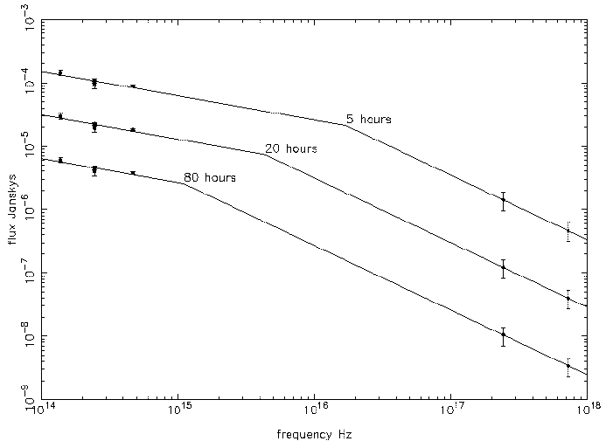
Broad-band SED
If α_{x} and α_{NIR} are constant, then
ν_{NIR} < ν_{c} < ν_{x} and
ν _{c} ∝ t ^{–α}, where α = 1.0 ± 0.2 to fit data

Slide 11
Conclusions
NIR and X-ray data are consistent with the following scenario:
  Jet has two components: narrow component that produces X-rays and broader component that produces optical
  Jet break of narrow component occurs before X-ray observations
  Produces self-consistent model with electron power-law index of about 1.9 – 2.0
XRT is working well and producing excellent data in spite of higher operating temperature
  Images are spectacular
  Spectroscopy is better than Chandra at beginning of GTO phase
  Spectroscopy expected to remain better than ASCA over life
  High resolution timing available (up to 140 microseconds)

Slide 12
Co-Authors
Penn State:
David Burrows
Joanne Hill
Judith Racusin
Shiho Kobayashi
Peter Meszaros
John Nousek
Jamie Kennea
David Morris
Claudio Pagani
OAB:
Guido Chincarini
Gianpiero Tagliaferri
Sergio Campana
Alberto Moretti
Patrizia Romano
Daniele Malesani
Stefano Covino
Paolo D’Avanzo
UL:
Paul O’Brien
Alan Wells
Julian Osborne
Tony Abbey
Andy Beardmore
Mike Goad
Kim Page
Dick Willingale
GSFC:
Neil Gehrels
Lorella Angelini
UNLV:
Bing Zhang
OAR (Rome):
Luigi Stella
Angelo Antonelli
ASDC:
Paolo Giommi
Milvia Capalbi

Slide 13
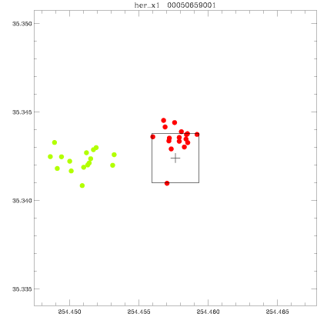
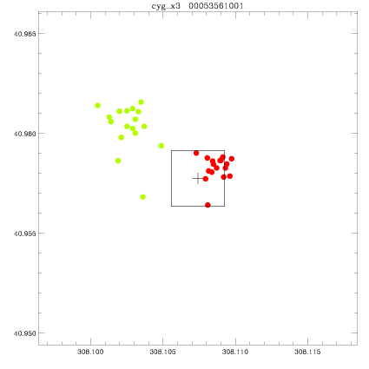
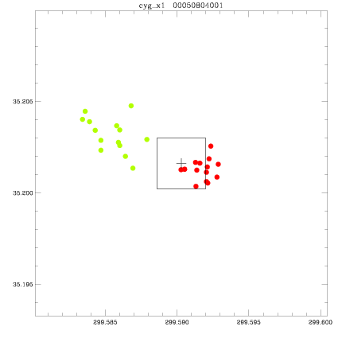
Centroiding
Her X-1
Cyg X-3
Cyg X-1
On-board calculation
Pipeline processing
10” x 10” box,
centered on source position

