Slide 1



Focus Area 27
Tobacco Use
Progress Review
Edward J. Sondik
National Center for Health Statistics
August 21, 2008

Slide 2
Tobacco Use
Tobacco Use
  Leading cause of preventable death
  438,000 smoking attributable deaths each year (1997-2001)
  8.6 million serious illnesses each year (2000)
Secondhand Smoke
  Contains over 50 known carcinogens
  According to the Surgeon General 2006 report--is a known cause of:
    50,000 deaths attributed to secondhand smoke each year
    Low birth weight and Sudden Infant Death Syndrome (SIDS)
    Increased lung problems, ear infections, asthma in children
    Heart disease and lung cancer in adults
Notes:
Tobacco Use:
438,000(number includes use and exposure) (1997-2001) from July 1, 2005 MMWR (Annual Smoking –Attributable Mortality, Years of Potential Life Lost, and Productivity Losses, US, 1997-2001) **The workgroup is working on updating with 2004 data and say that the numbers are comparable…
8.6 million serious illnesses each year : (in 2008 at a glance ,and, September 5, 2003 MMWR: Cigarette Smoking—Attributable Morbidity—US, 2000.)
From workgroup: “For every person who dies of a smoking attributable disease, there are 20 more people suffering with at least one serious illness from smoking.”
Environmental Tobacco Smoke: (also known as: secondhand smoke)
(more than 4000 chemicals and …more than 250 known to be toxic or carcinogenic…(surgeon generals report)
Over 50 carcinogens (NIEHS. 11th report on carcinogens)
50,000 SAD, (2005) (2006 Surgeon Generals Report on Secondhand Smoke (page 8))
*Exposure to environmental tobacco smoke is involuntary for children (NCHS experts)
From 2006 Surgeon Generals report on the Health consequences of involuntary exposure to tobacco smoke
Is a known cause of:
Sudden Infant Death Syndrome (SIDS) ,(Low birth weight)
Heart Disease,Lung Cancer
Increased lung problems (includes bronchitis and pneumonia), ear infections, asthma in children

Slide 3
Highlighted Objectives
27-1 a. Cigarette smoking, adults
27-2 a-e. Adolescent use of tobacco products in last month
27-5. Smoking cessation attempts by adults
27-9. Exposure to tobacco smoke at home, ages 6 and under
27-10. Exposure to environmental tobacco smoke, ages 4 and over
27-11. Smoke free and tobacco free schools
27-13 a-f, i. Smoke free indoor air laws
27-14 a. Enforcement of illegal tobacco sales to minors
27-15. Retail license suspension for sales to minors
27-16 a, b. Exposure to tobacco advertising and promotion
27-17 a-c. Adolescent disapproval of smoking
Target met
Improving
Little or no change*
Getting worse
*Percent of targeted change achieved is between -10% and 10%, and/or change not statistically significant.
Notes:
Youth, cessation, second-hand/environmental smoke

Slide 4
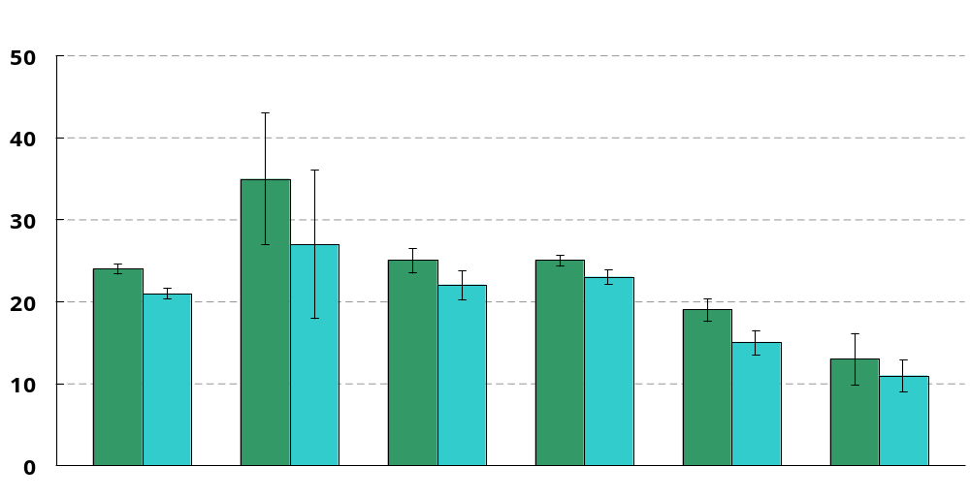
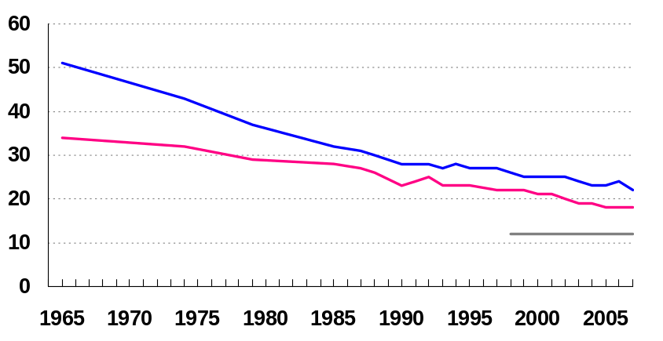
Cigarette Smoking,
Adults 18 Years and Over
Percent
1998
2006
Decrease desired
Percent
Cigarette Smoking, 1965-2007
Male
Female
2010 Target: 12
2010 Target: 12
Total
American Indian
Black
White
Hispanic
Asian
I = 95% confidence interval. Note: Data are for persons who have smoked at least 100 cigarettes in lifetime and currently report smoking everyday or some days. American Indian includes Alaska Native. The categories black and white exclude persons of Hispanic origin. Persons of Hispanic origin may be any race. Respondents were asked to select one race prior to 1999. For 1999 and later years, persons were asked to select one or more races. Data for the single race categories shown are for persons who reported only one racial group. Data are age adjusted to the 2000 standard population. Data prior to 1997 are not strictly comparable with data for later years due to the 1997 questionnaire redesign.
SOURCE: National Health Interview Survey, CDC, NCHS.
Obj. 27-1 a
Notes:
Trend line shows through 2007. Workgroup noted that that down tic seen for 2007 is statistically significant…
Year, approx. number of smokers, (percent)
1965: 50,200,000 (42%)
1974: 52,100,000 (37%)
1979: 50,600,000 (33%)
1985: 51,300,000 (30%)
1990: 45,400,000 (25%)
1998: 47,200,000 (24%)
1999: 46,500,000 (23%)
2000: 46,500,000 (23%)
2001: 46,100,000 (23%)
2002: 46,400,000 (22%)
2003: 45,400,000 (21%)
2004: 44,500,000 (21%)
2005: 45,100,000 (21%)
2006: 45,300,000 (21%)
2007: 43,400,000 (20%)

Slide 5
Cigarette Smoking,
Adults 18 Years and Over
2007
2010 Target: 12
Age-adjusted percent
11.7 - 17.1
17.2 - 19.3
19.4 - 20.8
20.9 - 22.6
22.7 - 28.2
Note: Data are for persons who have smoked at least 100 cigarettes in lifetime and currently report smoking everyday or some days. Data are age adjusted to the 2000 standard population. Legend represents quintiles of the percents.
SOURCE: Behavioral Risk Factor Surveillance Survey, NCCDPHP, CDC.
Obj. 27-1 a

Slide 6
Lung Cancer Deaths, 2003-2005
Age-adjusted per 100,000 population
13.0 - 45.6
45.7 - 53.8
53.9 - 59.9
60.0 - 66.7
66.8 - 100.2
Note: Data are for ICD-10 codes C33-C34. Data are age-adjusted to the 2000 standard population. Legend represents quintiles of the rates. Rates are calculated by health service area. Rates are per 100,000 population.
SOURCE: National Vital Statistics System—Mortality, CDC, NCHS.
Obj. 3-2

Slide 7
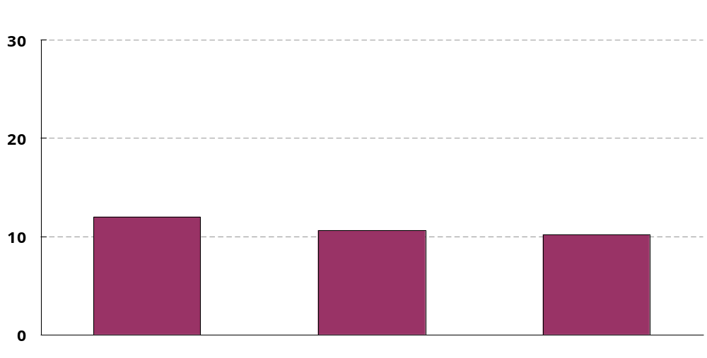
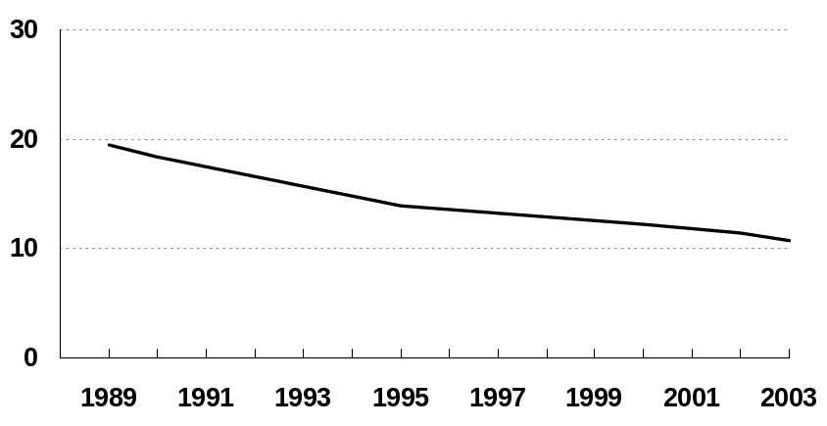
Cigarette Smoking During Pregnancy, 2005
Percent
Percent
Cigarette Smoking During Pregnancy
1st Trimester
2nd Trimester
3rd Trimester
Note: Data by trimester for 2005 are for 11 states and are based on the 2003 revision of the U.S. Certificate of Live Birth. Trend data for 1989-2003 are based on the 1989 revision of the U.S. Certificate of Live Birth. For the trend line, the number of areas reporting increased from 43 states and DC in 1989 to 49 states and DC in 2000-2002 and decreased to 47 States and DC in 2003. Data based on the 2003 revision are not comparable with data based on the 1989 revision.
SOURCE: National Vital Statistics Survey, CDC, NCHS
Notes:
11 states using 2003 revision in 2005 –ID, KS, KY, NB, NH, NY state (excluding NYC), PA, SC, TN, WA
Other data related to pregnancy and smoking:
PRAMS data: The workgroup brought up the possibility of showing PRAMS data here. PRAMS data are state data that measure smoking cessation during the last trimester of pregnancy (for women who report smoking in the 3 months before they were pregnant). For the 19 states measured by PRAMS in 2003, 30% (West VA.) to 65% (Utah) of women who smoked in the 3 months before they became pregnant reported no smoking in the last 3 months of pregnancy.
Healthy People 2010 objective 27-6: Note also, for objective 27-6 (smoking cessation during pregnancy—which measure those who reported having a live birth in the past 5 years and smoking at any time during their pregnancy with their last child AND reported that they quit in the first trimester and stayed off of cigarettes for the rest of the pregnancy.
For this objective the 1998 baseline is 14%, and the 2005 data update is 11% (not statistically different), and the target is 30% (Source: NHIS)

Slide 8
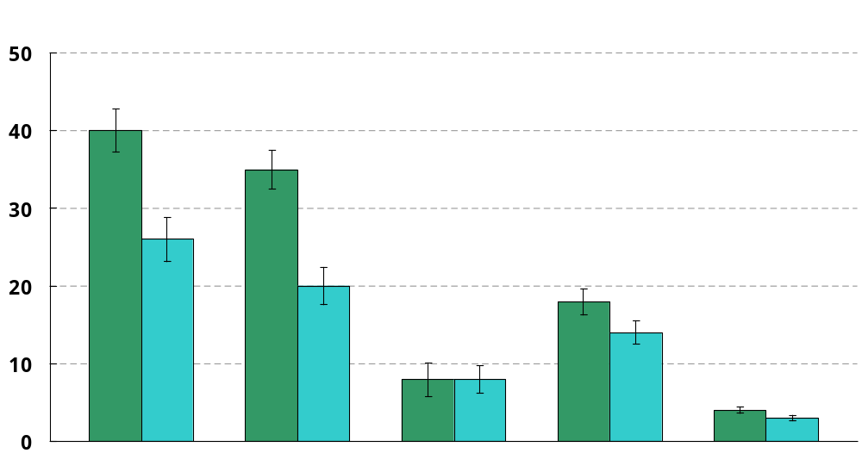
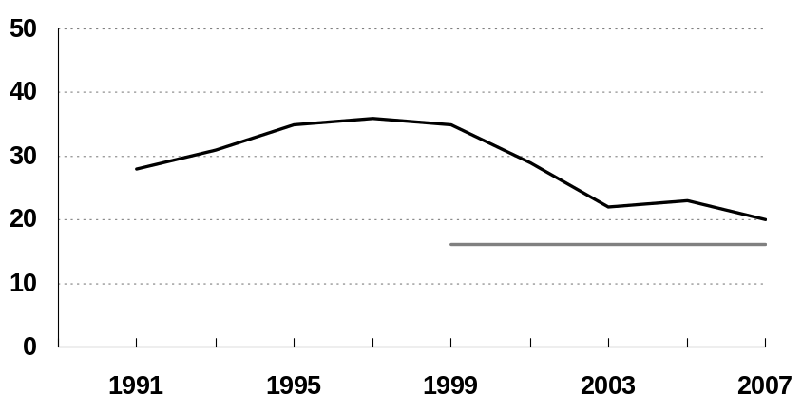
Use of Tobacco Products,
Adolescents Grades 9-12
1999
2007
2010
Targets
Decrease desired
Percent
Percent
Cigarettes
All Tobacco
Cigarettes
Spit Tobacco
Cigars
Bidis*
I = 95% confidence interval. *Data displayed for Bidis are for data years 2000 and 2006. Note: Tobacco use is defined as using cigarettes, spit tobacco, or cigars on 1 or more of the 30 days preceding the survey. These categories are not mutually exclusive; students are counted for each tobacco type used in the past 30 days.
SOURCE: Youth Risk Behavior Surveillance System, CDC, NCCDPHP and National Youth Tobacco Survey, American Legacy Foundation and CDC.
Obj. 27-2 a-e
Notes:
Decline has slowed substantially in the last 4 years.
Cigarette smoking is the dominant product…determines trends—therefore is most important to focus on.
Exerpt about BIDIS from: http://www.cdc.gov/tobacco/data_statistics/factsheets/bidis_kreteks.htm
Fact Sheet
Bidis and Kreteks
(updated February 2007)
Bidis (pronounced "bee-dees") are small, thin hand-rolled cigarettes imported to the United States primarily from India and other Southeast Asian countries.1,2 They consist of tobacco wrapped in a tendu or temburni leaf (plants native to Asia), and may be secured with a colorful string at one or both ends.1,2 Bidis can be flavored (e.g., chocolate, cherry, and mango) or unflavored.1 They have higher concentrations of nicotine, tar, and carbon monoxide than conventional cigarettes sold in the United States.1,3

Slide 9
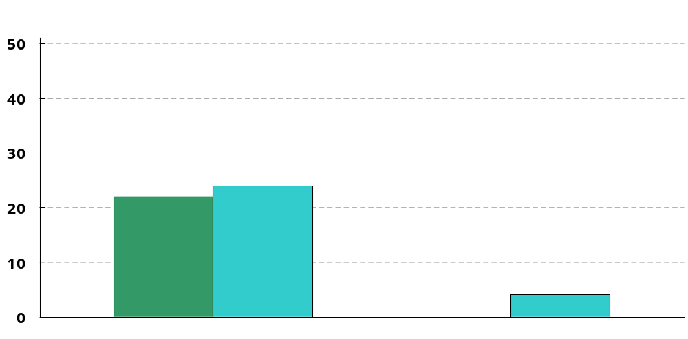
Restricting Tobacco Sales to Minors
States and DC
1998
2007
Increase desired
2010 Target: 51
2010 Target: 51
*
Laws for retail license suspensions for sales to minors
States with ≤ 5% illegal sales rate to minors
* In 1998 there were no jurisdictions that had an illegal sales rate of ≤5% among minors.
SOURCE: State Tobacco Activities Tracking and Evaluation, CDC, NCCDPHP, OSH and State Synar Enforcement Reporting, SAMHSA, CSAP.
Obj. 27-14 a, 27-15
Notes:
27-15 (on right) STATE data provided by OSH. Number of state and DC with minors’ access laws with provisions for license suspension and/or revocation for violation.
27-14a (on left)—As required by the Synar Amendment, all 50 states and DC submit sales to SAMHSA in compliance checks as part of the Substance Abuse Prevention and Treatment (SAPT) block grants. Inspections are run by the states, and may use ‘stings’ or minors, but can also use other methods if approved. For the first two years of the Synar program states were required to do a ‘resonable number of random unannounced inspections.) For the third year, and all subsequent years, states must conduct ‘random unannounced inspections of outlets that represent a probablility sample of outlets accessible to youth’.
SAMHSAs ‘legal’ target is 20% and 49 states and DC have met SAMHSAs requirement in 2007 (Mass. (with rate if 22.7) is the only state not under 20% in 2007). [per workgroup—SAMHSAs requirement was set years ago, but subsequent studies have shown that an illegal sales rate as low as <=5% is necessary]
The four states that have an illegal sales rate <=5% are Arkansas (4.7); Delaware (5.0); Louisiana (4.7); Mississippi (3.2).
*27-14 b (not shown)–Measures territories, 1998 baseline was 0 territories had less than or equal to 5% illegal buy rate among minors, in 2007 that number is up to 2 territories (8 territories are tracked)

Slide 10
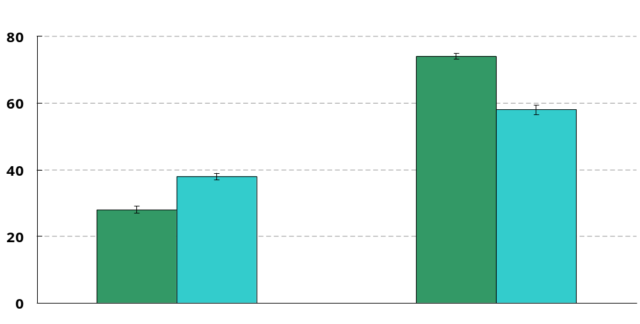
Recall of Tobacco Advertising,
Adolescents Grades 6-12
Percent
2000
2006
Decrease desired
2010 Target: 67
2010 Target: 25
Internet
Magazines and Newspapers
I = 95% confidence interval. Note: Data are for students who answer ‘most of the time’ or ‘some of the time’ to how often they see advertisements for cigarettes and other tobacco products when searching the internet or when reading magazines or newspapers.
SOURCE: National Youth Tobacco Survey, American Legacy Foundation.
Obj. 27-16 a,b
Notes:
*Does not include students who answered ‘hardly ever’…
*I asked the workgroup about where the tobacco ads are on the internet since I have never seen any, and they said that the ads are not as blatant and tend to be more hidden…
Wording of question asked:
“When you are searching the internet on a computer, how often do you see ads for cigarettes and other tobacco products?
1-I don’t search the internet
2-most of the time
3-some of the time
4- hardly ever
5- never
“When you read newspapers or magazines how often do you see ads for cigarettes and other tobacco products?
1-I don’t read newspapers or magazines
2-most of the time
3-some of the time
4- hardly ever
5- never

Slide 11
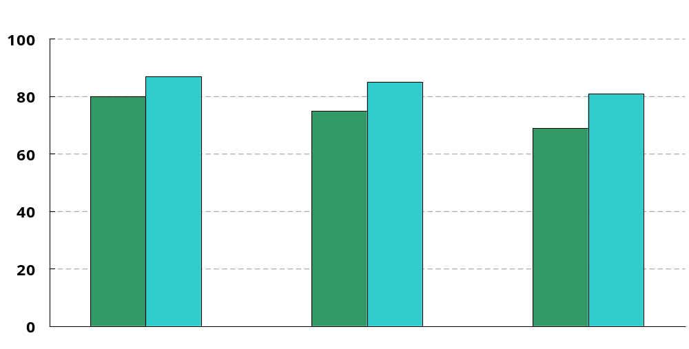
Disapproval of Smoking, Adolescents
Percent
1998
2007
Increase desired
2010 Target: 95
8th grade
10th grade
12th grade
Note: Data are for students who disapprove of smoking one or more packs of cigarettes per day.
SOURCE: Monitoring the Future, NIH, NIDA.
Obj. 27-17 a-c

Slide 12
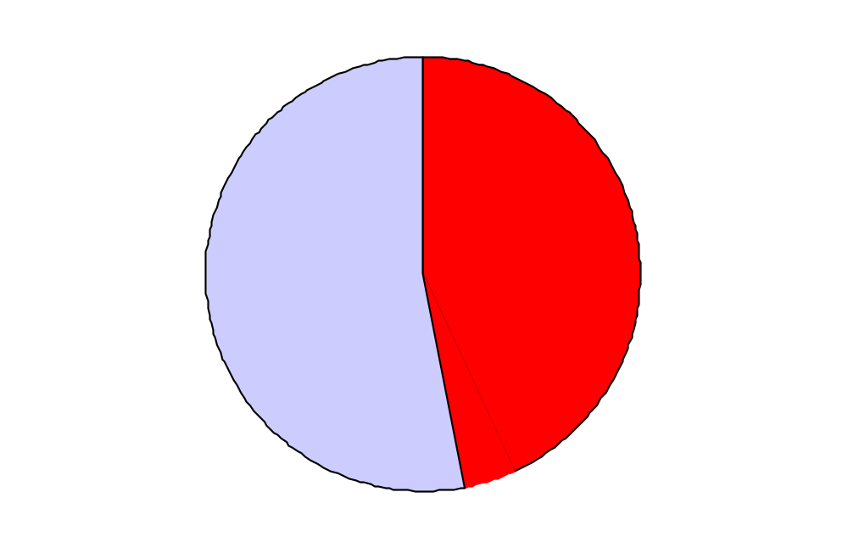
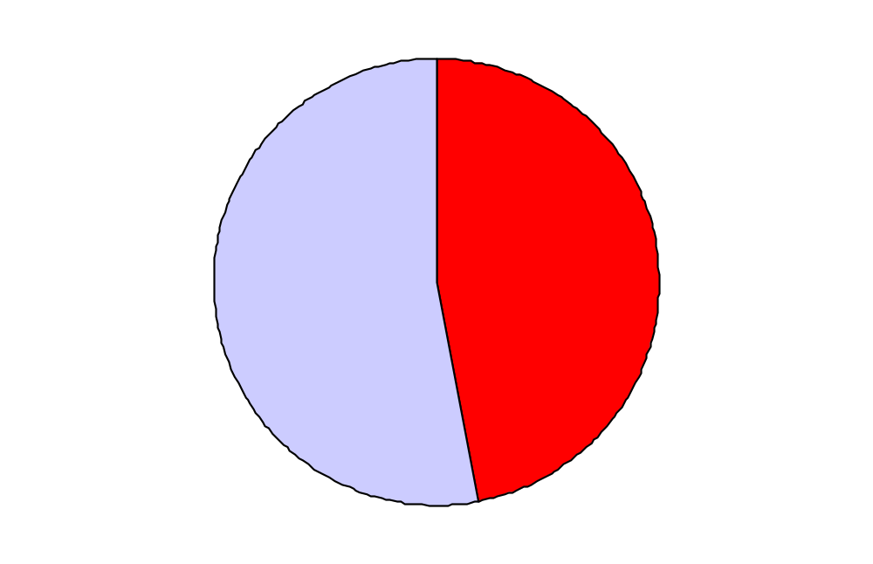
Smoking Cessation Attempts,
(Smoked or Quit in the Last Year)
Percent
Increase desired
100
Adult Smokers, 2006
2010 Target: 80
47% of adult smokers attempted to quit
75
All attempts
50
25
4% abstinent at time of survey
Successful attempts
0
1998
1999
2000
2001
2002
2003
2004
2005
2006
Note: Data are for adults 18 years and over; cessation attempts are counted for cigarette smokers who quit for one day or longer during the 12 months prior to the interview and former smokers who stopped smoking in the 12 months prior to the interview. Data are age adjusted to the 2000 standard population.
SOURCE: National Health Interview Survey, CDC, NCHS.
Obj. 27-5
Notes:
Questions asked:
Have you smoked at least 100 cigarettes in your entire life?
<if yes>
Do you now smoke cigarettes everyday, some days, or not at all?
<if everyday or some days (current smokers—failed attempts)>
During the past 12 months, have you stopped smoking for 1 day or longer because you were trying to quit smoking?
<if not at all (former smokers—successful attempts)>
How long has it been since you quit smoking cigarettes?
(looking only for <1 year)

Slide 13
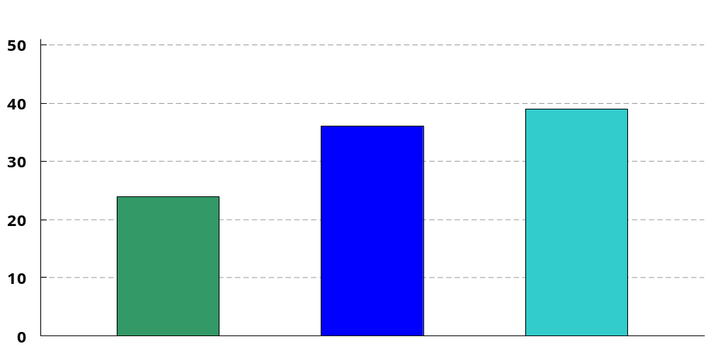
Medicaid Program Coverage for Treatment
of Nicotine Dependency
States and DC
1998
2002
2006
Note: Data are for States that have at least one form of tobacco dependence treatment (medication or counseling) for all Medicaid recipients.
SOURCE: Center for Health and Public Policy Studies at UC Berkeley.
Notes:
1 state program (Oregon) covers all PHS recommended treatments. (PHS=2000 Public Health Service Clinical Practice Guidelines.)
(These are states that have any treatment for all medicaid recipients)References:
State Medicaid Coverage for Tobacco-Dependence Treatments—United States, 2006
February 8, 2008 / Vol. 57 / No. 5 http://www.cdc.gov/mmwr/preview/mmwrhtml/mm5705a2.htm
State Medicaid Coverage for Tobacco-Dependence Treatments—United States, 2005
November 10, 2006 / Vol. 55 / No. 44 http://www.cdc.gov/mmwr/preview/mmwrhtml/mm5544a2.htm
State Medicaid Coverage for Tobacco-Dependence Treatments—United States, 1994–2002
January 30, 2004 / Vol. 53 / No. 3 http://www.cdc.gov/mmwr/preview/mmwrhtml/mm5303a3.htm
State Medicaid Coverage for Tobacco-Dependence Treatments—United States, 1994–2001
May 30, 2003 / Vol. 52 / No. 21 http://www.cdc.gov/mmwr/preview/mmwrhtml/mm5221a3.htm
State Medicaid Coverage for Tobacco Dependence Treatments—United States, 1998 and 2000
November 9, 2001 / Vol. 50 / No. 44 http://www.cdc.gov/mmwr/preview/mmwrhtml/mm5044a3.htm
These data relate to Objective 27-8 b : Medicaid program coverage for treatment of nicotine dependency (number of states and DC). Target for the objective is total coverage (51 states and DC)
Baseline data for 1998 from the Health Policy Tracking Service, National Conference of State Legislators.
24 States recorded as having Medicaid program that covers smoking cessation services, including counseling and nicotine replacement therapies

Slide 14
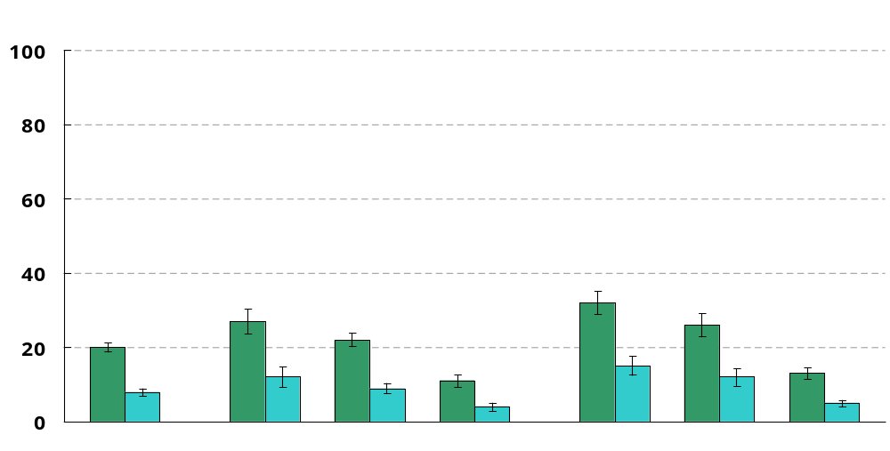
Reported Exposure to Tobacco Smoke
at Home, Children 6 Years and Under
Percent
1998
2005
Decrease desired
2010 Target: 6
Total
Black
White
Hispanic
Poor
Near poor
Middle/ High
I = 95% confidence interval. Note: Data are for children who live with a household resident who smoked inside the home at least 4 days per week. The categories black and white exclude persons of Hispanic origin. Persons of Hispanic origin may be any race. Respondents were asked to select one or more races. Data for the single race categories are for persons who reported only one racial group. Poor is below Federal poverty level (FPL). Near poor is 100 to 199% of FPL. Middle/High income is 200% or more of FPL.
SOURCE: National Health Interview Survey, CDC, NCHS
Obj. 27-9

Slide 15
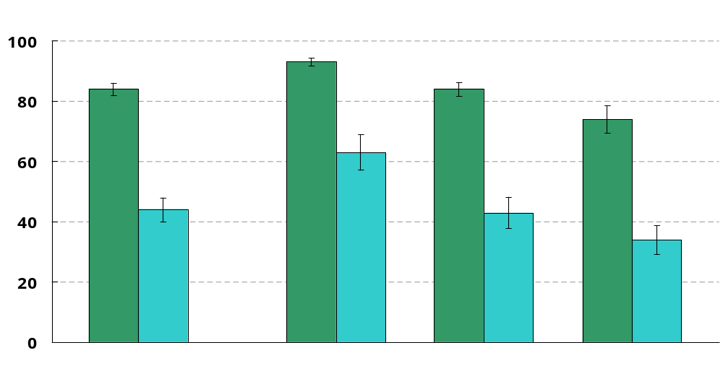
Measured Exposure to Tobacco Smoke,
Non-Smokers
Percent
1988-94
2003-06
Decrease desired
2010 Target: 56
Total
Black
White
Mexican American
I = 95% confidence interval. Note: Data are for non-smokers ages 4 and older who had a serum cotinine level ≥ 0.05 ng/ml. Data are age adjusted to the 2000 standard population. The categories black and white exclude persons of Hispanic origin. Persons of Mexican American origin may be any race. Respondents were asked to select only one race prior to 1999. For 1999 and later years, respondents were asked to select one or more races. For all years, the categories black and white include persons who reported only one racial group.
SOURCE: National Health and Nutrition Examination Survey, CDC, NCHS
Obj. 27-10
Notes:
Children less than 8 are not asked question about smoking status and are assumed to be non-smokers. This age changes to 12 for the *1999-2000* survey. --persons less than 12 years old are assumed to be non-smokers in these analyses.
The folks in DHANES look at non smokers with cotinine levels of >= 0.05 -10.0 ng/ml. The healthy people objective does not have the upper cutoff and only looks at non-smokers (people who have reported that they did not use any tobacco product in the last 5 days) who have a cotinine level >= 0.05 ng/ml.

Slide 16

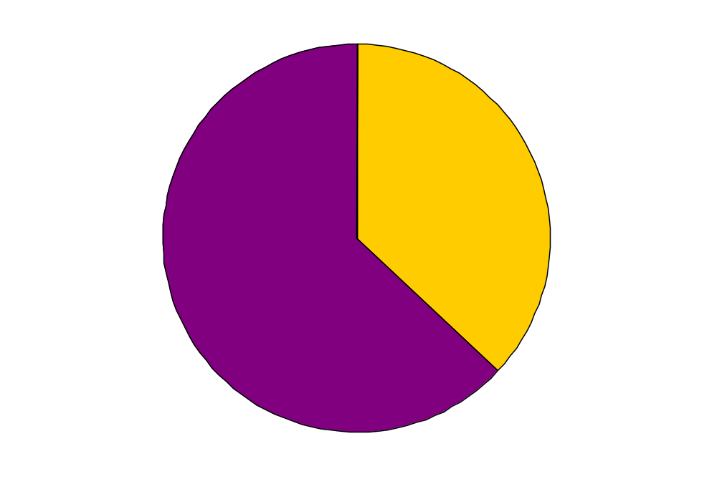
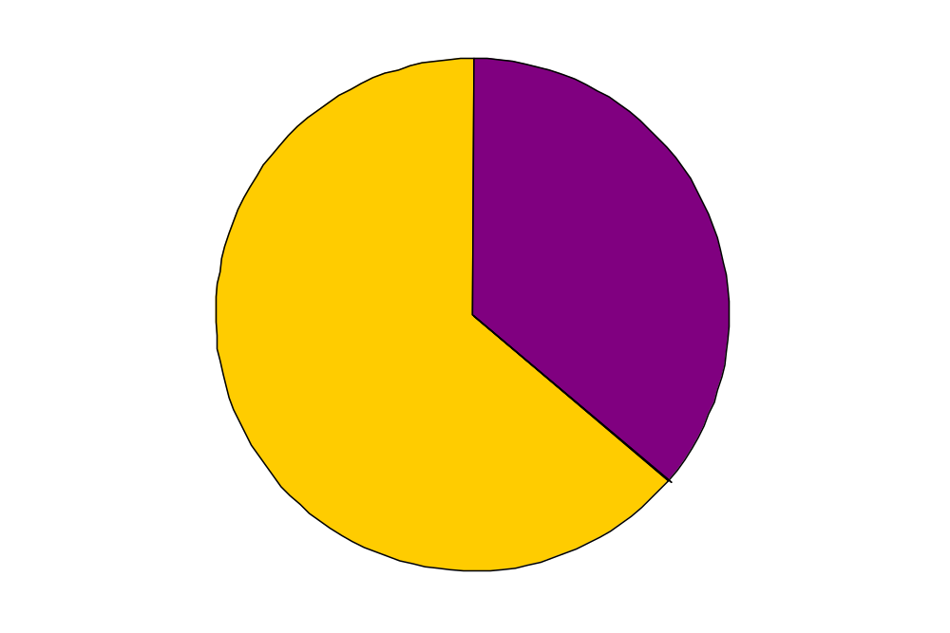
Tobacco-Free Schools
Increase desired
Tobacco-Free
2010 Target: 100
37%
64%
1994
2006
Note: Data are for Junior High, Middle and Senior High schools that allow no smoking AND no smokeless tobacco use by students, staff, or visitors on school facilities, property, vehicles and school events.
SOURCE: School Health Policies and Progress Study, CDC, NCCDPHP.
Obj. 27-11

Slide 17
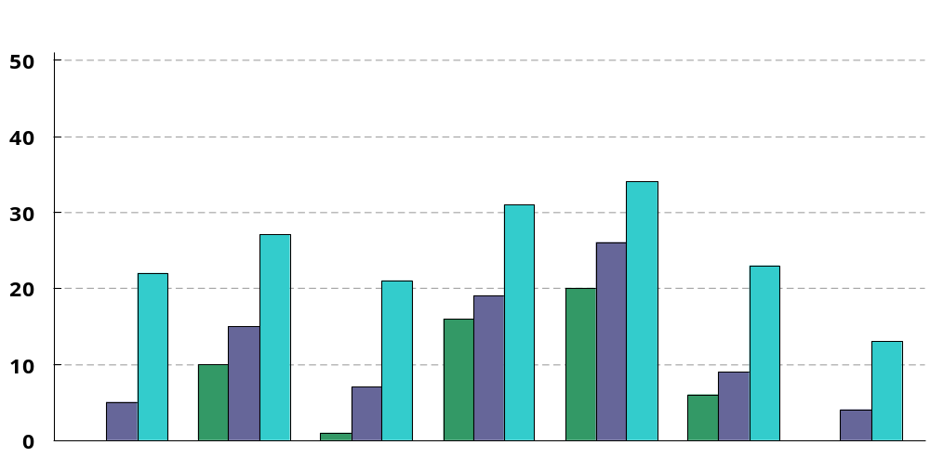
Smoke-Free Indoor Air Laws
States and DC
1998
2004
2007
Increase desired
2010 Target: 51
*
*
Private Workplace
Public Workplace
Restaurants
Public Transportation
Day Care Centers
Retail Stores
Bars
*No states had established laws prohibiting any smoking. Note: Data for day care centers include both commercial and home based centers. Data for retail stores include only malls and grocery stores.
SOURCE: State Tobacco Activities Tracking and Evaluation System, CDC, NCCDPHP, OSH.
Obj. 27-13 a-f, i
Notes:
Language about limiting smoking to a “separately ventilated area” was dropped at the midcourse review
*Day care centers include both commercial and home based centers. Commercial and home based are each tracked separately but they are combined in this objective.
*retail stores only looks at Malls and grocery stores.

Slide 18
Progress Toward 2010 Targets
Target met or exceeded
Improving
Little or no change*
Getting worse
No trend data (baseline only)
Dropped at midcourse
Retained as developmental
3
24
11
2
3
2
4
*Percent of targeted change achieved is between -10% and 10%, and/or change not statistically significant.
Notes:
Measures dropped at midcourse:
27-1d—Other tobacco use—Adults
27-8c—Insurance coverage for treatment of nicotine dependency
Measures retained as Developmental:
13g—smoke free indoor air laws--tribes
13h—smoke free indoor air laws --territories
18b—evidence based tobacco control programs—territories
18c—evidence based tobacco control programs--tribes

Slide 19
Remaining Tobacco Use Objectives
27-1 b-d. Adult Tobacco Use
27-3 a,b. Initiation of cigarette use
27-4 a,b. Average age at first tobacco use
27-6. Smoking cessation during pregnancy
27-7. Smoking cessation attempts by adolescents
27-8 a-c. Coverage for treatment of nicotine dependency
27-12. Indoor worksite policies that prohibit smoking
27-13 g,h. Smoke free indoor air laws
27-14 b. Enforcement of illegal tobacco sales to minors
27-18 a-c. Evidence based tobacco control programs
27-19. Pre-emptive tobacco control laws
27-20 a-c. Sales weighted toxic chemicals in cigarette smoke
27-21 a,b. Increased taxes on smokeless tobacco
Target met
Improving
Little or no change*
Getting worse
Baseline only
No data
*Percent of targeted change achieved is between -10% and 10%, and/or change not statistically significant.
Note: Objectives 27-1d and 27-8c were dropped at the Midcourse Review.

Slide 20
Summary
Exposure to secondhand tobacco smoke has decreased
Smoke free indoor air laws have increased substantially
Smoking cessation attempts among adult smokers are virtually unchanged—most attempts are unsuccessful
Tobacco use among adults continues to gradually decline
Tobacco use among adolescents has decreased considerably, although decline has stalled since 2003

Slide 21
Acknowledgements
  Lesley Agress
  Health Statistician
  CDC/National Center for Health Statistics
  LKA7@cdc.gov
  Contributors:
  Allison MacNeil, CDC/OSH
  Gabbi Promoff, CDC/OSH

Slide 22

Progress review data and slides
can be found on the web at:
http://www.cdc.gov/nchs/hphome.htm

