Slide 1
ORM
One Step At A Time

Slide 2
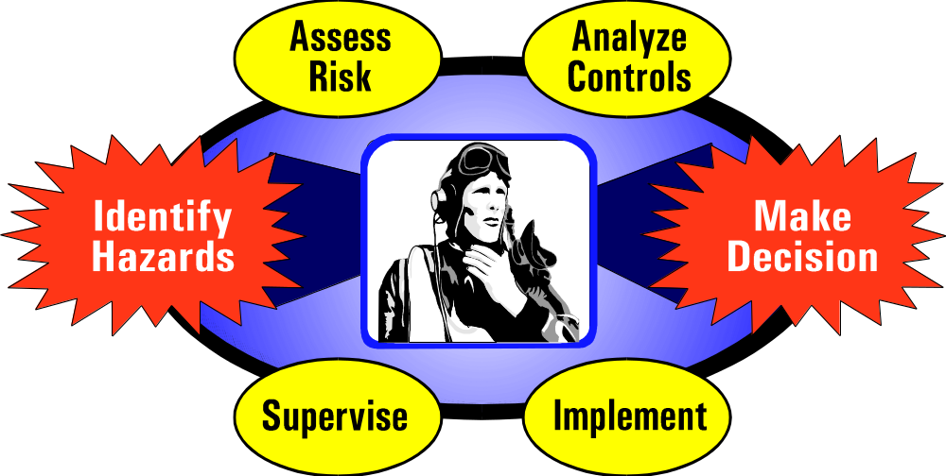
ORM Process
Notes:
42
1. Sort out what is important from what’s unimportant
2. Decide what mission implication there are from 1
3. This analysis allows the process to constrain and focus the decision for maximumopportunity
4. Select the controls that best support the mission. Bang for buck1
5. First dynamic that leads to WCE. First step where resources are expended. This is committment. Culture change time
6. This is where an assessment is made to determine if risk controls meet defined organizational standards. Also it is where the process is measured, and the process repeated as necessary.

Slide 3
An Accident is the unplanned result of a behavior or a condition that is likely part of an organization’s culture

Slide 4
“ Culture is the integrated pattern of human behavior that includes thought, speech, action and artifacts, and depends on man’s capacity for learning and transmitting knowledge to succeeding generations.”

Slide 5
Or, more simply
It’s the way we do things around here

Slide 6
Every Organization Has a Culture
Sometimes it’s difficult to read
You ever been the “new guy?”
Do you want to stand out?
Fit in?
You strive to achieve balance with everyone else.
Our goal is a strong, cohesive, tight-knit
single direction organization

Slide 7
What is the Safety Culture?
If it’s safe, it’s good
If it not, then you’re headed for trouble.
You have to demonstrate:
  Vision
  Values
  Beliefs

Slide 8
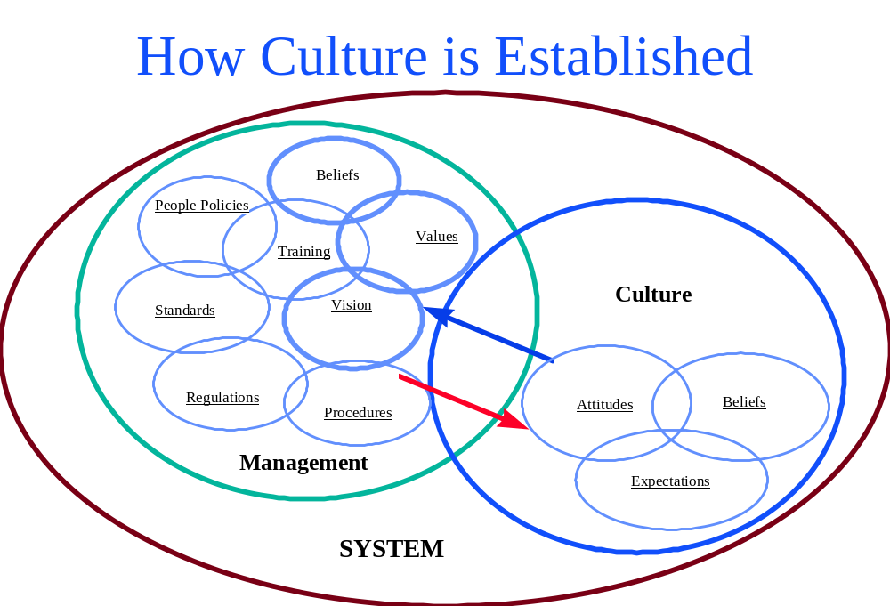

Slide 9
Culture Belongs to the Members
Look to your managers
  CFI’s
  Staff Members
  Check Pilots
  Planners
  Informal Leaders

Slide 10
Elements of Culture
Environment: The ether around us at work
  Events triggering – most powerful force in shaping culture
Values: Heart of Culture. Defines success.
  If you do this, you will be a success. No deviation is allowed
Role Models and Heroes – they set examples
Rites & Rituals – They set the routine in the culture. Set behavior.

Slide 11
The “Next Accident”
Brainstorm with your squadron
  What will the next accident be?
    Make a list of all the topics
  Prioritize the list
    Have the members rank them in importance, using a ballot
    Tally from most to least likely to happen
Email me the results
  jquick1@earthlink.net

Slide 12
5M Concept
Management
Mission
Man
Machine
Media
Notes:
66

