Slide 1
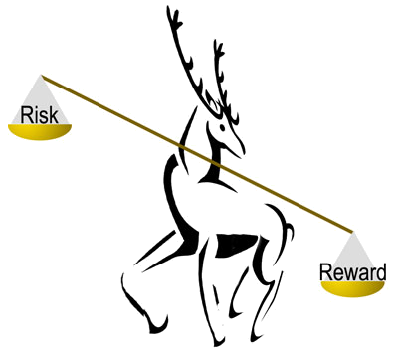
DEAR 101
DOI Enterprise Architecture Repository (DEAR)
A Tool for Improving Our Business

Slide 2
Course Topics
What is DEAR?
What is DEAR for?
Who benefits from DEAR?
What does DEAR look like?
When will DEAR be installed?
Conclusion

Slide 3
What Is DEAR?
Course Topic 1
Overview of the DOI Enterprise Architecture Repository.

Slide 4
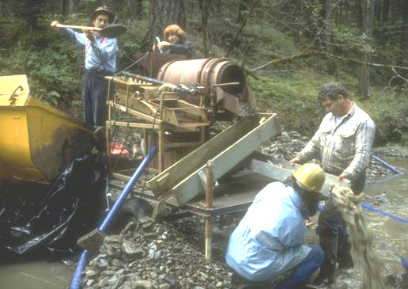
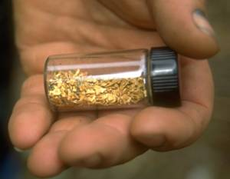
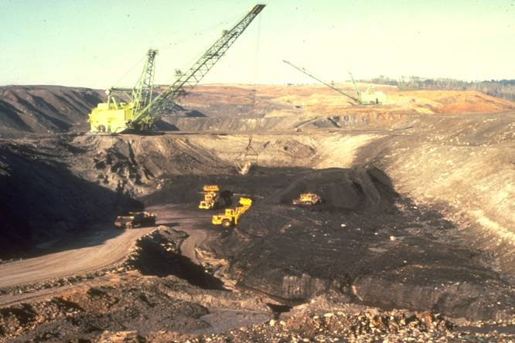
What Is DEAR?
DOI Enterprise Architecture Repository
A tool to help you manage IT investments for the best value.
Without DEAR: you don’t know where the business value is; you have to dig up everything.
With DEAR: less work, less disturbance, more result. You dig only where there’s value.

Slide 5
What Is DEAR?
“It is a capital mistake to theorize before one has data.”
--Sir Arthur Conan Doyle
DEAR gives managers data for theorizing, and models for trying out the theories.

Slide 6
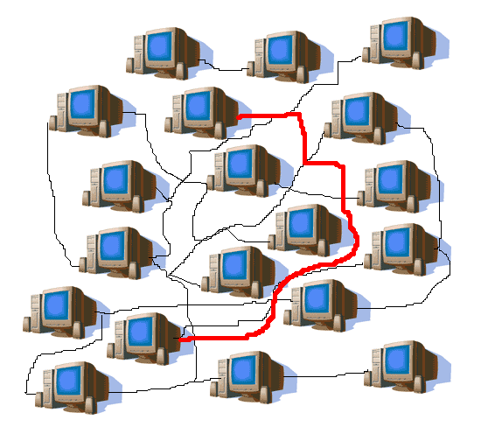
What Is DEAR?
Improves IT decisions by linking data on Interior’s
  Business objectives
  IT systems
  Technology standards
Like a combination of graphics software and database software
  “Visio on steroids”
  Lets you use text and diagrams together
Bridges the islands of information that are spread across the DOI
  Takes data in many formats and sizes
  Combines and compares related data
DEAR shows obscure connections

Slide 7


What Is DEAR?
Reporting tool: gives decision-makers critical information for analyzing architecture
Central to EA: stores all architecture-related models, data, and artifacts, produces reports for EA
Updates Interior-level data from bureau-level data
  Bureau-level data is maintained by bureaus, not by Interior
  Interior-level data
    Integrates the data tracked at the bureau level
    Includes significant bureau investments and critical systems
    Relates bureau-level data to Interior objectives and goals
DEAR organizes information so patterns become clear

Slide 8
What Is DEAR?
“Throughout our 150-year history, Interior bureaus have largely operated as semi-independent entities. As such, they have built a rich history and deep internal bonds of dedication and commitment. It is increasingly clear today, however, that a continued ‘stovepipe’ orientation across Interior and its bureaus is no longer adequate for the challenges we face.”
—DOI Strategic Plan
DEAR brings all the stovepipes into one chimney.

Slide 9
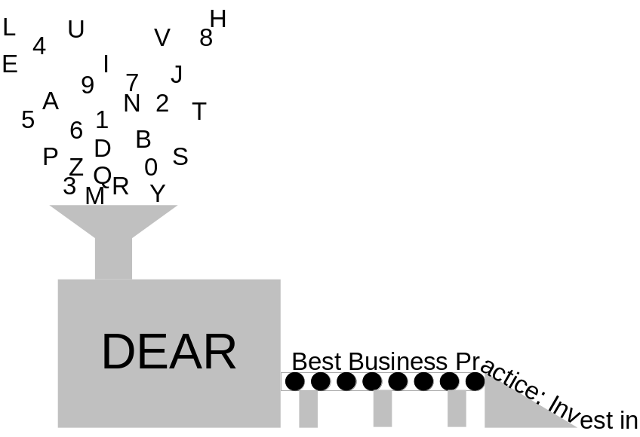
What Is DEAR?
What goes into DEAR
  Data and models describing what we do in Interior, how we do it and what information we need (functions, processes, and data)
  Data on Interior’s
    Strategic goals, objectives, planned outcomes and measures
    Systems and IT investments
    Endorsed products and standards

Slide 10
What Is DEAR?
What comes out of DEAR
  Reports on what processes, equipment, software, data, etc. Interior owns, and where it all is
  Models (DEAR stores models, but also creates them)
  Reports suggesting where to find cost savings
  Reports showing gaps where we may need new IT systems
  Reports showing overlaps where we need to streamline the IT portfolio
  Reports showing where systems need to talk and don’t
  In general, DEAR maps relationships between the data so it can be analyzed. The analysis drives Interior’s IT investments.
Who uses DEAR
  People who collect and input architecture data
  People who analyze architecture data
  People who use this information for IT decisions

Slide 11

What Is DEAR?
DEAR Is Central to EA
DEAR standardizes data so it’s available for a variety of uses
  EA will not work without this commonality
DEAR also holds the standards to evaluate architecture
EA target models are built in DEAR
DEAR is itself an EA data warehouse
  Combines information from many databases (such as ITIPS) into one store of Interior working data
  Interior EA source-of-record
DEAR reports
  show gaps and redundancies
  track progress toward target
EA without DEAR is like flying at night without instruments

Slide 12
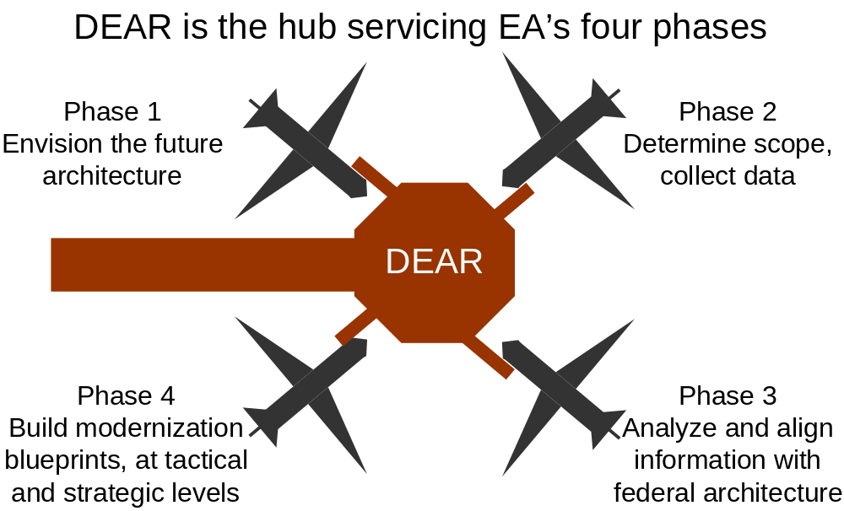
What Is DEAR?
DEAR Is Central to EA

Slide 13
What Is DEAR For?
Course Topic 2
What is valuable about DEAR.

Slide 14
What Is DEAR For?
EA Phase | EA task | How DEAR is used
1 | Envision the future architecture | Build the architecture model in DEAR, showing how inputs relate to outputs
2 | Determine scope, collect data | DEAR models show the scope; DEAR holds the data
3 | Analyze and align information with federal architecture | Query DEAR’s models and analyses to compare with federal models
4 | Build modernization blueprints, at tactical and strategic levels | Use DEAR’s information to generate modernization blueprints

Slide 15
What Is DEAR For?
“Intelligence complicates. Wisdom simplifies.”
--Mason Cooley
DEAR takes complex information and simplifies it into models, lists, and reports that managers can use to make wise decisions.

Slide 16
What Is DEAR For?
The work from phases 1 through 3 all leads up to phase 4: Modernization Blueprints
There are two modernization blueprints, produced and managed in parallel, using DEAR
  Tactical = short-term; what we can get a return on right now
  Strategic = long-term; a broader view on saving and improving
Tactical modernization blueprint supports these decisions:
  O&M expenditures
  Project management
Strategic modernization blueprint supports these decisions:
  Investment proposals
  Business cases

Slide 17
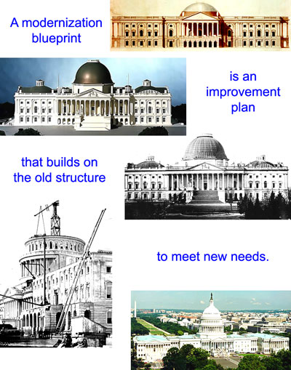
What Is DEAR For?

Slide 18
What Is DEAR For?
“Unobstructed access to facts can produce unlimited good only if it is matched by the desire and ability to find out what they mean and where they lead.”
“The computer can provide a correct number, but it may be an irrelevant number until judgment is pronounced.”
—Norman Cousins
Having artifacts, a methodology, or even a blueprint, is not enough. There has to be a connection to the customer. DEAR shows the customer what the data means.
But—DEAR is a management tool, not a manager. DEAR only analyzes the relevant data. The manager decides what to do.

Slide 19

What Is DEAR For?
How to use a Tactical Modernization Blueprint
The blueprint shows managers
  Best candidates for tactical improvements
  Estimated time/money involved for each
  Models of architecture: as it now is, and as it should be
  Dependencies
Managers can then
  Define and manage a baseline
  Set improvement targets
  Identify, select, and propose improvements
Analysts use DEAR’s information to create a Tactical Modernization Blueprint Sequencing Plan
  Shows start and finish dates of events
  Shows which events depend on others

Slide 20

What Is DEAR For?
How to use a Strategic Modernization Blueprint
Supports
  Mission goals
  Tactical plans
  What phase of investment each system is in
  Systems that overlap (candidates for cost savings)
  Relationships between systems and initiatives (such as e-government)
  Federal guidance on architecture and e-government
DEAR is used to derive a Strategic Modernization Blueprint Sequencing Plan
  Road map to a more cost-effective architecture
  Plan for retiring and re-engineering systems
  Shows which investment proposals are most urgently needed for the future architecture

Slide 21
What Is DEAR For?
Value of modernization blueprints from DEAR
Tactical recommendations give managers something to use now, with today’s dollars
  Top-down effect: High-level managers can watch how results affect overall mission
  Bottom-up effect: Practical tool for middle managers’ wise spending
Strategic recommendations give managers an overall business direction for their technology and line of business
  Top-down effect: Practical tool for high-level managers to use in major decisions
  Bottom-up effect: Big-picture view for middle managers, showing where business is headed

Slide 22
Who Benefits From DEAR?
Course Topic 3
Description of the various people who will collect data for DEAR or use its output reports.

Slide 23
Who Benefits From DEAR?
This type of stakeholder… | Is in this position… | And DEAR helps them with…
Executive | OMB, ITMC, MIT, Agency Head, IRB, OCIO | Vision, guidance, direction
Functional | Agency Sponsor, Project Sponsor, Functional Managers, Program Managers, IBAT | Requirements, portfolio funding requests, acceptance
Execution-Level | Project Managers, System Managers, DEAR IPT | Life-cycle information
Enterprise/Cross-Cutting | Strategic Planners, Investment Planners, IAWG, Security Managers, A-130 Managers | Strategies, plans, integrated views, standards, oversight

Slide 24
What Does DEAR Look Like?
Course Topic 4
An overview of how DEAR is set up.

Slide 25
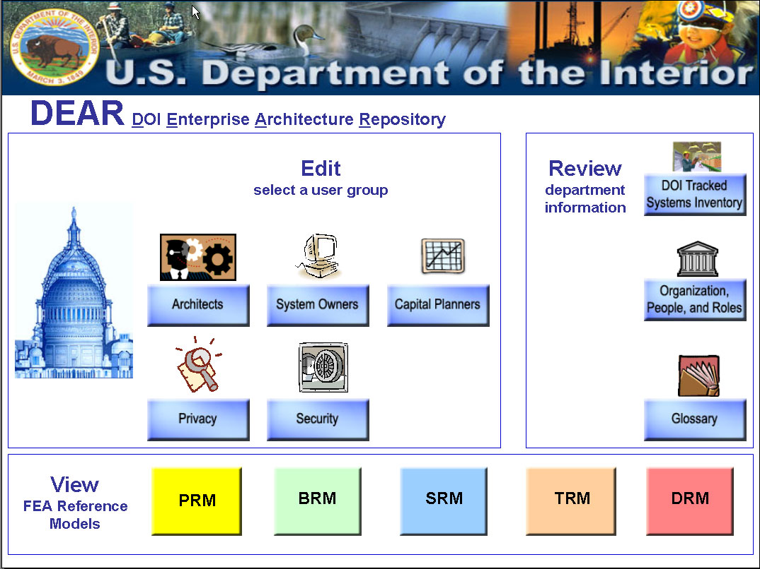
What Does DEAR Look Like?
The entry screen for DEAR guides the user to the diagrams and definitions most useful to each type of user.
Clicking on one of the buttons filters the DEAR domains the user sees.

Slide 26
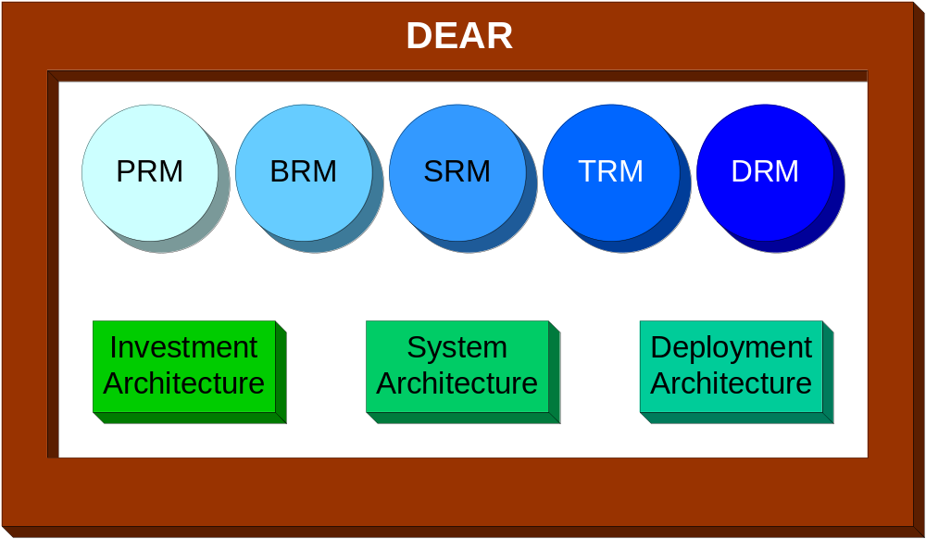
What Does DEAR Look Like?
DEAR has 8 domains…
PRM = Performance Reference Model
BRM = Business Reference Model
SRM = Service Component Reference Model
TRM = Technical Reference Model
DRM = Data Reference Model

Slide 27
What Does DEAR Look Like?
5 domains are FEA models:
PRM—strategy/goals/objectives that drive the architecture
BRM—business functions/activities/processes
SRM—service components, or capabilities
TRM—technology that performs the services, and standards
DRM—data standards and models used by the services
3 domains are sub-architectures—other ways to look at the architecture
Investment Architecture—investment information (pending)
System Architecture—systems and their building blocks
Deployment Architecture—where things are

Slide 28
When Will DEAR Be Available?
Course Topic 5
When to expect each of DEAR’s capabilities.

Slide 29
When Will DEAR Be Available?
Step | DEAR will roll out this capability… | For these people… | On this date…
1 | Architecture | DOI enterprise architects Strategic planners Performance & ABC teams System owners & developer reps Others who need to conduct integrated architecture analyses | November 2003
2 | Security, Privacy, and A-130 | Security managers A-130 managers Others who need to conduct integrated architecture, security, privacy, & A-130 analyses | November 2003
3 | Investment | DOI investment managers Focus is on integrating investment analysis with architecture, security, privacy, & A-130 analyses | TBD/Pending

Slide 30
Conclusion
Course Topic 6
Summary and references.

Slide 31
Conclusion
“My definition of an educated man is the fellow who knows the right thing to do at the time it has to be done…. You can be sincere and still be stupid.”
—Charles F Kettering
“Nine-tenths of wisdom consists in being wise in time.”
—Theodore Roosevelt
DEAR’s data storage format opens data up for re-use. As new questions come up, managers can often use data already in DEAR, rather than take time for a new data call.

Slide 32
Conclusion
Now: We’re using DEAR to collect data to model the architecture we have now
Next: We will analyze the data in DEAR and find the best direction to move forward
Finally: We will use DEAR to create the modernization blueprint that will get Interior’s key business areas to the architecture we want to have

Slide 33


Conclusion
Remember
DEAR is a method of communication; a way for many contributors to come to a shared understanding
DEAR has the potential to give decision-makers vital information at the time they need it
DEAR makes analysis easier for EA modelers
But—
The ultimate purpose of DEAR is not to build successful models, but a successful Interior!

Slide 34
For More Information: Contacts and References
Colleen Coggins—Interior Chief Architect, (202)208-5911, Colleen_Coggins@ios.doi.gov
  Jim Johnson—Interior Business Architecture (IBA) Contract Team Lead, (202)452-7733, James_Johnson@blm.gov
  Jim Barrett—IBA Contract Technical Lead, (303)236-5353, James_Barrett@blm.gov
Draft DEAR metamodel: http://www.doi.gov/ocio/architecture/dear/
Popkin website: http://www.popkin.com

Slide 35
Glossary
A-130 Circular A-130, Management of Federal Information Resources. See http://www.whitehouse.gov/omb/circulars/a130/a130.html
ABC Activity-Based Cost management; a system of breaking tasks into work activities to show how money is spent
Activity model Data model of an activity
Affinity reports Reports showing where similar systems are; used for consolidating systems
Artifact Piece of architecture information discovered through data collection
Attribute A quality of an entity; a piece of an entity’s description
BPR Business Process Re-engineering; Examining a business process in-depth to find ways to improve the process
BRM Business Reference Model; FEA model showing business functions in a hierarchical model
C&A certification and accreditation
Component A self-contained, re-usable object, in programming or architecture
CRUD Create/Read/Update/Delete; basic functions of a database
Data definition The form in which a piece of data is stored and used. For instance, the data entity “name” may be defined as a last name, a first name, and a middle initial
Data model Picture of relationships between data entities and attributes
Deployment Architecture Picture of where data/hardware/software is located
DRM Data Reference Model; FEA Model of the data standards and models used by the services
Encyclopedia The data repository underlying DEAR; holds all the model’s components (artifacts, domains)
Entity An object described in a data model
FEA Federal Enterprise Architecture; federal standards and templates for enterprise architecture. See http://www.feapmo.gov
ICOM Inputs, Controls, Outputs, and Mechanisms; parts of an IDEF0 diagram

Slide 36
Glossary
IDEF0 A type of diagram used in activity modeling; shows the inputs, outputs, controls, and mechanisms
IDEF3 A type of diagram used in activity modeling; shows sequence and causes
Investment Architecture Structure of investment information
IPT Integrated Product Team – brings process, data, applications, and technology skills together
Matrix A table showing relationships between each item on the horizontal and vertical axis
Metadata Data about data; for instance, keywords, or other data used to categorize data
Metamodel Database schema for DEAR data elements; map of DEAR; model of how models will be built
Modernization blueprint A plan for improving the enterprise architecture
OO programming Object-Oriented programming; code that defines or uses objects and their descriptions
PRM Performance Reference Model; FEA model showing strategy/goals/objectives that drive the architecture
Repository A storage place for data; could be a database or could be much more
Service component A capability; an independent piece of a business function. Service components are related to data and technology, which are used by the service component
SRM Service component Reference Model; FEA model showing service components, or capabilities
Subfunction A piece of a business function; similar level as ABC work activities
System Architecture Structure of systems and their building blocks
TRM Technical Reference Model; FEA model of the technology that performs the services, and standards

Slide 37
Document Abstract
Key Words: | Architecture, curriculum, DEAR 101 | FEAF Area: Subject Function Code: | M 1230 | Contract #: NBD020221 Task Number: 8
Part of the Architecture Curriculum for the Communications task
Revision History
Doc Status | Rev. Date | Author/Editor | Description of edit | Filename/lineage
WIP | 11/07/03 | Karen Tallentire | Made Colleen’s changes from draft | S:\Dear\IBA\WIP\Communications\Architecture Curriculum finals (sent to Colleen)\DEAR 101

