Slide 1


The RTMA
Real-time Mesoscale Analysis
2006 NWS Southern Region SOO Conference
11July 2006
      Jeffrey M. Medlin
      Science and Operations Officer
      National Weather Service
      Mobile, Alabama

Slide 2
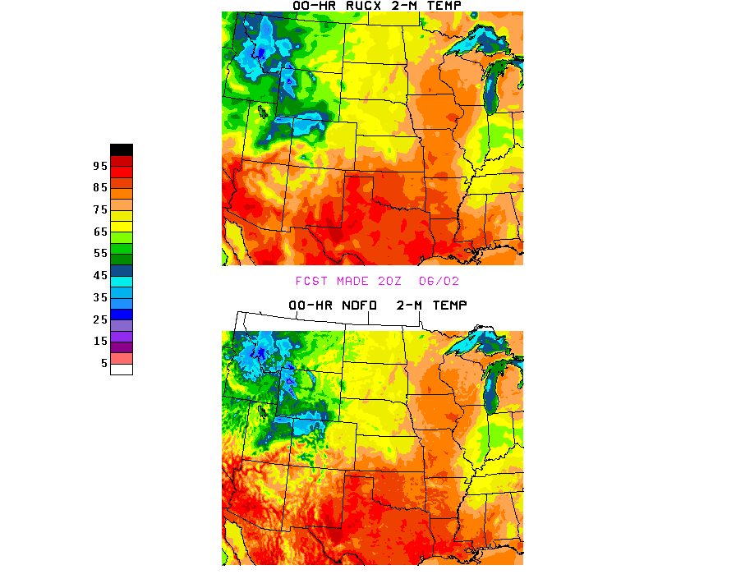
Outline
Presentation Overview
What is the RTMA?
RTMA Procedure Outline
RTMA Details
Individual Element Examples
Access and Where We’re Headed next?
Discussion (5 min)

Slide 3
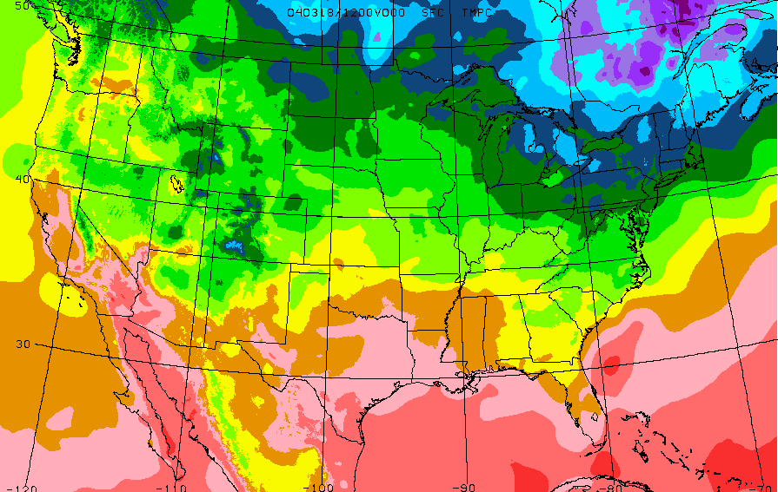
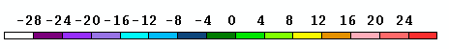
Analysis of Record
“A comprehensive set of the best possible analyses of the atmosphere at high spatial and temporal resolution with particular attention placed on weather and climate conditions near the surface.”

Slide 4
Three Phases of AOR
Phase I – Real-time Mesoscale Analysis
  Hourly within 30 minutes
  Prototype for AOR
  NCEP and FSL volunteer to build first phase
Phase II – Analysis of Record
  Best analysis possible
  Time is no object
Phase III – Reanalysis
  Apply mature AOR retrospectively
  30 year time history of AORs
This talk

Slide 5
Phase I: RTMA
The RTMA is a fast-track, proof-of-concept effort intended to:
Enhance existing analysis capabilities in order to generate and establish a real-time process that delivers a subset of fields to allow for comparisons between CONUS-scale NDFD forecast and observed grids
Establish benchmark for future AOR efforts.
Build constituency for subsequent AOR development activities.
*** Primary contact: Stan Benjamin (FSL)
*** Implemented by Geoff Manikin (EMC/NCEP)

Slide 6
Why not another solution?
Overarching Constraints:
  No funding available – must rely on volunteered resources
  Need to generate centrally as part of NCEP operations
RSAS, OI, SCM or Barnes – legacy techniques with known issues where obs density changes
ADAS, LAPS or STMAS – built around non-NCEP environments, too long & costly to adapt, no expertise at NCEP (for O&M and evolution)
Ensemble Kalman Filter – brand new technique (risk), does not scale to large number of obs, too long & costly to adapt, no expertise at NCEP

Slide 7
RTMA – Basic Procedure Outline
2m Temperature and Dewpoint & 10m wind
  RUC forecast/analysis (13 km) is downscaled by FSL to a 5 km NDFD grid (FSL-developed Procedure).
  Downscaled RUC is used as first-guess in NCEP’s 2DVar analysis of ALL surface observations.
  Estimate of analysis error/uncertainty provided.
Precipitation – Derived from NCEP Stage II analysis.
Sky cover – Derived form NESDIS GOES sounder effective cloud amount (ECA).
Archived at NCDC

Slide 8
Why 2DVar solution?
2DVar is subset of NCEP’s more general 3DVar Grid-point Statistical Interpolation (GSI).
Connected to state-of-the-art unified GSI development.
2DVar is already running in NAM (low risk).
Anisotropy built into 2DVar provides way to restrict influence of obs based on:
  Elevation (terrain height – NAM & ADAS in WR)
  Flow (wind)
  Air mass (potential temperature)
2DVar is more than fast enough to run overtop of hourly RUC in tight NCEP Production suite.
Can provide estimate of analysis error as well as “accuracy” via built-in cross-validation.

Slide 9
RTMA Details
- Mesonet Issues -
NCEP currently honors FSL-MADIS quality markers. FSL has constructed a “Uselist” of acceptable networks based on overall siting strategies etc.
Bad quality marks can be put on the mesonet data based on the SDM’s reject-list.
Some gross checks result in bad quality marks for data that are outside reasonable limits, data with missing lat./lon., etc..

Slide 10
Background error treatment
Old: Downscaled version of background error derived from NCEP global model.
New: Background error computed from auto-covariances based on 8 km forecasts of WRF-NMM (W.-S. Wu 2005, personal communication).

Slide 11
H, the forward model
Description:
  Converts analysis variables to the observation type and location.
  The quality of simulated observation depends on the accuracy of the forward operator:
  In turn, the accuracy of the analysis depends upon the effectiveness of the algorithm used to match obs with the background values.
***Realized in the MM5-3DVAR system (Barker et al. 2004). It has been used for surface data assimilation in operational analysis systems and has proven to be encouraging in many contexts (e.g., Shin et al. 2002; Hwang 2005).

Slide 12
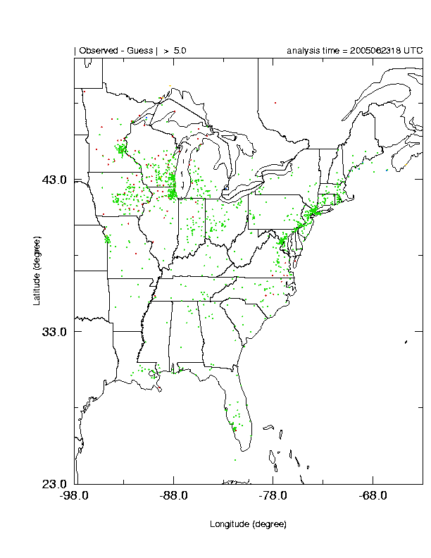
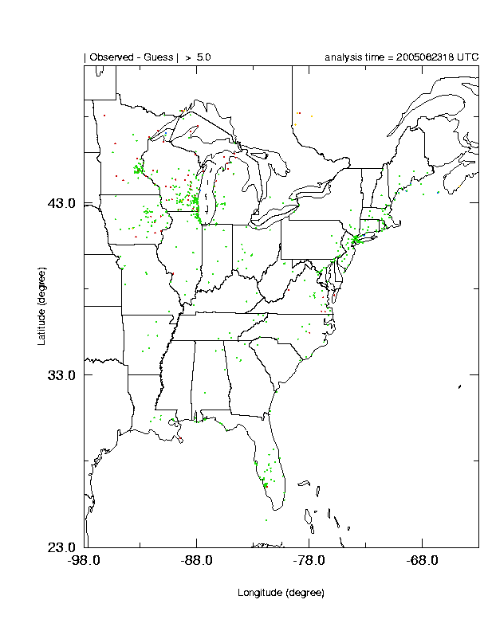
H, the forward model
Number of sites with large innovations (Observed-Guess) is reduced!
Old
simple
interpol.
New
fwd
model

Slide 13
Element Examples
Downscaled 2 m Temperature
Original 13 km
Downscaled 5 km

Slide 14
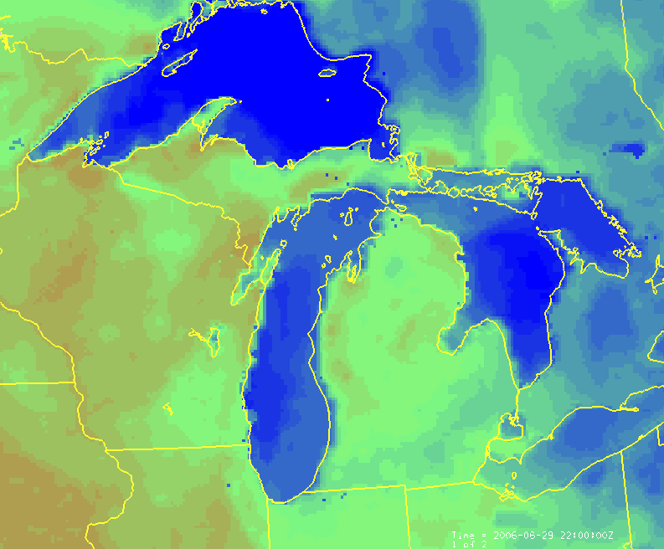
Problems with Land-Water Interface
Element Examples
Found in some Areas where water is on land (i.e., boundary not well-defined)
  UP Michigan

Slide 15
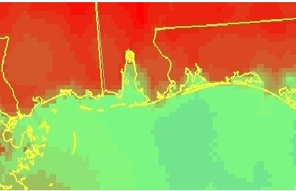
Problems with Land-Water Interface
Element Examples
…but Not Others.
  Mobile Bay

Slide 16
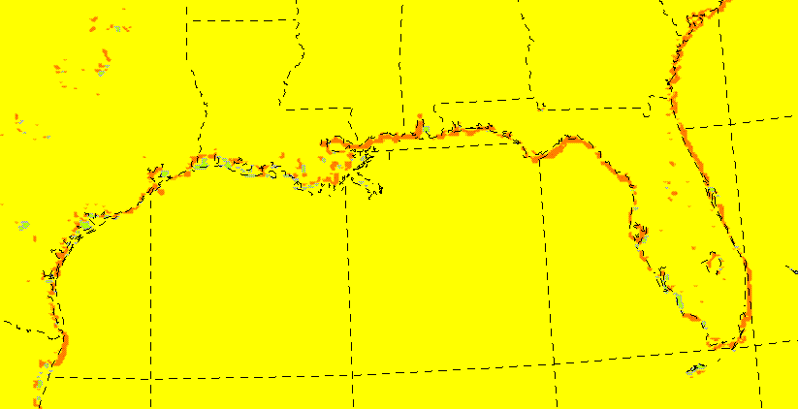
Problems with Land-Water Interface
Element Examples
A new technique to revise the RTMA downscaling of the RUC data. Geoff Manikin put it in on 28 June 2006. Note sharpening of coastline.
Source: Stan Benjamin (FSL)
Change - Coast
Implemented 28 June 2006

Slide 17
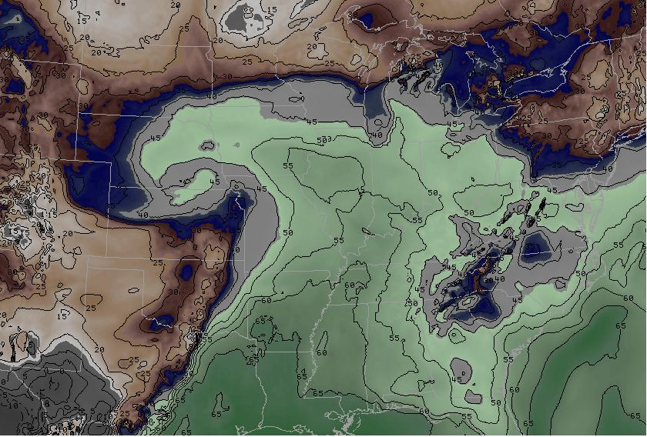
Element Examples
Downscaled 2 m Dewpoint Temperature
L
Color Curve Courtesy - J. Medlin
***Noted dry bias exists (2-6F) depending on US Region

Slide 18
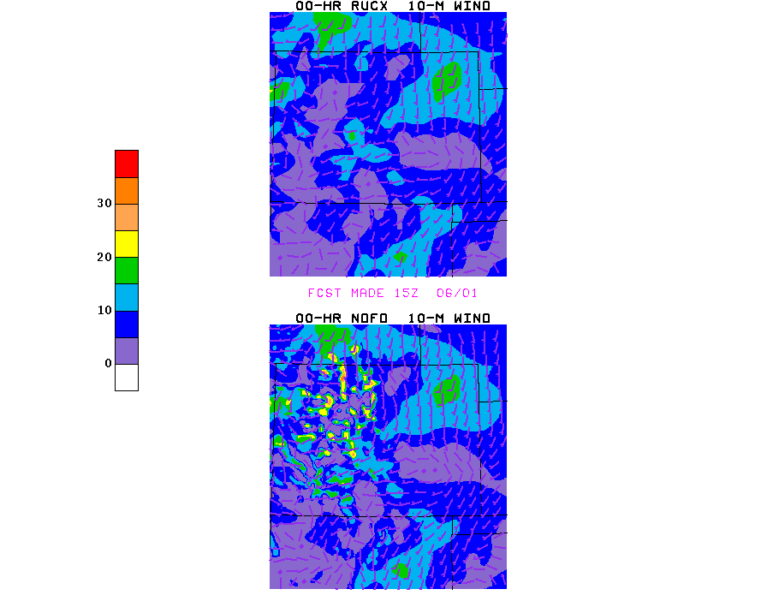
Element Examples
Downscaled 10 m Wind
Original 13 km
Downscaled 5 km
CO
CO

Slide 19
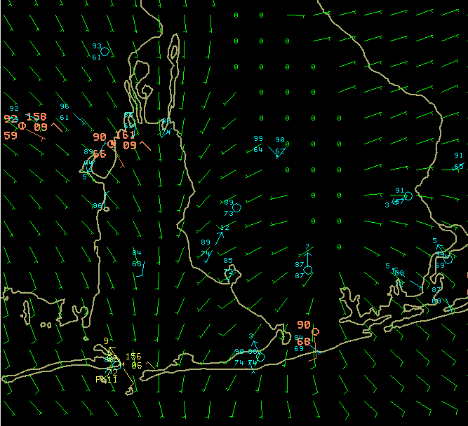
Element Examples
Mobile Bay

Slide 20
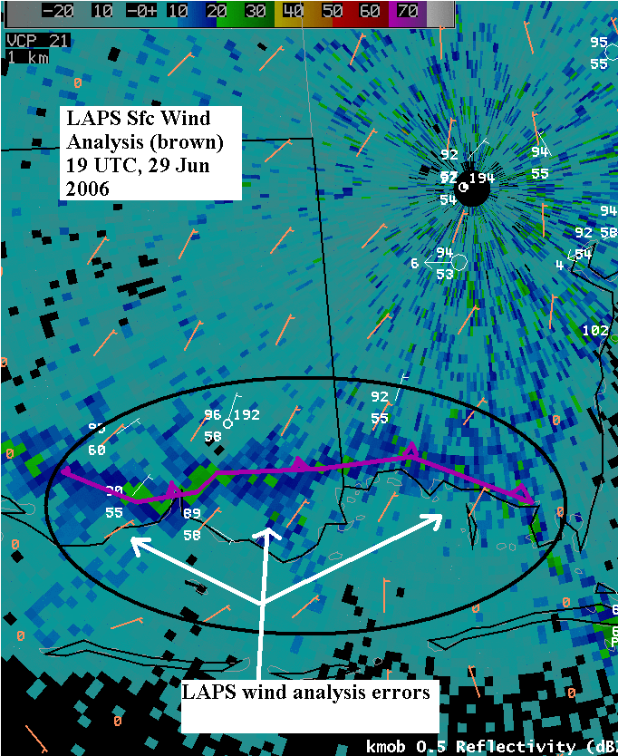
Element Examples – LAPS 10 m wind

Slide 21
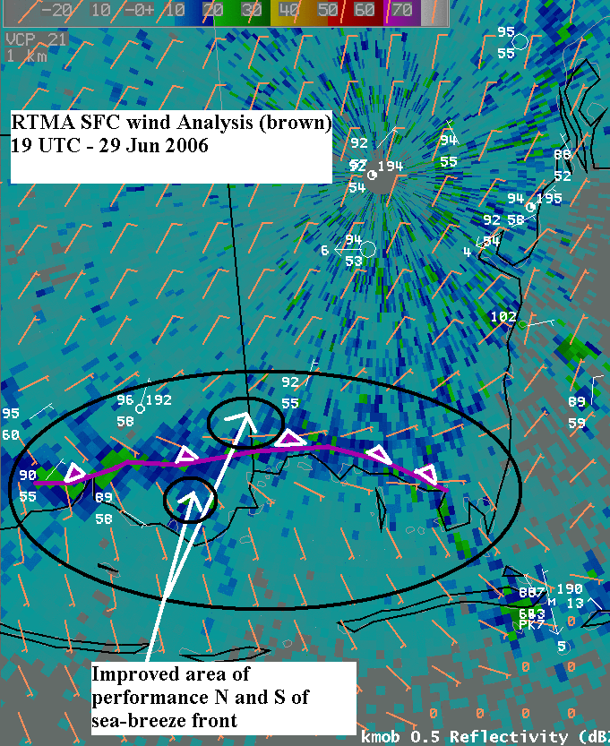
Element Examples – RTMA 10 m wind

Slide 22
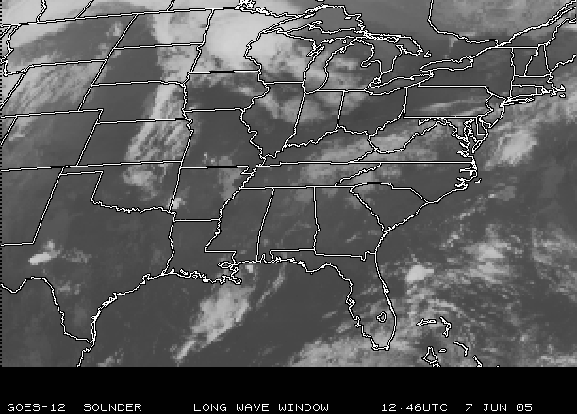
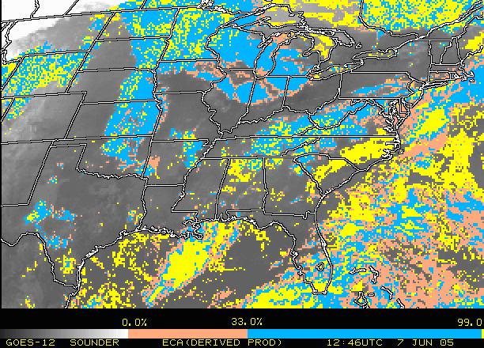
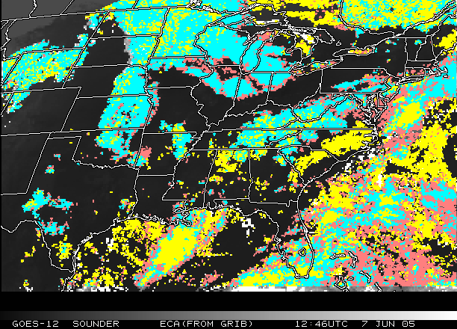
Element Examples - ECA
(a)
Effective Cloud Amount (ECA, %)
Derived from GOES sounder
Mapped onto 5-km NDFD grid
Converted to GRIB2 for NDGD
Contact: Robert Aune, Advanced Satellite Products Branch, NESDIS (Madison, WI)
GOES-12 IR image (11um)
(b)
(c)
Derived ECA from GOES-12
ECA from GRIB2 file – 5km grid

Slide 23
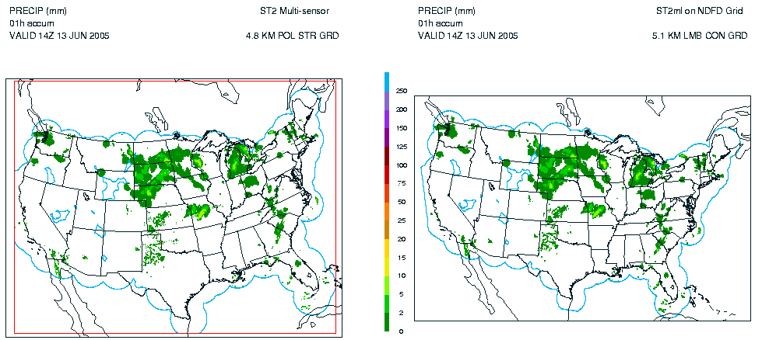
NCEP RTMA Precipitation Analysis
NCEP Stage II (real-time) and Stage IV (delayed) precipitation analyses are produced on the 4-km Hydrologic Rainfall Analysis Project grid
Existing multi-sensor (gauge and radar) Stage II precipitation analysis available 35 minutes past the hour
RTMA is mapped to the 5 km NDFD grid and converted to GRIB2
Upgrade plan including OHD analysis + improved gauge QC from FSL
Primary contact: Ying Lin, NCEP/EMC
http://wwwt.emc.ncep.noaa.gov/mmb/ylin/pcpanl/
ORIGINAL
NDFD GRIB2

Slide 24
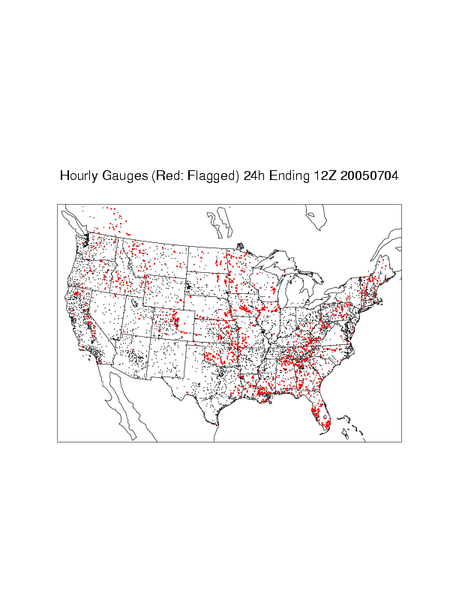
Hourly Gages Available for Stage-II Analysis

Slide 25
RTMA Access and Where We’re Headed Next?
Access - SR Server to push to WFOS via LDM – Use AWIPS D2D Volume Browser
Prior to ‘widespread’ advertisement, NCEP is tying up a few loose ends which includes:
  Fixing Td Problems (something implemented 1 Jun 2006)
  ECA
  1h Pcpn Accumulation not showing up in AWIPS VB
RTMA SMARTINITs soon to be made available from Tim Barker. Can use first few hours of GFE forecsat.
RTMA Survey – conducted by ISST (J. Medlin operational processing feedback forms).

Slide 26
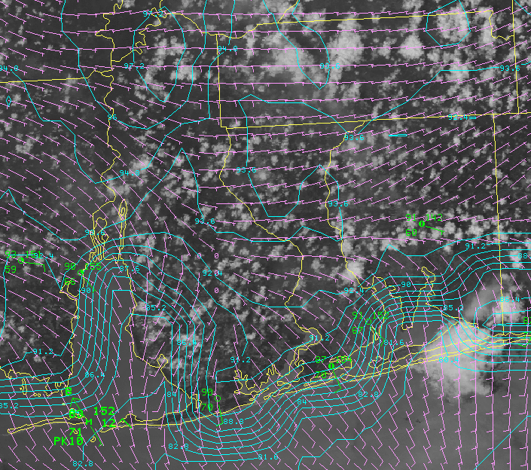
Questions?
1900 UTC - 01 Jun 2006
MODIS 250m VIS / MTRs / MADIS / C-MAN / RTMA Temps (cyan) and Winds (magenta)

Slide 27
Slide Credits
Brad Colman
NOAA/National Weather Service -- Seattle
brad.colman@noaa.gov
John Horel
NOAA Cooperative Institute for Regional Prediction
Department of Meteorology -- University of Utah
jhorel@met.utah.edu
and
Lee Anderson
Office of Science and Technology
NOAA/National Weather Service -- Silver Spring, MD
Lee.Anderson@noaa.gov
Geoff DiMego, Ying Lin, Manuel Pondeca, Seung-Jae Lee,
Wan-Shu Wu, David Parrsh, and Stacie Bender
Mesoscale Modeling Branch
National Centers for Environmental Prediction

