Slide 1

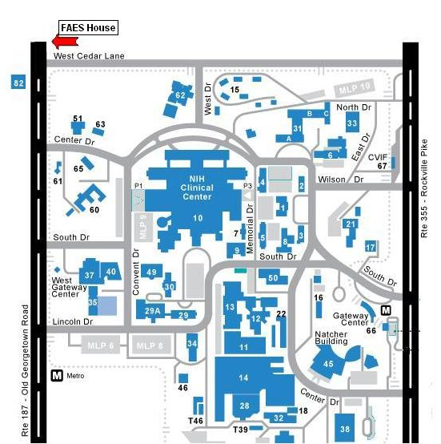


FelCom/GSC Holiday Party
Thursday December 11th 6-11PM
In partnership with the Graduate Student Council, FelCom is organizing the Holiday Party at the FAES House. A jazz band will perform at the event!
So bring your good mood and come celebrate the holidays!
Where: FAES House
9101 Old Georgetown Rd, Bethesda
Tickets: $10 for all you can eat and drink!
Tickets selling points:
Chaya Pooput : Bldg 8, Rm B1A06
Philip Wang: Bldg 50, Rm 4148
Nuria Gavara: Bld 10, Rm 5D49
Megan Cleland: Bldg 35, Rm 2C1016
Buy your ticket in advance to enter the $25 VISA gift card raffle!
For more information, please contact:
Chaya Pooput (pooputc@niddk.nih.gov)
Philip Wang (wangph@nidcd.nih.gov)
Gayani Weerasinghe (weerasingheg@niddk.nih.gov)

