Slide 1
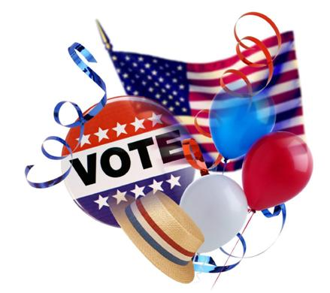
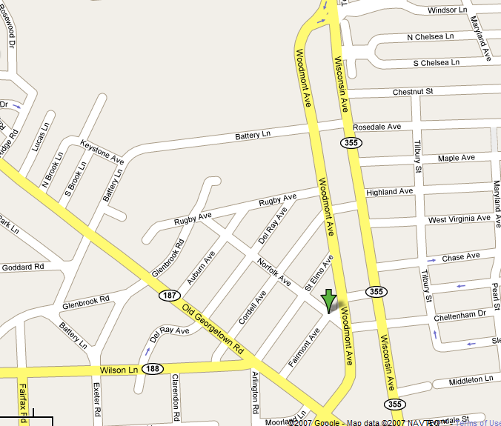

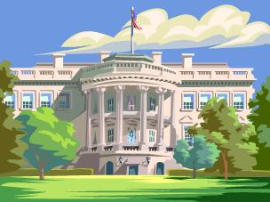
FelCom Social Happy Hour
Wednesday, November 5th, 6 PM
Come discuss the presidential election results or simply relax after work! The Pearl Room (bar on the upper floor) is exclusively reserved for us! And don’t forget to bring along, friends, co-workers and family.
Where? BlackFinn
4901 Fairmont Ave., Bethesda
www.blackfinnbethesda.com
Specials until 10PM!!
$4 on selected appetizers
Reduced prices on beverages
NIH
For more information, please contact:
Philip Wang (wangph@nidcd.nih.gov), Chaya Pooput (pooputc@niddk.nih.gov)
FelCom Social Subcommittee

