Slide 1


The use of Mobile Information Communication
Technology (MICT) in clinical settings”
Henrique MG Martins, MD, MPhil
PhD Supervisor: Dr Matthew R. Jones
Judge Institute of Management; University of Cambridge
National Institutes of Health – 24th Oct 2005

Slide 2

Introduction I
Claims: Use of Mobile ICTs → → Increases in the efficiency of work [1-3].
Growing variety of mobile computing devices: Laptop Personal Computers (PCs), Tablet PCs, handheld PCs/Personal Digital Assistants (PDAs), and PDA-phones/smartphones,
The terms mobile, ubiquitous, pervasive and anytime/anywhere computing are often used interchangeably in the literature [2, 4].
Lyytinen and Yoo [5], however, suggest that mobile computing should be restricted to situations that increase our “capacity to physically move computing services with us. As a result, the computer becomes a taken-for-granted, ever-present device that expands our capabilities to inscribe, remember, communicate, and reason independently of the device’s location” [5].

Slide 3
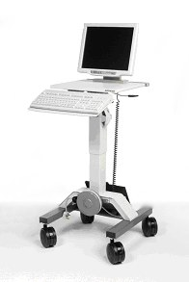
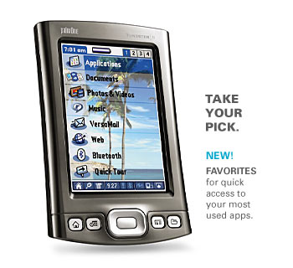

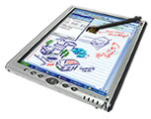
Introduction II - Mobility
MICT → Professionals “can” be connected (perhaps
intermittently, if not wirelessly connected) to others and to
organizational IS (e.g. EMR)/info sources (e.g. medical reference
data or the Internet) while moving
→ MICTs as “time flexible” and “space-adjusting technologies”
that reduce the impact of physical distance on work patterns and relationships and may alter activity [6].
Potential and Visions --- VS --- “Realities” and “Challenges”

Slide 4
Introduction III – MICT Potential and Visions
It has been suggested [10, 11] that MICTs may improve ward rounds by:
(i) making available up-to-date patient data “at the point of care”, or allowing faster updating of treatment plans, leading to better treatment;
(ii) allowing access to reference information, leading to improved clinical decision-making, and increased opportunities for learning
Some assumptions/Themes in MICT in Health commentary articles:
a) Doctors are highly mobile, always “on the run” but making important decision as they do so.
b) Doctors cannot memorize and thus need a computer with them at all times.
c) Effective healthcare IS, for example EMRs, are in place to be accessed by MICT
d) Online access to as much information as possible (eg. full medical articles in a PDA) is relevant everywhere for medical decision-making and enhances medical education.
e) Remote access to patient data could mean fewer visits to real patient, saving time in patient “care”. VS → MICTs will save time for clinicians, releasing resources for patient care or enabling reduced staffing levels.

Slide 5
Introduction IV – MICT: Academic Literature Review
Scarce! ---- YET ---- Two main sources: Survey studies (Handheld, US); pilot/implementation cases (often with RCT design)
Surveys [11, 13-15] :
a) The number of users seems to influence the utility of functions like sending information (“beaming”) and may be related with higher uptake.
b) The numbers of users varies between sites and from 1998 to 2003 does not seem to present a clear trend
c) Different work-roles and settings may explain the differences found, especially between resident and attending physicians.
Pilots [26]:
a) MICTs create new challenges that are different from Desktop IS
- no case described implementation processes in hospitals
b) Modalities of Mobility (eg. traveling, wandering, visiting) are not taken into account when choosing device or analyzing data on usage
c) Little evidence to support claims about possible effects on work practices except more convenient info access, preference for link EMR.

Slide 6
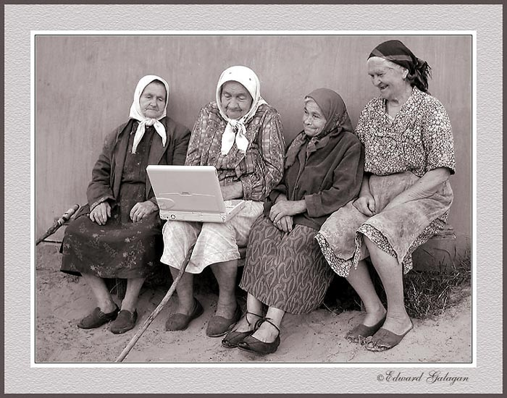

Slide 7
Research question (Qs)
How, and with what implications for clinical work practices, are doctors and hospital organizations using mobile ICT?
This was addressed in three ways:
1) assessing usage of mobile ICTs in different clinical settings, with respect to issues such as the types of hardware, software and applications in use, the extent and domains of use, user characteristics;
2) identifying factors influencing the adoption of mobile ICTs both at the individual and organizational level;
3) evaluating the effects of the use of mobile ICTs on clinical work practices, on an individual, group and organizational level.
Strategy : breadth (across several groups of doctors in several countries)
+ depth (detailed study of departments using MICT)

Slide 8
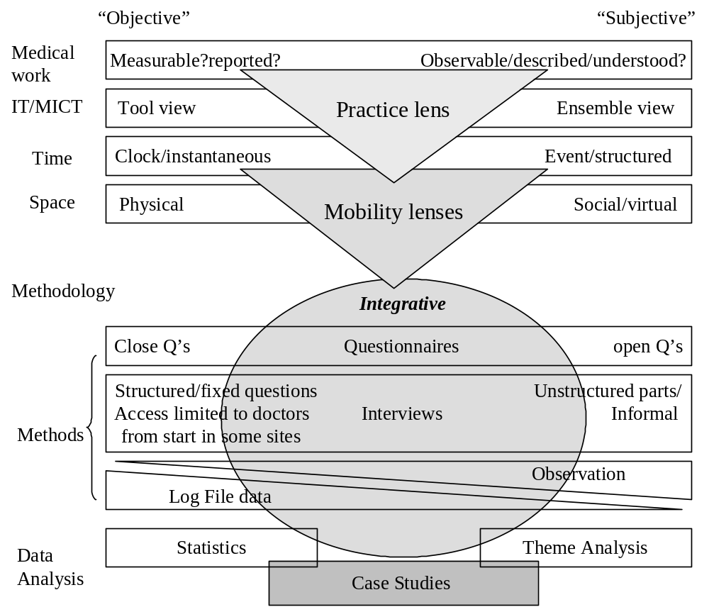
Research Approach

Slide 9
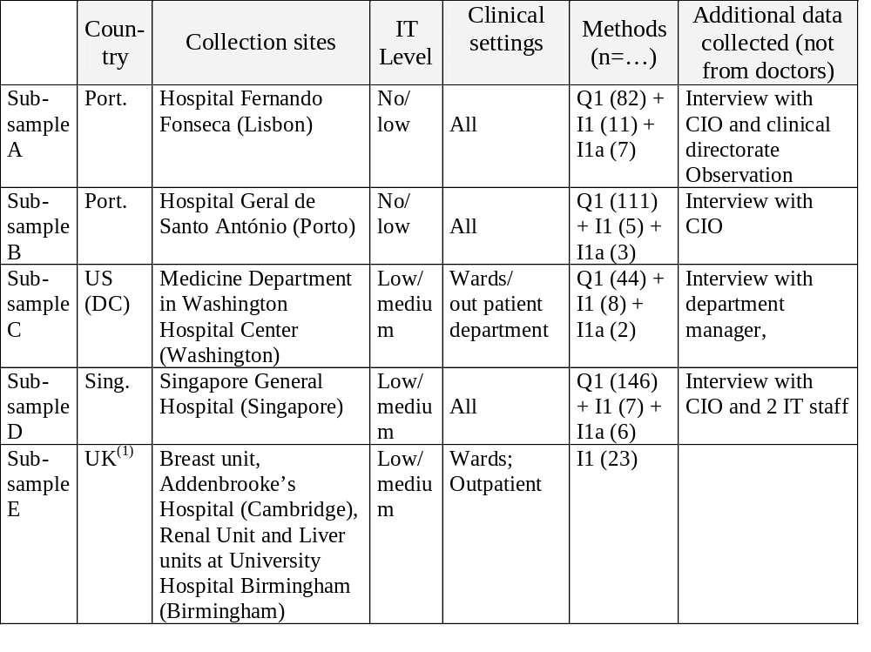
Research Carried out – 1. Dept. Without deployed MICT - AD HOC USAGE
AMIA
Paper

Slide 10
Survey of US and Portuguese Docs usage of MICT - conclusions
A significant proportion of doctors did not have or use MICT devices.
Ownership was not clearly related to either usage pattern or frequency of use (“voluntary” ownership seems to relate higher use).
Providing handheld computers (“involuntary” ownership) did not lead to higher number of users, higher frequency of use or significant differences in tasks carried out
Doctors owning handheld computers alone, or in combination with laptops, used them more frequently than those using laptops alone.
Differences in usage pattern proportions (i.e. having both a Handheld and a Laptop PC against having either of these in isolation), rather than demographics, were a better indication of differences in usage frequencies and the tasks for which MICT

Slide 11
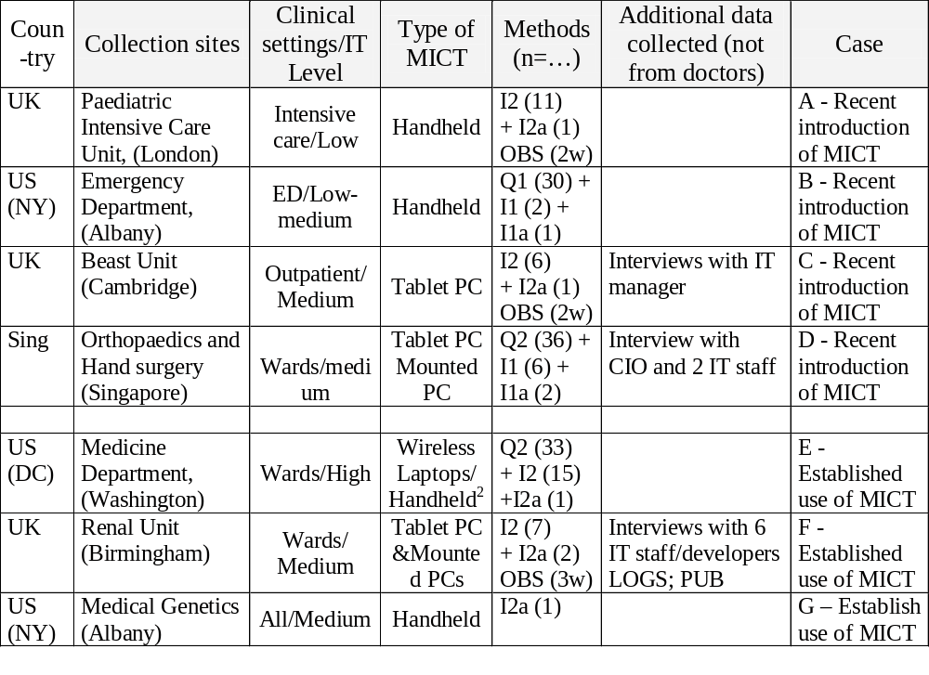
2. Dept. where MICT was made available to Docs – Uptake, Effects on Practice
CASE E
IFIP Paper
CASE F
HC2005
CASE G

Slide 12
Preliminary results I - individual and group level
Wireless tablet PCs (and recently Mounted PC) available 7 years
All clinicians clamed to use tablet PCs,
Log File analysis showed prominent use of Tablet PCs in morning
ePrescription and Labviewing main tasks, little use of webBNF
CASE E
CASE F
Adoption/non-adoption of Wireless laptops – In detail later
CASE G
Enthusiastic use of Smarthphone – “living with clinical information anywhere anyplace

Slide 13
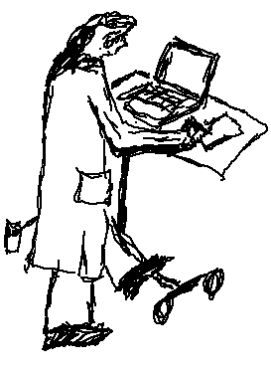
Mobility in the Round:
Use of Wireless Laptop PCs in Clinical Wardrounds
Results I – Case Description - The Department and its “Wireless Laptops”
Multi-speciality tertiary care facility.
60 doctors ; 12-bed intensive care unit; 87 beds wards ; outpatient clinics.
MICT: standard laptop PCs with WiFi wireless connection. Attached to a food trolley and could not be removed,
  AC adapter and cable
  No mouse or extra battery
  Movable as a whole – tray adjusted/ free space
Full access to Windows software,
2 hospital systems (full EMR – including all imaging studies, and a drug administration system mostly used by the nurses)
Intranet resources (links to departments guidelines and protocols, library holdings and online resources),
Broadband access to the Internet.
Source: Martins, HMG, Jones, MR (2005) “Mobility in the Round: Use of Wireless Laptop PCs in Clinical Wardrounds, Proceedings of the IFIP 8.2 Conference, August 2005, Cleveland, OH, USA

Slide 14
Mobility in the Round:
Use of Wireless Laptop PCs in Clinical Wardrounds
Results II – Case Description - The Department and its “Wireless Laptops”
33 staff studied - 24 Attendings - 9 Residents or Interns,
= % of men and women.
< half owned a handheld/PDA.
All used a desktop every day (60% more than 10 times a day. Attendings more often than Residents).
The Internet was used for clinical work – by all at least once a week
Wireless laptop usage in the department:
20% - high frequency users (>5x day), All - to check patient data,
35% - medium frequency users, 2 - for medical calculations
20% - less than once a week 1 - send clinical-related emails.
25% - non-users. Zero - checking hospital guidelines
Source: Martins, HMG, Jones, MR (2005) “Mobility in the Round: Use of Wireless Laptop PCs in Clinical Wardrounds, Proceedings of the IFIP 8.2 Conference, August 2005, Cleveland, OH, USA

Slide 15
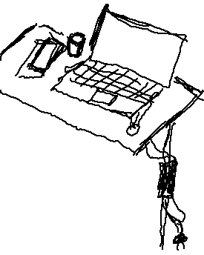
Mobility in the Round:
Use of Wireless Laptop PCs in Clinical Wardrounds
Results III – Case Description - The Department and its “Wireless Laptops”
Individuals can be divided into three groups:
“multi-task” users (enthusiastic-use) who browsed
the internet for medical information, checked medical and
drug reference information as well as consulting the EMR,
“standard” users, who used the laptops only to access the EMR
“Non”-users.
Age, gender, seniority and usage of technologies other than MICTs showed no significant difference between the user group and the non-user group.
The “multi-task” user group reflected the seniority and gender make-up of the department, but included predominantly high and medium frequency users, most of whom owned a handheld/PDA (compared to almost none of the other groups).
Source: Martins, HMG, Jones, MR (2005) “Mobility in the Round: Use of Wireless Laptop PCs in Clinical Wardrounds, Proceedings of the IFIP 8.2 Conference, August 2005, Cleveland, OH, USA

Slide 16
Mobility in the Round:
Use of Wireless Laptop PCs in Clinical Wardrounds
Results IV – Case Description - The Department and its “Wireless Laptops”
High turnover of staff. (4 weeks rotations)
knowledge of EMR use had to be continuously replaced.
Wardrounds – using laptops opportunity for Attendings to teach others about the operation and capabilities of the hospital’s systems.
Patients located in wards on two consecutive floors.
Ward: central area (with several desktop computers) from which six corridors of patient rooms lead off. Each floor had two or three doctors’ rooms (with five desktop PCs). The lift (elevator) was located away from the centre of the wards.
“Each of the teams has a laptop, chained, nailed, spiked or something to a portable table, which makes it quite cumbersome by the way because we tend to go up and down between the third and fourth floor and you have to carry the table with you or go use the elevators which are painfully slow.” Resident, Team Alpha
Source: Martins, HMG, Jones, MR (2005) “Mobility in the Round: Use of Wireless Laptop PCs in Clinical Wardrounds, Proceedings of the IFIP 8.2 Conference, August 2005, Cleveland, OH, USA

Slide 17
Mobility in the Round:
Use of Wireless Laptop PCs in Clinical Wardrounds
Results V – Case Description - Views of non-users
During observation only 2 out 5 teams regularly used Laptops
Team Alpha (recently arrived Attending, Resident, 2 Interns, med stud)
Last year (…) Rounds tended to be more administratively frenetic when we had the laptop with us. There was more a temptation to do orders immediately, there was more waiting for lab results to come back and interrupting a chain of thought regarding the patient Resident, Team Alpha
I didn’t want [the laptop] with us because I wanted folks on rounds to focus on the pieces of information that struck them as they were collecting it … The likelihood was [also] that there would be nothing more than one or two data points on a couple patients that we miss and that would be required for a decision at that point. Resident, Team Alpha
Source: Martins, HMG, Jones, MR (2005) “Mobility in the Round: Use of Wireless Laptop PCs in Clinical Wardrounds, Proceedings of the IFIP 8.2 Conference, August 2005, Cleveland, OH, USA

Slide 18
Mobility in the Round:
Use of Wireless Laptop PCs in Clinical Wardrounds
Results VI – Case Description - Views of non-users
During observation only 2 out 5 teams regularly used Laptops
– Team Alpha – Resident was charismatic and decided not to use them
- based on his previous experience as part of team that used them
- plan is discussed based on available information before round
- laptops seen as bad for education – diluting attention
- laptops seen as useful when rounding on large number of patients
- Laptops were also not used at other times
If I’m pushing the laptop around I can’t use the stairs, I can’t carry it with me, it’s hooked up to that desk, (…) I find that when I’m walking around the wards I’m running all over the place so I don’t want to have to be responsible … for the laptop; if it gets damaged or stolen or anything. So it’s not really a benefit. And there’s so many computers available anywhere I am, I’m no more than 5 or 10 seconds away from sitting down at a desktop and getting the information I need. Intern, Team Alpha
Source: Martins, HMG, Jones, MR (2005) “Mobility in the Round: Use of Wireless Laptop PCs in Clinical Wardrounds, Proceedings of the IFIP 8.2 Conference, August 2005, Cleveland, OH, USA

Slide 19
Mobility in the Round:
Use of Wireless Laptop PCs in Clinical Wardrounds
Results VIII – Case Description - Views of users
Efficiency and control over plan execution
“Because all of the orders are on the computer it just makes things run smoother if during rounds you come up and say, I need this order done, rather than waiting ‘til the end of rounds to do it, you know you can do it right there. (…) The round’s a lot more complete I think, also, much more efficient.”
Medical Student. Team Beta
“I want up to date information, I want to see the information myself rather than relying on somebody else’s recitation of it. (..)And then of course I do want to be able to review all the medications and not only rely on what somebody tells me the patient’s on. Because they sometimes are mistaken. (...) [and] I want to be able to implement whatever plan we’re concerned about immediately. I do not want to delay, I want to enter it into the system as we talk”
Attending, Team Gamma
Source: Martins, HMG, Jones, MR (2005) “Mobility in the Round: Use of Wireless Laptop PCs in Clinical Wardrounds, Proceedings of the IFIP 8.2 Conference, August 2005, Cleveland, OH, USA

Slide 20
Mobility in the Round:
Use of Wireless Laptop PCs in Clinical Wardrounds
Results VIII – Case Description - Views of users
Attending Physician Style
[With] the first Attending … we’d have more sit down rounds in our team room discussing things. So at that point we would be putting … the orders directly onto our desktops and then when we would round we wouldn’t really take the computer with us. The second Attending … would prefer us to have the computer with us but at that time we were having a lot of glitches with the computers. The last Attending we’ve had, again she seems to be more sit down, get things kind of under our grasp and then go from there. Although we still take the laptop with us. But again taking the laptop with us helps just getting orders done quicker and as something comes up you can order it at that time, or looking again at radiology is useful”. Medical Student. Team Beta
I am a data person. So I like the availability of data“ Attending 2, Team Beta
I mean usually we go a couple of days and then something goes wrong. But that’s been a constant. And everyday I’m going to a computer person going, they’re not working again.” Attending 1, Team Beta
Source: Martins, HMG, Jones, MR (2005) “Mobility in the Round: Use of Wireless Laptop PCs in Clinical Wardrounds, Proceedings of the IFIP 8.2 Conference, August 2005, Cleveland, OH, USA

Slide 21
Mobility in the Round:
Use of Wireless Laptop PCs in Clinical Wardrounds
Case Analysis I
- Accounting for the adoption of MICTs in wardrounds
No association
with usage
or non-usage
Age
Gender
Seniority
Use of desktop technology/internet
Previous experience
Team size
Availability of desktop computing
Availability of full EMR on the laptops
Association
with both usage
and non-usage
Walking wardround
Source: Martins, HMG, Jones, MR (2005) “Mobility in the Round: Use of Wireless Laptop PCs in Clinical Wardrounds, Proceedings of the IFIP 8.2 Conference, August 2005, Cleveland, OH, USA

Slide 22
Mobility in the Round:
Use of Wireless Laptop PCs in Clinical Wardrounds
Case Analysis II
- Accounting for the adoption of MICTs in wardrounds
Some
association
with
non-usage
Unreliability of technology
Building layout
Device characteristics
Senior doctors’ satisfaction with existing wardround practices
Senior doctors’ preference for decision-making
with data available before the round
Senior doctors’ belief that junior doctors need
    to be able to present and defend their decisions
Senior doctors’ concern about distraction
    of junior doctors during wardround
Sitting wardround
Source: Martins, HMG, Jones, MR (2005) “Mobility in the Round: Use of Wireless Laptop PCs in Clinical Wardrounds, Proceedings of the IFIP 8.2 Conference, August 2005, Cleveland, OH, USA

Slide 23
Mobility in the Round:
Use of Wireless Laptop PCs in Clinical Wardrounds
Case Analysis III
- Accounting for the adoption of MICTs in wardrounds
Some
association
with
usage
Senior doctors’ willingness to instigate new practices
High case load
Senior doctors belief in the benefits of laptop use
Senior doctors’ perception of benefits of rich data
  availability for education and decision-making
Senior doctors’ perception of need for timely data and action
Senior doctors’ belief in collective, real-time decision-making
Source: Martins, HMG, Jones, MR (2005) “Mobility in the Round: Use of Wireless Laptop PCs in Clinical Wardrounds, Proceedings of the IFIP 8.2 Conference, August 2005, Cleveland, OH, USA

Slide 24
Mobility in the Round:
Use of Wireless Laptop PCs in Clinical Wardrounds
Discussion
In contrast to findings of other studies it appeared that characteristics such as age, gender and seniority did not seem to influence MICT device use.
Benefits of MICT use in wardrounds were not self-evident
- significant proportion of doctors did not use the laptops at all.
- immaturity (and hence unreliability) of the technology is only a partial explanation
What helps us understand use and non-use behaviours displayed ??
Source: Martins, HMG, Jones, MR (2005) “Mobility in the Round: Use of Wireless Laptop PCs in Clinical Wardrounds, Proceedings of the IFIP 8.2 Conference, August 2005, Cleveland, OH, USA

Slide 25
Mobility in the Round:
Use of Wireless Laptop PCs in Clinical Wardrounds
Discussion I
1) Not all wardrounds are equal:
- they are not the uniform, highly mobile practice suggested by some advocates of MICT use. (eg. Sitting wardrounds)
- different perceptions of the function of ward rounds (for example decision-making with available data and testing of junior doctors’ presentations or collective decision-making moments with all possible data)
- attitudes regarding rich and timely data in clinical decision-making, the effectiveness of existing practices and their willingness to change practices.
- the costs and benefits of MICT use based on individual perceptions as measurable evidence was lacking.
- strong social influences. such as the power relationships, existing work routines, team dynamics and department practices, such as on device sharing, shaped laptop usage and were also influenced by it.
Source: Martins, HMG, Jones, MR (2005) “Mobility in the Round: Use of Wireless Laptop PCs in Clinical Wardrounds, Proceedings of the IFIP 8.2 Conference, August 2005, Cleveland, OH, USA

Slide 26
Mobility in the Round:
Use of Wireless Laptop PCs in Clinical Wardrounds
Discussion II
2) Local circumstances
- High staff turnover, for example, meant that training needs were high and continuous but also that using laptops on wardrounds provided an important opportunity for sharing of experience on EMR use.
- Hospital architecture, combined with specific device characteristics caused problems for even the most enthusiastic users.
3) Mobility of the device itself is therefore not necessarily the same as its mobility in practice.
4) Active role of users in the adoption of MICT devices. This operates in a variety of ways:
- their perceptions of the costs and benefits of wider availability of information
- their willingness to change routines to accommodate device usage.
Source: Martins, HMG, Jones, MR (2005) “Mobility in the Round: Use of Wireless Laptop PCs in Clinical Wardrounds, Proceedings of the IFIP 8.2 Conference, August 2005, Cleveland, OH, USA

Slide 27
Mobility in the Round:
Use of Wireless Laptop PCs in Clinical Wardrounds
Discussion III
4) Active role of users in the adoption of MICT devices.
➔ Important because individual users’ access to mobile, computer-based resources is often dependent on whether they bring the devices to the work setting themselves.
➔ if the purpose of MICT use is seen to be the provision of ubiquitous information resources, rather than devices per se, then users may feel that their needs are adequately met by static devices, providing these are sufficiently numerous and available, without needing to have the device at the exact point of use.
Ubiquity may therefore be seen not as an objective characteristic of a technological resource, but as dependent also on users perceptions and effortful action.
Source: Martins, HMG, Jones, MR (2005) “Mobility in the Round: Use of Wireless Laptop PCs in Clinical Wardrounds, Proceedings of the IFIP 8.2 Conference, August 2005, Cleveland, OH, USA

Slide 28
Mobility in the Round:
Use of Wireless Laptop PCs in Clinical Wardrounds
Conclusions
Evidence from this and other sites in our study suggest that common issues may extend beyond the particular medical setting:
- variability of apparently standard work practices,
- importance of individual perceptions (and the social processes influencing them),
- the role of established organisational routines
Evidence presented suggests that possibilities for “ubiquitous information(-rich) environments”) do not arise automatically or instantly.
- especially in the context of current attempts to provide such environments through mobile devices, the realisation of these possibilities appears to be subject to significant social influences.
- Without clear evidence of unequivocal benefits, adoption will rely on users’ beliefs about the value of ubiquitous information. – these cannot assumed to be universally positive.
Source: Martins, HMG, Jones, MR (2005) “Mobility in the Round: Use of Wireless Laptop PCs in Clinical Wardrounds, Proceedings of the IFIP 8.2 Conference, August 2005, Cleveland, OH, USA

Slide 29
Preliminary results II - Organization use of MICT to support clinical work
MICT Device
Individual (s)
Size, screen size,
screen brightness,
battery longevity,
weight, robustness
Computing power
Operating system
General IT/MICT
proficiency
Training received
Perception of usefulness
Feeling of
Empowerment/
vulnerability
Enthusiastic Use
- use of the device’s full
potential for the work
situation enacted as desired
Problematic use
a) disrupting effects on
work practice as desired
b) non-use of device’s
mobile potential
Non-use
MICT
device at hand
Clinical
work context
Mobility
in practice
Screen visibility
Usable Charge
Wireless access
to HIS.
Available
applications
Transport burden
Risk of theft/lost
Mobility
“modalities”
involved
Time required
Aims
Data needs
Data processing
needs
Isolated vs
Collaborative
Individuals involved
MICT Implementation
Context
Work
Travelling, Visiting
Wandering
Nature data
Certain tasks required
Individual vs collective
info/decision sharing
Established
perceived aims
Data usage patterns
Thinking processes
Wireless coverage
Battery chargers
Privacy and Security
Policy about usage
Application provided
Training provided
Workspace
Open - Close
Architecture
Layout
Lighting
Reproduced from: Martins HMG, Jones MR. “Relevance of mobile computing in the field of Medicine” in “Handbook of Research on Mobile Business: Technical, methodological and social perspectives” edited by Unhelkar, B., IDEA group publishing (IGP), Hershey, PA, USA (in press)

Slide 30
The use of Mobile Information Communication
Technology (MICT) in clinical settings
Open Discussion
Further contact – hmgm2@cam.ac.uk
Acknowledgements - Funding for this research was been received from Fundação para a Ciência e Tecnologia (BD/8121/2002) and Fundação Calouste Gulbekian, Lisbon, Portugal; and from the Smuts Memorial Fund and St Edmunds College, Cambridge, UK. The support of all people involved at the study sites is gratefully acknowledged. All necessary IRB and Hospital Administrations authorizations were obtained at research sites

