Slide 1


U.S. Small Business Administration
8(a) Program Certification
&
How to Win a Federal Government Contract

Slide 2

8(a) Program Objectives
To promote business development among small business concerns owned and controlled by socially and economically disadvantaged individuals

Slide 3
8(a) Program Eligibility
Individuals Upon Whom Eligibility is Based:
  U.S. Citizens
  Applicant must own at least 51% of the business
  Owner must conduct 100% of the business operations
  Determined by SBA Socially & Economically disadvantaged criteria
  Firm established for two years with Tax Returns and Revenues based on Primary NAICS Code
  Two (2)-Year Waiver Eligibility
  Five conditions must be met per 13 CFR 124.l07 (b) (1)

Slide 4
Socially disadvantaged
U.S. Citizen who have been subjected to prejudicial practices because of their identity as members of designated groups as:
  Black American
  Asian American/Pacific Islander
  Hispanic American – (includes Spanish & Portuguese descent)
  Native American
  Subcontinent Asian American

Slide 5
MEMBERS OF NON-DESIGNATED GROUPS
MUST ESTABLISH SOCIAL DISADVANTAGE ON THE BASIS OF THE “PREPONDERANCE OF THE EVIDENCE” SUCH AS:
Rejection letters of Job applications
Denials of credit applications
Rejection of contract offers, i.e. Bids Abstracts or Solicitations
Personnel Records
Payroll Records

Slide 6

Economically disadvantaged
Those individuals socially disadvantaged and whose prejudicial experiences have resulted in impairment of access to capital, credit and markets.

Slide 7

Net worth criteria:
After excluding the individual’s equity in the firm and equity in the primary residence, net worth may not exceed $250,000.00
NET WORTH
less equity in primary residence
less equity in business
equals adjusted net worth (which must not exceed $250,000)

Slide 8
Term of Participation
START = date of approval
Year 1
2 Developmental
3 Stage
4
Year 5
6 Transitional
7 Stage
8
9

Slide 9

Obtain a DUNS Number
Obtain a Data Universal Number System (DUNS) Number
Call D&B at 1-866-705-5711 to obtain a free DUNS number for federal CCR registration. The process takes about 10 minutes. Or, you can register online at:
https://eupdate.dnb.com/requestoptions/government/ccrreg/
Notes:
For Federal Prime Contract Opportunities:
You need to be aware of the following:
The Department of Defense (DOD) buys its goods and services through procurement centers located throughout the country. Every center has a Small & Disadvantaged Business Utilization Specialist (SADBU) assigned to help you do business with that specific agency.
The major civilian agency that buys for the federal government is the General Services Administration (GSA). GSA manages the Federal Supply Schedules (FSS) Program. FSS are indefinite quantity contracts that allow federal agencies to order commercial products and services from approved vendors. The FSS systems is an excellent way for small businesses to obtain contract purchase orders from federal agencies.
Large Prime Federal Subcontracts Awards are also good opportunities for small businesses. For all procurement actions exceeding $100,000 prime contractors are required to make a “best effort” attempt to use small businesses as subcontractors. For procurement actions expected to exceed $500,000 (one million dollars for construction) prime contractors are required to provide the agency contracting officer with a written subcontracting plan that establishes small business subcontracting goals.

Slide 10
Get Registered in CCR
Central Contractor Registration (CCR)
www.ccr.gov
A CCR registration worksheet is available at:
http://www.dlis.dla.mil/ccr/PDFs/central_contr_reg_form.pdf
Dynamic Small Business Search Registration
When successfully registered in CCR, you’re given the option to create a profile in SBA’s small business database.
Notes:
CCR registration is a must if you want to do federal procurement. Begin at the website and get registered. If you would like to gather your information together before going in to do the CCR registration, link to the registration worksheet, print it out, fill it out, and then begin the registration process. At the end of the CCR registration, you will receive a message that you have the option of creating a profile in SBA’s small business database. Follow the instructions to register in the Dynamic Small Business Search, a powerful search engine used by contracting personnel to locate small businesses.
By having a profile on Dynamic Small Business, you have the ability to present your company’s capability to anyone using the Dynamic Small Business Search Tool on the CCR homepage. This is where the contracting personnel, small business advisors and other decision-makers will go when they need to find out whether small businesses can do the work they have in mind.
It is free to federal and state government agencies as well as prime and other contractors seeking small business contractors, subcontractors and/or partnership opportunities. Dynamic Small Business is open to all small firms seeking federal, state and private contracts.
Businesses profiled on the Dynamic Small Business Search can be searched by NAICS codes; key words; location; quality certifications; business type; ownership race and gender; EDI capability, etc.

Slide 11
Application
For Each Firm:
SBA 1010 - “Eligibility”
For each person claiming disadvantage and each officer, director, shareholder with more than 10% holding, proprietor, partner and each person claiming disadvantage:
SBA 413 - Personal Financial Statement
SBA 912 - Personal History
Additional required documentation is listed on the SBA Form 1010

Slide 12
Where To File
Applications for the 8(a) program are filed with the SBA Division of Program Certification & Eligibility (DPCE)
San Francisco DPCE
455 Market Street, 6th Floor
San Francisco, CA 94105
(415) 744-0328

Slide 13
Application Process
DPCE reviews application for completeness within 15 days.
If incomplete, corrections submitted within 15 days and DPCE makes determination within 10 days
Applicant advised of outcome within 90 days from the date application was accepted.
If declined, applicant can ask reconsideration within 45 days of date of decline.
Reapplication: Mandatory 12 month wait from final decision date.

Slide 14
Federal Government Contract Process
A requirement is offered to the 8(a) program by federal procuring agencies as a result of aggressive self-marketing on the part of the 8(a) firms.

Slide 15
Contract Process
Nature of contracts: Contracts are awarded by procuring agencies to SBA as the prime contractor. SBA subcontracts to the named 8(a) firm. Special contract clauses delegate administration responsibility to the procuring agency.
Competitive threshold: When the estimated value (including options) exceeds $3.5 million for services and construction and $5.5 million for manufacturing, requirement will be competed among 8(a) firms.

Slide 16
8(a) Contract Process
SBA plays a role at the beginning of contract process by verifying/approving the requirement/contract for the 8(a) firm. The verification is provided to the federal agency with an acceptance letter.
Upon acceptance from SBA, the federal agency will issue the 8(a) firm a Request for Proposal (RFP) at which time the firm begins the preparation of its technical and cost proposal needs to be discussed with the contracting officer.
Actual administration of the contract is delegated to the procuring agency.

Slide 17
Marketing the 8(a) Program
Identify who buys your Products or Services… (www.fpdc.gov)
Know your NAICS Codes (www.sba.gov)
Register in Government Procurement
1. www.fedbizopps.gov
2. www.fedbid.com
3. web.sba.gov/subnet
4. www.ccr.gov
(a pre-requisite for certification)

Slide 18
Various Programs to Assist You
HUBZone Program
Small businesses located in areas identified as historically underutilized business zones, and with 35% of employees coming from HUB Zones, eligible to receive competitive and ‘sole source’ awards.
Small Disadvantaged Business (SDB) Program
Three-year certification for small, socially and economically disadvantaged firms eligible to receive prime and subcontract preferences.
Notes:
The different program categories carry with them different rules. Some involve formal applications and certifications; others simply require that you review the regulations and make a decision about whether you qualify.
For government procurements you will be asked to certify as to the type of business you are, as well as certify which special programs you are entitled to.
The 3 formal certifications will be discussed in more detail. Check our website at sba.gov for further information on all certifications.

Slide 19
Know the Federal Contract Certifications
Self-Certifications
Small Business – NAICS Codes
Woman-owned Small Business (WOSB)
Veteran-owned Small Business (VOSB)
Service Disabled Veteran-owned Small Business
(SDVOSB)
Formal Certification Programs
8(a) Business Development
HUBZone Empowerment Contracting
Small Disadvantaged Business (SDB)
Notes:
The different program categories carry with them different rules. Some involve formal applications and certifications; others simply require that you review the regulations and make a decision about whether you qualify.
For government procurements you will be asked to certify as to the type of business you are, as well as certify which special programs you are entitled to.
The 3 formal certifications will be discussed in more detail. Check our website at sba.gov for further information on all certifications.

Slide 20
Finding Prime Contract Opportunities
  Research Past Purchases
    Federal Procurement Data System – Next Generation https://www.FPDS.gov
    Register, Read “First Time Using Reports”, Obtain standard, special, or customized award data.
  Identify Current Opportunities
    Federal Business Opportunities www.fedbizopps.gov
  Identify your product and/or service codes & search.
  Obtain Agency Forecasts from sites like
    http://www.womenbiz.gov/forecasts.html
Notes:
Researching past purchases and looking for active buys is the best way to target your niche in the federal procurement world.
A good example is the “Government Purchasing and Sales Directory.” This is a text book which lists alphabetically, all of the products and services purchased by the Federal Government. These products and services are then matched up to specific buying activities.
Active buys valued at $25,000 or more can be found at the Federal Business Opportunities website. You can build your own email notice from FedBizOpps to alert you to new postings daily.

Slide 21
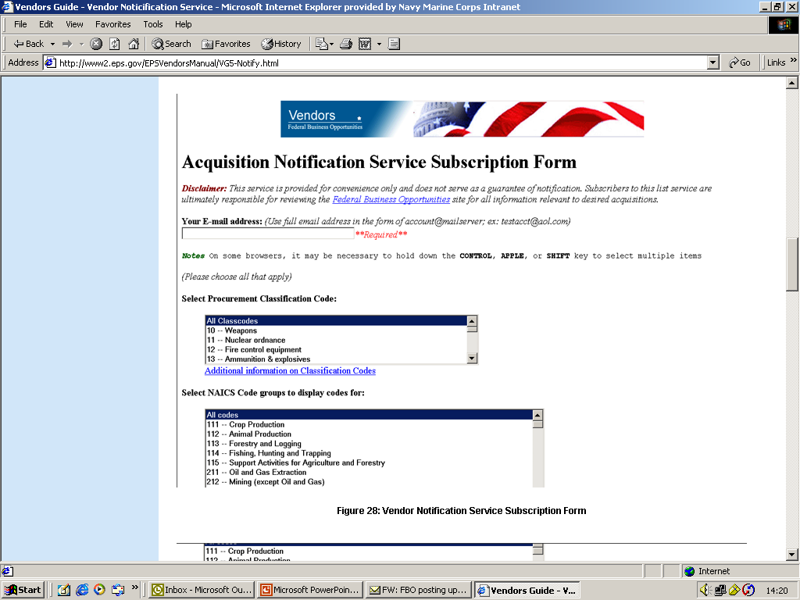
FedBizOpps
1. Select Procurement
Code, NAICS
and/or
Buying Activity
The following postings have been made on FBO:
DLA
Logistics Operations Defense Distribution Center
49 -- ICE MACHINE MAINTENANCE AT DEFENSE DISTRIBUTION DEPOT
Synopsis
http://www.fbo.gov/spg/DLA/J3/DDC/SP3100%2D06%2D0061/listing.html
2. Receive
daily links
to buys
Notes:
To register for the Vendor Notification Service, go to www.fedbizopps.gov and click on "Vendor Notification Service". The Vendor Notification Service will send out email notifications for synopses, modifications, and uploaded documents (solicitations, amendments, etc.).
You can register to receive notification for:
1 - Particular solicitation numbers
2 - Selected organizations and product service classifications or NAICS Code
3 - All notices
We recommend that you choose option # 2, as this will assist you in narrowing the number of listings you receive from the notification service.

Slide 22
Finding Subcontracting Opportunities
Subcontracting Opportunities
Directory of Large Prime Contractors
www.sba.gov/GC/indexcontacts-sbsd.html
SUB-Net
http://web.sba.gov/subnet
FedBizOpps - Find Business Opportunities, Search for: Awards
Notes:
Many firms find the subcontracting world a beneficial place to do business. But, finding subcontracting opportunities can be a challenge. You need to identify which large federal prime contractors need what you can provide. Use the directory on our web-site along with actual subcontract postings on SUB-Net to help you in that process.
Each large prime contractor has a Small Business Liaison Officer (SBLO) who serves as a contact point for companies wishing to sell to them. They are identified in the subcontracting directory.
Many of the large prime federal contractors post subcontracting opportunities and notices on SBA’s Sub-net. Solicitations can be searched there.
As part of the Integrated Acquisition Environment (IAE) using the Electronic Subcontracting Reporting System (eSRS), all federal subcontractors will be required to be registered on the Central Contractor Registration.
Finally, the FedBizOpps “Find Business Opportunities” search page allows you to narrow your search to only see award notices.

Slide 23
Joint Ventures & Teams
Investigate Joint Venture/Teaming Arrangements
  Excluded from affiliation – 13 CFR 121.103(f)(3)
  “bundled” requirement
  other than a “bundled” requirement
Consider Mentor-Protégé Programs
  SBA – limited to 8(a) firms;
  DOD, US Navy, Air Force, FAA, Dept of State, Dept of Energy, & more – check individual small business programs for details.
Notes:
Many small businesses are looking into joint venture and teaming arrangements to better compete for federal contracts.
Make sure you understand the rules behind joint ventures and teams if this looks like the best way for you to maximize your potential.

Slide 24
Market Your Firm
One on One - Present your capabilities directly to the federal activities and large prime contractors that buy your products and services
Attend procurement conferences and business expos
Attend Business Matchmaking events
Add details to DSBS your Dynamic Small Business Search profile (e.g., GSA schedule number, commercial customers, federal customers, special capabilities).
Notes:
There are many ways to “narrow down” the federal marketplace. But, once you know where your products or services are being procured, make an effort to market your capabilities to those sites.

Slide 25
View Solicitations
Request or download a bid package
Obtain copies of relevant specifications
& drawings
Understand relevant purchasing regulations
Federal Acquisition Regulations:
Contract clauses
Notes:
When you are familiar with the rules, the terms, and know your market, it is time to consider preparing a quote, a bid or a solicitation.
Understanding the rules behind each method will ensure your success – for example, buys valued at less than $100,000 usually result in a purchase order instead of a contract. Your particular area of interest may fall within the micro-purchase threshold, making government credit cards an important issue for you.
In addition, always read the contract clauses cited in anything for which you quote. Be sure to know what you are promising to provide before you sign and submit any type of offer.

Slide 26

Prepare Your Offer
3 Rules for a solicitation:
-Read it…Read it…Read it!!!
Request a Procurement History
Attend Pre-Bid Meetings
& Walk-Throughs
Get clarification of ambiguities
Proofread your proposal
Submit it on time!
Notes:
Some other pointers to remember as you prepare your offer.

Slide 27

Contract Award
Are you Responsive?
Are you Responsible?
  Pre-Award Survey: Technical capability
  & production capability
  Financial: accounts receivable, net worth, cash flow
  Accounting System
  System for Qualifying Suppliers
  Packaging, Marking, Shipping
Notes:
The contracting officer will take all offers received and make an award decision. This list shows some of the areas a contracting officer may evaluate.

Slide 28
Contract Performance
  Contingency Plans
  Have a back up plan if something goes wrong
  Give yourself enough time to react
  Anticipating Final Inspection
  Make an appointment before shipping date
  On-Time delivery
  Establish a good track record
Notes:
If you get the award, solid performance is your key to future contracts.

Slide 29

Getting Paid
  Know the paperwork process
  Keep good records
  Know your options
    Progress payments
    Prompt Payment Act
  EFT (electronic funds transfer)
  Accept government credit cards
Notes:
Navigating through the payment process can be an interesting experience. Smooth the way by following these tips.

Slide 30
Seek Additional Assistance
Procurement Technical Assistance Center
(PTACs) www.dla.mil/db/procurem.htm
Small Business Specialists
www.acq.osd.mil/sadbu/doing_business/index.htm
Procurement Center Representatives (PCRs)
www.sba.gov/gc/contacts.html
Commercial Marketing Representatives
(CMRs) www.sba.gov/gc/contacts.html
Notes:
You will have questions along the way. This slide highlights a few of the most popular sources of free or low-cost assistance that’s available to you.
Each provides free counseling to small businesses and may host low-cost training workshops for specific interest areas.
SBA’s Procurement Center Representatives (PCRs) monitor federal agencies to ensure that a variety of procurements are reserved exclusively for small business participations. These transactions are known as “small business set-asides.”
Also SBA’s Commercial Marketing Representatives (CMRs) can assist you in marketing to large prime federal contractors.

Slide 31
SBA Assistance Programs
  Federal Agency Contract Goal Program
  Procurement Marketing (Dynamic Small Business Search & SUB-Net)
  Prime Contract Program (PCRs)
  Subcontract Program (CMRs)
  Certificate of Competency Program (COC)
  Size Program – NAICS Information
  E-Business Institute
Notes:
Since the federal government spends approximately 200 billion dollars for purchases of goods and services from private firms each year, SBA assists small businesses seeking federal contracts and subcontracts by negotiating small business goals (in terms of a percentage of annual expenditure) with the various federal agencies. The current negotiated goals are:
23% - SB, 5% - WOSB, 3% - SDVSBs, 5% - SDBs and 3% - HUBZone.
Listed here are a few of the ways that SBA is ready to assist you and your firm.

Slide 32
Helpful Web Sites
DOD Small & Disadvantaged Business Utilization Office
www.acq.osd.mil/sadbu/
Procurement and Technical Assistance Centers
www.sellingtothegovernment.net
Small Business Development Centers
http://www.sba.gov/sbdc/
SBA’s Home Page: www.sba.gov
Government Contracting: www.sba.gov/GC
Site includes links to all major government contracting programs discussed here plus much, much more.
Find a Procurement Center Representative
www.sba.gov/GC/pcr.html
Notes:
The department of defense has specific people at each buying activity to assist small businesses. Find the right point of contact through resources on their website.
Should you require in-depth counseling in seeking federal or state government contracts, there are many Procurement and Technical Assistance Centers and Small Business Development Centers to assist you. They can help your firm register with the Central Contractor Registration (CCR) and obtain a DUNS number. Many times, they also can match your firm’s capability with procurement opportunities, as well as help you obtain military and federal specifications and drawings.

Slide 33
Things To Remember
TARGET YOUR CUSTOMER: Who buys your product or service? How do they buy?
When do they buy?
KNOW THE RULES: Federal Acquisition Regulations
Contract requirements and specifications
How to obtain Contract history
PERFORM AS PROMISED: On-time delivery,
Good Quality, at a Fair Price
Notes:
In summary, you can be a success selling to the Federal Government with careful planning, research, and solid performance.

Slide 34
Today’s Presenter
Ilene P. Rubio
Assistant District Director
8(a) Business Development Division
U.S. Small Business Administration (SBA)
South Florida District Office
Ilene.rubio@sba.gov – E-mail Address
www.sba.gov/fl/south - Web site address

