Slide 1
Barriers to Resources for Rural Caregivers
Rhonda J.V. Montgomery
University of Kansas

Slide 2
Not All Rural Barriers are Unique
Common to other socially and economically disadvantaged groups

Slide 3


Alzheimer’s Demonstration
Grant to States

Slide 4
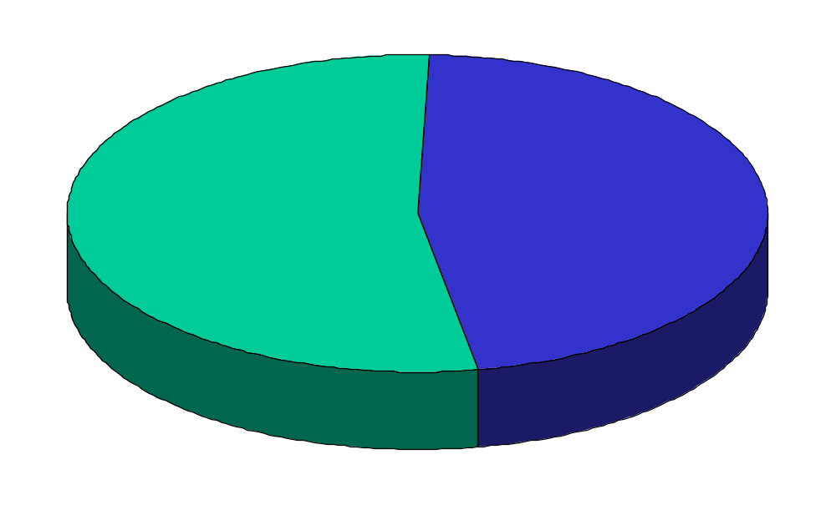
Geographic Region of Elders
Rural
Urban
53.2%
46.8%
Total of 6938 clients

Slide 5
112 Direct Respite Care Providers
76 Day Care Providers
Ave. Service Cap = 792 Hrs per year
Mean hrs monthly= 91.6
Staffing
  All Paid = 33%
  Paid and Volunteer=67%
Type:
  Adult day 51%
  Group Day 39%
50 In-Home Providers
Ave. Service Cap = 406 Hrs per year
Availability
  Daytime only = 64%
  Anytime = 36%
Staffing
  All Paid = 62%
  Paid and Volunteer = 36%

Slide 6
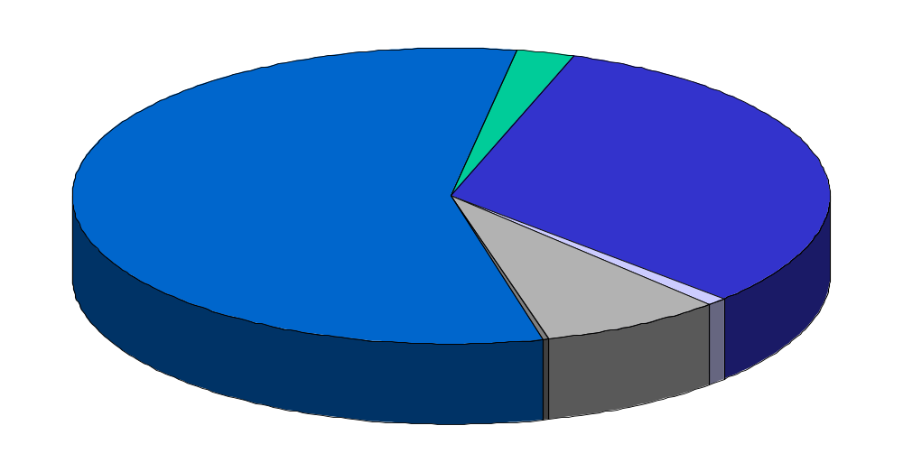
Elders by Ethnicity in Longitudinal Study
Asian/Pacific Island
2.5
White
African American
56.8
31.5
Unknown
2.0%
Hispanic
Native American
7.7%
0.3%
Total of 4369 clients

Slide 7
Data Sources
Interviews with 500 clients
Interviews with 50 service providers
  42 front line staff
  8 administrators

Slide 8
Unique Qualities of Rural Clients
Isolated
Independent

Slide 9
Isolation Means
Fewer educational opportunities
Limited access to medical care
Limited range of services

Slide 10
Limitations Translate
Dependence on local general practitioner for information
Limited knowledge of dementia or other specialized diseases
Limited knowledge of treatments

Slide 11
Independence means
Belief in self-reliance
Family First
Church as central to community

Slide 12
Strong Independence linked to
Views of services as Welfare
Guilt when services are used
Fear of Bureaucracies

Slide 13
Increased Familiarity
Know families
Know family histories

Slide 14
Familiarity breed special concerns
Privacy
Suspicion of outsiders including
  Staff
  Government
  Researchers
Discrimination based on
  Race
  Economics
  Religion
Preferences for service by “ones own”

Slide 15
Rural Program Issues
Transportation
Limited Resources
Lack of Economy of Scale
Staff and Staff Retention
(especially professional staff)

Slide 16
Solutions to these issues
Innovation and Creativity
Responsiveness to clients Needs

Slide 17
Examples of Approaches
Emphasis on service as a compliment not a substitute for family
Co-payment through service

Slide 18
Empowerment of Families
Teach them to ask questions
Teach them to talk with the doctor

Slide 19
Examples of Creative solutions
Mobile Day Care
Shared Staff
News letters
Long Distance Support Groups
Caregiving Buddies
Thrift shop respite

Slide 20
Quality still counts! A lot!
Become familiar with your service community
Develop appropriate and responsive service programs
Build trusting Relationships
Educate the community

Slide 21
Become familiar with your service community
Get to know culture and language
Become aware of other available resources and services
Understand issues related to service use such as socio-economic levels, education, employment status
Understand family structures and caregiving beliefs

Slide 22
Develop appropriate and Responsive Service Programs.
Culturally appropriate materials and activities
Hire “from the community”
Individualize care plans
Match hours of service availability to caregiver needs
Create a homelike environment
Use “socializing” context for support groups
Use sliding fees to negate welfare stigma

Slide 23
Build trusting Relationships
Create clear expectations for care with clients
Follow through! Follow through!
Recognize and reward excellent staff members
Hold team meetings and give staff members and opportunity to provide input
Build partnerships with key community providers/organizations

Slide 24
Educated the Community
Let families know about the purpose of your services
Inform community leaders about the ways that your service can enhance family care
Create new partners through education

