Slide 1


American Society for Therapeutic Radiology and Oncology Cancer Disparity Symposium
Patient Navigation:
Facing the Challenge of Involving Underserved Populations
in Clinical Trials
October 16, 2005
Harold P Freeman, M.D.
Senior Advisor to the Director, The National Cancer Institute
Founder and CEO of Ralph Lauren Cancer Center
New York

Slide 2
Key Questions:
What are cancer disparities?
What is patient navigation?
What is the major challenge of the Program?
How has Patient Navigation improved cancer survival in Harlem?
What are some observations from the Cancer Disparities Research Program (CDRP) Navigation Pilots?

Slide 3
The Discovery-Delivery Disconnect
Discovery
Development
Delivery
Critical Disconnect
This discovery to delivery “disconnect” is a key determinant of the unequal burden of cancer.
Voices of a Broken System: Real People, Real Problems
President’s Cancer Panel, Freeman, March 2002

Slide 4
Profound advances in biomedical science have contributed to:
increased longevity
improved quality of life for many Americans.

Slide 5
Despite these advances, some Americans have not fully benefited from this progress - particularly the poor and underserved -
as evidenced by their high cancer incidence, mortality, and lower survival.

Slide 6
Disease always occurs within a context
of human circumstances
including economic status social position, culture, and environment.
These human circumstances are determinants of:
survival, and quality of life.

Slide 7
Causes of Health Disparities
Poverty/
Low Economic
Status
Social Injustice
Culture
Early Detection
Diagnosis/
Incidence
Post Treatment/
Quality of Life
Survival and Mortality
Prevention
Treatment
Freeman, Adapted from Cancer Epidemiology Biomarkers & Prevention, April 2003

Slide 8
POVERTY
CULTURE
Risk-promoting lifestyle,
attitude, behavior
Inadequate physical and social environment
Inadequate information
and
knowledge
Diminished access to
health care
DECREASED SURVIVAL
Freeman, H.P., 1989.

Slide 9
Poverty acts through the prism of culture.
Culture may augment or diminish poverty’s expected negative effects.

Slide 10
Race
Perhaps the single most defining issue in the history of American society

Slide 11
Popular conceptualizations of race date back several centuries and in, particular, are rooted in 19th and 20th century scientific thought.
The presumption was that visible traits produced the measure of all other traits in an individual or population.

Slide 12
Race
While health disparities have been framed historically as racial and ethnic differences, race and ethnic classifications have been socially and politically determined
There is no genetic basis for racial classification.
  95% variation within “race”
  5% variation between “races”
Marcus Feldman, 2003

Slide 13
“Racial and ethnic categories used in the census have been socially and politically determined and were never intended to be scientific or anthropological in nature.”
Office of Management and Budget
Directive Number 15

Slide 14
Patient Navigation Model
Outreach
Rehabilitation
Patient Navigation
Resolution
Abnormal Finding
Abnormal Results
Diagnosis
Treatment
Conclude
Navigation
Freeman, et.al., Cancer Practice, 1995.

Slide 15
The Challenge:
Navigating a Patient from suspicious finding to resolution
through the complex Health Care Delivery System

Slide 16
Cancer Disparities Research Partnership (CDRP)
Patient Navigation Model
Outreach
Patient Navigation
Rehabilitation
Cancer Diagnosis
Resolution
Abnormal Finding
Abnormal Results
Diagnosis
Treatment
Conclude
Navigation
Freeman, et.al., Cancer Practice, 1995.
Abnormal results
Diagnosis
Treatment
Conclude
Navigation

Slide 17
The Challenge:
Navigating a Patient from diagnosis to resolution

Slide 18
Resolution:
Universal access to Cancer Treatment
Enrolling and Navigating patients through clinical trials to access state-of-the-art cancer treatment or
Navigating patients through the complex Health Care Delivery System to access standard cancer treatment

Slide 19
A cancer diagnosis at later stages of disease is common among poor, and underserved patients, making them ineligible to participate in clinical trials.

Slide 20
The Harlem Experience
A Personal Journey

Slide 21
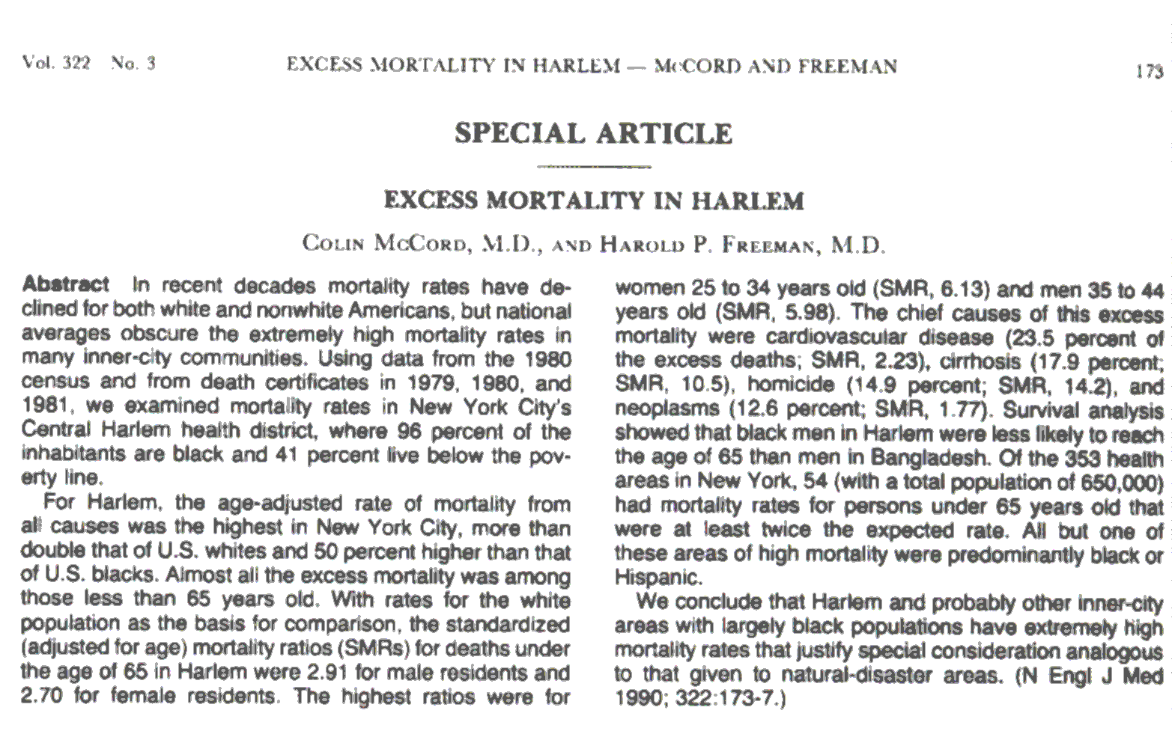
Harlem: Geographic Area of Extreme Excess Mortality

Slide 22
Central Harlem
Community Characteristics
Ethnicity is predominantly African-American.
Median household income in Central Harlem is $22,367/year.
Median years of school completed is 12.
  11% less than high school
  47% high school, no diploma
  17% high school graduate
  18% some college
  8% 4+ yrs. of college
Source: National Cancer Institute INFORUM database

Slide 23
East Harlem Community Characteristics
  Ethnicity
    Puerto Rican, 51.8% – Central American, 3%
    Mexican, 9% – Ecuadorian, 1%
    Dominican, 5%
  Median household income in East Harlem is $23,309/year.
  Median years of school completed is 11.
    30% less than high school – 13% some college
    31% high school, no diploma – 5% 4+ yrs. of college
    22% high school graduate
Source: National Cancer Institute INFORUM database

Slide 24
The Harlem
Patient Navigator Program

Slide 25
Impact of Harlem Hospital Center
Breast Cancer Screening and Patient Navigator Program
1964-1986 1995-2000
Stage 0 0% 12%
Stage I 6% 29%
Stage II 45% 38%
Stage III 39% 14%
Stage IV 10% 7%
Freeman HP, Wasfie TJ (1989). Cancer of the breast in poor black women. Cancer, 63(12), 2562-2569.
Oluwole, et.al., Journal of American College of Surgeons, 2003

Slide 26
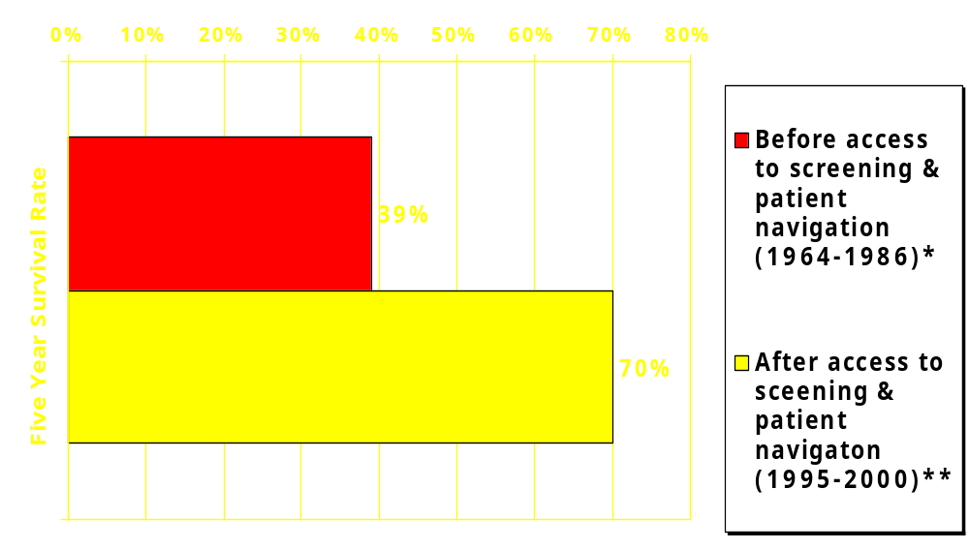
Impact of Screening and Patient Navigation on
Breast Cancer 5-year Survival Rates
Harlem Hospital Center
*Freeman HP, Wasfie TJ (1989). Cancer of the breast in poor black women. Cancer, 63(12), 2562-2569.
Oluwole, et.al., Journal of American College of Surgeons, 2003

Slide 27
Some Observations:
CDRP Pilot Patient Navigation Programs
Patient-centered navigation programs tend to yield better compliance to treatment schedules.
Financial issues, transportation, and skepticism over being a “guinea pig” in clinical trials are primary concerns for patients

Slide 28
Some Observations:
CDRP Pilot Patient Navigation Programs
How we approach patients about navigation and clinical trials can greatly affect participation.
Building trust is an essential component of the Patient Navigation Program.

Slide 29
Causes of Health Disparities
Poverty/
Low Economic
Status
Social Injustice
Culture
Early Detection
Diagnosis/
Incidence
Post Treatment/
Quality of Life
Survival and Mortality
Prevention
Treatment
Freeman, Adapted from Cancer Epidemiology Biomarkers & Prevention, April 2003

Slide 30
Of all of the forms of inequality, Injustice in health is the most shocking and inhumane.
Dr. Martin Luther King Jr.

