Slide 1
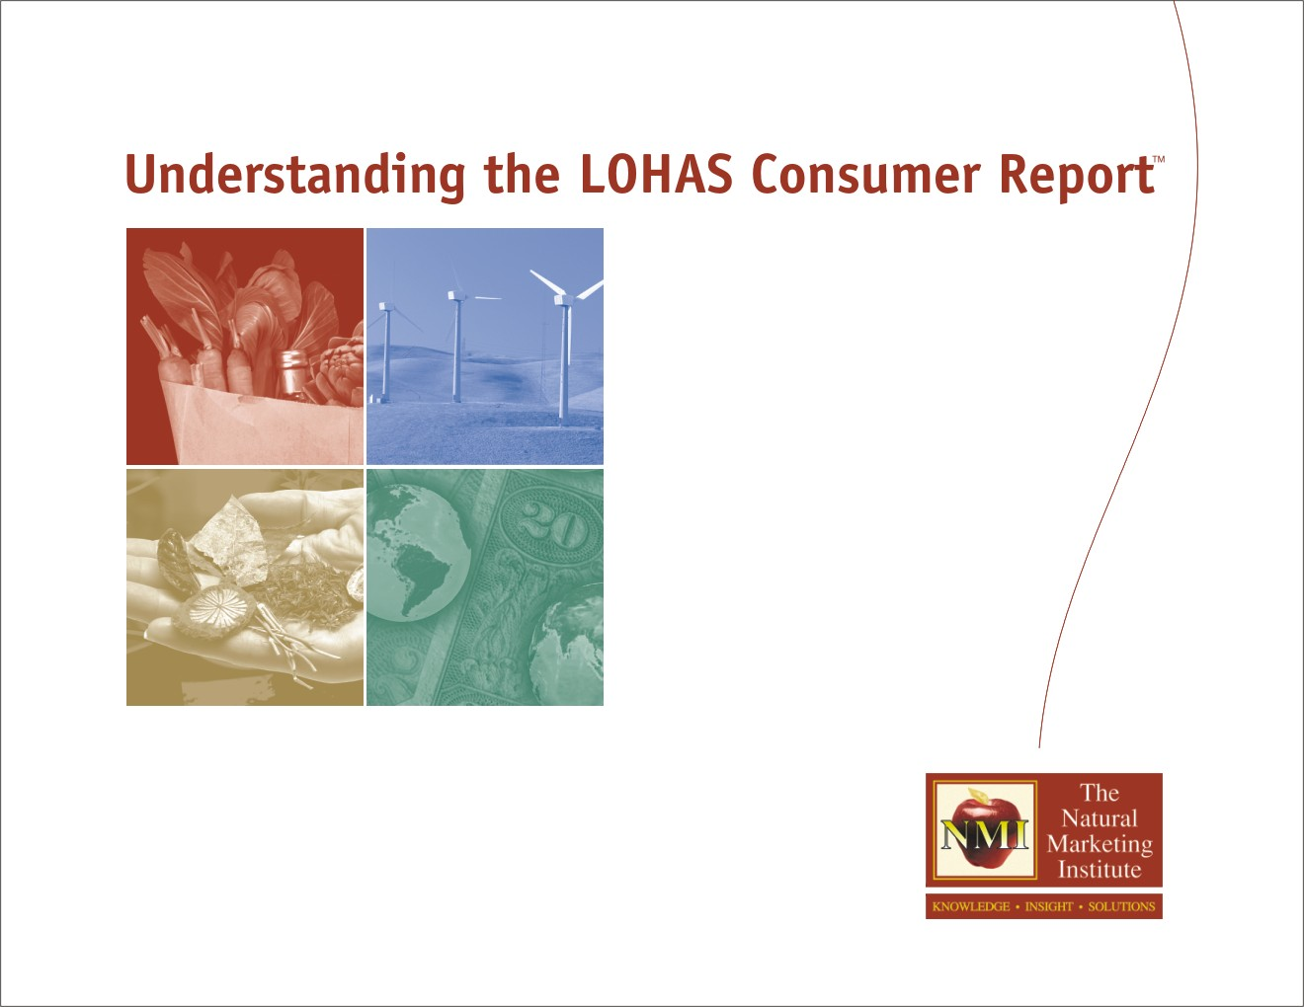
Consumer Research on Energy Efficiency and Renewable Energy:
Research Results from the 2004 LOHAS Consumer Trends Database™
Steve French
Managing Partner
The Natural Marketing
Institute (NMI)

Slide 2
NMI’s 2004 LOHAS Consumer Trends Research Study…
LOHAS = Lifestyles Of Health And Sustainability
An integrated consumer database which:
  Identifies LOHAS consumer attitudes
  Measures LOHAS consumer behavior patterns
  Determines consumer usage of LOHAS products and services
Research project methodology:
  Annual tracking study, now in its third year
  Sample Size: 2,000+ U.S. households each year (6,000+ total)
  Nationally projectable U.S. adult population
  Online methodology
  Accurate at the 95% confidence level to +/- 2%

Slide 3
The LOHAS Database Summary Content & Scope
Attitudinal Measures:
50+ LOHAS-related measures
16 additional psychographic drivers/consumer behavior predictors
Usage Patterns:
Across 10 distinct industries
90+ product categories
95 specific product attributes
110 brand usage patterns
Information Sources:
100+ sources of influence
40 magazines
19 TV shows, radio programs, other specific media venues
Behavior/Demo’s:
Membership to 10+ organizations
Shopping patterns across 30+ specific retailers
Complete demographics

Slide 4
New Ways Of Thinking Leads To The Need To Develop Consumer Insight
Identifying
the LOHAS
Consumer
Product
Attribute
Drivers
Communication
& Reach
Strategies
WHO
WHAT
HOW
  attitudes, beliefs, values, shopping behavior, lifestyle, media patterns, psychographics, product/service usage dynamics, etc.

Slide 5
The LOHAS Consumer Hierarchy
Mainstream
Protecting the environment
Social issues
Brand image
Personal health
Differentiated
Values alignment
Choice of environmentally friendly products
Sustainable product interest
LOHAS
Willingness to pay
Teach others
Planetary health
Sustainable product usage

Slide 6
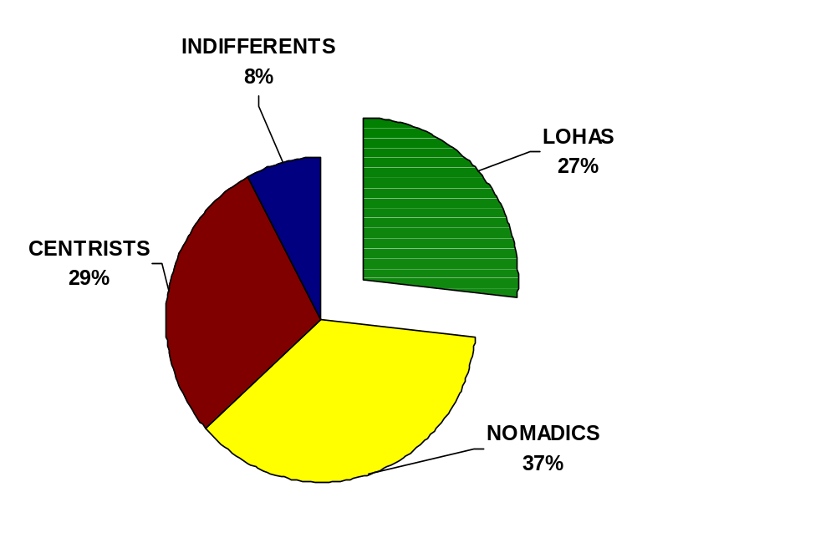
NMI’s NEW 2004 Consumer Segmentation Model Identifies Four Distinct Segments
(% general population U.S. adults…)
xxx
LOHAS =
Almost 60 Million
U.S. Adult
Consumers

Slide 7
Summary Trends Among The LOHAS Consumer: A Snapshot of 2004 Versus 2003…
Increase in alignment of personal values with company/brand values
Higher concern for socially responsible business practices
They’re becoming more influential about “spreading the word”
They’re more likely to be early adopters of new products/services
Much higher usage rates of many products and services, such as:
    Natural/organic consumable/packaged goods
    Renewable power/energy
    Green building products/services
    Energy-efficient durable goods (autos, appliances, electronics, etc.)
    Socially responsible investing

Slide 8
Many Inherent Challenges Exist in Marketing EE And RP to the U.S. General Population
58% care about use of renewable energy sources
  But… fewer than 15% even know they can buy renewable power
79% say energy efficiency is important for electronics/ appliances
  But… only 34% say it’s important for products to have ENERGY STAR label
AND 48% state: (a) they don’t know what “sustainability” means, (b) that it is simply a marketing ploy with no real meaning or benefit, or (c) have never heard of the term…

Slide 9
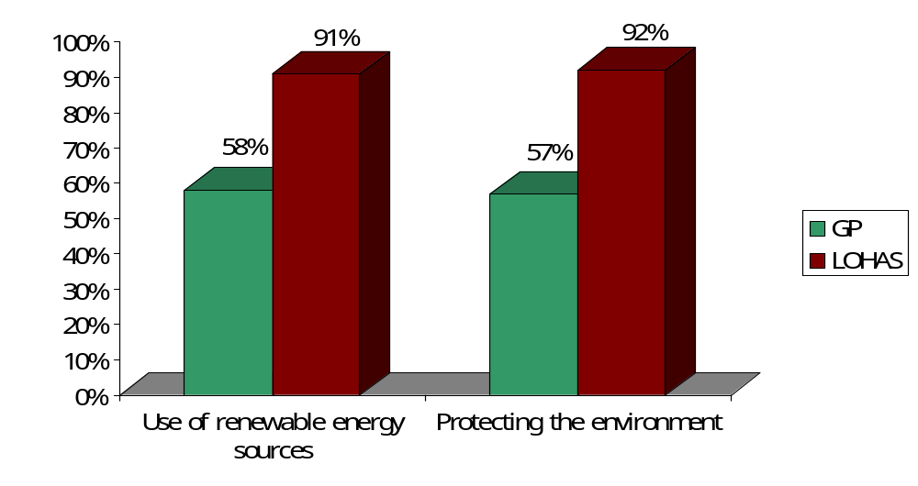
LOHAS Consumers Can Be Identified Via Their Intense Environmentally-Based Attitudes
(% consumer segment agreeing “completely” that they care about…)
Notes:
NOMADICS, as mentioned previously, behave most similarly to the GP with respect to their environmental attitudes:
For protecting the environment: 55.4% agree completely
Sustainable ag: 39.5 % agree completely
Renewable energy: 55.6 % agree completely
Recycled materials: 35.0% agree completely
Preservation of biodiversity: 28.7% agree completely

Slide 10
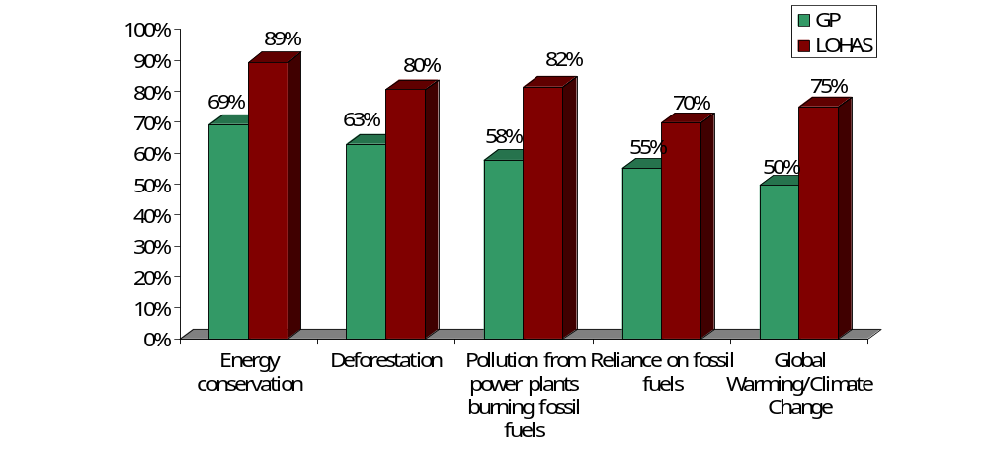
Concern About Specific Environment and Energy Issues
(% consumer segment stating that they are concerned about the following)

Slide 11
ENERGY STAR Attitudes
(% consumer segment stating agreeing “completely” with the following)
 | GP | LOHAS
It is important for household appliances, electronics, heating/cooling systems, and lighting products to have the ENERGY STAR label. | 50% | 75%
The importance of the ENERGY STAR label is to save money on my energy bill. | 50% | 53%
The importance of the ENERGY STAR label is to be energy-efficient and environmentally friendly. | 55% | 80%

Slide 12
Interest In Energy Efficient Products
(% consumer segment stating the following)
 | GP | LOHAS
“Energy efficient” is important for electronics or appliances | 79% | 88%
“Energy efficient” qualified is important for building products | 67% | 80%
“ENERGY STAR” qualified is important for electronics or appliances | 50% | 61%
“ENERGY STAR” qualified is important for building products | 44% | 54%

Slide 13
Specific Renewable Power Attitudes
(% consumer segment stating agreeing “completely” with the following)
 | GP | LOHAS
I believe that increasing use of renewable power is important for human health. | 45% | 79%
I believe that increasing use of renewable power sources is important to the U.S. economy. | 50% | 77%
I would like my electric company to decrease reliance on fossil fuels and nuclear power. | 43% | 73%
I believe the energy choices I make are important in protecting the environment. | 38% | 72%
I would like to be able to purchase renewable power from my energy company. | 39% | 72%

Slide 14
Although 40% of The U.S. General Public Shows Interest, Most Don’t Know That RP is “Available”
(% consumer segment stating the following)
 | GP | LOHAS
I have the option to buy renewable power from my electric/utility company
Yes | 8% | 10%
No | 50% | 53%
Don’t Know | 42% | 36%
I have the option to buy renewable power from someone other than my current electric company
Yes | 6% | 8%
No | 46% | 51%
Don’t Know | 48% | 42%

Slide 15
The LOHAS Market Is Attractive, But Many Challenges Exist
Multiple sub-targets with different value sets
Multiple industries create cross-business challenges
Many LOHAS products/services cost more
“Values” are important, but price, brand, delivery all play a role
Consumers aren’t sure whom to trust
Complex value propositions (specifically renewable power)
This represents a necessity to position products not as “more expensive alternatives,” but as “necessary, values-based solutions”

Slide 16
Summary Perspective – Energy Efficiency
Opportunities:
  A more mainstream proposition driven by both cost savings and environmental benefits
  Product “availability” has higher penetration
  There is still potential for the ENERGY STAR program to expand
    Need to rotate messages
    Need to target consumers interested in energy efficiency
Challenges:
  Relying on “ENERGY STAR” without talking about “energy efficiency” leaves many consumers “in the dark”
    DOE/EPA need to further educate consumers (again through targeting those consumers not aware of the term)
    Manufacturers need to use terminology accordingly

Slide 17
Summary Perspective – Renewable Power
Opportunities:
  LOHAS consumers are an attractive target based on their related attitudes and usage of other healthy and green products
  Health, economic, and environmental benefits of renewable power provide multiple value propositions to consumers
Challenges:
  Immense confusion over consumer availability to renewable power
  →Must target most opportunistic consumers, start small, and grow consumer base from there
In both industries, need to:
      Market uniquely
      Provide simple solutions
      Think differently

Slide 18
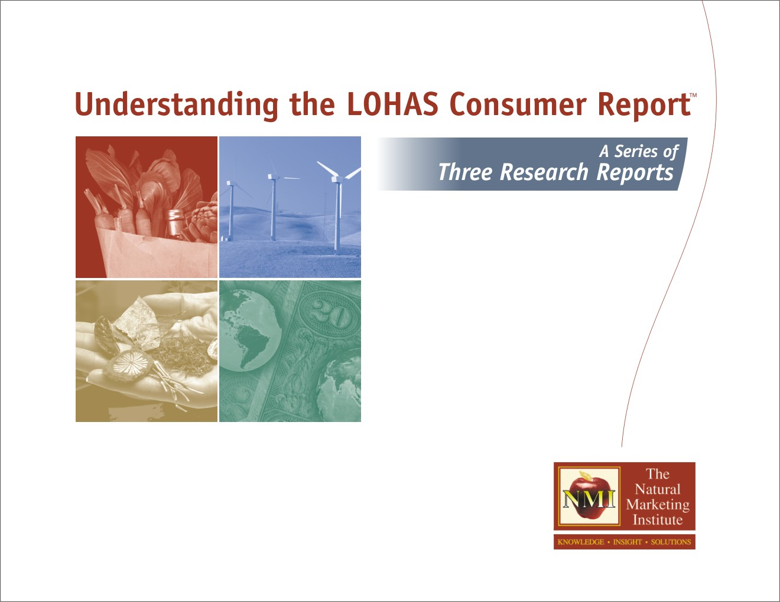
The LOHAS Consumer Trends Database™ (LCTD) Has Three Main Uses
Published Reports:
Sector-Specific Reports
100+ Pages Each
Hard Copy & Electronic Versions
Sponsorship Opportunities:
Proprietary Sponsor Content
Interaction Across Core Database
Customized Analysis & Report
2005 Sponsorships Now Available
Customized Analysis:
Target Identification
User Profile Analysis
Product Driver/Attribute Analysis
Communications Strategy
1000’s of Others…

Slide 19
For additional information on this exciting project or how you can capitalize on the LOHAS market:
Visit: www.NMIsolutions.com
Or contact:
Steve French, (215) 513-7300, ext. 214
Steve@NMIsolutions.com

Slide 20
Use Prohibited
All materials herein are © 2004 by The Natural Marketing Institute.
All rights reserved. Reproduction, publication (internal and/or external), transmission, or other use of any of the within materials, including but not limited to graphics, data, and/or text, for any commercial or non-commercial purposes, is strictly prohibited without the prior express written permission.
Copyright Attribution Notice
If written permission for use of any portion of the within materials shall have been granted by The Natural Marketing Institute, and if any portion of the said materials provided by The Natural Marketing Institute shall thereafter be published in any form at any time to any third party, the following notice must be prominently included in any and every such publication:
Source: The LOHAS Consumer Trends Database™
© The Natural Marketing Institute, 2004

