Slide 1
STD Prevention: The Female as Health Communicator and Risk Manager
Miriam Y. Vega
University of California, Berkeley

Slide 2
Study’s Goals
To examine how perception of risk-preventive sexual behavior, such as condom use and communication regarding condom use, varies in accordance with:
  (1) specific dyadic relationship forms
  (2) gender roles
  (3) power differentials within relationship

Slide 3
Social Aspects of STD Research
STDs socially transmitted
Sexual behavior is social behavior
Missing from past models: impact of social context on risky decision making
Need to incorporate findings about human interaction into STD prevention

Slide 4
Relational Schemas
….are cognitive structures that are representational models of oneself and of others, along with the self as experienced in differing types of relationships (Baldwin, 1992)
  These cognitive structures are interconnected by interpersonal scripts
    Scripts: stereotyped sequences of actions detailing who, what, when, where, and why of appropriate actions (Delameter, 1987)

Slide 5
Exploratory Study
Respondents asked how they decided on protective measures
Most respondents said “By mutual agreement”
Further explanations never offered
Lack of explanation for how agreement is reached indicative that script is only vaguely sketched

Slide 6
The Present Study
Used a written vignette methodology
Addressed 4 primary questions
  (1) Are condoms part of relational schemas?
  (2) Is condom use scripted as a contraceptive or as a prophylactic?
  (3) How is communication about protective measures scripted?
  (4) How are power dynamics scripted?

Slide 7
The Written Vignette
Hypothetical couple talks for a while, then begin to kiss
Scene stops immediately following the kiss, forcing respondents to “fill in the gaps”

Slide 8
Relationship Types:
(1) One-night stand
(2) First-date relationship
(3) Casual, non-exclusive relationship (“just physical”)
(4) Primary Relationship (“committed”)

Slide 9
Sociodemographics
188 subjects (93 men, 95 women)
Age range 17-29 years (average: 19.52)
Racial composition
  52% Asian
  32% Caucasian
  9% Hispanic
  7% Other
Sexual experience
  51.4% Virgin Status
  48.6% Non-Virgin Status

Slide 10
Condom Use Communication
Three central questions investigated:
  (1) Does communication about condom use occur?
  (2) Who initiates the conversation?
  (3) What communication strategies are used?

Slide 11
Does Condom Use Communication Occur?
Respondents were first asked as yes/no question (Does condom use occur?)
Only 23% of all respondents said the couple would talk about condom use
Respondents perceived communication as very unlikely across all relationships (M=2.78)
In open-ended probe questions: 46% of respondent mentioned communication unlikely as it would “interrupt the moment”

Slide 12

How Likely is the Couple to Talk About Condoms Before Sex?

Slide 13
Who Initiates the Conversation?
90% of all respondents reported the female in a heterosexual dyad would initiate the conversation.

Slide 14
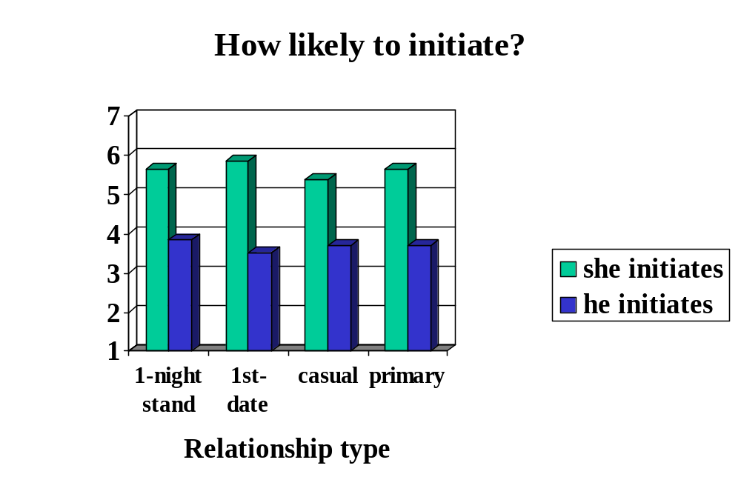

Slide 15
Introducing the Condom...
What does the male say in trying to introduce a condom?
  57.6% of respondents indicated that the male, regardless of relationship type will ask, “Should I get a condom?”
What does the female say in trying to introduce a condom?
  Casual relationship: “It is best for both of us.”
  Committed relationship: “Time to put the raincoat on.”
  One-night stand: “No condom, no sex.”
  First-date: “Should I get a condom?”

Slide 16
Power Differentials
Respondents were asked: (1) Who has the most power overall? (2) Who has the most power over condom use? (3) Who has the most power over sexual intercourse?
The female, across all relationships, is seen to have more control in all 3 areas.

Slide 17
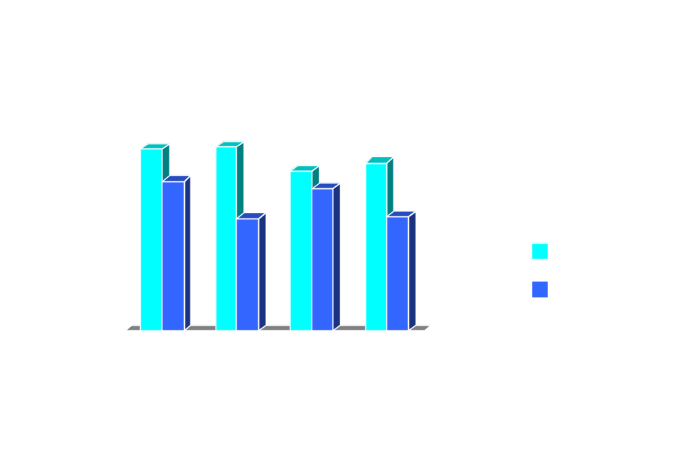

Slide 18
Conclusion
Cognitive structures organizing how people comprehend heterosexuality are structured around gendered scripts.
Females are perceived as initiators of communication and in control of condom-use.
Condom-use communication not part of sexual scripts.

