Slide 1


MADD/NHTSA
Regional
Law Enforcement Leadership Summit
Dallas, Texas
June 6-7, 2005
Notes:
Thank MADD and NHTSA for sponsoring this Summit.
Thank the NHTSA South Central Region for hosting this.
Thank MADD and NHTSA for inviting me to participate in this Summit and give this background information.

Slide 2
Impaired Driving and Underage Drinking Enforcement:
Effective Strategies
James C. Fell
Pacific Institute for Research and Evaluation
Notes:
I have been asked to provide some of the latest information we have on impaired driving enforcement…….and underage drinking enforcement….the so-called most effective strategies in the field.

Slide 3
Impaired Driving
Notes:
Let’s talk about the IMPAIRED DRIVING problem first…and then move into the underage drinking problem in the U.S. after that.

Slide 4
In the 1970s
About 60% of traffic deaths in America were alcohol related – an estimated 28,000-30,000 people killed yearly.
Drunk driving was socially accepted in American culture; tolerated as an “accident” — not a serious crime.
Limited awareness, no victim rights or services and no citizen activist groups working to stop drunk driving.
Notes:
30 years ago here is where we were.

Slide 5
Today
35% decline in alcohol-related traffic deaths (from 26,173 in 1982 to 17,013 in 2003).
Efforts have saved more than 300,000 lives over the past 25 years.
More than 2,300 alcohol-impaired driving laws have been adopted.
One of Department of Transportation’s top priorities
MADD is the largest crime victim service organization in the world.
Impaired driving enforcement plays a significant role in overall law enforcement in the United States.
Notes:
This is the good news.

Slide 6
The Impaired Driving Problem:
United States
17,013 alcohol-related traffic fatalities in 2003
16,654 preliminary estimate for 2004
An estimated 500,000 people injured in alcohol-related traffic crashes each year
$51 billion in annual costs to society
1,400,000 drivers arrested for driving while intoxicated or driving under the influence
Notes:
Here is the bad news.
So where do we stand today? We still have an enormous problem in this country.
The 17,000 alcohol-related traffic deaths are very close to the number of homicides each year and more than the number of annual deaths due to AIDS.
How much do we spend on AIDS as a public health issue? Not enough, but certainly more than we spend on drunk driving or underage drinking COMBINED.

Slide 7
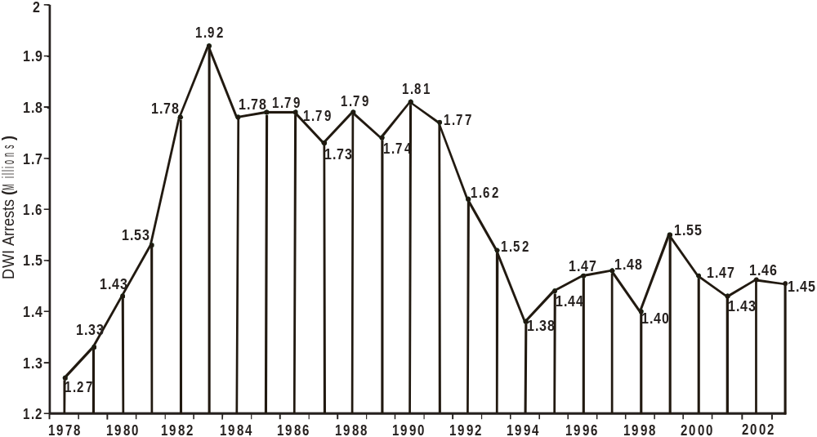
Estimated DWI Arrests in the United States (1978–2003)
Notes:
With regard to DWI arrests, we saw a substantial increase in the early 1980s when the public was demanding more action on this issue. Then arrests went down and have leveled off.

Slide 8
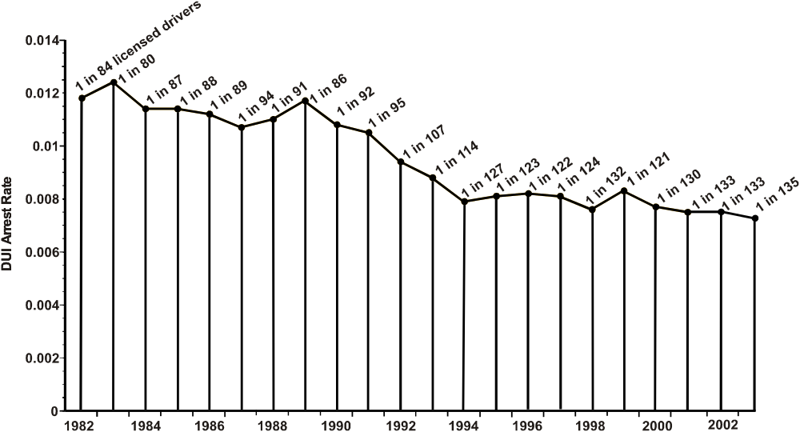
Estimated DUI Arrests per Number of Licensed Drivers in the United States
(1982–2003)
Notes:
One way to measure DWI arrests is the rate per number of licensed drivers in the US, which has been steadily growing.
So you can see that DWI arrest rates, by this measure, have been steadily decreasing.
There are probably 2 major reasons for this: (1) there has been a reduction in drinking and driving; (2) there has been a reduction in impaired driving enforcement.

Slide 9
DWI Enforcement in the United States
1,400,000 drivers arrested for DWI/DUI each year
1 DWI arrest for every 135 licensed drivers
1 DWI arrest for every 772 reported episodes of driving after drinking
1 DWI arrest for every 88 episodes of driving over the BAC limit
1 DWI arrest for every 6 stops by police for suspicion of DWI
Sources: FBI Uniform Crime Report; Zador, et al (2000)
Notes:
So here is where we stand today.
And you all know in this room that we can’t arrest every DWI. So we must depend to a large extent on deterrence strategies if we are to make any more strides in this problem.

Slide 10
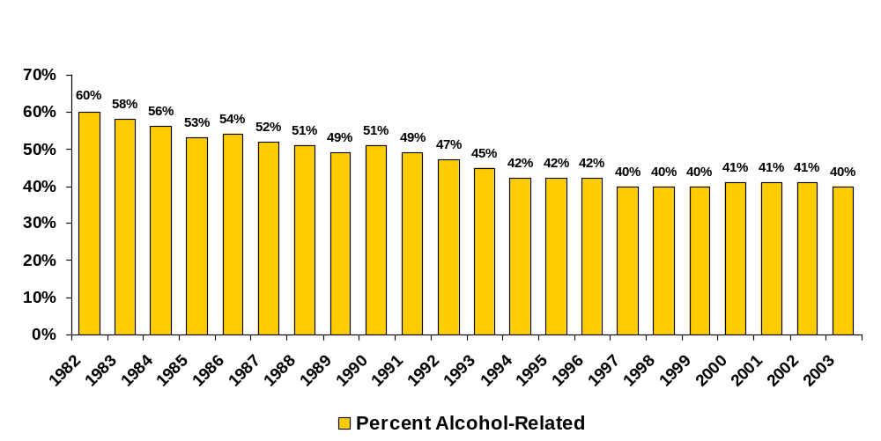
Alcohol-Related Traffic Fatalities
Notes:
Here is the progress we have made over the past 21 years. This has saved over 300,000 lives. By that I mean, if we had remained at 60% and not gone down to 40%, an additional 300,000 people would have died on our highways over the years.

Slide 11
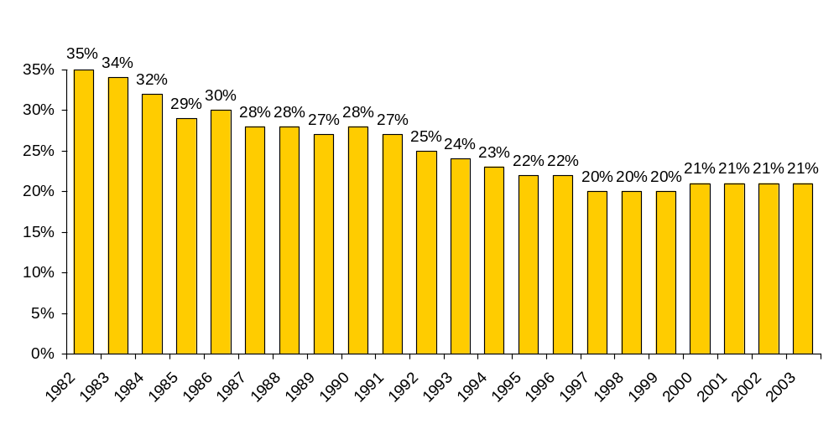
Proportion of all Drivers Involved in Fatal Crashes Estimated to Have Been Legally Intoxicated (BAC=>.08)
Notes:
More importantly, we have reduced the proportion of drivers with illegal BACs (>=.08) from over 1/3 of all drivers involved in fatal crashes to about 1/5.

Slide 12
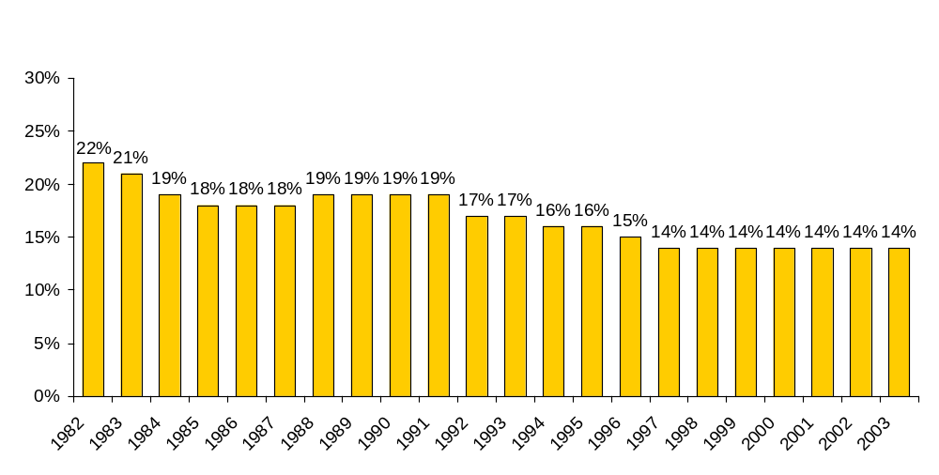
Proportion of Fatally Injured Drivers with
Very High BAC =>.20
Notes:
We have also made great progress with the so-called “hard core” offenders----those with very high BACs (.20+).
Don’t believe the myth that we have made all the easy gains and have only affected the “social drinkers.” Our laws and enforcement strategies have equally affected drinkers at all levels.

Slide 13
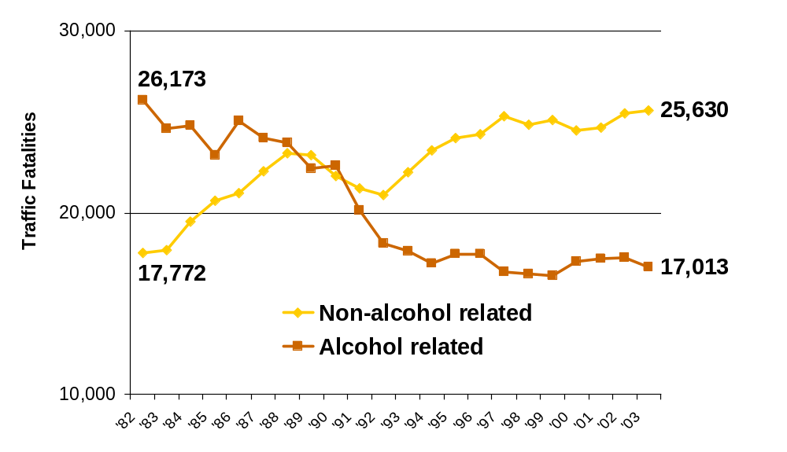
Traffic Fatalities 1982–2003
Notes:
So, alcohol-related fatalities have decreased by about 1/3rd while non-alcohol-related fatalities have increased by well over a third (44%).

Slide 14
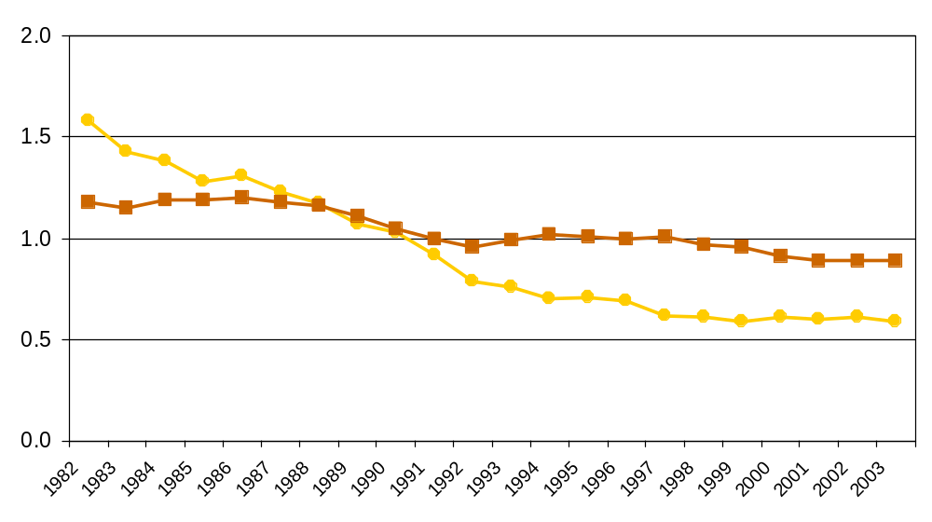
Alcohol and Non Alcohol-Related Traffic Deaths Per 100 Million Vehicle Miles Traveled (US) 1982–2003
1.58
Alcohol-related
Rate per 100 million VMT
1.18
25% ↓
Non Alcohol-related
.89
.59
63% ↓
Notes:
Here is the way NHTSA likes to measure the problem---per 100,000,000 vehicle miles traveled.

Slide 15
The Problem
Drunk driving is America’s most frequently committed violent crime
Alcohol-related traffic deaths account for 40% of all traffic fatalities
Major cause: Public and political complacency
Notes:
By violent crime, you need to consider the 17,000 deaths, 500,000 injuries and the 1,000,000 crashes that are alcohol-related.

Slide 16
To Reduce Drunk Driving:
We Need Increased Enforcement
Establish an effective general deterrence approach
  Routine year-round enforcement of impaired driving laws
  Studies show that checkpoints reduce alcohol-related crashes by 18-24%
  Call on state leaders to change laws needed to permit sobriety checkpoints
Notes:
The strategy that will have the most immediate effect on impaired driving is increased enforcement.

Slide 17
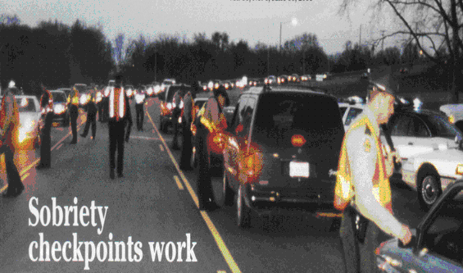
Notes:
The simple truth is that sobriety checkpoints work!
Now I know some of you are in States where they are prohibited, but if something similar to checkpoints can be done in your State, I would urge you to do so.
Why? Here’s why.

Slide 18
Checkpoint Tennessee
A Statewide Sobriety Checkpoint Program (Checkpoints 1994-1995)
Checkpoints conducted 882
Drivers checked 144,299
Drivers arrested for DUI 773
Seat belt violations 1,517
Drug violation arrests 201
Felony arrests,
stolen vehicles, weapons 88
Youth offender violations 84
Other traffic citations 7,351
Notes:
Here are results from a statewide sobriety checkpoint program in the mid-1990s.
Please note that this program was conducted after several years of Tennessee only conducting a handful of checkpoints in previous years….so it was quite a change in policy.
Note only an average of less than 1 arrest per checkpoint. You do not need a lot of arrests for the general deterrent value….just publicity and visibility and some credibility.

Slide 19
Results of “Checkpoint Tennessee”
Significant effect associated with the checkpoint program
20% reduction over the projected number of drunk-driving fatal crashes that would have occurred with no intervention
Reduction of 9 drunk-driving fatal crashes per month
5 comparison states showed nonsignificant increase in drunk-driving fatal crashes coincident with “Checkpoint Tennessee”
Effect present 21 months after initial year
Notes:
There were immediate, significant and fairly long-lasting results.

Slide 20
Georgia’s Operation Zero Tolerance
A Statewide Highly Publicized Sobriety Checkpoint Program (Checkpoints 2000-2001)
Checkpoints conducted 2,837
Drivers checked 280,082
Drivers arrested for DUI 2,322
Seat belt violations 5,348
Drug violation arrests 1,001
Felony arrests 236
Stolen vehicles recovered 57
Suspended/Revoked
Licenses 2,481
Other traffic citations 14,776
Notes:
More recently, NHTSA has funded a checkpoint program in Georgia that was even more extensive than Tennessee’s (but GA has a larger population, too).
Look at these numbers! Also note less than 1 DWI arrest per checkpoint.

Slide 21
Results
Georgia
Significant decrease in the ratio of drinking drivers to non-drinking drivers in fatal crashes (–14%; p<.005).
5% decrease in number of alcohol-related fatalities per 100,000,000 vehicle miles driven (nonsignificant).
27% decrease in proportion of people who reported driving after drinking (from 26% to 19%).
50% decrease in proportion of people who reported driving after drinking too much (from 18% to 9%).
Enforcement program saved an estimated 60 lives in the first year of operation.
Notes:
Again, a significant decrease in drinking drivers involved in fatal crashes---on the order of 14%-----saving an estimated 60 lives in the first year.

Slide 22
Reviews of the Literature on Sobriety Checkpoints
Review | # Studies | Conclusion
Ross (1992) | 9 | Cumulation of evidence supports the hypothesis that checkpoints reduce impaired driving.
Peek-Asa (1999) | 14 | Decreases in alcohol-related fatalities associated with checkpoints: 17% to 75%.
Shults et al. (2001) | 16 | Median decrease of 20% in alcohol-related fatal and nonfatal injury causes associated with sobriety checkpoints.
Notes:
Three reviews of the literature on checkpoints come to the same conclusion.

Slide 23
NHTSA Guidelines
Stuster & Blowers (1995)—checkpoints effective regardless of staffing levels (3-5 vs. 8-12) or location movement
Compton (1983); NHTSA (1990)—guidelines for conducting sobriety checkpoints
NHTSA (1999)—training video on how to conduct checkpoints
NHTSA (2000)—How-to Guide for Planning and Publicizing Checkpoints
Miller et al. (1998)—for every $1.00 spent on checkpoint programs, $6.00 is saved in reductions in crashes
Notes:
NHTSA has published and issued numerous guidelines on the conduct of checkpoints.

Slide 24
Checkpoint Status in the United States
39 states plus DC conduct sobriety checkpoints
11 states—sobriety checkpoints are illegal (ID, IA, MI, MN, OR, RI, TX, WA, WY), prohibited (WI), or not conducted (AK)
Notes:
Despite all of this evidence on sobriety checkpoints, here is their status today (or at least as of the year 2000) in the States.

Slide 25
Saturation Patrols
In California, highly publicized saturation patrols reduced alcohol-related crashes by 17%.
In comparison, four California communities that used highly publicized sobriety checkpoints reduced alcohol-related crashes by 28%.
(Stuster and Blowers, 1995)
Notes:
We have plenty of evidence that highly publicized, visible enforcement is effective----in reducing drunk driving, speeding and increasing safety belt use.

Slide 26
Other Enforcement Strategies
Low Staff Checkpoints
Happy Hour Checkpoints
Mobile Awareness Checkpoints (Phantom)
Safety Belt Enforcement Zones
Safety Belt Enforcement at Night Using Night Vision Goggles
Notes:
We have plenty of evidence that highly publicized, visible enforcement is effective----in reducing drunk driving, speeding and increasing safety belt use.

Slide 27
We Need Increased Enforcement
Checkpoints not only detect impaired drivers, but also result in arrests for illegal weapons, drugs, stolen vehicles, and fugitives. They will help improve Homeland Security.
Checkpoints may well be as “productive” as saturation patrols in terms of arrests per enforcement hour (one study). We need to document and publicize this.
Strategies need to be data driven, highly visible, frequent, and publicized
Notes:
So, in States that can conduct checkpoints, we need more of them. Easier said than done, right?

Slide 28
Enforcement Activity in Fairfax and
Montgomery Counties:
Early 1990s
 | Fairfax | Montgomery
Number of sobriety checkpoints | 0 | 30-50
DUI arrests per 10,000 drivers | 96 | 31
Notes:
Back in the early 1990s, the IIHS conducted a survey of two counties in the Washington, DC, area.

Slide 29
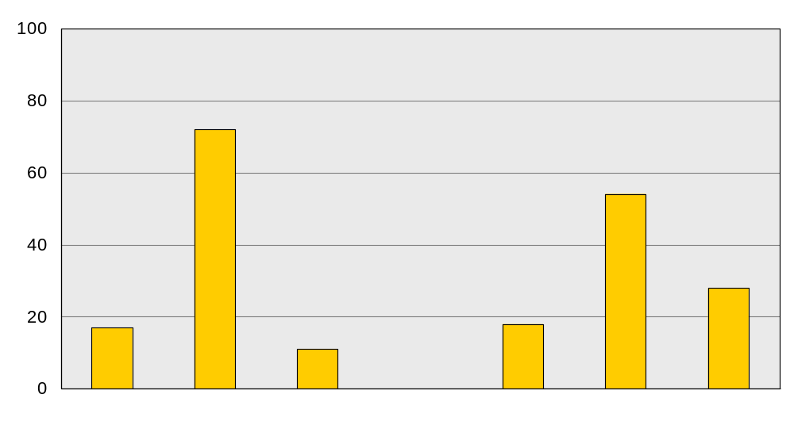
County in Which Respondents Thought they Would be More Likely to be Arrested for Drunk Driving
Percent
equally
likely
Montgomery
Fairfax
equally
likely
Montgomery
Fairfax
Montgomery Residents
Fairfax Residents
Notes:
Montgomery county, because of their checkpoint program, was perceived by the public as being tougher on drunk driving.

Slide 30
What is Needed?
A checkpoint system that uses few officers so that it can be mounted without outside funding.
Use of passive alcohol sensors (PAS) so that all those stopped can be checked for drinking.
An operational plan that allows checkpoints to be mounted as a regular feature of the DUI enforcement program.
Notes:
Because of limited resources, this is what we think needs to be done.

Slide 31
Police Detection of High BAC Drivers, with and without Passive Alcohol Sensors (PAS)
 | Percent detected
 | W/O PAS | With PAS
Sobriety checkpoints Charlottesville, VA Fairfax, VA | 45 55 | 68 71
Routine patrol Columbus, OH | 69 | 77
Special DUI patrol Chattanooga, TN | 88 | 94
Notes:
The use of Passive Sensors have increased the detection of drivers with BACs>= .10 in each study conducted.

Slide 32
The “PAS-Point” Concept
4 to 5 officer checkpoints conducted several times a week.
Checkpoints manned by regular traffic patrol officers who assemble at pre-established sites for 2-hour periods.
Auxiliary officers set up and tear down sites.
Officers are equipped with passive sensors and use them with every driver interviewed.
Notes:
We have come up with what we term as the “PAS-Point” concept: frequent, visible, low staff, routine checkpoints using passive sensors.

Slide 33
PAS-Point Operations
Low manpower checkpoints using Passive Alcohol Sensors being pilot tested in West Virginia.
So far, operations are feasible and logistics are being worked out.
Project is sponsored by IIHS. Initial effectiveness in reducing impaired driving was evaluated.
Notes:
But will this concept work? Well, we tested it in West Virginia in a studt sponsored by IIHS.

Slide 34
Low Staff Checkpoints
Study conducted in 4 rural counties in West Virginia.
Low staff checkpoints used 3-5 officers.
Weekly checkpoints conducted in 2 experimental counties for one year.
Notes:
We had 2 checkpoint counties and 2 comparison counties.

Slide 35
Low Staff Checkpoints Results
Relative to drivers in the 2 comparison counties, the proportion of drivers on the roads in the experimental counties with BACs>=.05+ was 70% lower.
The proportion of drivers on the roads in the checkpoint counties with BACs>=.08+ was 64% lower than the comparison counties.
Notes:
We conducted roadside surveys of drivers out on the roads on Friday and Saturday nights in each of the 4 counties. We conducted these surveys before the enforcement and several months into the program.

Slide 36
Summary
Checkpoints need not be big and expensive.
Police officers need not be burdened with the requirement to make rapid judgments about drinking based on a very limited interview with a driver.
Notes:
Routine, low staff checkpoints using passive sensors appears to have great potential.

Slide 37
Underage Drinking
Notes:
Now let’s turn to underage drinking for a few minutes…..because this is where the impaired driving problem starts and we know that underage 21 drivers are at increased risk of a fatal crash when they drink----much more so than older drivers.

Slide 38
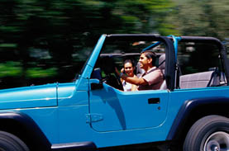
Underage Drinking
FACTS
Half of 8th graders and ¾ of high school seniors report consuming alcohol within the past year.
Half of high school seniors report being drunk in the past year.
Half of all college students report high-risk drinking (five or more drinks per session) within the past year.
Notes:
Despite our Minimum Drinking Age 21 Law…..here are the facts.

Slide 39
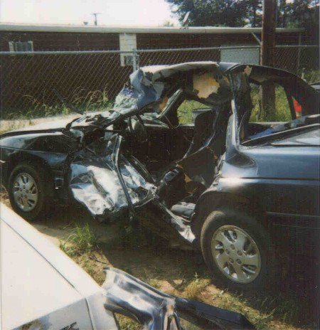
Underage Drinking
FACTS
More than 2,200 youths aged 15-20 are killed annually in alcohol-related traffic crashes.
Underage drinking is related to youth crime, suicides, rapes, assaults, alcohol poisoning, and unintentional injuries. This costs society $62 billion annually.
Notes:
I would contend that in the majority of communities, underage drinking is related to more deaths, more injuries, more crime, more problems than illegal drugs, gangs, and most other issues you can name. It needs priority.

Slide 40
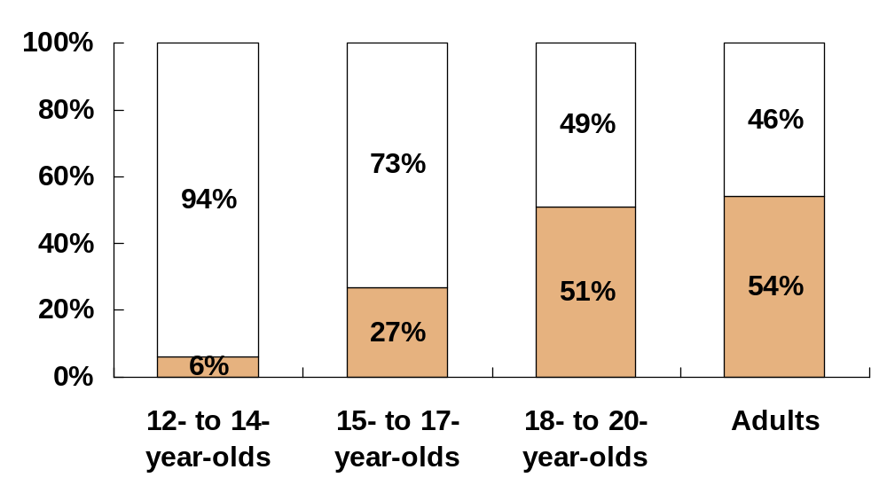
Fewer Youth Drink Compared to Adults
Comparison of drinking patterns for adult and underage drinkers (past 30 days)
Nondrinkers
Drinkers
Notes:
Fewer youth tend to drink alcohol, but….

Slide 41
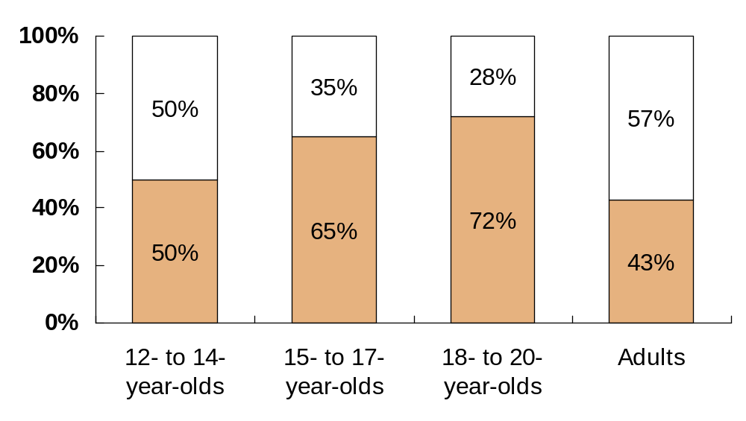
Young Drinkers Tend to Drink More Heavily than Adult Drinkers
Comparison of drinking patterns for adult and underage drinkers (past 30 days)
Nonbingers
Bingers
Notes:
…when they do, they drink to get drunk.

Slide 42
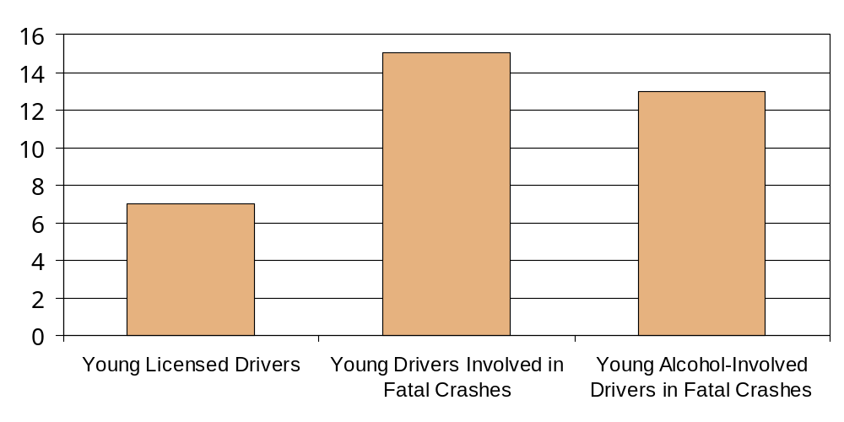
Young Drivers’ Over-Involvement in Fatal Crashes in 2000
Ages 15-20
15% of All Drivers Involved in Fatal Crashes
13% of All Alcohol-Involved Drivers in Fatal Crashes
7% of All Licensed Drivers
Notes:
And they are substantially over-represented as drivers in fatal crashes.

Slide 43
Why Should Underage Drinking Laws Be Enforced?
Minimum drinking age 21 laws save 1000 lives per year in reductions in traffic fatalities involving young drivers.
Medical research shows that the brain is not fully developed until about age 25 and excessive drinking by youth under age 21 may cause brain damage as well as reduce brain function.
Notes:
There are at least four good reasons to have 21 as the minimum legal drinking age.

Slide 44
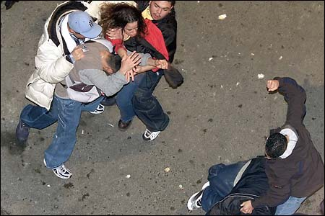

Why Should Underage Drinking Laws be Enforced?
Early onset of drinking increases the risk for future alcohol abuse problems, crashes, and assaults.
European countries with lower drinking ages experience higher percentages of youth that report intoxication in the past month.
Notes:
You have probably heard people say that in Europe, where the drinking age is lower or non-existent, they don’t have any problems with alcohol.

Slide 45
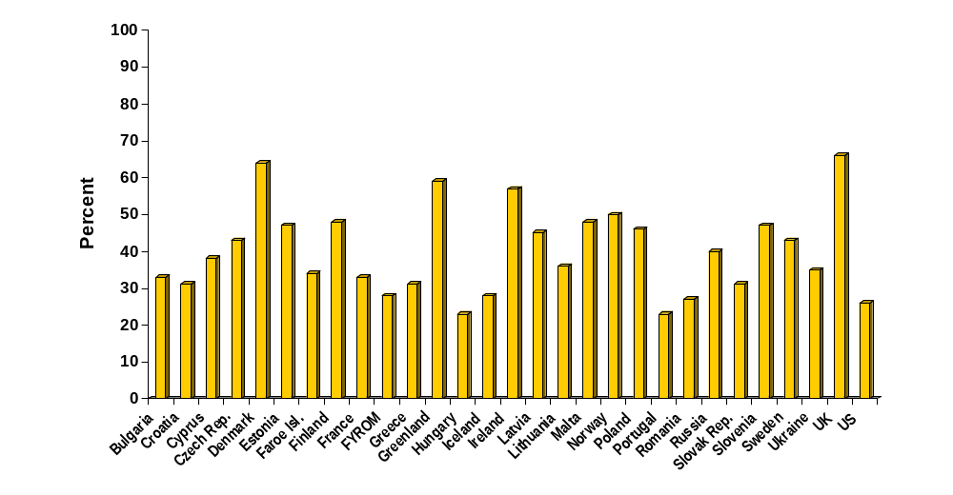
Prevalence of 5+ Drinks Among European and U.S. Adolescents
Notes:
Not true. These are 15 year olds.

Slide 46
Summary of Underage Drinking Sources
Range of Underage Respondents from Surveys Who Report Alcohol Source
Commercial Outlet
3% — 21%
Parties
32% — 63%
Adult/Family Member Over Age 21
46% — 85%
Friends <21
10% — 83%
0
20
40
60
80
100
Notes:
A number of surveys tell us that most kids get alcohol from other kids, adults and family members….and a smaller number directly from commercial outlets. We have to face these facts.
But there is still a lot more we can do.

Slide 47
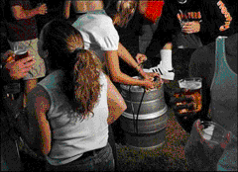
Enforcement of Underage Drinking
Compliance Checks (“Stings”)
False ID Detection
Shoulder Tap Programs
Party Dispersal
Keg Registration Tracking
Sobriety Checkpoints
Traffic Stops
Notes:
There are a number of ways and strategies in which we can enforce minimum drinking age laws.
These have had at least some reported success.

Slide 48
National Academy of Sciences
Reducing Underage Drinking:
A Collective Responsibility
2003
Notes:
For an extremely thorough and comprehensive look at the underage drinking problem, I would strongly recommend that you read the recent report from the National Academy of Sciences.

Slide 49
MADD’s Impaired Driving Priorities:
Highly visible, highly publicized and frequent enforcement
Primary Safety Belt Usage Laws in every State
Tougher Sanctions, better system for dealing with high risk drinking drivers
Notes:
MADD’s mission is to stop drunk driving, prevent underage drinking, and serve the victims of these crimes.
Here are MADD’s current 3 top priorities to reduce impaired driving.
Note the #1 priority. There is collective agreement on this issue, from NHTSA, the States and the traffic safety community in general.

Slide 50
Why Primary Safety Belt Laws?
There is evidence that when safety belt usage increases from 70-75% to 85-90%, more high risk (drinking) drivers will be buckled up.
Preliminary studies are indicating that reductions in alcohol-related crash fatalities are greater than reductions in non-alcohol-related fatalities when States upgrade to Primary Safety Belt Laws.
Notes:
A safety belt is the best protection against a drunk driver.

Slide 51
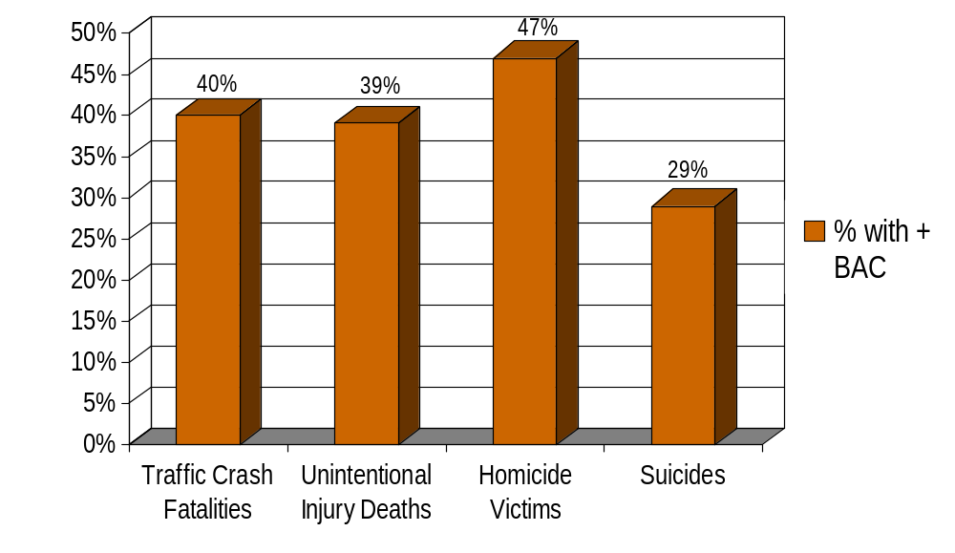
Alcohol Involvement in Fatal Injuries
Notes:
Keep in mind, alcohol-related traffic fatalities are just part of an overall problem with alcohol in this country.
Unintentional injuries include drownings, fires, poisonings, falls, etc.
Source: Smith GS, Branas CC, Miller TR. Fatal Nontraffic Injuries Involving Alcohol: A Metaanalysis. Annals of Emergency Medicine, 1999; 33(6).

Slide 52
Recommendations for Increased Enforcement:
Highly publicized and frequent sobriety checkpoints probably have the greatest potential for immediately reducing impaired driving crashes in this country.
Minimum drinking age 21 and zero tolerance laws save more than 1,000 lives per year. Imagine how many lives would be saved if they were enforced to any great extent?
Notes:
So, if we can increase enforcement of both impaired driving and underage drinking---we have the best chance of reducing alcohol-related traffic fatalities in this country IMMEDIATELY!

Slide 53
Enforcement Barriers
Resources (money, personnel, equipment)
Complexity of the arrest process
Knowledge about and buy-in to what works
Motivations, attitudes, priorities of the community
Notes:
We know there are a considerable number of barriers to increasing this type of enforcement.

Slide 54
Dealing with the Barriers
Smaller (4-5 person) checkpoints
Enhanced training in arrest procedures, in providing testimony
Equipment that facilitates enforcement, e.g., in-car videos, PBTs, passive alcohol sensors
Computerized forms, digital dictation systems that reduce paper work and recording errors
Community coalitions to support increased enforcement
Notes:
Here are some ways to deal with these barriers.
I would also ask you to compare the magnitude of the problem (drunk driving and underage drinking) with other problems in your community. I’ll bet you the numbers come out in the top 3 or 4 issues.
We need community coalitions that will stimulate action and get citizen support for increased enforcement.

Slide 55
Contact Information
James C. Fell
Pacific Institute for Research and Evaluation (PIRE)
11710 Beltsville Dr. Suite 300
Calverton, MD 20705-3102
301 755 2746
E-mail: fell@pire.org
Notes:
Feel free to contact me if you have questions or need further information.

