Slide 1
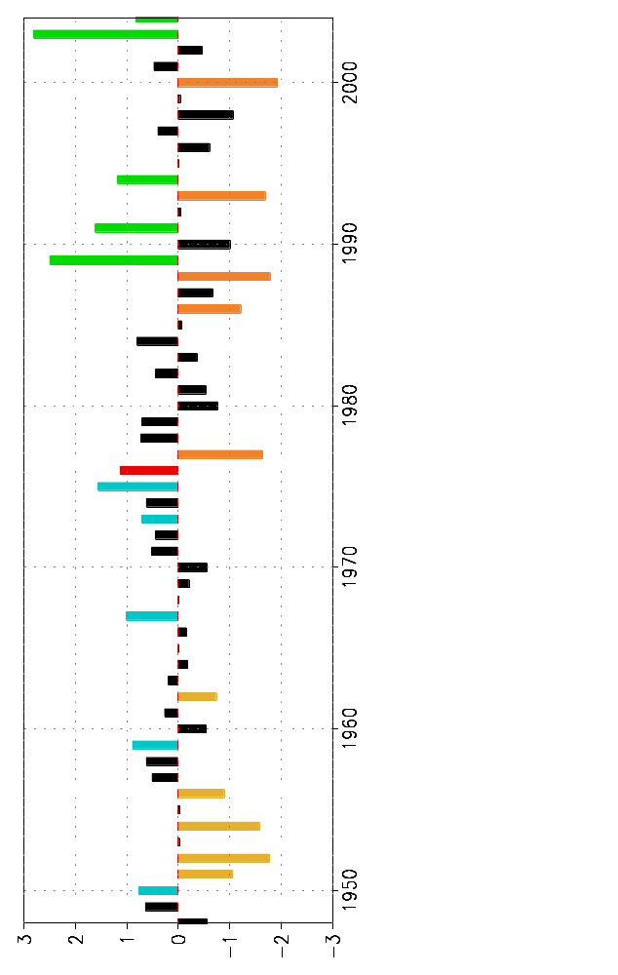
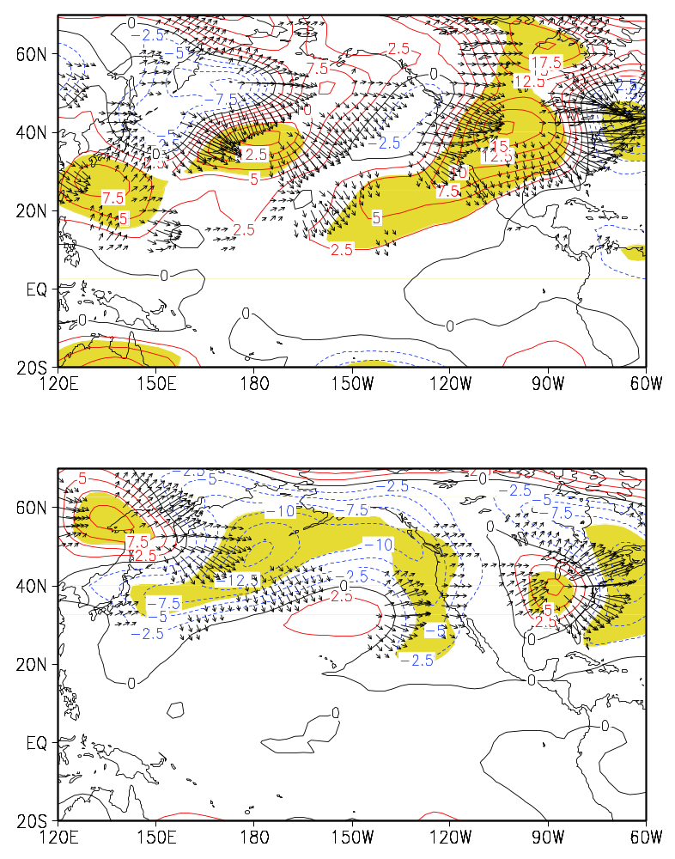
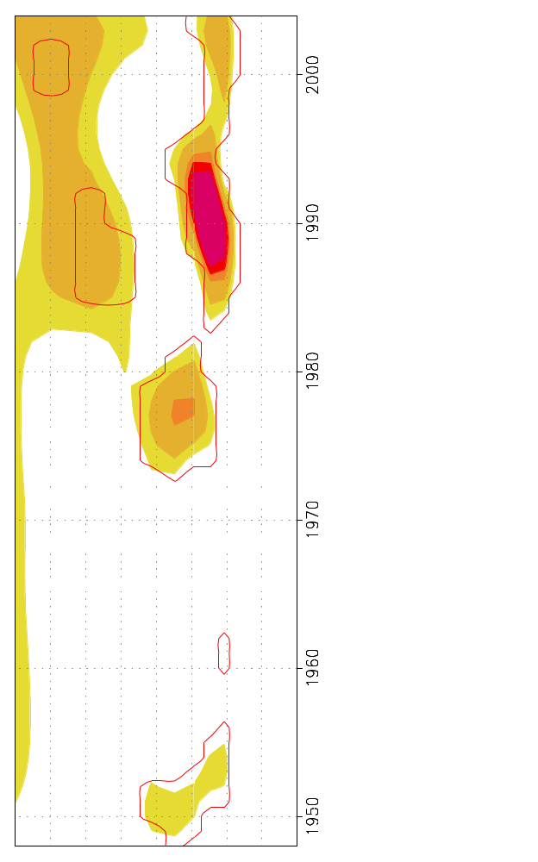
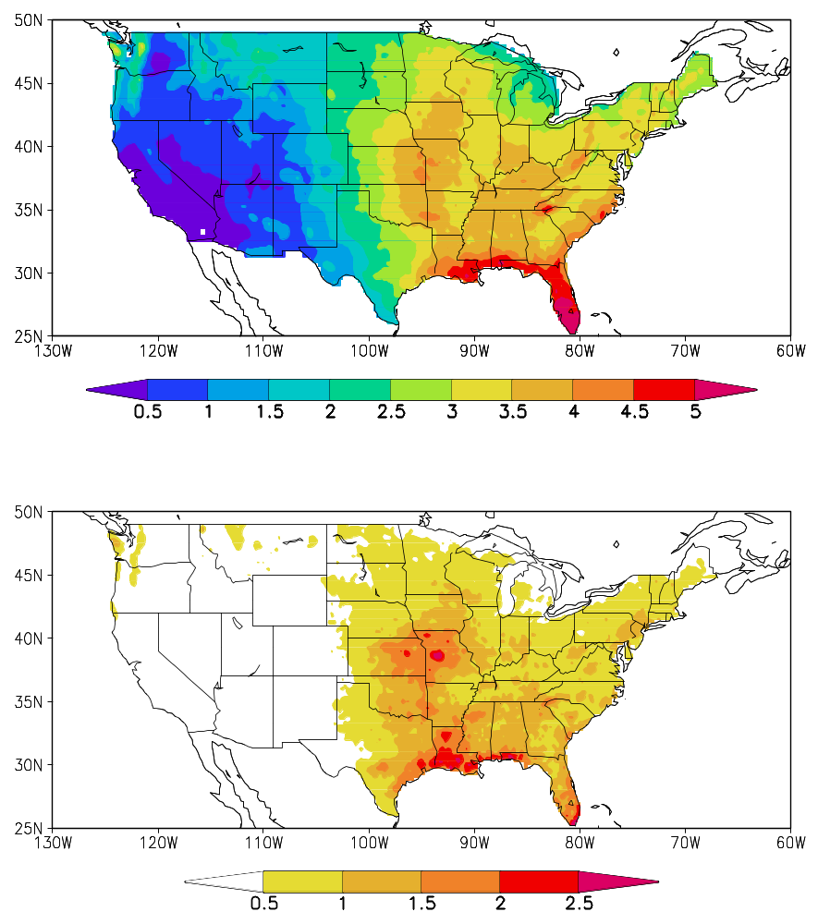
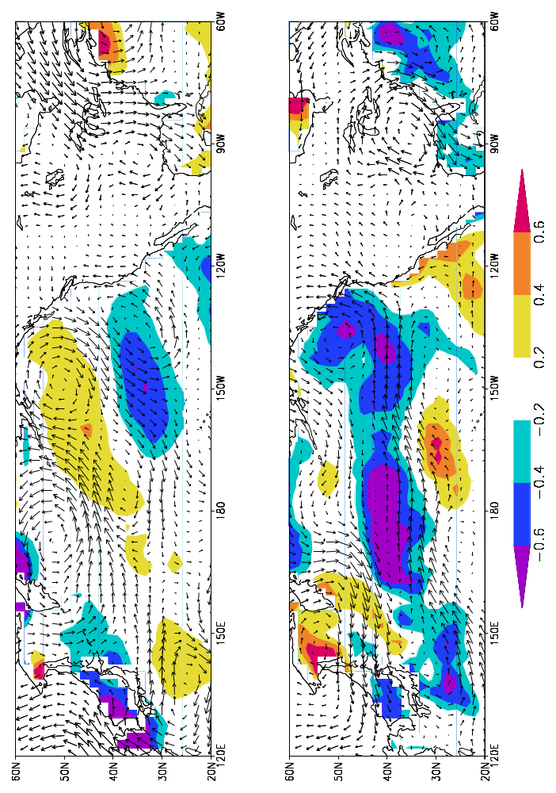
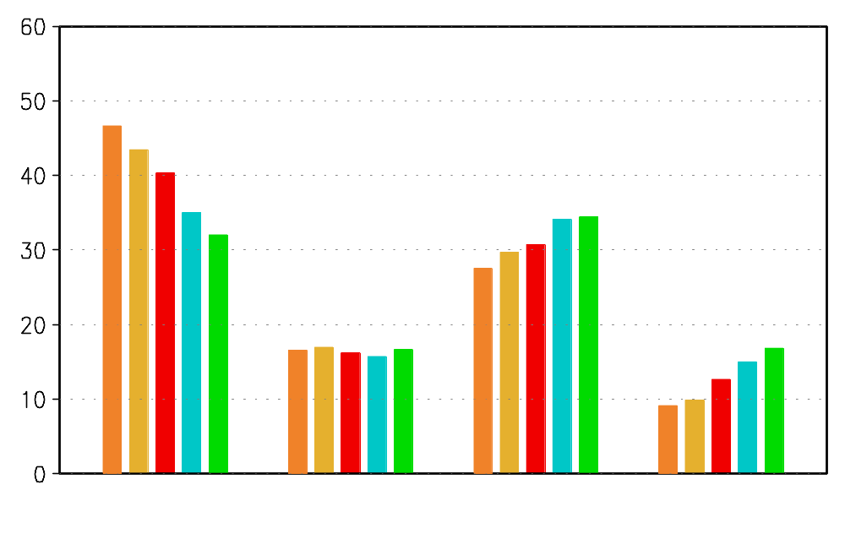
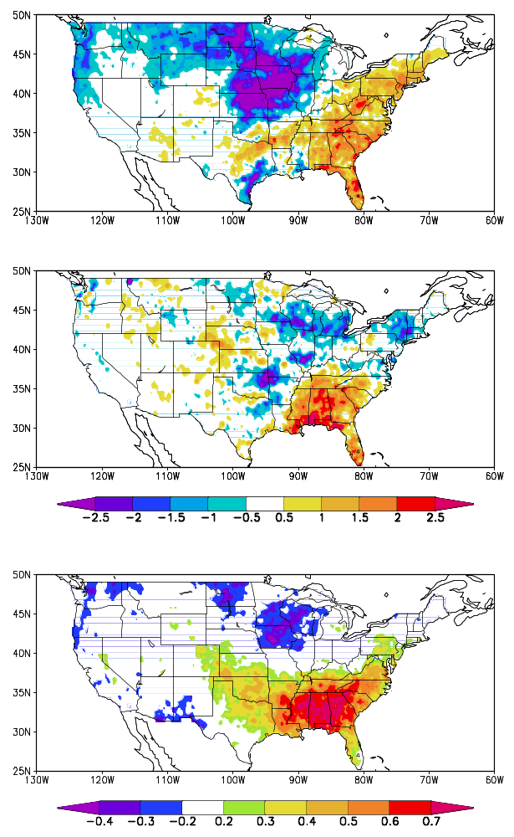
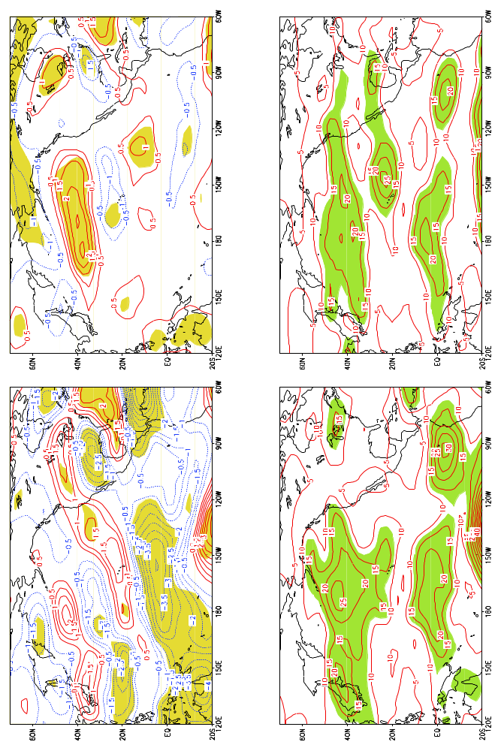
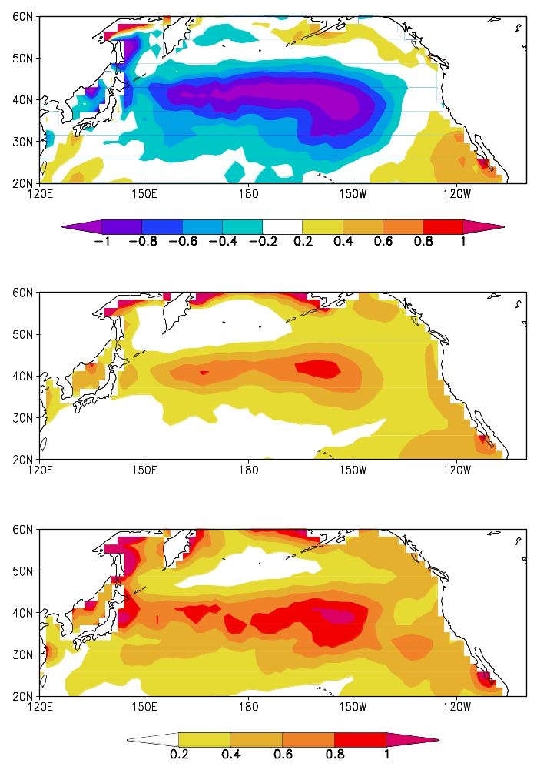
Shift of Summer Precipitation Variability in the Southeast United States
Hui Wang and Rong Fu, School of Atmospheric Sciences, Georgia Institute of Technology, Atlanta, GA 30332-0340
1. Introduction
The Southeast United States is one of the fastest growing regions in the nation. Water supplies in this area are increasingly stressed especially during summer. The year-to-year fluctuations in summer precipitation over the Southeast thus have vital influence on regional hydrology, agriculture, and related industries. In the past three decades, summer droughts repeatedly struck the Southeast and had a devastating impact on this region both socially and economically.
3. Variability of Southeast summer precipitation
1948–1975 500-hPa Height and Wave Activity Flux 1977–2004
The Southeast summer precipitation (Fig. 2) displays higher interannual variability with more wet and dry extremes in the second half of the period (1977–2004).
Southeast US Summer Precipitation Index
Variance: 30% 70%
5% significance level
Fig. 6
8
6
4
2
0
1976
In both periods southeast summer drought is associated with positive height anomalies in the central and eastern United States and negative anomalies along the coasts of New England and the Pacific Northwest. Over the North Pacific the relation to the circulation pattern is very different between the two periods.
5% significance level
Summer Mean Precipitation
Period (yr)
Fig. 2
Wavelet Power Spectra
Year
Summer Rainrate Distribution
Precipitation Anomaly 1993
Southeast droughts are associated with an anticyclonic circulation over the central and eastern United States. The northeasterly flow off the Gulf coast suppresses moisture transport to the Southeast.
850-hPa Wind and SST Anomalies 1948–1975
5 driest summers (1948-1975) 5 wettest summers (1948-1975)
5 driest summers (1977-2004) 5 wettest summers (1977-2004)
1948-2004 long-term mean
mm/day
Fig. 3
Precipitation Variance
% of summer days
Precipitation Anomaly 2000
1977–2004
No rain 0.1 – 1 1 – 10 > 10 mm/day
Rainrate
Changes in both frequency and intensity of rainfall contribute to the higher precipitation variability after 1976 (Fig. 3).
mm²/day²
Fig. 1
r( US Precip, SE Precip Index)
mm/day
Fig. 7
Figure 1 indicates that Southeast summer precipitation is an important part of warm season rainfall on the continental scale.
Precipitation anomalies in the Southeast and the Midwest are out of phase (Fig. 4).
In the North Pacific large wind anomalies occur in regions between warm and cold SSTs, indicating a circulation response to the SST gradient.
Objectives
a. To determine whether the interannual anomalies of Southeast summer precipitation have become more variable and whether Southeast summer droughts and wetness have become more intense in the most recent three decades.
b. To explore potential causes of the changes in the Southeast summer precipitation variability.
Fig. 4
SST Difference between
(1977–2004) and (1948–1975)
SST Variance
1948–1975
4. Relation to large-scale circulation
1948–1975 200-hPa Zonal Wind 1977–2004
K
1977–2004
A phase change of the PDO in 1976 reinforces the meridional SST gradient south of 40ºN. North Pacific SST also exhibits higher variability after 1976.
5% significance
level
2. Data
Precipitation: U.S. Unified Precipitation for 1948–1998
U.S. Daily Precipitation Analysis for 1999–2004
0.25º lat × 0.25º long
NCEP Reanalysis: 200-hPa and 850-hPa wind, 500-hPa height
1948–2004
SST: Reconstructed Reynolds Data, 1948–2004
1948–1975 Zonal Wind Variance 1977–2004
K²
Fig. 8
5. Summary
Southeast summer rainfall has exhibited higher interannual variability since around 1976, with a larger decrease (increase) of frequency and intensity of precipitation in dry (wet) summers. It is suggested that a phase shift of the PDO in 1976 and higher SST variability after that may help enhance the variability of Southeast summer precipitation.
Fig. 5
Regression patterns of 200-hPa zonal wind anomalies associated with 1 mm/day rainfall deficit in the Southeast and variance of 200-hPa zonal wind.

