Slide 1
Making the Business Case for Improving HIV Testing Rates in the US Dept of Veterans Affairs
Henry D. Anaya PhD
Quality Enhancement Research Initiative (QUERI HIV-HEPATITIS)
United States Department of Veteran’s Affairs
Notes:
Thank you and good afternoon. My name is Henry Anaya, I am a sociologist with the US Department of Veteran’s Affairs. Today I am going to tell you how we at QUERI HIV has been making the case to the VA that HIV testing rates should be improved. We have used a variety of novel ways to persuade people; today I will be discussing our development of business case modeling for HIV care within the VA.
Before I begin I’d like to thank my study collaborators, Dr. Steven Asch, Matthew Goetz, and Dr. Uday Karmarkar from the UCLA Anderson School of business, who was instrumental in assisting me with the development of this model.

Slide 2
VA QUERI
Centers
  National research program
  Health-related research pertinent to vets
  Nine research centers nationwide (HIV, colorectal cancer, diabetes, heart disease, mental health, spinal cord injury, trauma blast, stroke, and substance use disorders)
Notes:
I’d like to begin by providing you with an overview of the VA QUERI centers.
QUERI is an acronym for Quality Enhancement Research Initiative is a national research program that brings researchers across the country together to improve the care that veterans receive. We are multi-disciplinary centers staffed with sociologists, physician health researchers, social workers, statisticians, and other public health specialists.
There are 9 QUERI centers scattered nationwide and they each engage in focused research on a health topic of particular concern to veterans.
Our research has consistently shown that it was in the VA’s best interest to improve HIV screening rates, which have historically been pretty low. However, this research has mainly been epidemiologically-based. We also had to find a way to make cost-related arguments about increasing HIV screening.

Slide 3
Business Case Modeling
Business case modeling is more than return on investment, and more than simply about money:
It is how to socially market an idea for improving care within a complex organization.
Notes:
This is the story of how we made the case to all VA stakeholders by the use of a novel tool called Business Case Modeling.
What we have learned is that making a business case is more than return on investment, about more than money.
It is primarily how to socially market an idea for improving care within a complex organization.

Slide 4
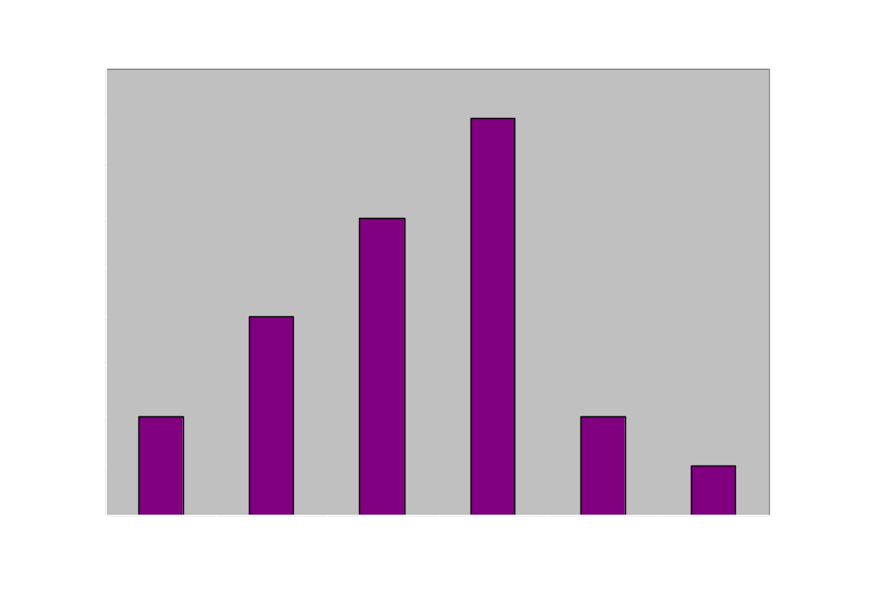
VHA Seroprevalence Exceeds CDC Threshold
CDC
Notes:
QUERI HIV is obviously interested in increasing HIV testing of veterans, which has been low historically. We use a variety of data to provide evidence to stakeholders that HIV seroprevalence is high in the VA, which warrants increased testing efforts.
Our work has also shown that the VA general medical population does indeed have high rates of HIV seroprevalence. For example, one piece of evidence we hae used in the past is a study by Doug Owens, a QUERI-affiliated researcher at the Palo Alto VA. He conducted a blinded serological survey at 6 VA sites which showed an infection rate to be on average 3.7%.
All sites were at or above the CDC 1% testing threshold shown as the red line on this slide.

Slide 5
Motivation behind
Increasing HIV Testing
The VA has high HIV prevalence;
HIV is easier and cheaper to treat if detected early;
Screening improves health at far less cost than other tests;
The VA is falling far short of testing those at risk.
Notes:
In terms of our goal to increase HIV testing within the VA, our main message is condensed into 4 salient points:
The VA has high HIV prevalence;
HIV is easier and cheaper to treat if it is detected earlier rather than later when a person’s immune system has incurred irreversible damage;
Screening patients improves health at far less cost than other kinds of care the VA already supports;
The VA is falling far short of testing people who are at risk of contracting HIV.

Slide 6
Making the Case within VA
National
Quality Enhancement Research Initiative (QUERI)
Public Health Strategic Healthcare Workgroup (13B)
Regional
VISN Director/ VISN Quality Manager
Clinical Practice Council
Quality and Performance Improvement Council
Local
Medical Executive Committee (MEC)
Primary care clinic directors
Provider groups
Notes:
Now we had to make our case. We found that there were many different stakeholders at various level in the VA. Each of them had there own specific concerns:
The first was making the case at the national level. As you know, all QUERIs have a centralized national management. We had to convince our QUERI managers that screening was important and cost effective and that our proposed interventions had evidence behind them.
In addition, we had to convince PHSHG, which is the QI arm within VA. They were already convinced of the need for screening, but we had to convince them that we would be an effective ally.
Regionally, we made visits to our VISN Director as well as our Clinical Practice Council which is made up of nurse and physician managers, who set clinical policies for the VISN.
Locally, we also have had to present our case to our local Medical Executive Committee, and primary care clinic directors and provider groups who all had the same concerns: Namely, how will our busy clinicians be able to take the time to do the required counseling that goes with HIV testing?

Slide 7
The Question
“You’ve given us a strong rationale for long-term benefits of earlier identification, but what is the short term impact of increasing screening and an acute influx of HIV patients on the system?”
or
“Where is it coming out of my budget when?”
Notes:
At all levels, we were surprised at how easy it was to make the case for the effectiveness of screening. Most groups seemed to agree that it would be cost-effective to screen in the long run.
But what they were really concerned about was the impact this quarter or next, on how much primary care time they would need to conduct the screening, how many more docs would they need to care for newly identified HIV patients, how much more would they have to budget for HIV drugs? Really the main question was…
Where is it coming out of my budget when?

Slide 8
Business Case Modeling
Proposal justifying cost-benefit action
Prerequisite for beginning large projects
Contains issues such as project relevance, benefits, costs, and risks
Typically reviewed at initiation and throughout
Notes:
This brings us to the Business Case.
A business case is a structured proposal that justifies an action regarding costs and benefits.
It is typically a prerequisite for the initiation of a large project.
The business case addresses the need that a given project seeks to resolve and includes such issues as project relevance, as well as expected benefits, costs and risk.
A business case is typically reviewed at initiation and can also be reviewed periodically during each stage to ensure continued relevancy , cost-effectiveness, etc.

Slide 9
Business Case Modeling (cont’d)
Data-driven models for making managerial or technical decisions
Valuable tool for program managers although vastly underused
Used by Dept of Defense
Notes:
It is a mathematical method for constructing data-driven models that forecast costs under varying specified conditions that support managerial or technical decision making.
Business Case models are valuable tools for program managers although this approach has not been as widely used in the public sector as it should. One exception is the Pentagon.

Slide 10
Process Map Method
  Flowchart approach
  MS Excel-based
  Top-to-bottom and quarter-to-quarter
  Links rates/costs over time
  Evaluated 1st year org. costs associated with two scenarios ⁭ screening from:
    0 to 5%
    0 to 10%
Notes:
The approach starts with a process map, a type of flowchart approach that logically orders inputs and processes to produce outputs.
We used an MS Excel-based spreadsheet to construct our process map
It is a top down, and quarter-to-quarter sequencing of organizational estimates
We used the model to estimate the 1st year costs in these specific categories under two scenarios,
Increasing screening from 0 to 5% and from 0 to 10%.

Slide 11
Process Map Entry Points
Initial enrollment estimates based on past enrollment patterns (20,000 unique patients annually),
Estimates of patients previously tested (20%)
Estimates of all tests resulting in new HIV infections (.45%)
The clinical settings at which these patients were cared for
Estimated % based on CD4 count at time of entry into care
Estimates of patient flow in and out of these three CD4 marker states
Estimates of patient mortality
Estimates of per-patient and infrastructure costs associated with newly identified HIV-positive patients
Notes:
Basically, the entry points are:
Initial starting enrollment estimates based on past enrollment patterns at our VA site (20,000 unique patients annually),
Estimates of percentages of patients who had previously been tested for HIV (20%),
Estimates of percentages of all tests that would result in a new HIV infections;
The clinical settings at which these patients were cared for
estimated proportions based on one’s CD4 count at time of entry into the VA system.
Estimates of patient flow in and out of these three CD4 marker states.
We also estimated patient mortality
Finally, we also estimated the per-patient and infrastructure costs associated with newly identified HIV-positive patients

Slide 12
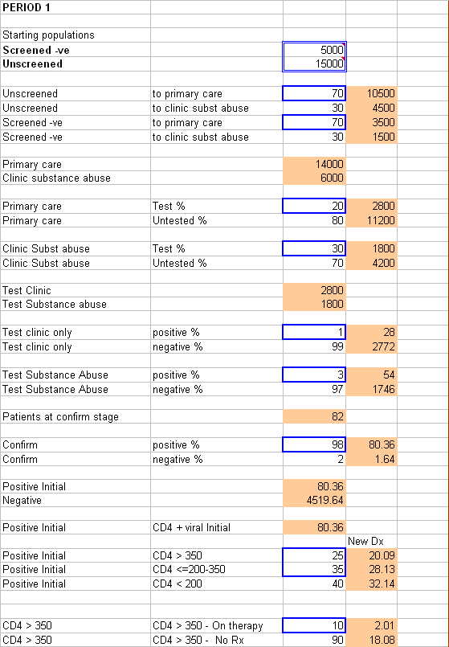
Excel Inputs
Notes:
This is a screenshot of our Excel model. It can be thought of as a top down and quarter-to-quarter flowchart of sorts with calculations embedded into each cell.

Slide 13
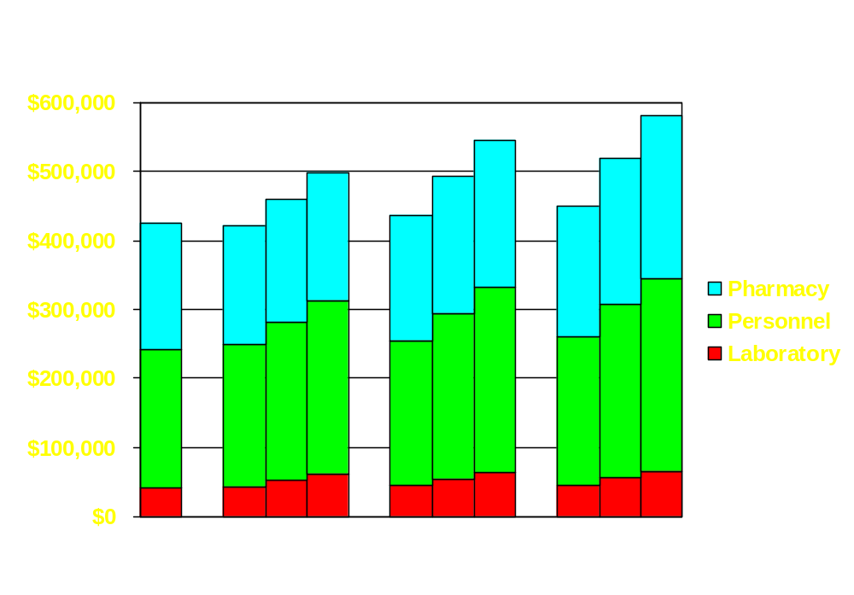
Direct Quarterly Costs of Expanded HIV Testing Baseline vs. 0%, 5% or 10% Increase (0.45% Pos. Tests)
Notes:
After all the estimates are entered, a final cost result is calculated. Ours were based on three main cost-points. Pharmacy, Personnel and Laboratory costs.
As you can see here, lab costs do go up, but don’t change much on a quarter to quarter basis.
The same can be said for personnel costs, in green. They do go up as screening increases, but stabilize over time.
The costs that do go up dramatically over time are pharmacy costs, which makes sense, in that as you increase screening rates and identify more HIV positive people, there will be more pharmacy costs associated with their care over time.

Slide 14
Implications
BCM effective, powerful, simple
Cost-modeling has implications for org. impacts
Models are highly flexible
Stakeholders should consider BCM
Notes:
That concludes my brief remarks. I’d like to close by saying that business case modeling is an effective, powerful (and potentially simple) method for analyzing effects of contemporaneous policy decisions on future organizational impacts, fiscal and otherwise.
The effectiveness of cost modeling has important implications for organizational impacts associated with changes in care delivery.
These models can be tailored to be highly flexible and can be used to estimate the short and long-term objectives of both an individual facility or large healthcare organization.
Stakeholders and facility/organizational managers should consider the use of capacity planning models of this sort to extrapolate future costs based on current actions.
Thank you very much.

