Slide 1

Understanding Risk Perception’s Role in the Four Phases of Emergency Management
FEMA
10th Annual All-Hazards Emergency Management Higher Education Conference
June 4-7, 2007
Emergency Management Institute
Emmitsburg, MD

Slide 2
What is Risk?
Multiple Definitions and Multiple Measures of Assessing Risk
(Probability of an Accident) X (Losses per Accident)
R=P (of the Event) X C (Consequences)
Risk = Hazard + Outrage
Case Fatality Rates v. Incidence Rates
The Great Debate: Quantitative v. Qualitative
Objective v. Subjective

Slide 3
Risk Perception
Psychometric Model
Subjective Experience
Socially Constructed
Expert/Lay Evaluations

Slide 4
What are…
The most dangerous occupations?
The most deadly diseases?
The most likely criminal threats?
The most dangerous disasters and/or emergencies?

Slide 5
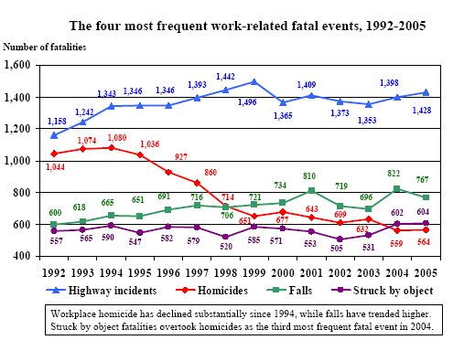
Reconciling Fact and Perception
Most Frequent Work-Related Fatalities. Source: U.S. Department of Labor, Bureau of Labor Statistics, Census of Fatal Occupational Injuries (2005)

Slide 6
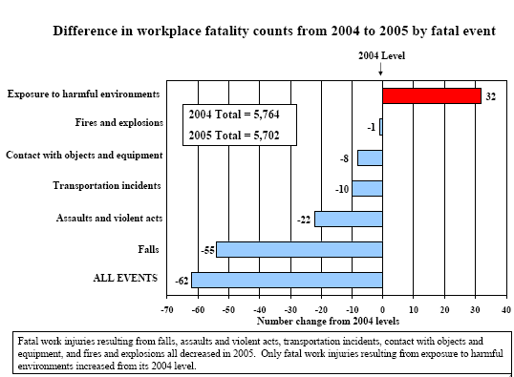
Fact v. Fiction
Difference in Workplace Fatality Counts. Source: U.S. Department of Labor, Bureau of Labor Statistics, Census of Fatal Occupational Injuries (2005)

Slide 7
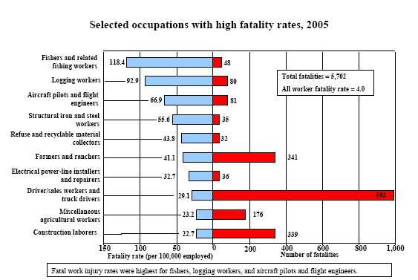
Fatality Rates by Occupation
Fatality Rates by Occupation. Source: U.S. Department of Labor, Bureau of Labor Statistics, Census of Fatal Occupational Injuries (2005)

Slide 8
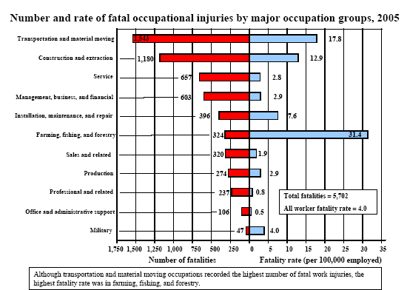
The Numbers Game
Number and Rate of Fatal Occupational Injuries. Source: U.S. Department of Labor, Bureau of Labor Statistics, Census of Fatal Occupational Injuries (2005)

Slide 9
The Subjective Experience and Risk
Outrage Factor | More Accepted Risks | Less Accepted Risks
Voluntariness | Voluntary | Imposed
Controllability | Under an Individual’s Control | Controlled by Others
Benefits | Clear Benefits | Little or No Benefit
Equity | Distributed Fairly | Distributed Unfairly
Natural v. Human Origin | Natural | Human Caused
Catastrophic Potential | Random, Scattered Effects | Fatalities/Injuries Centralized
Trust in Source | Generated by a Trusted Source | Generated by Distrusted Source
Familiarity | Familiar | Exotic
Age of Victims | Affects Adults | Affects Children
Understanding | Self-Explanatory | Poorly Understood
Uncertainty | Relatively Known to Science | Relatively Unknown/Uncertain
Dread | Little or no Fear, Terror, Anxiety | Evokes Fear, Terror, Anxiety
Reversibility | Reversible Adverse Effects | Potentially Irreversible
Personal Stake | No Direct Personal Threat | Places People Directly at Risk
Victim Identity | Produces Statistical Victims | Produces Identifiable Victims
Ethical/Moral Nature | Not Perceived to be Immoral | Ethically Objectionable
Subjective Factors that Influence Risk Perception. Source: Northwest Center for Public Health (2007)

Slide 10
Quantifying Perceived Risk: Expert v. Layperson Perception
Risk of Death | Layperson | Expert
Nuclear Power | 1 | 20
Smoking | 4 | 1
X-Rays | 22 | 7
Electric Power | 18 | 9
Police Work | 8 | 17
Alcohol | 6 | 3
Mountain Climbing | 15 | 29
Adapted from Ordering of Perceived Risk for 20 Activities and Technologies. Source: Fischhoff, Slovic, Lichtenstein, Read et al (1979)

Slide 11
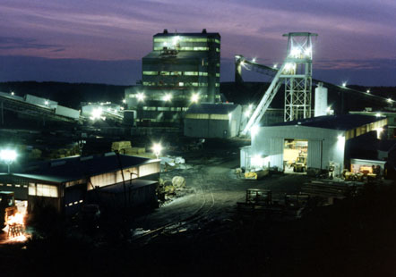
Risk Perceptions, Consequences, and Communication: the Explosion at JWR, Inc.’s No. 5 Mine
September 23, 2001
Brookwood, Alabama

Slide 12
Background
Mine No. 5 and JWR, Inc.
Mine No. 5 is the deepest vertical shaft in North America
2,140 feet deep
Over 9 miles long
Runs along the Blue Creek coal seam
Opened in 1979, closed in 2006
Considered one of the most “gassy” mines in the U.S.
Owned and operated by Jim Walters Resources, Inc.
Company has annual payroll >100 million dollars, employs >1400, and produces 7 million tons of coal each year

Slide 13
The Accident
Sunday, September 23, 2001
Idle maintenance day
Less than 10% of the normal workforce was working the 3-11 shift (32 workers in the mine)
Miners working in unfamiliar areas of the mine
Accident occurred during “normal” cribbing activities
Components of a normal accident led to a double explosion

Slide 14
The First Explosion
Roof collapses in section 4, onto a scoop battery (5:10 P.M.)
Shortly thereafter, the arching battery ignited a large amount of methane gas, causing an explosion (5:20 P.M.)
No one killed during this explosion
Three miners sustained minor or moderate injuries and one miner was seriously injured
Human error, lack of communication, and operator failure (JWR’s) contributed to a second more powerful explosion

Slide 15
Communication
Miner involved in first explosion contacted the control office (CO) within ten minutes of the explosion and advised:
that there had been an explosion
section 4 was damaged
there was a large amount of gas/dust present
one man was badly injured
that all electrical currents should be turned off

Slide 16
Lack of Communication
CO contacted 911, supervisors, and Lifeflight, but lost contact with miners
Asked a supervisor at the other end of the shaft (40 minutes away) to investigate
Did not issue a mine-wide evacuation or indicate to the 28 other miners in the mine that they were in imminent danger

Slide 17
Best Intentions
After the first explosion, with limited knowledge of what occurred and little guidance from the command office, 12 miners who were in unaffected areas of the mine rushed to the aid of the sole injured miner remaining in section 4

Slide 18
The Second Explosion
Occurred nearly an hour after the first (6:15 P.M.)
An energized track haulage block light system ignited the second explosion
Second explosion fueled in part by the large amount of methane gas released during the roof collapse and first explosion

Slide 19
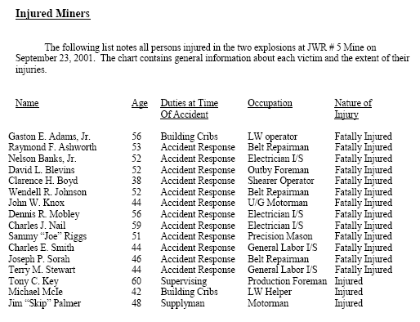
The Aftermath
List of Injured Miners. Source: United Mine Workers of America (2002)

Slide 20
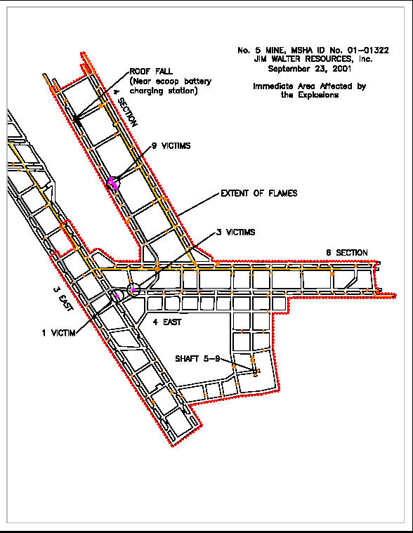
The Aftermath
Area Affected by Explosions. Source: United States Mine Rescue Association ( 2002)

Slide 21
Two Versions of Cause and Blame
UMWA
A failure to adequately control the mine roof
A failure to have the mine properly examined for hazards
A failure to properly vent the mine
A failure of the mine operator to comply with the Mine Act and a failure of the MSHA to effectively enforce the Mine Act
UMWA’s Accident Findings. Source: UMWA’s Report on JWR’s No. 5 Mine Accident (2002)

Slide 22
Two Versions of Cause and Blame
MHSA
Failure of JWR to:
Determine the seriousness of the roof conditions at Section 4
Failure to contain rock dust
Failure to adequately inspect mine
Failure to initiate a mine-wide evacuation
Failure to de-energize all electrical circuits entering Section 4
MSHA Accident Findings. Source: John R. Correll, Deputy Assistant Secretary, MHSA (2002)

Slide 23
Fall Out
Internal investigation of MHSA District 11
Emergency Temporary Standard issued nationwide on December 12, 2002
Nearly $500,000 in fines levied by MHSA at JWR, Inc.
Multiple lawsuits on behalf of decedent’s family members— settled out of court in 2005
Mine closure in December, 2006

Slide 24
Emergency Temporary Standard
Requires that a designated responsible person take charge in any mine emergency and evacuate the mine if there is imminent danger to the miners
Only properly trained and equipped persons essential to respond to the emergency may remain underground

Slide 25
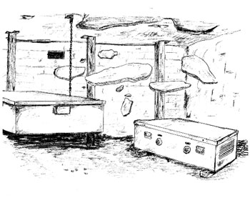
FATALGRAM
Best Practices
Always ensure that the roof and ribs are stable at electrical installations.
Ensure that stoppings are well constructed and maintained.
Ensure that roof and ribs are closely evaluated during the required examinations and always be aware of changing conditions.
Fatalgram, JWR Inc.’s No. 5 Mining Accident. Source: MSHA (2002)

Slide 26
What Does this Mean for Emergency Management?
Understanding risk perception helps the EM understand public priorities
The EM becomes cognizant of how risk perception impacts behavior
The EM better understands risk amplification and attenuation
Understanding risk perception is important when developing appropriate education and communication strategies
Risk Perception and Emergency Management. Source: Adapted from Clinton Jenkin’s Risk Perception and Terrorism: Applying the Psychometric Paradigm (2006)

Slide 27
What Does this Mean for Higher Education?
Additions to Curriculum:
Social Psychology
Communication
Epidemiology
Occupational Health and Safety

Slide 28
Communicating Risk
Know Your Audience
Don’t be Afraid to Frighten People
Acknowledge Uncertainty
Share Dilemmas
Give People Things to Do
Speculate — Responsibly
Stress Magnitude Rather than Probability
Release Messages Early and with Candor
Guide Adjustment Reaction — “New Normal”
Communicating Risk. Source: Perspectives in Health Magazine (PAHO), Peter Sandman and Jody Lanard (2005)

Slide 29

Questions? Comments?

Slide 30
References
Jenkin, C. (2006) Risk Perception and Terrorism: Applying the Psychometric Paradigm. Homeland Security Affairs. 2 (2). 1-12. Retrieved March 1, 2007, from http://www.hsaj.org/?fullarticle=2.2.6.
Northwest Center for Public Health. (2007) Risk Communication. Retrieved April 20, 2007, from
http://www.nwcphp.org/riskcomm/intro_erc/resources/ofactor.html
Sandman, P.M., & Lanard, J. (2005). Bird Flu: Communicating the Risks. Perspectives in Health, 10 (2), 2-9.
Slovic, P., Fischhoff, B. & Lichtenstein, S. (1979). Rating the Risks. Environment 2 (3). 14-20. Revised in Slovic, P. (ed). (2000). The Perception of Risk. Sterling, VA: Earthscan.
United States Department of Labor, Bureau of Labor Statistics. (2005). Census of Fatal Occupational Injuries Charts 1992-2005. Retrieved
May 1, 2007, from http://www.bls.gov/iif/oshcfoi1.htm#charts
United States Department of Labor, Mine Safety and Health Administration. (2002, December 11). DOL News Release, USDL (02-689). Retrieved March 2, 2007, from http://www.msha.gov/MEDIA/PRESS/2002/NR021211, HTM
United States Department of Labor, Mine Safety and Health Administration. (2002, December 11). Report of Investigation: Fatal Underground Coal Mine Explosion September 23, 2001. Retrieved February 27, 2007, from http: www.msha.gov/fatals/2001/jwr5/ft101c2032light.pdf
United States Department of Labor, Mine Safety and Health Administration. (2003, January 24). Internal Review of MSHA’s Actions at the No. 5 Mine Jim Walter Resources, Inc. Brookwood, Tuscaloosa County, Alabama. Retrieved February 28, 2007, from http: www.msha.gov/MEDIA/PRESS/2003/MSHA-IR-JWR5.pdf
United States Mine Rescue Association (n.d.). Death Underground. Retrieved February 26, 2007, from http:// www.msha.gov/REGS/FEDREG/FINAL/2002finl/02-31358.htm
United Mine Workers of America, Department of Occupational Health and Safety (n.d.). Jim Walter Resources #5 Coal Mine Disaster: September 23, 1001. Retrieved march 1, 2007, from http://www.umwa.org/brookwood/UMWA_JWR_Report.pdf

