Slide 1
Cognitive Rehabilitation and Driving
Karlene Ball
University of Alabama at Birmingham

Slide 2
Cognitive Decline
The possibility of cognitive decline is one of the greatest fears that people have as they age. Such fears understandably prompt questions about whether such declines are inevitable and what can be done to prevent or even reverse such declines.

Slide 3
Mental Decline is not a given
Research over the past two decades suggests that mental decline is not an inevitable aspect of growing older. In fact, sustaining cognitive activity may be one of the keys to how well we age.

Slide 4
Protecting against decline
Stay physically active
Remain socially active
Practice daily stress reduction
Seek help if suffering from depression
Get plenty of sleep
Practice good nutrition

Slide 5
Protecting against decline
Keep challenging yourself
  Crossword puzzles
  Playing cards, chess, checkers
  Visiting museums
  Playing a musical instrument
  Learning a foreign language
  Reading regularly

Slide 6
Link between cognitive function and mobility
What is the impact of cognitive function and cognitive decline on everyday activities that require adequate mobility (e.g., driving)?

Slide 7
Roybal Center
Predictions of driving competence, driving habits, and other markers of mobility
Impact of medical, educational and cognitive interventions on driving competence, mobility, and other everyday activities

Slide 8
ACTIVE Clinical Trial
Advanced Cognitive Training for Independent and Vital Elderly
Primary aim was to test the effectiveness and durability of three cognitive interventions in improving the performance of elderly persons on basic measures of cognition and on measures of cognitively demanding daily activities.
Notes:
Extends prior laboratory-based research showing that cognitive training improved the targeted cognitive ability.
Limited evidence to suggest transfer from the targeted cognitive ability to cognitive demanding ADL’s

Slide 9
Multi-Site Clinical Trial
Six Field Sites:
University of Alabama at Birmingham
Hebrew Rehabilitation Center for the Aged
Indiana University School of Medicine
Johns Hopkins University
Pennsylvania State University
University of Florida/Wayne State University
Coordinating Center:
New England Research Institutes
Notes:
Representing the ACTIVE SC
6 field Sites
Coordinating Center
Project Offices at NIA and NINR

Slide 10
Interventions
Three cognitive training interventions:
        Speed of Processing
        Reasoning
        Memory
Notes:
Briefly describe each intervention.

Slide 11
Initial Training Effects
Each intervention reliably improved the targeted cognitive ability at post test in:
  87% of Speed of Processing trained
  74% of Reasoning trained
  26% of Memory trained

Slide 12
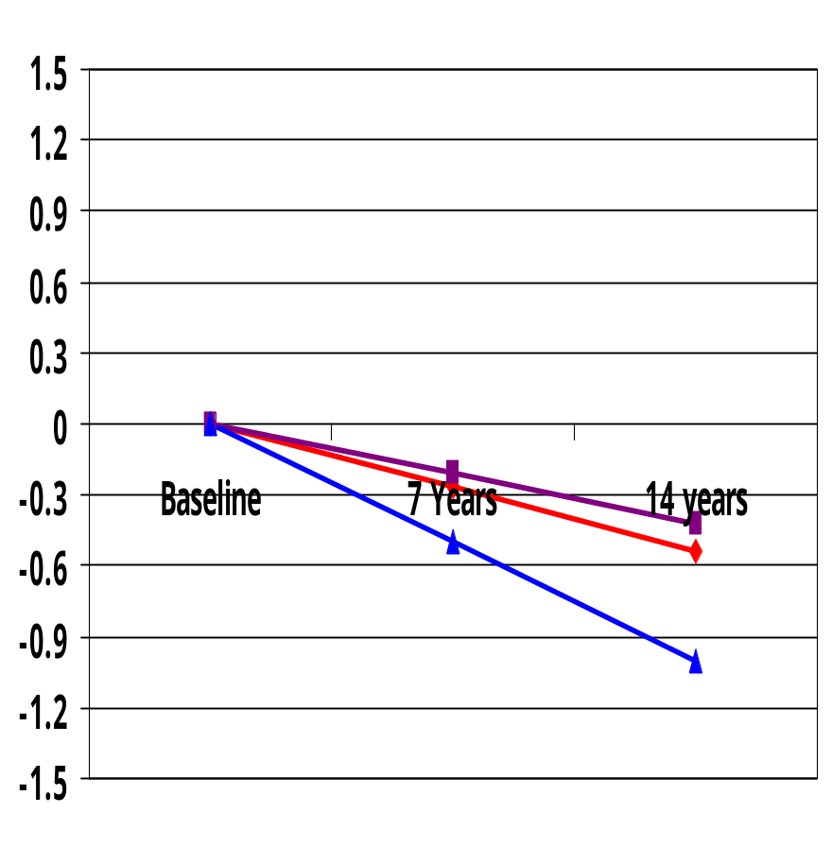
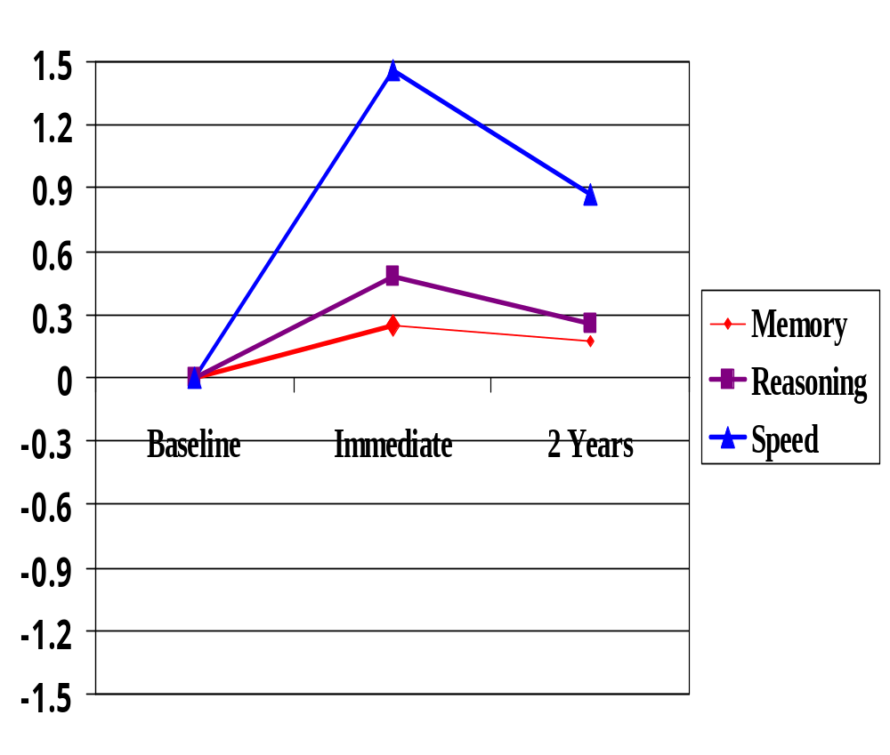
Primary Result
Expected Decline
Training Gains

Slide 13
Significance
Cognitive interventions helped normal elderly persons perform better on multiple measures of the specific cognitive ability for which they were trained.
Training gains were comparable to, or greater than, the amount of decline that has been reported in previous studies over a 7 - 14 year period among older adults without dementia.

Slide 14
Improved Driving Performance
We are currently collecting accident records for the ACTIVE participants to evaluate the impact of training on driving performance over the subsequent five year period.

Slide 15
Additional Training Studies
Speed of Processing training has been shown in several studies to result in:
  Fewer dangerous maneuvers while driving
  Improved hazard detection in simulations
  Faster reaction times to road signs
  Increased mobility

Slide 16
Design
Speed of Processing Training
Pre -Test
Battery
Immediate
Post-Test
18 month
Follow-up
Simulator Training
Reference Control Group
No Training

Slide 17
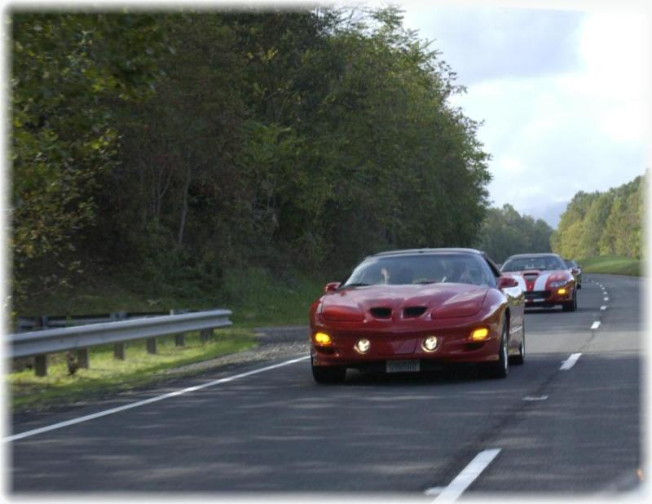
Driving Evaluation
One mile warm up
Two loops of 7 mile course
Overall Rating by Driving Instructor
455 item checklist completed by 2 backseat evaluators

Slide 18
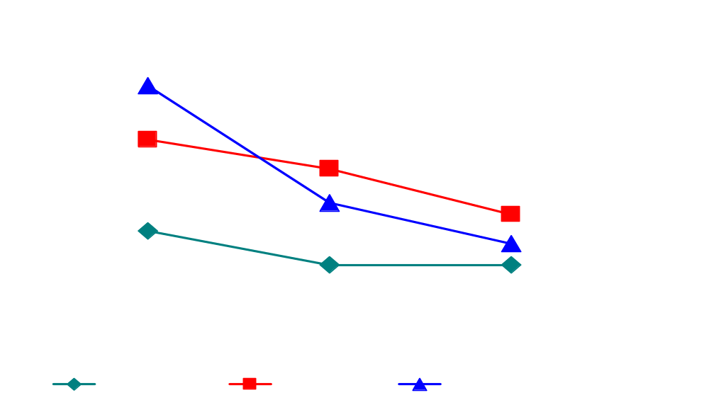
Response Time (Simulator)

Slide 19
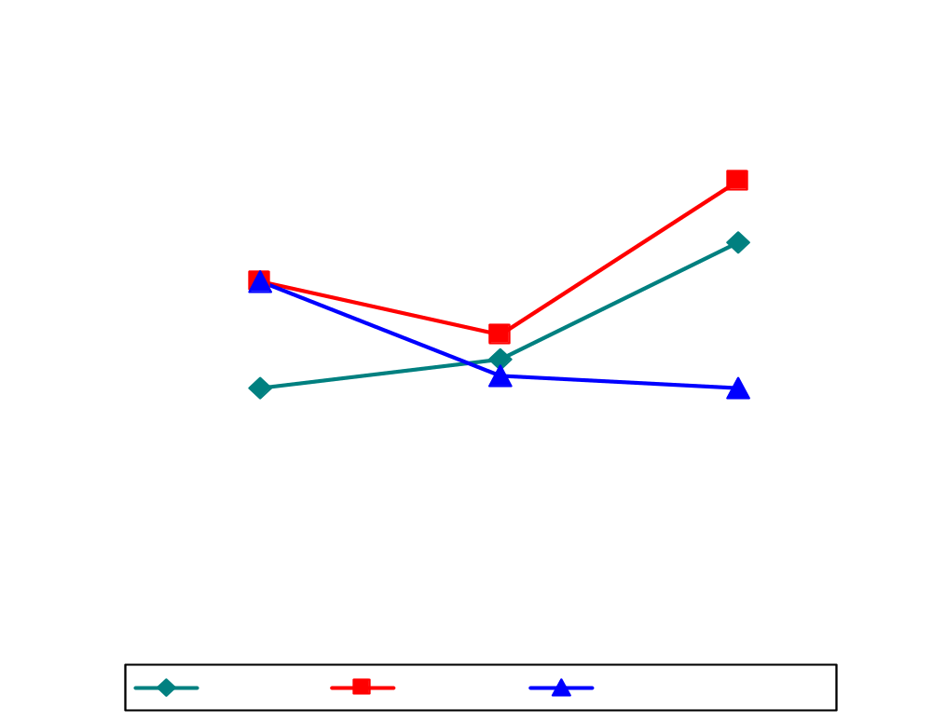
Results Driving -
Dangerous Maneuvers

Slide 20
Conclusions
Speed of Processing training resulted in:
  Faster Response Time in a driving simulator
  Fewer Dangerous Maneuvers on the road
  Maintenance of improvements for up to 18 months
Simulator Training resulted in:
  Short term improved performance on skills trained (e.g., signal use, turn positioning)
  Effects had largely dissipated by 18 months

Slide 21
Driving Cessation
Ceasing to drive is a very negative outcome for many older adults – frequently leading to depression and reducing quality of life.
In a large sample of licensed drivers in Maryland, we found that half of the drivers who quit driving over a five year period showed evidence of cognitive decline.
In fact, cognitive impairments were more likely to lead to driving cessation than crash involvement.

Slide 22
Mobility
Several studies have found that speed of processing training extends the safe driving period for older adults.

Slide 23
Conclusions
Collectively these findings suggest a program of early detection and rehabilitation for age-related cognitive decline. Such a program would help to sustain independent safe mobility in older adults with associated benefits to quality of life.

Slide 24
Needs
Education – Older individuals should be made aware of potential age-related changes.
Identification – Only a small subset of older drivers are impaired, and identification of this subset is feasible.
Rehabilitation – In many cases training may help to sustain or improve the cognitive abilities needed to drive safely.

