Slide 1
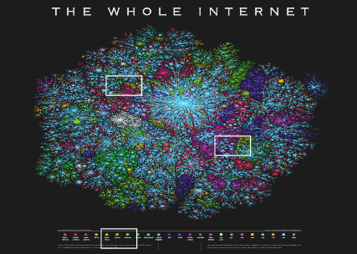
Wanted: a National Information Strategy for the Interconnected Age
Dr Dan Kuehl “kuehld@ndu.edu”
Information Resources Management College
National Defense University
“My Opinions…not the USG/DOD/NDU”

Slide 2
Thesis #1
“the battlespace”
Information
  Weapon - Tool - Process – Target ?
    more than aid to “Blast - Heat - Fragmentation”
        LTG Mike Hayden, DirNSA
Synergy
  human factors + information technology
Information is now…
  element of national power
  operational environment/”battlespace”

Slide 3
Thesis #2
“the threat”
Modern societies are increasingly vulnerable
  Technologically/Economically
    Infrastructures
      telecommunications, energy, transportation, etc
  Socially/Politically
    Perception management, politics
      “CNN Effect”, “strategic influence”, Al Jazeera, etc
Employment/Protection requires BOTH technological capability AND political will

Slide 4
Thesis #3
“the partnership”
The Department of Defense (or MOD), Federal Government, and the private sector share
  Roles
  Responsibilities
  Capabilities
In protecting, leveraging, exploiting:
“national cyberspace” & information power

Slide 5
4 Fundamental Changes
New Geostrategic Context
  Cyberspace: new operational realm/battlespace
    Dominant in business, politics, warfare
  Convergence
    Digital: 1110101110001010 = lingua franca
    Information mediums (radio, TV, phone, etc)
  Global Omnilinking
    Electronic digital connectivity of people, organizations, governments…globally & instantly
  Critical Infrastructure Protection
    Opportunity….and vulnerability
    Critical to advanced societies, but public/private links poorly understood
      Roles and missions; what does “interagency” mean?

Slide 6
What it Adds Up To
Global Economy
  Dependent on interlinked networks
  Information as critical as energy and capital
Global Audience
  Real-time 24-hour cycle
  Waning controllability of information
Global Society
  Contact anyone, anywhere, anytime
Strategic Impact: Diplomatic, Economic, Military

Slide 7
Information & National Power
The information component
    “Use of information content and technology as strategic instruments to shape fundamental political, economic, military and cultural forces on a long-term basis to affect the global behavior of governments, supra-governmental organizations, and societies to support national security”
        Drs Dan Kuehl/Bob Neilson, Georgetown’s NSSQ 1999
        President Ronald Reagan:
        NSDD 130 (1984)
        National Security Strategy (1987)
Notes:
I did not invent this, although I and a colleague from my college published it two years ago, in Georgetown University’s journal National Security Studies Quarterly, which you can access on the World Wide Web at their website.
This is based on US strategic policy and national security directives from the 1980s, from the administration of President Reagan.
Key points:
Information content as well as technology are strategic instruments, used globally, to improve our national security.

Slide 8
Information Environment
Physical: “Ether”/Cyberspace/”eSpace”
  Realm of electronic connectivity
  Physical space
    Future: increasingly dominant
      business/economics, politics, warfare
Contextual: “influence/perception space”
    “Cognitive Space”
  analogy: “political/economic environments”
    Example: Serbian TV vs NATO cohesion 1999
  If you lose the battle here, winning the other may not matter: see Mogadishu, 1993
Notes:
The Information environment is both a physical place and a context.
The physical place is cyberspace. I define cyberspace as the electronic realm in which global connectivity exists, and in which computer networks function. For those of us who are soldiers or airmen, its also where electronic warfare is waged. It is becoming increasingly dominant in business, economics, politics, and warfare.
The information environment is also context, in HOW humans use and are affected by information. Does anyone not understand the question “what’s the political environment?” You cannot locate it physically, but it’s real! How do human beings use what I call the “wetware”…we have hardware, software, and “wetware”…that’s the part between our ears… how do we apply meaning to the information?

Slide 9
IO Roadmap
SecDef 30 October 2003
IO as a core military competency, on par with air-ground-maritime-special ops
  We must dominate the information spectrum
Core capabilities
  EW, CNO, Psyop, Military Deception, Opsec
  Why these five?
    Immediate operational impact
    Interdependent and require integration
    Organize-Train-Equip implications
Supporting/Related functions
  Physical attack and security, IA, Counter-Intel, Public Affairs, Civil-Military Ops

Slide 10
Paradigm Kuehl
National Information Power
  -- Broadest range of military, governmental and civilian capabilities; exploit the global information environment & dominate strategic context
Information Operations
  -- Wide range of military and governmental operations to protect and/or exploit the environment
Information Warfare
  -- Military offensive & defensive actions to control/exploit the environment
C2W (information tech in war)
- - blast, heat, fragmentation
        Dan Kuehl, “Joint Information Warfare”
        NDU Press Strategic Forum #105 www.ndu.edu/inss

Slide 11
National Security Strategy
Last Clinton NSS, December 2000
3 Key pillars
  Critical Infrastructure Protection (CIP)
    Vital national interest, use force to defend
    “Partnership” of public-private sectors
  Information Warfare/Operations (IW/IO)
    Lead to Network Centric Ops -- Transformation?
  Public Diplomacy/International Public Information (PD/IPI)…..”Softpower”, “Information Engagement”
    “increasingly vital….transmit [our] message to people around the world” to “counter misinformation/incitement…mitigate conflict”

Slide 12
National Security Strategy
First Bush NSS, October 2002
“Infrastructure”, “Information Ops”
  1 reference to each
“Public Diplomacy/Information”
  3 references
No sense of information as power or environment: no sense of its impact
No coordination of Administration efforts
  Diplomatically, militarily, economically
    Kuehl/Neilson ”No Strategy for an Info Age” USNIP Sept 2003

Slide 13
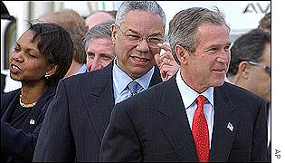
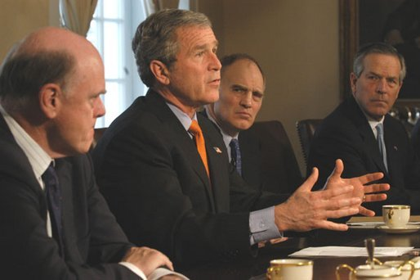
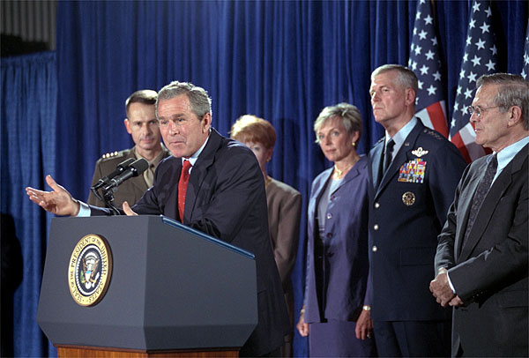
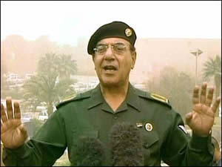
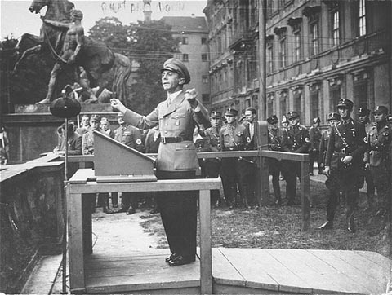
Information Power…
Who’s in Charge?
Diplomatic and Military…
Centralized and Hierarchical
Economic and Information…
Diffused and Shared

Slide 14
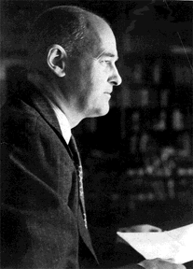
What’s Lacking
Who and Where do we go for the COGs of Information Power?
  National Information Council?
  Who would be on it?
What do need from them? What are we lacking?
  National Information Strategy
  Why don’t we have one?
  We need a strategic and conceptual foundation for how we can employ Information Power to support national security
The “Long
Telegram”
861.00/2 - 2246: Telegram
The Charge in the Soviet Union (
Kennan) to the Secretary of State
SECRET
Moscow, February 22, 1946--9 p.m. [Received February 22--3: 52 p.m.]
511. Answer to Dept's 284, Feb 3 [13] involves questions so intricate, so delicate, so strange to our form of thought, and so important to analysis of our international environment that I cannot compress answers into single brief message without yielding to what I feel would be dangerous degree of over-simplification. I hope, therefore, Dept will bear with me if I submit in answer to this question five parts, subjects of which will be roughly as follows:
(1) Basic features of post-war Soviet outlook.
(2) Background of this outlook
(3) Its projection in practical policy on official level.
(4) Its projection on unofficial level.
(5) Practical deductions from standpoint of US policy.

Slide 15
National Information Strategy (Suggested)
Build on ‘99/’00 National Security Strategies
Partnerships
  Need to build on PDD-63/HSPD-7 efforts…globally
Information Superiority
  New American Way of War; JV2010/2020
    Cyberspace and Information Operations…Net Centric Ops
The Economy
  IT’s decisive and dominant role…globally
Influence
  Internet and TV in “global cognitive battlespace”
  Essential operational medium for “War of Ideas”
        Dr Dan Kuehl, “Information Power & the National Security Strategy”, Cyberwar 3.0

Slide 16
What’s Needed
Information-age corollary to the “Long Telegram”
New strategy is not “Containment”…it’s CONNECTIVITY!
Free flows of information can enhance
  Democracy
  Human rights
  Economic development
  Peace

Slide 17
Conclusion
The information environment and element of power: critical to current/future military & national security strategy
Learn how to exploit and defend the information environment…or be defeated via it
National security in the Interconnected Age requires new alliances and partnerships
  In Defense, in the Government, in the World
At least the future won’t be dull and boring!

Slide 18
Q & A

