Slide 1
Otis W. Brawley M.D.
Director, Georgia Cancer Center
Associate Director, Winship Cancer Institute
Professor of Hematology, Oncology, and Epidemiology
Emory University
Atlanta, Georgia

Slide 2
“First get your facts, then you can distort them at your leisure.”
-Mark Twain

Slide 3
Race, Economics and Disparities in Health
The Meeting of Politics and Science:
Truth, Lies, and Superstitions

Slide 4
RACE MEDICINE
The concept that phenotypic racial differences mean biologic differences in disease. For example syphilis is a different disease in Negroes versus Whites.

Slide 5
“Those who do not appreciate history are destined to repeat it.”
Santiana

Slide 6
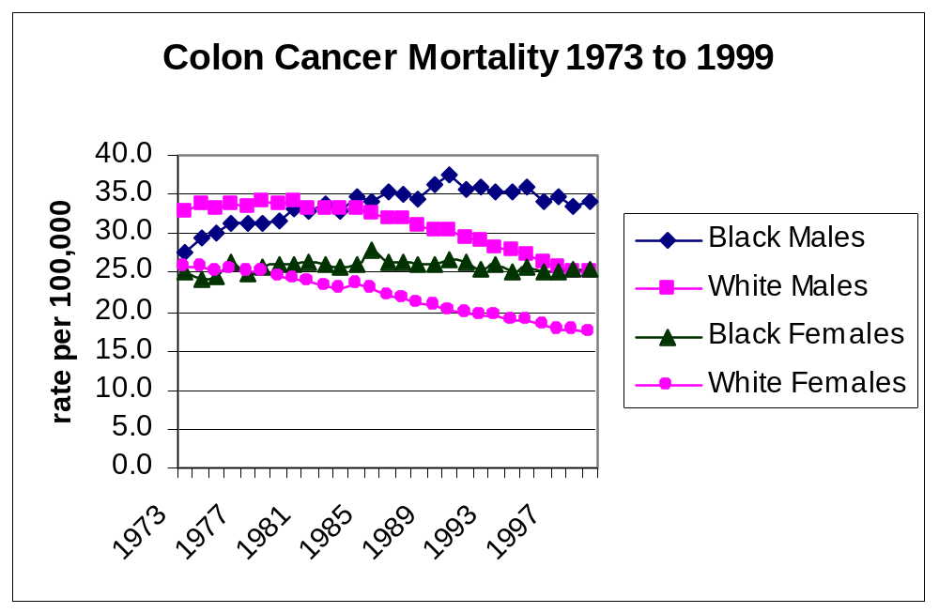

Slide 7
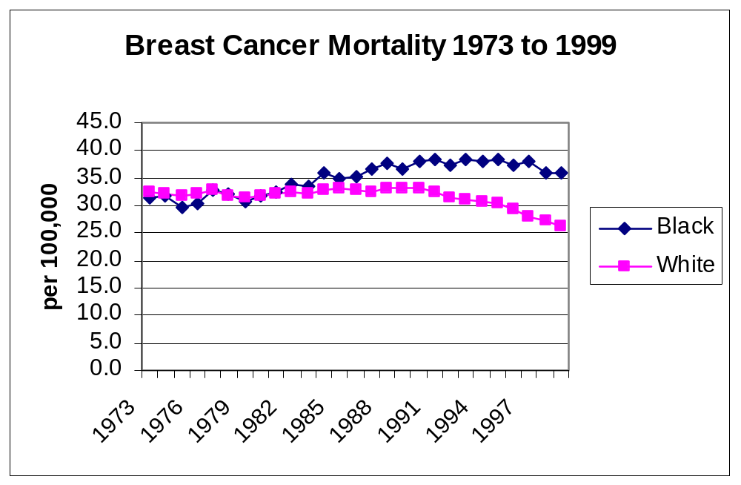

Slide 8
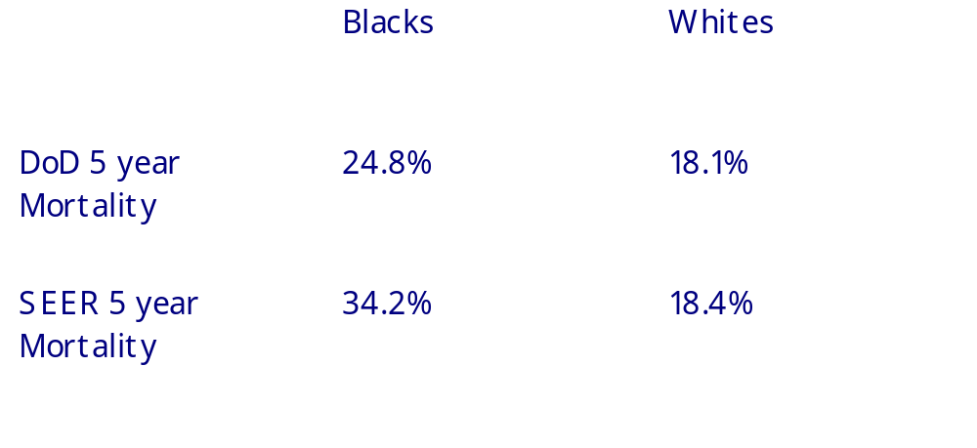
Breast Cancer Survival
The DoD Experience
Wojcik et al. Cancer 1998

Slide 9
Breast Cancer Survival
The DoD Experience
Suggests a benefit from fixing socially derived issues:
  the ready access to high quality medical care.
  the availability of a full complement of treatments (there was likely not full usage in the DoD studies.
  Wojck et al. Cancer 1998

Slide 10
Breast Cancer Survival
The DoD Experience
These observations suggest:
  The Black breast cancer mortality rate in the U.S. can be reduced.
  The 5 year mortality for Black women in the U.S. can be reduced by at least 60%.
  Wojck et al. Cancer 1998

Slide 11
Breast Cancer
The Reality
From 1993 to 1997, 561 Black women died of breast cancer in Atlanta.
If Atlanta’s Black population had the DOD Black rate 330 would have died (231 less)

Slide 12
Equal Treatment Yields Equal Outcome among Equal Patients in several case series
All show no B/W difference when adjusted for stage and SES
  The University of Chicago
    Heimann et al., J. Clin. Oncology, 1997
  M.D. Anderson Cancer Center
    Franzini et al., Ann. Surg.Oncol., 1997
  Henry Ford Hospital
    Yood et al., JNCI, 1999

Slide 13
Equal Treatment Yields Equal Outcome
In NSABP node negative breast cancer trials:
  The overall 5 year survival rate was 93% for Blacks and 92% for whites.
  5 year disease free survival rate was 81% for Blacks and 80% for whites.
  Dignam et al, Cancer 1997

Slide 14
How can we provide adequate high quality care to a population that has so often not received it?

Slide 15
The Meaning of Race in Science and Medicine
Differences in patterns of care by race documented in:
  Prostate Cancer
  Colon Cancer
  Breast Cancer
  Lung Cancer
The full reasons for the differences have yet to be explained

Slide 16

Equal Treatment Yields Equal Outcome
There is not Equal Treatment
Studies suggest that disparities may be due to:
  Cultural differences in acceptance of therapy.
  Disparities in comorbid diseases making aggressive therapy inappropriate.
  Lack of convenient access to therapy.
  Racism and SES discrimination.
This is still an active area of research.

Slide 17
Disparities in Breast Cancer Care
In an analysis of women in the SEER Black-White Study, 1985-1986:
  36% of women with late stage disease did not receive minimum expected therapy compared to four percent of the patients with early stage disease.
  21% of Black women did not receive minimum expected therapy compared to 15% of white women
  Breen et al, Ethnicity and Disease 1999

Slide 18
Disparities in Breast Cancer Care
  Older women and women with no usual source of care were significantly less likely to receive minimum expected therapy.
Breen et al, Ethnicity and Disease 1999

Slide 19


Slide 20
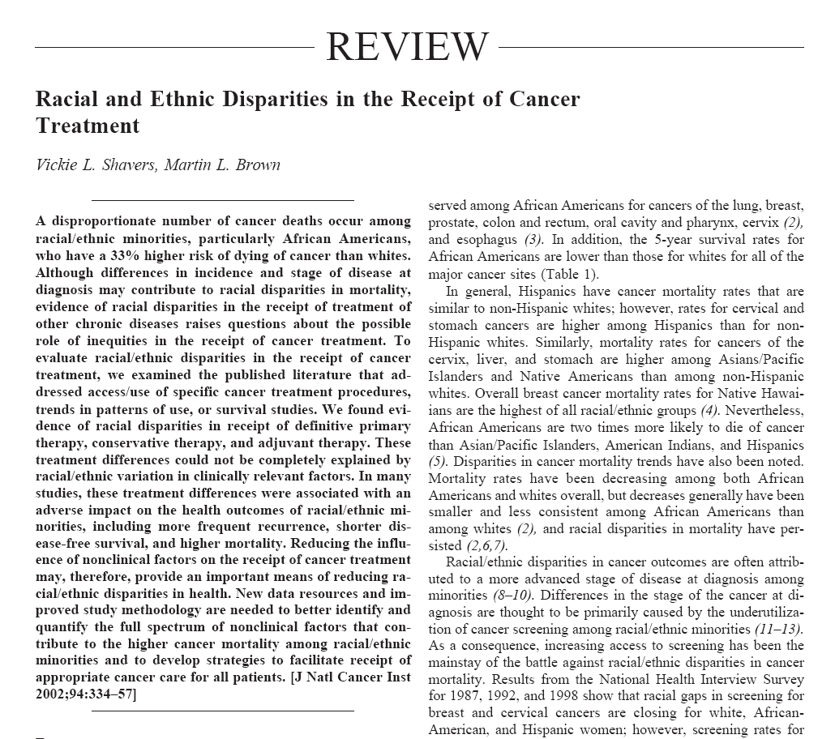

Slide 21

Defining Populations
What are the influences on population differences in disease causation?
  Extrinsic
    Social condition
    Culture
    Environment
  Intrinsic
    “Biologic” or “genetic”

Slide 22
Cancer and Population Science
Migration studies show the effects of extrinsic influences:
  Migration of Chinese and Japanese to America increase their incidence and mortality rates of colon, breast, and prostate cancer
  Europeans moving from eastern to western Europe increase their mortality rates in several cancers

Slide 23
Breast Cancer Pathology
Racial Issues
At diagnosis the Black population with breast cancer has disproportionately more:
  Advanced disease
  Higher grade tumors within stage
  Less ER + tumors
  Younger women (age 35 to 44)
  SEER data 1973 to 1997

Slide 24
Breast Cancer Pathology
Socioeconomic Issues
Lower SES white women present with disproportionately more:
  Advanced disease
  Higher grade tumors within stage
  Less ER+ tumors
  Younger women (age 35 to 44)
  Gordon Am.J.Epidemiol., 1995

Slide 25
Breast Cancer
Pathology and Stage
Social deprivation studies in Europe and U.S. suggest more virulent tumors in the poor.
Several studies suggest a correlation between higher body mass index and higher stage at presentation (higher BMI can be a cultural phenomenon).

Slide 26
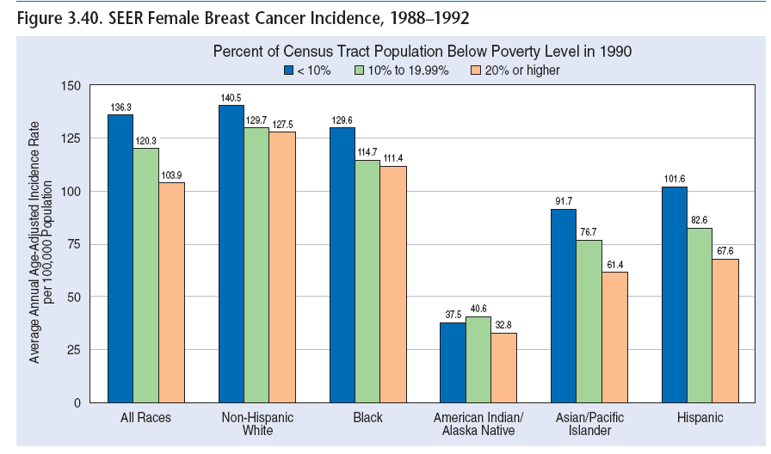

Slide 27
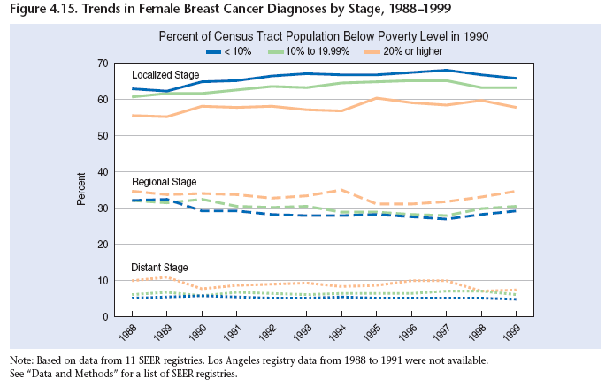

Slide 28
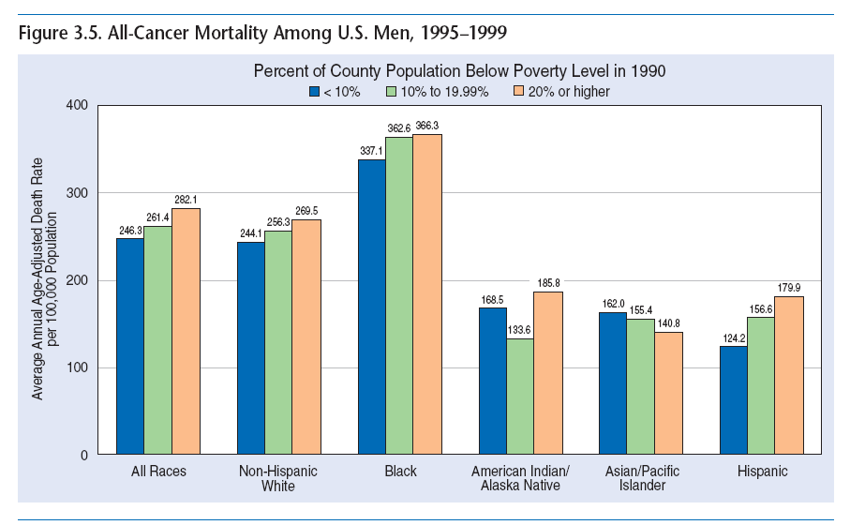

Slide 29
Cancer Disparities
Are we asking the right scientific questions?
Are we allowing certain questions to allow us to ignore other legitimate questions?

Slide 30
Conclusion
  Its bad to have cancer
  Its worse to have cancer and be poor
Important Questions?
  What are the elements of poverty that influence the experience of cancer and cancer biology?
  These are social science and epidemiologic questions and it is crucial that it be addressed if we are to decrease “health disparities”

Slide 31
How can we provide adequate high quality care to a population that has so often not received it?

Slide 32
Otis W. Brawley M.D.
Director, Georgia Cancer Center
Associate Director, Winship Cancer Institute
Professor of Hematology, Oncology, and Epidemiology
Emory University
Atlanta, Georgia

