Slide 1
JDO & ODBMS
Relevant Technologies
for Metadata Management

Slide 2
Agenda
Putting things in context
  A quick look at XMDR and ISO/IEC 11179-3 from a combined application + persistence perspective
Focus on JDO
  What it is and why it’s important
Thoughts about Metadata Persistence
  ODBMS is different
  Why that’s important for metadata management
Conclusion / Summary

Slide 3
ISO/IEC 11179-3: Metamodel Constructs & Terms
Association
Association Class
Attribute
Class
Composite Attribute
Composite Datatype
Generalization
Identifier (unique)
Relationship
Binding
Characteristic
Conceptual (aka Abstract) Data Model
Data Model
Entity
Object
…
These are all concepts that have direct applicability in the “object” world

Slide 4
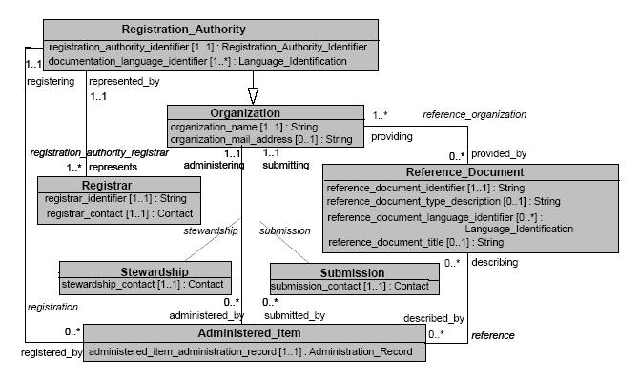
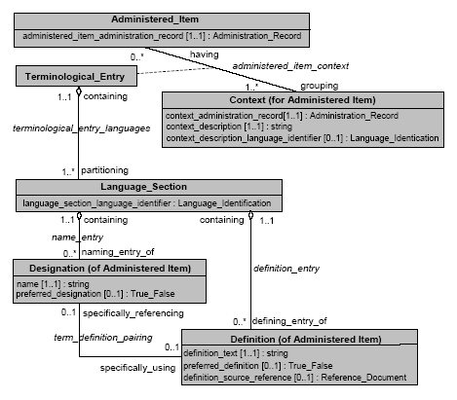
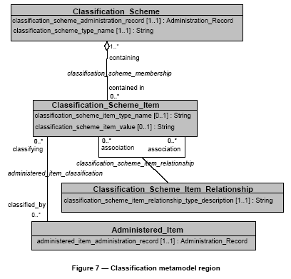
ISO/IEC 11179-3: Some Metamodels
Object-oriented
  Inheritance
  Lots of associations
Data complexity!

Slide 5
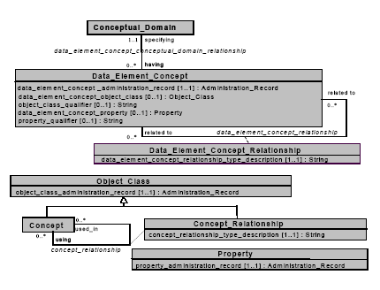
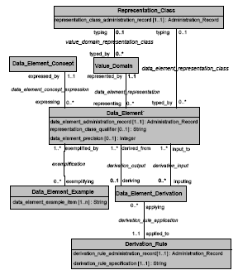
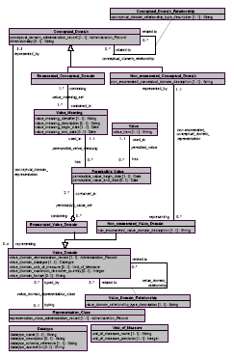
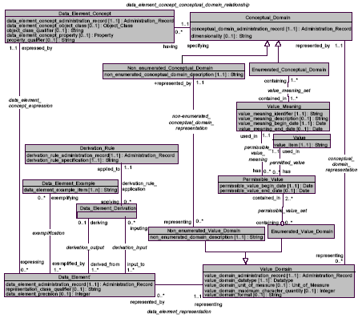
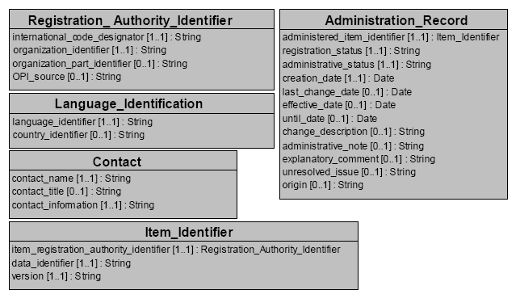
ISO/IEC 11179-3: And Still More!

Slide 6
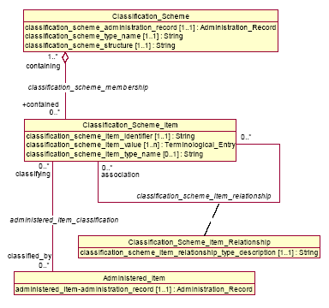
Metadata Content May Include …
Data Element Characterization
  definitions - natural language, logic-based
  types
  dimensionality / measurement units
Taxonomies (is-a relationships) - linguistic, biological, ...
Partonomies (part-of relationships) - geographic, organizational, anatomic, manufactured, ...
Code Sets - e.g., country codes, CAS numbers, airport codes
Terminologies - controlled vocabularies
Schemas - e.g., for databases, messages, file formats, etc.
Ontologies
Matchings, Mappings - across terminologies, schemas, ...

Slide 7
From a “Graph-Theoretic” Perspective …
Tree
  e.g., Dewey Decimal Classification
  an acyclic undirected graph
Faceted Classification
  e.g., LOINC, ...
Directed Acyclic Graph (DAG)
  e.g., instance-of relations
  also known as a acyclic digraph
Partial Order
  e.g., is-a, and part-of relations
  Partial order = DAG + transitivity
Lattice
  temporal intervals, sets
General Graph
  e.g., UMLS - may contain cycles
This all falls under the umbrella of “data complexity”

Slide 8
XMDR: Potential Approaches for Prototype
“Traditional”
  Application Layer + Persistence Layer
  Concerns
    Application data model must be tightly coupled to the persistence abstraction
    Rigid
  John’s thoughts
    Not necessarily as bad as it sounds
    Depends on data complexity, selected repository, etc.
    In SOA, persistence issue still exists within a “service” (or at least some of them)
DBMS-centric
  Logic moved to DBMS side of things
  Rigid, not standard, potential to lock to a specific platform
  John’s thoughts
    I agree … Just say No!

Slide 9
XMDR: Potential Approaches for Prototype (cont)
Model Driven (Architecture -- MDA)
  Deployment code and persistence layer gets generated
  Technologies still immature
  John’s thoughts
    OMG standard … isn’t really
    Not to be confused with “model-driven vs. data-driven” development
    Cool idea, don’t bet the farm just yet
Fully Modular
  Plug-in based
  Flexible, clean separation of concerns
  Seems to be the preferred approach
  John’s thoughts
    Great from a SOA point of view
    Flexibility ⬄ Performance & Scalability are often mutually exclusive
    Where’s the persistence?
      Modularity doesn’t make the need go away
    View a service – or combination of services – as a “traditional” implementation

Slide 10
Focus on JDO

Slide 11
Java Data Objects (JDO)
Standard for transparent Java object persistence
  Provides developers with a Java-centric and object view of persistence and data store access
Designed to allow pluggable vendor “drivers” for accessing any database/data store
  Relational, Object Database, In-memory, Flat file
Designed to work in conjunction with J2EE
  “Connector Architecture” used to specify the contract between JDO Vendor and Application Server for instance, connection, and transaction management

Slide 12
JDO from an Application Point-of-View
Application
Transparent Persistence …
JDO
Magic happens …
who cares how?
RDBMS
Flat
File
XML,
Other
Versant

Slide 13
JDO Abstracts Away the Disk
The beauty of JDO is that it abstracts away the disk
  Common API for the application regardless of the storage medium
  Transparent persistence doesn’t infiltrate the developer’s code
  Allows disk-related decisions to be postponed
    Until much later in the development cycle, or
    Even until deployment!
But under the covers, the disk is still there!
  The disk can’t be ignored forever
  Data must be read, written, and transferred
  The right storage decision is based on a number of factors
    Green field or preexisting data?
    Data complexity
    Performance needs

Slide 14

Disk Oriented Point-of-View
Application
Transparent Persistence …
From the Application’s
Point-of-View!
Fact: Something (or someone!) must map the data model as it exists on disk into the application’s data model and vice versa!
But …
JDO
Mapping
Code
Mapping
Code
Mapping
Code
It's magic!
RDBMS
Flat
File
XML,
Other
Versant

Slide 15
Why the Mapping Layer Matters
Even with JDO!
For most repositories, mapping code must be created
May be created by hand or via a tool
Tools work for relatively simple / normalized data
  More direct mapping (i.e. classes to tables)
Beyond the “simple,” manual intervention is required
  Pre-existing data may not be normalized enough for automatic mapping
  Generated JDBC or SQL may not be fast enough
  Data may be too complex

Slide 16
JDO Gives Flexibility
Fact: JDO allows application developers to delay repository decisions until much later in the development process than ever before possible
Decisions can be made once the facts are truly known
Decisions are non-binding!
  An error in judgment can be corrected without impacting the application
Mapping code is required for RDBMS, not for Versant
  Even if RDBMS is necessary for deployment due to legacy application requirements, Versant’s ease of use benefits may make it a good choice for early stage development and prototyping.
  JDO makes this possible

Slide 17
Benefits of JDO
It’s a standard
Simplifies application development
  Eliminates hand coded mapping (perhaps 40% of code)
  Don’t need to know SQL, intricacies of JDBC
  Simplified code/build/test cycles
Greater degree of portability
  JDO vendor, database vendor, deployment architecture
Closest thing to transparent persistence “nirvana”
  Promotes model-driven application development
Keeps Options Open

Slide 18

Thoughts about Persistence

Slide 19

Application Without Persistence
In-Memory
Polygon poly = new Polygon();
for(i=0; i<100; i++)
{
Point p = new Point();
p.x = 10;
p.y = 20;
poly.contents[i] = p;
}
poly.contents[5].x = 100;
In memory only
Data disappears at the end of program execution or failure
Significant effort to address scalability, concurrency, etc.

Slide 20

Adding Persistence to an App
Disk
In-Memory
convert_data_model_to_memory
Application Logic
convert_memory_to_data_model
Conversion code includes
  Persistence API (e.g. ODBC, JDBC, JDO, proprietary (TopLink, CocoBase, etc.))
    Includes the generic ability to store, retrieve data
    Transactional capabilities
  Physical mapping layer
    Maps “physical” data model on disk to the application’s “logical” data model in memory

Slide 21
Application Persistence
Application
Persistence
API
JDBC
ODBC
JDO
Proprietary
Physical / logical mapping happens …
Does it matter how?
RDBMS
Flat
File
XML,
Other
Versant

Slide 22
RDBMS Mapping Layer Challenges
Fact: The farther out you get, the more likely
it is that manual intervention in the
mapping process will be required.
Fact: The more complex the data model is or the higher the performance requirements for the application, the more difficult it is to implement a mapping layer that performs and scales as required.
Mapping Code
Implementation Difficulty
Required Performance
Data Complexity

Slide 23

File-Based Persistence
In-Memory
{ convert_file_to_memory(); }
Polygon poly = new Polygon();
for(i=0; i<100; i++)
{
Point p = new Point();
p.x = 10;
p.y = 20;
poly.contents[i] = p;
}
poly.contents[5].x = 100;
{ convert_memory_to_file(); }
File System
Different in-memory and storage models
Conversion / mapping code is required
  Implemented by hand or with a tool
How do you manage concurrency, scalability, etc.?

Slide 24
Using an RDBMS
In-Memory
SELECT FROM table1 ...;
SELECT FROM table2 ...;
convert_tables_to_memory();
Polygon poly = new Polygon();
for(i=0; i<100; i++)
{
Point p = new Point();
p.x = 10;
p.y = 20;
poly.contents[i] = p;
}
poly.contents[5].x = 100;
convert_memory_to_tables();
INSERT INTO table1 ...;
UPDATE table2 ...;
RDBMS
Tables
Different in-memory and storage models
Even more conversion / mapping code is required
  Separate programming and data manipulation languages
    Relies on JDBC / SQL for the database side of things
    Implemented by hand or with a tool
Significantly degraded performance when (de)composing data

Slide 25

Versant ODBMS Solution
VERSANT
In-Memory
Polygon poly = new Polygon();
for(i=0; i<100; i++)
{
Point p = new Point();
p.x = 10;
p.y = 20;
poly.contents[i] = p;
}
poly.contents[5].x = 100;
In-memory and storage models are the same
  Java is both DML and DDL
Orders of magnitude faster
No additional conversion code
Improved programmer productivity

Slide 26
ODBMS Supports Direct Object Navigation
The underlying data store really does matter
  Use of tools does not create them all equal
Relational Databases
  Object-to-relational mapping and navigational joins impact performance
Versant
  Cold navigation is faster than relational joins … period!
    No query optimization required
    No join processing
    Anything can be related to anything … try that with RDBMS!

Slide 27
Why Use Versant?
Reduced development time
  Cleaner, more natural design
  Application data model is the database data model
  No mapping layer
    Less code to write and maintain
Performance
  Navigation is faster, more intuitive than joins
  Benchmarks prove this point easily
Flexibility
  More natural design reduces impact of future change
Lowest TCO
  Less code, more natural design ➔ lower development cost
  Reduced need for training, administration, and management

Slide 28
Conclusions
Metadata
  By definition object-oriented
  By definition “complex”
  Regardless of architecture, it needs to be persisted
JDO
  Given the requirements, Java appears to be a very appropriate language for development
  JDO is not intrusive into the domain model
  Appropriate for any deployment architecture (2-tier, 3-tier, etc.)
  JDO “abstracts away” the disk
    Data storage technology and vendor neutral
ODBMS
  The best choice for complex data management
  Ease of use makes it great for iterative design, prototyping, etc.
  The more complex the data, the more it will outperform RDBMS

Slide 29
Reserve Info

Slide 30
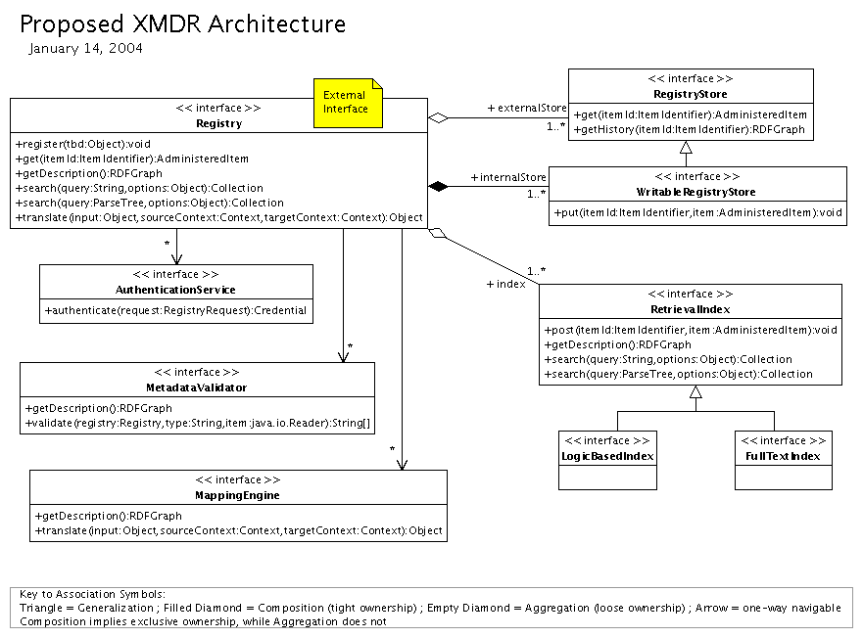
Proposed Prototype Architecture

