Slide 1
Demonstrating Benefits to Your Network's Members
GSU - Rural Health Network Development Technical Assistance Program Conference Call
October, 2003
Gregory Bonk, President
HMS Associates
Getzville, NY

Slide 2
Adapted from the
Real-World Benefits of Collaboration Session*
at the
Health Resources and Services Administration
Office Of Rural Health Policy
Annual Grantees Meeting
Washington, DC
August 22, 2003
*One of the highest rated sessions at the conference

Slide 3
Potential participants
Rural Health Networks - learn how to focus your energies and identify and deliver benefits to your members
State Offices of Rural Health - learn how to encourage collaboration as a basis for meaningful change
Critical Access Hospitals - learn about potential new beneficial relationships between you and your support hospital

Slide 4
Preparation for discussion
Think about the benefits your network is expected to deliver to the community and each member
Identify your biggest obstacles
Review this presentation
During the Q+A, ask about ways to identify benefits, fast-track your objectives, and sustain needed programs

Slide 5
Presentation phases and topics
    Phase I. Key concepts for developing networks, collaboratives and partnerships (Slides 6 - 19)
    Phase II. Tools: Mapping current member interest and benefits, identifying new benefits, and fast-tracking program development (Slides 20 - 41)
    Phase III. Network management concepts and tips (Slides 42 - 57)
    Each phase is 25 to 30 minutes - 20 minutes for presentation followed by 5 to 10 minutes for Q+A.

Slide 6
Phase I. Key concepts
Collaboration as a means for change
Principles of collaborative action
Lessons learned

Slide 7
Collaboration as a means for change
Nature of collaboration and networks:
  No single agency can accomplish the goal
  Collaboration occurs between similar types (horizontal) of health care providers, i.e., hospitals; different types (vertical) of health care providers, i.e., CHCs and Substance Abuse Clinics; and different “pillars of the community”, i.e., healthcare and faith-based
  Agencies collaborate to the extent to which they, and the communities they serve, benefit from participation

Slide 8
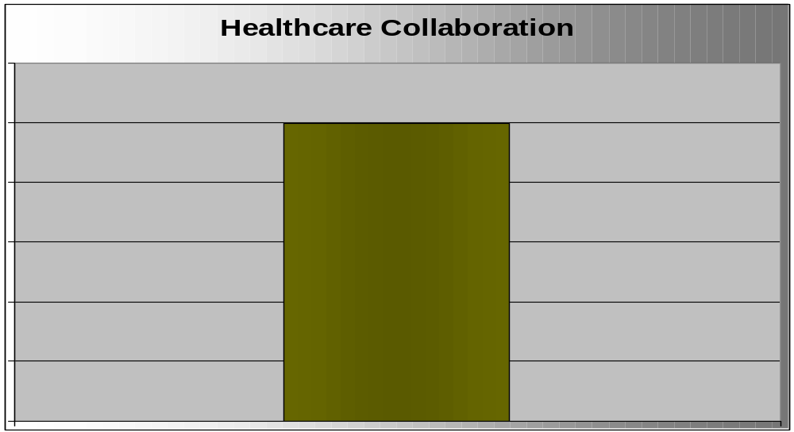
Collaboration within the pillar
Substance Abuse Services
Public Health
Hospitals
Community Health Centers
Physicians
Vertical
Horizontal

Slide 9
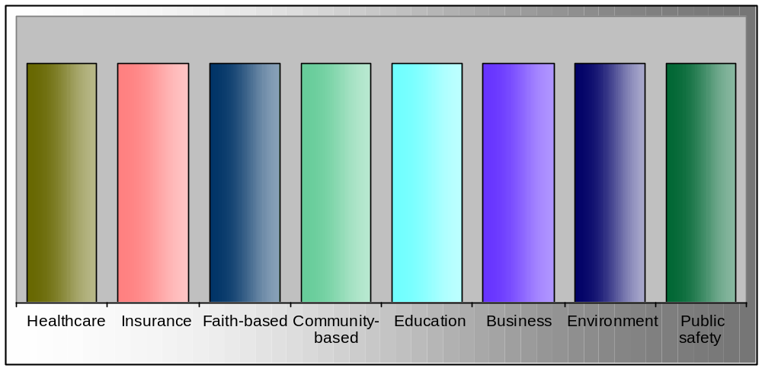
Collaboration between pillars
Pillars of the Community

Slide 10
Collaboration
Participation of independent agencies or different pillars of the community is not only desirable but MANDATORY for success
Participants have unique roles that only they can perform

Slide 11
Principles of collaborative action
I. The critical nature of benefits
II. Understanding your network’s dynamics
III. How networks work
Notes:
11/6/01
2

Slide 12
Goals, objectives and benefits
Goal: The over-riding shared vision
  Objectives: How you get there — attain the vision
    Benefits: The importance of the objective to each member of the network or collaborative

Slide 13
Benefits
  Agencies participate to the extent to which they, and the communities they serve, directly benefit:
    Quality of Care
    Financial Viability
    Market Share
    Stability — Mission critical
    Community Image
    Spirituality or Wellness
  Success (benefits) generates sustainability

Slide 14
Benefits
The benefits that each member expects to receive must be recognized by all
  The quality of care benefit in one sense is a given
  How the network will improve quality must be stated
Although less altruistic and “PC”, other benefits, specifically, financial, market share, and stability, should not be under-valued.
Why not? Maslow’s Hierarchy of Benefits

Slide 15
Maslow’s Hierarchy of Benefits
Level 1 – Physiological needs: Financial, market share
Level 2 – Safety needs: Stability
Level 3 – Love and belongingness needs: Community image, wellness
Can not reach Level 3 unless 1 and 2 are reached. Financial, market share and stability benefits should not be under-valued.

Slide 16
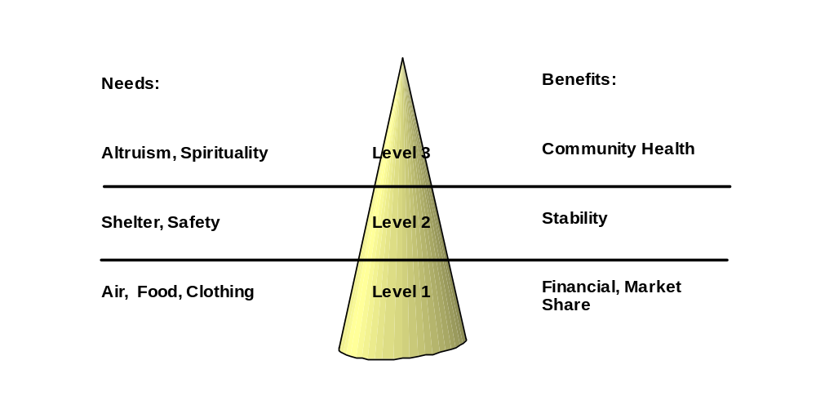
Needs/benefits Hierarchy

Slide 17
Lessons Learned
Never too early to identify benefits.
Emphasis on process management, i.e., listening, empathizing, and relationship building, can be counterproductive. How many members of your collaborative will provide financial support because you are a good listener who understands their concerns?
By their nature, collaboratives have high process requirements but they are a means to an end. How much energy do you place on managing relationships versus delivering benefits?
As you provide benefits you build relationships rather than vice versus.

Slide 18

Critical balance:
Process and benefit

Slide 19
Critical balance:
Monitoring progress and benefits
Formally report on workplan each quarter
Formally assess progress toward expected benefits
Formally re-assess member interests and potential new member benefits - semi-annually - See Universe Checklist Tool

Slide 20
Phase II. Tools
Mapping current member interest and benefits
Identifying new benefits
Fast-tracking development

Slide 21
Mapping member interests and benefits
Identify or reaffirm core participants
  Compelling needs
Identify and share expectations
  Benefits
Mapping tools

Slide 22
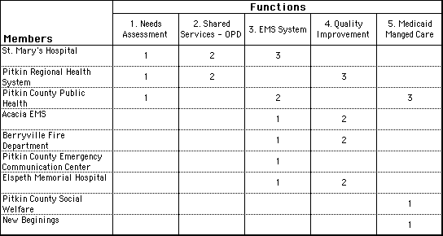
Member interests by program
Program Type

Slide 23
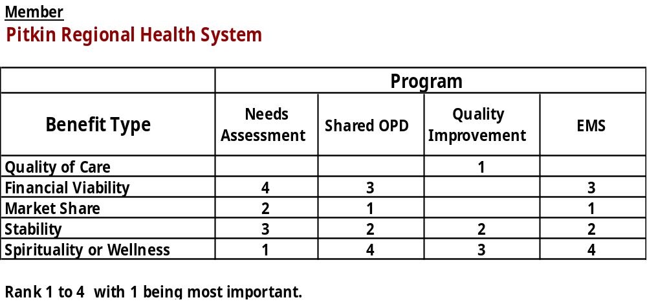
Member benefits by type

Slide 24
Benefits beyond getting the grant
Some members thought that getting the grant was the benefit for the community
Assess each members own priorities
Show them how their own priorities relate to the grant’s objectives: a network health care benefits counseling program brings approximately $4,000 to service providers per year for each new covered individual.
If the relationship is in fact minimal, recognize that and focus on members whose priorities are similar to grant objectives or adjust priorities

Slide 25
Interest and benefit maps
Interest map shows who’s most likely to be involved, perceives objective as compelling and must act - core resource
Benefit map shows type of motivation - is a preliminary self-sustainability check in that member attaining better financial results are most likely to be the core for a hard money - dues/fees structure
  Track financial benefits

Slide 26
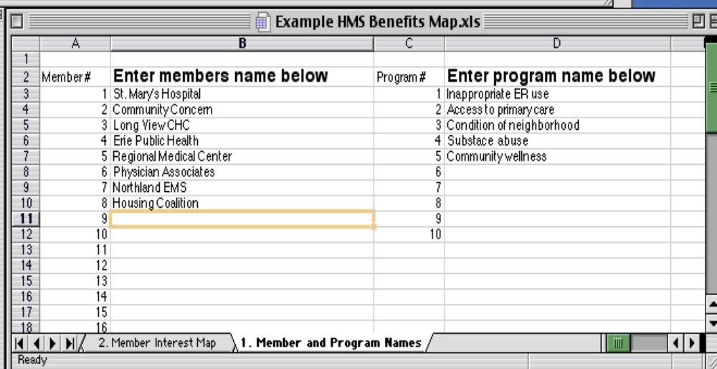
Interest and benefits mapping:
Interest, compelling needs
See Excel Shareware: HMS Benefits Map.xls

Slide 27
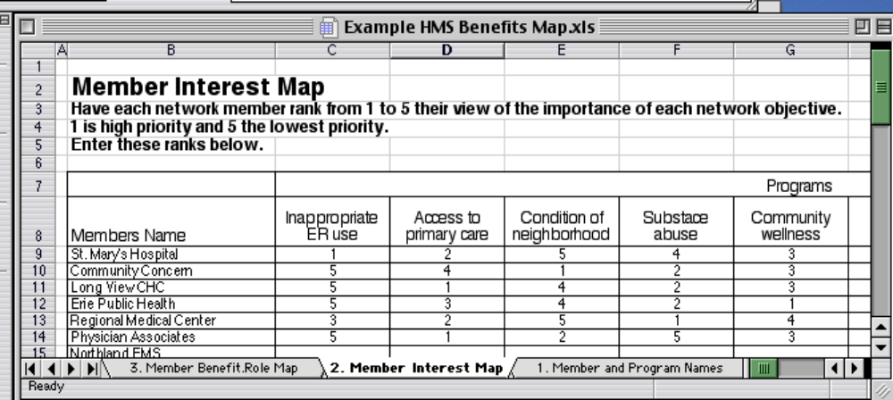
Mapping: High priority (interest) equals locally compelling
See Excel Shareware: HMS Benefits Map.xls

Slide 28
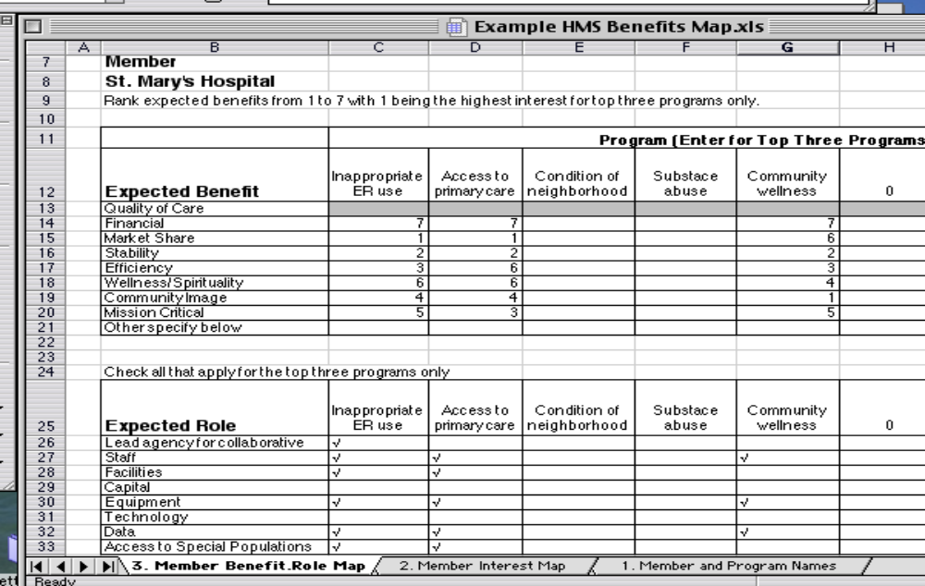
Mapping and documenting: benefits and roles
See Excel Shareware: HMS Benefits Map.xls

Slide 29
Adjusting objectives
Health care market place is ever-changing
Objectives must be relevant
If interests is waning in general, re-assess member and community needs
Have you ever thought about:

Slide 30
Universe of collaborative potential
“Within the box”
See Universe Checklist Tool

Slide 31
Fast-tracking program development and self-sustainability
Capacity assessment
Best practice assessment
Timely action plans
3 to 5 months to complete

Slide 32
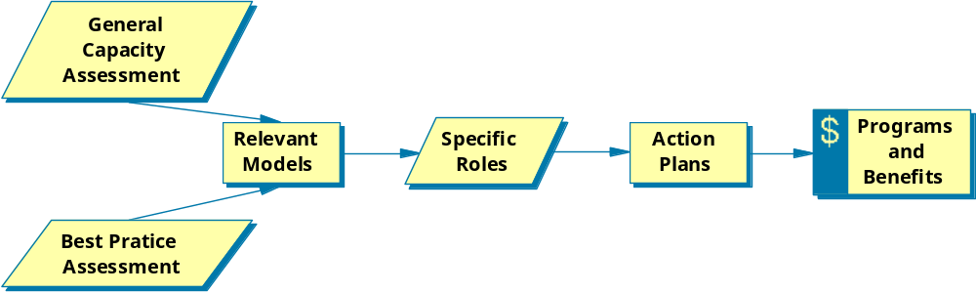
Fast-track Model
3 to 5 months

Slide 33
Capacity assessment - members as resources
What does each member bring to table
  Staff
  Programs
  Facilities
  Technology
  Access to special populations

Slide 34
Best practice assessment
Program specific
Talk with other collaboratives/networks but be sure that their programs and experiences relate to your community: A centralized access point to a closed system is very different from one to an open system.
Literature review
Federal technical assistance programs

Slide 35
Relevancy
Rural
Type of members - horizontal/vertical
Cultural sensitivity
Resource requirements
Development and operational issues
Self-sustainability
Lessons learned

Slide 36
Selection of model
Use the most relevant as a model
Shape to local conditions
Design/build only when circumstances warrant
  Time
  Money

Slide 37
Tools: Fast-track questionnaire
Internet based: Inexpensive, best response rate
1. What are your organization's major priorities for 2003/2004?
2. Do any of these priorities pertain specifically to (special population) or (community)? If so, which one(s)?

Slide 38
Questionnaire
3. The collaborative is working on five major objectives with financial support from the federal government. Please rank from 1 to 5 with 1 being the most important to your organization and 5 being the least important.
    Inappropriate ER use
    Access to primary care
    Condition of neighborhood
    Substance abuse services
    Community wellness
4. What tools or resources may your organization bring to the table to help address these objectives?

Slide 39
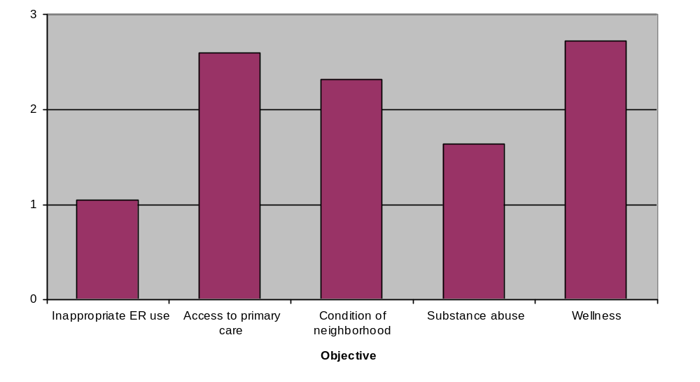
Complex collaborative results - objectives - overall interest
High ranks/bars are high interest

Slide 40
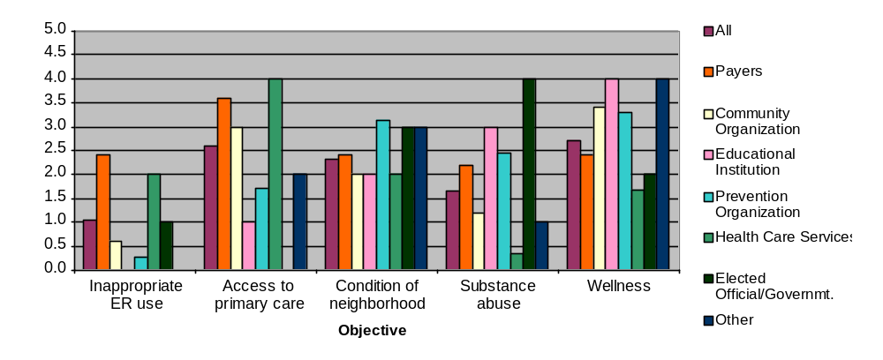
Complex collaborative results - objectives by type of agency
High ranks/bars are high interest

Slide 41
Action plan
Meet with interested members
Discuss best practice model
Discuss their potential role
Revise or adjust as needed
Act

Slide 42
Phase III. Network management concepts and tips
Guiding concepts
  Principles of network development
  Compelling needs
  Incrementalism
Management tips
  Interest in network approach
  Asking members for financial support
  Competition between members
  Cooperation of network agency staff
  Inertia
  Power brokers
  Self-sustainability

Slide 43
Principles of network development
Organizations participate in networks to the extent to which they benefit: strategically, financially, mission critical programs
Participation will vary by member
Membership will contract and expand over time
Membership needs and expectations should be assessed annually and network program emphasis should be adjusted accordingly
Both centralized and decentralized capacities are useful
Objectives requiring changes in the internal operations of network members are labor and time intensive

Slide 44
Compelling needs: Must be locally determined
Eminent closure of hospital
Entry of urban providers or plans in community
Extremely high infant mortality rates
Extremely fragmented care: similar immunizations in 1 month
Extremely high rates of diabetes
Need to maintain obstetrical capacity to keep local employers
Extremely high insurance premiums
Extremely high levels of people with no insurance
Eminent loss of physicians
Extremely high levels of accounts receivable/rejected claims

Slide 45
Incremental growth - small steps
Northeast Alliance
Initial reason for the network (1990)
  Severe lack of primary care
  Eminent closure of public hospital
Service Area
  Primary 22,000 people
  Migrant workers
  Hill tops and valleys - many radio “dead spots”
  High poverty + unemployment
Lead Agencies
  Two hospitals, county public health

Slide 46
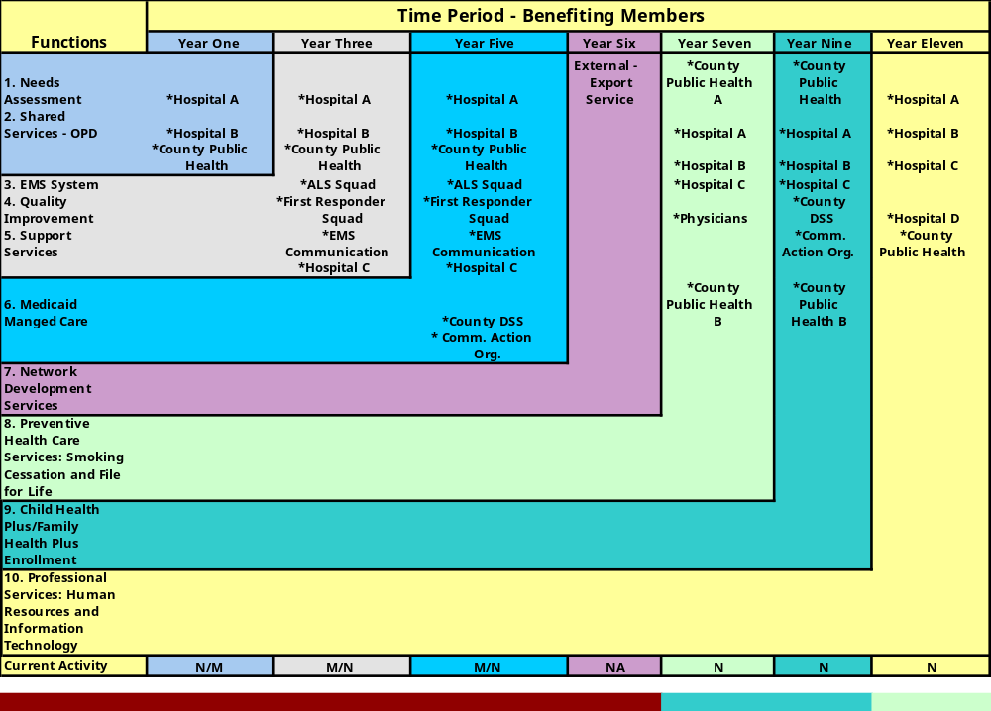
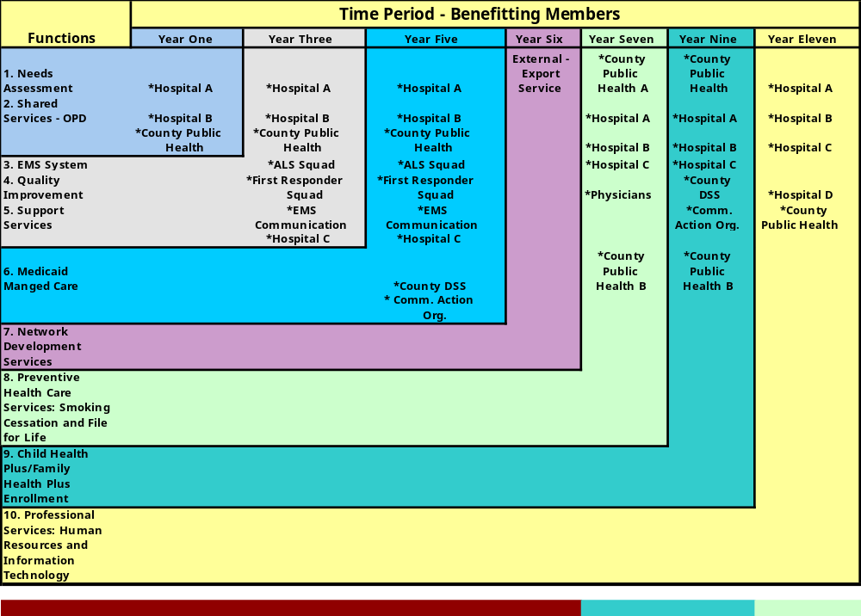
Incremental benefits
Self-sustainability

Slide 47
Collaborative Management:
Answers to FAQs
Interest in network approach
Asking members for financial support
Competition between members
Cooperation of network agency staff
Inertia
Power brokers

Slide 48
How can I get agencies to be more interested in the collaborative?
Describe how the collaborative’s programs correspond to the needs of their agency and the community it serves
Ask them about their top five priorities
Relate their priorities to these programs
Recognize that all may not be interested but may become more interested as the network provides benefits to its members
Do not try and convert everyone to the need for a collaborative. If essential agencies will not participate, develop work-arounds or place a lower priority on the program

Slide 49
We are in our third year and I have a difficulty asking my members for financial support.
Start discussing benefits and self-sustainability in the first six months of the grant period
  Horizontal networks should have dues and fees as an integral part of their business plans.
Focus immediately on objectives which:
  Have potential financial benefits to your members
  Address realistic outsourcing needs of network members

Slide 50
Some network members are competing in some ways with other network members. How can I deal with that?
Collaborative programs can always be contaminated by outside unavoidable competition between members
Consider competition to be an issue only if it negatively effects your program
  Competing parties start to use network as a battleground and automatically disagree with each others action
  Competitors want to withdraw from programs unless one drops out
If unavoidable, suspend action plans and examine options

Slide 51
How can I get the staff of network member organizations to cooperate?
  CEOs should be unwavering in their support of collaborative programs when these programs impact the internal operations of their organizations. If the CEO is not committed, do not expect staff to be
  CEOs should not be expected to provide details on day-to-day operations of their agencies
  Involve all types and levels of staff in the planning and implementation process, for example, clerical, administrative, and clinical staff
  Be prepared to adjust activities to conform to the terminology and procedural requirements of the participating agency
  Examine the issues staff raise regarding plans and adjust plans as needed

Slide 52
We do not seem to be accomplishing much and commitment is weakening. What steps can be taken to revitalize the network?
    Action plans should contain both short term - one year - and long term - three year - objectives
    Celebrate the small successes - development of MOUs, completion of surveys/assessments, meetings with key parties, development of deliverables in workplans
    Examine the source of inertia - bad plans, members are not doing what they said they would, lost funding, staff, or objectives are no longer important or feasible
    Change is incremental
    Recognize that if the collaborative cannot provide benefits that it may not be needed in its current form

Slide 53
I’m being torn apart by the two power brokers on the board.
Re-examine the collaborative vision: mandatory participation
Obtain input from other board members
Consider multiple approaches to consensus: Other interested parties, previously unidentified benefits

Slide 54
Self-sustainability
Successful programs are the basis for self-sustainability
Many programs will not be self-sustainable
Programs which provide significant financial benefits to their members are the most likely candidates for hard money support: dues or fees
Community health status improvement programs are the most difficult to find hard money support for. Soft money, grants, is more likely
Complimentary worksheets and network development consultative services are available from Greg Bonk at
(716) 688 - 8448 consulthms@aol.com
Visit us at www.askhms.com

