Slide 1
National Education Technology Plan 2004
Susan D. Patrick
Director
Office of Educational Technology
U.S. Department of Education

Slide 2
ECONOMY

Slide 3
“The people of the United States need to know that individuals in our society who do not possess the levels of skill, literacy and training essential to this new era will be effectively disenfranchised, not simply from the material rewards that accompany competent performance, but also from the chance to participate fully in our national life.”
-- A Nation at Risk, 1983

Slide 4
Economy
Changing
  80% of jobs in 2010 do not exist today (U.S. Department of Labor report)
  Information-based, changing world
Global
  Other countries are working hard, moving fast and using technology to accelerate progress. . .
Innovation, creativity & tolerance for risk-taking is a strength of the U.S.

Slide 5
Transforming education vs automating old instructional methods.

Slide 6
“Education is the only business still debating the usefulness of technology. Schools remain unchanged for the most part, despite numerous reforms and increased investments in computers and networks.”
-- U.S. Secretary of Education Rod Paige

Slide 7
Aligning Environments to the Real World
From an industrial to a knowledge-based economy . . .
Students today are online, multitasking, highly productive. Students learn quickly, manage and are responsible for their own learning. They are online and ultra communicators. They learn new communication skills, learn just-in-time, and are digital. They are flexible, critical and creative.

Slide 8
“We cannot assume that our schools will naturally drift toward using technology effectively. We must commit ourselves to staying the course and making the changes necessary to reach our goals of educating every child. These are ambitious goals, but they are goals worthy of a great nation such as ours. Together, we can use technology to ensure that no child is left behind.”
-- President George W. Bush

Slide 9
Where We Are Today
Over the past 20 years America invested hundreds of billions of dollars in education, yet reading and math scores remained essentially flat.
Today change is in the air. Innovative approaches. New appreciation of technology.
We see a new excitement in the vast possibilities of the digital age for changing how we learn and teach.
NCLB imposes new standards of accountability and provides increased flexibility and funding.

Slide 10
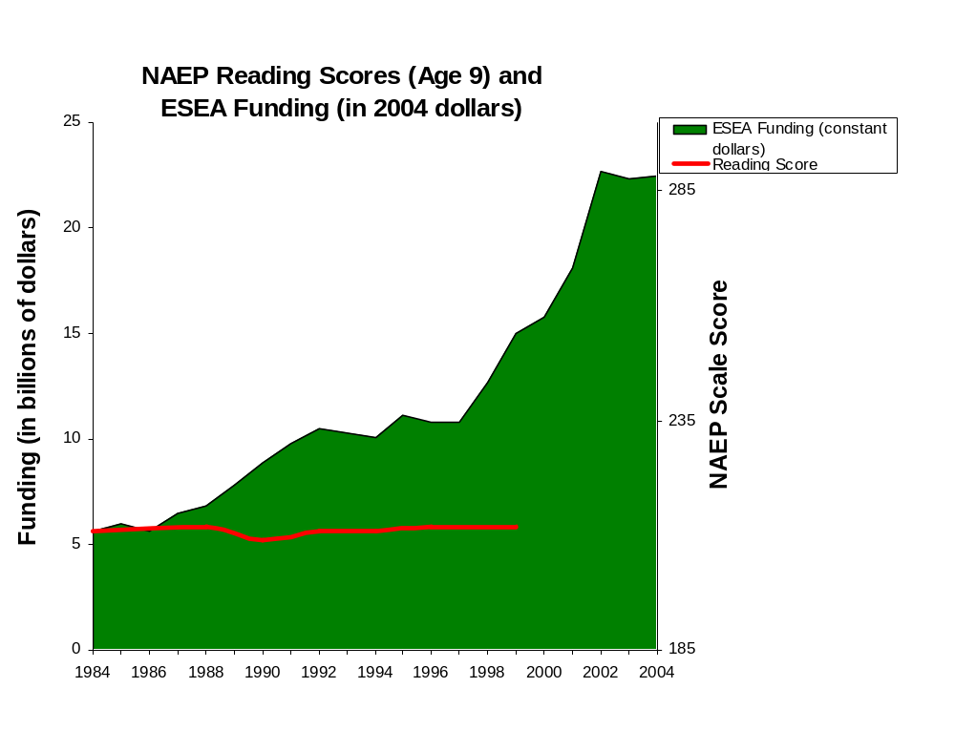

Slide 11
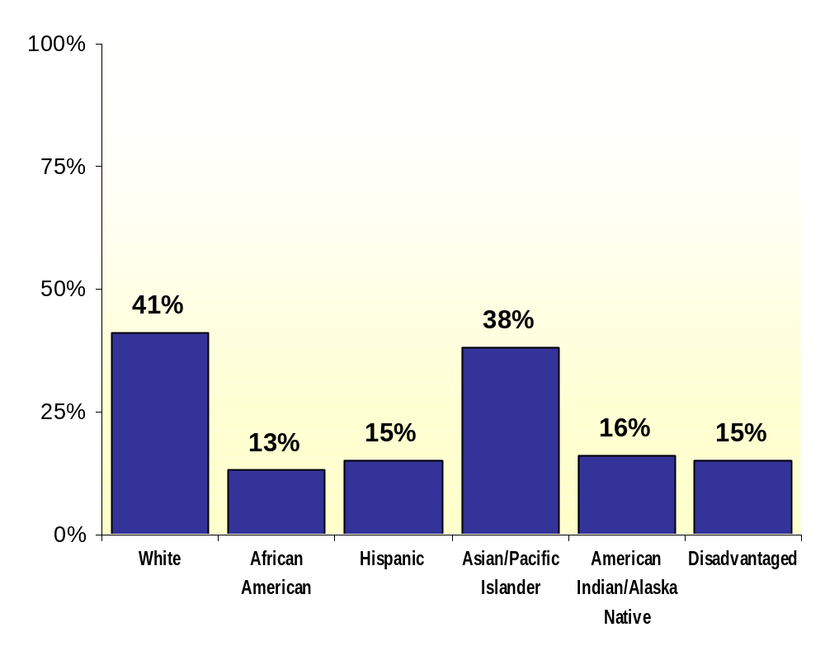
Fourth Grade Students
Proficient in Reading
Source: National Assessment of Educational Progress 2003

Slide 12
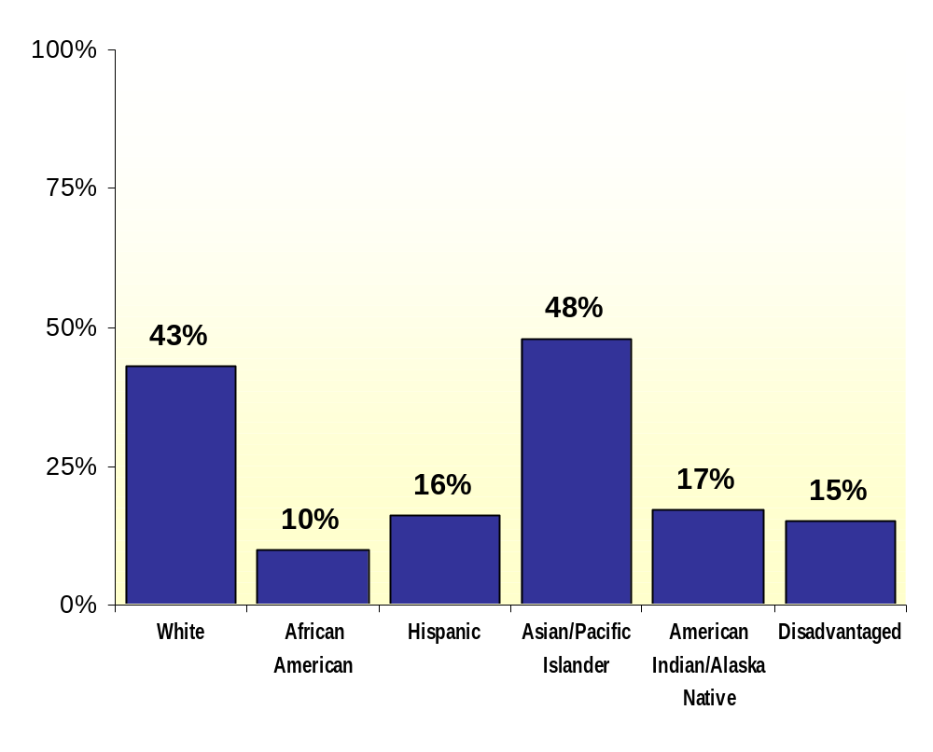
Fourth Grade Students
Proficient in Mathematics
Source: National Assessment of Educational Progress 2003

Slide 13
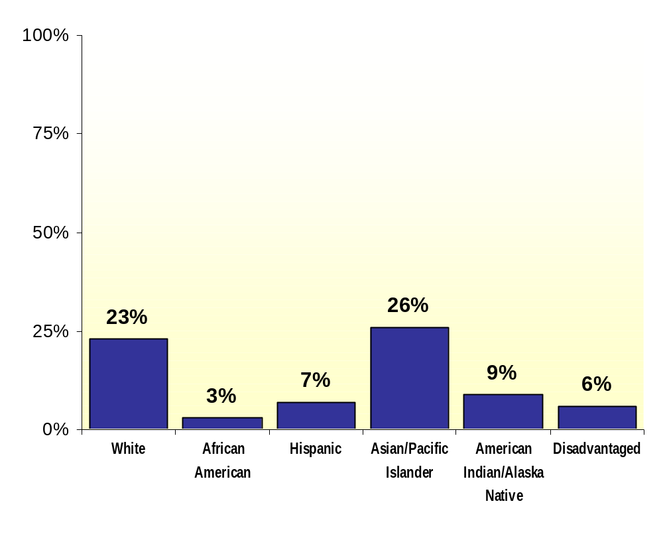
Twelfth Grade Students
Proficient in Science
Source: National Assessment of Educational Progress 2000

Slide 14
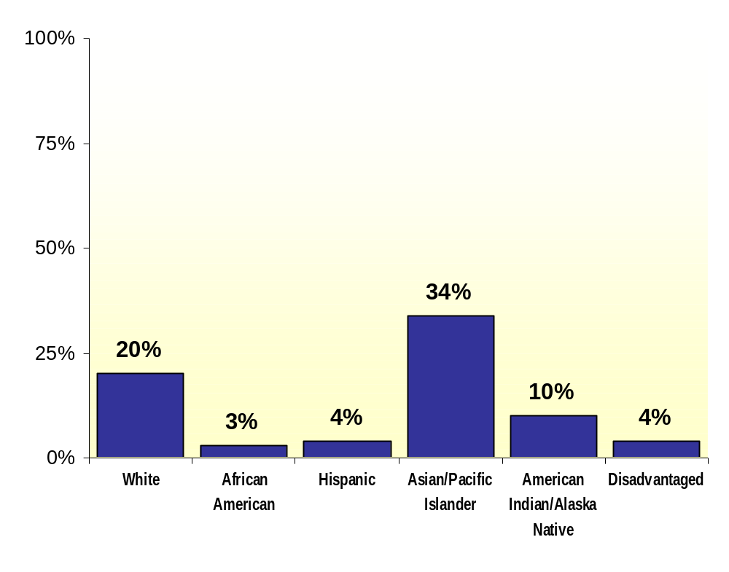
Twelfth Grade Students
Proficient in Mathematics
Source: National Assessment of Educational Progress 2000

Slide 15
Toward a New Golden Age in American Education:
How the Internet, the Law and Today’s Students are Revolutionizing Expectations

Slide 16
There is a new fervor in American education, a new creativity that bodes well for the future of our country.
Driven in part by this generation of tech-savvy students and by the requirements of the No Child Left Behind Act of 2001.
We are already seeing remarkable results through better use of technology.

Slide 17
Goals of NCLB
Every child can read by the 3rd grade.
Students are technology literate by the 8th grade.
A highly qualified teacher in every public school classroom by 2005.
Data used to drive decisions, target resources and support instruction.

Slide 18
Who Are Our Students?
Largest generation (36% of total population).
31% are minorities; more diverse than the adult population.
Have come of age along with the Internet.
Information has been universally available and free to them; community is a digital place of common interest, not just a shared physical space.

Slide 19
Family is Important
91% of students felt they have at least one family member they can confide in.
If they could, 50% of students would spend more time with their family.
74% get along with their parents extremely or very well.
When picking one person as a role model, 44% of students pick a family member.
Notes:
“The State of Our Nation’s Youth.” Horatio Alger Association of Distinguished Americans, Inc. 2003. 7 Aug. 2003 <https://www.horatioalger.com/pubmat/surpro.htm>.

Slide 20
Education Beliefs
91% of students have a teacher/administrator who personally cares about their success.
60% of students report that standardized tests are a good measure of progress.
96% say doing well in school is important in their lives.
88% of students report that attending college is critical or very important to future success.
Notes:
“The State of Our Nation’s Youth.” Horatio Alger Association of Distinguished Americans, Inc. 2003. 7 Aug. 2003 <https://www.horatioalger.com/pubmat/surpro.htm>.
Just Kids Inc. 2001
“The State of Our Nation’s Youth.” Horatio Alger Association of Distinguished Americans, Inc. 2003. 7 Aug. 2003 <https://www.horatioalger.com/pubmat/surpro.htm>.
CONTRAST with what ends up happening:
67% of students graduate from high school
38% enter college
26% are still enrolled sophomore year
80% of jobs now require postsecondary training
(source: Margaret Spelling white house chat online)

Slide 21
Interested in World and Community
76% of students would like to learn more about the world.
28% of high school students use a foreign news source to learn about current events.
After September 11, 2001, 78% of students felt optimistic and hopeful. Two years later, 75% still look toward a future with optimism and hope.
70% of students report volunteering or participating in community service.
Notes:
“The State of Our Nation’s Youth.” Horatio Alger Association of Distinguished Americans, Inc. 2003. 7 Aug. 2003 <https://www.horatioalger.com/pubmat/surpro.htm>.

Slide 22
Have Substantial Purchasing Power
In 2002, teens (ages 12-19) spent $170 billion.
15.6 million college students (ages 18-30) spend almost $200 billion annually.
Two out of three students report influencing their parents’ buying decisions.
20% of teens own stock.
Notes:
“Teens Spent $170 Billion in 2002.” Teenage Research Unlimited. 17 Feb. 2003. 8 Aug. 2003 <http://www.teenresearch.com/PRview.cfm?edit_id=152>.
“College Students Spend $200 Billion Per Year.” Harris Interactive. 29 July 2003. 8 Aug. 2003 <http://www.harrisinteractive.com/news/allnewsbydate.asp?NewsID=480>.
“Interprise Poll on Personal Finance 2002.” Junior Achievement, Inc. 12 Apr. 2002. 11 Aug. 2003 <http://www.ja.org/about/about_newsitem.asp?StoryID=44>.
“Interprise Poll on Personal Finance 2002.” Junior Achievement, Inc. 12 Apr. 2002. 11 Aug. 2003 <http://www.ja.org/about/about_newsitem.asp?StoryID=44>.

Slide 23
Millenials
Studies show that they are a capable, conscientious, concerned and optimistic generation, determined to succeed:
  96 percent say that doing well in school is important to their lives.
  94 percent say they plan to continue their education after high school.
  90 percent of children between 5 and 17 use computers.
  94 percent of teens use the Internet for school-related research.
  Teens spend more time online using the Internet than watching television.
  High school and college students spend nearly $400 billion a year.
  And they increasingly are involved in making spending decisions for their parents.

Slide 24
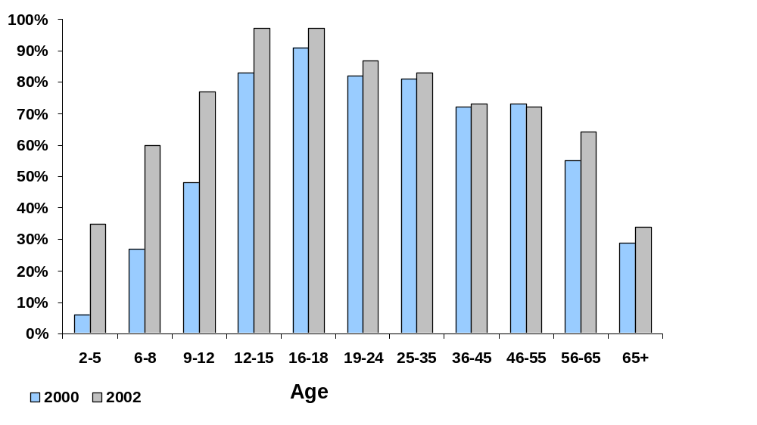
Internet Use by Age
Notes:
Graph data is compiled from three sources:
Cole, Jeffrey I., et al. “UCLA Internet Report: Surveying the Digital Future, Year Three.” UCLA Center for Communication Policy. Feb. 2003. 7 Aug. 2003 <http://ccp.ucla.edu/pdf/UCLA-Internet-Report-Year-Three.pdf>.
“Connected to the Future: A Report on Children’s Internet Use.” Corporation for Public Broadcasting. 2002. 7 Aug. 2003 <http://www.cpb.org/ed/resources/connected/>.
Horrigan, John, et al. “The Ever-Shifting Internet Population.” Pew Internet & American Life Project. 16 Apr. 2003. 7 Aug. 2003 <http://www.pewinternet.org/reports/toc.asp?Report=88>.

Slide 25
Even Young Children
72% of all first graders used a home computer during the summer on a weekly basis.
Over 85% of young children with home computers used them for educational purposes.
By 1999, 97% of kindergartners had access to a computer at school or home.
35% of children ages 2-5 use the Internet from any location.
Notes:
United States. Dept. of Education. National Center for Education Statistics. “Young Children’s Access to Computers in Home and at School in 1999 and 2000.” Early Childhood Longitudinal study: Kindergarten Class of 1998-1999. Mar. 2003. 7 Aug. 2003 <http://nces.ed.gov/pubs2003/2003036.pdf>.
United States. Dept. of Education. National Center for Education Statistics. “Young Children’s Access to Computers in Home and at School in 1999 and 2000.” Early Childhood Longitudinal study: Kindergarten Class of 1998-1999. Mar. 2003. 7 Aug. 2003 <http://nces.ed.gov/pubs2003/2003036.pdf>.
United States. Dept. of Education. National Center for Education Statistics. “Young Children’s Access to Computers in Home and at School in 1999 and 2000.” Early Childhood Longitudinal study: Kindergarten Class of 1998-1999. Mar. 2003. 7 Aug. 2003 <http://nces.ed.gov/pubs2003/2003036.pdf>.
“Connected to the Future: A Report on Children’s Internet Use.” Corporation for Public Broadcasting. 2002. 7 Aug. 2003 <http://www.cpb.org/ed/resources/connected/>.
“Strong Growth in Wireless Devices Seen Among Kids.” Spectracom, Inc. September 2002. 7 Aug. 2003 <http://www.spectracom.com/pressreleases.shtml>.

Slide 26
Online Teens
71% of online teens say they relied mostly on Internet sources for the last big project they did for school.
48% say their use of the Internet improves their relationship with friends.
94% of online teens report using the Internet for school-related research.
74% of online teens use instant messaging.
24% of online teens have created their own Web pages.
The number of children ages 4 to 18 who own at least one wireless device (e.g. cell phones, PDAs) grew from 32% in 2002 to 43% in 2003.
13% of those age 7 and under own a
wireless device
Notes:
Lenhart, Amanda, Lee Rainie, and Oliver Lewis. “Teenage Life Online.” Pew Internet & American Life Project. 20 June 2001. 7 Aug. 2003 <http://www.pewinternet.org/reports/toc.asp?Report=36>.
Lenhart, Amanda, Lee Rainie, and Oliver Lewis. “Teenage Life Online.” Pew Internet & American Life Project. 20 June 2001. 7 Aug. 2003 <http://www.pewinternet.org/reports/toc.asp?Report=36>.
“Strong Growth in Wireless Devices Seen Among Kids.” Spectracom, Inc. September 2002. 7 Aug. 2003 <http://www.spectracom.com/pressreleases.shtml>.
“Strong Growth in Wireless Devices Seen Among Kids.” Spectracom, Inc. September 2002. 7 Aug. 2003 <http://www.spectracom.com/pressreleases.shtml>.

Slide 27
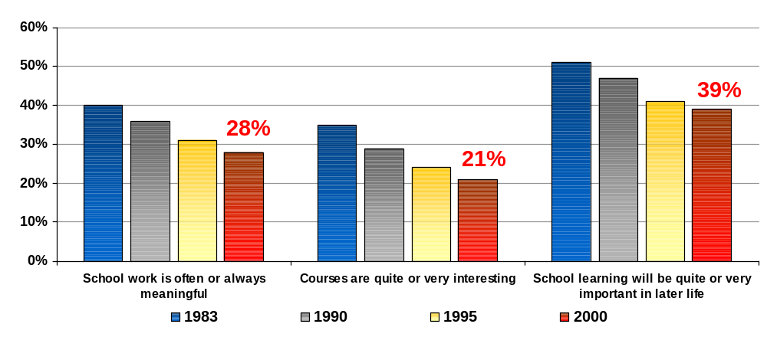
12th Graders
Perceptions About School
Notes:
United States. Dept. of Education. National Center for Education Statistics. “The Condition of Education 2002.” June 2002. 11 Aug. 2003 <http://nces.ed.gov/pubsearch/pubsinfo.asp?pubid=2003067>.

Slide 28
Millennials influence the present and are the future.
Pay close attention to them, as their usage of media influences other demographic groups and they literally represent the
world to come.
Yahoo: Born to Be Wired
Notes:
“Born to be Wired: The Role of New Media for a Digital Generation; A New Media Landscape Comes of Age: Executive Summary.” Yahoo! and Carat Interactive. July 2003. 7 Aug. 2003 (press release) <http://biz.yahoo.com/bw/030724/245198_1.html>.

Slide 29
Our Challenge
Are our schools ready for this generation?
How do we create the learning environments that engage this generation to help them reach their full potential?
How do we equip these students with the skills and knowledge they need to be competitive in a global, information-based economy and contributing citizens?
What assumptions about education do we need to question?

Slide 30
What Are They Telling Us?
Today’s students feel strongly about the positive value of technology and use it in nearly every aspect of their lives.
They are more comfortable with computers than their parents – and their teachers.
What they are telling us is they want to help us understand this great new world of technology and its vast possibilities.
And they want us to listen to them.

Slide 31
What Are They Telling Us?
    “We have technology in our blood.”
    -- High School Student

Slide 32
Tear Down Those Walls: The Revolution is Underway
Creative new teaching models are emerging that embrace technology to redesign curricula and organizational structures.
The results in educational achievement often have been striking.
The percentage of schools making Adequate Yearly Progress (AYP) toward NCLB goals from 2003-2004 is up in most states.
In nine states – North Carolina, Pennsylvania, Maryland, Kentucky, Alaska, Georgia, Virginia, West Virginia and California – the proportion of schools making AYP has increased by at least 10 percentage points.
Over the past five years there has been an explosive growth in online and multimedia instruction and “virtual schools.”

Slide 33
Success Stories from States, Districts and Schools Leading the Way
Chugach School District, Alaska
Poway Unified School District, California
Henrico County Schools, Virginia
Florida Virtual School
West Virginia Virtual School
Louisiana Online Professional Development
Virginia Online Assessment and Data Systems
New Mexico Reading First Handheld Assessment
Pennsylvania school-home connections

Slide 34
Explosion in E-Learning and Virtual Schools
About 25 percent of all K-12 public schools now offer some form of e-learning or virtual school instruction.
Within the next decade every state and most schools will be doing so.
E-learning offers flexibility in the time, place and pace of instruction.
It offers educators an alternative means of meeting their students’ academic needs.
It gives parents a significant choice of providers.

Slide 35
Impact of No Child Left Behind
States and school districts across the country have to reexamine their standards, set targets for improvement, introduce rigorous testing and give options to parents.
States have reported significant gains meeting AYP goals for the 2003-2004 school year.
New York has reported improvements in math test scores in New York City and across the state for the third year in a row.
While boosting overall performance, many schools are reporting sharp gains for poor and minority children, particularly in the elementary grades.

Slide 36
“Across America, school teachers did something this year that many of them didn’t expect to do. They raised their students’ math and reading scores…In a majority of the states that have released results under No Child Left Behind, fewer schools are failing to meet the law’s goals. And because teachers are the most important factor in student achievement, they deserve at least some credit for that.”
-- National Journal (9/11/04)

Slide 37
National Education Technology Plan: The Future is Now
Seven Action Steps and Recommendations

Slide 38
Steps
Strengthen Leadership
Consider Innovative Budgeting
Improve Teacher Training
Support E-Learning and Virtual Schools
Encourage Broadband Access
Move Toward Digital Content
Integrate Data Systems

Slide 39
1. STRENGTHEN LEADERSHIP
Invest in leadership development programs to ensure a new generation of tech-savvy leaders.
Retool administrator education programs to provide training in technology decision making and organizational change.
Develop partnerships between schools, higher education and the community.
Encourage creative technology partnerships with the business community.
Empower students’ participation in the planning process.

Slide 40
2. CONSIDER INNOVATIVE
BUDGETING
Consider a systemic restructuring of budgets to realize efficiencies, cost savings and reallocations. This can include reallocations in expenditures on textbooks, instructional supplies, space and computer labs.
Consider leasing with 3-5 year refresh cycles.
Create a technology innovation fund to carry funds over yearly budget cycles.

Slide 41
3. IMPROVE TEACHER TRAINING
Teachers have more resources available through technology than ever before, but have not received sufficient training in the effective use of technology to enhance learning.
Teachers need access to research, examples and innovations as well as staff development to learn best practices.
The U.S. Department of Education is currently funding research studies to evaluate the effective use of technology for teaching and learning.

Slide 42
4. SUPPORT E-LEARNING AND VIRTUAL SCHOOLS
Provide every student access to e-learning.
Enable every teacher to participate in e-learning training.
Develop quality measures and accreditation standards for e-learning that mirror those traditionally required for course credit.

Slide 43
5. ENCOURAGE BROADBAND ACCESS
Evaluate existing technology infrastructure and access to broadband to determine its current capacities and explore ways to ensure its reliability.
Ensure that broadband is available all the way to the end-user for data management, online and technology-based assessments, e-learning, and accessing high-quality digital content.
Ensure adequate technical support to manage and maintain computer networks, maximize educational uptime and plan for future needs.

Slide 44
6. MOVE TOWARD DIGITAL CONTENT
Ensure that teachers and students are adequately trained in the use of online content.
Encourage that each student has ubiquitous access to computers and connectivity.
Consider costs and benefits of online content, aligned with rigorous state academic standards, as part of a systemic approach to creating resources for students to customize learning to their individual needs.

Slide 45
7. INTEGRATE DATA SYSTEMS
Establish a plan to integrate data systems so that administrators and educators have the information they need to increase efficiency and improve student learning.
Use assessment results to inform and differentiate instruction for every child.
Implement School Interoperability Framework (SIF) Compliance Certification as a requirement in all RFPs and purchasing decisions.

Slide 46
Conclusions
America’s students need the knowledge and competence to compete in an increasingly technology-driven world economy.
This need demands new models of education facilitated by educational technology.
Industry is far ahead of education. Tech-savvy high school students often are far ahead of their teachers.
Some of the most promising new educational approaches are being developed outside the traditional educational system, through e-learning and virtual schools.
This is an exciting, creative and transforming era for students, teachers, administrators, policymakers and parents.
The next 10 years could see a spectacular rise in achievement – and may well usher in a new golden age for American education.

Slide 47
Thank you!
www.ed.gov
www.NationalEdTechPlan.org

Slide 48


http://www.ed.gov
http://www.ed.gov/Technology
http://www.NationalEdTechPlan.org
http://www.nclb.gov

