Slide 1
brookhaven - fermilab - berkeley
BEAM INSTRUMENTATION
A. Ratti
LBNL
Presented at the DoE Review of the US LARP
FNAL
1-2 Jun 2003

Slide 2
Outline
Introduction - motivation and mission
Systems description + progress report
  Lumi
  Tune Feedback
  Schottky - new task
Program management
  Systems definitions, interfaces and responsibilities
  Integration within LARP and the LHC
Budget
Conclusions

Slide 3
LARP Instrumentation Systems
LARP Instrumentation will deliver unique capabilities that will greatly enhance the LHC and facilitate both commissioning and performance optimization
Luminosity Monitors
  Bunch-by-bunch measurement of luminosity
Tune Feedback and Coupling measurements
  Tune measurement and PLL feedback
Schottky Monitors
  Non invasive bunch-by-bunch tune (+ Chromaticity)

Slide 4
LARP Instrumentation Goals
LARP Instrumentation will help:
Bring LHC to full energy
Betatron tune, coupling, and chromaticity control during ramp
Bring LHC to design luminosity
Real-time luminosity monitor
These contributions advance the state-of-the-art in beam instrumentation and have direct contributions to present and future US accelerator projects.

Slide 5
LUMI - Requirements
Help bring beams into collisions too

Slide 6
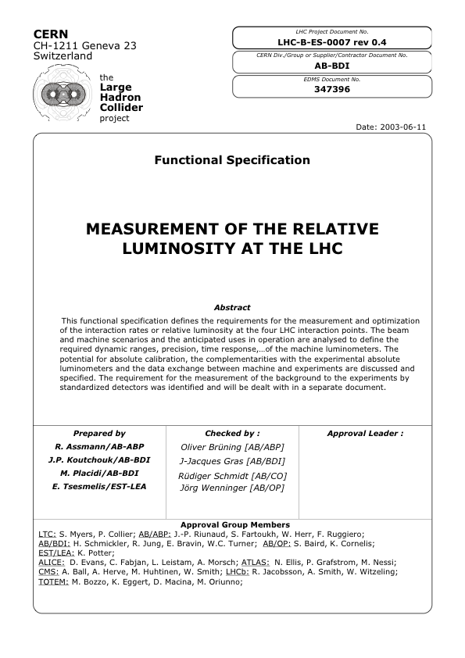
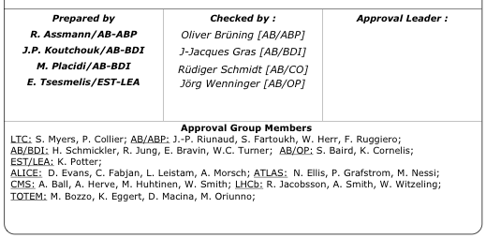
LUMI - Specification

Slide 7
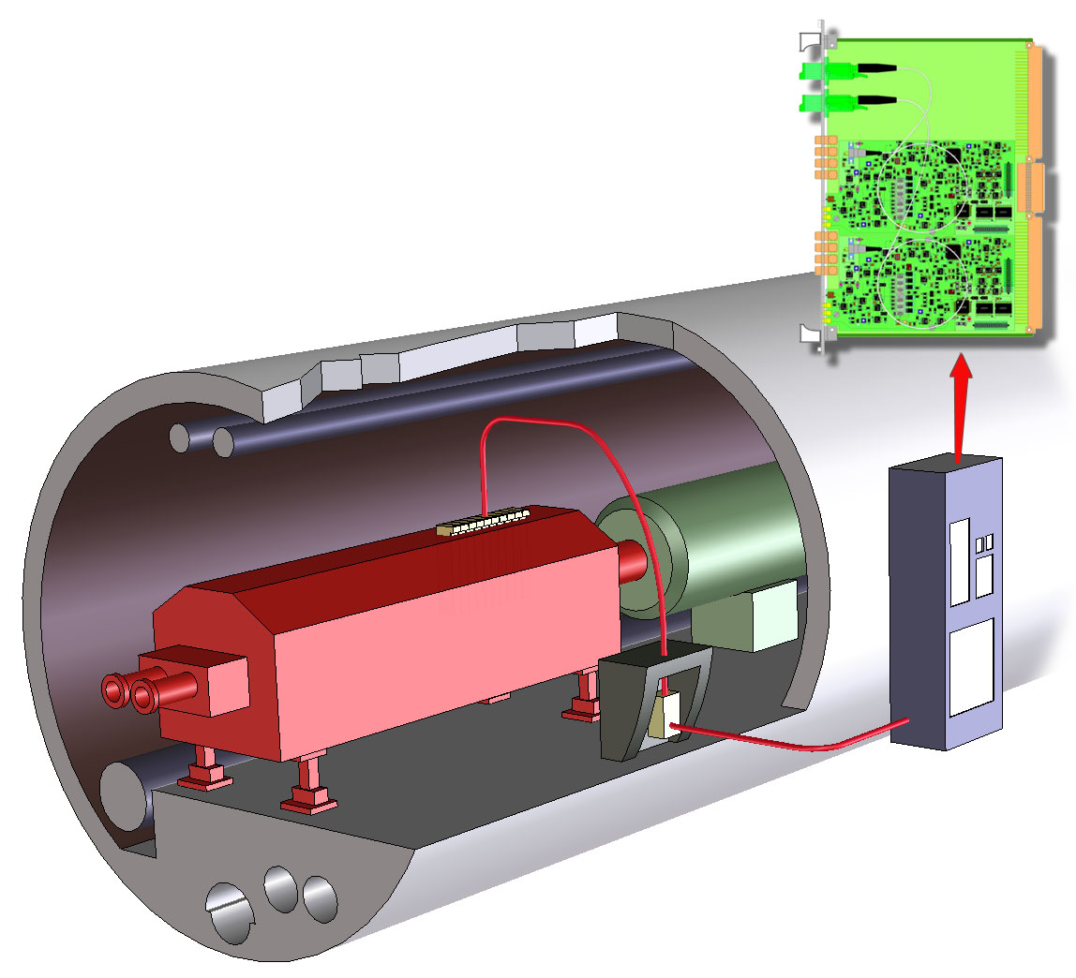
LUMI - Installation Concept
DAQ
TAN
FE electronics located
behind TAN
(shown here for illustration purposes)

Slide 8
LUMI - Detector Assembly

Slide 9
LUMI - Conceptual Design
Argon Ionization Chamber
V+
N_{GAP}=2
τ = x_{GAP}/v_{D}
x_{GAP}
I₀
τ
Signal is proportional to the number of parallel gaps
Capacitance add up with n. of gaps + slows down the signal
Optimized for 6 gaps
Must live in a radiation environment 100 x worse than accelerator instruments have ever seen

Slide 10
LUMI - Pulse Shaping + DAQ
Active termination front end to properly compensate the chamber capacitance
  Initial design in collaboration with Univ. di Pavia, INFN, Italy
Pulse shaping electronics necessary to limit the noise bandwidth.
Pulse shaping is also necessary to reduce the width of the pulse to accommodate the 40MHz repetition rate.
Baseline recovery (Pole-Zero cancellation)
Shaped pulse is digitized in a mezzanine board designed for the DABIV VME64 card used as standard interface by CERN - BI
FPGA programming by LBL, controls programming by CERN

Slide 11
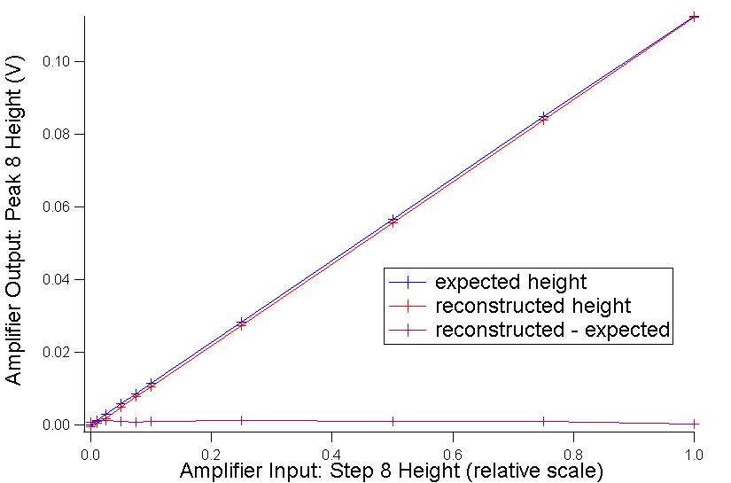
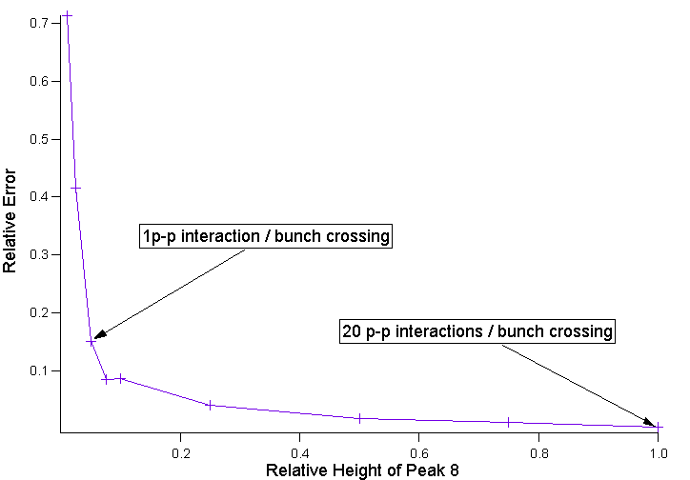
Deconvolution Errors
The current method uses the arbitrary waveform generator to the limits of its capabilities.
The alternative solution is to use a true deconvolution algorithm using Fourier transform.

Slide 12
LUMI - Status
Activity started as early as 1997
  initially part of LHC construction project
Participated in 40 MHz runs at CERN in 2000 and 2001
Present approach and chamber design developed in 2003
Beam tested at ALS booster transfer line at 1 Hz
  Validated all system modeling
  Fully tested integration with FE electronics
Plans for a 40 MHz test with hard X-rays at ALS beamline

Slide 13
LUMI - LARP Review
Successful LARP review of LUMI held on April 11, 2005
  Shea (chair), Bravin, Drees, Field, Fisher, Nygren
Presented technical design, planning, budget & resource loaded schedule
  Program fully endorsed by the committee
Among recommendations:
  Improve integration with CERN
    Expediting system integration planning and documents
  Import as much knowledge as possible on material properties
Other findings:
  1% bunch to bunch resolution and 40 MHz capability is not a baseline requirement for commissioning of LHC and routine operations. Instead a few percent up to 10% resolution is requested.
  Although prototype construction must remain the highest priority, the committee endorses continued testing in parallel with this construction.

Slide 14
LUMI - Integration
LBNL to deliver
  4 chambers with electronics
  DAQ with programming
  Installation support
  Hardware commissioning
CERN to provide
  Local installation
  Control system integration
  VME64 infrastructure
  Agreement being defined in a system integration document part of the LHC document control system

Slide 15
LUMI Milestones
FY05
Complete high speed tests
Complete conceptual design of FE electronics
Complete and formalize system integration document
FY06
Design and build first unit of DAQ system
Final design of complete first unit
Test prototype at RHIC
FY07
Build all units
Install and HW commission all units

Slide 16
Tune Feedback
Challenge: persistent current effects in SC magnets can strongly perturb machine lattice, especially during energy ramp (aka “snapback”). Effects for LHC predicted to be large.
  Betatron tunes (Q_{x,y}) and chromaticities (Q’_{x,y}=EdQ_{x,y}/dE) can vary significantly due to “snapback” resulting in beam loss, emittance growth.
Solution: make fast, precision Q, Q’ measurements and use these signals to feedback to tuning quadrupoles and sextupoles.
This effort is ideally suited for a collaboration with RHIC, which can be the benchmark and testing ground for this effort.
The Two Issues at RHIC:
Dynamic Range
Coupling

Slide 17
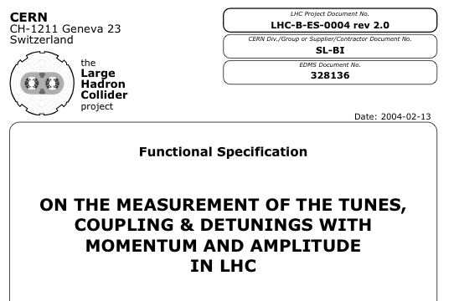
Tune Feedback - Goals and Integration
The goal is to control the tune during the acceleration ramp to avoid resonance crossing and beam loss
The PLL method is to shake the beam and observe the resonant beam transfer function when the shaking frequency is at the fractional betatron tune
Once the fractional tune is measured with the PLL it is used in a feedback system to regulate the quadrupole current and tune

Slide 18
The Approach - from RHIC to the LHC
At RHIC
  resonant pickup, above the coherent spectrum
  defeated by transition - short bunches, fast orbit changes
  defeated by coupling - strong sextupoles, vertical orbit changes affect coupling, coupling drives tune feedback unstable
AT LHC (and next generation RHIC)
  direct diode detection - mix all betatron lines to baseband, solves dynamic range problem
  measure all four eigenmode projections - results in PLL that is robust in the presence of coupling
  CERN and BNL personnel are actively collaborating on tune feedback and using RHIC as a platform for developing the system

Slide 19
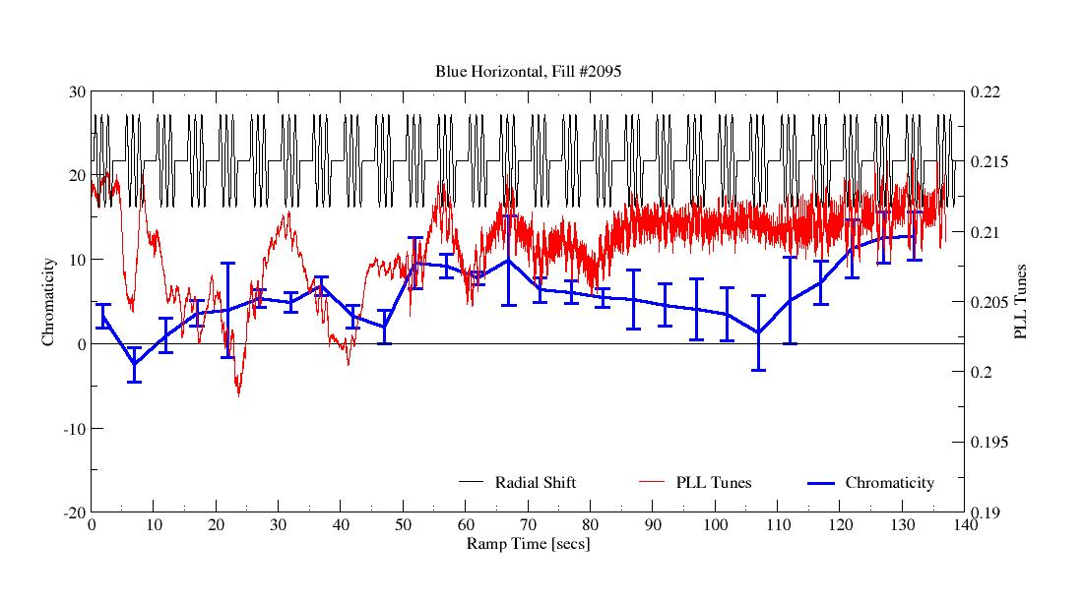
Effects of persistent currents in RHIC
Q_{x} and Q_{x}’ measured in RHIC
Energy increasing

Slide 20
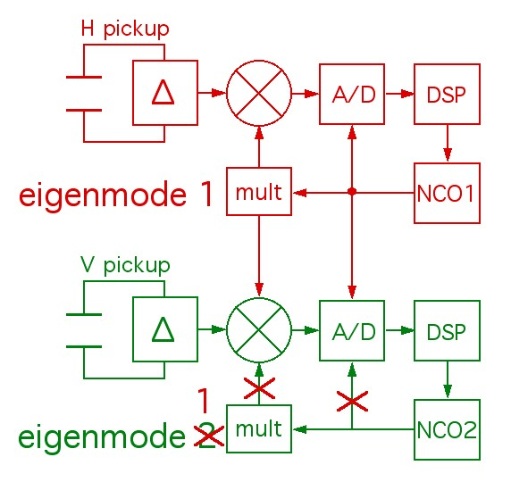
Results - Tune and Coupling
Tune
  PLL tune measurement operational at RHIC for several years, automated, controlled by sequencer. Specialist checks status every few days.
  Used for ramp tune and chrom measurements, IR corrections, machine studies,...
Coupling
  PLL re-configured to measure all
  four eigenmode projections
  results in PLL that can be made
  robust in the presence of coupling

Slide 21
Results - 3D and PLL
3D (Direct Diode Detection) - installed at PS, SPS, Tevatron, RHIC
  solves dynamic range problem
  significant improvement in sensitivity
  greater sensitivity reveals 60Hz problem
    beam is excited horizontally at betatron line by line frequency harmonics
    excitation appears in vertical due to coupling
    It is at baseband, will show up everywhere in the spectrum - we can't escape it
    Required modulation of dipole current at harmonic ~300 is actually pretty small - one part in 10¹¹
Baseband PLL - loop closed, performance superior to present RHIC system, but locks on 60Hz lines

Slide 22
TF - LARP Preliminary Design Review
Review held in Port Jefferson in April 2005
  Pasquinelli (chair), Brennan, Fisher, Lamont, Lebedev, Shea
Demonstrated potential to satisfy LHC tune feedback requirements
Established the rapport that enables a successful collaboration
3D (Direct Diode Detection) provides a vast improvement over previous attempts
Proposed coupling compensation is very clever, needs testing
60Hz problem needs to be clearly defined by measurements in RHIC
Modeling of coupled loops (tune, chrom, coupling, orbit feedback, RF,...) is needed
Fully operational system should be implemented at RHIC

Slide 23
Scope, Boundaries, Responsibilities...
CERN provides essentially all hardware
  kicker amplifiers, kickers, and pickups for LHC
  Direct Diode Detection AFEs
  Digitizer boards
  DAB64 Boards - FPGA for processing plus VME interface
    LHC (BPM, BLM, BCM,...) and LARP (PLL, Lumi, Schottky) standard
  VME crates and crate computers for CERN installation
LARP provides all software up to LHC Control System
  VME crates and crate computers for LHC test installation at BNL
  gate array programming
  FEC programming
  LabVIEW control program, collaboration on LHC equivalent (FESA)
  specification and testing of LHC TF Applications software
  testing at RHIC, with and without beam
  pre-beam and beam commissioning support at LHC

Slide 24
Tune Feedback Milestones
FY05
Apr 05 - Preliminary Design Review - completed
Jun 05 - finalize prototype system architecture (need 60Hz balancing at RHIC, clarification of 50Hz magnitude at LHC)
FY06
Nov 05 - prototype (4 planes) ready for RHIC beam
Feb 06 - deliver 2 planes to CERN for SPS testing
Apr 06 - Final Design Review
May 06 - SPS testing, initial Controls integration (FESA)
Jun 06 - finalize architecture
FY07
Nov 06 - final system (4 planes) ready for RHIC beam
Feb 07 - deliver final system to CERN, system integration and testing
Summer 07 - system commissioning with beam

Slide 25
Schottky Monitor
Advanced enabling technology
Extremely versatile instrument will provide unique capabilities
  Only tune measurement during the store
  Bunch-by-bunch measurement of important parameters
    Tune, Chromaticity
  Average measurements as well
  Momentum spread + emittance
  Beam-beam tune shift
Non invasive Technique
Very powerful tool for beam physics
  Beam-beam interaction studies
  Bunched beam Schottky signal studies
Used to measure the stability of beam tunes during each cycle of the LHC

Slide 26
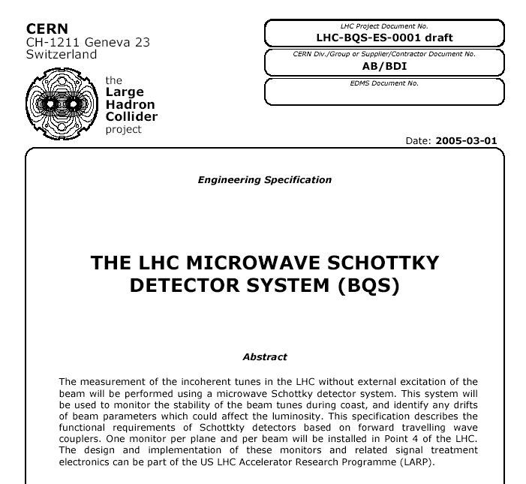
Schottky - Integration with CERN

Slide 27
Schottky - Technical approach
1.7 GHz 109 x 75 mm aperture at Tevatron
4.7 GHz 60 x 60 mm proposed for LHC

Slide 28
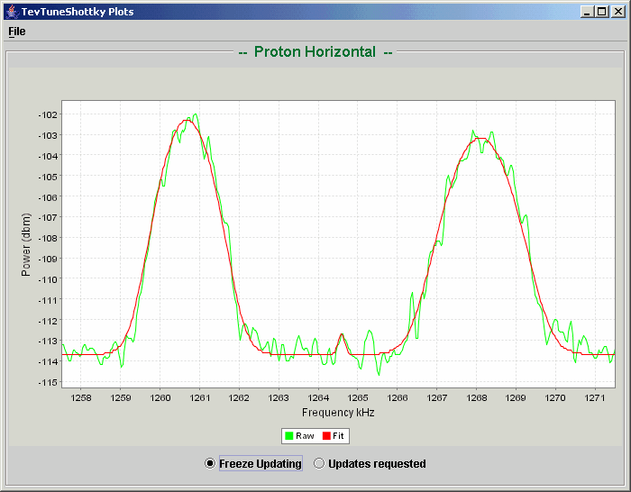
Schottky - Excellent Experience at Tevatron
Allows measurements of:
Tunes from peak positions
Momentum spread from average width
Chromaticity from differential width
Emittance from average band power

Slide 29
Schottky - LHC Design

Slide 30
Schottky Planning
FNAL will deliver:
A complete design and analysis
A drawing package
The analog signal processing electronics
Analysis software
Installation and HW commissioning support at CERN
CERN will provide:
Manufacturing and local installation
DAQ system
Controls system integration
BNL is collaborating on DAQ activities thanks to synergy with TF electronics

Slide 31
Schottky Milestones
FY06
S/N study of low intensity bunches in Tevatron
Design pick-up structure
Study PLL DAB board for DAQ (with BNL)
FY06-07
Design and build front-end electronics
Adapt Fermilab analysis software
FY07-08
Hardware commissioning at CERN (w and w/o beam)
Beam studies (e.g. chromaticity, ramp)
Non-destructive average tune, emittance, momentum spread and chromaticity measurement capability (LARP)
Non-destructive bunch-by-bunch tune, emittance, momentum spread and chromaticity measurement capability (LARP)

Slide 32
Future Tasks Proposals
As these tasks are under development, our community is still active
  More activities are ready for consideration
  Will slowly be introduced as the current ones are completed
Beam/Beam studies
  AC dipole for reactive excitation of beam
  beam-beam compensation with electron lens or wire
Electron Cloud
  In situ low energy electron spectrometer
Optical based diagnostics
  Under development at the Tevatron in collaboration with BNL
These or other ones will be added to the LARP program as need arises and funding permits.

Slide 33
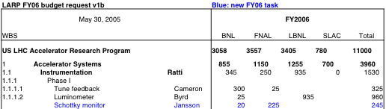
FY06 Budget
This remains a best effort program, with short term goals
A 10% reduction would be have a big impact:
  Milestones will slip
  Deliverables will change (may eliminate task(s))
  Or both
In the timeframe of these activities the slip could be significant
  Some instruments may miss first collisions in LHC

Slide 34
Integration and Planning
As the LHC commissioning approaches, and these programs finalize their efforts towards devices for LHC installation, this collaboration has started to tighten its internal agreements and those with CERN
  So far, things have been handled by CERN specs and LARP task sheets
    Adequate for funding received
  Moving towards a more formal structure
    Developing integration documents
      Define deliverables, interfaces, requirements
      Direct involvement of CERN’s points of contact

Slide 35
Challenges
Due to the nature of the devices, instrumentation activities have hard deliverables tied to LHC commissioning, yet are part of an R&D program
  Must manage budgetary uncertainty
  Work closely with LARP management and CERN to define and manage scope on a year to year basis
    Task sheets define FY deliverables
System integration documents are prepared and authored by all labs involved
  Define deliverables, schedules, responsibilities, interfaces
Integration with beam commissioning activities is essential to the survival of the instruments provided by the LARP collaboration

Slide 36
Summary
LARP Instrumentation will build, commission, and integrate into LHC operations advanced instrumentation and diagnostics for helping LHC
  reach design energy
  reach design luminosity
Strong collaborative efforts are in place and evolving
  Tune feedback is fully leveraging RHIC experience and includes CERN staff
  Lumi is planning on the same
  Schottky’s experience at FNAL is a great asset
    synergies with BNL are fully leveraged
This program will advance the US HEP program by
  Enhancing US accelerator skills
  Developing advanced diagnostic techniques that will apply to present and future US programs
  Help maximize LHC performance

