Slide 1
RECYCLER BPM SYSTEM UPGRADE,
BPM TEST STATUS
& FUTURE PLANS
Brajesh Choudhary & Martin Hu

Slide 2
Thanks to:
Jim Crisp, Peter Prieto, Duane Voy, Tom Meyer & Craig McClure for hardware and software support.
Special thanks to:
Bill Foster & Ming-Jen Yang for ideas and discussion. To Consolato Gattuso for his ever helpful presence.
Thanks also to:
Mark Ross, Jim Sebek,Till Straumann and Douglas McCormick of SLAC for ideas.

Slide 3
BASICS
Recycler Ring is an 8 GeV storage ring constructed using permanent magnets. It is expected to increase the Tevatron collider luminosity in two ways:
Maintain high pbar production rate in the Accumulator by periodically sending the pbar stack to the Recycler, and
By recycling the left over pbars from the Tevatron to the Recycler and further cooling it, before injecting again in the Tevatron.

Slide 4
WHAT IS A BPM?
Beam Position Monitor:
The conventional beam position monitor has a pair of electrodes (or 2 pairs, if 2 beam position coordinates are to be measured) on which signals are induced. The ratio of the amplitudes of the induced signals at the carrier frequency, either the beam-bunching frequency or a harmonic, is uniquely related to the beam position.
Recycler BPM system:
The present recycler BPM system consists of 30cm long elliptical split-plate detectors matching the Recycler pipe shape, with axis dimensions of 9.6cm by 4.4cm. In some of the straight sections the Recycler uses round BPM’s that have a 10cm aperture.

Slide 5
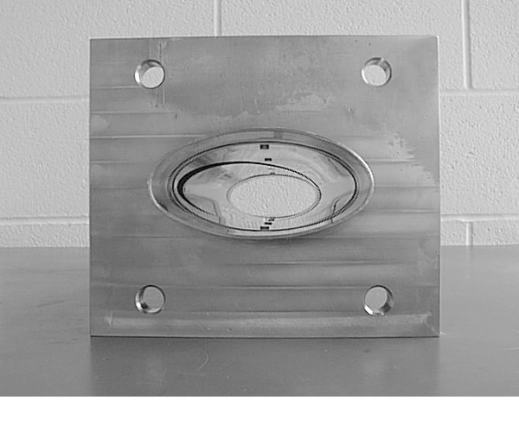
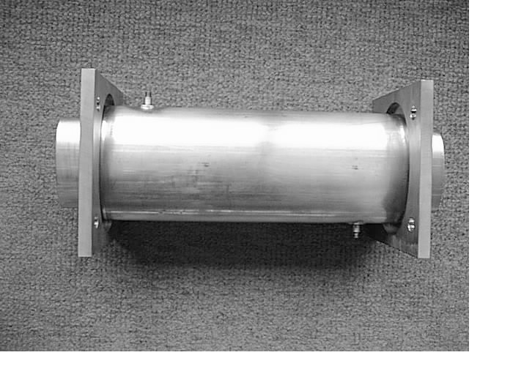
RECYCLER BPMs
End View
Top View
Split tube BPM Design
Pictures - Courtesy Jim Crisp

Slide 6
NEED FOR GOOD BPMs
In the Recycler, the BPM system is used for orbit measurement, as well as for ion clearing purpose. For this reason, initially it was decided to have 2 BPM’s per half cell or a total of 414 BPM’s for the 3320 meter ring. The associated injection and extraction beam lines together have an additional 28 BPM’s.
Why do we need a precision BPM system:
To measure “Injection oscillation” or “Orbit closure”.
To have a proper “Global orbit control” or to minimize the feed down effect, and
To have proper turn-by-turn (TBT) lattice measurement.

Slide 7
PRESENT BPM SYSTEM - A BRIEF OVERVIEW
In the present BPM system, the BPM electrodes reside in a vacuum inside the Recycler beampipe. The capacitance of the BPM electrodes and inductors at the input of the first pre-amp forms a resonant circuit at 7.5 MHz with a ‘Q’ of about 6. A second amplification stage with another 7.5 MHz resonant circuit (‘Q’~15) is used to drive the long cable runs from the tunnel to the service buildings. In the service buildings, the signals are transformed from differential to single-ended and routed to the log amplifier modules which provides the log of A/B to the digitizers and the ACNET front-end. The output of the log amplifier is a sample and hold signal triggered relative to beam revolution markers.

Slide 8
STATUS OF THE CURRENT BPM SYSTEM
Inadequacies of the present BPM system:
Frequency capability – Does not work at all required frequencies. Tuned to the third harmonic (a single frequency of 7.5 MHz) and is very sensitive to RF parameters. Need to work at 89 KHz, 2.5 MHz & 7.5MHz.
Logarithmic Amplifiers – Non-conformity of log amps leads to sampling time error. Log amps are designed to measure steady state signal, and are not very reliable with transient signal.
Channel Coupling – Coupling between BPM plates degrades the signal.
Reliability Issues – for example, switch failure due to perceived radiation damage.

Slide 9
USER's OBSERVATIONS ABOUT THE PRESENT BPM SYSTEM
The present system is noisy (large rms).
Poor transient (first turn) measurement of the beam position due to log non-conformity error inherent in the log amp modules.
Poor consistency of measurement of the same beam.
Uncertainty in offset or the physical center of the BPM.
Uncertainty in the reported absolute position.
Inconsistencies in reported relative position (orbit difference).
The measured relative displacements fall short of the MAD model prediction.
Poor measurement reproducibility on longer time scale (hours, days etc.).

Slide 10
WHY AN UPGRADE?
The motivation for upgrade has been necessitated to overcome the inherent limitations as well as performance shortfalls of the current system. The Digital BPM has the following characteristics (from Peter Preito’s note & Jim Crisp):
The new system uses a low pass preamp filter.
The BPM, pre-amp and the cable forms a band pass circuit.
Preamp input R and C_{plate}+C_{cable} set the corner frequency of 10MHz.
Reduces coupling at 2.5MHz and 7.5MHz by reducing the preamp input impedance.

Slide 11
UPGRADE PROPOSAL
Replace log amps with commercial digital receivers EchoteK ECDR-GC814 board (in the service building).
Modify preamps in the tunnel to work at 89 KHz, 2.5 MHz & 7.5 MHz – make the system more flexible.
No. 2 requires work on VME crates and cables (in service buildings).
New modified software to read out digital down converter.
Implement MDAT decoder software. MDAT is a communication system that transmits a variety of machine related information. In the case of the Recycler, MDAT provides the facility to track barrier bucket location based upon data provided by the Recycler Ring Low Level RF.

Slide 12
FUNCTIONAL SPECIFICATIONS AND REQUIREMENTS
Alignment Requirements:
The required relative alignment of the detector is defined in the “alignment reference table”. The position of the BPM’s also have a specific offset from the center line of adjacent magnets depending on the type of gradient magnets at the given location.
Tolerance for BPM Value
Transverse Offset 0.25mm
Relative Roll 5 mrad

Slide 13
FUNCTIONAL SPECIFICATIONS AND REQUIREMENTS
RECYCLER OPERATIONAL MODE (for Protons and Pbars):
2.5 MHz – In this mode of operation the MI completes a bucket to bucket transfer of 4 coalesced (2.5MHz) bunches spaced 21, 53MHz buckets apart into the Recycler. The Recycler captures the beam in the 2.5MHz buckets spaced 21, 53 MHz buckets apart.
7.5 MHz – Same as above but in this case the Recycler also plays out a 7.5MHz waveform on top of the 2.5MHz waveform.
89 KHz debunched beam in the barrier buckets – barrier buckets in the Recycler are typically 40 buckets wide (53 MHz buckets) and can have separations from 20 to 504 buckets with varying intensity listed in the dynamic range.

Slide 14
FUNCTIONAL SPECIFICATIONS AND REQUIREMENTS
System Performance Requirements:
The BPM system should be able to measure the beam position with these RF’s:
4 x 2.5 MHz Bunches (σ_{t} = 25 to 50 nsec)
12 x 7.5 MHz Bunches (σ_{t} = 6 to 12 nsec)
Barrier buckets with de-bunched beam (89KHz)

Slide 15
FUNCTIONAL SPECIFICATIONS AND REQUIREMENTS
Dynamic Range - We need to be able to measure:
1. From 0.3E10/bunch (1.2E10 total) to 7.5E10/bunch (30E10 total) particles for all 2.5MHz transfers.
From 0.1E10/bunch (1.2E10 total) to 2.0E10/bunch (24E10 total) particles for all 7.5MHz transfers.
From 1E10 to 400E10 particles for 89 KHz stored beam.

Slide 16
FUNCTIONAL SPECIFICATIONS AND REQUIREMENTS
SPECIFIC MEASUREMENTS:
For less than 1E10 particles or greater than 10mm amplitude, 1.5mm rms in absolute position and 0.5mm rms resolution reproducibility - subsequent measurements of the same beam.
For greater than 10E10 particles and less than 10mm amplitude 0.5mm rms in absolute position and 0.15mm rms resolution reproducibility – subsequent measurement of the same beam.
Ability to close the Recycler injection orbit to the closed orbit to less than 250 microns.
Day to day stability to the level of 1 and 2.

Slide 17
FUNCTIONAL SPECIFICATIONS AND REQUIREMENTS
SOFTWARE REQUIREMENTS:
The BPM system must provide real time data acquisition modes, operation mode coordination, and data scaling and access methods. The real-time component of this package implements the following operational modes:
Flash Mode: Single turn position of beam orbit around the ring. One need to be able to measure the first turn beam orbit in the Recycler after injection to the same accuracy as later orbits.
Background Flash Mode: Flash data taken at 200Hz.
Closed Orbit Mode: Average of up to 128 background flashes.
Turn-by-Turn Mode: Flash data for up to 1024 consecutive turns.

Slide 18
TESTS OF DDC BPM’s
Three bump scale and linearity measurement and comparison with the model.
BPM noise measurement.
Beam position stability over long time (hour, day) for stored beam.
Beam position stability for repeat injection (proper orbit closure).
Beam Position vs. Beam Intensity measurement.
Beam Position vs. Injection Phase Error measurement.
Position of 2.5 MHz beam with a large amount of debunched beam nearby.
Position of debunched beam in the barrier bucket, leading and trailing edges.
System sensitivity over a large range of RF voltage (Beam Position vs. Bunch Width measurement without barrier bucket).
Test the transient response besides moving phase and TBT measurement.

Slide 19
STATUS OF DDC CHANNEL TEST
We have acquired two EchoTek ECDR-GC814 digital receiver board. Each DDC board replaces four channels of the BPM. Both the board has been tested on the test stand with 2.5 MHz test pulse. The following 8 channels of old BPM system (with log amps) were replaced with the DDC board:
HP426, HP428, VP427, & VP429
HP604, HP606, VP603, & VP605
Several of the measurements described earlier (nos. 1, 2, 3, 4, 5, 6 & 9) were made with these 8 channels. Studies described in nos. 7, 8 and 10 are in progress.

Slide 20
VISUAL COMPARISON OF OLD BPM W/LOGAMP & NEW BPM W/DDC
6mm
Fast Time Plot with IBEAM=1.25E11
HP226 Present Log amps
12mm
New BPM’s w/DDC looks much quieter compared to the old BPM system.
VP429 w/DDC
HP428 w/DDC
VP427 w/DDC
-6mm

Slide 21
SATURATION OF PREAMPS IN THE NEW BPM SYSTEM
Six different injections with IBEAM~2.4E11. Fast time plot for each data set for about 12mts. No correction elements were moved. Beam position “as recorded” changed. Saturation of BPM preamps. To be fixed when we get the tunnel access. (FIXED)
HP428
20mm
VP427
VP429
HP426
3:43AM
4:52AM

Slide 22
SATURATION OF PREAMPS IN THE NEW BPM SYSTEM
6 different injections. 3 w/IBEAM~2.4E11. 3 w/IBEAM~1.25E11. Beam position is very stable for IBEAM~1.25E11. Variation in positions could be seen for IBEAM~2.4E11. Saturation effect. Each data set is for ~12 mts. The thickness of the trace is not noise. These are 29 ramps.
IBEAM = 2.4E11
1.25E11
HP428
1.25E11
VP427
20mm
VP429
HP426
16:52
18:10

Slide 23
MI RR RF Alignment

Slide 24
DISPERSION MEASUREMENT NOMINAL FREQ = 52810196
HP426
VP427
RMS=18μm
RMS=13μm
IBEAM = 1.25E11
HP428
VP429
RMS=27μm
RMS=18μm

Slide 25
DISPERSION MEASUREMENT
Nominal Frequency = 52810196
Changed Frequency = 52810696
Change by +500

Slide 26
DISPERSION MEASUREMENT NOMINAL FREQ + 500 = 52810696
HP426
VP427
RMS=12μm
RMS=8μm
IBEAM = 1.10E11
HP428
VP429
RMS=15μm
RMS=12μm

Slide 27
DISPERSION MEASUREMENT
Nominal Frequency = 52810196
Changed Frequency = 52809696
Change by -500

Slide 28
DISPERSION MEASUREMENT NOMINAL FREQ - 500 = 52809696
HP426
VP427
RMS=22μm
RMS=12μm
IBEAM = 0.95E11
HP428
VP429
RMS=25μm
RMS=18μm

Slide 29
DISPERSION MEASUREMENT
BPM Position | Frequency Change | IBEAM | Calculated Dispersion | MAD predicted value
HP426 | +500 | 2.40E11 | 1.80m | 1.79m
HP426 | +500 | 1.10E11 | 1.81m | 1.79m
HP426 | -500 | 0.95E11 | 1.78m | 1.79m
HP428 | +500 | 2.40E11 | 1.60m | 1.62m
HP428 | +500 | 1.10E11 | 1.60m | 1.62m
HP428 | -500 | 0.95E11 | 1.59m | 1.62m
THE VERTICALS SHOWED ALMOST NO CHANGE

Slide 30
RF VOLTAGE vs. STABILITY
RF Voltage lowered by 50%. FARBG2 changed from 0.8 to about 0.4

Slide 31
RF VOLTAGE vs. STABILITY. VOLTAGE LOWERED BY 50%.
HP426
VP427
RMS=16μm
RMS=18μm
IBEAM = 2E11
HP428
VP429
RMS=34μm
RMS=23μm
No difference in data quality.

Slide 32
RF VOLTAGE vs. STABILITY. VOLTAGE LOWERED BY 50%
FARBG2 changed from 0.8 to 0.4. No difference in data quality. Some beam can be visibly seen outside the RF buckets on MI channel 17.
VP427
HP426
VP429
HP428

Slide 33
RF VOLTAGE vs. STABILITY. VOLTAGE LOWERED BY 87%.
RF Voltage lowered by 87%. FARBG2 changed from 0.8 to about 0.1.
RF Bunches barely visible on MI Ch17.

Slide 34
RF VOLTAGE vs. STABILITY. VOLTAGE LOWERED BY 87%.
Wider RMS but the mean remains within the error.
HP426
VP427
RMS=144μm
RMS=59μm
IBEAM = 2E11
HP428
VP429
RMS=126μm
RMS=76μm

Slide 35
RF VOLTAGE vs. STABILITY. VOLTAGE LOWERED BY 87%.
FARBG2 changed from 0.8 to 0.1. Noisy measurement but measurement still possible.
VP427
HP426
VP429
SYSTEM IS INSENSITIVE TO A LARGE RANGE OF RF VOLTAGE.
HP428

Slide 36
BEAM POSITION STABILITY FOR REPEAT INJECTION
Repeated injection with different IBEAM of 1.25E11, 5E10, 2E10, 9E9, 4E9 and 2.5E9 and then went back to IBEAM of 5E10, 1.25E11 and 2.47E11
HP428
VP427
VP429
HP426
18:50
19:20

Slide 37
BEAM POSITION STABILITY FOR REPEAT INJECTION
Beam position for all the four BPM’s are very stable for different injections with different beam intensity.
HP428
VP427
VP429
HP426
19:35
20:00

Slide 38
BEAM POSITION STABILITY FOR REPEAT INJECTION
HP428
Beam position does not change as we make fresh injections with varying beam intensity.
VP427
VP429
HP426
20:30
21:00

Slide 39
BEAM POSITION STABILITY FOR REPEAT INJECTION
HP428
As the beam intensity goes down the rms of the distribution widens but still the mean beam position is within errors.
VP427
VP429
HP426
21:00
21:30

Slide 40
BEAM POSITION STABILITY FOR REPEAT INJECTION
HP426
VP427
RMS=19μm
RMS=9μm
IBEAM = 1.24E11 RMS = 10 – 20 μm
HP428
VP429
RMS=18μm
RMS=13μm

Slide 41
BEAM POSITION STABILITY FOR REPEAT INJECTION
HP426
VP427
RMS=70μm
RMS=24μm
IBEAM = 2.0E10 RMS = 25 – 70 μm
HP428
VP429
RMS=57μm
RMS=29μm

Slide 42
BEAM POSITION STABILITY FOR REPEAT INJECTION
HP426
VP427
RMS=98μm
RMS=48μm
IBEAM = 8.0E9 RMS = 50–100 μm
HP428
VP429
RMS=102μm
RMS=52μm

Slide 43
BEAM POSITION STABILITY FOR REPEAT INJECTION
HP426
VP427
RMS=311μm
RMS=142μm
IBEAM = 2.5E9 RMS = 140- 325 μm
Wider distributions, larger rms’s, but the beam position is still consistent within the measured error.
HP428
VP429
RMS=323μm
RMS=163μm

Slide 44
BEAM POSITION STABILITY FOR REPEAT INJECTION
Fast Time Plot for IBEAM = 2.5E9. The distribution is noisy (larger rms) but the beam position is clearly measurable.

Slide 45
BEAM POSITION STABILITY OVER 100 mts FOR CIRCULATING BEAM
IBEAM | HP426 | HP428 | VP427 | VP429
2.40E11 | -7.275±0.017 | 2.955±0.113 | 2.190±0.053 | -1.716±0.023
2.34E11 | -7.290±0.010 | 3.192±0.037 | 2.286±0.017 | -1.713±0.015
2.30E11 | -7.291±0.012 | 3.239±0.029 | 2.311±0.013 | -1.719±0.020
2.26E11 | -7.291±0.009 | 3.241±0.018 | 2.312±0.008 | -1.716±0.013
2.22E11 | -7.286±0.010 | 3.240±0.022 | 2.313±0.011 | -1.718±0.016
2.19E11 | -7.285±0.013 | 3.234±0.030 | 2.310±0.015 | -1.718±0.021
2.17E11 | -7.278±0.013 | 3.230±0.028 | 2.310±0.014 | -1.712±0.020
2.13E11 | -7.273±0.014 | 3.226±0.031 | 2.310±0.016 | -1.714±0.022
Each measurement was taken for about 12 minutes. Beam position is very stable. RMS varies between 10-30μm. In red, wider distribution (larger RMS) due to BPM saturation. Not a problem.

Slide 46
LINEARITY STUDY
BPM Position | Measured Slope mm/amp | MAD Prediction @corrector mm/amp (within ±10% )
HP426 | 4.21 | 4.66
HP428 | 4.49 | 4.66
VP427 | 3.22 | 3.46
VP429 | 2.72 | 2.99
Linearity was measured at 6 different beam intensities of 1.2E11, 5E10, 1.5E10, 8E9, 4E9 and 2E9 respectively. The response was found to be linear and the slope was identical for a particular BPM at all intensities.

Slide 47
LINEARITY STUDY
3
HP426
mm
IBEAM = 1.2E11
-17
-3 amp 2

Slide 48
LINEARITY STUDY
3
HP426
IBEAM = 5E10
mm
-17
-3 amp 2

Slide 49
LINEARITY STUDY
3
HP426
IBEAM = 1.5E10
mm
-17
-3 amp 2

Slide 50
LINEARITY STUDY
3
HP426
mm
IBEAM = 8E9
-17
-3 amp 2

Slide 51
LINEARITY STUDY
3
HP426
mm
IBEAM = 4E9
-17
-3 amp 2

Slide 52
LINEARITY STUDY
3
HP426
IBEAM = 2E9
mm
-17
-3 amp 2

Slide 53
RF PHASE RESPONSE
Without barrier buckets, 2.5MHz only.
FARBP2 changed from 36 to 34 buckets at 205 sec.
NO CHANGE IN BEAM POSITION

Slide 54
RF PHASE RESPONSE
Without barrier buckets, 2.5MHz only.
FARBP2 changed from 36 to 38 buckets at 255 sec.
NO CHANGE IN BEAM POSITION

Slide 55
RF PHASE RESPONSE
Without barrier buckets, 2.5MHz only.
FARBP2 changed slowly from 36 to 32 buckets.
NO CHANGE IN BEAM POSITION

Slide 56
RF PHASE RESPONSE
Without barrier buckets, 2.5MHz only.
FARBP2 changed slowly from 36 to 26 buckets.
NO CHANGE IN BEAM POSITION

Slide 57
RF PHASE RESPONSE
Without barrier buckets, 2.5MHz only.
FARBP2 changed from 36 to 26 buckets abruptly.
The BPM’s became noisy and the noise stays.

Slide 58
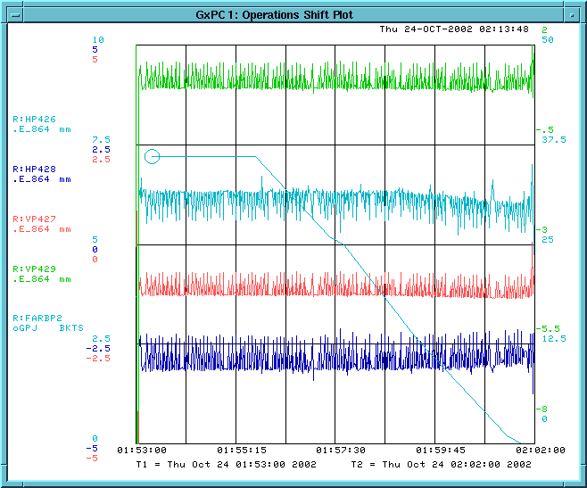
RF PHASE RESPONSE w/o BARRIER BUCKETS
FARBP2 decreased from 36 to 0, one 53MHz bucket at a time. Observed no drastic change in the beam positions but the positions show "transient noise" while the delay was changed. The positions shifted slightly as the delay was decreased by more than 16 buckets.
VP429
HP426
VP427
HP428

Slide 59
RF PHASE RESPONSE
Conclusion: We consider two buckets to be the “upper limit” for phase misalignment. When phase is changed slowly by several buckets (from 36 to 34, from 36 to 38, from 36 to 32or from from 36 to 26) the beam position does not change. The positions shifted slightly as the delay was decreased by more than 16 buckets. When the phase is shifted suddenly by several buckets, the noise increases on all the BPM’s and it does not go away. This may be because some beam spilled out of the bucket.

Slide 60
SUMMARY OF THE TEST CHANNELS MEASUREMENTS
We believe that these “8 test channels” have good stability, good linearity and good resolution. The preamp gain was modified to address the saturation issue and it made 5-7E9 the lower intensity limit. We re-did most of the measurements after proper gain modification and the system looks robust.

Slide 61
WHAT MORE TESTS NEED TO BE DONE?
Re-check the resolution and gain scale (histograms and three bumps) after gain modification throughout the specified dynamic range of current. (DONE)
Test the transient response besides moving the RF phase with TBT measurement.
Absolute Calibration – measure offset, scale correctness and long term consistency.
Integrate MDAT decoder into the system.

Slide 62
TASKS & SCHEDULE
Install the modified pre-amps, transition and DDC modules for the 4 test channels by 10/01 (Peter Prieto - 4 channels done).
Finish front-end software by 10/07 (Duane Voy – done).
Finish DAQ software by 10/07 (Tom Meyer – done).
Finish MDAT decoder integration into the current system by 10/18 (Craig McClure – still working - to be done).
Make measurements with the test channels and determine whether the performance meets the requirements. (Brajesh Choudhary and Martin Hu) (mostly done by 10/24). Some more work needs to be done.

Slide 63
TASKS & SCHEDULE
Test with 2nd set of 4 channels by 10/28 – BCC & Martin Hu. Most of the studies have been done. More in progress.
Make decision on which and how many BPM’s to replace and place the order for technical components by 10/30 – Mishra, Choudhary & Crisp.
It was agreed that if the test boards meet the specification, log amps associated with 216 BPM’s in the RR and 14 BPM’s each in both the transfer lines will be replaced. This will require 244 channels or 61 digital receiver card. Warren Shappert needs 4 digital boards for his BLT’s. It was agreed to buy a total of 70 DDC boards.
9. Try to install the crates, transition modules, cables etc. by 01/15/03 (Peter Prieto).

Slide 64
TASKS & SCHEDULE
Before January 03 shutdown make modification to all the preamps (Peter Prieto).
11. All the DDC’s should be available within 12-14 weeks of placing the order (hopefully by 2/15/03). Test all the DDC cards on bench within 6 weeks of arrival (by 3/20/03).
12. Complete tunnel calibration work during the shutdown (Peter Prieto).
13. Install and test (hardware and software) in the service building by 4/07/03 – Peter Prieto, Tom Meyer and Duane Voy.
14. Test, certify, run and integrate the new system by 4/21/03 – ALL.

Slide 65
COST ESTIMATE
1. Prototype test $ 30K
2. 70 EchoTek DDC card $ 525K ($7.5K/card)
3. Other Related Items $ 270K**
4. EchoTek Test stand $ 1K
5. Preamp upgrade $ 2.5K
Total $ 828.5K
** Other related items include VME64x crates, 2401 PowerPC, PMC UCD clock decoder, IPTSG, Digital I/O Board, rack top fan out cables etc.
Cost Estimated with Jim Crisp & Sergio Zimmermann.

Slide 66
SUMMARY & CONCLUSIONS
Three bump scale and linearity was measured. It agrees with the MAD model.
BPM noise was measured for the beam intensity of 1E10 to 40E10 and the measured noise is within the specified range.
The beam position was found to be stable over long time (about 100 minutes) for the stored beam.
The beam position was found to be stable within rms for repeat injection at different beam intensities.
Beam Position vs. Injection Phase Error was measured and it was found that the beam position is not very sensitive to slow & small phase change.
System sensitivity was measured over a large range of RF voltage and the system was found to be insensitive to a large voltage change.

Slide 67
SUMMARY & CONCLUSIONS
Still to Do:
Beam based alignment using MI-60 powered quadrupoles.
Position of 2.5 MHz beam with a large amount of debunched beam nearby.
Position of debunched beam in the barrier bucket, leading and trailing edges. (After MDAT system is incorporated)
Test the transient response besides moving phase and TBT measurement.

