Slide 1
Tricks of the trade for analysts in the energy biz
Jonathan Koomey, Ph.D.
numbers@numbersintoknowledge.com
http://www.numbersintoknowledge.com
Presented June 20, 2001 at Enron

Slide 2
Preliminaries: Genesis of this course
Names and introductions.
Tim wanted a review of “energy math” and of the structure of the U.S. energy system.
Turning Numbers into Knowledge deals with many key tricks of the trade.
Class is still a bit experimental.
Purpose is to help you “get it right” in a timely way.

Slide 3
Introduction: Philosophy
It takes work to absorb tools, tricks, and data--there’s no substitute for organization, discipline, and focus.
Know what you know, and what you don’t know.
Get it 70-90% right while noting uncertainties and data holes (much better than getting 99% and being late).

Slide 4
Put facts at your fingertips: Key references and data sources
Get organized--be systematic in your use of information.
Put widely used sources within easy reach (build a personal library and data sheet).
Make friends with a reference librarian.
Statistical Abstract of the U.S., almanacs, web sources (see handout)

Slide 5
Put facts at your fingertips: Documentation
Always date your work, even your roughest handwritten notes. Put date / time stamp in footer of spreadsheets, and manuscripts.
Stamp “Draft” and “Confidential”, as appropriate.
Carefully document code and assumptions in spreadsheets.

Slide 6
Understanding Data: Pitfalls in data acquisition and handling
Holdren’s four golden rules
  Avoid data that are mislabeled, ambiguous, badly documented, or otherwise of unclear pedigree
  Discard unreliable data that are invented, cooked, or incompetently created
  Beware of illusory precision
  Avoid spurious comparability.

Slide 7
Understanding data: Techniques for success
Be skeptical of statistics, even official ones
  Self generation data in a restructured market
  CA electricity use (CEC estimate ≠ EIA estimate)
Check for internal consistency
Identify numbers that are too small or large.
Read the footnotes.

Slide 8
Understanding data: Techniques for success (p.2)
Rounding errors (note different conventions)
  91.4 = 91 when rounded. 2.4 = 2 when rounded. The sum of the rounded numbers is 93, but the sum of 91.4 and 2.4 = 94.
Type data into the spreadsheet yourself.
Check that totals = the sum of the subtotals.
Check that the input data are correct and current (e.g., 1990s model using 1970s data)

Slide 9
Understanding data: Techniques for success (p. 3)
Check relationships between numbers that should be related in a predictable way.
Compare the numbers to something else with which you are familiar, as a “sanity check”.
Check that you can trace the calculation through from data to final results.

Slide 10
Understanding data: Consistent comparisons
Always note the year for dollars.
Correct dollars for inflation (nominal vs. real)--see data sheet
  Use GDP deflator, CPI, or specialized indices
  Nominal interest rate = Real interest rate + inflation
Normalize numbers to make comparisons easier (per GDP, per capita, per physical unit [like kWh], or to a base year).

Slide 11
Understanding data: Normalizing to a base year

Slide 12
Back of the envelope calculations: Introduction
You can figure out almost anything in an approximate way. You may not believe it, but it’s true!
Group exercise # 1: Figure out how much electricity (kWh) was used for each home in the U.S. in 1999, using numbers you know, then calculate the total used by all U.S.households (in billion kWh)

Slide 13
Back of the envelope calculations: Introduction (p.2)
Group exercise #2: How much gasoline is used in the U.S. for all light duty vehicles (passenger cars, SUVs and light trucks) in 1 year? Give the answer in gallons, barrels, and quadrillion Btus per year.

Slide 14
Back of the envelope calculations: Some key info
deca = 10, k = kilo = Thousand = 1,000 = 10³, M = mega = Million = 1,000,000 = 10⁶, G = giga = Billion (except if you’re British) = 1,000,000,000 = 10⁹, T = tera = Trillion = 1,000,000,000,000 = 10¹², P = peta = Quadrillion = 1,000,000,000,000,000 = 10¹⁵, E = exa = Quintillion = 1,000,000,000,000,000,000 = 10¹⁸
Exponential notation: 10² = 100, 10³ = 1,000. The exponent equals the number of zeros. This notation is also sometimes written 10e2. So, kilo = 10³, mega = 10⁶, etc. Note also that 10⁰ = 1.

Slide 15
Back of the envelope calculations: General approach
First make a model, balancing accuracy against the time needed to create the calculation
  Back of the envelope, spreadsheet, or code
A simple model
  Gas used per week (gallons) =
  If a car gets 20 mpg in normal use, for a 1000 mile trip, the simple estimate is that the car will use 50 gallons.

Slide 16
BOE calculations: A more complex model
If a 1000 mile trip doesn’t have same highway/city split as normal use, must rely on the 2d model
  Gas/week (gals) =
  assuming 15 mpg city, 25 mpg highway, 95:5 split between highway and city driving, yields 41.3 gallons
Assumptions about how many miles driven are buried in the first model. There are always buried assumptions

Slide 17
BOE calculations: some parting advice
Once you’ve made a model, plug in the numbers you know, and make assumptions for those you don’t know.
Don’t get hung up on a particular number! Set up the calculation and get data later.
Don’t be afraid to approximate to speed things up (e.g., to divide 4000 by 35, divide 3500 by 35 instead to get 100).

Slide 18
BOE calculations: More tips
Bound the problem
  Plug in high and low estimates for key parameters
  Combine all high estimates in one scenario, and all low estimates in another
  Test sensitivity of each variable in analysis to arbitrary changes in inputs
Create a data sheet, and memorize key conversion factors (handout)
Understand commonly used units (Quads, TWh, joules, Mbtus, MMBtus, kW vs kWh)

Slide 19
BOE calculations: Unit analysis
You can always multiply some number by 1 without changing its value.
Example: 1 kWh = 3412 Btus. The ratio of 1kWh/3412 Btus = 1.0, so if I have 100 kWh, that is equivalent to 100 kWh * 3412 Btus/1 kWh = 341,200 Btus. In that equation, the kWhs cancel, yielding Btus.

Slide 20
BOE calculations: Unit analysis (p.2)
What is a Watt, and why does kWh have hours in it?
  1 Watt = 1 Joule/second
  A watt is a rate of flow, like gallons of water per hour. A watt-hour is the amount of energy if a 1 Watt power drain continues for 1 hour (it’s like the water that collects in the tub, in gallons).
  So if a 1 gallon per minute flow rate continues for 1 hour, there will be 60 gallons of water in the tub after 1 hour. If a 1000 W load continues for 1 hour, then 1000 Wh (1 kWh) will be used (i.e., will be “in the tub”).

Slide 21
BOE calculations: Unit analysis (p.3) and concluding remarks
Let’s show that 1 kW = 1000 J/s:
  =1 kW
Let’s convert 1 kWh to Joules to prove kWh is an energy unit:
= 3.6 MJ
• You can estimate almost anything!

Slide 22
Summary of the U.S. energy system: Introduction
Everyone in this industry needs to have a basic understanding the production and use of energy in the U.S.
U.S. is the world’s largest energy user, and one of the largest energy producers.
The U.S. is also one of the largest importers of energy.

Slide 23
Summary of the U.S. energy system: Major events
1973--Arab Oil Embargo
1979-80--Iranian revolution, CAFE stds
1986--Oil price decline
1992--Energy Policy Act
1987-2001--Efficiency standards, energy Star programs.
2000-2001--Oil & gas price hikes, electricity crisis in CA and the West.

Slide 24
Major oil supply disruptions
Of course, these would be best viewed normalized as a % of total world consumption.

Slide 25
Summary of the U.S. energy system: Lessons from history
Forecasting is tough, but scenarios can help (Royal Dutch Shell in 1970s)
Energy demand and GDP need not grow in lock step
Demand-side technologies and programs can save energy at a cost that is typically half of the cost of supplying that energy.

Slide 26
The Brownian Random Walk of World Real Oil Price, 1881–1993
Year-to-year percentage price changes with a one-year lag between the axes. If the price movements showed a trend, the “center of gravity” would
favor a particular
quadrant. All that
happened after 1973 is that volatility tripled; changes stayed perfectly random,
just as for any other commodity.
Graph used courtesy of Amory B. Lovins, RMI
Graph devised by H.R. Holt, USDOE; presented by Rocky Mountain Institute, www.rmi.org © RMI 2001

Slide 27
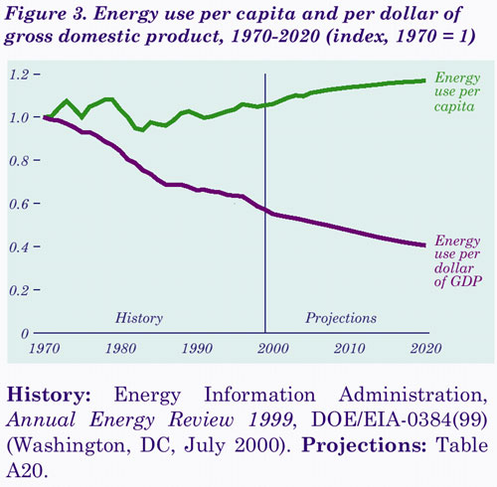
Energy use per capita and per GDP

Slide 28
Efficiency is cheaper than supply
Potential Electricity Savings from High-Efficiency Case in 2010
Notes:
23

Slide 29
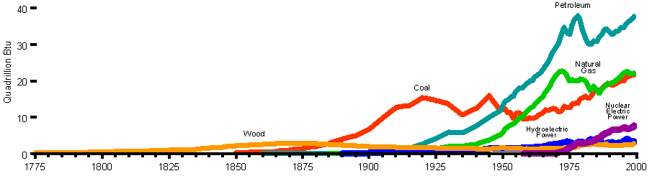
Historical U.S. energy use by fuel
Source: U.S. Energy Information Administration, U.S. DOE, Annual Energy Review 1999.

Slide 30
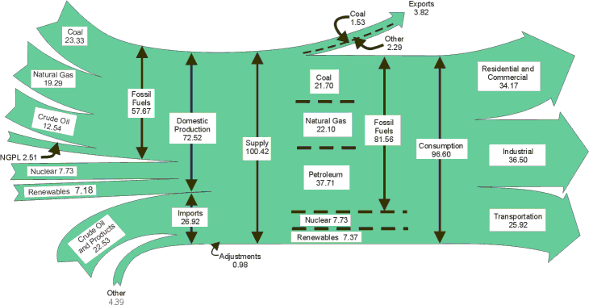
Energy flows in the U.S. in 1999 (Quadrillion Btus, or Quads)
Source: U.S. Energy Information Administration, U.S. DOE, Annual Energy Review 1999.

Slide 31
Summary of the U.S. energy system: A subtlety about electricity
When converting electricity use from kWh to Btus, for comparison to other energy forms, you can use two different methods:
  Site energy (measured at the customer’s meter using a conversion factor of 3412 Btus/kWh)
  Source energy (including the generation, transmission, and distribution losses), resulting in a conversion factor that is typically 10,500 Btus/kWh (though this varies by power plant).

Slide 32
Summary of the U.S. energy system: A subtlety about fuels
There are two ways to measure heat content of fuels: Lower heating value (LHV) and higher heating value (HHV)
  LHV eliminates from the heat content the heat needed to evaporate moisture in the fuel, while HHV includes that heat content.
  Efficiencies measured using LHV are 5-10% higher for fuel fired power plants than using HHV
  Make sure both efficiency and prices are consistent.
  US uses HHV, Europe uses LHV, typically.

Slide 33
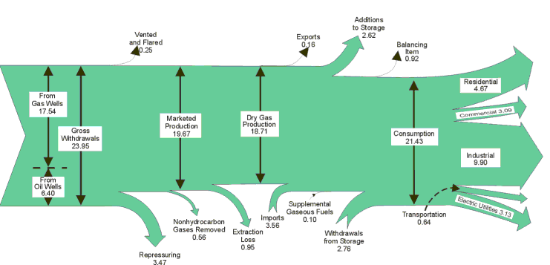
Energy flows in the U.S. natural gas sector in 1999 (Quads)
Source: U.S. Energy Information Administration, U.S. DOE, Annual Energy Review 1999.

Slide 34
Summary of the U.S. energy system: An exercise
Group exercise #3: A typical U.S. home that is heated by natural gas uses about 100 MMBtu (million Btu)/year. How much gas is that at standard temperature and pressure? How does that volume compare to that of a typical house?

Slide 35
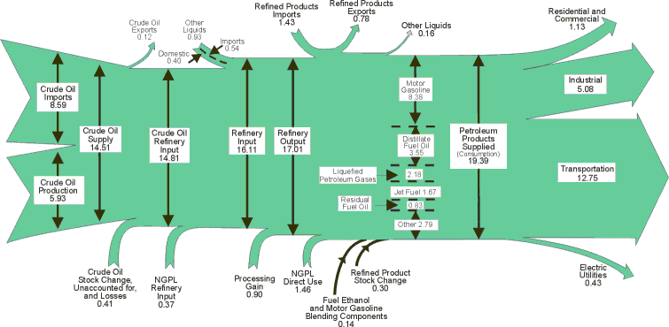
Energy flows in the U.S. petroleum sector in 1999 (Quads)
Source: U.S. Energy Information Administration, U.S. DOE, Annual Energy Review 1999.

Slide 36
Summary of the U.S. energy system: Prices

Slide 37
Summary of the U.S. energy system: Res. natural gas costs
Total delivered nominal natural gas cost to residences in 2000 = $0.96/therm

Slide 38
Summary of the U.S. energy system: U.S. criteria air pollutants
Source: U.S. Energy Information Administration
Particulate matter
Fugitive dust
Sulfur dioxide
Organic compounds
Nitrogen oxides
Carbon monoxide

Slide 39
Summary of the U.S. energy system: U.S. carbon emissions
Source: U.S. Energy Information Administration.

Slide 40
Summary of the U.S. energy system: Forecasts
The official source of U.S. energy forecasts is the Energy Information Administration, which is part of the U.S. Department of Energy (http://www.eia.doe.gov)
Consult the EIA web site for their truly outstanding and colossal collection of publicly available data.

Slide 41
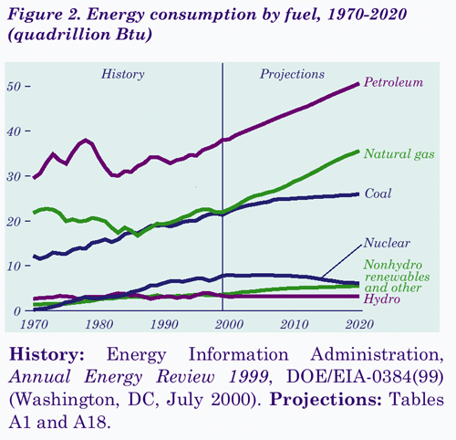
Summary of the U.S. energy system: Consumption forecasts
Note: Hydro is relatively small on the National scale, but is very important in the Northwest.

Slide 42
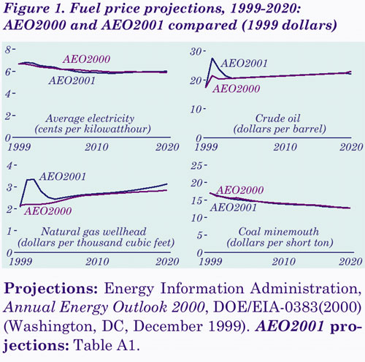
Summary of the U.S. energy system: Price forecasts

Slide 43
Summary of the U.S. electricity system: Introduction
U.S. is the world’s largest electricity producer and user
The U.S. electricity system is still one of the most reliable and cost effective in the world (CA problems notwithstanding).
Power systems vary greatly by region.

Slide 44
Summary of the U.S. electricity system: Major events
Early 1900s--competitive market with multiple providers (duplication led to appreciation of natural monopoly status and the regulatory compact--obligation to serve, geographic monopoly, regulation of rates).
Economies of scale in generation reduced costs until about 1970, then costs went up.
1978 PUR_x0008__x0008_PA, implemented early 1980s (SO_x0008_4 in CA)_x0008_--Deregulation of generation.

Slide 45
Summary of the U.S. electricity system: Major events (continued)
1987 to mid-1990s, Heyday of utility DSM
Early to mid-1990s, realization that generation might not be a natural monopoly any more (T&D still is, of course)
In 1992 EPACT deregulated transmission (also FERC order 888 opened T up)
Retail restructuring in mid to late-1990s, sometimes successful, sometimes not
2000-2001+, CA power crisis

Slide 46
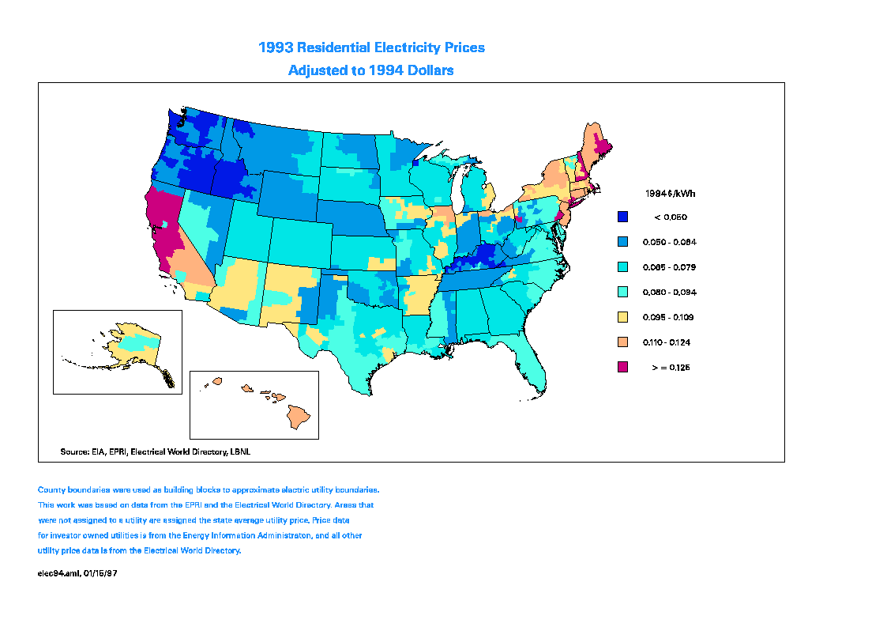
High Electricity Prices Were a Strong Driver for Retail Restructuring - 1993

Slide 47
Summary of the U.S. electricity system: Lessons from history
Forecasting is tough, but some techniques (e.g., end-use analysis) are better than others (Huss at Northeast utilities analyzed this)
Electricity demand and GDP need not grow in lock step, though the connection is stronger than for primary energy and GDP.
Demand-side technologies and programs can save electricity at a cost that is typically half of the cost of supplying that energy.

Slide 48
Electricity Consumption Per CA GDP and Per Capita
Per GDP
Per capita
source: California Energy Commission

Slide 49
Summary of U.S. electricity system: History lessons (cont.)
Mass-produced technologies can achieve economies of scale more quickly than can site-built technologies
Non-utility generation can make major contributions to installed capacity

Slide 50
Cost of mass produced vs. site built generation technologies
Sources: Energy Information Administration, California Energy Commission, and other sources, compiled by Jonathan G. Koomey and Nate Hultman, LBNL (JGKoomey@lbl.gov, 510/486-5974)

Slide 51
Investor-Owned Utility Investment in Generation
Declined in the 1980’s

Slide 52
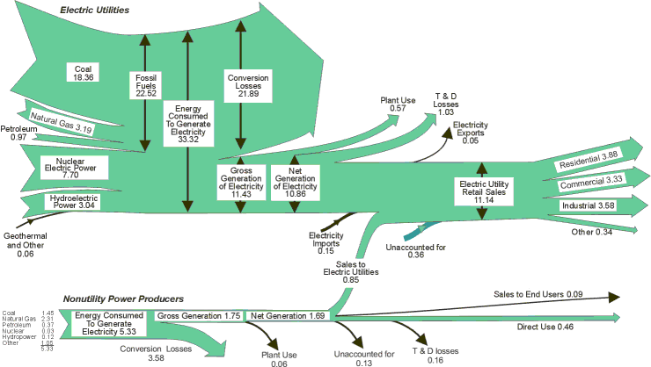
Energy flows in the U.S. electricity sector in 1999 (Quads)
Source: U.S. Energy Information Administration, U.S. DOE, Annual Energy Review 1999.

Slide 53
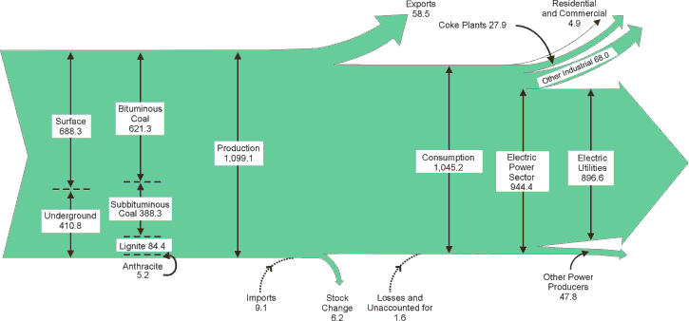
Energy flows in the U.S. coal sector in 1999 (Quads)
Source: U.S. Energy Information Administration, U.S. DOE, Annual Energy Review 1999.

Slide 54
Summary of the U.S. electricity system: An exercise
Group exercise #4: How big a pile of coal (in cubic meters) is burned by a typical 1000 MWe baseload power plant in one year? (Hint: Don’t forget the capacity factor)

Slide 55
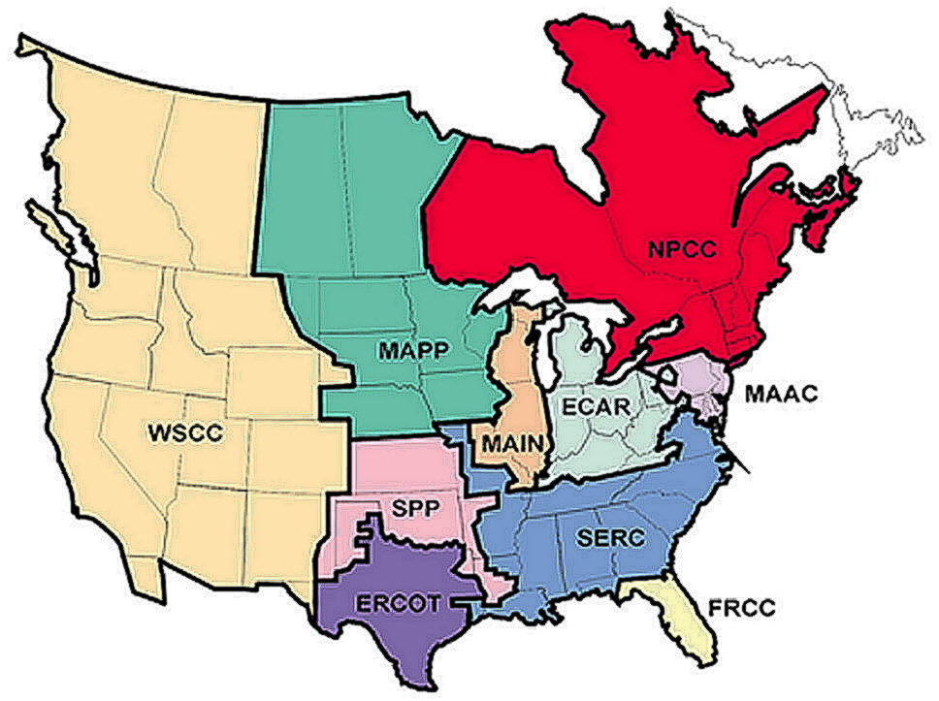
Electricity reliability regions

Slide 56
Summary of the U.S. electricity system: Peak demand
U.S. Peak demand = 690 GW in 2000

Slide 58
Summary of U.S. electricity system: WSCC demand and capacity

Slide 59
Summary of the U.S. electricity system: Power plant heat rates
Heat rates measured efficiency of power plants, and in the U.S. are often expressed in Btus/kWh
I also express heat rates as a unitless ratio of energy in/energy out (multiply by 3412 to get the more familiar HR in Btus/kWh)
Watch out for LHV vs. HHV!

Slide 60
Summary of U.S. electricity: Typical power plant heat rates
Heat rates for fuels measured using lower heating value.

Slide 61
Summary of U.S. electricity: U.S. electric generation--2000
Total U.S. generation in 2000 is 3400 TWh, not including cogeneration

Slide 62
Summary of U.S. electricity: U.S. electric capacity--2000
Total U.S. capacity in 2000 is 750 GW, not including cogeneration

Slide 63
Summary of U.S. electricity: U.S. cogeneration--2000
Total U.S. cogeneration in 2000 is 310 TWh

Slide 64
Summary of U.S. electricity: WSCC electric generation--2000
Total WSCC generation in 2000 is 620 TWh, not including cogeneration

Slide 65
Summary of U.S. electricity: WSCC electric capacity--2000
Total WSCC capacity in 2000 is 140 GW, not including cogeneration

Slide 66
WSCC Trading Hubs and Transmission Lines
British Columbia
Alberta
BC
Hydro
Alberta
Pool
WA
Mid
Columbia
MT
OR
ID
4800
WY
CA
COB
4800
3200
NOB
3200
NV
UT
NP-15
CO
1250
3000
AZ
Four
Corners
NM
SP-15
Palo
Verde

Slide 67
Summary of U.S. electricity: WSCC /SW generation--2000
Note: SW includes the Rocky Mountain States and Arizona.
Total WSCC/SW generation in 2000 is 150 TWh, not including cogeneration

Slide 68
Summary of U.S. electricity: WSCC/SW capacity--2000
Note: SW includes the Rocky Mountain States and Arizona.
Total WSCC/SW capacity in 2000 is 30 GW, not including cogeneration

Slide 69
Summary of U.S. electricity: WSCC/NW generation--2000
Total WSCC/NW generation in 2000 is 260 TWh, not including cogeneration

Slide 70
Summary of U.S. electricity: WSCC/NW capacity--2000
Total WSCC/NW capacity in 2000 is 53 GW, not including cogeneration

Slide 71
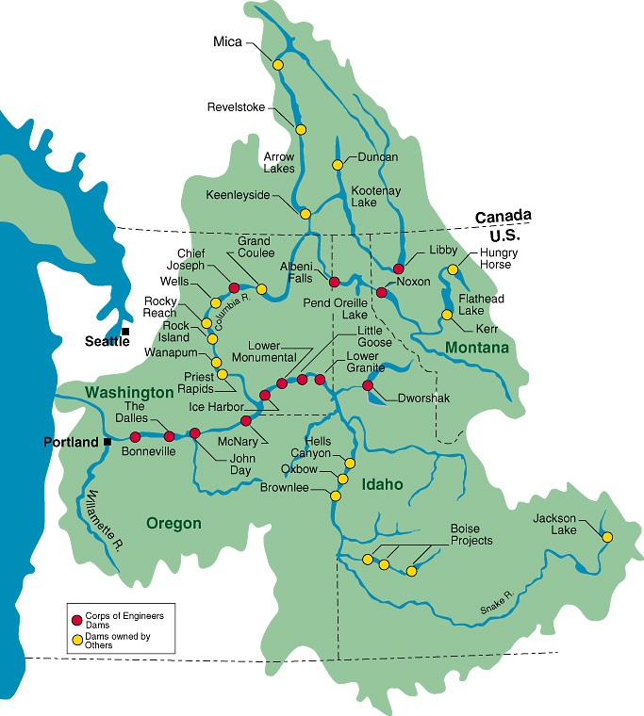
Columbia Basin Map

Slide 72


Slide 73
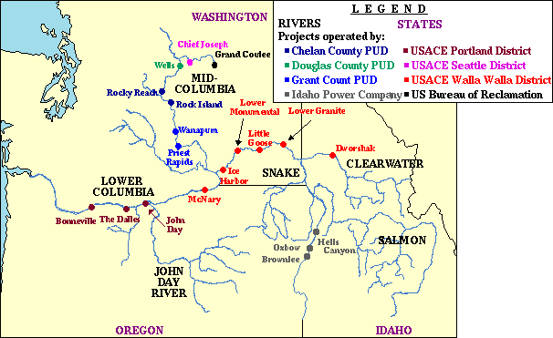

Slide 74
BOE calculations: One more exercise
Group Exercise # 5: How many acre-feet does a typical U.S. household use per year to take showers? How many gallons and acre-feet is that for the U.S. as a whole?

Slide 75
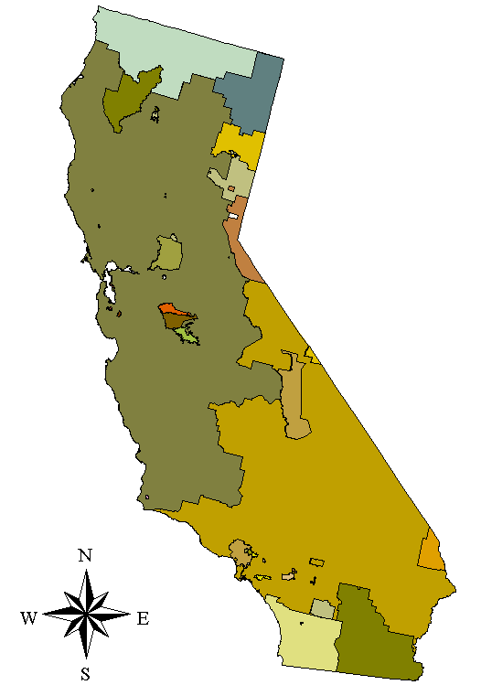
Disco & Utility Service Territories
PC ORP
PG&E
SMUD
LADWP
PG&E
SCE
SDG&E
source: California Energy Commission

Slide 76
Summary of U.S. electricity: WSCC/CA&NV generation--2000
Total WSCC/CA&NV generation in 2000 is 210 TWh, not including cogeneration

Slide 77
Summary of U.S. electricity: WSCC/CA&NV capacity--2000
Total WSCC/CA&NV capacity in 2000 is 56 GW, not including cogeneration

Slide 78
Summary of U.S. electricity: Load characteristics
What’s a load factor? LF =
Typical LFs are 50-60% for utility systems. Industrial LFs are higher, residential LFs are lower. Res. cooling LF can be 5-15%.
Load factors are a simple way to understand peak demand issues for a particular utility, sector, subsector, or end-use

Slide 79
CA peak day load shape 1999

Slide 80
Summary of U.S. electricity: Load characteristics (p. 2)
Peak vs. avg MW. One average MW for 1 year = 8760 MWh. Over one month = 730 MWh (a MW-month).
Peak period definition. If peak period is 10 hours per day, a peak MW is equivalent to 10 MWh/day.

Slide 81
Summary of U.S. electricity: Load characteristics (p. 3)
Typical definition of peak period in WSCC is from 0700 to 2300, 6 days per week (16 hours per day),
A peak MW in WSCC is therefore equivalent to 16 MWh per day or about 420 MWh/month.

Slide 82
Summary of U.S. electricity: Load duration curves (LDCs)
Rank order hourly loads starting from the highest to the lowest, assuming independence.
Stack supply resources up to fill the area under the curve, starting with the lowest marginal cost resources first.
LDCs were originally developed for computational convenience, but they are still useful conceptual constructs.

Slide 83
Summary of U.S. electricity: Prices

Slide 84
Summary of U.S. electricity: Levelized costs of generation
Need to calculate busbar costs for rough estimates.
Annualize capital costs (like a mortgage)
Add in fuel, O&M, and emissions trading costs
Don’t forget T&D losses to get to delivered costs at the meter.

Slide 85
Summary of U.S. electricity: Calculating levelized cost
Levelized Cost =
CRF (capital recovery factor) also =
n = lifetime, r = interest rate

Slide 86
Summary of U.S. electricity: Calculating levelized cost (p.2)
Fuel cost
Capital cost of $500/kW, using CRF = 0.1, fixed O&M of $30/kW/year, 91.3% CF
Add variable O&M of $0.005/kWh
Then add cost of NO_{x} permits.
=$0.032/kWh

Slide 87
Summary of U.S. electricity: Calculating levelized cost (p.3)
Externality cost =
Total delivered cost of power =
=$0.003/kWh
$0.032 + 0.01 + 0.005 + 0.003 = $0.05/kWh

Slide 88
Summary of U.S. electricity: Costs of power to CA residences
Total electricity price for CA residences is about $0.12/kWh in 2000
Distribution from Jon Koomey’s utility bill, January 2001

Slide 89
Summary of U.S. electricity: Introduction to forecasting
Forecasts are used
  For planning (either institutional or personal
  For advocacy (to raise awareness of an issue)
  For research (to explore the future)
All forecasts are wrong in some respect, but they are usually still valuable
  Systemize an investigation into future choices.

Slide 90
Summary of U.S. electricity: Background on forecasting
Most basic forecasts are econometric or trend based, using simple extrapolation or regressions on historical data.
These techniques are notoriously inaccurate for energy demand forecasting, except for short term projections.
Inaccuracy of econometric forecasts in the 1970s and early 1980s led to widespread use of the “end-use” approach in the U.S. by the late 1980s.

Slide 91
Summary of U.S. electricity: Forecasts vs. scenarios
A forecast is a prediction of how the future WILL unfold.
A scenario is a story of how the future MIGHT unfold if certain events come to pass (there is always more than one scenario) .
Scenarios are used for making decisions in the face of uncertainty (example: Royal Dutch Shell in the early 1970s).

Slide 92

US Primary Energy Consumption Is Now Within 2% of the 1976 “Soft Energy Path”
Graph used courtesy of Amory B. Lovins, RMI

Slide 93
Summary of U.S. electricity: More on scenarios
Tell stories using scenarios to help develop your intuition about the key driving forces affecting the future.
Develop strategies that are robust in the face of inevitably imperfect forecasts (e.g., build-to-order manufacturing).

Slide 94
The Golden Rules of Scenario Analysis
Models can be useful, but the focus should be on data development and scenario creation, NOT modeling. Models always lag the state of knowledge about new energy resources.
Watch out for the unexpected!

Slide 95
Gas Spot Price at PG&E Citygate for 2000

Slide 96
Summary of U.S. electricity: Exponential growth
Many phenomena grow exponentially for part of their life cycle.
  Characterized by an annual growth rate, say 2% per year
Exponential growth can be powerful over the long term (retirement planning--20 year old vs 30 year old)

Slide 97
Summary of U.S. electricity: Exponential growth (p. 2)
A key trick of the trade -- “the rule of 70”.
  For any annual growth rate, (e.g., 2% /yr), you can calculate the time for something growing at that rate to double, by dividing 70 by the growth rate (doubling time = 35 yrs)
Can use doubling times to do quick calculations when the data don’t warrant more detailed work or if you don’t have time

Slide 98
Summary of U.S. electricity: Forecasting exercise
Group Exercise # 6: Some have claimed that electricity used by office equipment is about 13% of all electricity use now, and that it will grow to half of all electricity use in 20 years. The same folks are claiming that all electricity use will grow 3.5% per year for 20 years, and that most of that growth will be due to increased electricity used by office equipment. Are these claims internally consistent? (note, these claims are not correct, but that’s another story). Total electricity use in the U.S. in 1999 was about 3300 billion kWh.

Slide 99
Summary of U.S. electricity: Another exercise (for after class)
Find a forecast on a topic you care about (doesn’t have to be electricity), and learn how it was created. Talk to the author and read any supporting documentation. Do you still find it plausible?

Slide 100
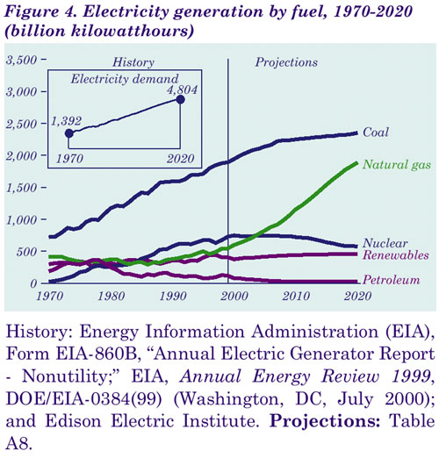
Summary of U.S. electricity: Forecasted electricity generation

Slide 101
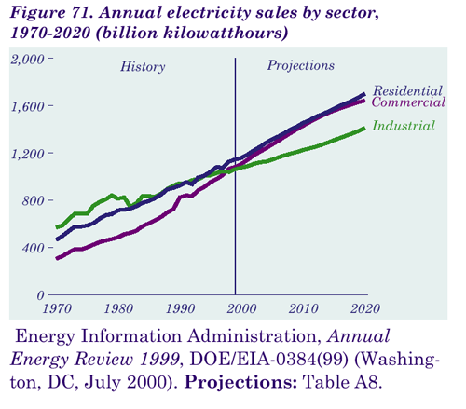
Summary of U.S. electricity: Forecasted electricity sales

Slide 102
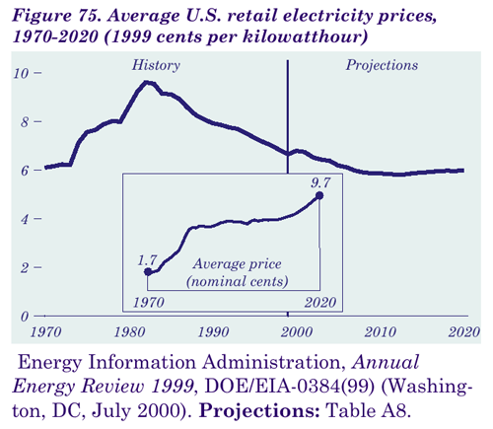
Summary of U.S. electricity: Forecasted electricity price

Slide 103
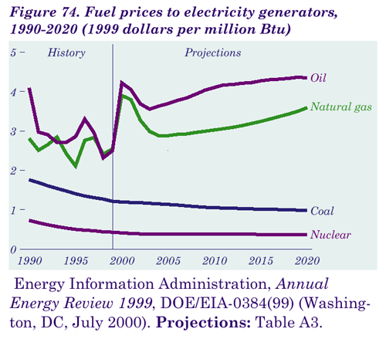
Summary of U.S. electricity: Forecasted generator fuel costs

Slide 104
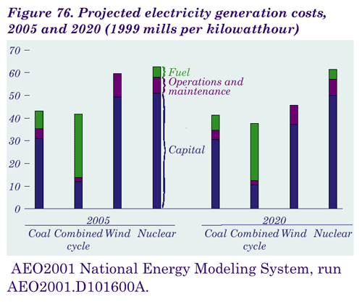
Summary of U.S. electricity: Forecasted generation costs

Slide 105
Conclusions/wrap up
Be deliberate, systematic, and methodical in how you use and present information.
Value your time and that of others—your time is your life, so make it count.
Questions or comments? Email me at numbers@numbersintoknowledge.com

