Slide 1

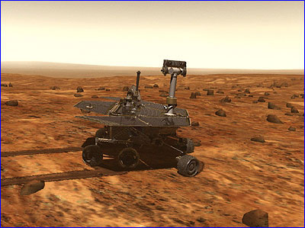
Reducing Software Security Risk Through an Integrated Approach
David Gilliam, John Powell, Josef Sherif, & Tom Wolfe
California Institute of Technology,
Jet Propulsion Laboratory
Matt Bishop
University of California at Davis
California Institute of Technology, Jet Propulsion Lab

Slide 2
NASA RTOP:
Reducing Software Security Risk
NOTE:
  This research was carried out at the Jet Propulsion Laboratory, California Institute of Technology, under a contract with the National Aeronautics and Space Administration.
  The work was sponsored by the NASA Office of Safety and Mission Assurance under the Software Assurance Research Program lead by the NASA Software IV&V Facility.
  This activity is managed locally at JPL through the Assurance and Technology Program Office.

Slide 3

Current Collaborators
David Gilliam – Principle Investigator
Network and Computer Security, JPL
John Powell – Research Engineer
Quality Assurance, JPL
Josef Sherif – Research Engineer
Network and Computer Security, JPL
Tom Wolfe – Research Engineer
Network and Computer Security, JPL
Matt Bishop –Professor of Computer Science
University of California at Davis

Slide 4
Introduction
Research Goal
The instrument contents
Software Security Checklist
Integration of the instrument contents
Model checking
The Flexible Modeling Framework (FMF)
  FMF components and combinations
  Rapid model updating

Slide 5
Research Goal
Reduce security risk to the computing environment by preventing and/or mitigating vulnerabilities and exposures through the software life cycle process
  Develop a Software Security Assessment Instrument (SSAI)
  Five foci
    Software Security Checklist (SSC)
    Model-based security specification and validation approach (MBV)
      Flexible Modeling Framework Instrument (FMF)
    Vulnerability Matrix (VMatrix)
    Software property-based testing tool (PBT)
    List of Security Assessment Tools (SAT)
Notes:
Vulnerabilities are internal weaknesses in the code that can be exploited
Exposures are external interfaces that are susceptible to intrusions
Specification, development, implementation, operations, maintenance

Slide 6
Software Security Checklist (SSC)
NASA NPG 2210
  External Release of Software
  Software Security Checklist
Two phases
  Phase 1: Provide instrument to verify external release of NASA software does not present a security risk to NASA and its partners
  Phase 2: Provide instrument to integrate security as a formal approach to the software life cycle

Slide 7
Software Security Checklist (cont.)
Phase 1
  Checklist for use prior to external release of software
    Concerns include the following:
      HR information
      Operational processes
      Internal processes
      Sensitive IP addresses
      Crypto Certificates and Keys
      Embedded userids and passwords
    Document describing purpose and use of the checklist

Slide 8
Software Security Checklist (cont.)
  Proposed procedure for using the checklist
  Examples for automating (as much as possible) software checking
    Perl script for checking strings with IP addresses
    Perl script for checking dangerous subroutines
      gets
      fgets

Slide 9
Software Security Checklist (cont.)
Phase 2
  Determine scope of Phase 2
    Analyze and prioritize what items are of concern
      Cost of life cycle (Risk cost grows exponentially throughout software life cycle)
      Cost of where problems occur
      Security risk analysis
    Determine and prioritize most effective solutions for addressing the concerns
      Need for software security for architect?

Slide 10
Software Security Checklist (cont.)
  Develop Checklists for use through the software life cycle process
  Develop Document describing purpose and use of the checklists
  Develop or Provide list of Tools/Instruments that can assist in automation of checks
  Provide Recommendations and lessons learned for software security architecture

Slide 11
Instrument Contents Integration
Each part of the instrument supports the other parts
VMatrix provides known vulnerability properties to PBT
PBT provides newly discovered code vulnerabilities to the Vmatrix property set and code level verification feedback to MBV
MBV provides newly discovered vulnerabilities scenarios to the Vmatrix property set and early lifecycle verification results to PBT for tracability purposes
VMatrix
Attacks not found
in the Wild
PBT
MBV

Slide 12
The Flexible Modeling Framework (FMF)
Collection of Model Components
Each Individual Component
Model Checker
If Combination State Space is too Large
Unique Component Combinations
Yes
No
Combinations Containing α
Heuristic Propagation of Results
Component Combiner
Updated Component α
Implicit
Explicit
MCCT

Slide 13
Model Checking (MC)
FMF uses MC as its core technology
Exhaustive search
Verification of temporal logic properties
MC limited by an exponential state space explosion
m^{n} s.t. m=val_range, n=|vars|
Can MC still be useful when the system is large?

Slide 14
FMF Components and Combinations
FMF models the system (S) as a series of small model components (c_{i} | 1 ≤ i ≤ n) which are model checked
  ({c₁, c₂, c₃, … c_{n}} = S) /\ (c_{i} ⊂ S)
FMF model checks component combinations
(C_{k} | (C_{k} ⊂ S) /\ (1 ≤ |C_{k}| ≤ m) where the state space of C_{m+1} is beyond memory thresholds

Slide 15
Model Component
Combination Tree (MCCT)
MCCT level l = {C_{k} | (| C_{k}| = n-l ) /\ (n = |S|)}
  MCCT root node (level 0) – full system of n components
  MCCT leaf nodes (level n-(n-1)) – single components
State space explosion threshold separates the explicit and implicit portions of the MCCT
  Explicit portion – <C_{k}, VV = 0||2, CR = 1>
    known property verification knowledge from MC results
  Implicit portion – <C_{k}, VV = (0,2), CR = (0,1)>
    derived verification knowledge from explicit portion of MCCT

Slide 16
A Simple Example
Implicit MCCT
CR_{i+1} = CR_{i} – p →
VV_{ABCD} = 1.33
CR_{i} = 1 – p →
0 < CR < 1
VV_{ABC} = 1.33
VV_{ABD} = 2.00
VV_{ACD} = 1.33
VV_{BCD} = 0.67
VV_{AB} = 2
VV_{AC} = 2
VV_{AD} = 2
VV_{BC} = 0
VV_{BD} = 2
VV_{CD} = 0
CR = 1 →
VV_{A} = 0
VV_{B} = 2
VV_{C} = 2
VV_{D} = 2
Explicit MCCT
CR = 1 →
CR = 1

Slide 17
Potential Follow-On Work
Training in use of security assessment tools in the software development and maintenance life-cycle
Development of re-composable model sub-components
Develop capability for easy storage and access of a library of common network security model components and past verification results
Develop a programmer interface to assist users with generating properties for input into the tools

Slide 18
Potential Follow-On Work (cont.)
Enhancing and augmenting the toolset
  Port the code to run on different operating systems in a run-time environment
  Include additional programming and scripting languages that the Tester’s Assistant tool can slice for vulnerabilities
  Augment the toolset by incorporating or developing additional tools
  Develop a graphical user interface front-end checklist and decision tree to assist in building the Model to be verified
  Develop an interface into the AART Tool

Slide 19
Summary
Growth of NASA’s network aware software applications and collaborative work increase risk to NASA environment
  Risk will continue to increase as collaboration increases
Software Security Assessment Instrument for use in the software development and maintenance lifecycle

Slide 20
Summary (Cont.)
Assessment Instrument composed of three tools and reports:
  Vulnerability Matrix
  Tester’s Assistant
  Flexible Modeling Framework
Tools can be used collectively or individually
There is a potential for wider application of the instrument beyond assessment of security of software

Slide 21
FOR MORE INFO...
David Gilliam
JPL
400 Oak Grove Dr., MS 144-210
Pasadena, CA 91109
Phone: (818) 354-0900 FAX: (818) 393-1377
Email: david.p.gilliam@jpl.nasa.gov
Website: http://security.jpl.nasa.gov/rssr/
John Powell
MS 125-233
Phone: (818) 393-1377
Email: john.d.powell@jpl.nasa.gov

Slide 22
Backup Slides

Slide 23
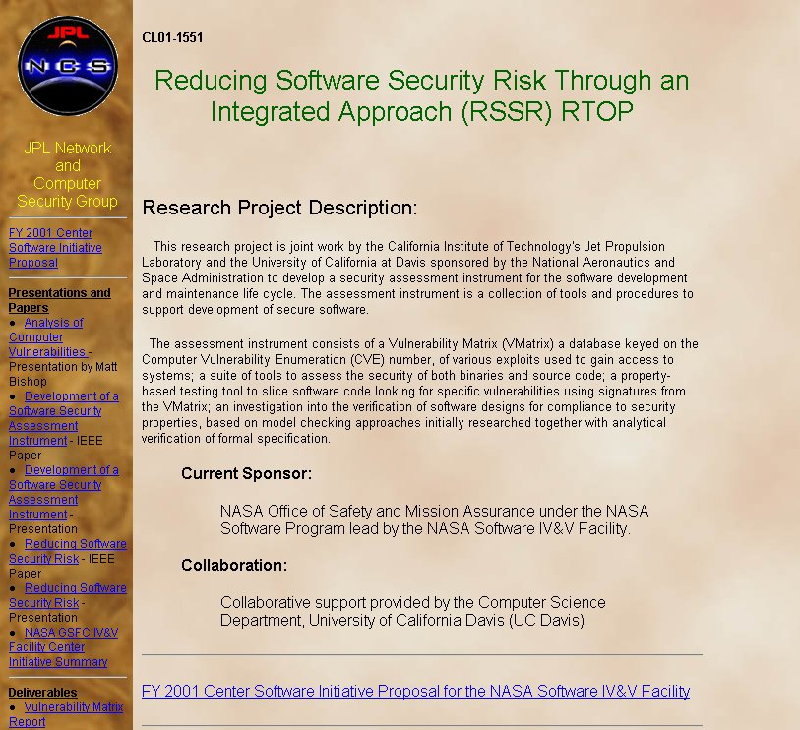

Slide 24
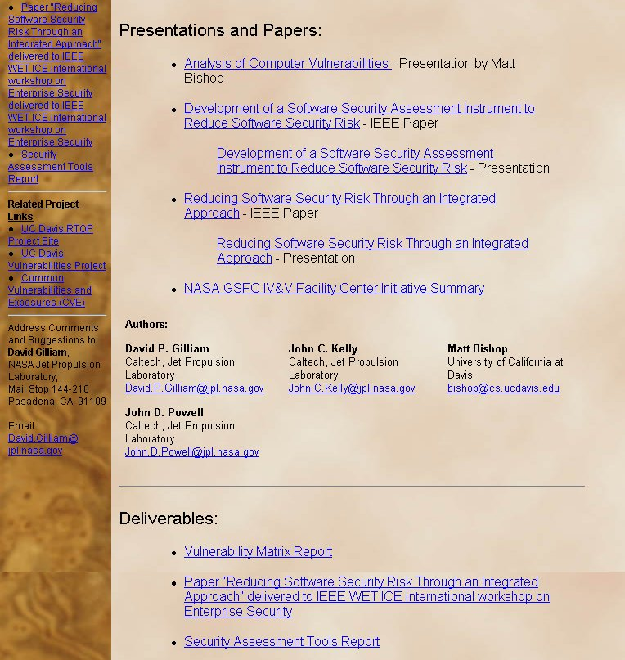

Slide 25
The Flexible Modeling Framework (FMF) – Part 1
Collection of Model Components
Each Individual Component
Model Checker
If Combination State Space is too Large
Unique Component Combinations
Yes
No
Component Combiner

Slide 26
The Flexible Modeling Framework (FMF) – Part 2
Collection of Model Components
Each Individual Component
Model Checker
If Combination State Space is too Large
Unique Component Combinations
Yes
No
Heuristic Propagation of Results
Component Combiner
Implicit
Explicit
MCCT

Slide 27
Heuristic VV and CR Propagation
Implicit MCCT
CR_{i+1} = CR_{i} – p →
VV_{ABCD} = 1.33
CR_{i} = 1 – p →
0 < CR < 1
VV_{ABC} = 1.33
VV_{ABD} = 2.00
VV_{ACD} = 1.33
VV_{BCD} = 0.67
VV_{AB} = 2
VV_{AC} = 2
VV_{AD} = 2
VV_{BC} = 0
VV_{BD} = 2
VV_{CD} = 0
CR = 1 →
VV_{A} = 0
VV_{B} = 2
VV_{C} = 2
VV_{D} = 2
Explicit MCCT
CR = 1 →
CR = 1

Slide 28
Heuristic Propagation
Verification Values (VV) – degree to which a property holds or does not hold (0 – 2)
Confidence Rating (CR) – degree of certainty that the VV is correct (0 – 1)
Why 2 heuristic values instead of 1?
  VV=1, CR=.99 – Confident inconclusiveness
    Known information is highly contradictory
    Variable model component resolution is unlikely to help
  VV=1, CR=.01 – Inconclusive due to heuristics
    Heuristic propagation’s prediction accuracy is degrading
    Variable model component resolution is more likely to help

Slide 29
Heuristic VV and CR Propagation
Implicit MCCT
CR_{i+1} = CR_{i} – p →
VV_{ABCD} = 1.33
CR_{i} = 1 – p →
0 < CR < 1
VV_{ABC} = 1.33
VV_{ABD} = 2.00
VV_{ACD} = 1.33
VV_{BCD} = 0.67
VV_{AB} = 2
VV_{AC} = 2
VV_{AD} = 2
VV_{BC} = 0
VV_{BD} = 2
VV_{CD} = 0
CR = 1 →
VV_{A} = 0
VV_{B} = 2
VV_{C} = 2
VV_{D} = 2
Explicit MCCT
CR = 1 →
CR = 1

Slide 30
Variable Component Resolution
Trading less abstract model components for more abstract ones.
  Increased ability to analyze interaction of more model component
  Decreased detail about the behavior of some model components
Used to Cope with State Space Explosion
Do Model Component resolution versions occur as a side effect of model updates?

Slide 31
Rapid Model Updating
FMF benefits software early in its lifecycle
  Earlier Discovery of Software Errors
  Correction is easier / better / less expensive
FMF must adapt to early lifecycle events
  Rapidly changing requirements and designs
  Varying / Increasing levels of detail defined for different parts of the system.
How can traditional model development for MC be enhanced to cope with volatile systems?

Slide 32
The Flexible Modeling Framework (FMF) – Part 3
Collection of Model Components
Each Individual Component
Model Checker
If Combination State Space is too Large
Unique Component Combinations
Yes
No
Combinations Containing α
Heuristic Propagation of Results
Component Combiner
Updated Component α
Implicit
Explicit
MCCT

