Slide 1

Division of Cellular and Gene Therapies (DCGT)
Overview of Activities
Raj K. Puri, M.D., Ph.D.
Division Director,
Division of Cellular and Gene Therapies
FDA, Center for Biologics Evaluation and Research

Slide 2
Outline
Mission and organizational structure
Regulatory scope
Approach to research
Tumor Vaccines Biotechnology Branch (TVBB) Site Visit September, 2006

Slide 3
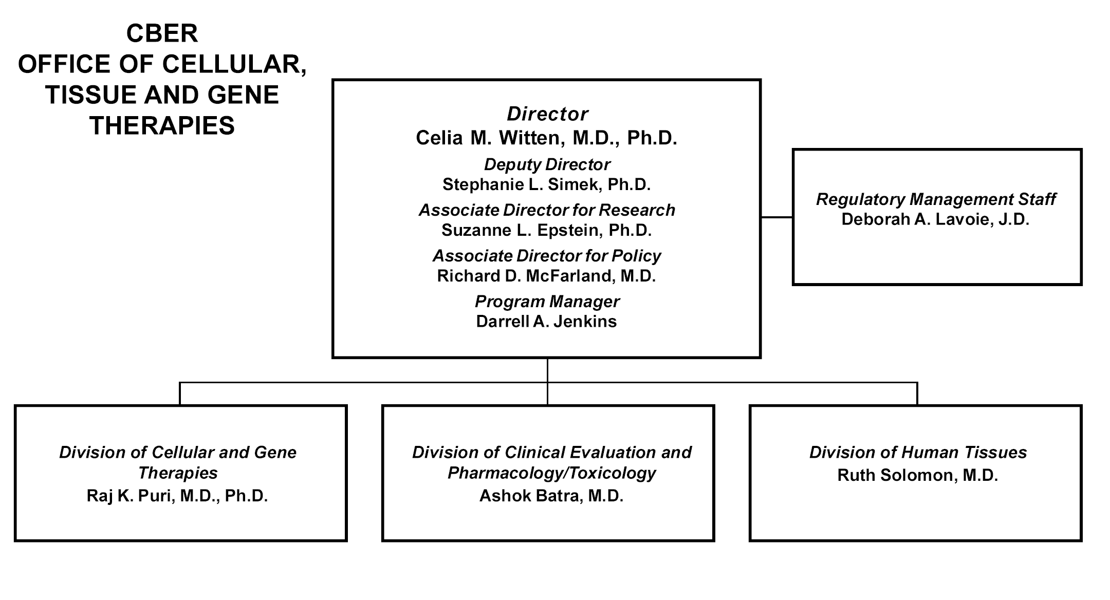
OCTGT Structure

Slide 4
DCGT Structure
Division of Cellular and Gene Therapies
Raj Puri, Ph.D., M.D., Division Director
Kimberly Benton, Ph.D., Deputy Director
Gene Therapies Branch
Daniel Takefman, Ph.D., Chief
Gene Transfer and
Immunogenicity Branch
Eda Bloom, Ph.D., Chief
Cell Therapies Branch
Keith Wonnacott, Ph.D., Chief
Tumor Vaccines and
Biotechnology Branch
Raj Puri, Ph.D., M.D., Chief*
Cellular and Tissue
Therapy Branch
Steven Bauer, Ph.D., Chief*
*Acting

Slide 5
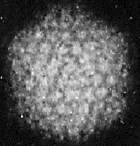

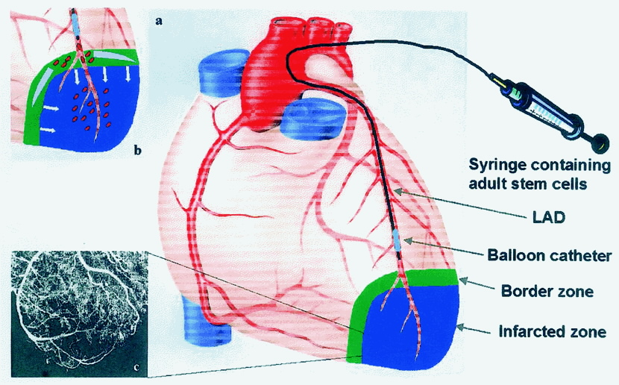
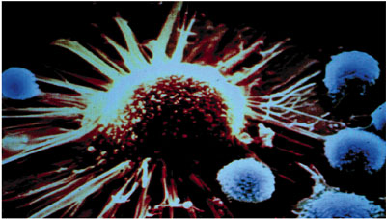
Products Evaluated
by DCGT
Cellular therapies
Gene therapies
Tumor vaccines and immunotherapy
Tissue engineered products
Xenotransplantation products
Combination products
Devices used with cells/tissue

Slide 6
DCGT regulatory portfolio and activities
Over 1100 active INDs, IDEs, and master files, several
thousand amendments per year, consult reviews
One licensed product, a growing number of products in phase 3
Devices: 510ks, PMAs, HDEs
Pre-INDs, pre-pre-IND advice
Advisory committee meetings
Inspections
Enforcement actions

Slide 7
Additional DCGT regulatory
portfolio and activities
Partnerships: National Toxicology Program, NIH, CDC, NCI/IOTF program, NIH stem cell task force, NIST, MATES
Participation in international conference on harmonization (ICH), WHO
Outreach talks at conferences, academic institutions, consumer and patient advocacy group meetings
Liaison activities with professional groups
Publication of papers on regulatory topics

Slide 8
Roles and work of researcher-reviewers
Product application review, policy and guidance development, regulatory outreach, regulatory mentoring, advisory committee preparation, enforcement, international activities
Research, training/mentoring
Administrative: branch chief duties, CBER peer review and coordinating committees, research management
Grant writing
Participation in the scientific community: scientific talks, chairing of conference sessions, editing, peer reviewing manuscripts and grant applications

Slide 9
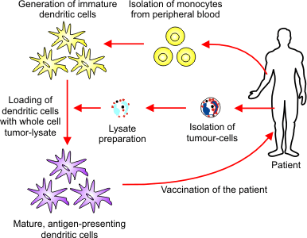
Approach to research: Stay ahead of the curve
as products and technologies evolve
For this wide spectrum, cannot have research related to each product.
If research addressed only the products and assays of today, we would already be obsolete. We must guide pre-IND work, prepare the way for anticipated products.

Slide 10
Research Strategy in DCGT
DCGT products are diverse and rapidly evolving. They require new regulatory paradigms which are developing rather than established
Critical Path: fill gaps, deal with scientific challenges, figure out what is important
Sponsors study individual products, results often proprietary
CBER scientists perform studies relevant to entire product classes, make results public, and thus accessible to all sponsors, to advance the entire field

Slide 11
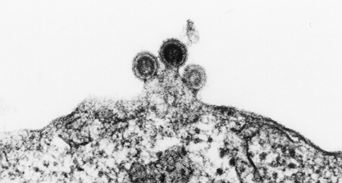


DCGT Research Priorities:
Led by Critical Path Challenges
Virology
  Retroviruses, adeno, herpes, filo
Immunology
  Anti-viral immunity, immunobiology of cell therapy and xenotransplantation
Cell biology
  Control of differentiation in animal models,
  stem cell biology
Cancer biology
  Molecular biomarkers, animal models
Biotechnology
Genomics, flow cytometry, proteomics

Slide 12
PIs Reviewed in TVBB
Raj K. Puri, M.D., Ph.D.
Cancer Biology and Genomics Program
Michail Alterman, Ph.D.
Proteomics Program

Slide 13
Public Health Issue and Regulatory Challenges
Cancer, a most difficult public health problem*
Biology of cancer – appropriate targets
Appropriate tests and biomarkers for purity, identity and potency
Animal models – safety and efficacy
Biomarkers for disease monitoring and response
*1,372,910 New Cases of Cancer in 2005
570,280 Cancer Deaths in 2005
Source: Cancer Facts and Figures, 2005 (American Cancer Society)

Slide 14
Critical Path Scientific Research Addressing Regulatory Challenges
Specific Aims:
Characterization of tumor associated cell surface proteins (antigens or receptors) to establish identity of tumor vaccines and target for cancer therapy
Establish animal models of human cancer to assess safety and efficacy of tumor targeted agents and gene therapy products
Characterization of tumor vaccines and stem cells by genomics technology to identify biomarkers of purity, identity and potency and cancer stem cells

Slide 15
Characterization of tumor associated cell surface receptors and antigens
Discovery of Th-2 derived cytokine receptors
Interleukin-4 receptors
  Renal cell carcinoma, head and neck cancer, malignant glioma, AIDS-Kaposi’s tumors, colon cancer, breast carcinoma, NSCLC, prostate cancer, pancreatic cancer, ovarian cancer, mesothelioma, and hematological malignancies (CLL-B)
Interleukin-13 receptors
  Renal cell carcinoma, malignant glioma, ovarian carcinoma, AIDS-associated Kaposi’s sarcoma, pediatric glioma, and head and neck tumors

Slide 16
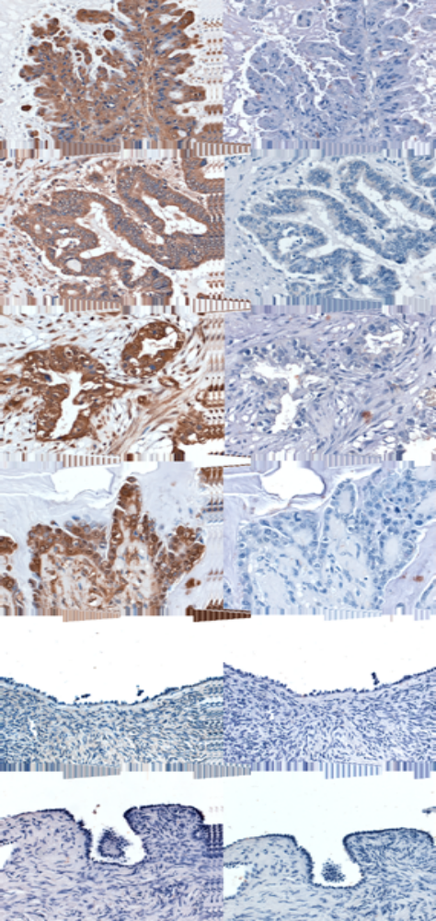
Animal models of human cancer to assess safety, toxicity and effectiveness of cancer targeted agents
Ovarian Cancer
Pancreatic cancer
Glioblastoma multiforme
SCCHN
Mesothelioma
Lung cancer
AIDS-associated Kaposi’s tumors
Breast cancer
Hodgkin’s lymphoma
Serous adeno Clear cell CA

Slide 17
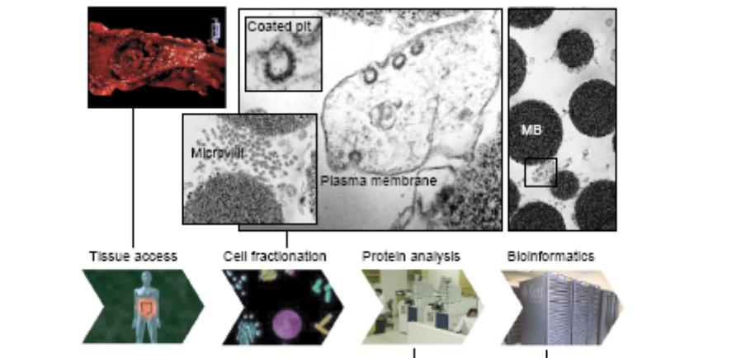
Analytical proteomics for the characterization of biologic products and discovery of biomarkers
Michail Alterman, Ph.D.

Slide 18
Specific Aims
Development of mass spectrometry-based analytical tools for testing of biological product quality and identity;
Identification of proteomics-based cellular molecular signatures to be tested as predictors of therapeutic success;
  Characterization of cell substrates used to produce gene therapy products and preventive and therapeutic vaccines.
  Proteomic characterization (profiling) of different cell lines with emphasis on stem cell lines.
Proteomic profiling of cytochrome P450 isozymes expression in tumors as potential biomarkers of cancer.

Slide 19
Expected Outcome and Deliverables
Development of a simple generic sample pre-fractionation technique enabling reliable analysis of a representative part of the cell proteome
Proteomic profiling of MDCK and MRC-5 cells and other cell substrates
Identification of a unique protein signature (biomarkers) of hESC and CD34+ cells and analysis of quantitative and qualitative changes during the differentiation of hESC to CD34+ cells.
The discovery of new CYP isozymes in tumors may lead to new biomarkers and development of new anti-cancer drugs and therapies.

Slide 20
Regulatory outcome
Identification of new antigens for cancer vaccines characterization and target for cancer therapy
Developing animal models for a variety of human cancer to test safety and efficacy of targeted agents
Promote development of novel technologies (e.g., genomics, proteomics) for product characterization (e.g., biomarker for identity, purity, and potency) and safety
Unique opportunity to identify molecular markers with in vivo outcomes

