Slide 1

Division of Cellular and Gene Therapies (DCGT)
Raj K. Puri, M.D., Ph.D.
Director,
Office of Cellular, Tissue and Gene Therapies Site Visit September 29, 2005

Slide 2
Outline
Division Organization
Mission and DCGT Activities
Regulatory workload
Researcher Reviewer Model
DCGT Resources
Key Regulatory Challenges in Cellular and Gene therapies
Critical Path Research Opportunities

Slide 3
Division of Cellular and Gene Therapies
Raj Puri, M.D., Ph.D., Division Director
Stephanie Simek, Ph.D., Deputy Director
Gene Therapies Branch
Martiza McIntyre, Ph.D.,
Chief
Laboratory of Immunology and
Virology
Eda Bloom, Ph.D., Chief
Cell Therapies Branch
Kimberly Benton, Ph.D.,
Chief
Laboratory of Molecular
Tumor Biology
Raj Puri, M.D.,Ph.D., Chief
Laboratory of Stem Cell Biology
Steve Bauer, Ph.D.,
Acting Chief
Laboratory of Immunology
and Developmental Biology
Suzanne Epstein, Ph.D., Chief

Slide 4
DCGT Mission
Evaluate investigational new drug, device, biological license, and pre-market applications for cellular, tissue engineering, and gene therapy products
Bring FDA, industry, patient advocates, scientists, and the public together in new partnerships to promote and develop new therapies for the 21st Century, while protecting human subjects and maximizing biological product safety
Plan and conduct research to support the Critical Path for cellular, tissue engineering, and gene therapy product development

Slide 5
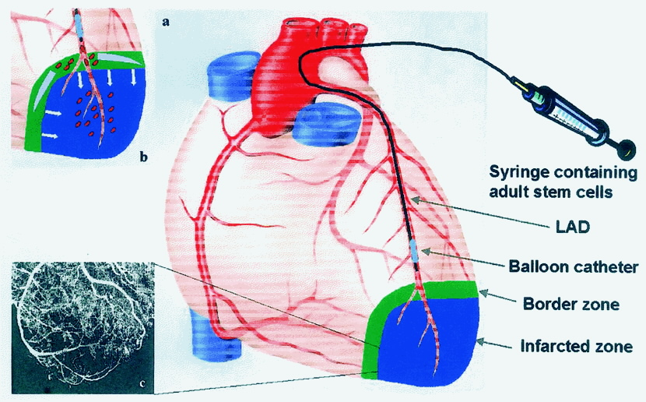
DCGT Products:
Cellular Therapy
Stem cells
Pancreatic islets
Cord blood cells
Chondrocytes
Lymphocytes
Macrophages
Myocytes
Circulation 2002;106:1913

Slide 6
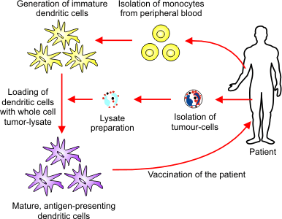
Tumor Vaccines
Cells
Lysates
Proteins, peptides
Gene therapies
Idiotypic and anti-idiotypic antibodies

Slide 7
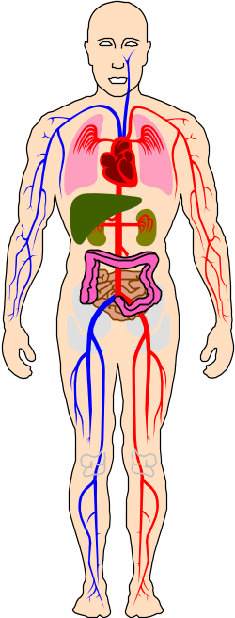

Xenotransplantation
(Cells and Tissues)
Procure & Process Xenotransplantation Product
Animal sources
Recipients, Contacts and the Public

Slide 8
Gene Therapy
Two Types of Gene Therapy
Ex Vivo
In Vivo
Vector
Cell
Cell
Expansion
of cells
Virus/Vector
Donor/
Recipient
Recipient
Manipulated Cells

Slide 9
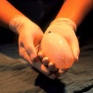
Tissue Engineering
Combination products containing living cells/tissues/matrix
  Artificial bladder
  Artificial pancreas

Slide 10
DCGT Activities
Ensure the safety of cellular, tissue engineering, and gene therapy products through:
  Development and implementation of a comprehensive risk-based regulatory framework
  Evaluation of new technologies for product characterization and rapid assessment of product safety
  Development of FDA Policies and Guidances for the regulation of cellular and gene therapy products

Slide 11
DCGT Activities continued..
Inspections:
  of manufacturing facilities
Consultation and Education:
  Provide scientific and technical advice to other CBER Offices, FDA Centers, and Government Agencies
  Information sharing and discussion with sponsors
Counterterrorism:
  COOP Coordination and Laboratory Red Alert Plan
  Participation in FDA’s CT exercise/simulations

Slide 12
DCGT Activities continued..
Community Outreach: (seminars, panel discussions)
  Stem Cell
  Tumor Vaccine
  National and International Cell Therapy and Cell Transplant
  Gene Therapy
  Tissue Engineering
  Xenotransplantation
  Foundations, Consumers and Patient Advocacy Groups e.g., National Hemophilia Foundation (NHF), Cystic Fibrosis (CF) Foundation, etc.

Slide 13
DCGT Activities continued..
Partnerships:
Development of Retrovirus and Adenovirus reference material
NIH Stem cell task force to address scientific issues
MOU with NIH NINDS and NHLBI for sharing of information and expertise
ERCC and Fluorescence standards for microarray and flow technologies
National Toxicology Program
Inter Agency Oncology Task Force between NCI and FDA for joint fellowship training program

Slide 14
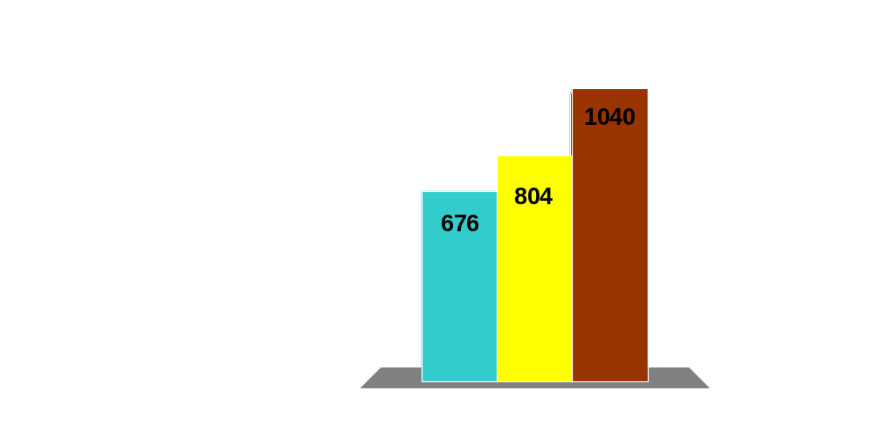
DCGT Regulatory Workload
(IND, IDE, 510k, MF)
2002
2003
2004

Slide 15
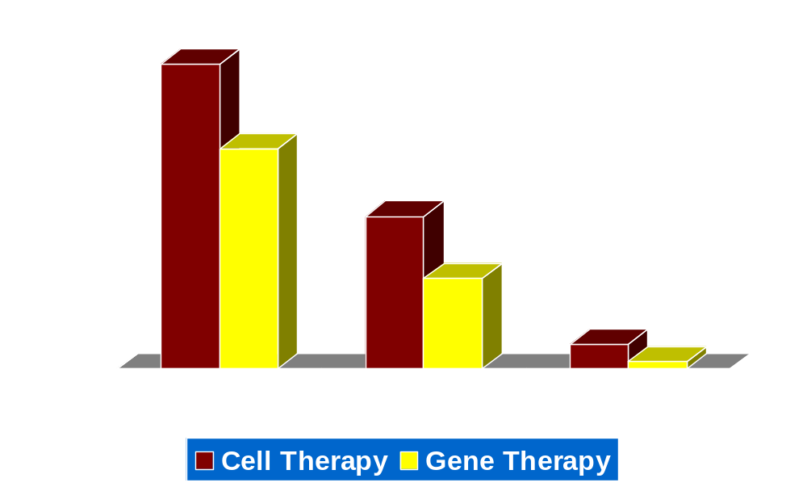
Phases of Active Cellular and Gene Therapy INDs
(370)
(247)

Slide 16
DCGT Research Priorities:
Driven by Critical Path Challenges
Virology (retrovirus, adenovirus, herpesvirus)
Immunology (host-vector interactions, transplant rejection)
Developmental biology (control pathways in animal models,
stem cell biology)
Molecular and cell biology (cancer biology, animal models)
Biomedical technologies:
• Microarray
• Proteomics
• Flow cytometry
Counterterrorism research

Slide 17
Researcher Reviewer Model
Cellular, tissue engineering, and gene therapies evolve rapidly and continually present new regulatory challenges
These novel products raise extraordinarily complex issues
DCGT seeks to foster a cadre of Researcher Reviewer scientists who :
  perform regulatory review and identify Critical Path research needs to enhance and promote product development and patient safety
  perform research in key areas to support the FDA mission and help sponsors solve product development problems to advance cellular, tissue engineering and gene therapy products to the market place

Slide 18
Types of Researcher Reviewers
Principle investigators (PIs) – tenured or tenure track researcher reviewers
Staff Scientists – tenured researcher reviewers supporting PIs program: do both review and research
Technicians: do primarily research, some do limited review work
Staff Fellows: do both review and research work
Postdoctoral fellows funded as ORISE, IRTA: do primarily research
Note: Resources are provided to PIs

Slide 19
DCGT Resources: Budget
Sixty employees (47 FTEs; 13 Post-doctoral fellows)
Eleven Regulatory Scientists
Twelve PIs – Research-review
Four staff scientists, 7 staff fellows, 13 technicians
ORISE/IRTA fellows support – funding from CBER
or grants
Many PIs supplement research activities from inside and outside grants (e.g., NVP, OSHC), CRADAs, royalties

Slide 20
Responsibilities of PIs
Product review
INDs, IDEs, PMA, 510k, HDEs, licenses, master files, inspections
- regulatory mentoring by lab chiefs and branch chiefs
Policy development
working groups, guidance development, advisory committees
Outreach
presubmittal advice, scientific and regulatory talks, refereeing and editing for journals, chairing sessions at scientific conferences, scientific collaborations relevant to the Critical Path
Research
lab management, training/mentoring/supervising, publishing papers, grant writing, leveraging/collaboration

Slide 21
Research Assessment/Management
Regulatory workload and quality
Publications (including research articles)
Success in securing external funding
Promotion and Conversion Evaluation (PCE) Committee review
Site visit and CBER Advisory Committee recommendations

Slide 22
Assessment Tools for the Regulatory Workload of Researcher-Reviewers
Reporting total active INDs, original submissions, amendments requiring product review, preIND meetings, other applications (510k, IDEs, license supplements)
Description of special workloads: products in phase 3 - unusually labor-intensive reviews
Other regulatory work: policy and guidance development, advisory committee meetings, outreach talks

Slide 23
Complexities and Key Challenges in Cellular and Gene Therapy Products

Slide 24
Complexity of a Gene Therapy Product
Ex Vivo Transduced HSC
Growth factors
Murine Retroviral Vector
(e.g., SCF, Flt-3, IL-3)
Fibronectin coated flasks
Donor HSC
Cell
Selection
Transduction
Transduced cells

Slide 25
Complexity continued…
HSC
  Donor screening, adventitious agents, purity, potency
Devices
  Monoclonal antibodies, surface markers, extracellular matrix
Retroviral Vectors
  Cell substrates, adventitious agents, reversion to wild type
Specified Products (SCF, Flt-3, etc.)
  Purity, potency, novel use (ancillary, not as primary effector)
Cellular Product
  Characterization, potency, evidence of gene transduction

Slide 26
DCGT Strategies
Advice from Advisory Committee
Release of Gene Therapy guidance document for Reviewers and Sponsors
Release of long term follow up guidance document
Research – viral and plasmid vector characterization, pathogenicity, safety testing, animal models, and assay development

Slide 27
Future Challenges
Development of new generation vectors that target specific integration sites in the host genome
Design new generation safe gene therapy vectors for better expression and higher efficiency of gene transfer
Design new generation vectors with low or no host immune responses

Slide 28
Key Scientific Challenges in the Regulation of Cellular Products
Rapidly and accurately confirm sterility of cellular products with a very short shelf life after final preparation
Determine identity of complex cell mixtures
Rapidly and accurately determine potency of cellular products

Slide 29
Key Scientific Challenges in the Regulation of Cellular Products Contd.
Stability of cellular products – effect of storage conditions on cellular product characteristics
Comparability of cellular products - to evaluate the effects of a process or facility change
Linking cellular product characteristics to clinical outcome

Slide 30
DCGT Strategies
Release of Cell Therapy guidance documents for Reviewers and Sponsors
Contribution in release of FDA pharmacogenomics guidance document
Conduct research:
  Cell-cell interactions, control of differentiation, cell signaling, and cell fate for product characterization and process controls
  Immune response and animal models for safety and efficacy

Slide 31
Future Opportunities
Develop novel technologies (e.g., genomics, proteomics) for product characterization (identity, purity, and potency) and safety testing
Biomarkers for product quality, product safety, and adventitious agent detection
Correlation of molecular markers with in vivo outcomes

Slide 32

Looking Ahead
Preparing for the next generation of products
  Improved manufacturing process controls
  Better assays for safety, purity and potency
  Future need for appropriate scientific support
  Best use of our expertise and stakeholder leverage to solve these challenges
Safe and effective products

Slide 33
Thank You

