Slide 1

Gene Therapy: Introduction and Regulation of Product
Maritza C. McIntyre, Ph.D.
Division of Cellular and Gene Therapies
Office of Cellular, Tissue and Gene Therapies,
CBER/FDA
mcintyrem@cber.fda.gov

Slide 2
Overview
Introduction to OCTGT
Introduction to Gene Therapy
Special Considerations for GT Product Review

Slide 3
Who Regulates Gene Transfer Research?
FDA/CBER
  Office of Cellular, Tissue, and Gene Therapies
    Division of Cellular and Gene Therapies
      Manufacturing and product-related issues
    Division of Clinical Evaluation & Pharmacology/Toxicology
      Clinical trial design, safety and efficacy issues
      Preclinical pharmacology and toxicology
Notes:
At the FDA, Gene Transfer research is regulated by the office of cellular, tissue and gene therapies within the Center for Biologics Evaluation and ResearchResponsibility for the review of Gene Therapy INDs and hopefully one day licensing of gene therapy products lies within the Division of Cell and Gene Therapies, which is responsible for the manufacturing and product-related issues, and The Division of clinical evaluation and pharmacology/toxicolgy whi is responsible for the review of clinical trial design, safety, efficacy and pharmacology and toxicology issues.

Slide 4
Office of Cellular, Tissue and Gene Therapies
Joyce Frey-Vasconcells, Ph.D., Acting Director
Cynthia Rask, M.D., Acting Deputy Director
Regulatory Management Staff
Andrea Wright, Branch Chief
Division of Cellular & Gene Therapies
Raj Puri, M.D./Ph.D., Acting Director
Stephanie Simek, Ph.D., Acting Deputy Director
Division of Human Tissue Products
Ruth Solomon, M.D., Acting Director
Martha Wells, Branch Chief
Division of Clinical Evaluation &
Pharmacology/Toxicology
Cynthia Rask, M.D., Director
Notes:
I will briefly go over the organization of the new office. Dr. Phil Noguchi, whom you all know well, is the acting director of OCTGT and Dr. Joyce Frey is the acting Deputy Director. The office is composed of three divisions, with the project management activities located within the immediate office of the Office Director.

Slide 5
Division of Cellular and Gene Therapies
Raj Puri, M.D./Ph.D., Acting Division Director
Stephanie Simek, Ph.D. Acting Deputy Director
Gene Therapy Branch
Stephanie Simek, Ph.D., Branch Chief
Laboratory of Immunology
and Virology
Eda Bloom, Ph.D., Lab Chief
Cell Therapy Branch
Vacant
Laboratory of Molecular
Tumor Biology
Raj Puri, M.D./Ph.D., Lab Chief
Laboratory of Immunology
and Developmental Biology
Suzanne Epstein, Ph.D., Lab Chief
Laboratory of Stem Cell Biology
Steve Bauer, Ph.D., Acting Lab Chief
Notes:
The Division of Cell and Gene Therapies was a direct transfer from OTRR to OCTGT. Dr. Raj Puri is the acting director and Dr. Stephanie Simek is acting Deputy. This division is responsible for the CMC portion of cell and gene therapy reviews as well as development of policy and outreach related to these products. These activities are performed by both full-time reviewers and research/reviewers, who also perform mission-related research and are located in one of these four labs.

Slide 6
Division of Clinical Evaluation &
Pharmacology/Toxicology
Cynthia Rask, M.D., Director
Clinical Evaluation Branch
Dwaine Rieves, M.D., Branch Chief
Pharmacology/
Toxicology Branch
Mercedes Serabian, M.S., DABT, Branch Chief
Notes:
Dr. Cynthia Rask is the Director of the Division of Clinical Evaluation and Pharmacology/Toxicology. This new division is now responsible for the review and policymaking for the clinical and Pharm/Tox aspects of the products regulated in the Office, with Mercedes Serabian acting as the Branch Chief for the Pharm/Tox branch.

Slide 7
Definition
Gene therapy (1993 FR)-
The administration of genetic material in order to modify or manipulate the expression of a gene product or to alter the biological properties of living cells for therapeutic use.
Notes:
3
Before I begin, I would like to provide you with the definition of gene therapy, or gene transfer, by which CBER operates. In a 1993 federal register notice which gave CBER authority to regulate gene transfer products as biologics, gene therapy is defined as the administration of genetic material in order to modify or manipulate the expression of a gene product or to alter the biological properties of living cells for therapeutic use. Thus whether the product is a gene transfer vector itself or cells modified by a gene transfer vector it is considered by the agency to be a gene therapy. In addition, if the cells are placed into a device that required review by the center for devices, primary review and approval rests with CBER and the product is considered a gene therapy.

Slide 8
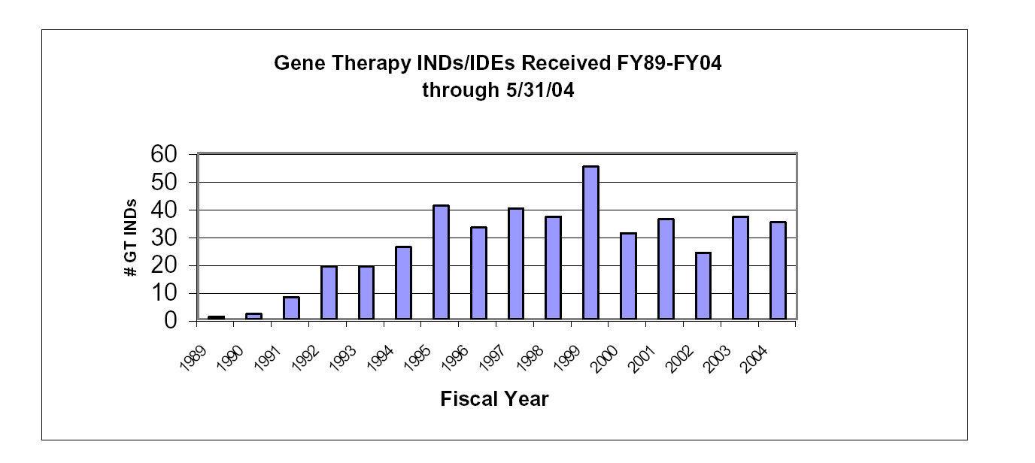
Gene Transfer Trials Reviewed by CBER
Notes:
This figure is to show you the types and number of vector currently being used in IND trial in the United States. Retroviruses are predominantly being used ex-vivo, while plasmids and ad vectors are often directly administered to subjects. To date, a very small number of trials have been initiated with AAV or herpes virus vectors, and these few involve direct administration.

Slide 9
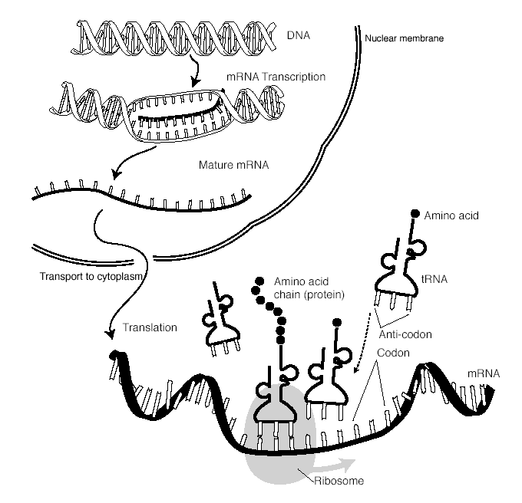
Genes encode Proteins

Slide 10
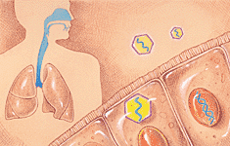
Mutated Genes Produce No/Defective Proteins: Gene Therapy Can Correct the Deficiency
Defective cystic fibrosis transmembrane regulator gene (CFTR)
Abnormal chloride transport leads to build-up of mucus in airways
Defective clearance of infectious agents;lung damage
CFTR gene carried by AAV vector introduced into lungs by nebulizer
http://www.targen.com

Slide 11
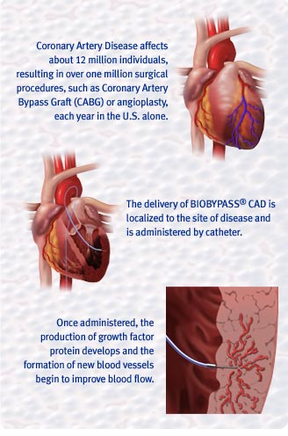
High-level Gene Expression Can Be Used to Exploit Therapeutic Potential of Certain Proteins
http://www.genvec.com/

Slide 12
Genes are Delivered into Cells by Vectors: Example Adeno-associated Virus
AAV
1960
Lytic
Non-pathogenic
Adenovirus
Latent
Hoggan, M.D., et al. Continuous carriage of adenovirus associated
virus genome in cell culture in the absence of helper adenovirus. in
Proceedings of the Fourth Lepetite Colloquium. 1972. Cocoyac, Mexico.
10,000/cell
R. Jude Samulski, Ph.D.
Notes:
Many of the characteristics of AAV that make it a desirable gene therapy vector can be discussed in terms of it’s life cycle. When AAV infects a cell it has two options: 1. In the presence of a helper virus, such as adenovirus or herpes virus, it can replicate and produce progeny virions. 2. In the absence of a helper virus, AAV integrates site specifically into the host genome and become latent until such time as superinfection with a helper virus allows it to replicate.
Two major characteristics beneficial to gene therapy vectors are realized. Primarily, it is a defective virus. Without a helper virus, AAV cannot propagate and has been not been implicated in any diseases. It is therefore considered a harmless virus. Secondly, AAV can integrate into the host chromosome via it’s terminal repeats. This feature predicts stability of the virus within a cell and propagation of the virus along with the host cell chromosome. While the site specificity of integration requires the AAV rep protein, maintenance of AAV within the host chromosome does not require any protein expression allowing complete deletion of all AAV open reading frames in recombinant vectors.

Slide 13
Recombinant AAV vectors
TR
TR
Transgene of Interest
Plasmid
AAV
AD
cell
Transgene
R. Jude Samulski, Ph.D.
Notes:
Recombinant vectors are made by replacing the entire genome except the terminal repeat with the transgene and promoter. The TRs are the only cis elements necessary for replication, packaging and as I just mentioned random integration. Recent advances allow us to make virus without wild type AAV or helper virus, by replacing these functions with helper plasmids, one containing the AAV genes rep and cap (without the TRs), and the other containing the few Adenovirus genes necessary for AAV replication. Co-transfection of these three plasmids into 293 cells permits replication and packaging of the recombinant virus. This virus is subsequently purified and can then be injected into animals where gene expression can last for long periods of time.
One of the concerns with long term gene therapy is the potential for the dose needs of the patient to change with time, for example because of a worsening condition or treatment side effects. Gene therapy vectors must therefore be adaptable. One manner in which to do that is to regulate the expression of the transgene by an exogenous drug. My project coming into the Samulski lab was to do just that.

Slide 14
IND Review Process
Upon receipt of IND or MF:
  Acknowledgement letter
  IND number
  Reminder of responsibility to make RAC submissions.
IND application reviewed within 30 days
Team approach to review: CMC/Pharm-Tox/Clinical
Communication of review decision: proceed or hold
Letter issued detailing hold issues and/or comments.
Notes:
18
I will next describe the IND review process in general and specifically the requirements for submitting information on the manufacture and control of the product.
Upon receipt of the IND submission, the FDA will send the sponsor an acknowledgement letter and an IND number will be assigned.
The receipt date begins the official review clock, which specifies that the review be completed within 30 days. 3 reviewers are assigned to an IND review team: a product, pharm/tox and clinical reviewer, with each concentrating the review to their area of expertise. A regulatory project manager, who handles the administrative processing of the IND, is also assigned to each IND.
After the review team has finished the review, a decision is made if study should proceed or be placed on clinical hold. This decision is communicated to the sponsor, usually by phone, followed by a letter detailing hold issues or other comments generated during the review of the IND.
Comments generated during the review will need to be addressed by the sponsor and be submitted to the IND as an amendment. For clinical hold issues the sponsor is required to address each issue in an official response to clinical hold which undergoes another 30-day review cycle.

Slide 15
CMC Section
Components Used for Product Manufacture
Manufacturing Process
Product Testing
Process Controls
Draft Guidance for Reviewers: Instructions and Template for Chemistry, Manufacturing, and Control Reviewers of Human Somatic Cell Therapy Investigational New Drug Applications. http://www.fda.gov/cber/genetherapy/gtpubs.htm
Notes:
Now I will talk in more detail about the CMC section, since this is my area of specialty. The focus of review for this section includes the examination of the components used for product manufacture, the manufacturing process, and the tests performed on the product in order to assure its safety and to characterize the product in terms of identity, purity and potency. We determine if the product is manufactured by a controlled process.
I have included a link to a recently released draft guidance document entitled Draft Guidance for Reviewers: Instructions and template for CMC Reviews of Human Somatice Cell Therapy INDs. This document provides the product reviewers with guidance on the types of information that should be documented when conducting a CMC review. It also provides us with a review template which we can fill in with the required information. I have provided the linkt to this document and urge you to look at it. While it is directed at somatic cell therapies, a similar document is awaiting release from our legal department for gene therapies. The two documents are very similar, differing mainly in the increased amount of information that is required for gene therapy products.

Slide 16
Components Used in Product Manufacture
Vector
  Viral bank/plasmid stock
    Testing for safety and characterization
Cells
  Cell bank system
    Testing for safety and characterization
Other Reagents/Devices Used During Manufacture
  Qualification program
Notes:
I’d like to discuss with you what we consider to be a component used to manufacture a gene transfer product. Compared to a chemically-based drug, review of the components used is more involved.
To ensure consistency, it is best that a stock of the vector be established from which all lots of the vector to be used in the clinic should be started. This bank is often called a viral bank or a plasmid stock. The stock should be characterized to ensure that it is the correct vector and that is it sterile and free from adventitious agents, such as mycoplasma and other viruses. These tests are important because they will ensure that a quality product is consistently produced.
Unlike chemically-based drugs, which are mass-produced by large-scale chemical synthesis, mass quantities of gene transfer vectors are produced by amplification of the vector in a producer cell, which provides the necessary cellular machinery to replicate the DNA and, in the case of a viral vector, to package it. To assure consistent yield of the vector with each manufacturing run, it is recommended that a stock of cells, or cell bank, be established so that the cells of the same age and characteristics are used each time a lot is manufactured. Again, tests should be performed on the banked cells to assure their identity, sterility, and freedom from adventitious agents.
Other reagents can include cell culture medium and supplements such as serum. Sponsors should describe the quality of these reagents and submit copies of the certificate of analysis provided by the manufacturer. If any devices are used during product manufacture, then a description of the cleaning and sanitation procedures for the device should be provided.

Slide 17
Product Evaluation
Demonstrate Safety and Quality of Product
  Testing
    Safety (Sterility, Adventitious Viruses, Endotoxin, Mycoplasma)
    Characterization (Identity, Purity, Potency, etc.)
Demonstrate Control of the Manufacturing Process
  Specifications
  GMPs
    Documentation
    Quality Assurance/Quality Control
Notes:
Finally, we evaluate the quality of the final product. Again, you will need to perform tests to demonstrate the safety and quality of the final product, including safety tests such as sterility, endotoxin and adventitious agents. In addition, tests to characterize the product should be performed. These would include tests to verify the identity of the vector, titer or concentration, purity and potency.
In addition, you will need to provide a description of the measures in place to control the manufacturing process.
Specifications for test results should be developed. Some test specifications can be set up front; for example sterility assays should be negative. For other tests, such as a test for residual host cell dna, specifications should be set based on data obtained after many lots have been produced. These specifications should be data driven.
Control of the manufacturing process also brings us to good manufacturing practices, or GMPs. I’ll discuss this in more detial further on but the most relevant aspects of the GMPs for INDs incldue documentation and QA/QC.

Slide 18
Regulatory Issues for Gene Therapy Products
Qualification of Components Used for Product Manufacture
  Producer cells can also produce unwanted viruses that enter the cells via the environment (other products, contaminants in air, from personnel)
Safety Testing on Final Product
  Sterility, endotoxin, mycoplamsa, recombinant virus that can replicate
Product Characterization
  Activity, purity (cellular/purification residuals)

Slide 19
“March 6, 2000 Letter”
Sent to determine the “state of the art” of gene therapy product manufacture and clinical trial monitoring.
Active IND sponsors required to respond in 60 days.
New IND sponsors must address questions in IND submission.
Notes:
Finally, at the investigational stage we require sponsors to provide responses to the March 6 2000 letter that was sent to sponsors of gene therapy INDs. This letter was sent in response to a series of problems that arose in the year preceeding the letter, which cause CBER to question the quality of the oversight of both product manufacture and clinical trials. This letter, which contains questions about both the product and clinical monitoring was sent to all current sponsors of Gene therapy INDs to determine the state of the art. The sponsors were required to respond in 60 days and the responses were reviewed. Sponsors found to not to meet current CBER standards were informed of the inadequacies and required to meet current requirements. New IND sponsors must address these questions in their original IND submissions.

Slide 20
Guidance Documents http://www.fda.gov/cber/reading.htm
Guidance for Industry: Guidance for Human Somatic Cell Therapy and Gene Therapy, March 1998.
PTC in the Characterization of Cell Lines to Produce Biologicals, CBER, FDA, 1993.
Proposed Approach to Regulation of Cellular and Tissue-Based Products, February 1997.
ICH Harmonized Tripartite Guideline: Viral Safety Evaluation of Biotechnology Products Derived from Cell Lines of Human or Animal Origin
Notes:
So, are you all ready to file your INDs? I realize that I have given you a lot of information in this talk and hopefully it has given you an understanding of how CBER regulates investigational drugs in general, and gene therapy INDs in particular. You can obtained detailed information on the requirements by consulting the Code of Regulations and relevant guidance documents listed on this slide.

Slide 21
Obtaining Information from CBER
http://www.fda.gov/cber/reading.htm
  Guidance Documents
  ICH Guidelines
  March 6, 2000 Letter
Email:
Manufacturers assistance: MATT@CBER.FDA.GOV
Consumers:OCTMA@CBER.FDA.GOV
Phone: 800-835-4709
301-827-1800
Notes:
This slide provides more information on where to obtain information on CBER documents and guidance's.

Slide 22
Submitting documents to OCTGT:
Regulatory Management Staff
Office of Cellular, Tissue, and Gene Therapies
HFM-99, Room 200 N
1401 Rockville Pike
Rockville, MD 20852
Notes:
12

