Slide 1

HighSpeed TCP for High Bandwidth-Delay Product Networks
Raj Kettimuthu

Slide 2
Introduction
Bulk data transfer has become one of the key requirements in many Grid applications
GridFTP has been widely deployed for high-speed data transport services
These services normally require reliable data transfer resulting in TCP as the preferred common base protocol
Unfortunately TCP performs sub optimally in achieving maximum throughput on the currently available “long fat networks” over the Internet
This work involves
  Appropriate instrumentation and study of standard Linux TCP stack, incorporating the recently proposed modifications for high-speed transport

Slide 3
Congestion Control in TCP
TCP uses two algorithm for congestion control: slow start and congestion avoidance
The maximum data that can be in flight is min(congestion window, advertised window)
  Advertised window: flow control imposed by receiver
  Congestion window: flow control imposed by sender
Slow start: Congestion window is initialized to 1 segment and each time an ACK is received, the congestion window is increased by one segment

Slide 4
Congestion Control in TCP
Congestion avoidance: increase in congestion window should be at most one segment each round-trip time (regardless of the number of ACKs are received in that RTT)
Slow start threshold is used to switch between slow start and congestion avoidance. Exit slow start and enter congestion avoidance when the congestion window goes above slow start threshold
Fast retransmit and recovery are proposed to improve the performance of TCP by retransmitting without waiting for the retransmit timer to expire

Slide 5
Limited Slow Start
The Problem:
  The current slow-start procedure effectively doubles the congestion window in the absence of delayed acknowledgments.
  For TCP connections that are able to use congestion windows of thousands of segments, such an increase can easily result in thousands of packets being dropped in one round-trip time.
  This is often counterproductive for the TCP flow itself and is also hard on the rest of the traffic sharing the congested link.

Slide 6
Limited Slow Start
The Solution – Limited Slow-Start:
  Limits the number of segments by which the congestion window is increased during slow-start, in order to improve performance for TCP connections with large congestion windows
  Introduces another threshold called “limited slow start threshold”
    Enter limited slow-start when the congestion window goes above this threshold
    During limited slow-start, the congestion window is increased by at most half of the maximum segment size for each arriving acknowledgment
    Exit limited slow-start and enter congestion avoidance when the congestion window goes above the “slow-start threshold”

Slide 7
High Speed TCP
Current standard TCP places a serious constraint on the congestion windows that can be achieved by TCP in realistic environments
High-speed TCP is a modification to TCP's current congestion control mechanism for high-delay, bandwidth networks
It introduces a threshold value. If the congestion window is less than the threshold, it uses the normal AIMD algorithm where the additive value is 1 and the decrease factor is 0.5
If the congestion window is greater than the threshold, it uses High Speed response function to calculate alternate values for AIMD

Slide 8
High Speed TCP
Benefits:
  Achieves high per connection throughput without requiring unrealistically low packet loss rates
  Reaches high throughput without long delays when recovering from multiple retransmit timeouts
The proposed change to the AIMD algorithm may impose a certain degree of unfairness as it does not reduce its transfer rate as much as standard TCP

Slide 9
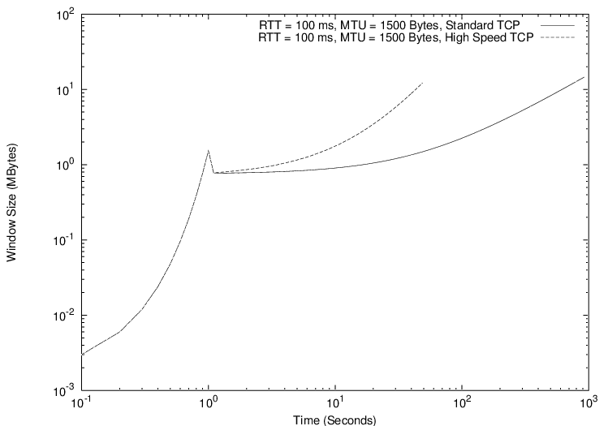
Idealized send window with single congestion event at 1 second

Slide 10
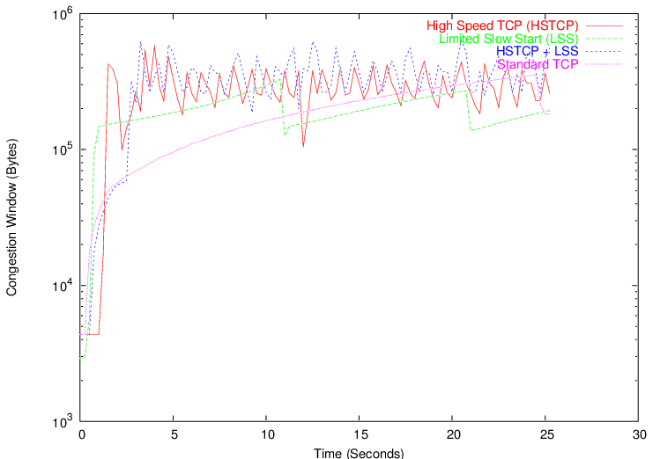
Performance of High-Speed TCP and Limited Slow-Start

Slide 11
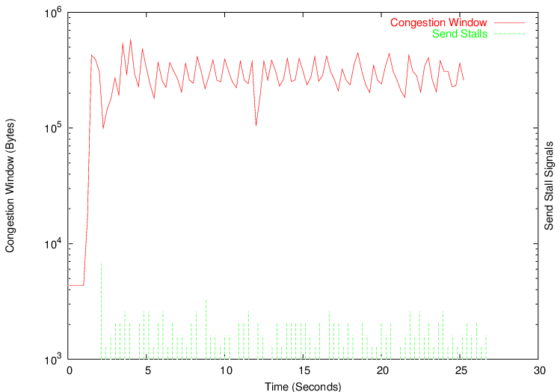
Send stalls

Slide 12
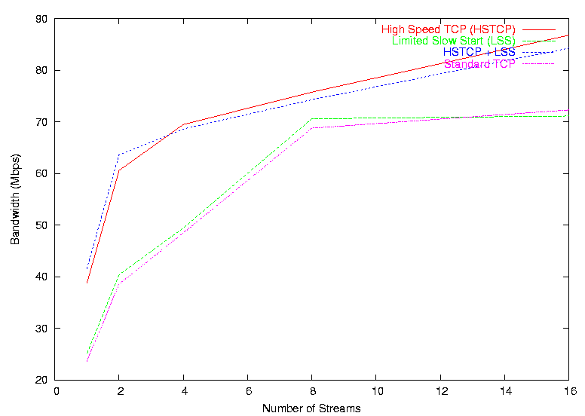
Multiple streams

Slide 13
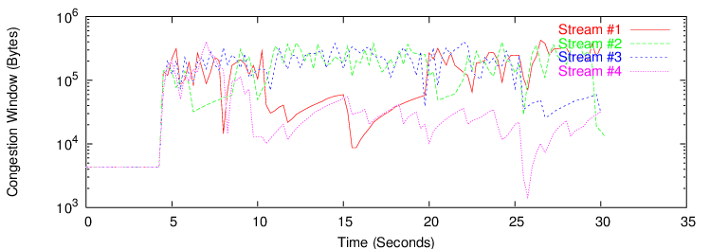
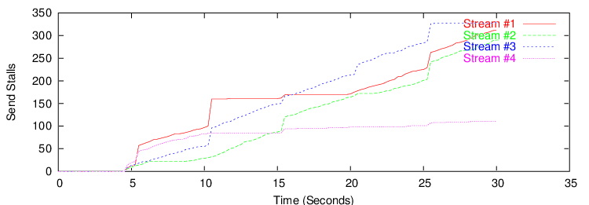
High-Speed TCP: Interaction of multiple streams

Slide 14
Web100
Provides improved TCP instrumentation, helps understanding the underlying operation of TCP within a host
Includes tools for measuring performance and network diagnosis to get a dynamic view of the behavior of the TCP sessions
Helped identify the cause of extreme round-trip time variance in a recent bulk data transfer experiment
Helped identify the various possible reasons for drop in the congestion window
Does not provide information about the process id for a TCP stream;

Slide 15
Future work
NETBLT (NETwork BLock Transfer):
  Transfer the data in a series of large data aggregates called “buffers”. The sending NETBLT must inform the receiving NETBLT of the transfer size during connection setup
RUDP (Reliable UDP)
  Layered on UDP/IP protocols and provides reliable in-order delivery. EACK is used to specify the out-of-order segments received and unlike TCP the receiver RUDP receiver cannot discard the out-of-order segments
RBUDP (Reliable Blast UDP)
  UDP augmented with aggregated acknowledgements to provide reliable bulk data transmission. Acknowledgements are delivered at the end of the transmission phase using a bit vector
Tsunami
  A hybrid TCP/UDP based file transfer protocol. It uses UDP for payload and TCP for signaling including request for retransmission

