Slide 1
Worldwide Acceptance
Major accredited fire testing laboratories in North America include Factory Mutual Research, Southwest Research Institute, Western Fire Center, Underwriters Laboratories, Omega Point Laboratories, Intertek Testing Services NA and Underwriters Laboratories of Canada
Accredited laboratories and agencies enjoy worldwide acceptance of their reports if their Accreditation Body is a signatory to the Mutual Recognition Arrangement (MRA) operated by various international cooperations:
International Laboratory Accreditation Cooperation (ILAC)
Asia Pacific Laboratory Accreditation Cooperation (APLAC)
National Cooperation for Laboratory Accreditation (NACLA) S domestic United States cooperation
InterAmerican Accreditation Cooperation (IAAC)

Slide 2
Worldwide Acceptance (cont’d.)
American Association for Laboratory Accreditation (A2LA), International Accreditation Service (IAS) and National Voluntary Laboratory Accreditation Program (NVLAP) are the three United States Accreditation Bodies recognized by the ILAC and APLAC MRAs.
Five accreditation bodies are covered under National Cooperation for Laboratory Accreditation (NACLA): A2LA, IAS, NVLAP, American Industrial Hygiene Association (AIHA) and Performance Review Institute (PRI).

Slide 3
Uncertainty of Measurements and Proficiency Testing for Laboratories
Uncertainty of measurements very important for large-scale fire testing laboratories. This subject is currently being actively debated in APLAC and ILAC
In-house retest of samples or items by several analysts
Local or national exchange of samples or items for test and formal analysis of results
(Proficiency Testing Suppliers accredited to ISO/IEC Guide 43 and ILAC G 13)
APLAC exchange of proficiency testing samples among member economies, each with several laboratories participating (mostly testing)

Slide 4
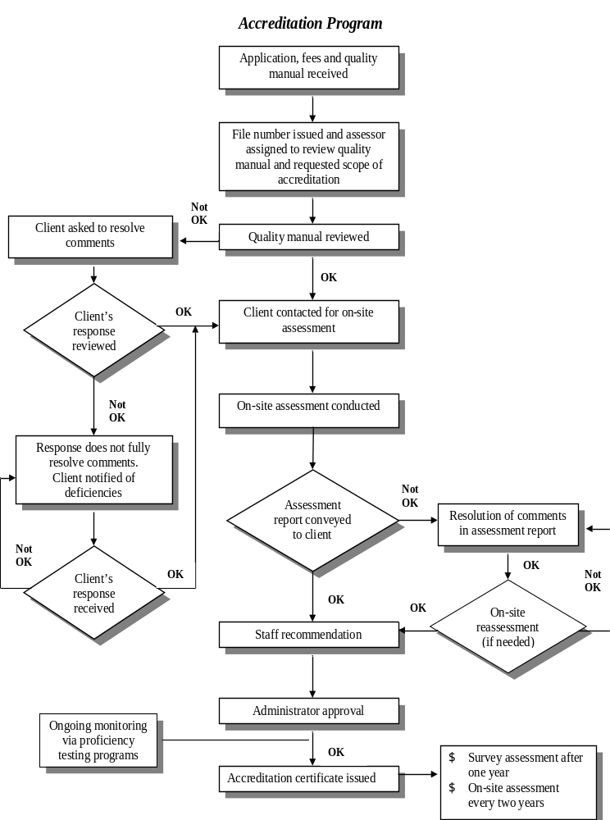

Slide 5
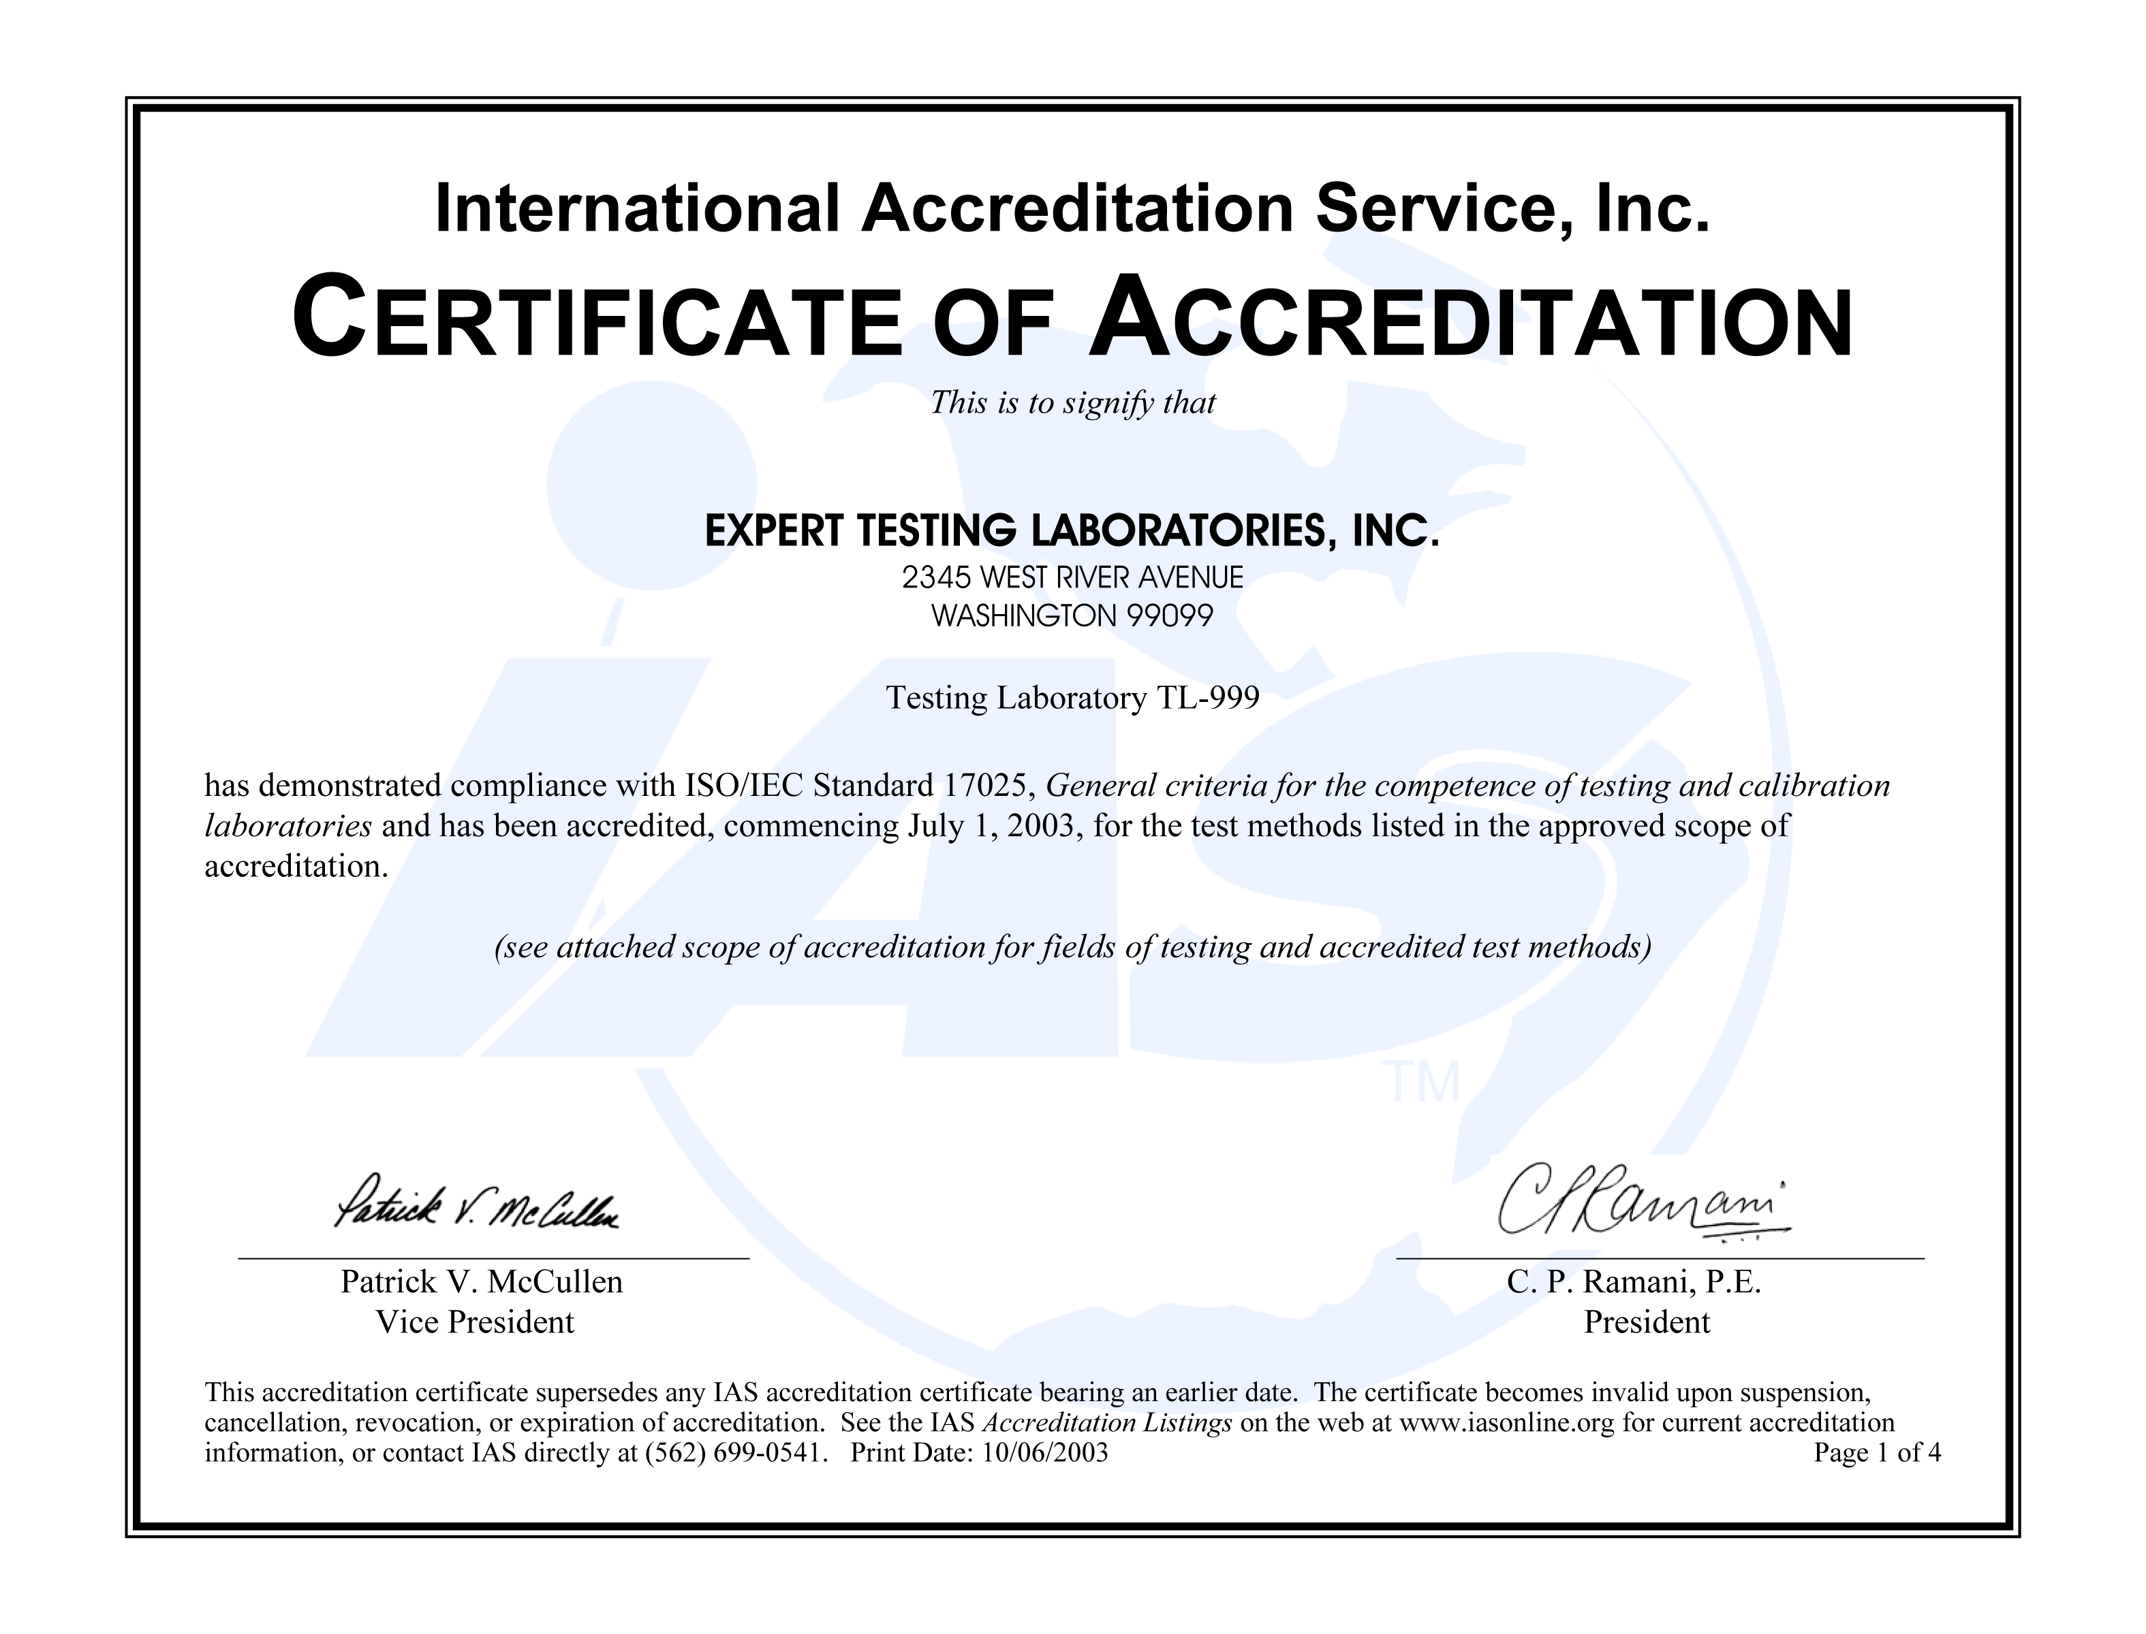

Slide 6
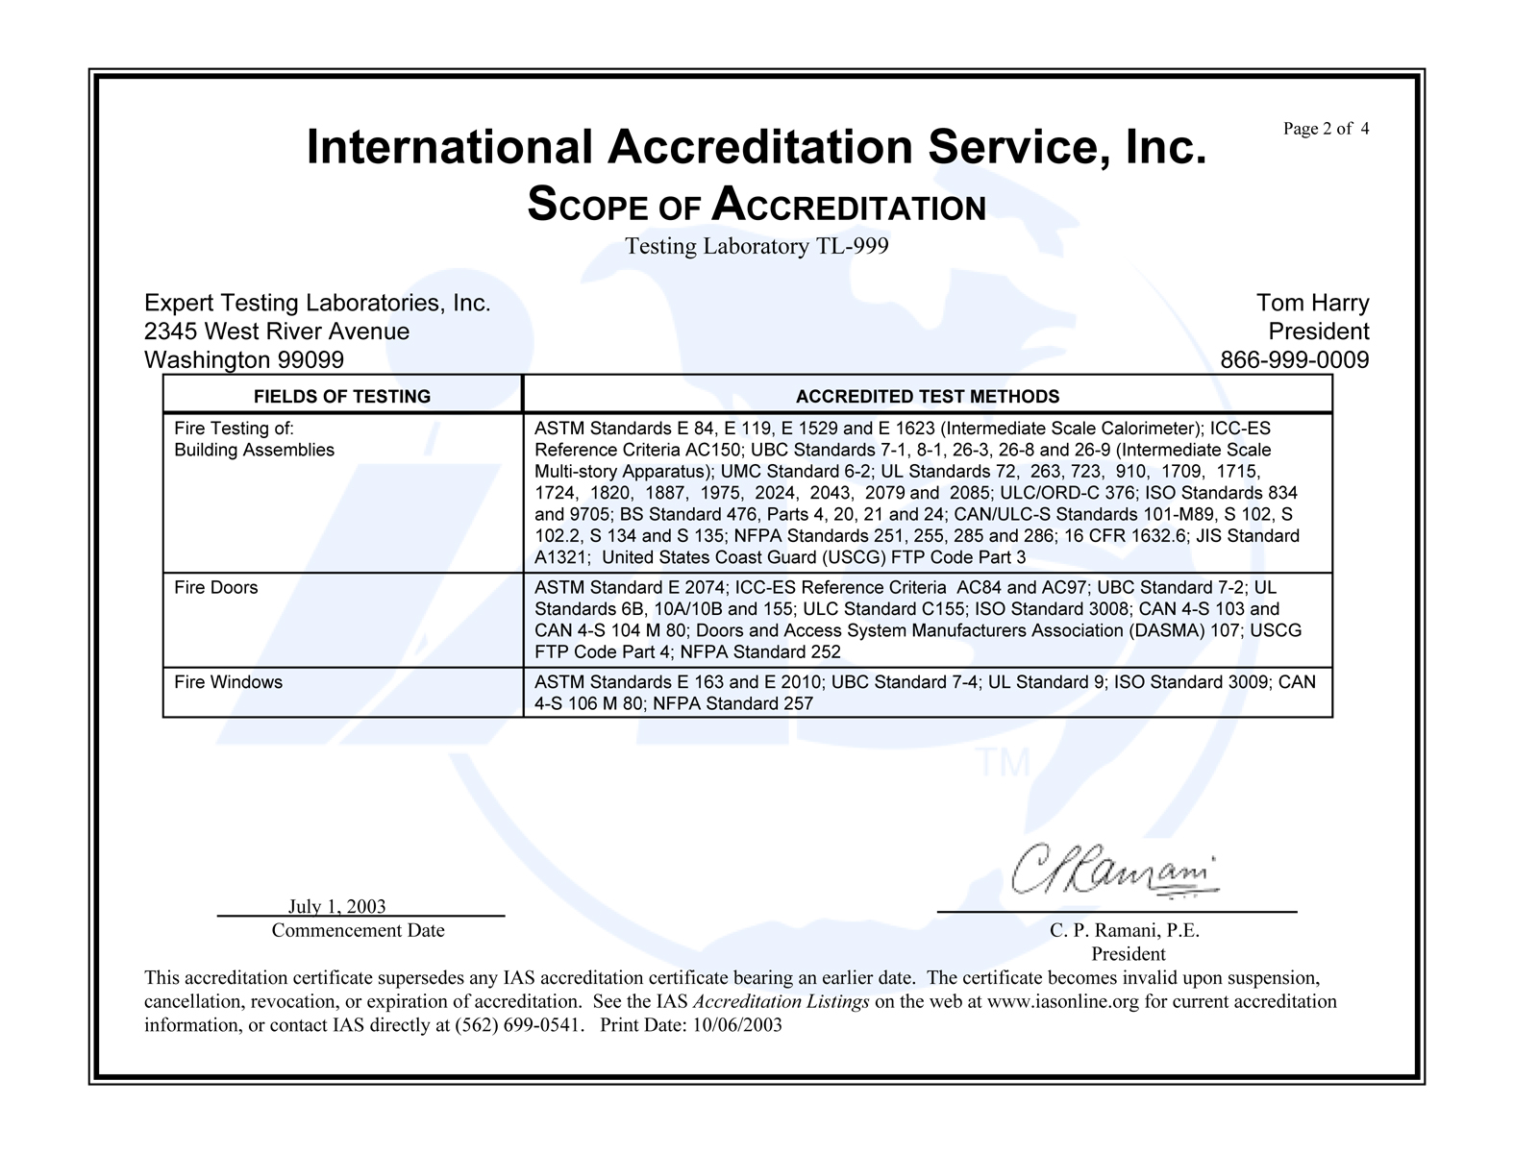
Typical Accreditation Certificate

Slide 7
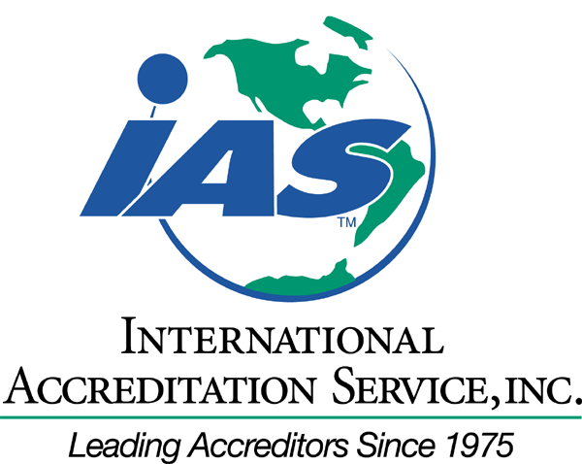

Thank You
www.iasonline.org
Phone: +562 699-0541
Facsimile: +562 699-8031

