Slide 1
Accreditation of Testing Laboratories
And Certification Organizations
National Institute of Standards and Technology
China Workshop on Fire Protection
in the Built Environment
September 21, 2004
Gaithersburg, Maryland

Slide 2
Accreditation
Procedure by which an authoritative body gives formal recognition that a body (laboratory/ inspection agency) or person (signatory) is competent to carry out specific tasks (scope) - ISO/IEC Guide 2: 1996
International Organization for Standardization/International Electrotechnical Commission (ISO/IEC)
Criteria: -ISO/IEC-17020 for Inspection Agencies
-17024 for Personnel Certification
-17025 for Testing and Calibration Laboratories
ISO/IEC Guide 65 for Product Certifiers
By and large accreditation is voluntary, although many regulators have started demanding use of accredited entities

Slide 3
Accreditation (cont’d.)
Recognizes the technical competence of organization staff
Assures the client that the results are technically valid
Endorses the quality management system
Ensures better support in the event of legal challenge
Assures the client that the procedures are technically valid
Saves money by getting it right the first time

Slide 4
Standards for Accreditation Bodies (ABs)
Laboratory ABs ISO/IEC Guide 58: 1993
Inspection Body ABs ISO/IEC TR 17010: 1998
Certification Body ABs ISO/IEC Guide 61: 1996
All to be replaced by ISO/IEC 17011: in 2004

Slide 5
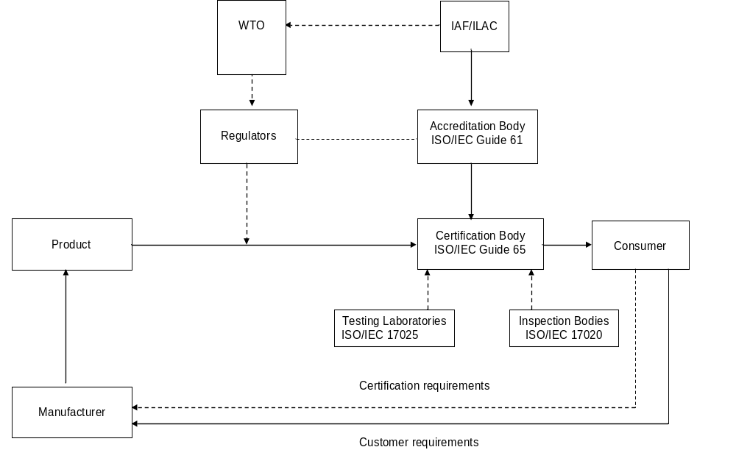
Product Certification Process – Who are the players?

Slide 6
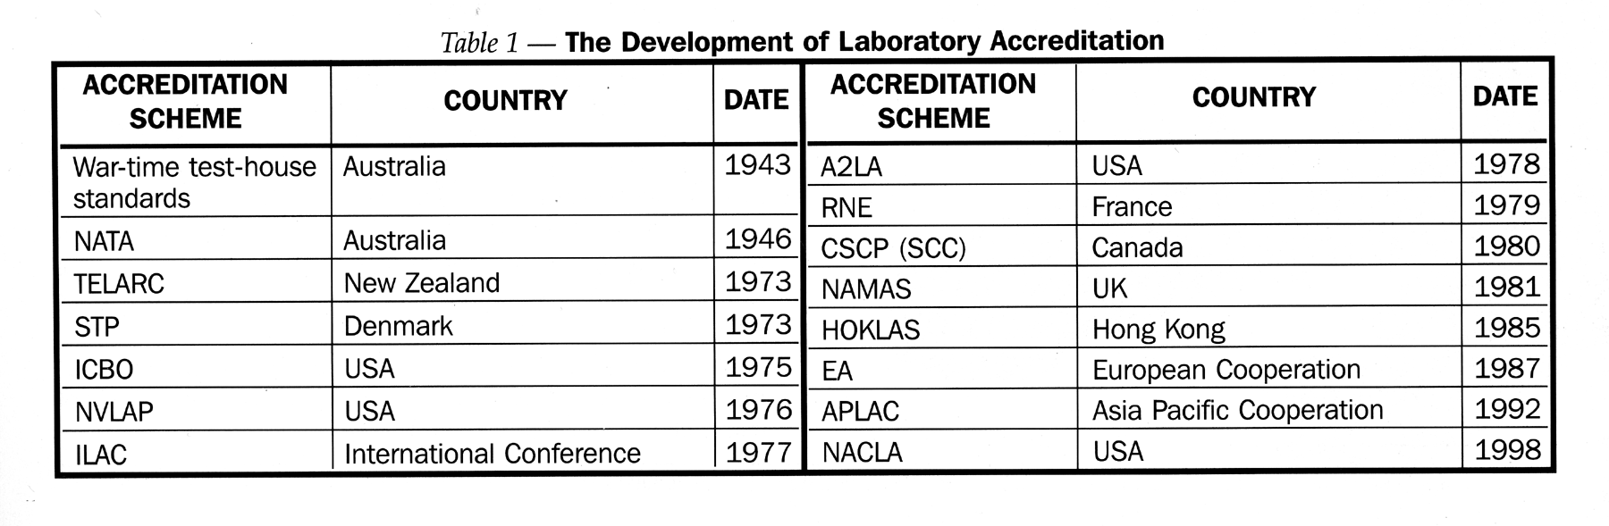
Development of Laboratory Accreditation
H
Currently IAS
H now UKAS

