Slide 1
The impact of Genital Herpes on Health Status Preferences
Raj Patel
University of Southampton

Slide 2
Agenda
Background
Methods
Study results
Conclusions

Slide 3
Background
Genital Herpes has substantial impact on morbidity and quality of life
  Pain, anxiety, depression and social isolation
  Impact on infected individuals and their partners
Utilities quantify patients’ preferences
Utilities combine measurement of the physical and psychosocial effects of a disease into one number that represents the overall impact
Suppressive antiviral therapy reduces:
  frequency of genital herpes recurrences
  sexual transmission of genital herpes (valaciclovir)

Slide 4
Study Objective
Measure utilities associated with genital herpes health states
Quantify their impact on the quality-adjusted life of an infected person and their partner

Slide 5
Methods
Develop genital herpes health states
Random sample of US general population, recruited through a Web-TV based survey network
Measuring utilities:
  Feeling Thermometer used to familiarize respondents with the health states and the notion of preferences
  Standard Gamble technique accounts for risk
  Utility weights from 0.0, reflecting death, to 1.0, reflecting perfect health

Slide 6
Identification of health states
Patient health states
Asymptomatic state between infrequent episodes
Asymptomatic state between frequently recurring episodes
Asymptomatic state while taking suppressive therapy
Primary/recurrent, non-classic (mild) episode
Recurrent, classic episode
Primary, classic episode
Partner health states
Healthy with partner who has genital herpes
Healthy with partner who has genital herpes and who is taking suppressive therapy

Slide 7
Description of health states
Attributes used in health state description:
  Appearance
  Symptomatology
  Transmission of disease
  Psychosocial/functioning impact
  Medical therapy

Slide 8
Feeling Thermometer
Familiarise respondents with the health state and the notion of preference
Participants asked to rank health states on a scale in which 100 is perfect health and 0 reflects death
Perfect Health
100
90
80
70
60
50
40
30
20
10
Death

Slide 9
Standard Gamble
Perfect Health
Chance of perfect health
P
P is varied until the person is indifferent (P_{i}) between the certain option of Health State “X” and the gamble.
P_{i} = Utility
Health
State
“X”
Chance of death
1-P
Death
Drummond, FM. et al.(1997). Methods for the Economic Evaluation of health Care Programmes. Oxford University Press. Oxford.

Slide 10
Standard Gamble question example
Imagine that you are in Health State “GREEN”. You can choose to stay in Health State “GREEN”, or you can choose to take a chance. If the chance offered is a 90% chance of Perfect Health and a 10% chance of Death, would you take the chance or stay in Health State “GREEN”?
CHOICE A
CHOICE B
Health State “GREEN” 100%
Perfect Health 90%
Death 10%
Choice A
Choice B
No preference
Utility = 0.90

Slide 11
Study Population
Sample is representative of the general US population
Population (N = 938)
Gender
Female 484 ( 52%)
Age
18 to <30 157 ( 17%)
30 - 44 years 275 ( 29%)
45 - 59 years 279 ( 30%)
60 + years 227 ( 24%)
Marital status
Married 565 ( 60%)
Single 202 ( 22%)
Other 171 ( 18%)
Highest education
Less than high school 84 ( 9%)
High school 302 ( 32%)
College/graduate school 552 ( 59%)

Slide 12
Utility scores for adult health states - Feeling Thermometer
100
Perfect Health
Asymptomatic with suppressive therapy (0.63)
Asymptomatic between infrequent episodes (0.61)
Asymptomatic between frequent episodes (0.52)
Primary/recurrent non-classic episode (0.49)
Recurrent classic episode (0.38)
Primary classic episode (0.28)
0
Death

Slide 13
Utility scores for adult partner health states - Feeling Thermometer
100
Perfect Health
Healthy with infected partner taking suppressive therapy (0.68)
Healthy with infected partner (0.64)
Partner has STD
(n =12)
100
Healthy with infected partner taking suppressive therapy
Healthy with infected partner
0.62
0.60
0
Death
0

Slide 14
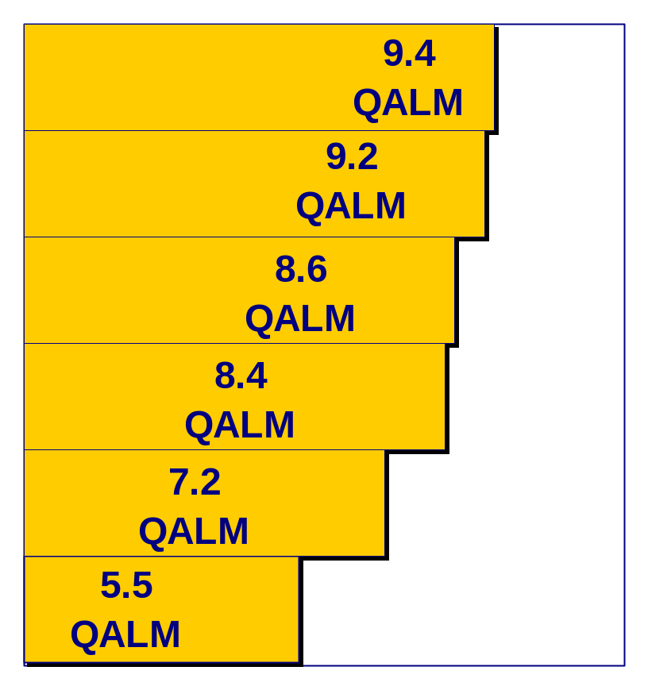
Standard Gamble utilities scores for adult health states
SG score x 12 months = Quality adjusted
life months (QALM)
Health State
Asymptomatic- suppressive therapy 0.78
Asymptomatic- between infrequent episodes 0.77
Asymptomatic- between frequent episodes 0.72
Primary/recurrent non-classic episode 0.70
Recurrent classic episode 0.60
Primary classic episode 0.46
Jan
Jul
Dec

Slide 15
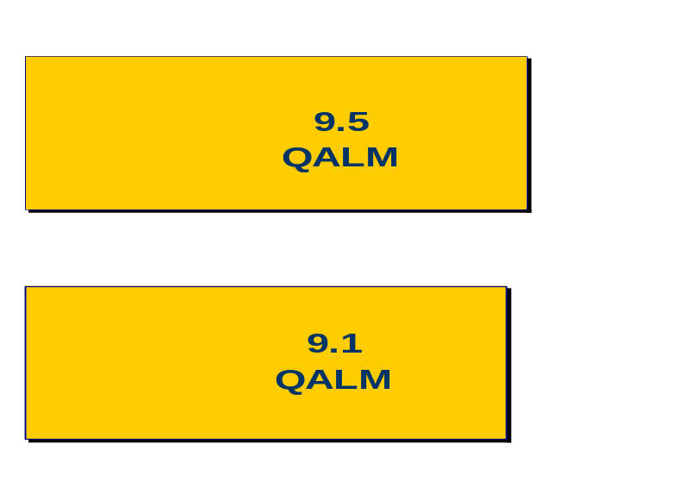
Standard Gamble utilities scores for adult partner health states
SG score x 12 months = Quality adjusted
life months (QALM)
Health State
Healthy with infected partner
taking suppressive therapy 0.79
Healthy with infected partner 0.76
Jan
Jul
Dec
Partner has STD (n = 12)
Healthy with infected partner taking
suppressive therapy 0.83 / 10 QALM
Healthy with infected partner 0.78 / 9.4QALM

Slide 16
Clinical significance of Standard Gamble utility differences from published literature
Mild state Severe state Difference
Mild/mod HCV infection vs. 0.79 0.60 0.19
decompensated cirrhosis¹
Minor AIDS defining illness vs. 0.65 0.42 0.23
major AIDS defining illness²
Mild vs.. severe tuberculosis 0.79 0.50 0.29
infection³
¹ Chong, CA. et al. Am J Gastroenterol 2003;98:630-8
² Bayoumi, AM. et al. Quality of Life Res 1999; 8:471-80
³ Dion, MJ. et al. Med Decis Making 2002;22 (Suppl):S102-S114

Slide 17
Study conclusions
Genital herpes can have a substantial detrimental impact on individual’s overall health state
Individuals without the disease value not getting genital herpes - i.e. interventions that protect against acquisition and spread
Interventions that prolong asymptomatic health states and reduce transmission risk can improve a patient’s and their partner’s quality adjusted life

Slide 18
Acknowledgements
Gale Harding¹
Kathleen Beusterien¹
Jean-Elie Malkin²
¹ Medtap International Inc, Bethesda, MD
² Centre Medical Institut Pasteur, Paris, France

