Slide 1
Landsat-5 TM and Landsat-7 ETM+ Performance Update
LDCM Science Team Meeting
January 9, 2007
Brian Markham
Landsat Calibration Scientist, NASA/GSFC Landsat Project Science Office
Brian.L.Markham@nasa.gov
301-614-6608

Slide 2
Landsat Calibration Team
Brian Markham¹, John Barker^{1*},
James Storey², Ron Hayes² , Mike Choate², Raj Rengarajan²
Pat Scaramuzza², Gyanesh Chander², Esad Micijevic²
Rynn Lamb², Julia Barsi³, Dave Landis³
Dennis Helder⁴, John Schott⁵, Simon Hook⁶, Kurt Thome⁷, and teams
¹ LPSO, NASA/GSFC, * retired 01/03/07
² SAIC/EROS**
³ LPSO, SSAI/GSFC
⁴ Image Processing Lab, South Dakota State University
⁵ Center for Imaging Science, Rochester Institute of Technology
⁶ NASA/Jet Propulsion Lab
⁷ Remote Sensing Group, University of Arizona
** Worked performed under U.S. Geological Survey contract 03CRCN0001

Slide 3
Landsat-7 ETM+ Geometric and Spatial Update
Band-to-Band registration typically 0.05 pixels or better in line and scan direction (excluding band 6)
MTF @ Nyquist changing consistent with pre-launch model--band 4 slightly below specification of 0.275
Geodetic accuracy improved to < 20 m RMS since March 2005 Gyro 3 depowering (approx 1/3 pre 3/2005 values)
Bumper mode transition expected during summer 2007

Slide 4
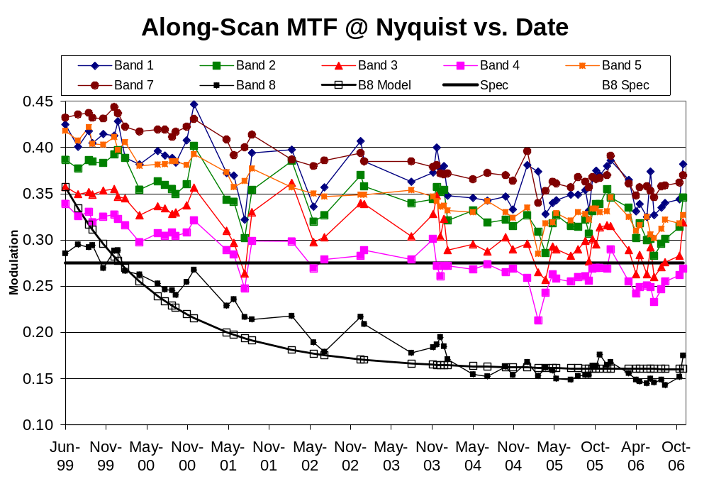

Slide 5
Landsat-5 TM Geometry Update
Landsat-5 TM operating in bumper mode since 2002
  Monthly parameter updates
  Best geometric performance if data are ordered at least 1 month after acquisition (predicted versus refined parameters)
Fixed array operations have introduced more uncertainty in spacecraft pointing knowledge
  We see larger and more frequent step corrections in the on-board attitude estimates
    Symptom of star updates correcting accumulated attitude error
  New processing logic was added to detect and correct the step offsets in the quaternion data

Slide 6
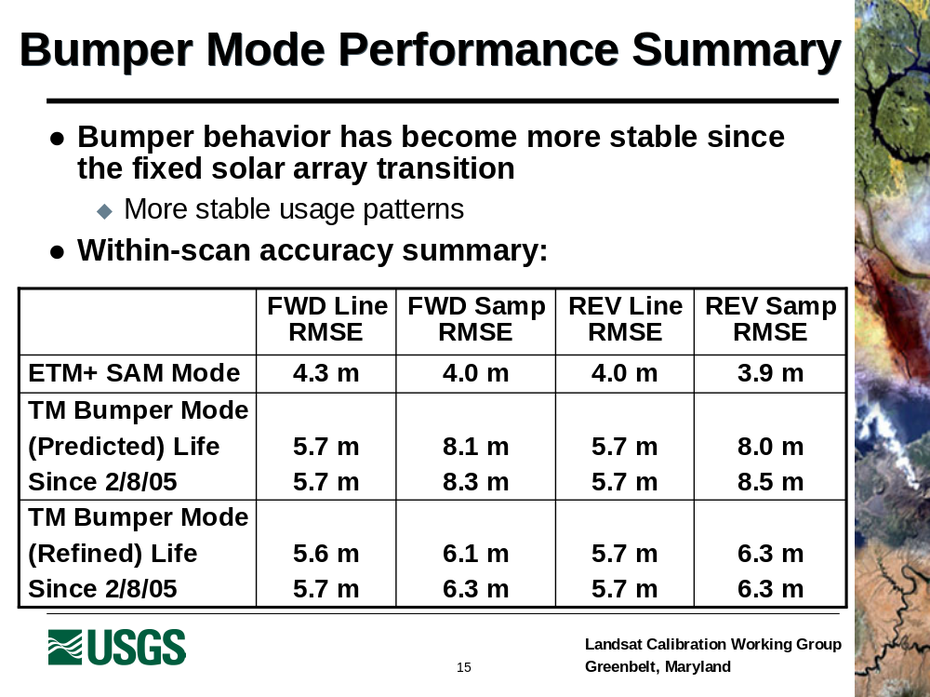

Slide 7
Landsat-7 ETM+ Reflective Band Radiometry Update
Relative detector-to-detector normalization, i.e., striping less than ± 0.1%
Between-date detector gain stable to < 3% over mission life (< 0.5%/year)
Absolute radiometric accuracy better than ± 5%
Noise stable over mission life
  Small improvement with SLC-off
  Anomalous coherent noise gone with SLC-off
SLC failure had no significant impact on L7 ETM+ reflective band radiometry- continues to be excellent

Slide 8
Landsat-7 ETM+ Thermal Band Radiometry Update
  Relative detector-to-detector normalization, i.e., striping less than ± 0.1%
  No observable change in instrument responsivity
  Absolute radiometric accuracy better than 1K
  Noise stable over mission life

Slide 9
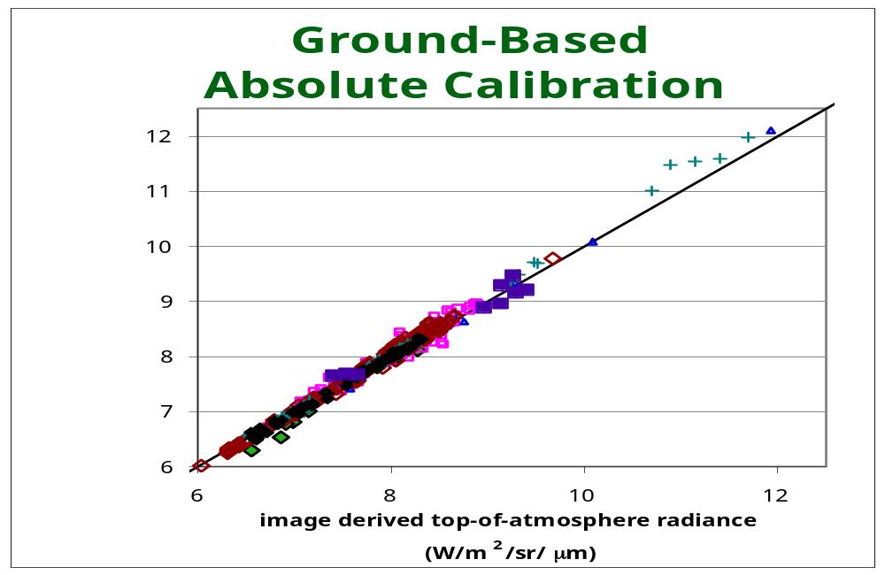
BLUE/GREEN: JPL data
PINK/BROWN: RIT data
BLACK: Historical recently processed Tahoe data
PURPLE: recent Salton Sea

Slide 10
Landsat-5 TM Reflective Band Radiometry Update
Within-band within-scene internal stability
  Scan-Correlated Shift (SCS) of up to 0.7 DN
    Correctable with scan line-by-scan line background subtraction
  Memory Effect of up to 4 DN
    Currently corrected in NLAPS processing
  Some banding and striping issues remain to be resolved
Between-date stability
  Interference cycling from icing on B5 and B7
    Correctable with IC processing or LUT that includes interference cycling
Radiometric calibration processing
  Uses Gain Calibration History stored in Look-Up Table
  Extracts and applies biases on a scan line by scan line basis
  Rescaled to Fixed Radiance Range (LMIN, LMAX)
  Recently obtained datasets from ESA indicate calibration history can be improved
    Revised calibration LUT release planned for 3/5/2007

Slide 11
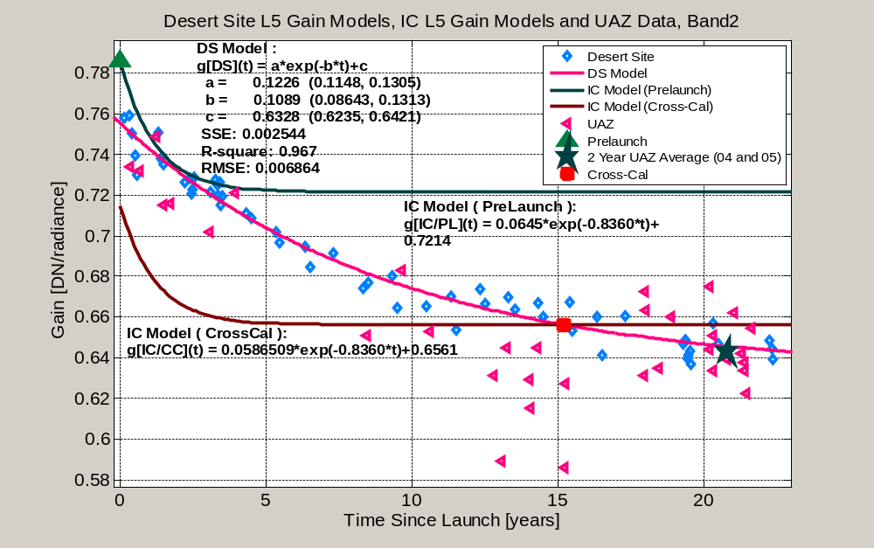
Proposed updated calibration curve in pink, tied to 1999 ETM+ cross-cal
Notes:
Band 2, pink curve anchored to L5 absolute gain from 1999 ETM+ cross call; 2004-2005 cal as determined by UAZ.
Note excellent agreement with 1999 cross cal point: 0.4%
Precision in UAZ cal point ~1.5%
Precision in 1999 cross-cal point based on Teillet paper is also around 1.5%
Again, two independent calibration agree very well.
Same comments regarding first two years of life—IC data of questionable use, initial DS data points may suggest steeper decay (Helder’s hypothesis, no on else agrees with!)

Slide 12
Landsat-5 TM Thermal Band Radiometric Calibration Update
Sensitivity reduced by up to 50% by icing build-up on cold focal plane window
  Correctable with Internal Calibrator
Current ground measurements show some bias compared to internal calibrator calibrated imagery
  Bias by +0.092 W/m² sr μm (~0.65K at 300K) for data processed beginning 3/5/2005
Radiometric Calibration on Scene-by-Scene Basis using the response to the Internal Calibrator
  Rescaled to Fixed Radiance Range (LMIN, LMAX)
  Absolute accuracy ±2%

Slide 13
