Slide 1
Landsat-5 TM and Landsat-7 ETM+ Performance Update
LDCM Science Team Meeting
January 9, 2008
Brian Markham
Landsat Calibration Scientist, NASA/GSFC Landsat Project Science Office
Brian.L.Markham@nasa.gov
301-614-6608

Slide 2
Landsat Calibration Team
Brian Markham¹, James Storey², Dennis Helder³,
Ron Hayes², Julia Barsi⁴, Obaidul Haque² , Raj Rengarajan²,
Esad Micijevic², Rynn Lamb², Mike Choate²,
Pat Scaramuzza², Gyanesh Chander²,
John Schott⁵, Simon Hook⁶, Kurt Thome⁷, and teams
¹ LPSO, NASA/GSFC,
² SAIC/EROS**
³ Image Processing Lab, South Dakota State University
⁴ LPSO, SSAI/GSFC
⁵ Center for Imaging Science, Rochester Institute of Technology
⁶ NASA/Jet Propulsion Lab
⁷ Remote Sensing Group, University of Arizona
** Worked performed under U.S. Geological Survey contract 03CRCN0001

Slide 3
Landsat-7 ETM+ Geometric and Spatial Update
Band-to-Band registration typically 0.05 pixels or better in line and scan direction (excluding band 6)
MTF has stabilized in all bands model
  band 4 slightly below specification of 0.275
  Band 8 behavior consistent with pre-launch predictions
Switch to bumper mode disrupted ETM+ sensor alignment calibration
  Degraded geodetic accuracy since April 1, 2007
    Pre-switch : 97% scenes better than 50 meters RMSE
    Post-switch: 65% scenes better than 50 meters RMSE

Slide 4
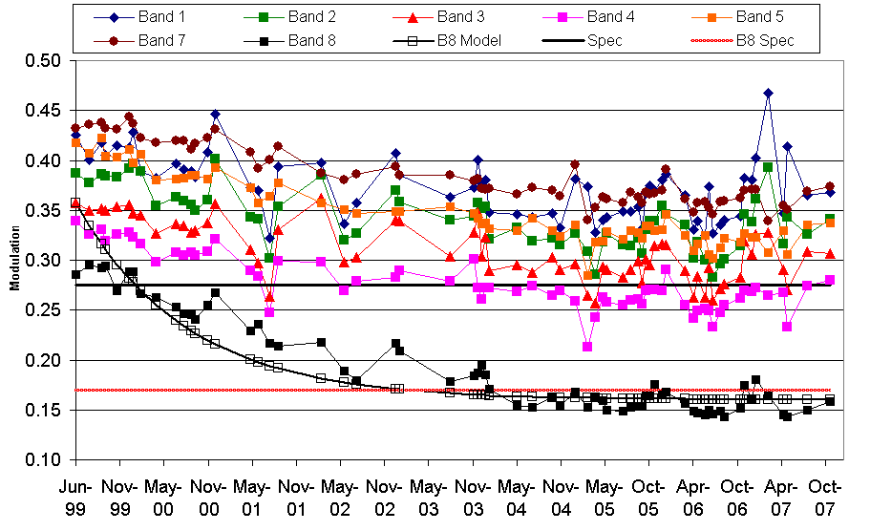
Along-Scan MTF vs. Date

Slide 5
ETM+ Bumper Mode Performance
Bumper parameter trends have stabilized following a brief adjustment period in early April
ETM+ bumper mode performance is monitored in the same way as L5 TM performance
  Analysis performed using daily calibration parameters
Within-scan accuracy statistics for ETM+ SAM mode, L5 TM bumper mode, and ETM+ bumper mode:
 | FWD Line RMSE | FWD Samp RMSE | REV Line RMSE | REV Samp RMSE
ETM+ SAM Mode | 4.3 m | 4.0 m | 4.0 m | 3.9 m
L5 TM Predicted ETM+ Predicted | 5.4 m 5.3 m | 7.6 m 6.5 m | 5.4 m 5.3 m | 7.0 m 6.4 m
L5 TM Refined ETM+ Refined | 5.4 m 5.3 m | 5.6 m 5.5 m | 5.4 m 5.3 m | 6.2 m 5.4 m

Slide 6
Landsat-5 TM Geometry Update
Landsat-5 TM operating in bumper mode since 2002
  Generate both monthly (heritage) and daily bumper mode parameter sets for L5
Bumper mode calibration will likely require immediate update and (initially) frequent refinement if / when Landsat 5 resumes imaging operations

Slide 7
Bumper Mode Performance Summary
Summary within-scan accuracy statistics are presented below for both the predicted and refined calibration parameters
  Lifetime and recent statistics are shown
ETM+ SAM mode values are shown for comparison
 | FWD Line RMSE | FWD Samp RMSE | REV Line RMSE | REV Samp RMSE
ETM+ SAM Mode | 4.3 m | 4.0 m | 4.0 m | 3.9 m
TM Bumper Mode (Predicted) Life Since 01APR2007 | 5.5 m 5.4 m | 7.9 m 7.6 m | 5.6 m 5.4 m | 7.9 m 7.0 m
TM Bumper Mode (Refined) Life Since 01APR2007 | 5.5 m 5.4 m | 6.4 m 5.6 m | 5.6 m 5.4 m | 6.7 m 6.2 m

Slide 8
Landsat-7 ETM+ Reflective Band Radiometry Update
Relative detector-to-detector normalization, i.e., striping less than ± 0.1%
Between-date detector gain stable to < 0.5%/year
  Based on desert sites--generally not statistically significant
Absolute radiometric accuracy better than ± 5%
Noise stable over mission life
  Small improvement with SLC-off
  Anomalous coherent noise gone with SLC-off
SLC failure had no significant impact on L7 ETM+ reflective band radiometry- continues to be excellent

Slide 10
Landsat-7 ETM+ Thermal Band Radiometry Update
  Relative detector-to-detector normalization, i.e., striping less than ± 0.1%
  No observable change in instrument responsivity
  Absolute radiometric accuracy better than 1K
  Noise stable over mission life
  Switch to bumper mode resulted in change in shutter bias extraction regions
    Incorrect shutter region windows as well as pulse losses resulted in severe banding (low gain) and striping (high gain) in data acquired and processed between April 1 and July1 and October 1 and October 28

Slide 11
remaining RMS
0.1 W/m²/sr/μm or 0.7 K
BLUE/GREEN: JPL data PINK/BROWN: RIT data
“reanalysis data” incorporated

Slide 12
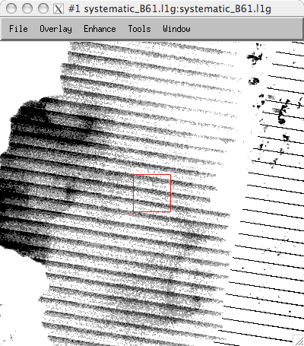
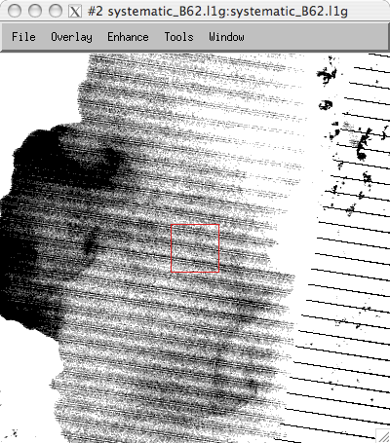
B61 - processed with Oct 1 CPF
B62 - processed with Oct 1 CPF
I2596
I2596

Slide 13
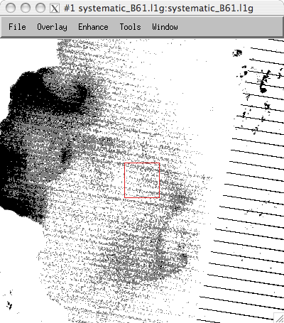
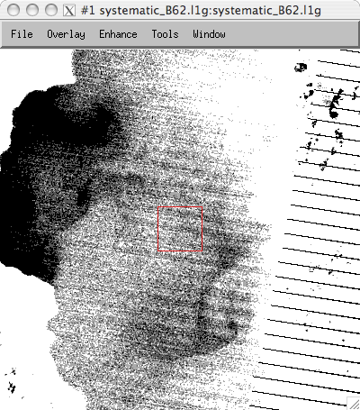
B61 - processed with modified CPF, new bias_locations and ACCA biases
B62 - processed with modified CPF, new bias_locations and ACCA biases
Still can’t compute gain for D3,5,7,8
I2607
I2607

Slide 14
Landsat-5 TM Reflective Band Radiometry Update
Within-band within-scene internal stability
  Scan-Correlated Shift (SCS) of up to 0.7 DN
    Correctable with scan line-by-scan line background subtraction
  Memory Effect of up to 4 DN
    Currently corrected in NLAPS processing
  Some banding and striping issues remain to be resolved
Between-date stability
  Interference cycling from icing on B5 and B7
    Correctable with IC processing or LUT that includes interference cycling
Radiometric calibration processing
  Uses Gain Calibration History stored in Look-Up Table
  Extracts and applies biases on a scan line by scan line basis
  Rescaled to Fixed Radiance Range (LMIN, LMAX)
  Look-up Table revised April 2, 2007 to reflect revised trends from Sahara desert site data obtained from ESA

Slide 15
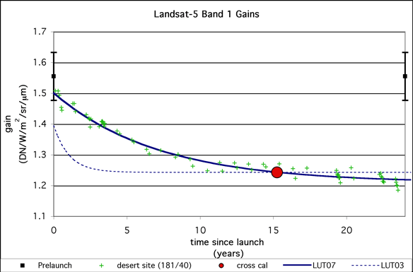
Notes:
Band 2, pink curve anchored to L5 absolute gain from 1999 ETM+ cross call; 2004-2005 cal as determined by UAZ.
Note excellent agreement with 1999 cross cal point: 0.4%
Precision in UAZ cal point ~1.5%
Precision in 1999 cross-cal point based on Teillet paper is also around 1.5%
Again, two independent calibration agree very well.
Same comments regarding first two years of life—IC data of questionable use, initial DS data points may suggest steeper decay (Helder’s hypothesis, no on else agrees with!)

Slide 16
Landsat-5 TM Thermal Band Radiometric Calibration Update
Sensitivity reduced by up to 50% by icing build-up on cold focal plane window
  Correctable with Internal Calibrator
Bias adjustment of 0.092 W/m² sr μm effective 02-Apr-07
  Only for data acquired since April 1999 (ETM+ era)
  Recommended users with data add 0.092 to their pre-02-Apr-07 processed radiance level products
  Pre-1999 era data under evaluation by RIT using Great Lakes buoys
Radiometric Calibration on Scene-by-Scene Basis using the response to the Internal Calibrator
  Rescaled to Fixed Radiance Range (LMIN, LMAX)
  Absolute accuracy ±1%

Slide 17
L5, L7 Delta-L comparison

Slide 18
Summary
Landsat-7 ETM+ performance stable, except for changes induced by switch to bumper mode
Landsat-5 TM performance stable through October
  Restart of imaging expected to require frequent bumper mode calibration
Landsat-5 TM reflective and thermal band calibrations updated 02 April 2007
  Thermal band calibration accuracy since 1999 now comparable to ETM+ thermal band

