Slide 1


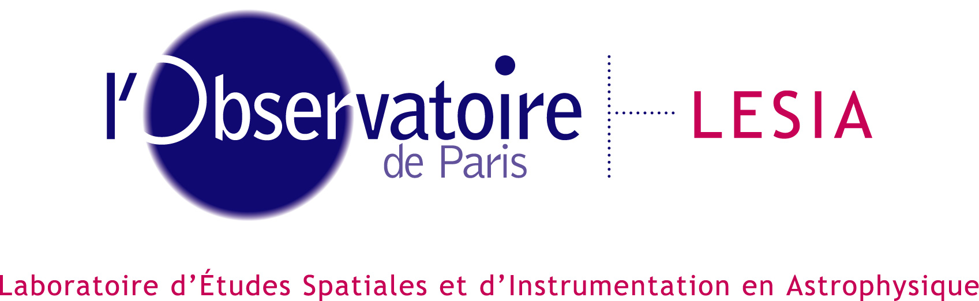
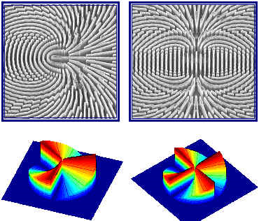
Optical vortex coronagraph with subwavelength gratings
AGPM & heirs
D. Mawet¹, P. Riaud^{1,2}, A. Boccaletti², P. Baudoz², J. Baudrand², O. Absil^{1,3}, J.L. Beuzit³, P. Labeye⁴, J. Surdej¹
1- IAGL, University of Liège
2- LESIA (Paris-Meudon Obs.)
3- LAOG (Grenoble)
4- CEA-LETI (Grenoble)
© Technion - Israel Institute of Technology
Dimitri Mawet, Coronagraph workshop, Pasadena, September 2006

Slide 2
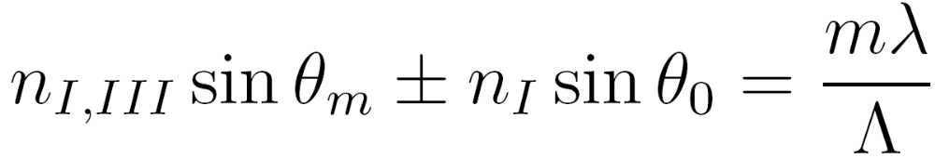
Subwavelength gratings
λ
Λ
m=-2
m=-1
m=0
m=1
m=2
Grating equation:

Slide 3
Subwavelength gratings
Λ
m=-1
m=0
m=1
Grating equation:

Slide 4
Subwavelength gratings
Λ
m=0
Grating equation:

Slide 5
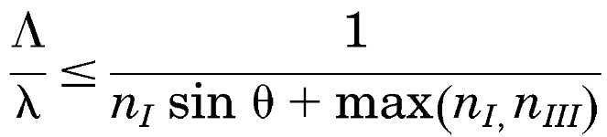
Subwavelength gratings
m=0
Subwavelength grating are called
zero-order gratings (ZOG) if they satisfy the
ZOG condition:

Slide 6
Subwavelength gratings
TM
TE
h
TE
∆Φ=2π/λ (n_{TM}-n_{TE}) h
TM
m=0
1D subwavelength gratings are artificially birefringent.
By controlling the grating geometry, one can tune the
so-called dispersion of form birefringence ∆n_{form} (λ)=n_{TM}-n_{TE}
and make the phase shift quasi-achromatic

Slide 7
RCWA
To analyse the response of subwavelength gratings, the vectorial nature of light must be taken into account through a resolution of the Maxwell equation
Rigorous Coupled-Wave Analysis (RCWA)
or Fourier Modal Method (FMM)
Fields and permittivities are decomposed in a Fourier basis and then matched at the grating layer boundaries to yield the diffraction order complex amplitudes..
ε₁
ε₂
ε(x)
x
TF
x

Slide 8
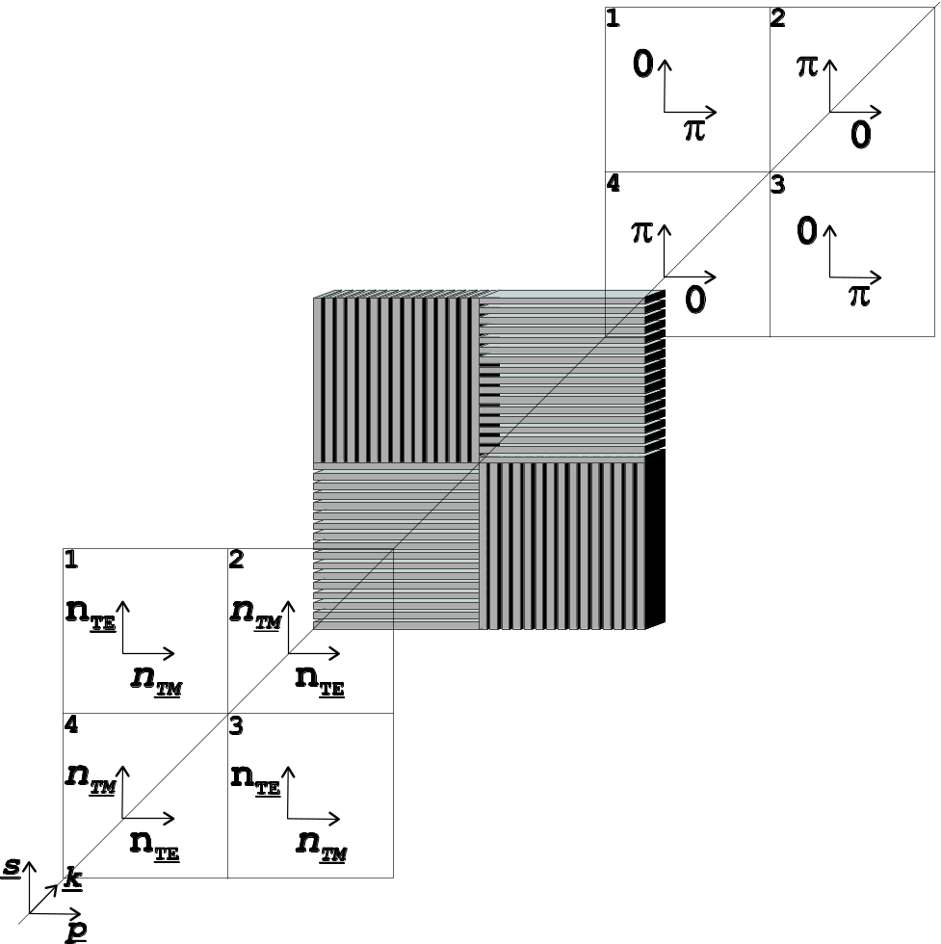
4QZOG
Mawet D. et al 2005, Appl. Opt.
Anti-symmetrical implementation of 4 identical ZOG at 90°
Unique monolithic substrate
→ phase distribution of FQPM
for s and p
→ OK in natural light
Final structure =
integrated surface relief structure
Optical function realized at the surface of the component (a few micron w/r to ~ mm)
0
π
0
π
π
π
0
0
π
π
0
0
0
0
π
π
TE
TM
TM
TE
TM
TE
TE
TM
s
p

Slide 9
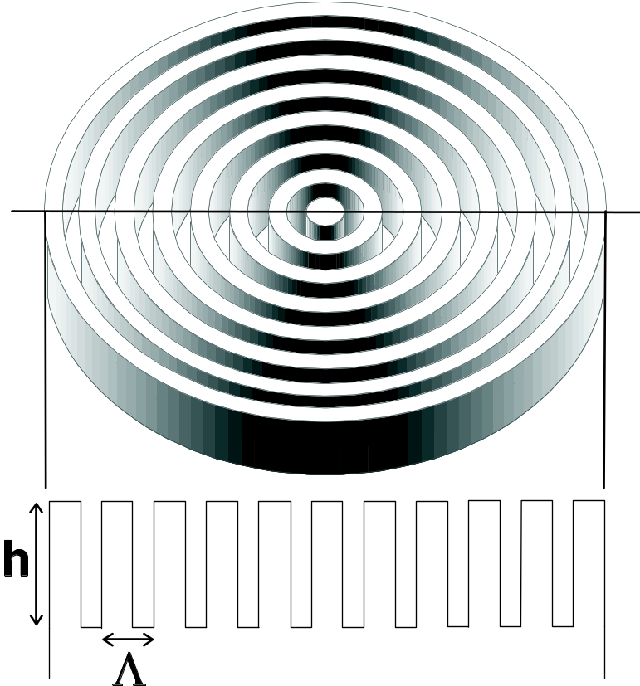
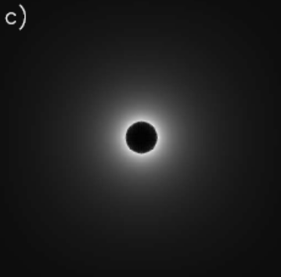
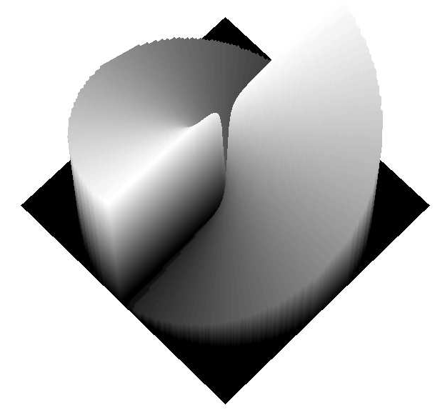
AGPM
Mawet et al. 2005, ApJ
AGPM =
Annular Groove Phase Mask Coronagraph.
AGPM creates a second order Optical Vortex (OVC2) = phase singularity.
Prevent the FQPM source attenuation on the quadrant transitions
→ very small IWA
→ discovery space complete
Present a certain intrinsic achromaticity thanks to the ZOG technology

Slide 10
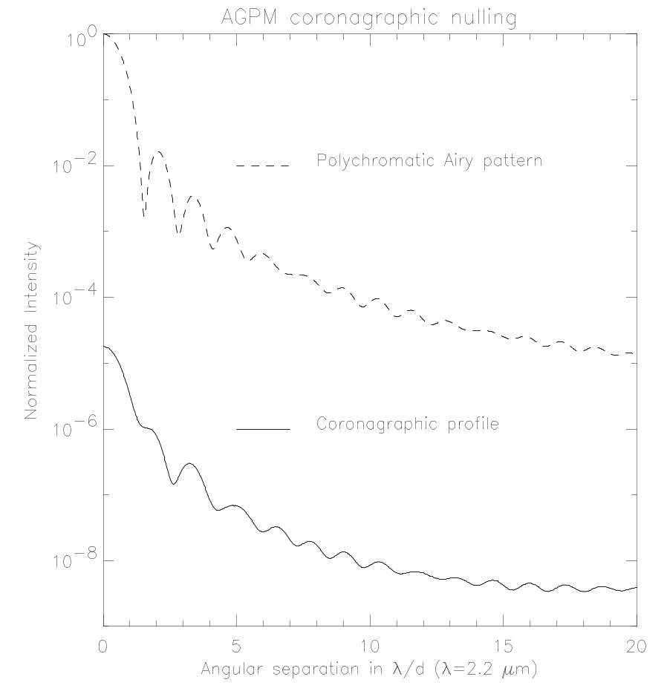
IR preliminary numerical simulation
Coronagraphic results in H, K and N bands:
  WFE of λ/70 rms at 632.8 nm (e.g. state-of-the-art Virgo mirrors)
  both polarizations
  (vectorial RCWA analysis)
  Residual chromatism
  Amplitude mismatches
RCWA allows
including technological
limitations upstream
Filters | H (R=4.7) | K (R=5.5) | N (R=4.86)
Null Depth (global) | 3.5×10⁻⁵ | 1.7×10⁻⁵ | 4×10⁻⁵
Contrast at 3λ/d | 2.9×10⁻⁷ | 1.4×10⁻⁷ | 3.3×10⁻⁷
Grating period (C) | 525 nm | 740 nm | 3.3 μm
Speckle level
3 λ/D

Slide 11



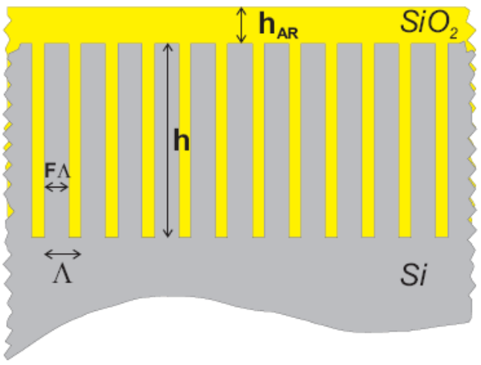
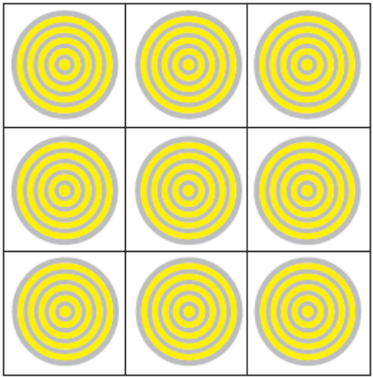
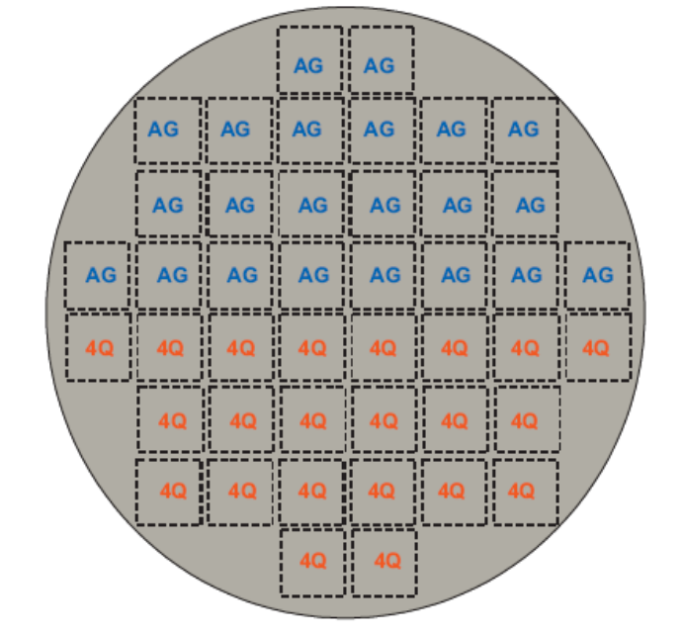
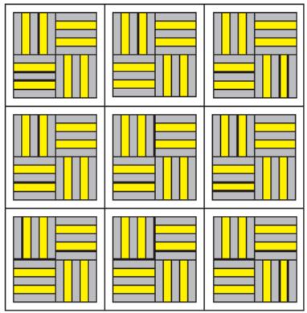
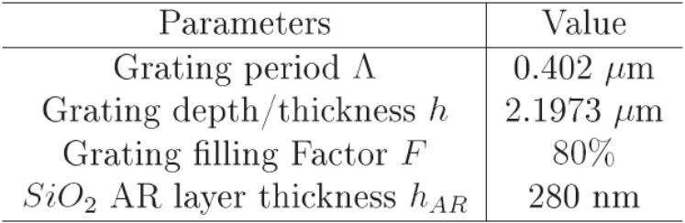
Manufacturing
CEA-LETI operation
  Micro-electronic techniques
  Silicon technology
Silicon 8” wafer
Stepper FOV
ZOG geometry

Slide 12
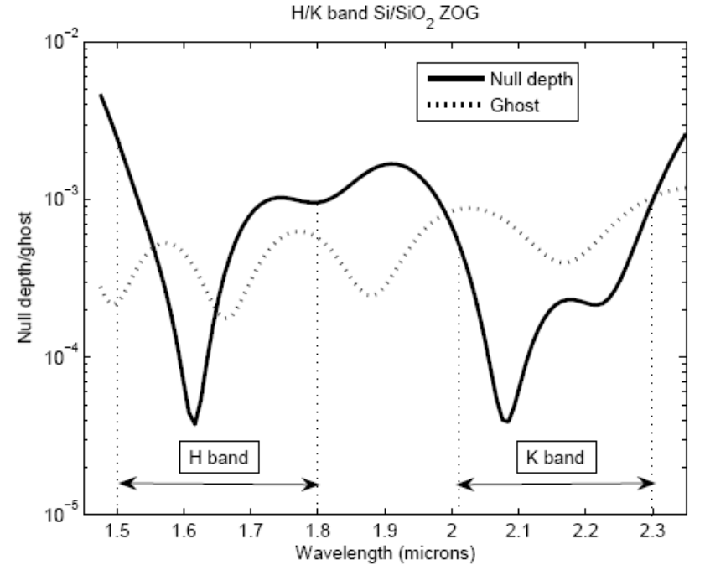
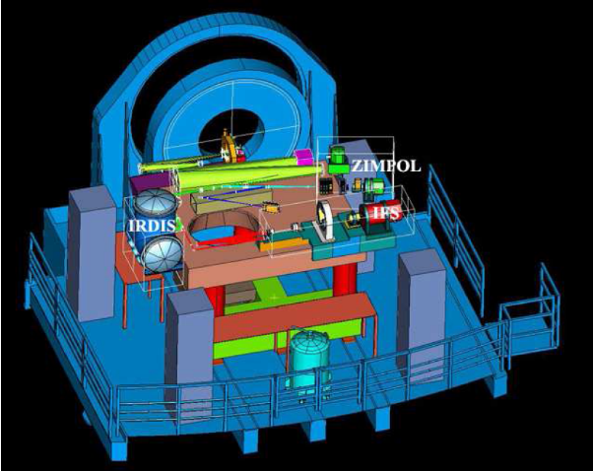
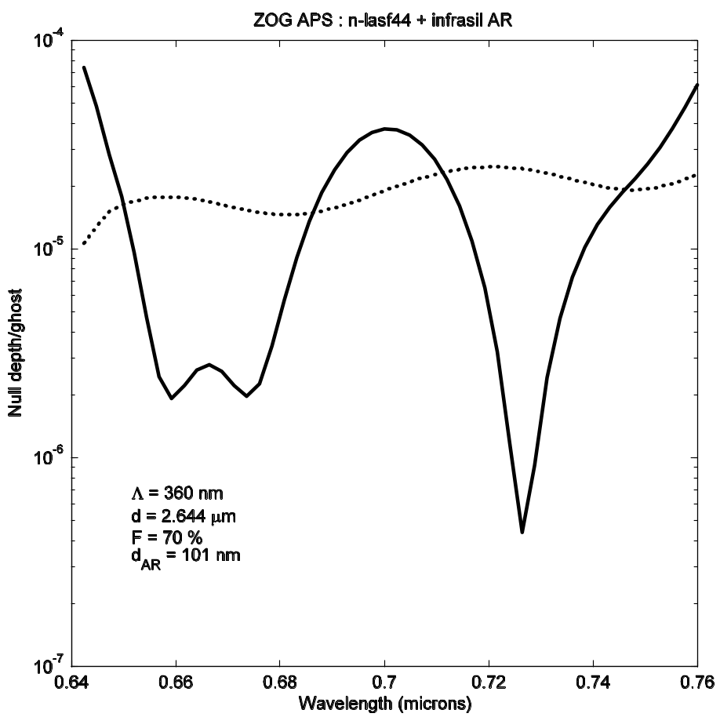
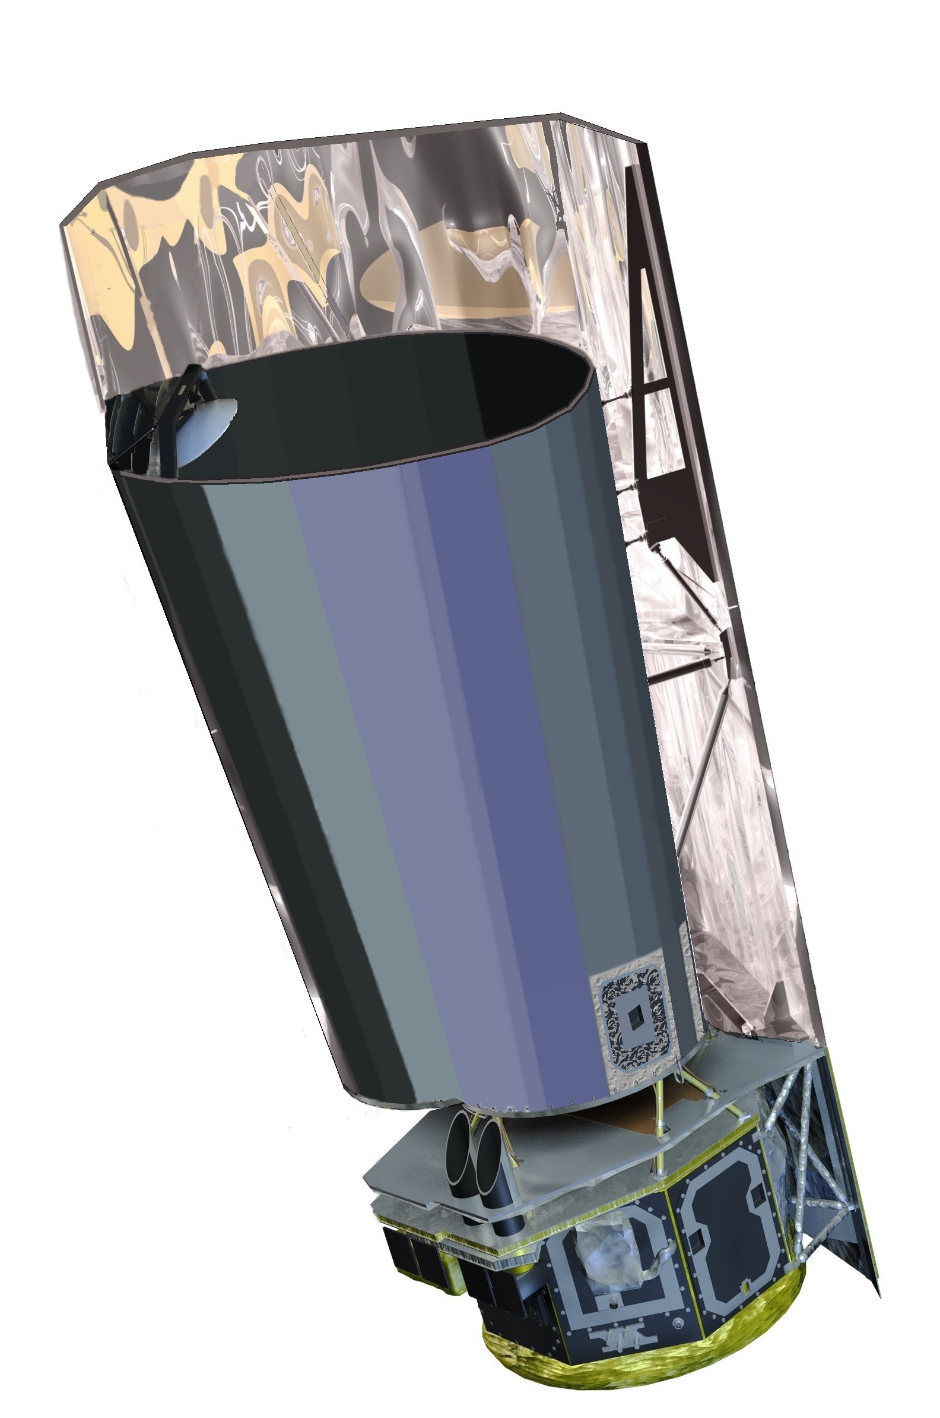
Current perspectives
VLT-PF/SPHERE
COAST

Slide 13
COASTsim (beta version):
an example with the AGPM
Telescope input: Diameter / overall transmission / dust scattering
polarization and amplitude mismatch (Ag coating)
Wavefront: one PSD before coronagraphic device (f^{-1,5}) λ/100 rms (common)
one PSD after coronagraph (f^{-1,5}) λ/100 rms @ 632 nm (common
+ non-common TBD)
Coronagraph: polarization mismatch with the AGPM coronagraph (RCWA input)
(amplitude and phase on the wavelength range R~5)
→ Polychromatic Fourier simulation
Gain: gain after reference subtraction (currently ~ 10)
potential gain after ZIMPOL analysis (polarization)
after “SDI” analysis (spectral) ~ 100
Stellar residue: @ λ/d for AGPM / CIA (simple radial function)
S/N calculus: stellar residue / zodiacal / exo-zodiacal /
stellar leakage / read-out / dark / TIS / Gain
(also stellar spectrum, planet spectrum, bandwidth )
Pierre Riaud (IAGL/LESIA): riaud@astro.ulg.ac.be

Slide 14
Warning: Check ...
Telescope input: Fresnel propagation on each mirror (increase size!)
Alignment (Zemax tolerancing)
Rotation of polarization
Coronagraph: Check technical limitations for the ZOG technology
(the main ones are taken into account upstream via RCWA)
(Applicable whatever the coronagraphic device)
→ limitation on the maximum input wavefront error (close loop)
if we increase quality of the input wavefront, there is only a small
gain on the speckle halo, but not on the residual stellar peak .
Wavefront: Problem of high precision wavefront measurement during the
telescope AIV for space mission ( T=100 K , L2 orbit )
Mirror mounting (FUSE telescope WFE l/30 rms @ 632 nm !)
Dust contamination
Pierre Riaud (IAGL/LESIA): riaud@astro.ulg.ac.be

Slide 15
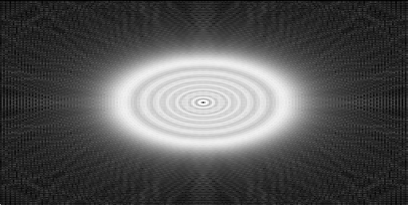
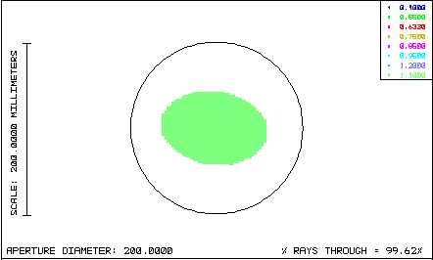
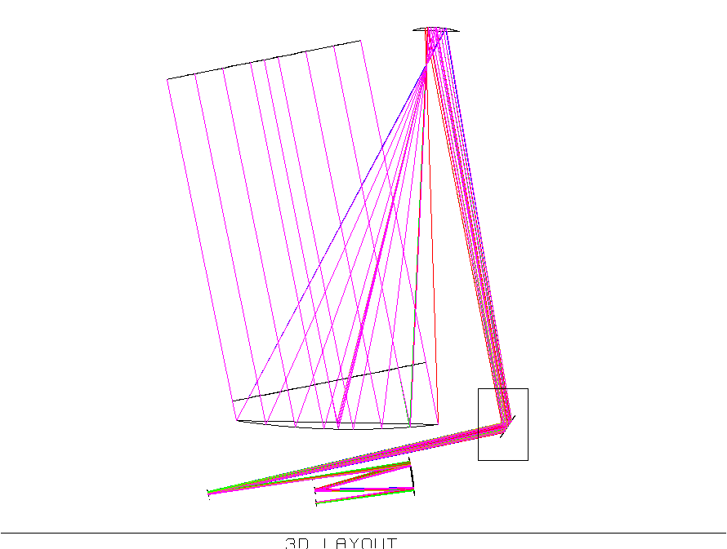
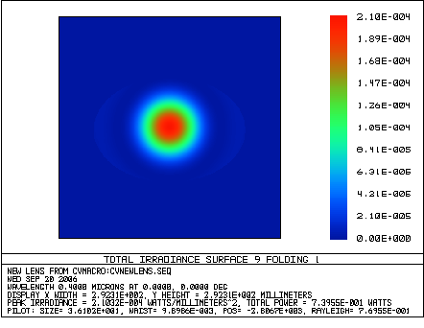
Warning: Check diffraction Σ U_{c}=1-ε
29.2 cm
Pierre Riaud (IAGL/LESIA): riaud@astro.ulg.ac.be

Slide 16
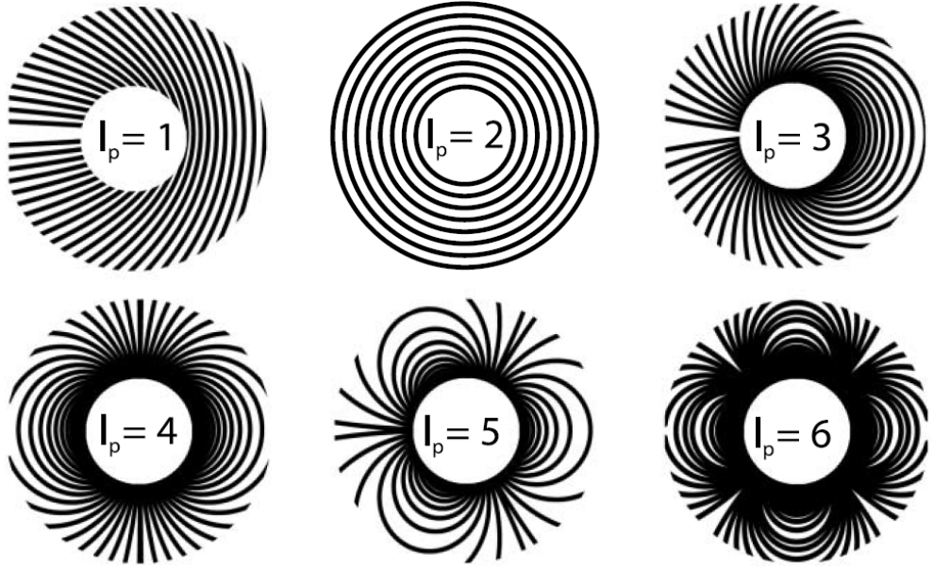
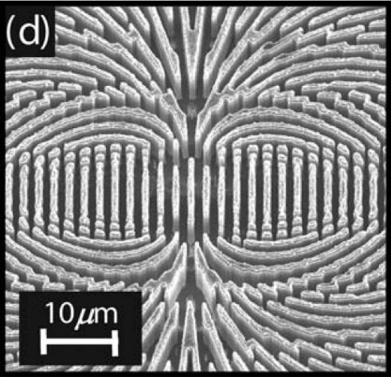
Higher order masks
Increase the topological charge
l_{p}=4
E. Hasman group
AsGa technology
(10.6 microns)
Geometry complexity

Slide 17
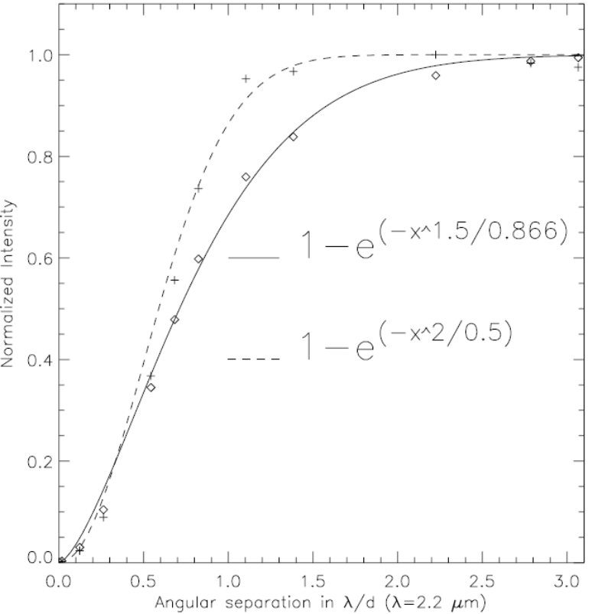
Higher order masks
leakage growths as θ^{m} ;
m being the topological
charge of the mask
AGPM
& FQPM
θ²
l_{p}=4
E. Hasman group
AsGa technology
(10.6 microns)
Geometry complexity

Slide 18
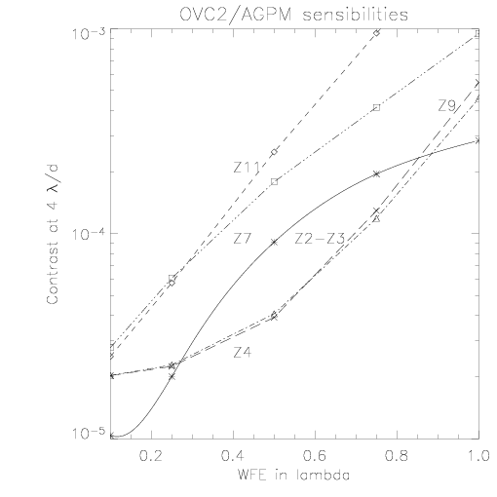
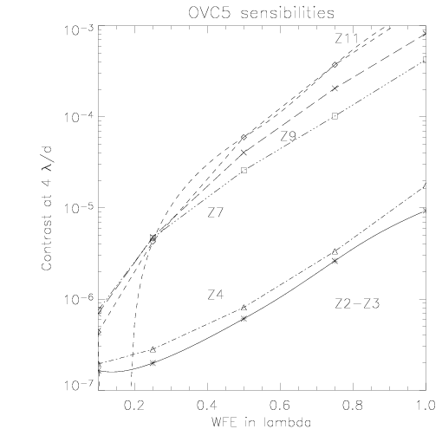
Higher order masks
WFE²
WFE⁵

Slide 19
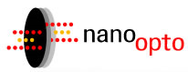
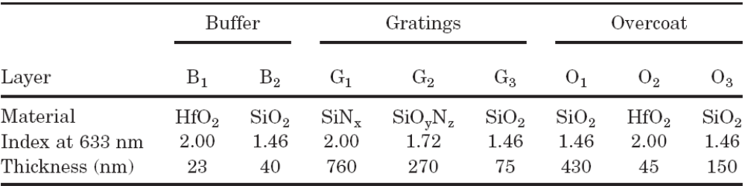
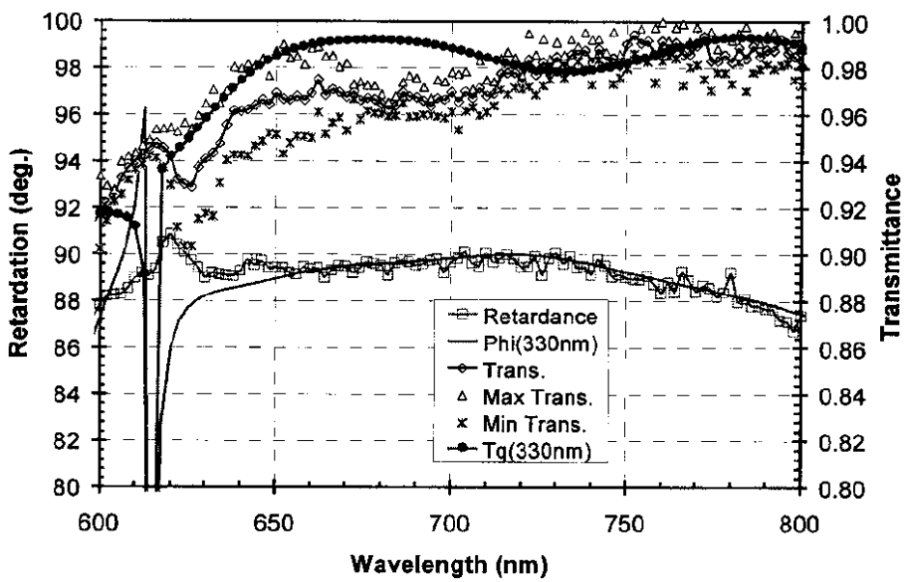
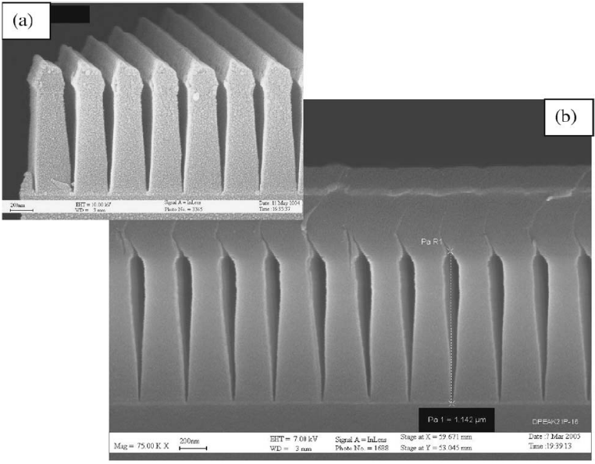
State-of-the-art in the visible
R~5, eq. nulling of 1000-10000 but complexity !!!
200 nm

Slide 20
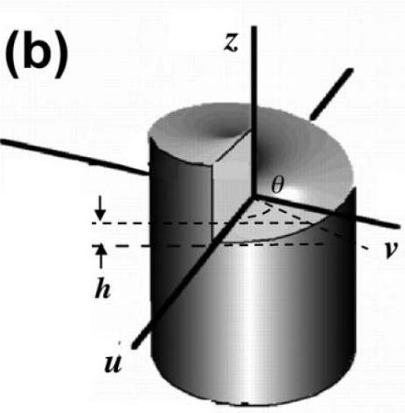
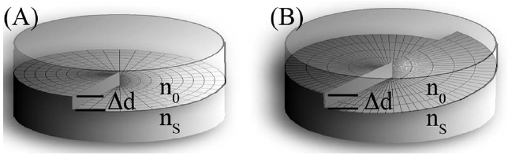
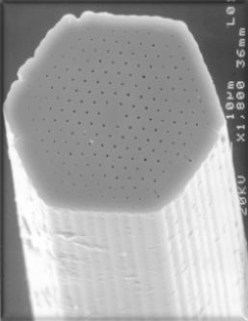
Towards the 10¹⁰ !?
With phase masks (FQPM, OVC_{m},…)
  control of the phase at the 10⁻⁴ radian level !!!
  ΔΦ=2π/λ Δn Δe → Δn Δe ~ 10⁻¹²
  - case 1:
  1 isotropic opt. mat.
  index step (OVC phase ramp)
  Δn ~ 1 → Δe ~ 10⁻³ nm !!!
  - case 2:
  2 (or more) isotropic opt. mat.
  Δn << → Δe relaxed, how much ?
  Find matched materials (dispersion)
  - case 3:
  1 anisotropic mat. (birefringent)
  Δn << → Δe relaxed, how much ?
  Depends on microgeometry : ZOG tech. → filling factor F
  Δn # 1/F
  e # F
Chromatic
Foo et al. 2005
(A)chromatic
Swartzlander 2006
(A)chromatic
relaxing Δe → photonic crystal of length e
with the proper embedded
geometry

Slide 21
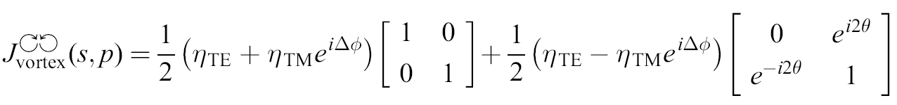
Towards the 10¹⁰ !?
Idea:
  Think vectorially and helically !!!
Minimum efficiency of the polarization filter ?
  10¹⁰ at 4 λ/D ?
  → ~ 10⁸ total rej. / ZOG R~5 rej. ~ 100-1000 ER
Residuals (η_{TE}≠η_{TM} ≠1; ΔΦ≠π)
not affected by the vectorial vortex
Left/right-handed circular
« vortexified » light
Left/right-handed circular
polarization filter
P
λ/4
VOVC
λ/4
P

Slide 22
Conclusion
OVC are attractive in terms of throughput, IWA, discovery space and simplicity of implementation (focal plane masks).
Subwavelength gratings provide a powerful, flexible and integrated solution for manufacturing « achromatic » OVC of any order.
Design necessitates upstream vectorial analysis (RCWA).
Broadband 10¹⁰ extremely challenging (feasible?) for phase masks in general
  need some new ideas
  require R&D !!!
Where are we ?
State-of-the-art
Hasman group: vect. vortex up to 4th order @ 10.6 micron (AsGa)
Nanoopto: ZOG visible achromatic (R<5) phase shifters (equivalent rejection of 1000-10000)
Our group (LESIA, ULg, LAOG, LETI):
AGPM lab demonstration this year
goal 5000 broadband (H/K) total nulling
→ 10⁻⁵/10⁻⁶ at 3-4 λ/D

