Slide 1
Space Weather
Joachim Raeder
Space Science Center & Physics Department
Many thanks to Howard Singer (NOAA/SEC) for much of the material

Slide 2
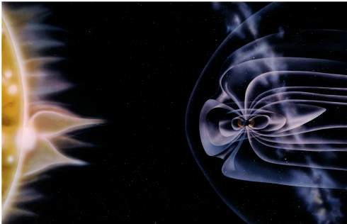
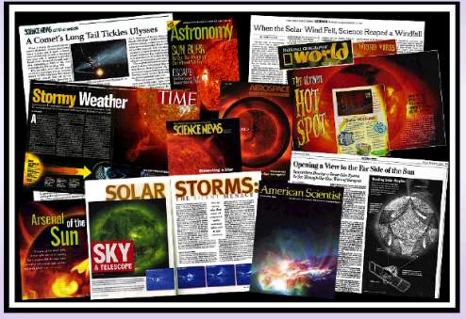
SPACE WEATHER, STORMS IN SPACE, AND THE AURORA

Slide 3
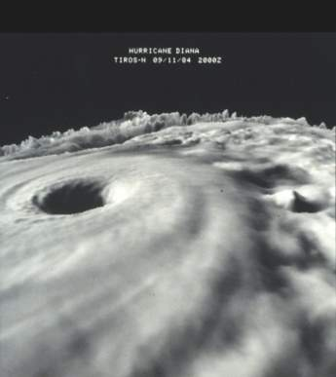
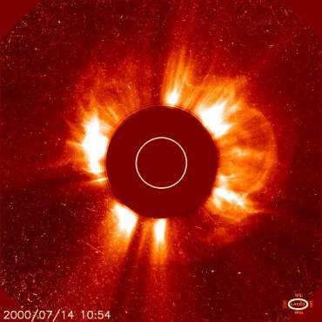
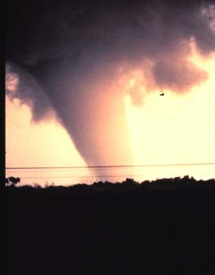
SPACE WEATHER, STORMS IN SPACE, AND THE AURORA
Weather
Space Weather
Hurricanes and Tornados
Solar Corornal Mass Ejection

Slide 4
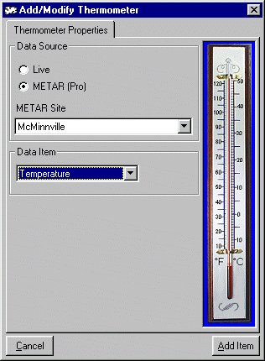
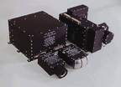
SPACE WEATHER, STORMS IN SPACE, AND THE AURORA
Monitor and Measure
Weather
Space Weather
Thermometer
Energetic Particle Sensor

Slide 5
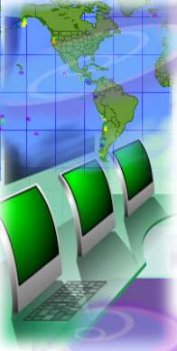
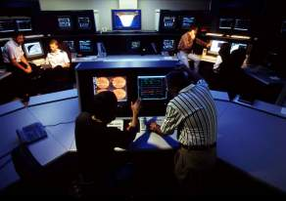
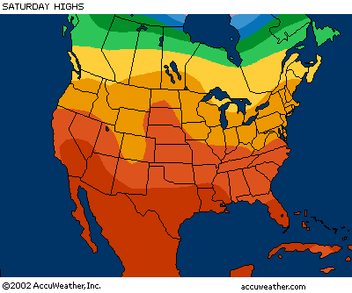
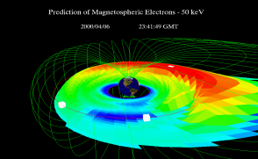
SPACE WEATHER, STORMS IN SPACE, AND THE AURORA
Services
Weather
Space Weather
NOAA
National Weather Service
NOAA Space Environment Center
Vendors with enhanced Products
Accuweather

Slide 6
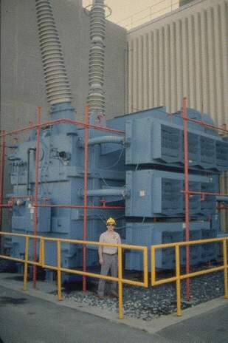
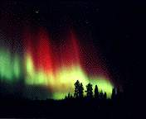
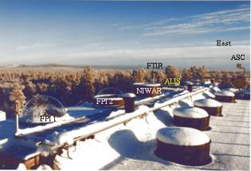
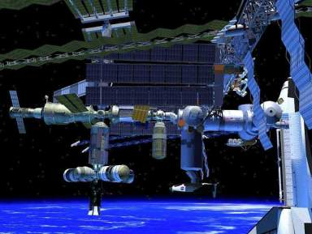
SPACE WEATHER, STORMS IN SPACE, AND THE AURORA
Auroral Research in Kiruna Sweden
Electric Power
Transformer
International Space Station

Slide 7
Geomagnetic Storm Effects on Telegraph
Operations - September 3, 1859
Boston (to Portland operator).--"Please cut off your battery entirely from the line for fifteen minutes."
Portland.--"Will do so. It is now disconnected."
Boston.--"Mine is also disconnected and we are working with the auroral current. How do you receive my writing?"
Portland.--"Better than with our batteries on. Current comes and goes gradually."
Boston.--"My current is very strong at times, and we can work better without batteries, as the aurora seems to neutralize and augment our batteries alternately, making the current too strong at times for our relay magnets. Suppose we work without batteries while we are affected by this trouble?"
Portland.--"Very well. Shall I go ahead with business?"
Boston.--"Yes. Go ahead."
(Annual of Scientific Discovery, ed. by D.A. Wells, Boston, Gould and
Lincoln, p414, 1860; Singer, H.J., Magnetospheric Pulsations, Model
and Observations of Standing Alfven Wave Resonances, Thesis, UCLA, 1980.)

Slide 8
1958 Geomagnetic Storm
On February 9, 1958 an explosive brightening was observed on the solar disk at the Sacramento Peak Observatory
A notice was radioed to the IGY Data Center on Solar Activity at the Univ. Colorado’s High Altitude Observatory in Boulder
28 hours later one of the greatest magnetic storms on record began
It was the 13th most disturbed day from 1932 to the present
Effects:
Toronto area plunged into temporary darkness
Western Union experienced serious interruptions on its nine North Atlantic telegraph cables
Overseas airlines communications problems
Brooks, J., The Subtle Storm, New Yorker Magazine, 39-77, Feb. 7, 1959.

Slide 9
1958 Geomagnetic Storm and Prophecy
“The forecasters at the Central Radio Propagation Laboratory are among the most valorous of prophets, since they are called upon to make their predictions with very little in the way of scientific knowledge to guide them.”
“In future years, it may be that the Weather Bureau or some Space Age equivalent will warn us of approaching magnetic storms, just as we are now warned of approaching hurricanes,…”
“…nobody knows what kinds of apparatus still undreamed of may come along to be thrown out of whack by their [storms] caprices.”
.
Brooks: The Subtle Storm, New Yorker Magazine, 1959.

Slide 10
The Sun
Nicholas Copernicus, Polish Astronomer (1473 -1543)
“In the middle of everything is the sun... For, the sun is not inappropriately called by some the lantern of the universe, by others, its mind, and, its ruler by others still….Thus indeed, as though seated on a royal throne, the sun rules the family of planets revolving around it.”
-- And is the birthplace of Earth’s Space Weather.

Slide 11
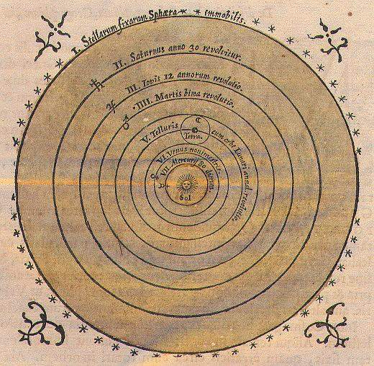
The Sun
Nicholas Copernicus puts it in the center

Slide 12
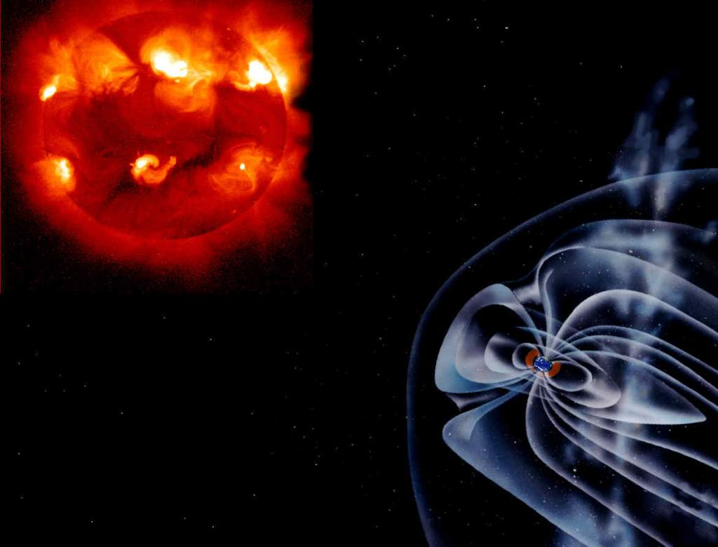
Space Weather:
What is it?
Space Weather refers to conditions in space that can influence the performance and reliability of space-borne and ground-based technological systems and can endanger human life or health.
Earth

Slide 13

Space Weather:
What is it?
Sun
Sun:
Energy released in the form of photons, particles, and magnetic fields
Sources of major disturbances:
  Coronal Holes
  Solar Flares
  Coronal Mass Ejections
  Solar Particle Events
Earth

Slide 14
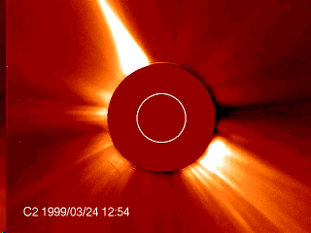
Space Weather:
What is it?
Sun
A
Sun:
Energy released in the form of photons, particles, and magnetic fields
Sources of major disturbances:
  Coronal Holes
  Solar Flares
  Coronal Mass Ejections
  Solar Particle Events
Earth

Slide 15
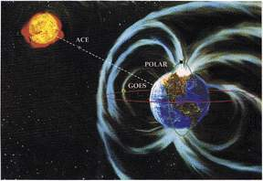
Space Weather:
What is it?
ACE Satellite
At L1
Sun
Interplanetary Space
Interplanetary Space:
Solar Wind
  Mostly electrons and protons
  very tenuous, a few per cm**3
  very hot, >10⁴ K
  Magnetic field, a few nano-T
  high velocity, 250-2000 km/sec
Disturbances from the sun make shocks and waves in the solar wind
Earth

Slide 16
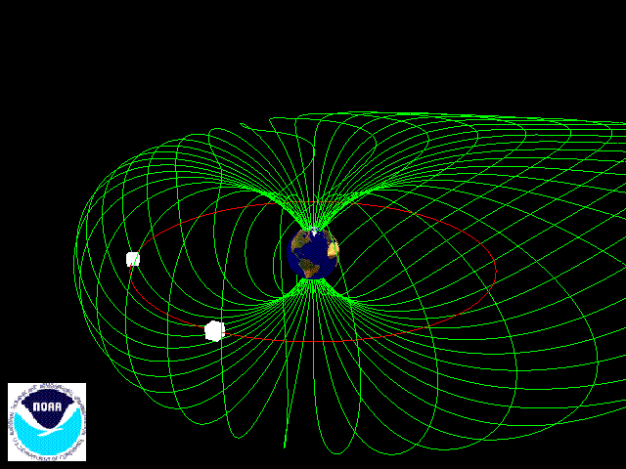
Sun
Interplanetary Space
A
Magnetosphere
Magnetosphere:
Created by Earth’s magnetic field
Deformed by the Solar Wind
  Particles ( mostly electrons and protons) trapped on magnetic field lines
  Polar regions are magnetically open
Earth

Slide 17
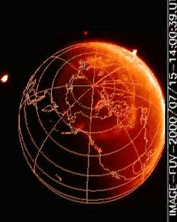
Sun
Interplanetary Space
A
Magnetosphere
Ionosphere:
Layer of electrons and ions at the top of the atmosphere (100 – 300 km and up)
Formed when extreme ultraviolet light from the sun impinges on Earth’s atmosphere
Critical in the reflection and transmission of radio waves
Ionosphere
Earth
Notes:
Image

Slide 18
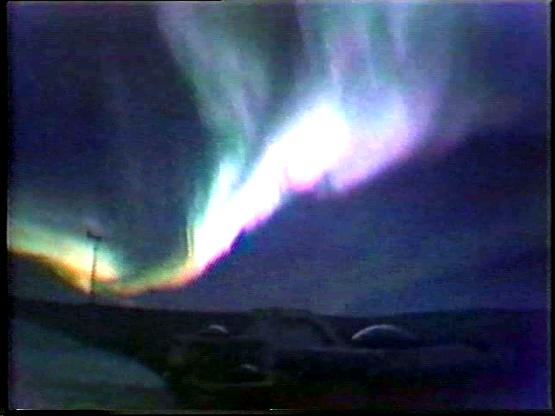
Sun
Interplanetary Space
A
Magnetosphere
Ionosphere:
Layer of electrons at the top of the atmosphere (100 – 300 km and up)
Formed when extreme ultraviolet light from the sun impinges on Earth’s atmosphere
Critical in the reflection and transmission of radio waves
Ionosphere
Earth
Notes:
Image

Slide 19
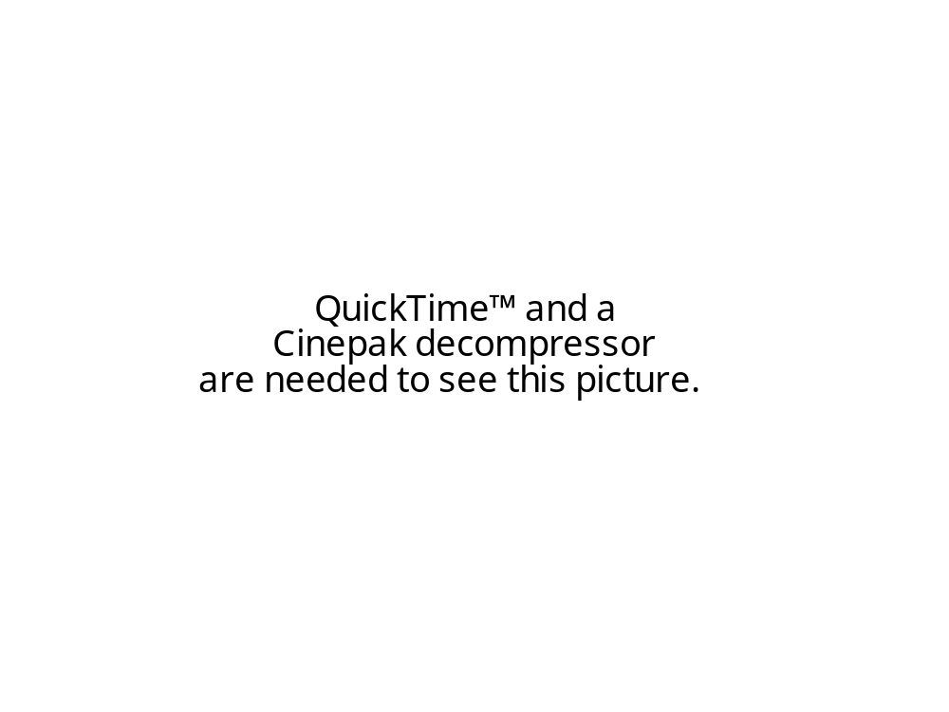
Sun to Earth
An animation of a space weather event as it starts at the sun and ends up at Earth
  Solar Flare
    Light
    Particles
  CME
    Particles and Fields
  Magnetosphere
    Deflects the solar wind
    Energy transfer from solar wind to magnetosphere when interplanetary field opposite direction of Earth’s field
    Accelerates particles
  Ionosphere
    Accelerated particles collide with the atmosphere producing the aurora

Slide 20
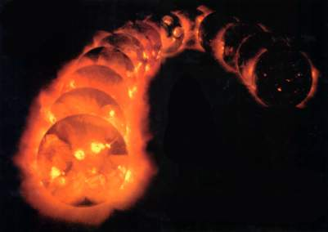
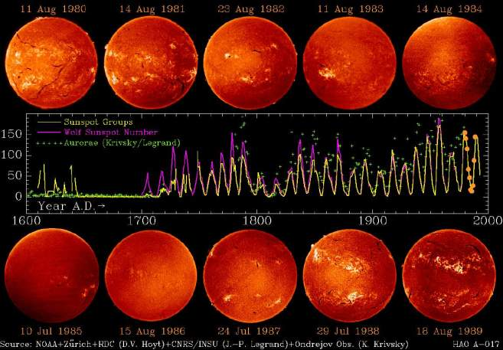
The Solar Cycles of the Past
Climatology
Sunspots have been recorded for the last 400 years
Note that there were no sunspots for nearly 60 years after 1640
During the same period, it was very cold in Europe. This is a period called “The Little Ice Age”
Is there a Connection?
Solar
Minimum
Solar Maximum

Slide 21
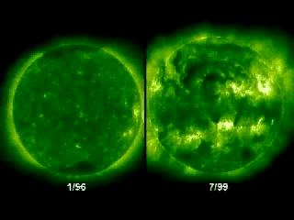
Solar Minimum – 1996/7 Solar Maximum – 2000/1
NASA SOHO EIT
A

Slide 22
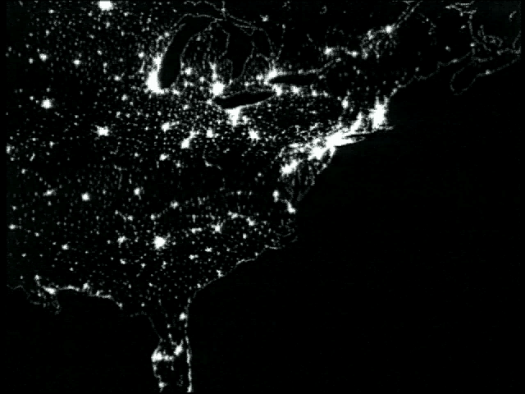
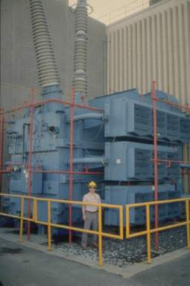
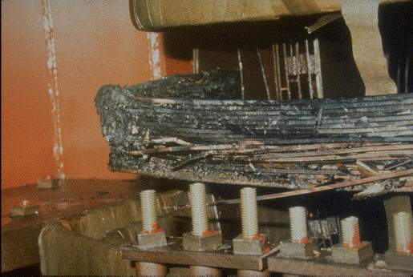
Geomagnetic Storm Effects
March 1989
Hydro Quebec Loses Electric Power for 9 Hours
Electric Power
Transformer
Transformer Damage
A

Slide 23
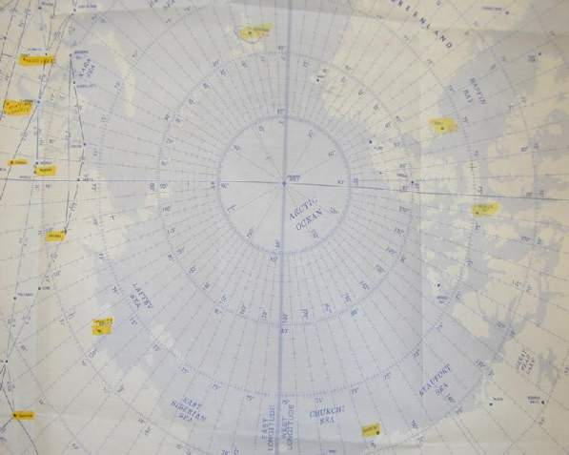
Energetic Particle Effects
High Latitude HF Communications
Polar airline routes loose ground communications
Alternate routes required
Uses more fuel
Flight delays
Polar Airline Routes
Sample of Flights Affected:
10/26/00: Lost of HF prior to 75N, re- route off Polar route with Tokyo fuel stop. 15:00 flight now 20:30
11/10/00: Due to poor HF, ORD to HKG flown non-polar at 47 minute penalty
3/30/01-4/21/01: 25 flights operated on less than optimum polar routes due to HF disturbances resulting in time penalties ranging from 6 to 48 minutes
11/25/00: Polar flight re-route at 75N due to Solar Radiation, needed Tokyo fuel stop
11/26/00: Operated non-polar at 37 minute penalty due to solar radiation
11/27/00: Operated non polar at 32 minute penalty due to solar radiation.
11/28/00: Operated non-polar at 35 minute penalty due to solar radiation
Radio Blackout
During
Particle Events
Polar 1
North Pole
Chicago
Polar 2
Polar 3
Hong Kong
Polar 4
Alaska

Slide 24
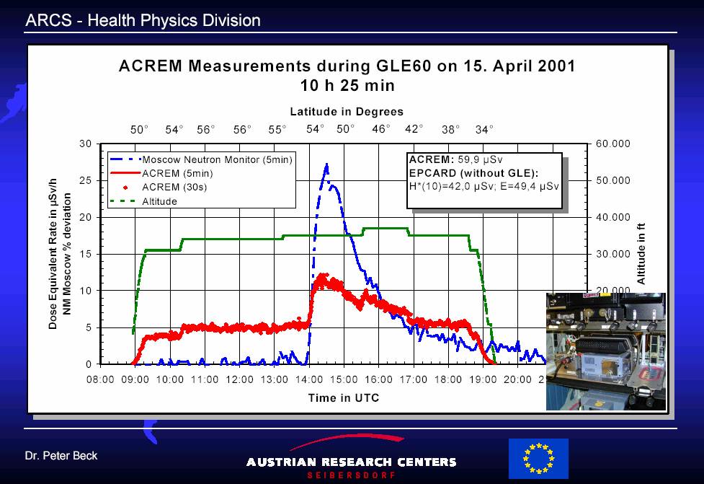
Cosmic Ray and Solar Proton Radiation Effects on Airline

Slide 25
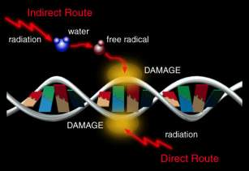
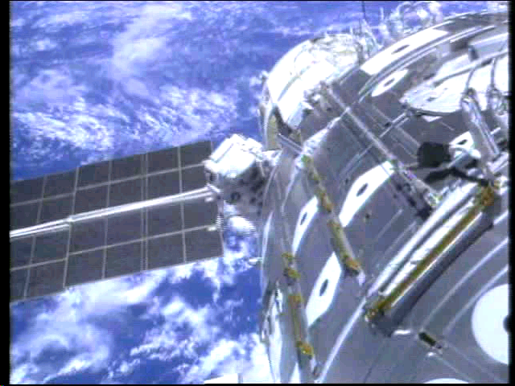
Energetic Particles Effects
Radiation Hazard
Health Hazards from Energetic Particles
Humans in space
  Space Shuttle, International Space Station, missions to Mars
Crew/Passengers in high-flying jets
  Concorde carries radiation detectors
  Exposure limits set for European flight crews
A

Slide 26
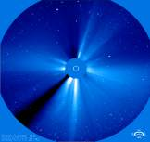
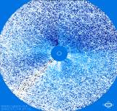
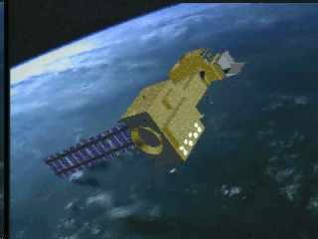
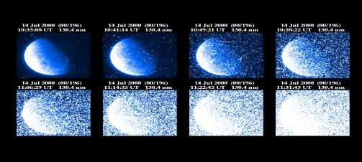
Energetic Particle Effects
Spacecraft Systems
Systems affected
  Spacecraft electronics
    Surface Charging and Discharge
    Single Event Upsets (SEU)
    Deep Dielectric Charging
    USAF attributes 35% of SEU to space weather
  Spacecraft imaging and attitude systems
SOHO Satellite Image Degradation
Spacecraft Surface Charging (animation)
Polar Satellite Image Degradation
A

Slide 27
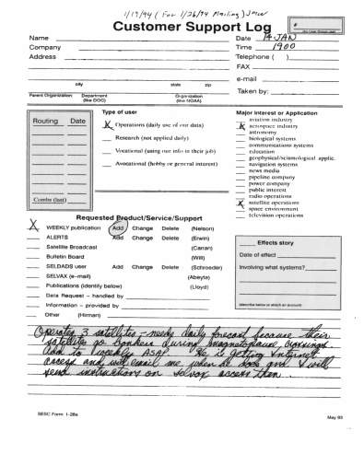
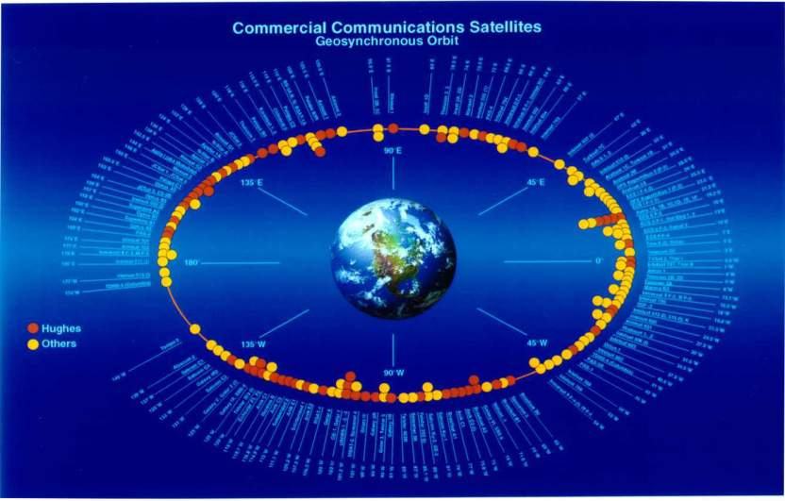
GEOSYNCHRONOUS COMMUNICATIONS SATELLITES
CUSTOMER NEEDS

Slide 28

SPACE WEATHER OPERATIONS
AT NOAA SEC
Nation’s official source of
Space Weather alerts,
warnings, and forecasts
Synthesis of space
environment data and
information
Works together with Research
and Development to bring
new understanding, models,
and data into operations

Slide 29
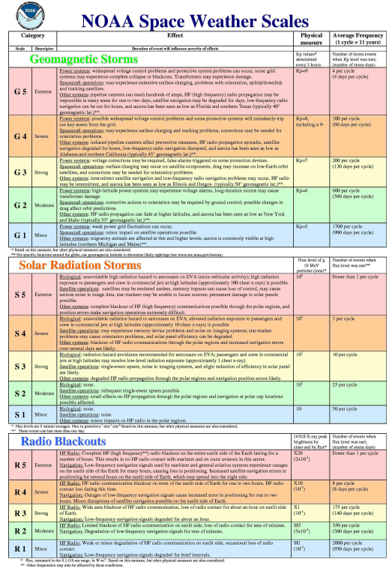
Space Weather Scales
Similar to hurricane (C1-C5)
and tornado (F1-F5) scales
3 Categories
  Geomagnetic Storms
    (CMEs)
  Solar Radiation Storms
    (Particle Events)
  Radio Blackouts
    (Solar Flares)
    http://sec.noaa.gov

Slide 30
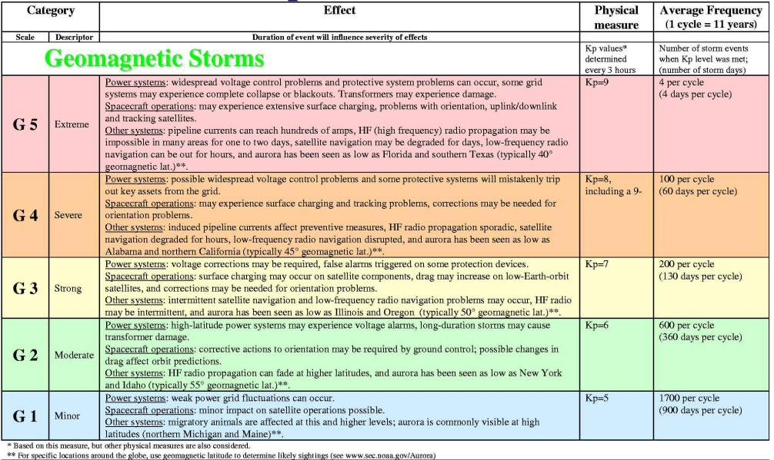
Geomagnetic Storm Scales

Slide 31
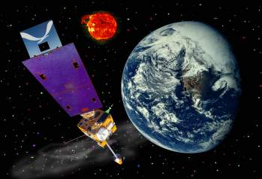
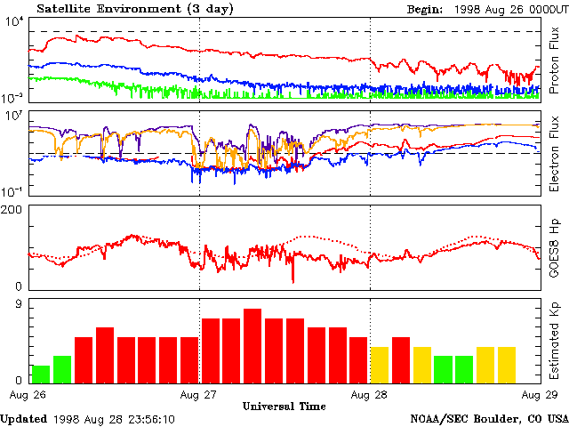
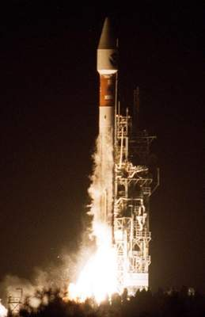
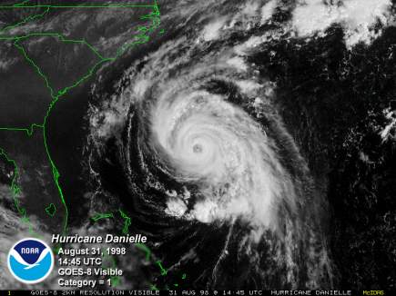
NOAA GOES Simultaneous Monitoring of
Tropospheric Weather and Space Weather
August 1998: Hurricane Danielle and a Geomagnetic Storm at the
same time!
H. J. Singer
NOAA/SEC

Slide 32
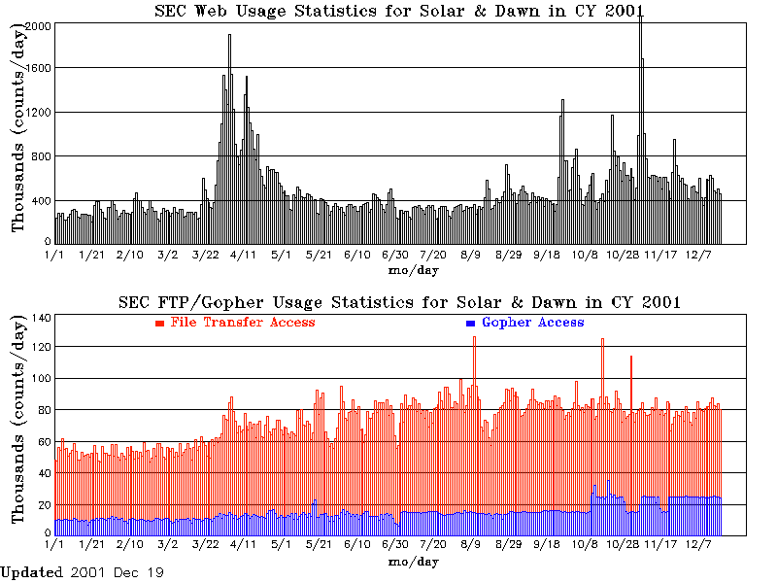
Public Response
NOAA Space Environment Center Web hits go from 400,000 hits per day to more than 2,000,000 hits per day during times of peak solar activity

Slide 33
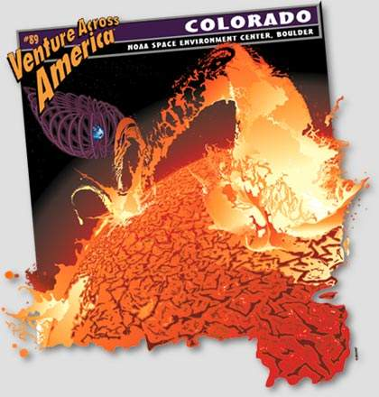
Unveiling of U-Haul Truck Supergraphic
Representing Colorado at Space Weather Week 2001
Did you know...
Scientists monitor the Earth's magnetic field, the sun and the solar wind to forecast the effect of space weather on our planet.
Graphic on the side of several thousand U-Haul Trucks
http://www.uhaul.com/supergraphic

Slide 34

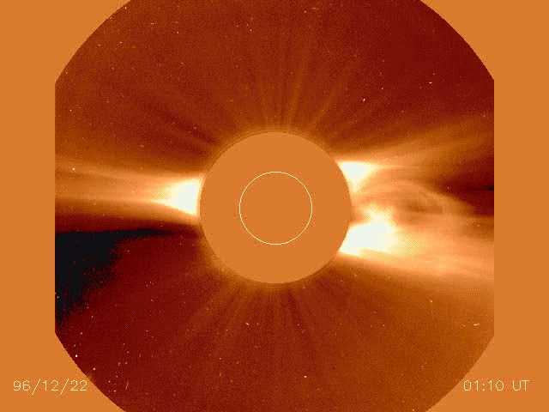
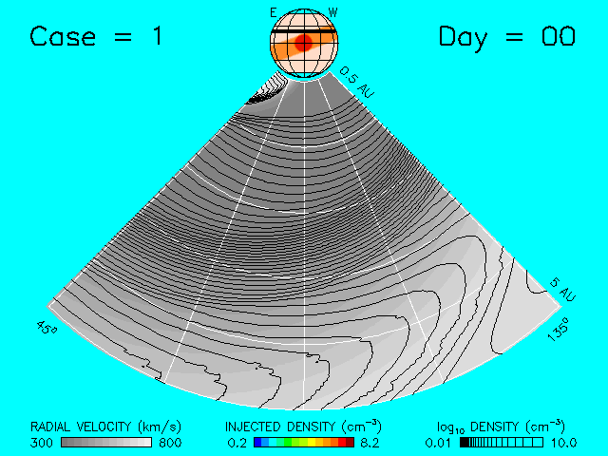
How to predict Space Weather

Slide 35
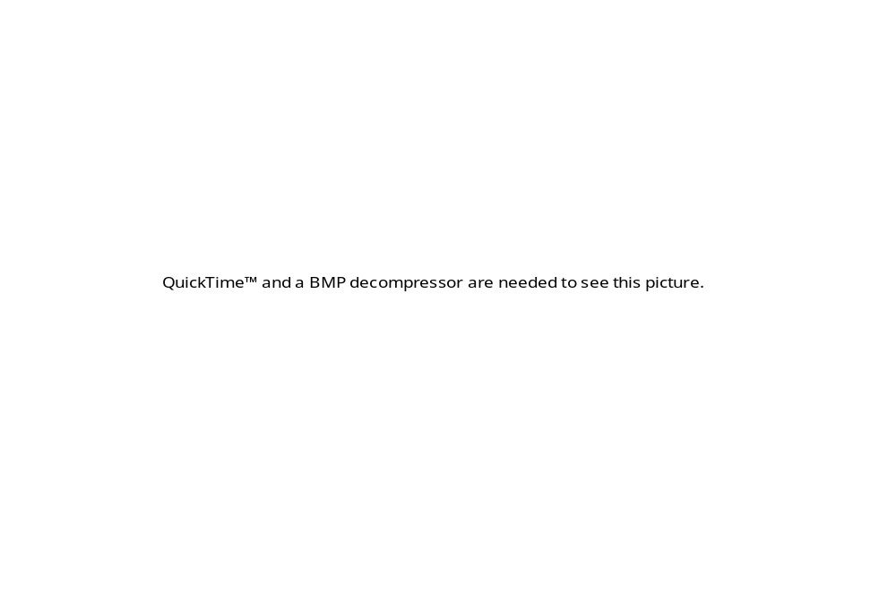
Simulation of CME Propagation in the heliosphere
extras

Slide 36


Brief History of Solar - Terrestrial Discoveries
800 B.C. : First plausible observation of sunspots recorded in China
200 B.C. : Aristarchos of Samos measures Earth-sun distance (wrong by a factor of 20, but he got the scale).
968: First mention of the solar corona (Leo Diaconus, Byzantine)
1128: First sunspot drawing
1185: First description of a prominence

Slide 37



1543: Copernicus puts the sun into center stage
1609: Kepler finds the laws of planetary motion
1610: First telescopic sunspot observations (Goldsmid, Harriot, Galileo, Scheiner)
1645-1715: sunspots disappear
1817: First solar spectroscopy (Wollaston, Fraunhofer)

Slide 38



1830: Discovery of the sunspot cycle (Heinrich Schwabe)
1645-1715: Sunspots vanish, the so-called Maunder minimum
coincides with `little ice age’ in Europe
1850: Wolf defines the sunspot number, the 1755-1766 cycle is named cycle 1

Slide 39

1852: sunspot cycle is linked to geomagnetic activity (Sabine, Gautier, Wolf)

Slide 40

1858: discovery of sun’s differential rotation (Carrington)
1880: Spoerer discovers sunspot migration

Slide 41

1859: First observation of a flare (Carrington)

Slide 42

1860: First observation of Coronal Mass Ejection (CME)
Drawing by G. Tempel during the 1860 eclipse

Slide 43


1919: Discovery of the magnetic nature of sunspots and the magnetic cycle (G. E. Hale)
Sunspot spectrum with Zeeman effect (line splitting due to the magnetic field)
The sun’s magnetic field switches polarity every sunspot cycle (11 years)

Slide 44


Now: Magnetic maps (magnetograms)
The sun’s magnetic field switches polarity every sunspot cycle (11 years)
The color shows the magnetic polarity (in/out of the surface) at the photosphere. Note the dual polarity of sunspots.

Slide 45

Now: SOHO coronograph

Slide 46

Now: TRACE

Slide 47
Now: TRACE sunspot motion

Slide 48
Now: TRACE: developing arcade

Slide 49

Now: TRACE: magnetic loops on the limb

Slide 50

Now: TRACE: flare and slinky

Slide 51

When it hits the magnetosphere: substorm

Slide 52

When it hits the magnetosphere: storm

Slide 53
Upcoming: THEMIS

Slide 54
fin

