Slide 1
RAID Training for Investigators:
Product and Regulatory Overview
Eda T. Bloom, Ph.D.
Chief, Gene Transfer and Immunogenicity Branch
Office of Cellular, Tissue, and Gene Therapies
Division of Cellular and Gene Therapies
Center for Biologics Evaluation and Research
FDA

Slide 2
Outline
FDA organization
Products regulated
Critical path issues in the development of cell based products

Slide 3
Organization
Office of the Commissioner
CBER (Center for Biologics Evaluation and Research): vaccines, blood and blood products, human tissue/tissue products for transplantation, cells, gene therapy
  Office of Cellular, Tissue, and Gene Therapy
CDER (Center for Drug Evaluation and Research): drugs, some biological products
  Office of Oncology Drug Products
  Office of Biotechnology Products
CDRH (Center for Devices and Radiological Health): devices for treatment, implants, diagnostic devices
CVM
CFSAN
NCTR

Slide 4
Office of Cellular, Tissue, and Gene Therapies
Celia M. Witten, Ph.D., M.D.
Stephanie Simek, Ph.D., Office Deputy Director
Richard McFarland, Ph.D, M.D., Associate Director for Policy
Suzanne Epstein, Ph.D., Associate Director for Research
Deborah Lavoie, J.D., Director RPM
Division of Cellular and Gene Therapies
Raj Puri, Ph.D., M.D., Director
Division of Human Tissues
Ruth Solomon, M.D., Director
Division of Clinical Evaluation and Pharmacology/Toxicology
Ashok Batra, M.D.

Slide 5
OCTGT Regulated Products
Products with Cancer indications
  Cellular therapies
  Tumor vaccines
  Gene therapies
  Tissue and tissue based products
  Combination products
  Anti-idiotype antibodies
Products generally not used for cancer
  Xenotransplantation products
  Devices used for cells/tissues

Slide 6
Office of Oncology Drug Products
Richard Pazdur, M.D., Director
Karen Weiss, M.D., Deputy Director
Glen Jones, Ph.D., Associate Director of Regulatory Affairs
Division of Drug Oncology Products
Robert Justice, M.D., Director
Division of Medical Imaging and Hematology Products
R. Dwaine Reeves, M.D., Acting Director
Division of Biologic Oncology Products
Patricia Keegan, M.D., Director

Slide 7
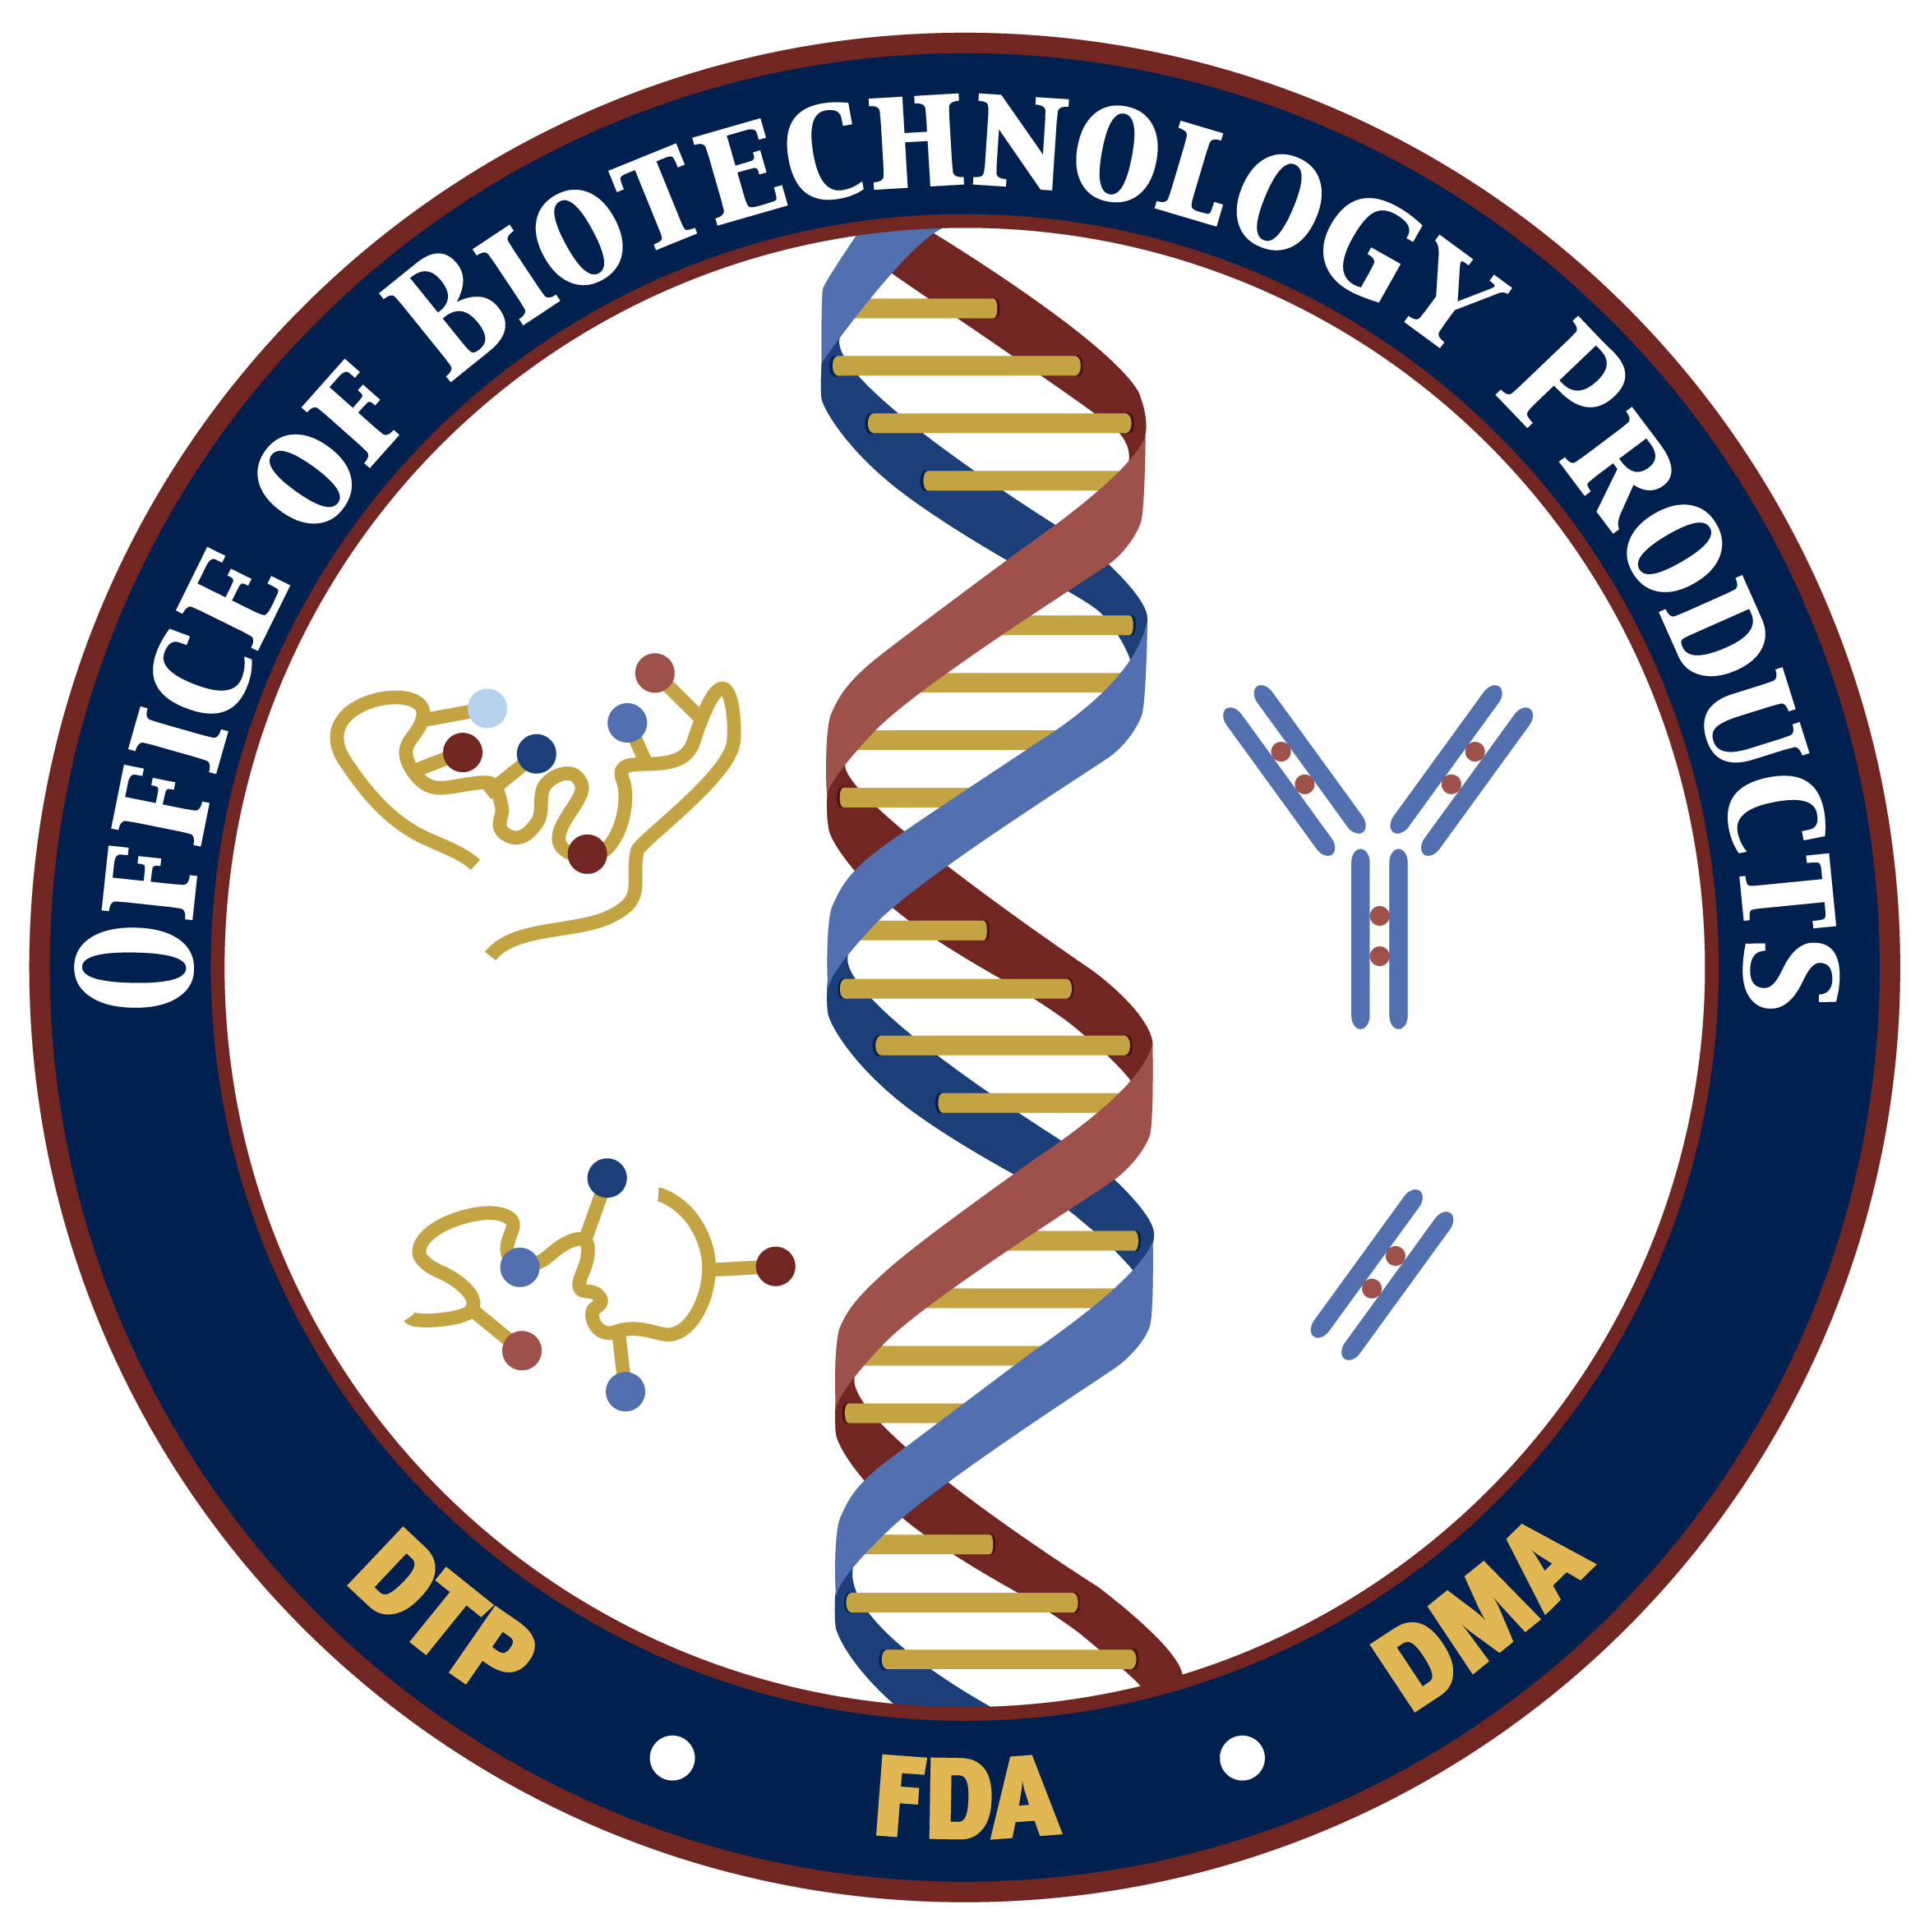
Office of Biotechnology Products
Steven Kozlowski, M.D., Director
Elizabeth Shores, Ph.D., Deputy Director
Division of Monoclonal Antibodies
Kathleen Clouse, Ph.D., Director
Division of Therapeutic Proteins
Amy Rosenberg, M.D., Director

Slide 8
Therapeutic Biological Products Regulated by CDER
Monoclonal antibodies for in vivo use.
Proteins intended for therapeutic use
  Includes cytokines (e.g. interferons), growth factors, enzymes (e.g. thrombolytics), and other novel proteins, except for those that are specifically assigned to CBER (e.g., vaccines and blood products).
  Includes therapeutic proteins derived from plants, animals, or microorganisms, and recombinant versions of these products.
Immunomodulators (non-vaccine and non-allergenic products intended to treat disease by inhibiting or modifying a pre-existing immune response).

Slide 9
Examples of Collaboration Between CBER, CDER and CDRH for Oncology Products
Inter-center reviews and discussions
  Monday morning meeting to discuss cross-FDA oncology related activities
  Monthly Executive Briefing on oncology activities
Joint participation in FDA and NCI Inter-Agency oncology Task force (IOTF)
Joint participation in policy development and critical path initiative to promote development of oncology products

Slide 10
FDA Perspectives (CMC)
Greater product knowledge (mechanism of action, characterization, etc) will aid in developing meaningful assays and/or novel approaches for product characterization and comparability
  Potency and identity testing should provide meaningful information about the product prior to its release
Control of manufacturing process is key to producing consistent biological products
A flexible approach and open communication is needed by both regulators and product developers

Slide 11
Potential CMC Issues for
Biological Products
Examples of cross-cutting concerns
  Immunogenicity
  Animal components
  Formulation, delivery, stability
  Identity, purity, potency, comparability
Some unique concerns for cell/gene therapy products
  Replication competent viruses
  Oncolytic viruses
  Cell/tissue source
Some unique concerns for protein products
  Post-translational issues
    Isoforms
    Glycosylation
  Aggregates

Slide 12
Key Points to Consider for Pharmacology/Toxicology Testing
Preclinical testing paradigm is influenced by:
  Data from previous preclinical studies on all components and combination
  Data from previous clinical studies (pre- and post-marketing) on all components and combination
  Regulatory status of each component
Provide safety and activity data for individual components and combination in appropriate animal models by intended clinical route of administration

Slide 13
Potential PT Issues for Biological Products
Examples of cross-cutting concerns
  Picking the relevant animal model
  Dosing, safety
  Biodistribution
  Toxicity, tumorigenicity
  Immunogenicity (rejection/elimination)
Some unique concerns for cell/gene therapy products
  Insertional mutagenesis
  Alteration of germline
  Long-term toxicity
  Migratory potential
Some unique concerns for protein products
  Immune-mediated problems
    Immune complexes
    Obfuscation of toxicity
    Allergy
  Species specificity

Slide 14
Science in Research and Review:
Critical Path Initiative
Bring scientific advances to medical product development process (simulation models, validated biomarkers, new clinical trial designs)
Stimulate development of applicable research programs in critical path scientific areas, aim to develop techniques that address challenges encountered during product development
Regulatory guidance/practice and standards to reflect best available science, integrate FDA involvement

Slide 15
OCTGT Research Program Areas
Virology
  Retroviruses, adeno, herpes, PERV
Immunology
  Host-vector interactions, transplant rejection
Cell biology
  Control of differentiation in animal models, stem cell biology
Cancer biology
  Molecular biomarkers, animal models
Biotechnology
  Microarray, flow cytometry

Slide 16
Cell Therapy Product Characterization
Morphologic evaluation
Unique biochemical markers
Gene and protein expression analysis
Cellular impurities profile
Biologic activity/Potency
Identity: HLA, other unique marker

Slide 17


Characterization
Gene expression profile, Antibodies, Enzymes,
In vitro differentiation
Developmental Stages
Exogenous Influences
Manufacturing Concerns
Self renewal
Terminal Differentiation
Commitment
Differentiation
Cell-cell interaction
Growth factors
Lot Release
Identity
Potency
Safety
Viability
Manufacturing
Cell Banks
Cell Characterization
Testing and Screening
Donors, Viruses, Genetic defects?
Apoptosis
Tumorigenesis
mutation

Slide 18
Patients
Medical Institutions
Research Community
Payors
FDA
Practitioners/Societies
Public
Sponsors

Slide 19
Contact Information
Eda Bloom, Ph.D.
Branch Chief,
Gene Transfer and Immunogenicity Branch
DCGT/OCTGT/CBER/FDA
1401 Rockville Pike (HFM 725)
Rockville, MD 20852-1448
eda.bloom@fda.hhs.gov
301-827-0452

