Slide 1
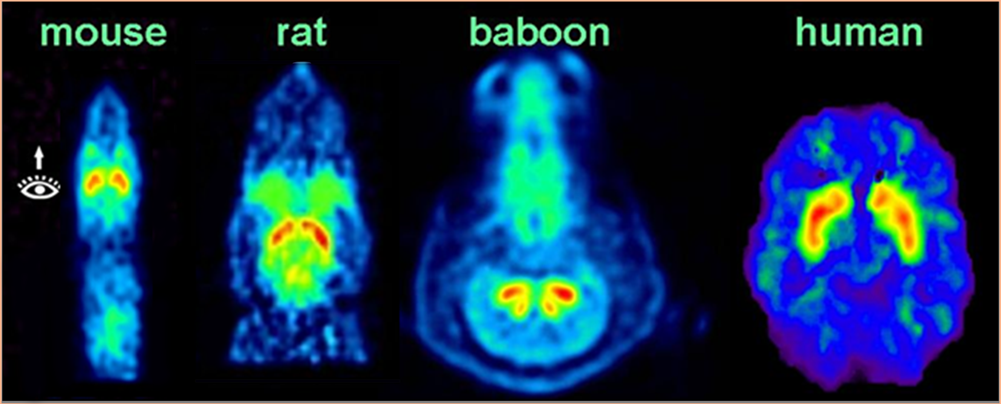
Recent Imaging Approaches to Studying Pharmacokinetics of Solvents
Stephen L. Dewey and Wynne K. Schiffer
¹Medical and ²Chemistry Departments, Brookhaven National Laboratory, Upton, NY 11973
Translational Neuroimaging: [¹¹C]raclopride

Slide 2

Neuroimaging approaches:
Positron Emission Tomography (PET)
microPET
Magnetic Resonance Imaging (MRI)
Functional MRI
High Field MRI and fMRI (9.4 T)
Optical Imaging
microCT

Slide 3
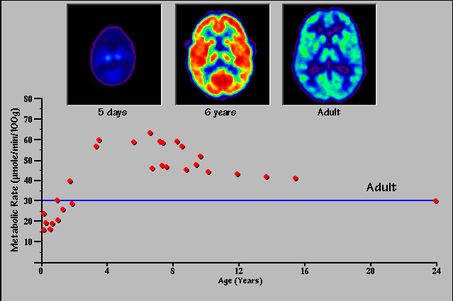
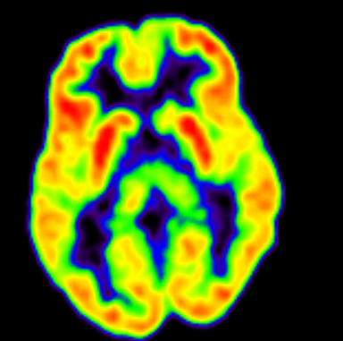
Medical Imaging at BNL
PET
Function

Slide 4
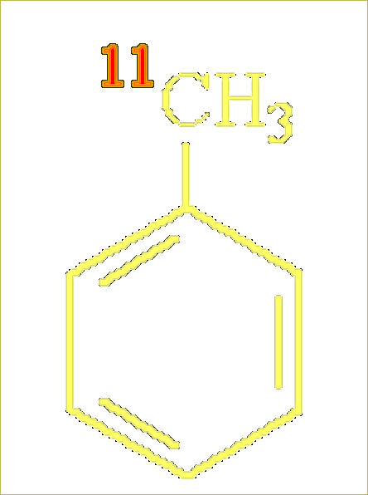

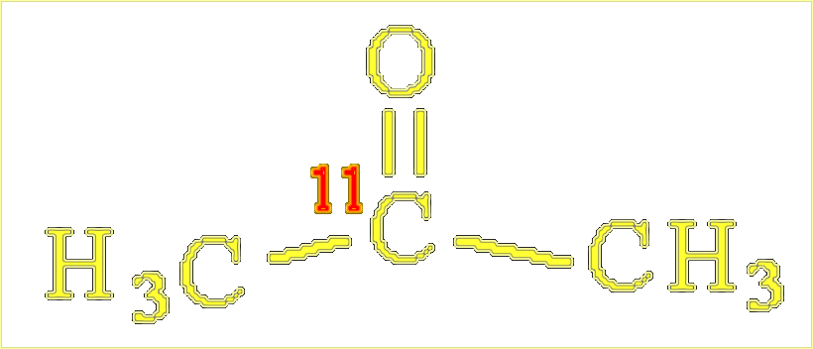
Positron labeled inhalants used for primate PET and rodent microPET studies
[¹¹C]-Butane
[¹¹C]-Toluene
Future development
¹¹C-TCE
¹¹C-Carbon-tetrachloride
¹¹C-Xylene
¹¹C-Propane
[¹¹C]-Acetone

Slide 5
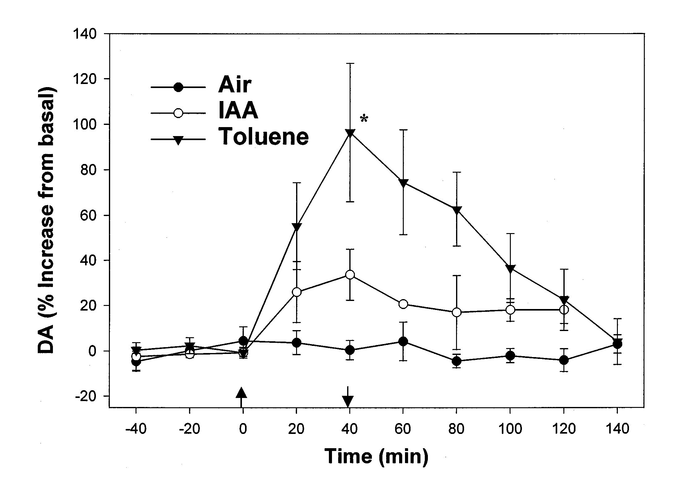
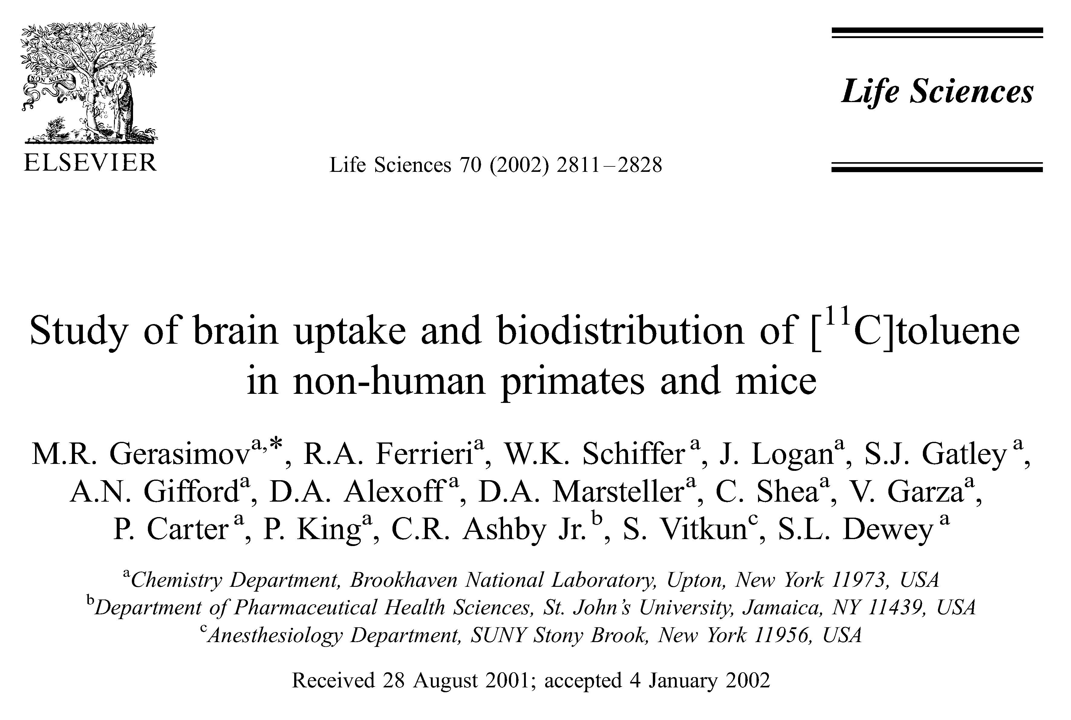
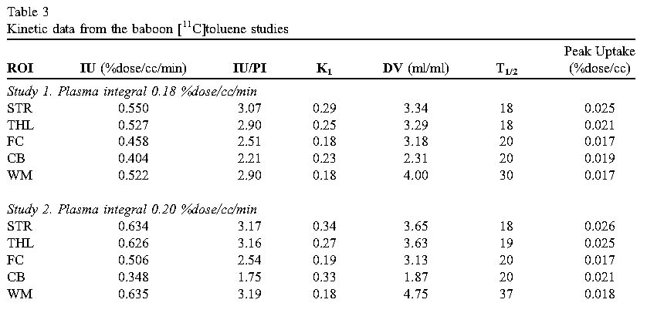
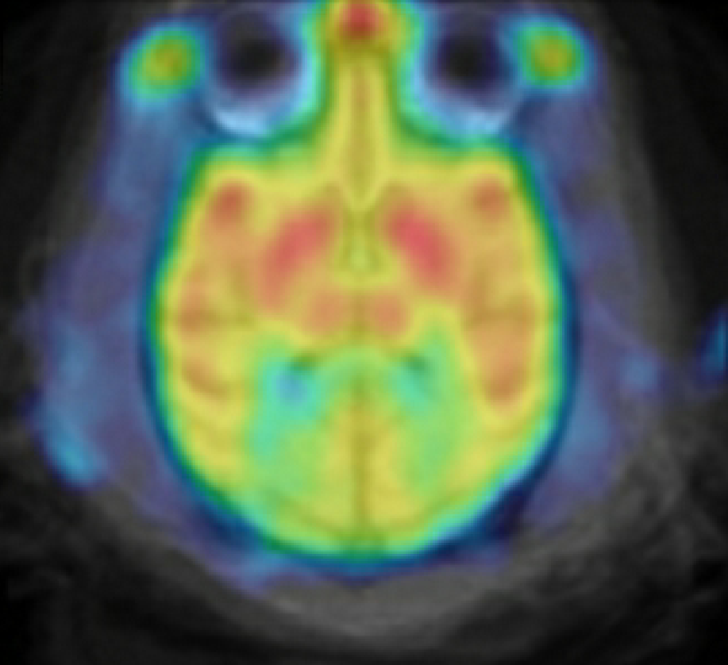
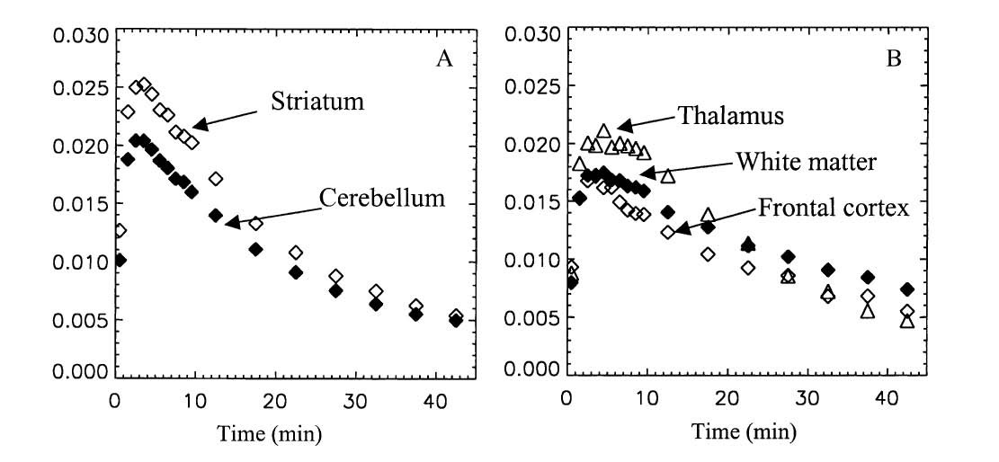
[¹¹C]-Toluene

Slide 6

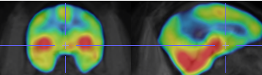
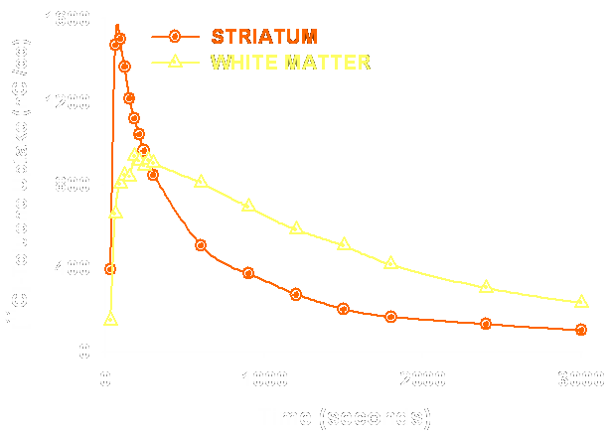
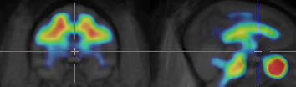
Time course of toluene in the brain
5 minutes after [¹¹C]toluene
25 minutes after [¹¹C]toluene
Might contribute to the leukoencephalopathy observed in toluene abusers (Filley, 2004)

Slide 7
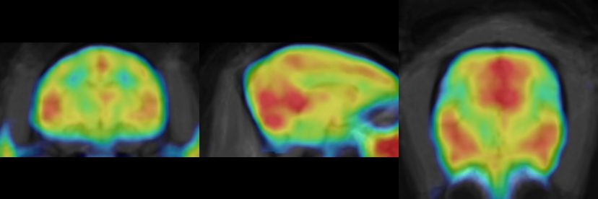
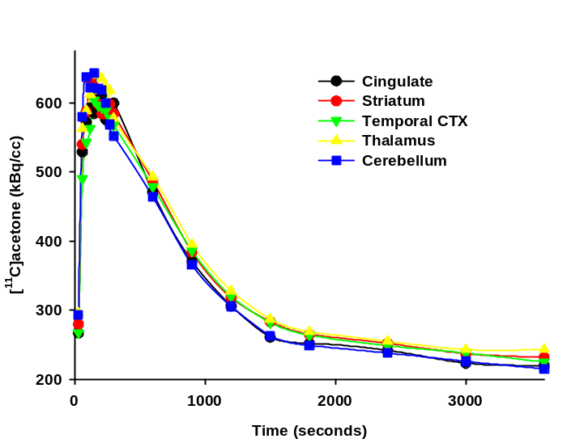

[¹¹C]-Acetone

Slide 8
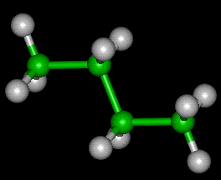
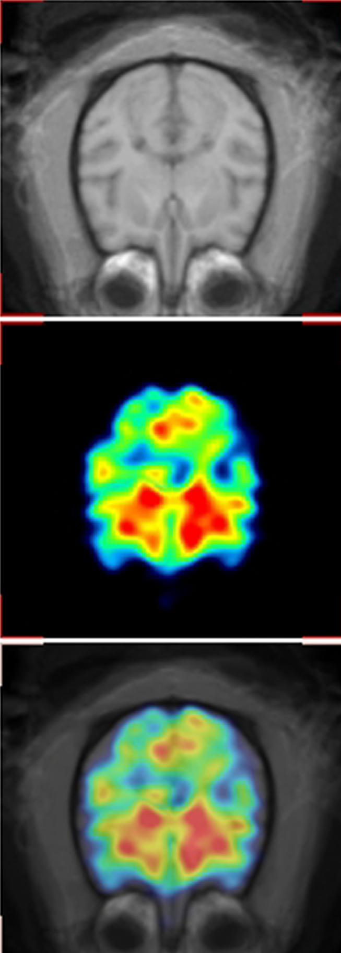
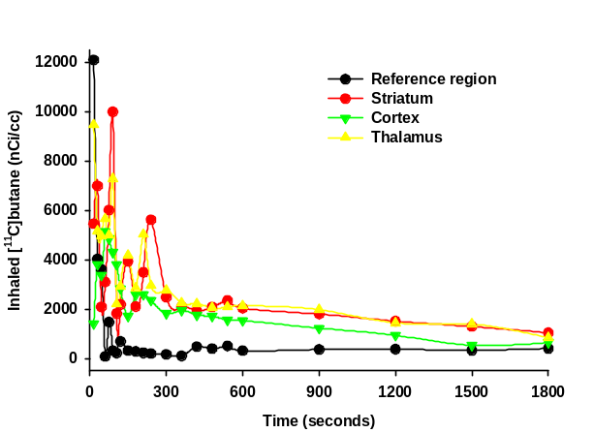
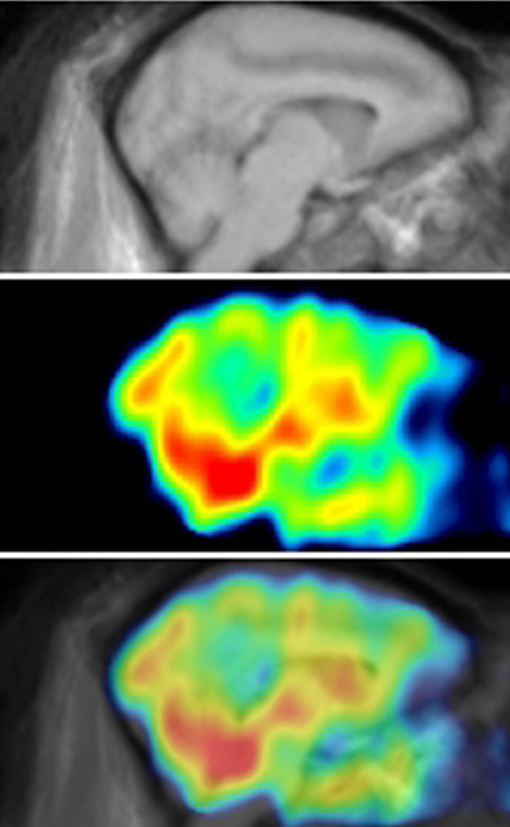
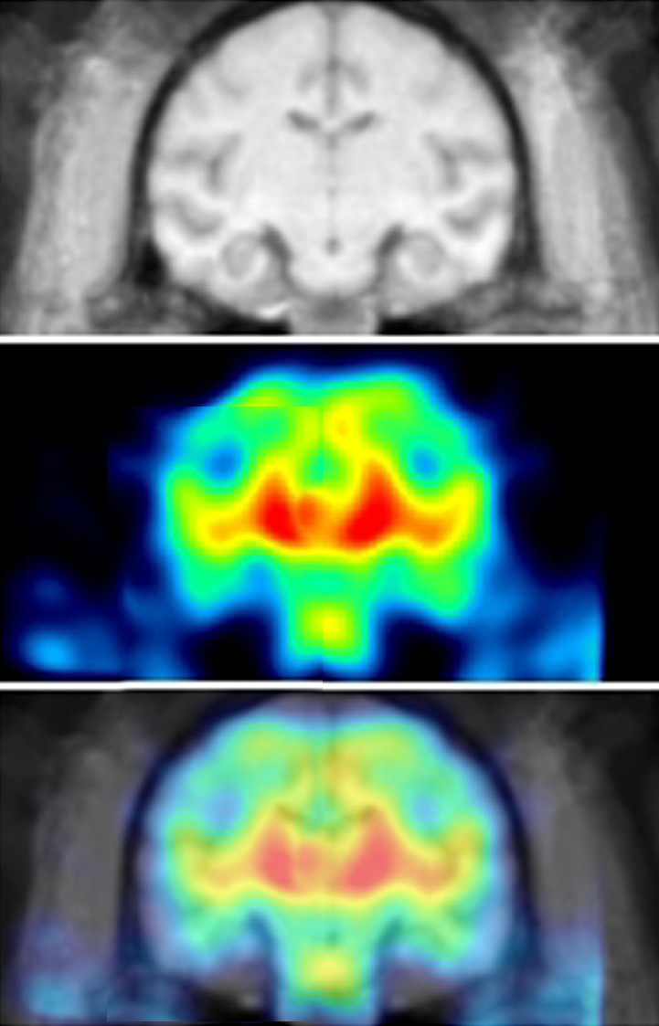
Inhaled [¹¹C]-Butane

Slide 9
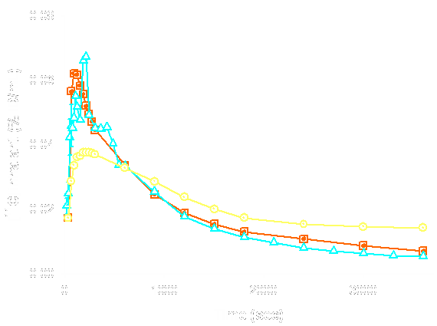
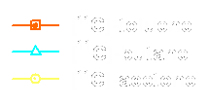
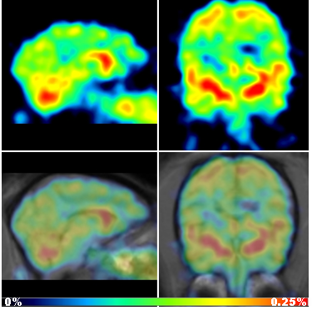
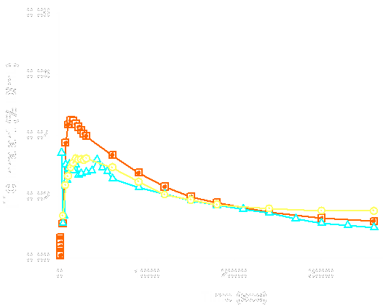
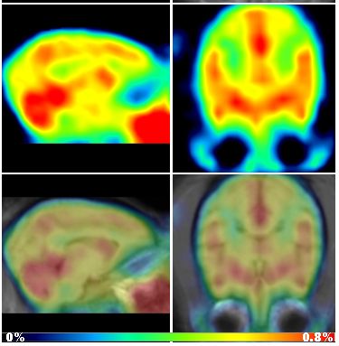
How do other inhalants compare to toluene?
[¹¹C]-butane
striatum
[¹¹C]acetone
white matter

Slide 10
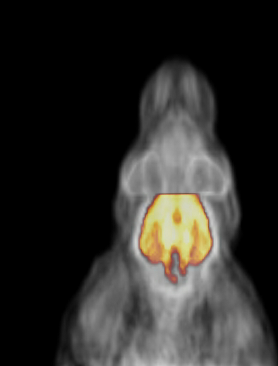
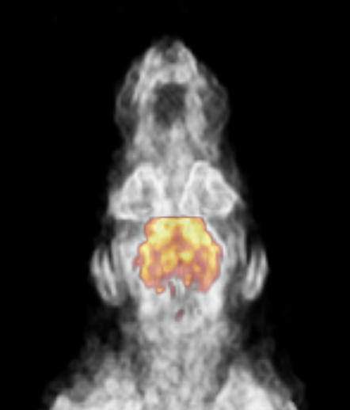
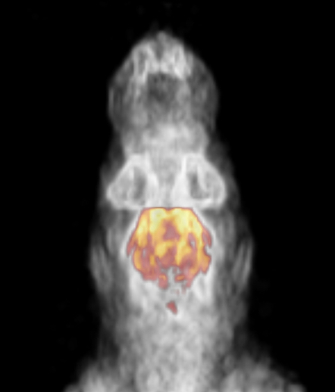
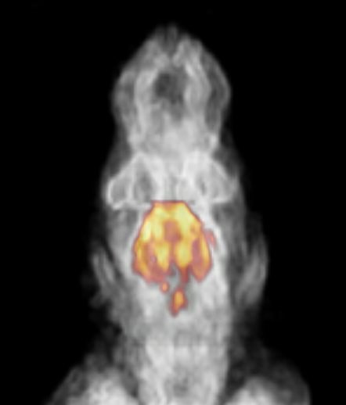
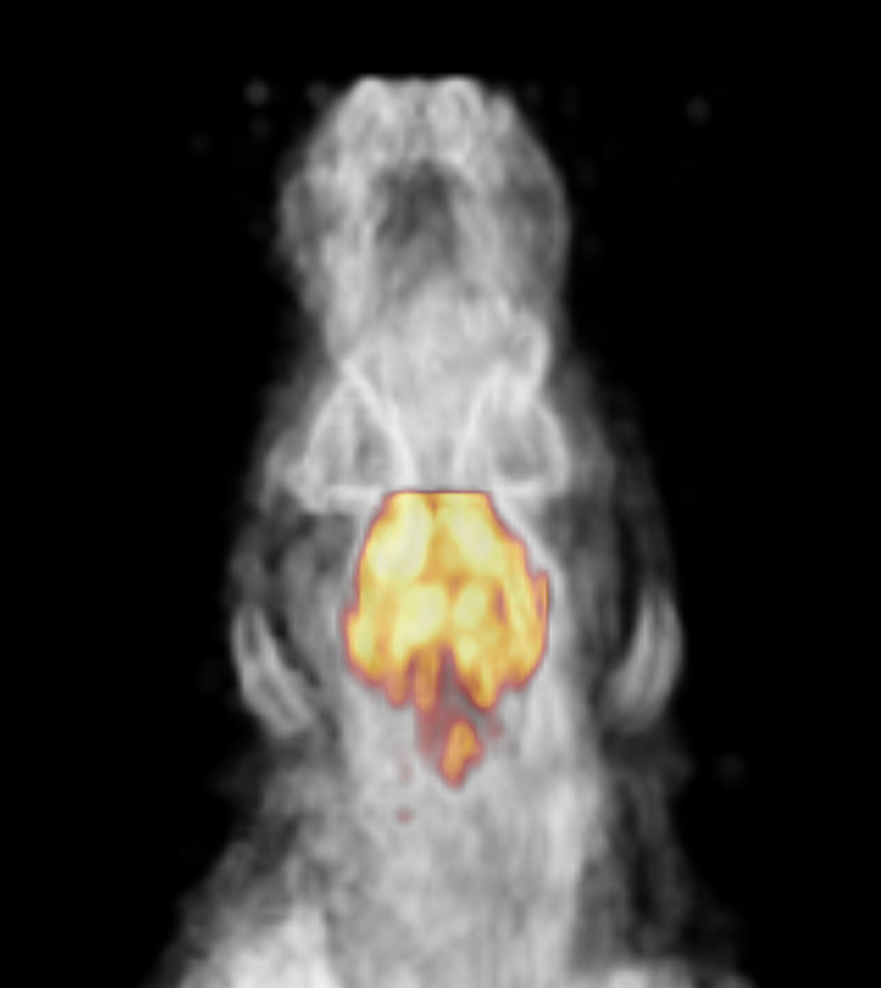

Impact of conditioned place preference (CPP) to 5000 ppm of inhaled toluene on ¹⁸FDG uptake in the same animal over time
Pre- conditioning scan
Day 0
3 wks into conditioning, 30m after tol
Day 25
1 day after last exposure
Day 40
14 days after last exposure
Day 54
45 days after last exposure
Day 99
100%
0%
Volumetric renderings created with Amide software and corrected for the injected dose (ID) of ¹⁸FDG and animal weight

Slide 11
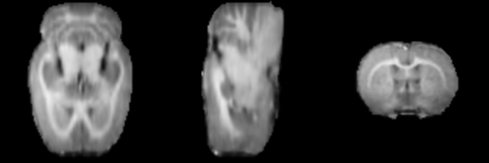

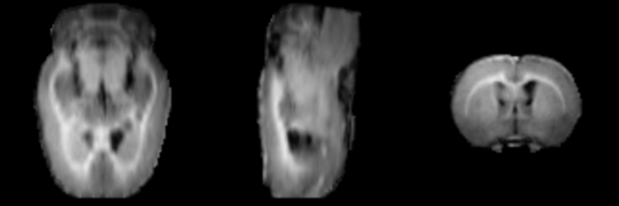
Toluene-induced changes in white matter measured with high field (9.4 T) µMRI
Animal 2
Prior to toluene
Animal 2
After 20 days 5000 ppm inhaled toluene

Slide 12
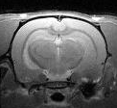
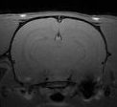
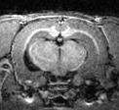
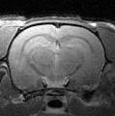
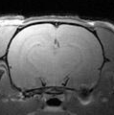
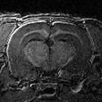
Toluene-induced changes in white matter (WM)
Magnetization transfer (MTC)
Proton density
(PD)
(1-MTC/PD)*100
before toluene
after toluene
Correlation with changes in metabolic function?
Could [¹¹C]-toluene be a WM ligand?

Slide 13
Does toluene alter synaptic dopamine?
Use toluene-induced displacement of ¹¹C-raclopride as an assay of synaptic DA
IV toluene (20 mg/kg in beta cyclodextrin)
Anesthetized animals

Slide 14
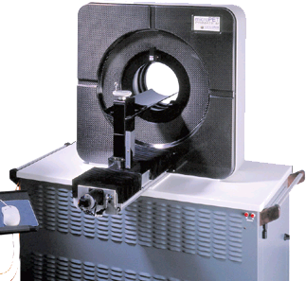
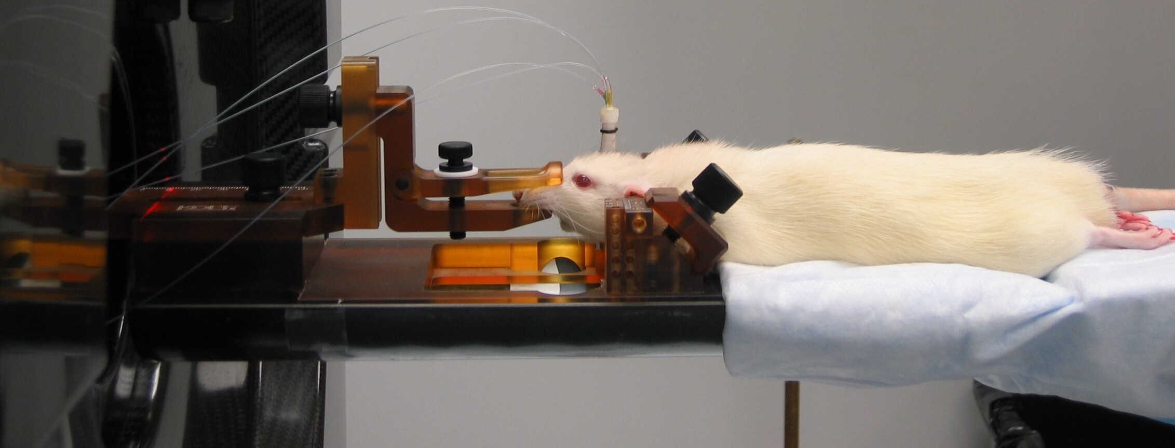
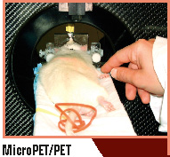
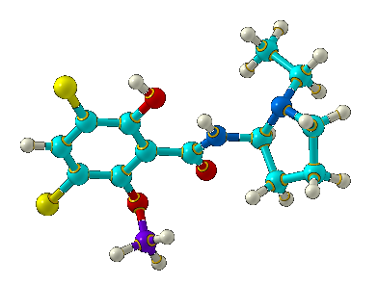
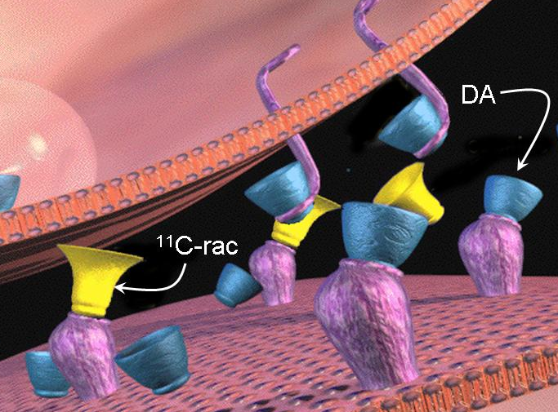
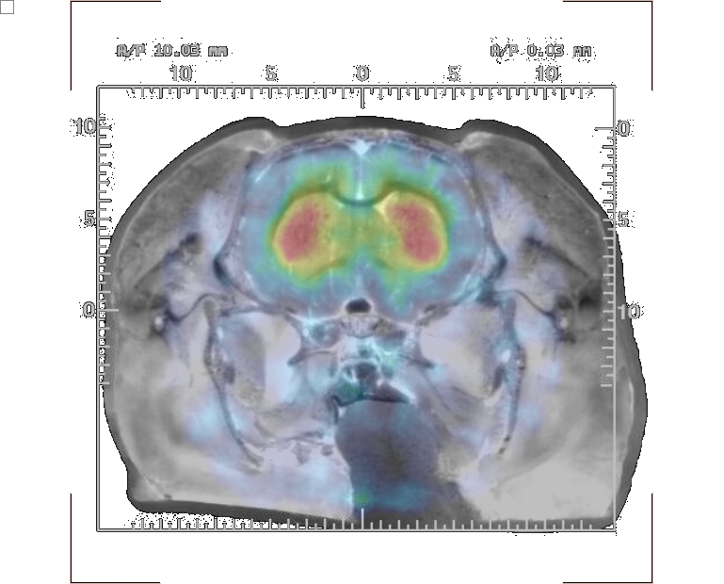
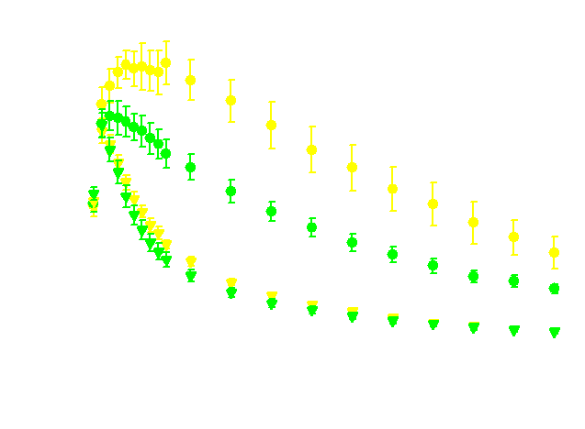
Small Animal Imaging with ¹¹C-Raclopride
Small animal tomograph
¹¹C-raclopride competes with endogenous DA at D₂R
¹¹C-raclopride
Radioactivity Distribution

Slide 15
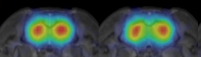
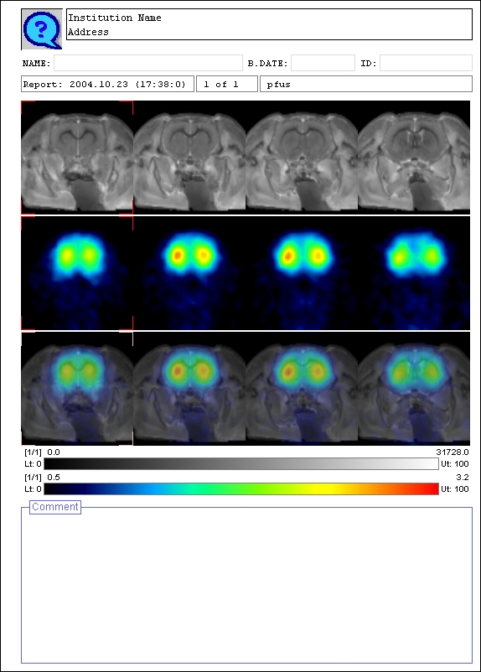
IV toluene increases synaptic DA and displaces ¹¹C-raclopride
Animal | BP baseline | BP challenge | % change
Rodent #1 | 2.55 | 2.29 | -10.19
Rodent #2 | 2.03 | 1.87 | -7.89
Rodent #3 | 2.21 | 1.76 | -20.36
Average | 2.26 ± 0.15 | 1.97 ± 0.16 | -12.81 ± 3.83
Baseline
Toluene Challenge
BP
0.0
2.2

Slide 16
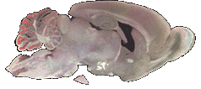
The Volatile Operant Conditioning Chamber for Inhalants (VOCCI)
Generation of toluene vapors
Mixture of toluene & air metered with mass flow controller
On-line measurement using flame ionization detector (FID)
3 chamber CPP apparatus with IR photocell recording of time spent in chambers.
Notes:
Compressed air coming into a round bottom flask and the outlet takes volitle toluene through a flame ionization detector which moderates the flow with air thorugh the valve to a tube in the side of the CPP chamber. What’s going out of the opening is set at the flame ionization detector. Heated to get more toluene off

Slide 17
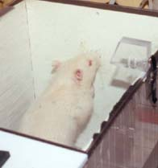
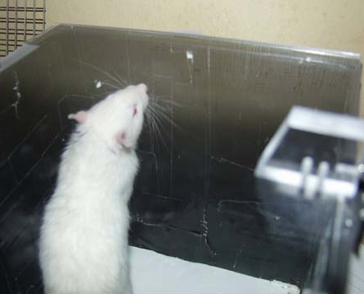
Conditioning Protocol
4 animals paired to black side, 4 to white side, 8 controls for air exposure only
Cage-mates were exposed to toluene or air in pairs
Pairing sessions: 12 days, 6 pairings for each treatment session, 30 min duration
Test session: 5 min acclamation, 15 min free access, no drug exposure on the test day

Slide 18


Toluene produces conditioned place preference in Sprague-Dawley rats
Average time spent in the white or black box (control, A) and in toluene or air-paired side (B). Test animals were conditioned using 2,000 ppm of toluene vapors (toluene-paired side). Data are means ± S.E.M. **, P<0.01
Gerasimov et al., 2002

Slide 19



Different reinforcing effects of toluene and acetone reflect pharmacokinetics
Preference for toluene-paired chamber
Preference for acetone chamber
*
*
*
*
5
20
30
60
30 + 60
Duration of pairing to 2000 ppm toluene (min)
Consistent with the pharmacokinetics, conditioned place preference to acetone requires much longer pairings (90 min) as opposed to toluene, which only requires 30 minute pairings.

Slide 20



Behavioral Neuroimaging:
Is there a metabolic signature of drug craving?
¹⁸FDG uptake during the expression of place preference to inhaled toluene
Images represent SPM t-maps of the brain areas where increases in ¹⁸FDG uptake correlate with increases in conditioning score (time spent in the toluene-paired chamber).

Slide 21
Can we block the effects of toluene on brain chemistry and behavior?
Vigabatrin (GVG, Sabril) blocks the biochemical and behavioral effects of cocaine, methamphetamine, amphetamine, alcohol, heroin, morphine, and nicotine and their combinations.
Completed 2 small open label clinical trials in Mexico in cocaine and methamphetamine-dependent subjects.

Slide 22

Effects of GVG on the expression of toluene-induced CPP
***
**
Significant difference from toluene chamber, **p < 0.05; ***p < 0.001 – student’s t-test
***
Test day 1: 6 pairings
Test day 2: 12 pairings
Test day 3: 14 pairings
GVG PRETREAT
Test day 3: 14 pairings
Saline PRETREAT

Slide 23

GVG blocks the expression of conditioned place preference to toluene - presence of aversion?

Slide 24
GVG blocks Toluene-induced increases in brain dopamine
Control
Toluene pretreat.
GVG/Toluene

Slide 25
Conclusion
The rewarding effects of inhaled toluene are mediated, at least in part, by DA. Thus, these effects are subject to GABAergic modulation by GVG.
Toluene produces persistent and profound decreases in ¹⁸FDG uptake that appear to partially recover over time.

Slide 26


Acknowledgments
This project was funded by the United States Department of Energy/ Office of Biological and Environmental Research (USDOE/OBER DE-AC02-98CH10886) and NIH DA017349, DA15874, DA015041.

