Slide 1
Virtual Mission Operations Center for Virtual Towers
2006 Integrated CNS
Conference and Workshop
Will Ivancic
NASA Glenn Research Center
wivancic@grc.nasa.gov
216-433-3494
Phil Paulsen
NASA Glenn Research Center
Phillip.E.Paulsen@grc.nasa.gov
216-433-8705

Slide 2
Consolidate Control Centers.
Virtual Towers is a Joint Program Development Office (JPDO) proposal for the Next Generation Air Transportation System (NGATS)
Idea: have a few strategically located facilities with virtual towers and TRACONS
Goal is to combine the delivery locations for ATM services not about decreasing service
This requires Network Centric Operations

Slide 3
Cost Savings
Projected cost savings in the order of $500 million
Evolving to spaced-based communication, navigation, and surveillance
  Reduce or eliminate much of the ground-based infrastructure cost
Dynamically adjusted airspace
  Reduce the number of sectors and boundary inconsistencies
  Eliminate or reduce “handoffs”
  Eliminate the distinction between Towers, TRACONS, and Enroute Centers.

Slide 4
Network Centric Operations
Key Issues
Interoperability
  Is the new network fully interoperable with existing open standards (IETF)?
Scalability
  Will the technology that works on a single vehicle also work on many?
Survivability
  Can I still maintain network connectivity, even if a primary data path fails?
Mobility
  Can I maintain network contact with something in motion without the need for manual reconfiguration?
Transparency
  Can I field a mobile network that is truly “set and forget”?
Security
  Can I securely cross multiple domains (i.e. open, closed, government, etc…)?
Use of Shared Infrastructure
  Can I take advantage of low cost (open) network infrastructure?

Slide 5
The FAA’s Goals for the Future NAS
Modernizing the NAS is based on improving:
  Safety - such as better weather information in the cockpit and on controller displays
  Accessibility - such as instrument approaches to many more airports
  Flexibility - such as allowing users to select and fly desired routes
  Predictability - such as meeting flight schedules even in adverse weather conditions
  Capacity - such as increasing aircraft arrival rates to airports
  Efficiency - such as saving fuel by reducing taxing times to/from the runways
  Security - such as controlling access to facilities and critical information systems.

Slide 6
Transformational Communications
Lessons Learned
For the Future NAS to fully succeed the following network issues need to be addressed:
  Establishment of a QOS policy
    Secure, assured, timely data distribution
    Bandwidth management
      Queuing Management
        Differentiated services
        Priority queuing
      High: emergency messages, commands, multimedia
      Medium: action reports, ISR data
      Low: status messages, logistics
    Latency management
    Jitter management (non-uniform distribution of data packets)
  Establishment of Encryption policy
    Key management
    User access management
    Security infrastructure
    Policy management
  Establishment of Information Assurance policy
    Information operations that protect and defend information and information systems
      Availability, integrity, authentication, confidentiality, auditing, countermeasures, and non-repudiation
    Methods for promulgating policy across the entire system simultaneously

Slide 7
Virtual Mission Operations
Virtual Mission Operations is a combination of hardware and software that has been designed to provide secure, virtual, command and control of a sensitive element
VMO is truly “virtual” and can be housed in any location that has sufficient network bandwidth (e.g. fixed & mobile sites, trucks, aircraft, ships, spacecraft, etc…)
VMO is platform independent and can be used by any IP-compliant device (satellites, aircraft, ships, etc…)
Virtual Mission Operations has been
implemented as a Service Oriented Architecture

Slide 8
VMOC Requirements
Enable system operators and data users to be remote
Verify individual users and their authorizations
Establish a secure user session with the platform
Perform user and command prioritization and contention control
Apply mission rules and perform command appropriateness tests
Relay data directly to the remote user without human intervention
Provide a knowledge data base and be designed to allow interaction with other, similar systems
Provide an encrypted gateway for “unsophisticated” user access (remote users of science data)

Slide 9
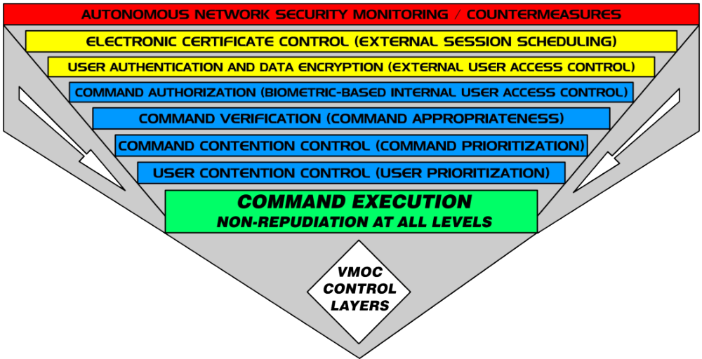
Virtual Mission Operations
Conceptual Design
Transparency
Availability
Confidentiality
Authentication
The Right Person, Time, and Command

Slide 10
Virtual Mission Operations
Autonomous Intrusion Detection and Countermeasures
External Session Scheduling
  Electronic Certificate Control
External User System Access Control
  Biometric-based User Authentication
  Data Encryption
  User Prioritization and Contention Control
Internal User Command Access Control
  Biometric-based Command Authorization Checks
Command Verification Checks
  Command Appropriateness
Command Prioritization and Queuing
Command Archive
  User Non-Repudiation

Slide 11
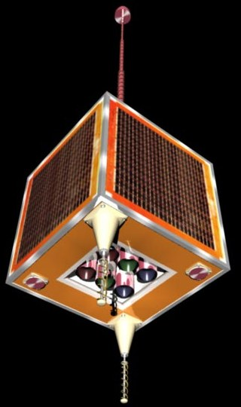






CLEO/VMOC Network
UK-DMC
satellite
low-rate UK-DMC passes over secondary ground stations
receiving telemetry
(Alaska, Colorado Springs)
CLEO onboard mobile access router
8.1Mbps downlink
9600bps uplink
other satellite
telemetry to VMOC
38400bps
downlink
‘battlefield operations’
(tent and Humvee, Vandenberg AFB)
UK-DMC/CLEO router high-rate passes over SSTL ground station
(Guildford, England)
Segovia NOC
USN Alaska
Internet
secure Virtual Private Network tunnels (VPNs) between VMOC partners
mobile router appears to reside on Home Agent’s network at NASA Glenn
primary VMOC-1
Air Force Battle Labs
(CERES)
‘shadow’ backup
VMOC-2
(NASA Glenn)
mobile routing Home Agent
(NASA Glenn)
Notes:
SSTL did not join the VMOC VPN, though it opened access through the SSTL corporate firewall for select VMOC use to request imagery and for mobile routing tunnels. Cisco Systems has donated a number of PIX firewalls to SSTL.
Passes where VMOC accessed the CLEO router were carried out over SSTL in Guildford. These passes also downloaded imagery requested by the VMOC to the ground station, for later notification and pick-up by VMOC.
Passes over the Universal Space Networks ground station in North Pole, Alaska and the Army Space and Missile Defense Battle Lab station in Colorado Springs received additional low-rate broadcast telemetry on the health of the UK-DMC satellite and communicated it across secure tunnels to VMOC.
The CLEO onboard router was accessed via the mobile routing Home Agent at NASA Glenn. The Home Agent is permanently connected, although CLEO and the UK-DMC satellite are not. NASA Glenn also housed the ‘flatsat’ ground-based testbed, other ‘virtual flatsat’ mobile access routers for experimentation, and a ‘shadow’ VMOC application.
As well as requesting new imagery from the UK-DMC via SSTL’s mission planning system, the VMOC could access NASA’s Earth Observation Database for stored imagery.

Slide 12
Virtual Mission Operations
Field (Cockpit and ATC) User Interface
JAVA-based (utilizes a generic web browser for access)
  Truly “virtual”, nothing to steal or compromise post-session
  Survivable system includes multiple, mirrored command elements
Cockpit user provided with local terrain / weather / traffic keyed to GPS location
ATC user input defines area of interest
  Position and velocity of moving objects at infinite granularity levels
  Changes over specified time period
  Ad hoc warning messages based on real time events
  Virtual black box data
  Virtual manifest data
  Handoff points / times (positive control assurance)
System responds to cockpit and ATC requests with: standard data sets, meta data, data file sizes, data latency, estimated time to download, alternative data sources, additional related data. Users can always:
  Request additional data products
  Request the generation of new data

Slide 13
Virtual Mission Operations
Support Across the Entire Mission Lifecycle
Develop as you Fly
Platform
Integrators
(Pre-Build,
Integrated
Testing)
Test as you Fly
Instrument
Manufacturers
(Component
Testing)
Platform
Integrators
(Final Factory
Integrated
Testing)
Process Begins Here
System
Developers
(Concept
Testing)
Platform
Integrators
(Pre-Flight
Integrated
Testing)
Mission Lifecycle
US Command
Authority
ATC
(Command &
Control)
VMOC
Pilots
(Data Users)
Foreign ATC
(Command &
Control)
Legacy
Systems
(Data)
Fusion
Engines
(Multiple
Data
Sources)
Comm’l
Providers
(Ground
Stations /
Network)
Extend Control to the Field
Fly as you Test

Slide 14
Virtual Mission Operations
Integrated Operations
FAA operations following transformation will not be limited to the direct command and control of aircraft
  The FAA routinely offers a variety of data products (like weather information and routing updates) to authorized users
  The VMOC, as currently envisioned, will offer three primary interfaces:
    A User Interface to provide a standards-driven, common user interface
    A Mission Interface to enable policy-based tasking / prioritization and a machine-to-machine interface (eliminating requirements for a man-in-the-loop)
    A Policy Interface to enable authorized organizations to establish system / platform policies
  VMOC is modular and has been designed to allow rapid adaptation to change and flexible response to dynamic mission requirements

Slide 15
Virtual Mission Operations
User Interface
Provides standard web-based interface for end users (pilots, ATC, etc…)
  User requests and priorities based on system policies promulgated by Policy Interface
Allows “unsophisticated” users to request information from sophisticated systems without the need for extensive training
  Utilizes generic web interface (a browser such as IE or Netscape)
  Compartmentalizes data products on a need-to-know basis
  Checks product centers for info that meets request
  Promulgates information to user in motion when available
  Can request tasking through other mission interfaces if user’s needs can not be not met with existing data (i.e weather updates from the National Weather Service)
  Fuses information from multiple sources (if required)

Slide 16
Virtual Mission Operations
Mission Interface
Logically located at operations and product centers, physically embedded within remote assets
Autonomously racks and stacks user requests based on policy driven from Policy Interface
  Authenticates users
  Integrates user requests
  Provides authorized information requested
  Integrates tasking
Enables machine-to-machine interface
  Enables autonomous UAV operations in the NAS
Note: This interface has not been developed yet

Slide 17
Virtual Mission Operations
Policy Interface
Most platforms will require policy-driven management
The VMOC will “rack and stack” policy requests from multiple communities of interest:
  FAA, USAF, USCG, NORAD, FBI, Intel Community, etc.
  Policy parameters will include such things as bandwidth allocations, quality of service, type of service, duration of service, prioritization of users, authorization of users
Will use predictive modeling and simulation to respond to and manage requests
Will adjust to the real-time situation
Will autonomously promulgate policies to all assets and mission interfaces
Note: This interface has not been developed yet

Slide 18
Virtual Mission Operations
GD’s Trusted Network Environment (TNE)
TNE technologies enable compartmentalized access to secure data from a wide variety of assets and locations using generic devices in physically secure locations
  TNE security capabilities meet or exceed NSA’s strict standards for processing the nation's most sensitive classified secrets
TNE is a scalable suite of Multi-Level Security (MLS) applications, servers, databases, gateways, and services that ensure fully audited, controlled access to all information and services across an IT enterprise, in full compliance with DCID 6/3
Trusted technologies label and segregate both data files and applications - users only “see” what their individual security profiles allow, with no knowledge of any other data files, applications or users on the enterprise
User A Sees:
User B Sees:
User C Sees:
X
X + Y
Y + Z

Slide 19
Future NAS: Policies to be Revisited?
Requirement to use dedicated links for high priority traffic
Use of shared infrastructure for high priority traffic
Requirement to use link layer (versus IP layer) security
Handover methodology (frequency versus IP addresses)

Slide 20
Legacy Interoperability Support
Integrating Disparate Radio Systems

Slide 21
Legacy Interoperability Support
VOIP Radio Bridge
A VOIP Radio Bridge treats a cell phone like a virtual radio (# sign = “push to talk”)
  Unlike existing cell phone services, multiple cell phone users can individually call the VOIP Radio Bridge to get connected together (not limited to just one or two users)
A VOIP Radio Bridge also accommodates inputs from a wide variety of systems
  Allowing connectivity between existing radio systems, wired phones, and cell phones
  Radio systems can be accommodated via the ACU1000 or through generic network devices (routers) offering “Land Mobile Radio” (LMR) service
    Note: RF is still line of sight. Each individual system (base station and antenna) will still need to be co-located and connected locally to either an ACU1000 or a LMR enabled router during the actual event
A VOIP Radio Bridge allows system managers to create “Communities of Interest” (COI) to segregate users by common mission or theme. For example:
  COI #1 would be the Air Traffic Contoller
  COI #2 would be DHS
  COI #3 would be DoD
  COI #4 would be FBI
  COI #5 would DoT/FAA
  COI #6 would local first responders
VOIP Radio Bridge Approach
COI
1
COI
6
COI
2
W
COI
5
COI
3
COI
4

Slide 22
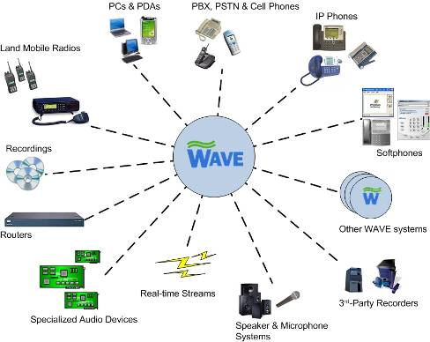
Legacy Interoperability Support
Managing VOIP Service in Real Time
A WAVE server is a VoIP-based Wide Area Voice Environment software solution that creates massively scalable group communications among all types of communication devices
  Already in use in theater providing SOF ground communications support
  As a “virtual” device it can be located anywhere that has Internet connectivity
  For “survivability”, multiple units can be mirrored and deployed in geographically distributed areas
  Can easily be integrated with encryption systems for secure communications & communications isolation
If it’s voice, it can easily be routed and managed by using a Wave server

Slide 23


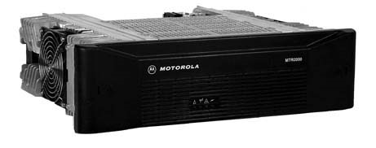


Legacy Interoperability Support
Tying Together Disparate Radio Systems Virtually
Land Mobile Radio Connection
M-lead (Cor)
The Internet
M-lead (Cor)
E-lead (PTT)
E-lead (PTT)
UHF Radio
VHF Radio
Generic Radio Base Station A
Generic Radio Base Station B
WAVE Server
Cisco’s Land Mobile Radio (LMR) allows any radio to be connected to the Internet using VOIP technology
The WAVE server allows the two disparate radio systems to be connected together “virtually”

Slide 24
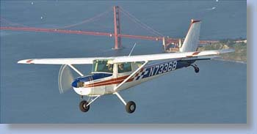
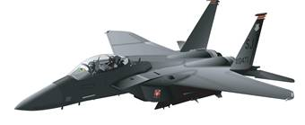
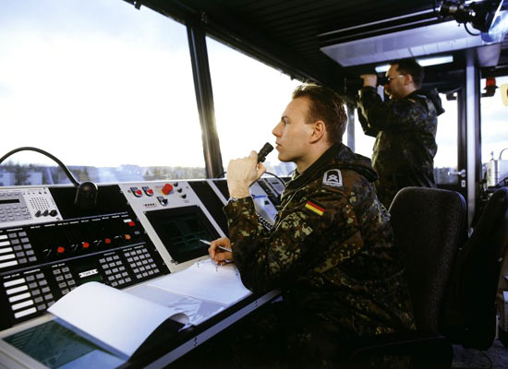
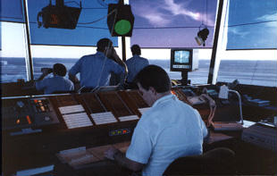
Legacy Interoperability Support
Emergency Communications Over Disparate Radios
Cessna 152! You are violating national airspace! Respond immediately and follow me to the nearest airport!
Generic F15E Interceptor
Generic (unmodified) Cessna 152
Civilian UHF Voice Communications
Land Mobile Radio Connection to tower radio base station
DoD VHF Voice Communications
The Internet
Network Centric FAA Control Tower
Network Centric DoD Control Tower
Twisted Pair Solutions WAVE™Server Cisco IP Interoperability and Collaboration System (IPICS)
The VOIP Radio Bridge can be used to tie together disparate radio systems for emergency communications

Slide 25
Where Do You Go From Here?
A strategic plan must be formulated which takes into account everything that has been learned:
  The Future NAS will be packet-based
  The security solution cannot be decoupled from the network solution
  The Future NAS will be fully interoperable with commercial, military, and foreign systems
  The network solution will apply to all phases of aircraft operations (not just flight)
  The network solution will apply to all types of aircraft (not just commercial aircraft)
  Generic data (voice, video, email) will commingle with data from secure systems
NASA GRC is well ahead of all others with regards to a
comprehensive, secure, scalable, survivable, mission operations system

Slide 26
Where Do You Go From Here?
Bandwidth considerations will need to be integrated into the security solution
  We will need to understand exactly what can be flown with all sources of overhead
A demonstration incorporating all elements of aircraft operations (gate to gate plus anomalies) would be useful for establishing a future baseline architecture
  Tools, techniques, and policies will all need to be developed and proven as a part of the demonstration
A sound business case will also need to be developed (the business case should speak to the estimated costs that will be incurred by all)
  General aviation, commercial aviation, etc…
  Path to system certification identified and costed
NASA GRC is well ahead of all others with regards to a
comprehensive, secure, scalable, survivable, mission operations system

