Slide 1
Genetic variation in West Nile virus
Alan D. T. Barrett
Department of Pathology,
Sealy Center for Vaccine Development,
Center for Biodefense and Emerging Infectious Diseases,
University of Texas Medical Branch at Galveston

Slide 2
Flavivirus Genome
ss (+) RNA genome
Approximately 11 kb
5’-m⁷GpppAmp cap
Lacks 3’-polyA tail
Codes for
  3 structural proteins
    Capsid (C), membrane (prM/M), envelope (E)
  7 non-structural proteins
    NS1, NS2A, NS2B, NS3, NS4A, NS4B, NS5
mRNA
Notes:
3

Slide 3
5’NCR Structural proteins Non-structural proteins 3’NCR
RNA
cap
C prM E NS1 NS2A NS2B NS3 NS4A 2KNS4B NS5

Polyprotein





Co- and Post-translational Processing
C prM E NS1 NS2A NS2B NS3 NS4A 2K NS4B NS5
pr
M
NS3’
NS3”
Signal peptidase site
Unique site
NS2B-NS3 protease site
NS3
Protease, helicase, NTPase

NS5
Methyltransferase, RNA polymerase

Slide 4
5’NCR Structural proteins Non-structural proteins 3’NCR
RNA
cap
C prM E NS1 NS2A NS2B NS3 NS4A 2KNS4B NS5

Polyprotein





Post-translational Processing
C prM E NS1 NS2A NS2B NS3 NS4A 2K NS4B NS5
pr
M
NS3’
NS3”
Signal peptidase site
Unique site
NS2B-NS3 protease site
NS3
Protease, helicase, NTPase

NS5
Methyltransferase, RNA polymerase

Slide 5
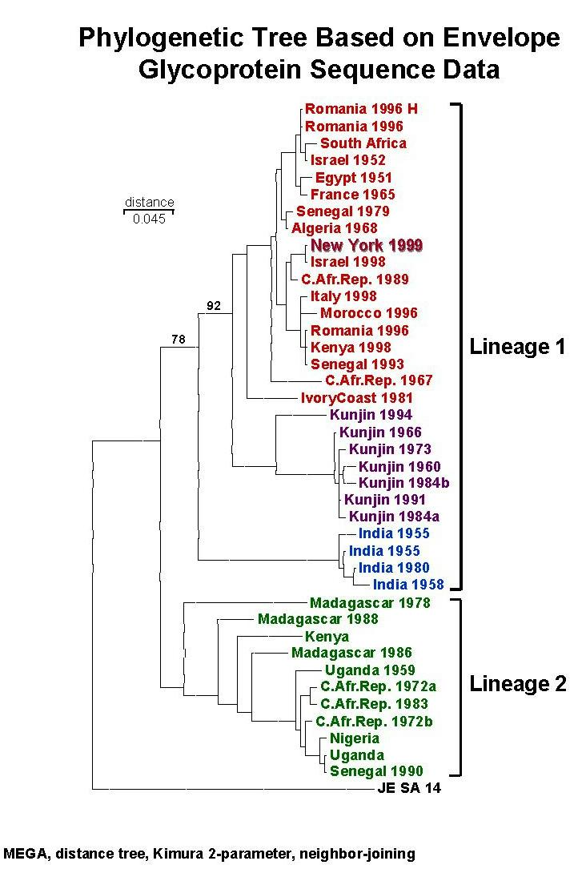
  Lanciotti et al. 1999. Origin of the West Nile virus responsible for an outbreak of encephalitis in the northeastern U.S. [Science 286:2333-337.]
  ≥ 99.8% nucleotide homology with Israel 1998 over complete genome
  Lanciotti et al. 2002. Virology

Slide 6
Phylogenetic studies of North American WN viruses
Anderson et al., PNAS 2001 and Ebel et al., EID 2001
  Partial nucleotide sequences (921 and 1,503 respectively) with 3 nucleotide mutations and 2 amino acid substitutions
Lanciotti et al., Virology 2002
  Complete genomes of 1999 and 2000 isolates ≥99.8% identical by nucleotides and ≥99.9% amino acids to WN-NY99
Huang et al., EID 2002
  Complete genome of human isolate from 2001: ≥ 99.7% nucleotide homology and ≥99.8% amino acid homology
  No sequence analyses of WNV isolates from 2002 had been reported and none were reported outside of the northeastern seaboard.

Slide 7
WN virus in Texas, 2002
(Beasley et al., 2003)
First isolated by Bob Tesh (UTMB), Ray Parsons (Harris County) and Pushker Raj (TDH) in Houston, June 2002.
Two “genetic variants”; one in Harris County and one on Bolivar Peninsula
Harris County: 0.18% nucleotide divergence from New York 1999 strain 382-99.
Bolivar Peninsula: 0.35% nucleotide divergence from New York 1999 strain 382-99.
Harris County and Bolivar Peninsula isolates differ by 0.5%.

Slide 8
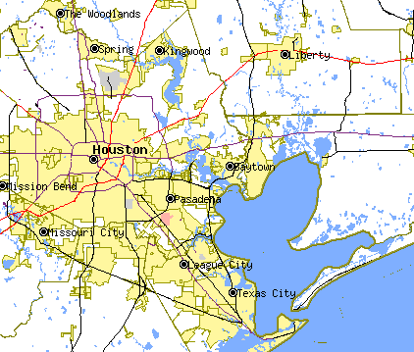
227
113, 114, 115, 116,118, 119, 123, 135
362

Slide 9
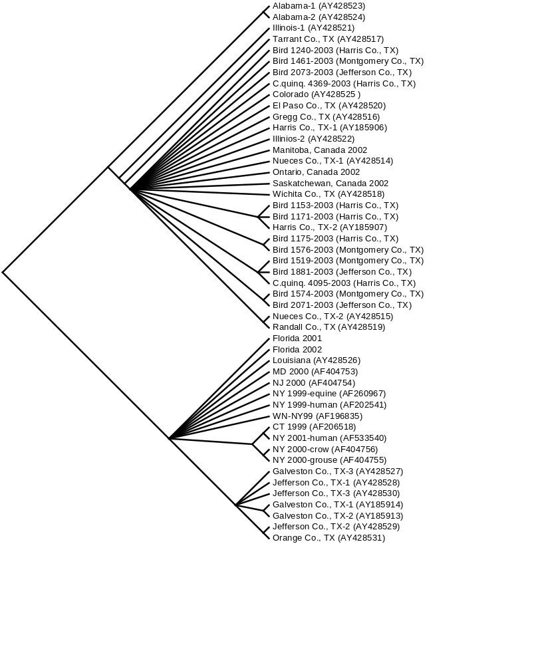
Cladogram based on maximum parsimony analysis comparing a 2004-nt sequence of WN virus isolates collected during 2001-2003 to a homologous region of WN virus isolates collected in 1999, 2000, and 2001 from the northeastern U.S.
(Davis et al., 2003)
86
North America 2001-2003
Eastern U.S. 1999-2002
100
99
Southeast coastal Texas 2002

Slide 10
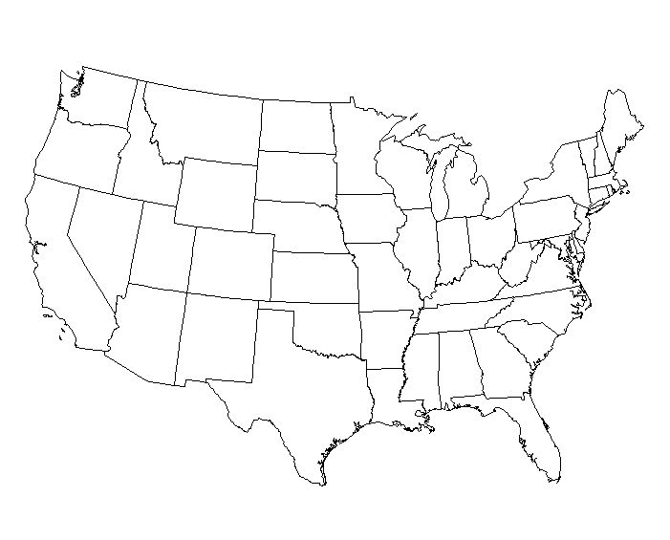
Genetic distribution of WNV isolates, 1999-2003
.
.
.
.
.
.
.
.
.
.
.
.
.
.
.
.
.
.
.
.
.
.
.
.
.= 1999-2000 (NE U.S.)
.
.
.
.
.
.
. = 2001-2003 (NA)
.
.
.
.
.
.
.
.= 2002 (SE Texas)
.

Slide 11
SE coastal Texas strain
(Granwehr et al., 2004)
Residue | SE coastal Texas | Lineage I | Lineage II
E-76 | Ala | Thr | Thr
NS1-94 | Gly | Glu | Asn
NS2A-90 | Met | Met | Lys
NS2A-138 | Ile | Val | Val
NS4B-173 | Ile | Val | Val
NS5-526 | Ile | Thr | Thr

Slide 12
Overview of sequence studies
Multiple introductions into TX during summer of 2002 and geographical clustering of variants (coastal vs. state-wide variants)
    Long-distance spread by birds with limited migration patterns (ie. circum-Gulf route)
    Localized spread by birds/mosquitoes over shorter-distance
Identified nucleotide mutations at 31 positions (8 in prM, 23 in E) not previously observed in North American WN virus strains (no changes shared with NE United States strains)
7 amino acid substitutions (2 in prM, 5 in E)
Revealed emergence of two distinct variants: 2001-2002 North America variant and coastal SE Texas variant
Most divergent strains to date: individual isolates with 7 nucleotide mutations and 3 amino acid substitutions.
Maximum nucleotide divergence from WN-NY99 was 0.35% (average of 0.18%)

Slide 13
Evolution of WN virus in the United States
Evidence suggests limited evolution between 1999 and 2002.
Majority of nucleotide changes are transitions (U ←→ C).
Strain isolated in 1999 and 2000 in NY, NJ, CT and MD differ < 0.35% from prototype New York strain 382-99.
SE coastal Texas isolates are the most divergent to date (0.55%).
Distinct populations of virus evolving?
No strong selection → genetic drift?

Slide 14
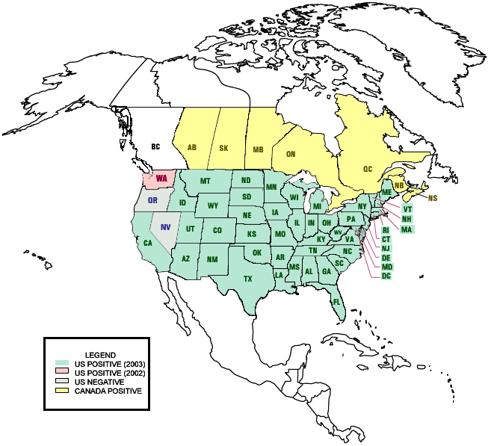

Slide 15
SN
NL

Slide 16
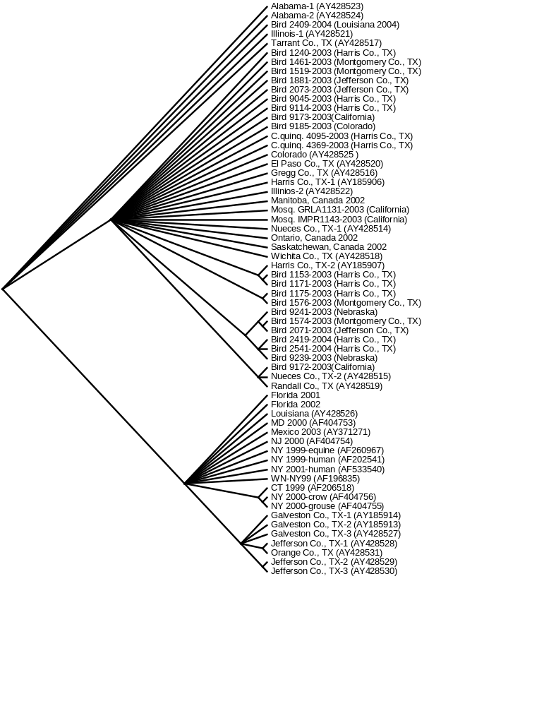
Cladogram based on maximum parsimony analysis comparing a 2004-nt sequence of WN virus isolates collected during 2001-2004 to a homologous region of WN virus isolates collected in 1999, 2000, and 2001 from the northeastern U.S.
North America 2001-2004
86
96
Eastern U.S. 1999-2002
100
Southeast coastal Texas 2002
99

Slide 17
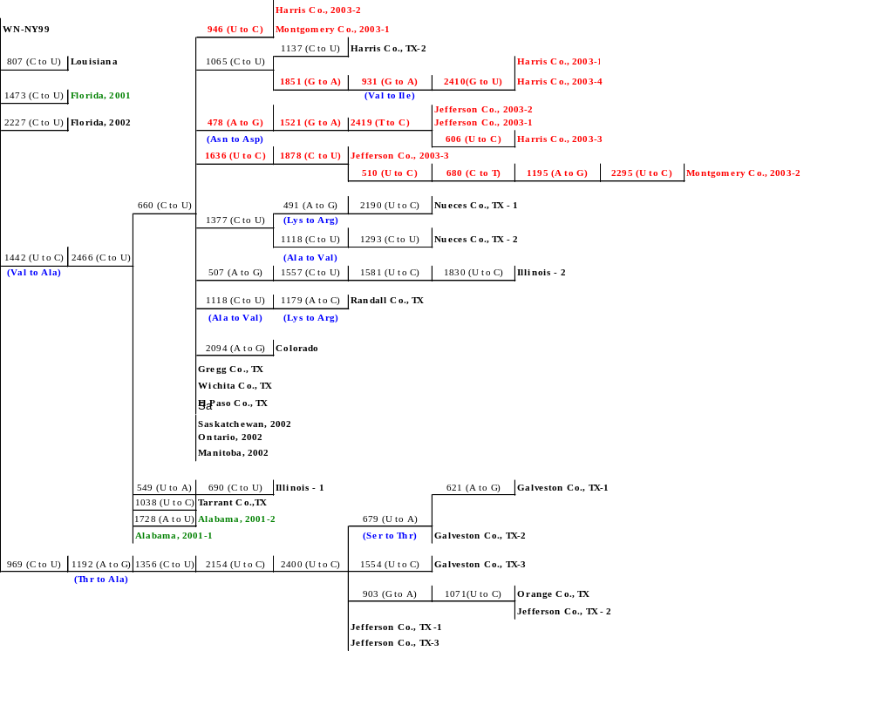
Phylogram comparing a 2004-nt sequence of WN-NY99 with 35 WN virus isolates collected during 2001, 2002, and 2003.

Slide 18
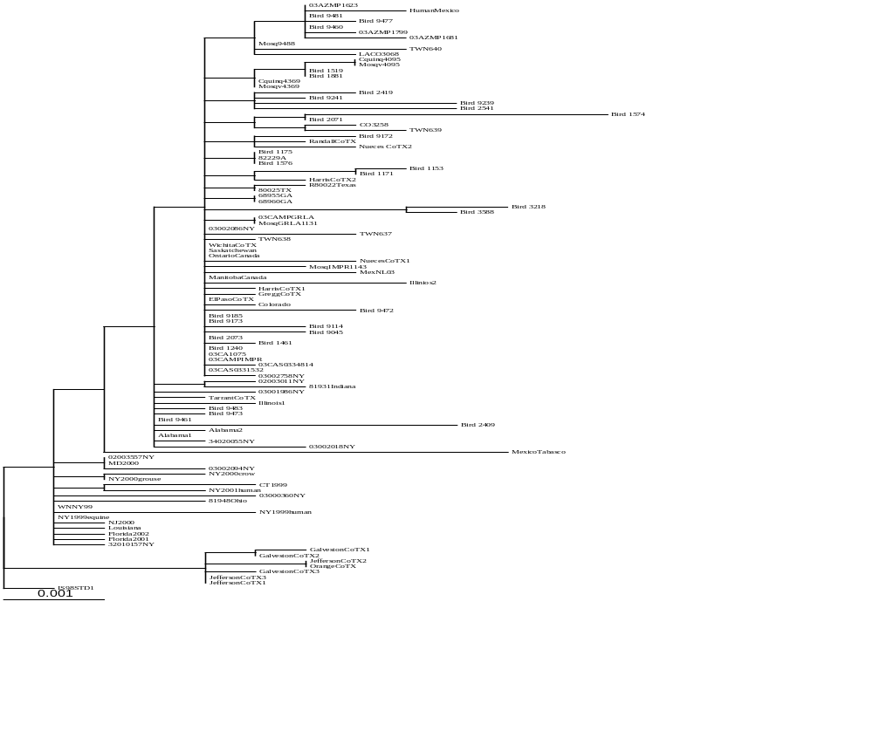
Bayesian analysis of prM and E genes of 115 North American WNV isolates. The following criterion were used in analysis:
N gen= 150,000
Print freq= 1000
Sampling freq= 100
N chains= 4
burnin= 200
North America genotype
100
100
100
100
Eastern U.S. isolates, 1999-2002
Southeast coastal Texas, 2002

Slide 19
Bayesian analysis of prM and E genes of 115 North American WNV isolates. The following criterion were used in analysis:
N gen= 150,000
Print freq= 1000
Sampling freq= 100
N chains= 4
burnin= 200
North America genotype
100
100
100
100
Eastern U.S. isolates, 1999-2002
Southeast coastal Texas, 2002

Slide 20
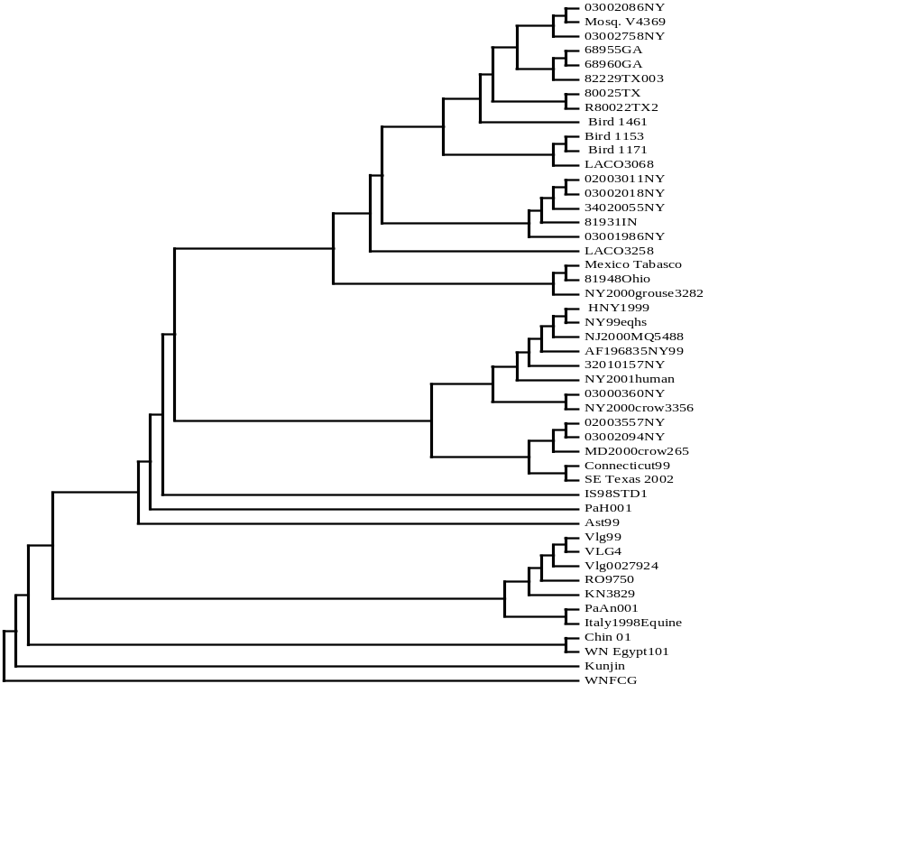
Maximum likelihood analysis of the complete genome of 48 WNV isolates. Bootstrap values represent 500 replicates performed with neighbor-joining analysis.
North America genotype
86
94
100
Eastern U.S. isolates, 1999-2002
92
100
Old World WNV isolates

Slide 21
Maximum likelihood analysis of the complete genome of 48 WNV isolates. Bootstrap values represent 500 replicates performed with neighbor-joining analysis.
North America genotype
86
94
100
Eastern U.S. isolates, 1999-2002
92
100
Old World WNV isolates

Slide 22
West Nile in the Americas
United States
Canada
Mexico
Dominican Republic
El Salvador
Jamaica

Slide 23
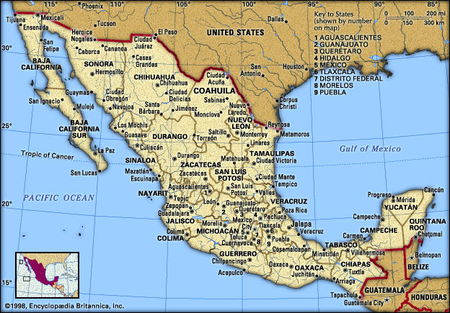
Genomic sequence of TM-171 Mex03 isolate
(Beasley et al., 2004)
Isolate from dead raven at wildlife reserve in Villahermosa, Tabasco.
RNA and, subsequently, Vero cell passaged virus sent to UTMB.
46 nucleotide differences (0.42%) from NY99; 4 amino acid differences:
prM/M-141 Ile → Thr
E-156 Ser → Pro* (loss of glycosylation motif)
NS4B-245 Ile → Val*
NS5-898 Thr → Ile*

Slide 24
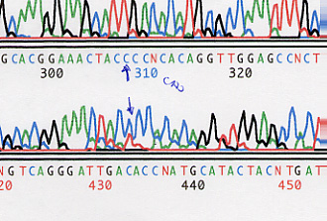
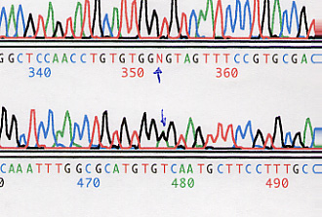
Mixed sequence at the E glycosylation site of Mex03 isolate.
Forward
Consensus sequences:
NY99 AAC TAC TCC ACA (NYST)
MEX AAC TAC CCC ACA (NYPT)
Cloned Mex03 PCR product and sequenced 5 clones:
three clones “CCC” – Pro
two clones “TCC” – Ser
Reverse

Slide 25
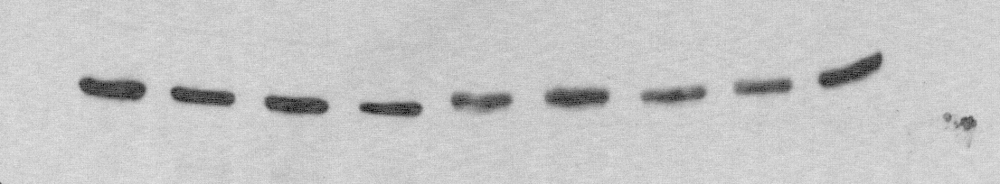
Plaque purification of E glycosylation variants of Mex03.
Variants selected by two rounds of plaque purification in Vero cells.
Screened by Western blot (diff. in apparent mol. wt.)
Selection of variants confirmed by nucleotide sequencing.
gly+ variants grew faster (~24hrs earlier to harvest) and to ~10-fold higher titer, and had slightly larger plaque size.

Slide 26
Mouse virulence of Mex03 glycosylation variants.
Virus | E154-156 | i.p. LD₅₀ (pfu) | A.S.T. ± s.d. (days) | PD₅₀ (pfu)
Mex03 | mixed | 0.5 | 8.2 ± 1.8 | n.d.
Mex03-pp1 | NYP | >1000 | -- | 5.0
Mex03-pp2 | NYP | 794 | 10.3 ± 0.6 | 0.8
Mex03-pp5 | NYS | 3.2 | 8.5 ± 0.8 | 0.5
Mex03-pp6 | NYS | 2.0 | 9.2 ± 1.0 | 2.0
n.d. – not determined
All strains contained prM-141 I→T; NS4B-245 I→V; NS5-898 T→I

Slide 27
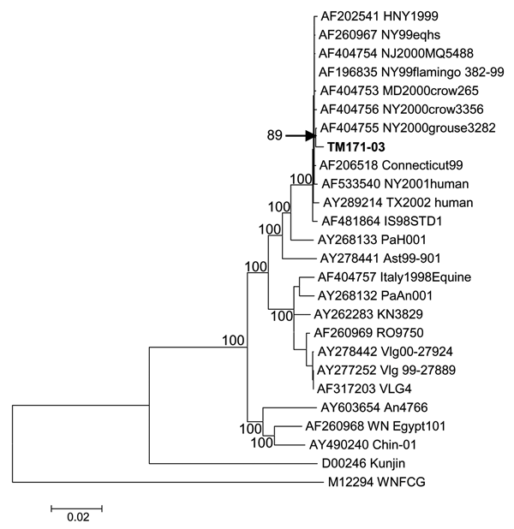
Neighbor-joining phylogenetic tree based on complete genome sequences of West Nile virus strains. The isolate from Tabasco, MX is designated TM171-03.
Beasley et al., 2004. EID

Slide 28
Conclusions
Evidence suggests limited, but continuing, divergence from isolates collected in 1999 and 2000
Emergence of genetically distinct variants
    Dominant North America variant since at least 2002
    Coastal SE Texas variant in 2002 only → become extinct?
Dominant variant has emerged throughout the majority of North America with >90% of isolates collected in 2002 and after belonging to the dominant clade
  Emergence of novel genotype corresponds with displacement or extinction of earlier genotypes
Subclades are readily illustrated depending on year of isolation and collection location
  Higher degree of nucleotide identity within individual states and during the same transmission season
Mexico 2003 isolate is most divergent from the Americas with 9 nt and 2 aa differences from New York 1999 isolates and has lost E protein glycosylation site.
Genetic mutations could eventually lead to phenotypic changes in viral antigenicity or associated virulence (mouse model shows no attenuation in either variant)?

Slide 29
Phenotypic variants – Texas 2003
(Davis et al., 2004)
Nucleotide sequencing and phenotypic comparisons of 29 WNV isolates collected by Harris Co. Mosquito Control Division in and around Houston, TX between 9 May – 8 Sept. 2003:
  17 from dead birds
  12 from mosquito pools (Culex spp.)
Viruses isolated in Vero cells, amplified by one additional passage and plaque titrated on Vero cells.
6 strains (5 bird, 1 mosq.) with small plaque (SP) morphology

Slide 30
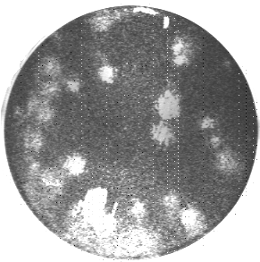
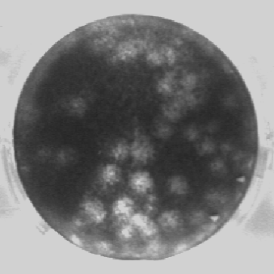
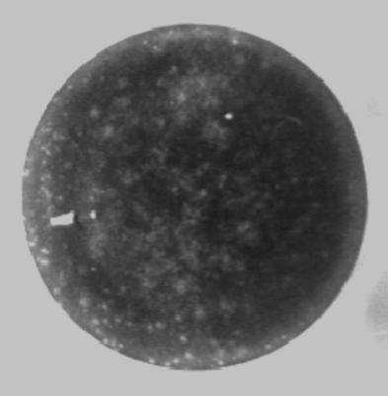
Plaque morphology of WNV isolates
WN-NY99 (382-99)
WNV 2002
WNV 2003 sp
Mean plaque size ≥ 1.5mm
Mean plaque size < 1.0mm
In Vero cells, 72 hours post-infection.
Stained with crystal violet.

Slide 31
Phenotypic comparisons of LP/SP WNV strains
Small plaque phenotype often a marker of attenuation of flaviviruses.
Other phenotypic comparisons:
  temperature sensitivity at 39.5°C
  mouse neuroinvasion
  - i.p. inoculation of 3-4 week old Swiss Webster mice

Slide 32
Phenotypic comparisons of LP/SP WNV strains (cont.)
Strain | Source | Plaque | TS index* | ip LD₅₀ (pfu) | AST ± sd | ic LD₅₀ (pfu)
382-99 | Flamingo | L | -0.5 | 0.8 | 7.2±0.6 | 0.1
TWN93 (02) | Bird | L | 0.3 | 0.5 | 8.0±1.0 | 0.1
TWN301 (03) | Bird | L | -0.2 | 0.6 | 7.0±1.0 | 0.2
TWN305 (03) | Bird | S | 0.3 | 51,000 | 9.0±4.0 | 0.1
TWN274 (03) | Bird | S | -2.7 | 23,000 | 9.5±1.0 | 0.3
TWN382 (03) | Mosq. | S | -1.8 | 645,000 | 8.3±3.0 | 0.1
TWN269 (03) | Bird | S | -2.7 | 2,000 | 9.7±3.3 | nd
*TS index is log₁₀ difference in virus titer at 39.5°C compared with 37°C; negative values indicate decreased titers.
nd – not determined; L = large, S = small.

Slide 33
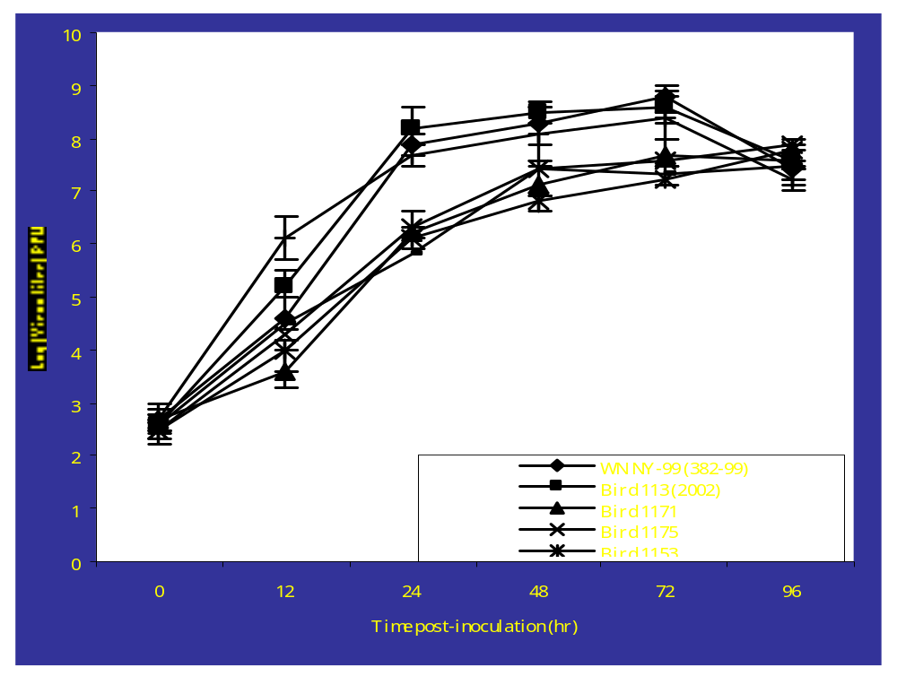
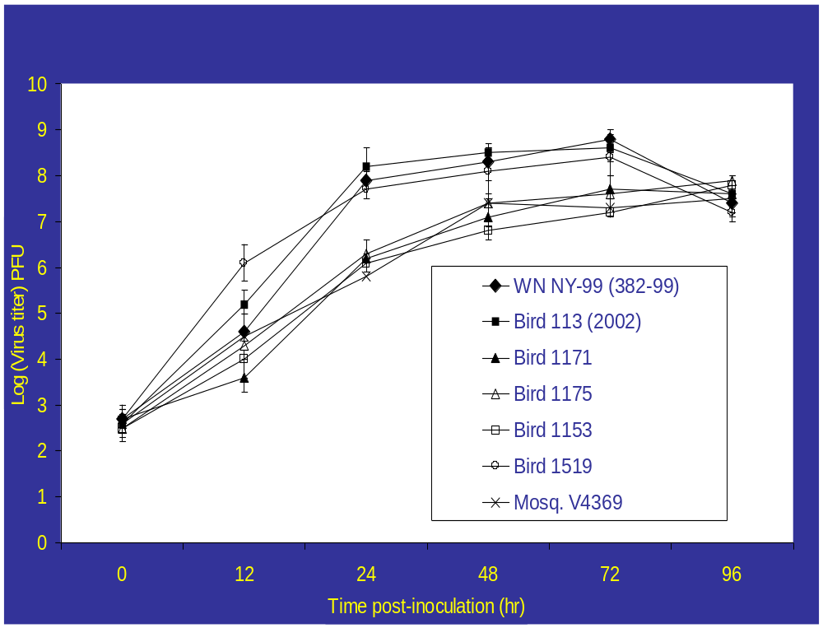
Viral growth curve in Vero cells of 2003 WNV isolates in comparison to isolates from 1999 and 2002
sp and ts
sp

Slide 34
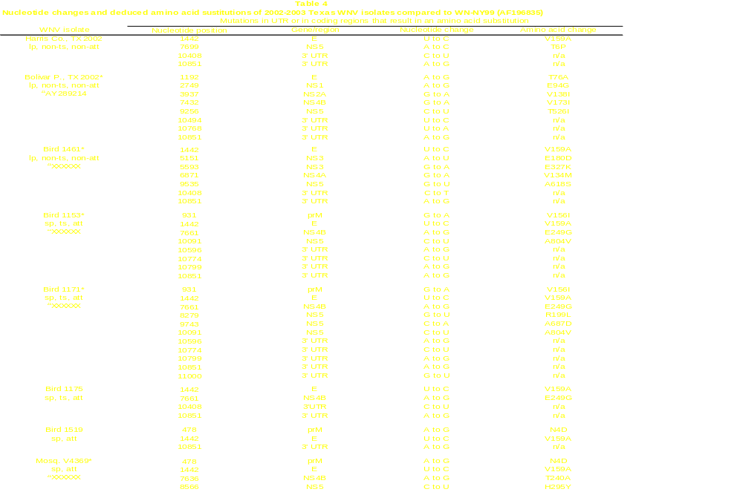

Slide 35
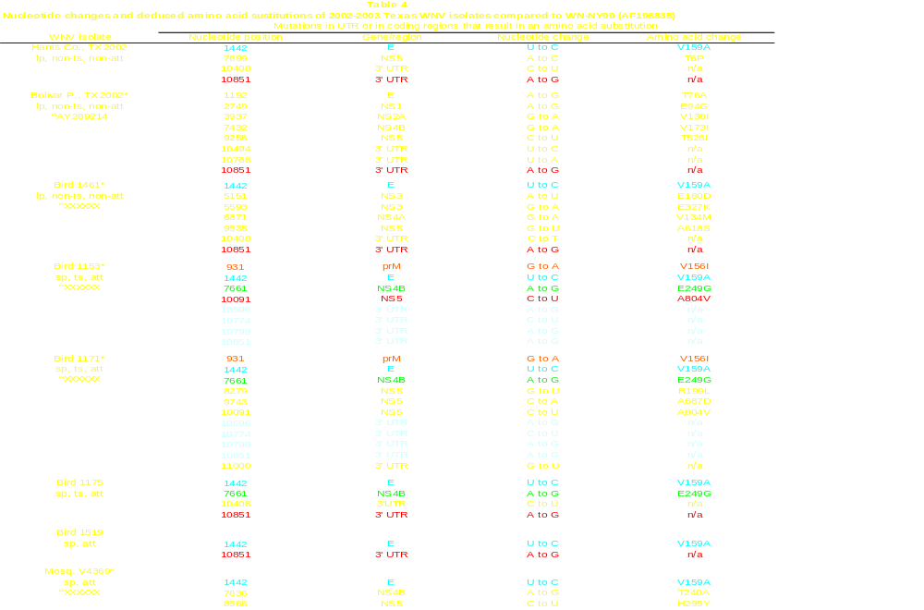

Slide 36
Conclusions
First evidence of phenotypic variation in North American West Nile virus
Attenuation of mouse neuroinvasiveness may not be indicative of attenuation in birds, horses, humans
No indication that attenuated viruses persist in nature
- No more SP/mouse attenuated isolates identified → another extinct lineage?
Sequencing and reverse genetics studies can be used to identify molecular determinants of phenotypic variation

Slide 37
Genetic and phenotypic variation in New York, 2002
Ebel et al. 2004. AJTMH
New genotype emerged in New York in 2002 (55% of all isolates in 2002 and 85% of all isolates in 2003)
Genetically homogeneous to Texas isolates from 2002-2003 (prM and E)
In vitro growth studies (C6/36 and Vero) showed no significant differences
In vivo mosquito transmission studies (Culex pipiens)
  Significantly higher proportion of mosquitoes became infected (infectious virus in bodies) and developed disseminated infections (infectious virus in legs) following feeding with dominant genotype compared to WN-NY99
  Significantly higher proportion of mosquitoes were able to transmit (infectious virus in salivary secretions) at days 5 and 7 post-feed with dominant genotype
Displacement of WN-NY99 genotype by dominant genotype may be due to differences in mosquito transmission efficiency (reduction of EIP with dominant genotype)

Slide 38
Acknowledgements
Barrett lab Other UTMB
David Beasley Bob Tesh + lab
Mike Holbrook
Todd Davis Steve Higgs + lab
Amber Engel
Li Li Scott Weaver + lab
Monica McArthur Jose Estrada-Franco
Melissa Whiteman
Jason Wicker
Shuliu Zhang
Bruno Granwehr
Funding
CDC; State of Texas Advanced Research Program;
Clayton Foundation; McLaughlin Foundation

Slide 39
Collaborators
  Harris County Mosquito Control Division
  Texas Department of Health
  CDC, Division of Vector-Borne Infectious Diseases
  Illinois Natural History Survey
  University of Alabama, Birmingham
  Louisiana Dept. of Health
  Florida Dept. of Health
  Colorado State University
  Nebraska Dept. of Health
  University of California, Davis
  New York State Dept. of Health
  Health Canada
  Mexico – Dept. de Salud Publico

