Slide 1
The Operational NCEP GODAS:
Evaluation and Application
Yan Xue
Climate Prediction Center, NCEP/NOAA
David Behringer
Environmental Modeling Center, NCEP/NOAA
Thanks to Kyong-Hwan Seo
NCEP CFS Assessment Meeting, Camp Spring, Maryland, November 16, 2004

Slide 2
NCEP GLOBAL OCEAN DATA ASSIMILATION SYSTEM
CDAS.2
SST
Altimeter
Oceanic I.C. for
Coupled Model
Momentum Flux
MOM.v3
GFDL Ocean Model
3D VAR
Ocean Data Assimilation System
Statistical
ENSO Model
CCA, Markov
Heat Flux
E-P Flux
Temperature
XBT
TAO
ARGO
ENSO Monitoring
Synthetic
Salinity
LEVITUS T-S
CDAS.2

Slide 3
GODAS
Model:
MOM v.3
Grid:
    Quasi-global, 40 vertical levels.
Physics:
    KPP boundary layer mixing scheme,
    free surface.
Forcing:
    Wind stress, heat flux, E-P from
    Reanalysis 2, surface salinity
    relaxed to Levitus monthly SSS
    climatology.
Assimilation method:
    3D VAR, analyzes temperature and
    salinity, error covariance varies
    geographically and temporally.
Assimilation data:
    Temperature profile data from XBTs,
    profiling floats (Argo), moorings
    (TAO), synthetic salinity from local
    Levitus T-S climatology.
RA6
Model:
MOM v.1
Grid:
    Pacific basin, 27 vertical levels.
Physics:
    Richardson number based scheme,
    rigid lid.
Forcing:
    combining anomalies from FSU winds
    with Hellerman and Rosenstein climatology, no E-P flux, no constraint on SSS.
Assimilation method:
    3D VAR, analyzes temperature only,
    fixed error covariance prior to
    TOPEX era.
Assimilation data:
    Temperature profile data from XBTs,
    profiling floats (Argo), moorings
    (TAO), TOPEX sea level since
    1993.

Slide 4
MODEL RUNS
  GODAS
  RA6
  SIM (same as GODAS except no data assimilation)
VERIFICATION
Dependent Data:
TAO temperature profiles
Independent Data:
Tide Gauge (sea level)
Gregory Johnson’s CTD (salinity)
Gregory Johnson’s ship ADCP (velocity)
Peter Niiler’s drifter current (velocity)
TAO ADCP (velocity)

Slide 5
Applications of GODAS at CPC
CFS model uses GODAS as oceanic initial conditions.
“Weekly ENSO Update” uses GODAS pentad temperature and sea level fields to monitor intraseasonal oceanic variability.
“Climate Diagnostic Bulletin” uses GODAS monthly temperature and sea level fields to assess interannual oceanic variability.
Markov model uses GODAS monthly sea level field as predictor.
CCA ENSO model uses GODAS monthly sea level and depth of 20 degree as predictors.
Study relationship between ENSO and MJO-related oceanic Kelvin waves.
Study coupled ocean-atmospheric modes in the Tropical Atlantic Ocean, and improve forecast skill of SST and precipitation there.

Slide 6
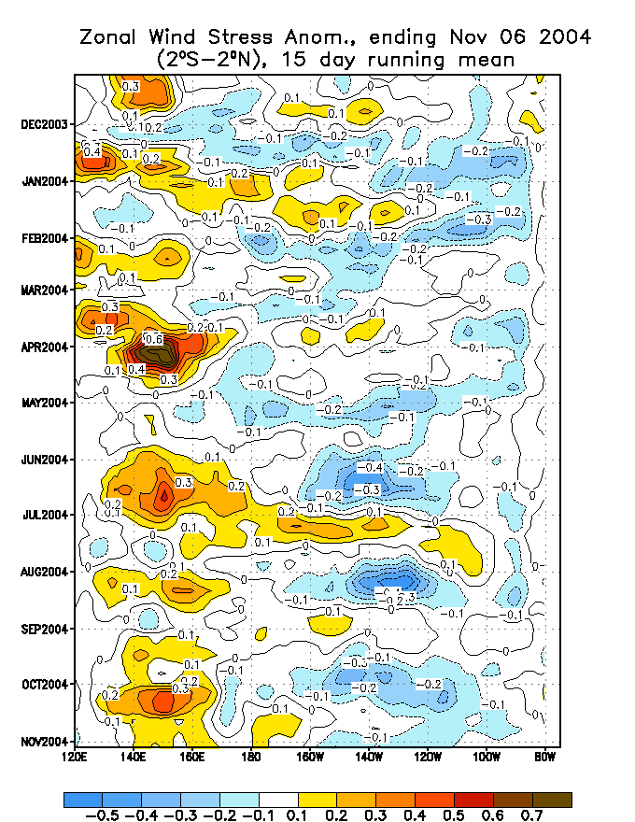
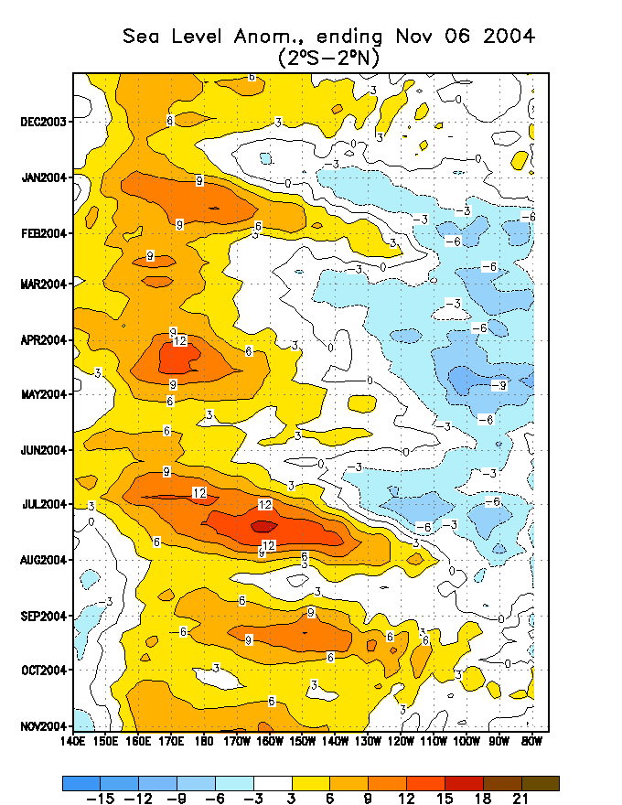

Slide 7
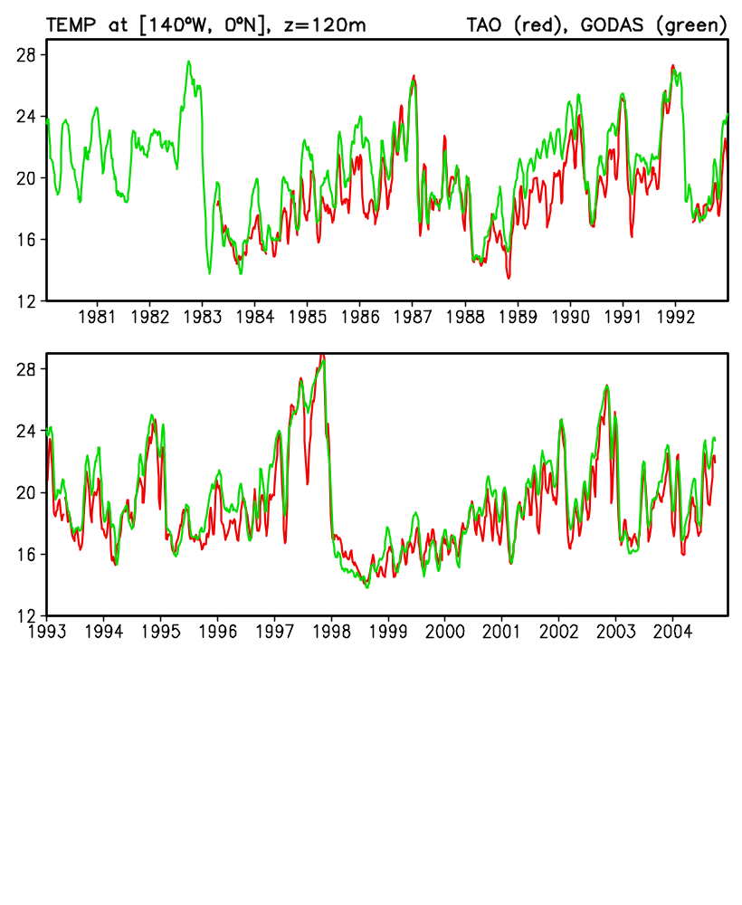

Slide 8
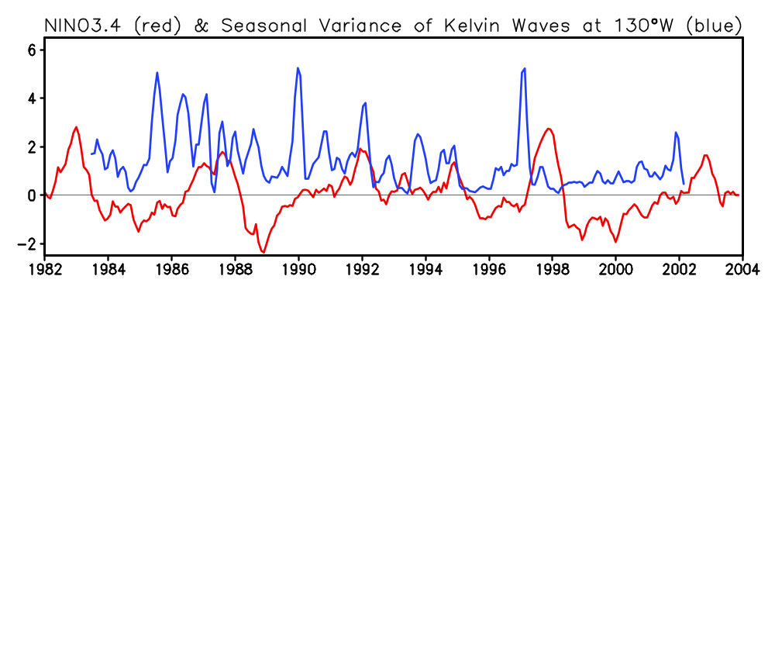

Slide 9
Warm Biases in GODAS

Slide 10
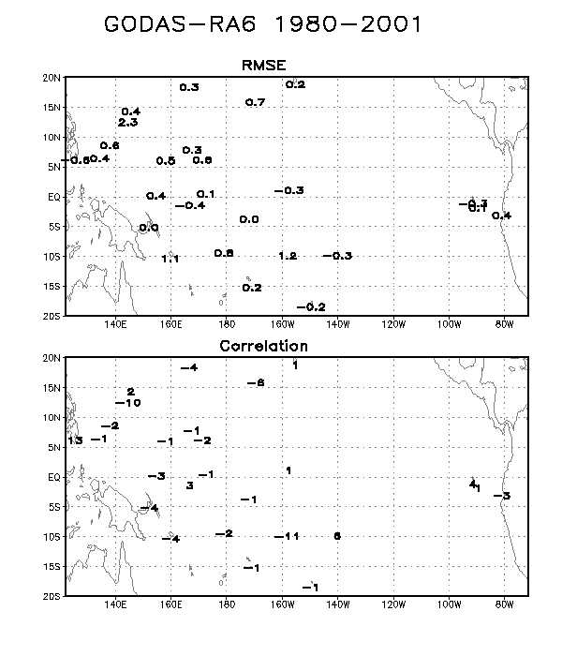
Guam
Kwajalein
Rabaul

Slide 11
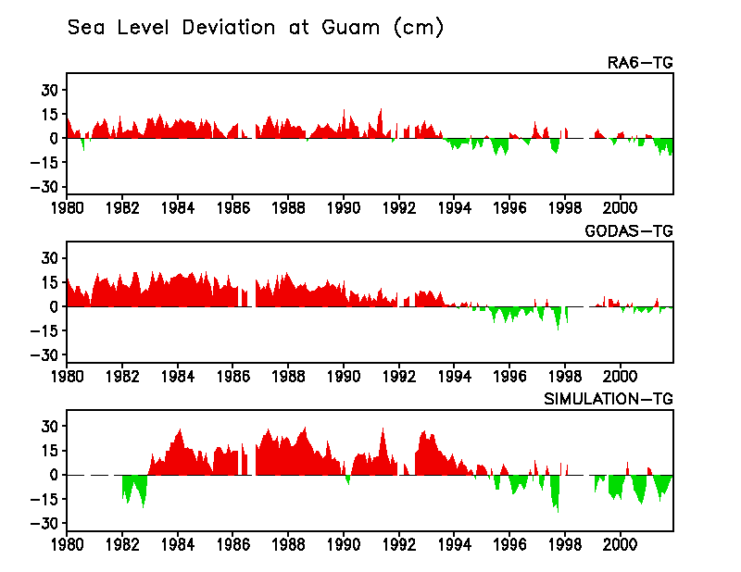
from 1992-2000 mean

Slide 12
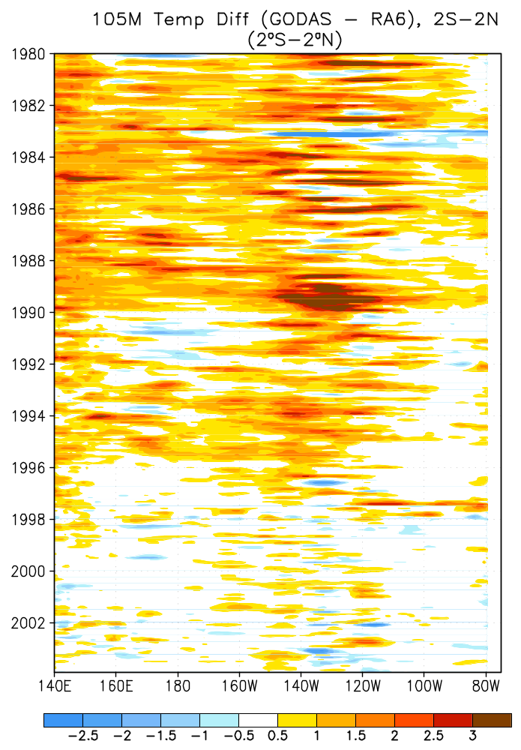

Slide 13
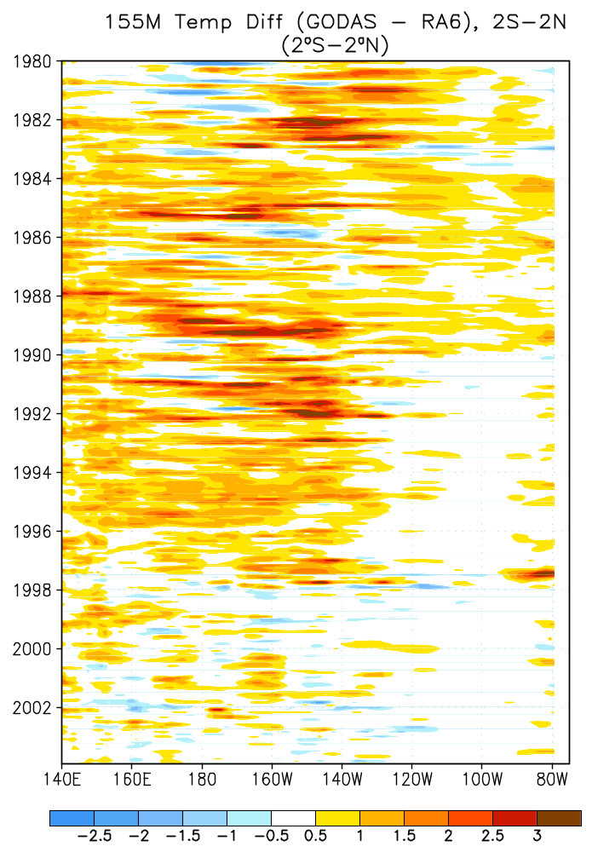

Slide 14
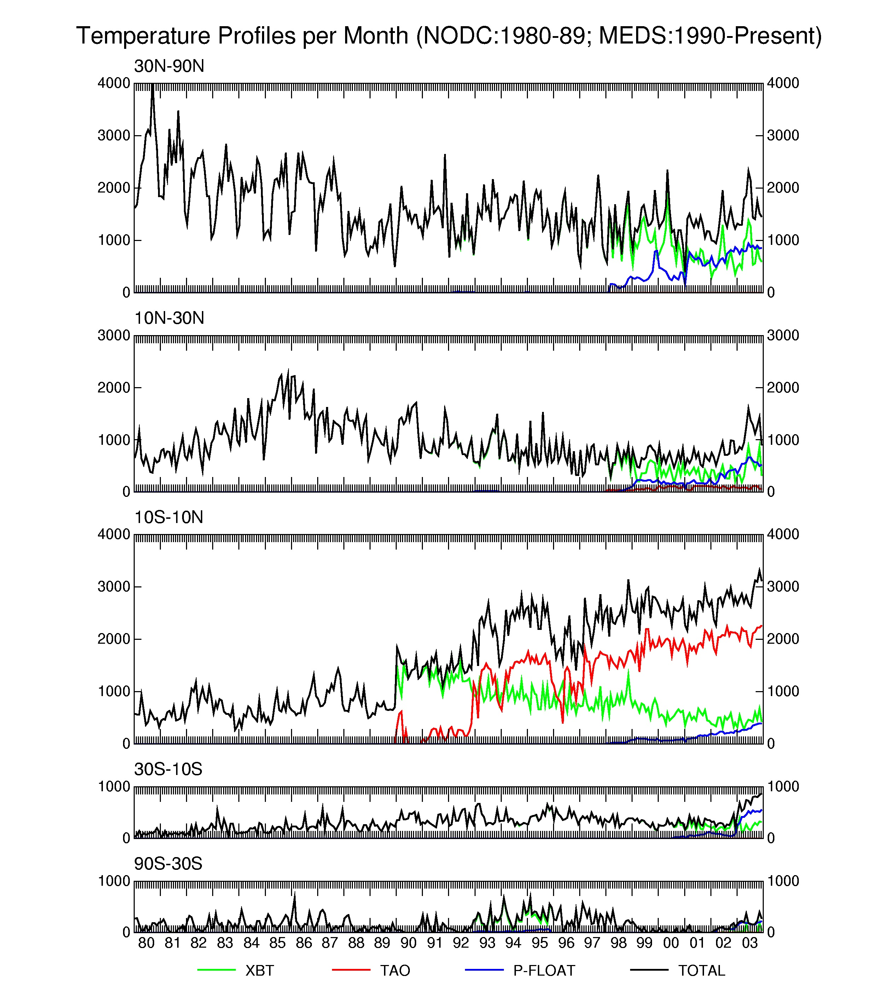

Slide 15
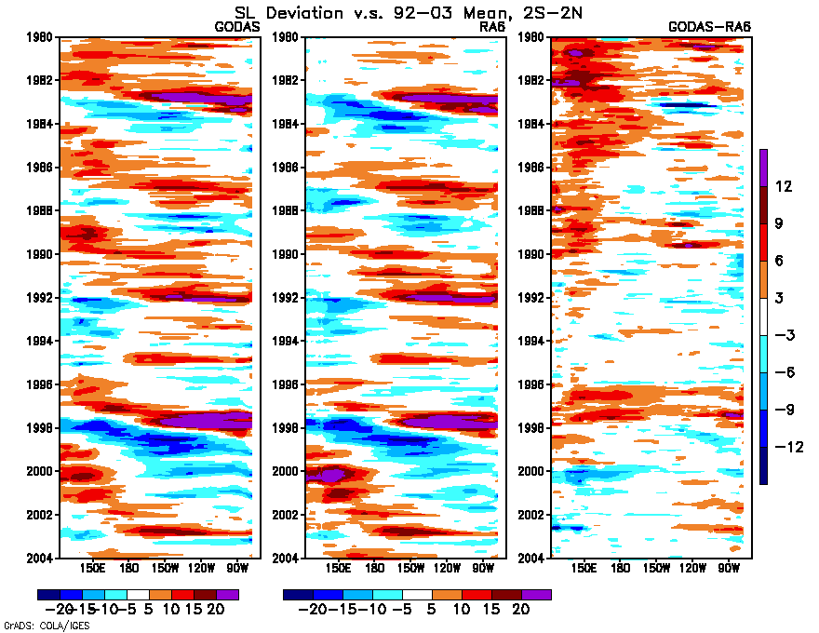

Slide 16
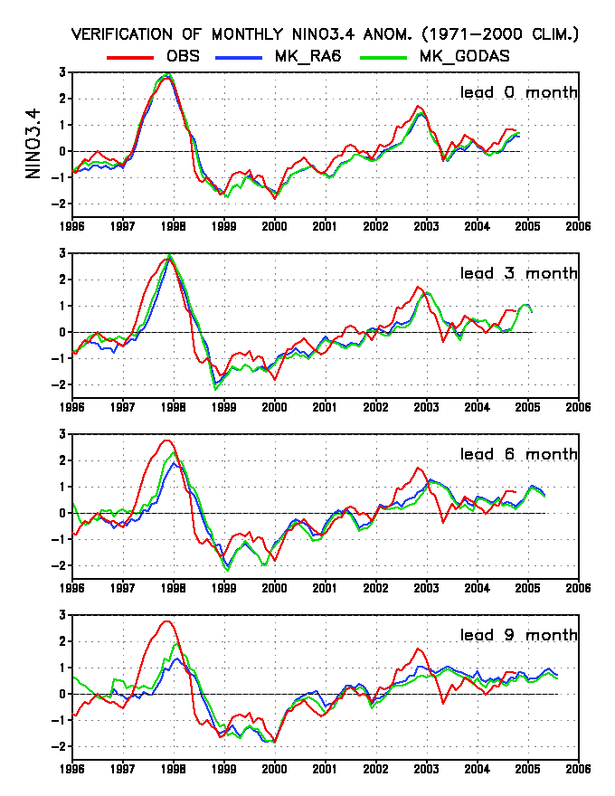

Slide 17
Surface Current Errors in GODAS

Slide 18
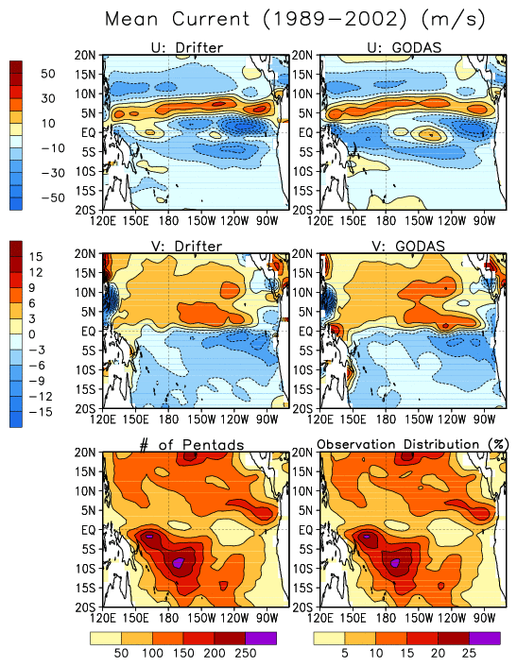
Peter Niiler’s Drifter Current
6 hour
daily
pentad
5ºx1º grid
pentad
GODAS

Slide 19
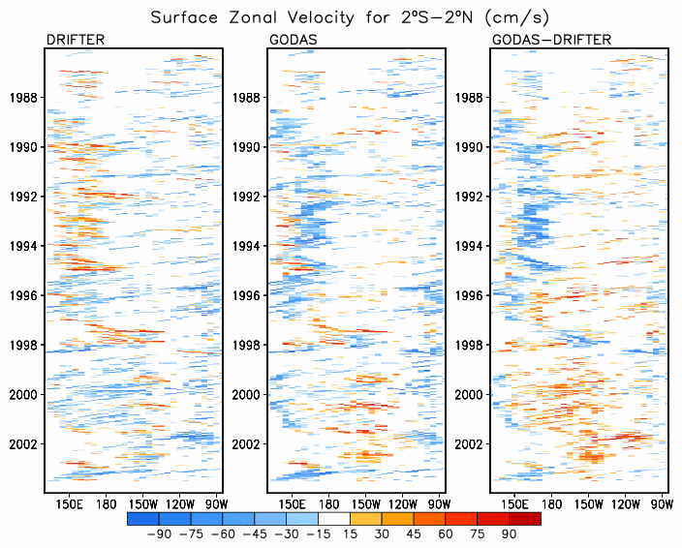

Slide 20
EXPERIMENTAL RUNS
  GODAS.v2
    pentad, 1992-2001
    salinity in mixed layer was made closer to SIM than
    to GODAS
  GODAS_TJ
    pentad, 1993-2003
    TOPEX/Jason1sea level assimilated
  GODAS_EE
    pentad, 1996-2003
    ERS2/Envisat sea level assimilated

Slide 21
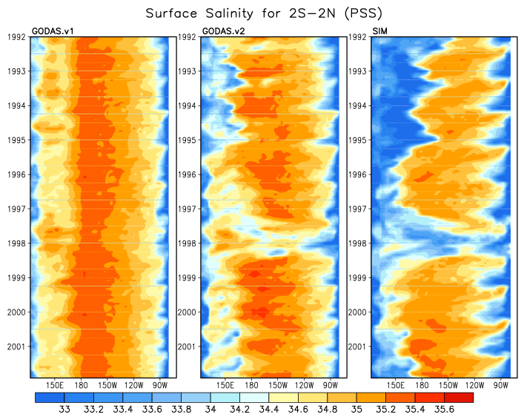

Slide 22
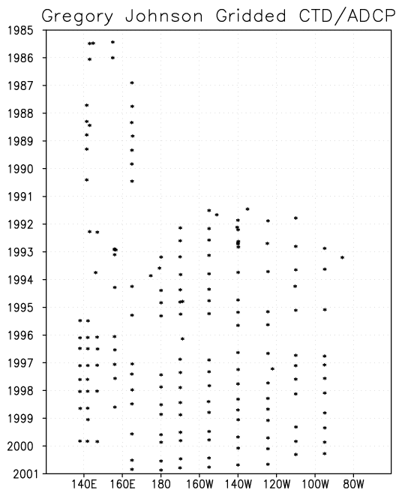
Johnson et al. 2000, JGR
172 sections
for 1985-2000
gridded in y
TAO cruises
twice per year

Slide 23
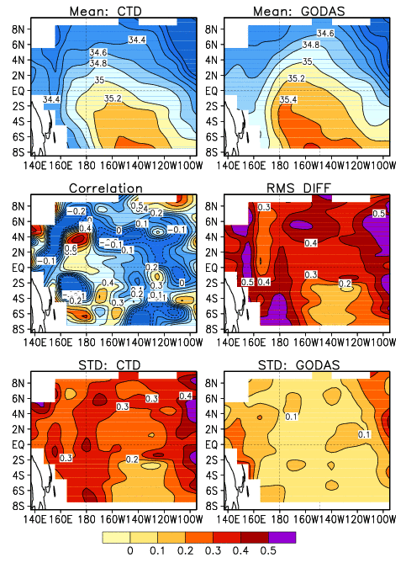
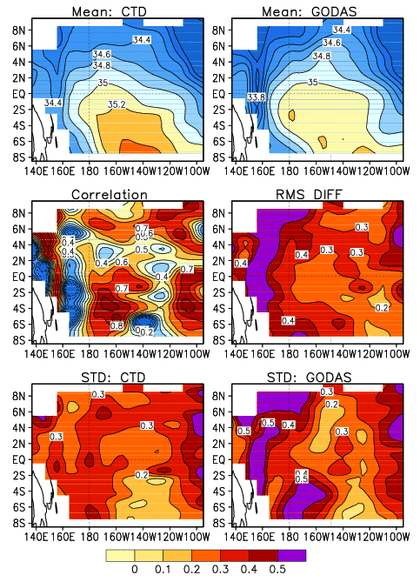
GODAS.v1
Salinity at Z=5m
GODAS.v2

Slide 24
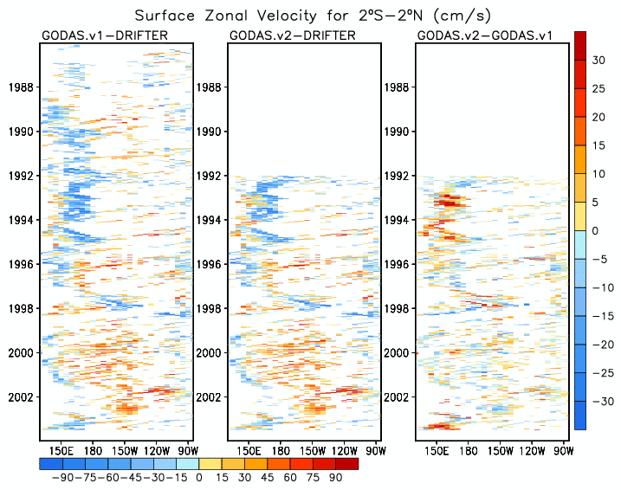

Slide 25
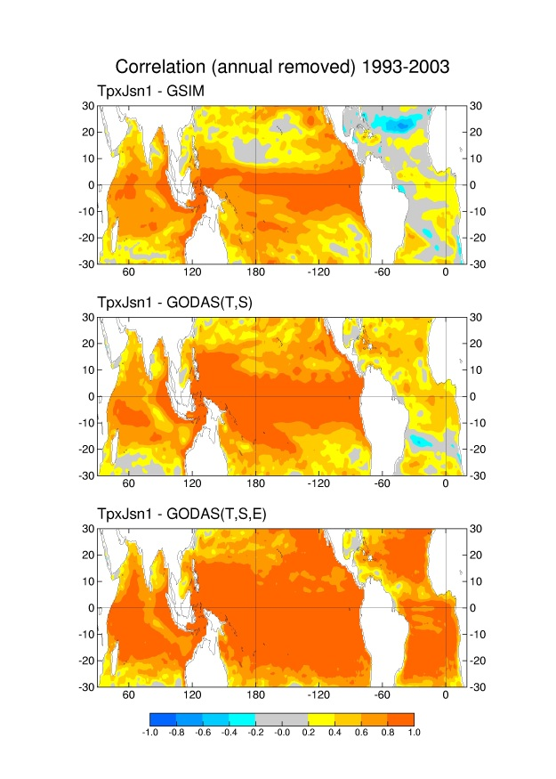

Slide 26
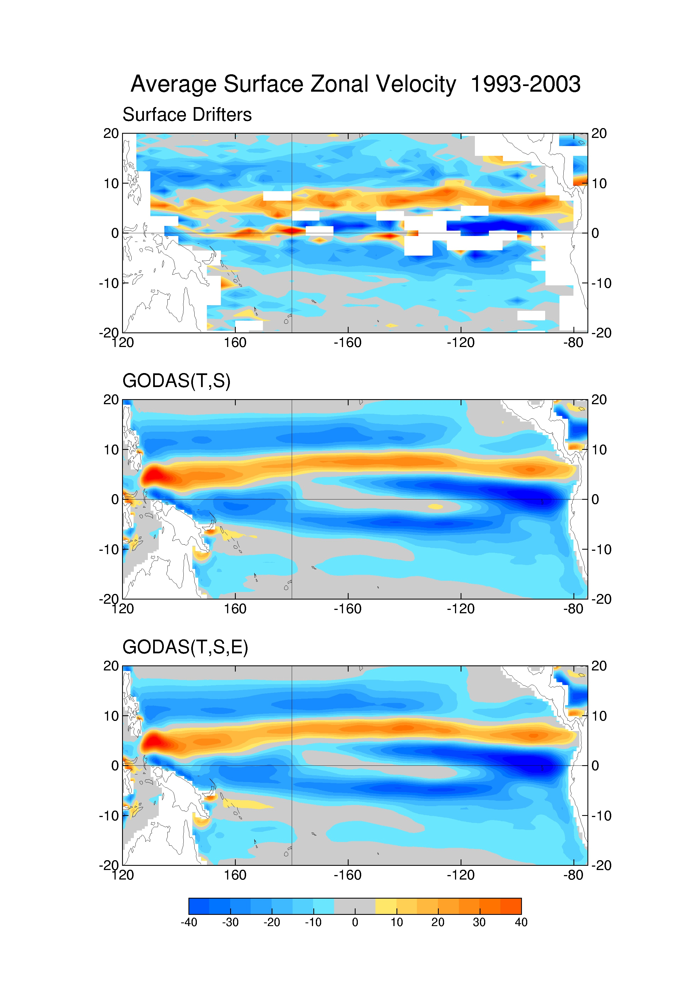

Slide 27
Summary
Assimilation of synthetic salinity seriously underestimated SSS variability, which contributes to large errors in surface currents.
Surface currents are slightly improved when more weights are given to model salinity than to synthetic salinity in the mixed layer.
Assimilation of altimetry appears to improve sea level analysis significantly in the Atlantic and Indian Ocean, but whether it improves other variables is unknown.
Assimilation of altimetry does not improve deficiencies in GODAS surface currents.

Slide 28
Future Works
Impacts of geostrophic adjustment on GODAS
Impacts of boundary forcings on GODAS
  Momentum fluxes: CDAS2, ERA40 and FSU winds
  E-P fluxes: CDAS2, Xie-Arkin and GPCP Prec.
(Glen White shows that CDAS2 correlates with FSU at 0.3 in the eastern Pacific)
Impacts of altimetry sea level on GODAS
Impacts of ARGO data on GODAS
Evaluation of Atlantic and Indian Oceans
Evaluation of intraseasonal variability

Slide 29
Ocean Observations for Seasonal Forecasting at NCEP
 | RA6 (~opr) | GODAS (opr) | GODAS (dev) | Verify
Temperature
XBTs | X | X | X
TAO | X | X | X
Argo | X | X | X
Salinity
Synthetic |  | X | X
Argo |  |  | X | X
Altimetry
TPX / Jason-1 | X |  | X | X
ERS-2 / Envisat |  |  | X | X
Tide Gauges |  |  |  | X
Moored CMs |  |  |  | X
Drifters |  |  |  | X
Ocean SST is relaxed to the NCEP SST OI analysis. Scatterometer winds enter the atmospheric wind-stress analysis

Slide 30
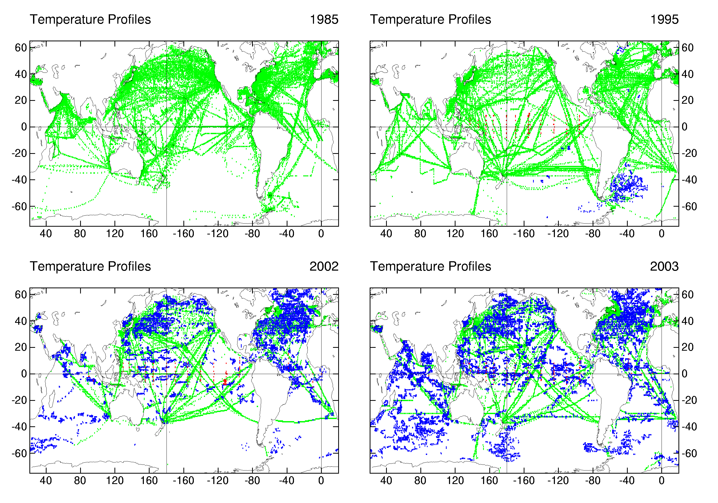

Slide 31
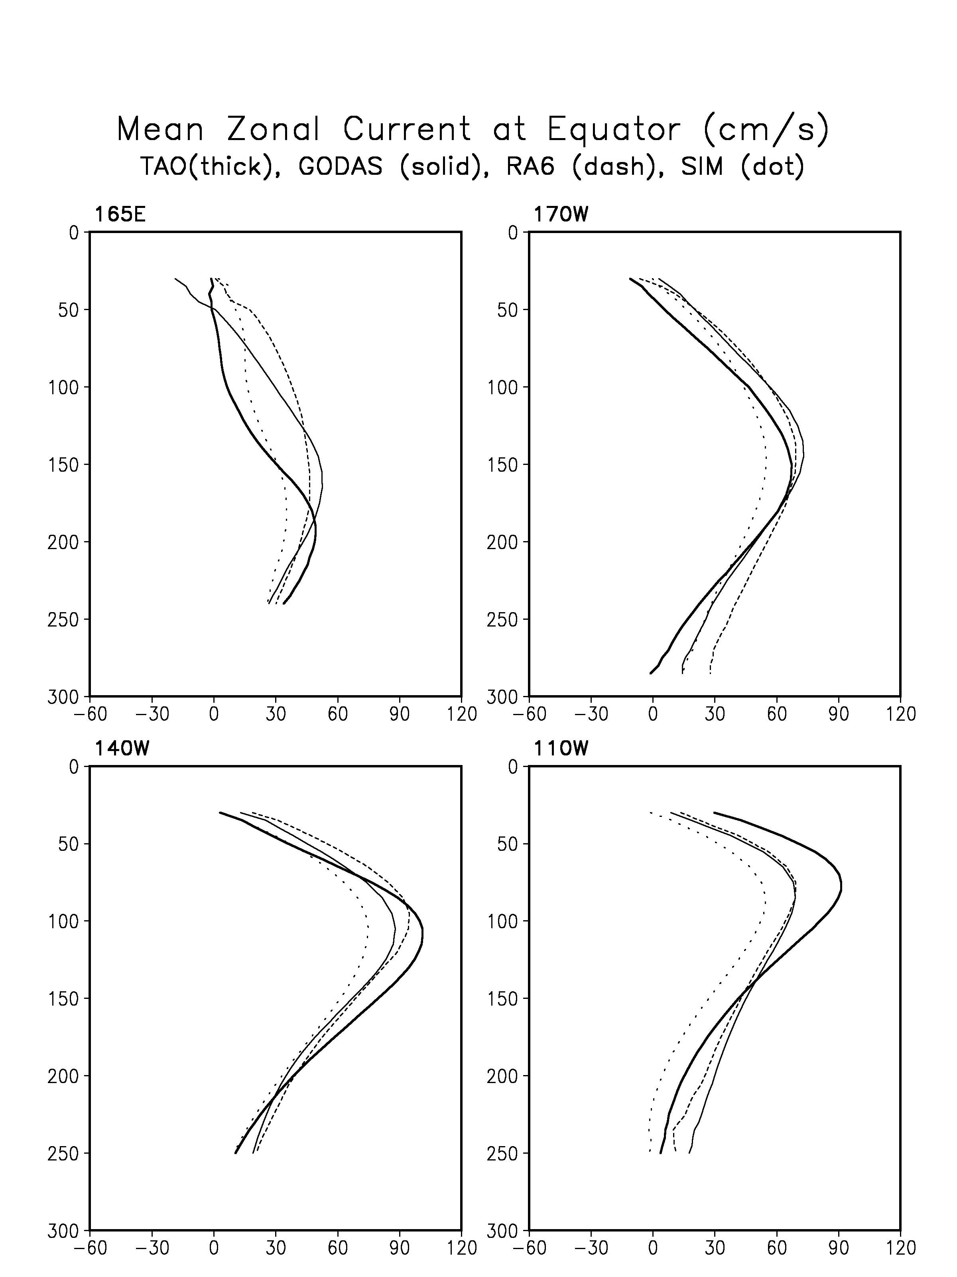
RA6
GODAS
SIM
TAO

Slide 32
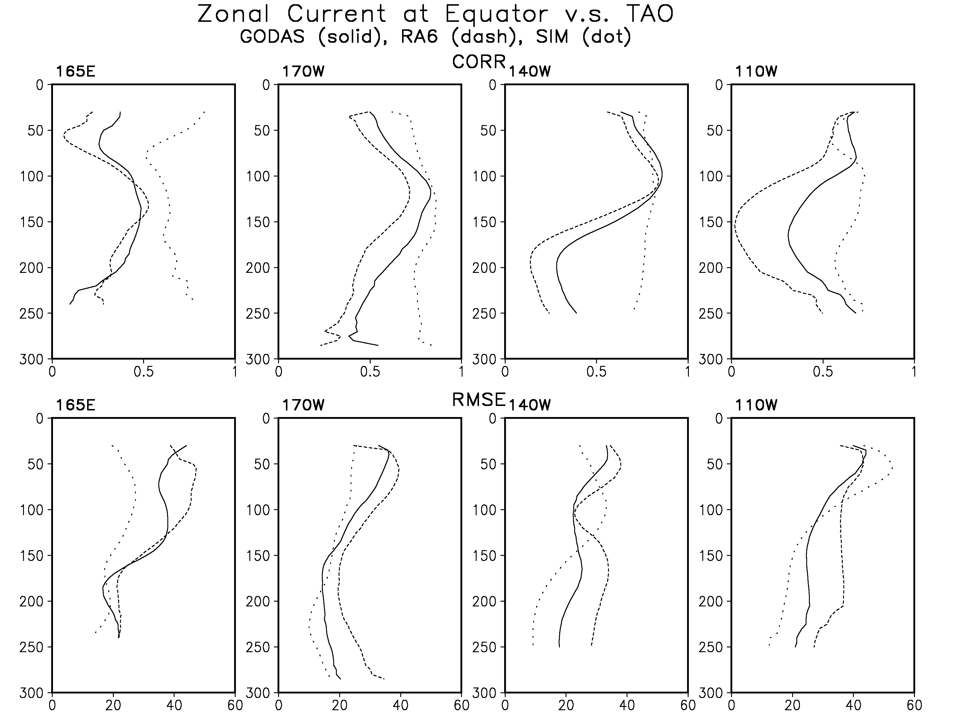
SIM
RA6
GODAS

Slide 33
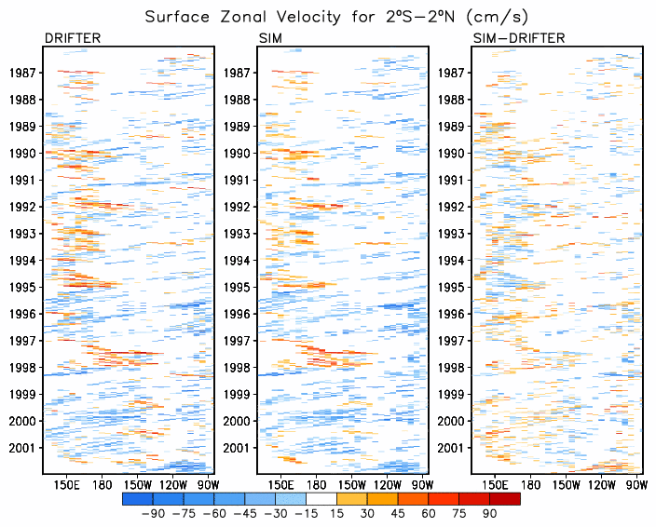

Slide 34
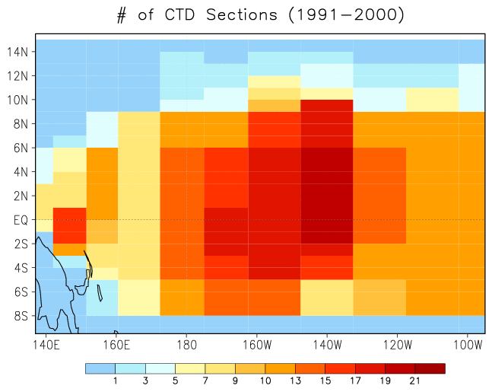
~15ºx1º grid

Slide 35
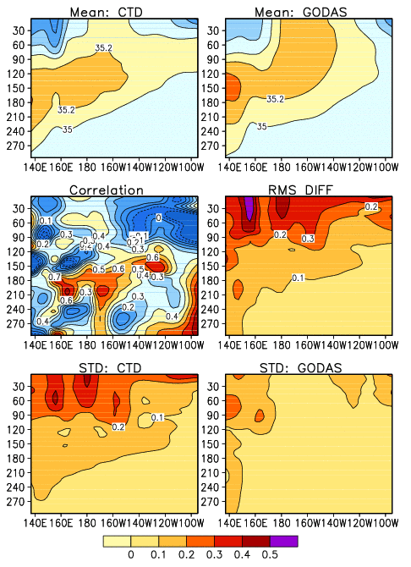
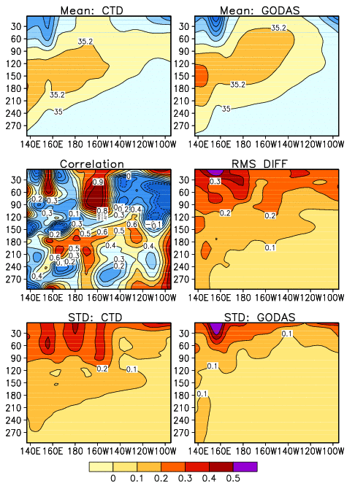
GODAS.v1
Salinity at Eq
GODAS.v2

