Slide 1
Decay and Snap-back in LHC Main Magnets
Presented by L. Bottura
Prepared for the Mini-Workshop on Decay and Snapback in Superconducting Magnets
Fermilab, November 8th, 2002
Notes:
Acknowledgements are due to:
the MTA measurement team
Z. Ang, O. Bruening, A. Burns, M. Haverkamp, Q. King, L. Larsson, P. Proudlock, M. Schneider, L. Walckiers, R. Wolf

Slide 2
Overview
Definition of decay & SB
Decay & SB statistics on LHC dipoles
Operation, history and memory effects
Physics understanding
Fun ideas
  degaussing
  injection on-the-fly
The Multipoles Factory and other ideas for the LHC

Slide 3
Definition of decay & SB
Decay & SB statistics on LHC dipoles
Operation, history and memory effects
Physics understanding
Fun ideas
  degaussing
  injection on-the-fly
The Multipoles Factory and other ideas for the LHC

Slide 4
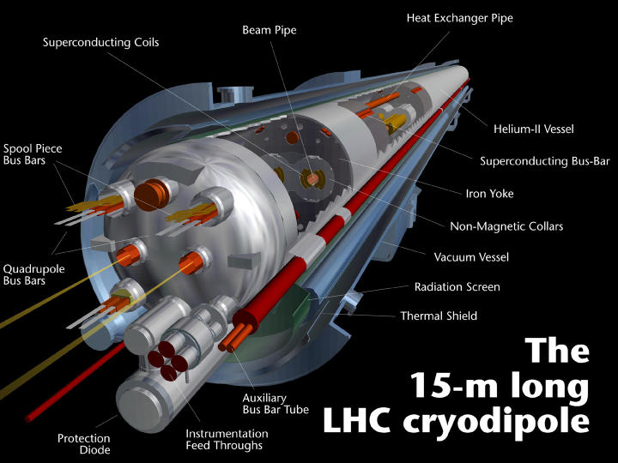
LHC dipole

Slide 5
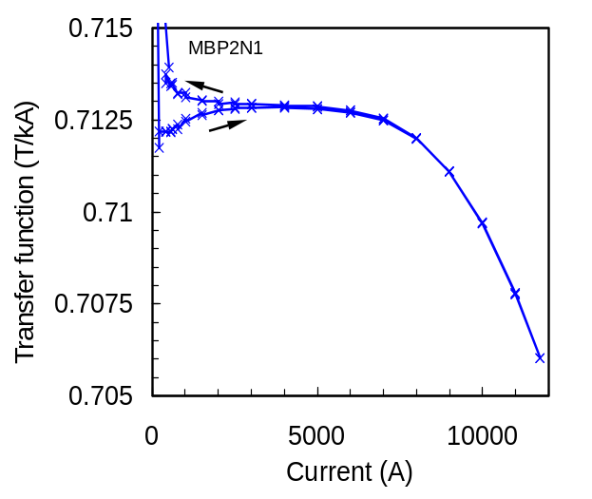
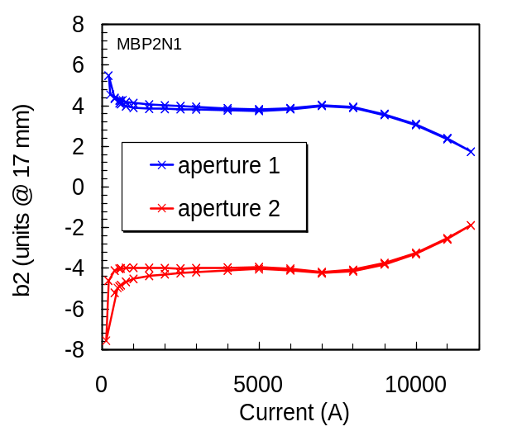
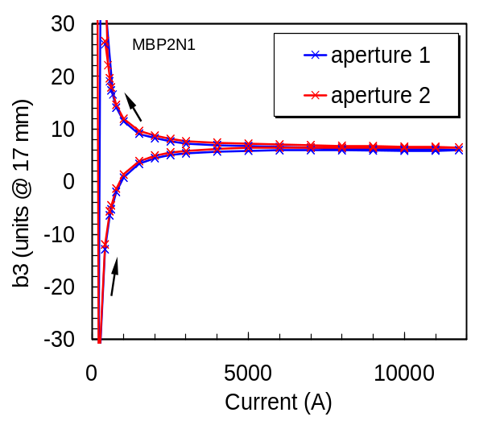
Static Field Quality
geometric (linear) contribution
T = 0.713 T/kA
persistent currents (and other effects ?)
δT = -0.6 mT (0.1 %)
overshoot forbidden !
partial compensation of persistent currents at injection
iron saturation
systematic b2 from two-in-one geometry

Slide 6
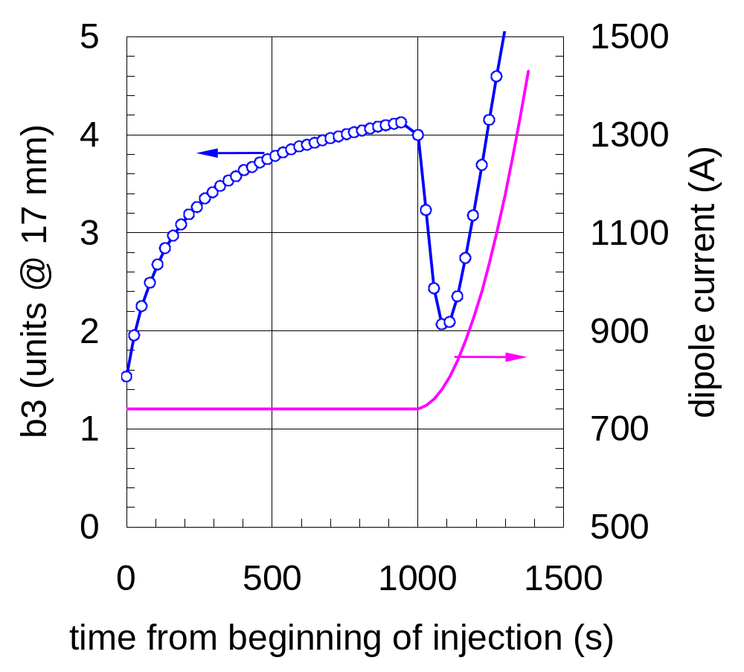
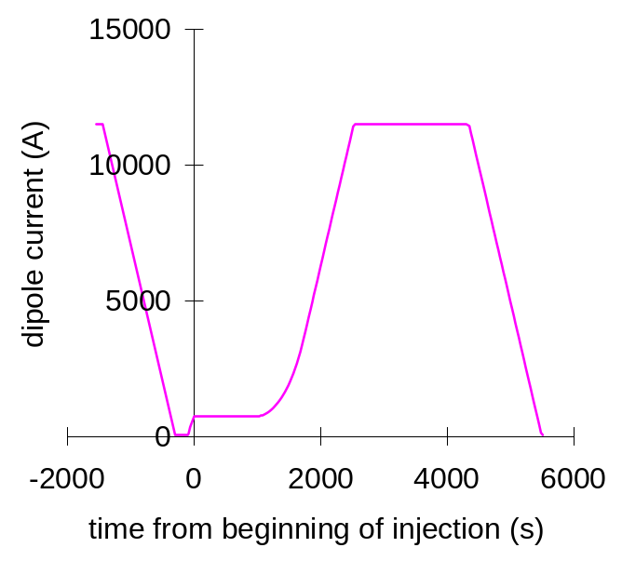
Decay and Snap-back – 1
accelerator operation cycle
decay
snap-back

Slide 7
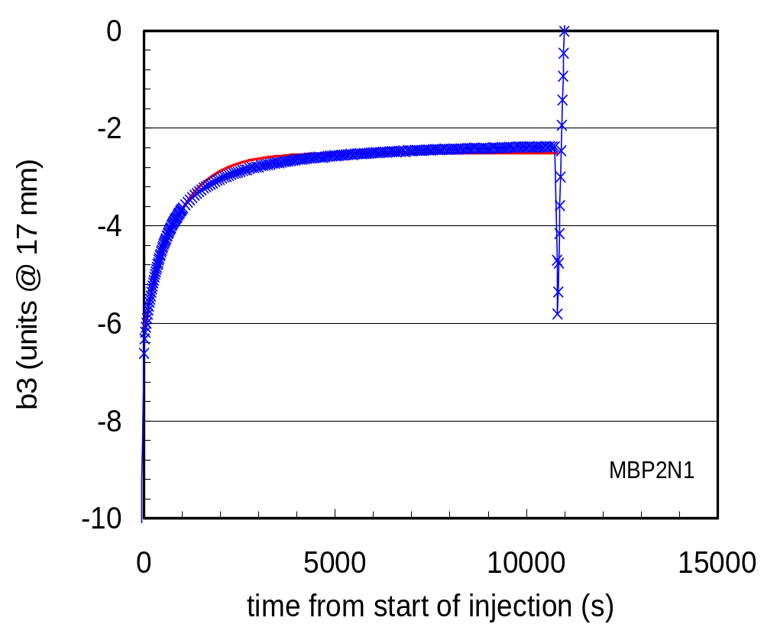
Decay and Snap-back – 2
exponential fit
τ_{i} = 900 s
decay during simulated 10,000 s injection
Notes:
The decay is a slow process, with characteristic times in the range of several thousands of s.

Slide 8
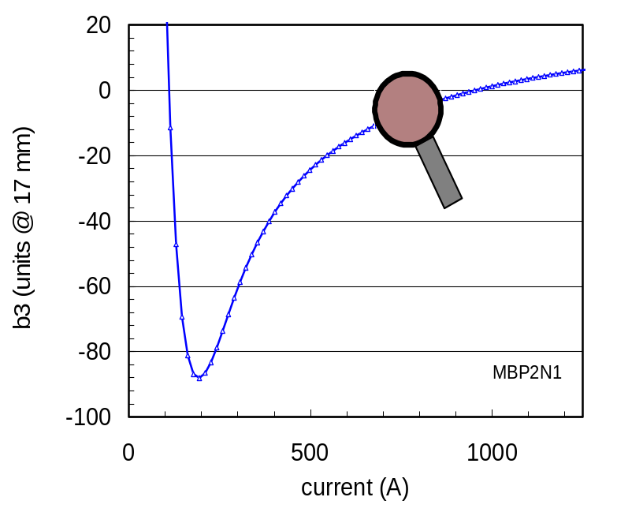
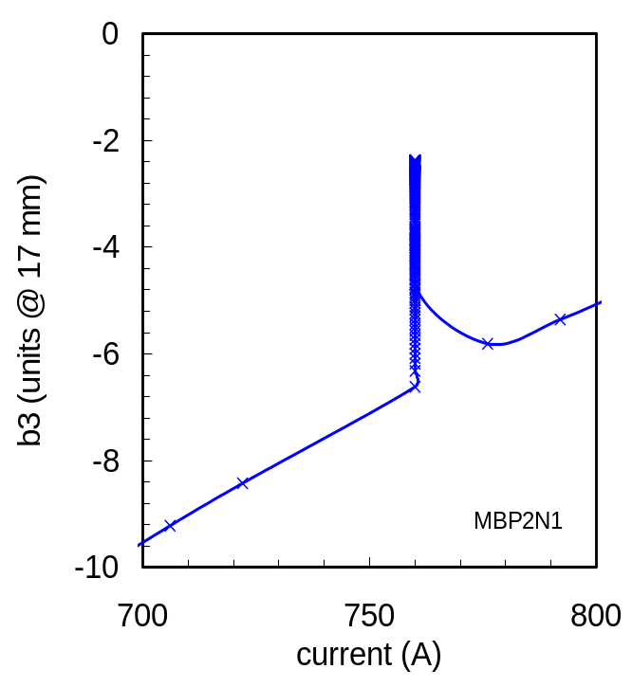
Decay and Snap-back – 3
Snap-back at the start of the acceleration ramp
decay during injection
Notes:
The second class of effects usually classified under dynamic effects is a decay of the field during periods of constant excitation (e.g. injection) followed by a rapid snap-back to the original value as soon as the field is ramped. This effect was first observed at the Tevatron, caused a wide concern and was carefully addressed at HERA. Both machines have developed successful strategies for dealing with decay and snap-back.

Slide 9
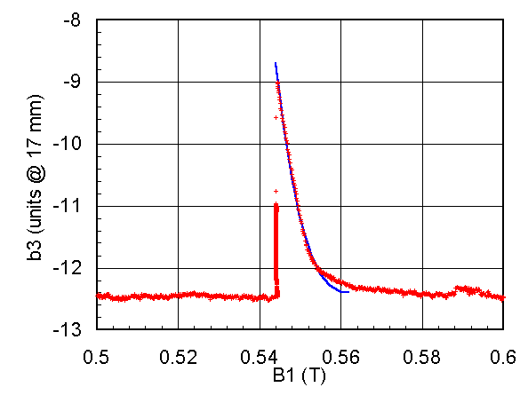
Decay and Snap-back – 4
snap-back fit:
Δb₃ [1-(I-I_{inj})/ΔI]³
Δb3= 3.7units
ΔI = 27A → ΔB = 19 mT
decay
snap-back
Notes:
On the other hand the snap-back is a very fast recovery of the original multipole values, taking place in a small field sweep (typically some 10 to 20 mT for the MB dipoles). The agreement with a cubic fit suggests that snap-back may be associated with penetration of de-magnetized filaments.

Slide 10
Measurement conditions
current regulation at injection
  typically 10 ppm, 0.1 A
timing of current cycle and measurements
  automatic control of current cycle, measurement devices and acquisition
  logging (… which cycle did we use in that measurement 3 months ago ?)
temperature stability
  typically better than 5 mK
always, always, always quench the magnet before a measurement

Slide 11
Measurement sample
10-m and 15-m long LHC prototypes
short dipole models (1-m long) of the LHC R&D program (two X-sections):
  11 single aperture models
  7 twin aperture model
15-m long pre-series dipoles
  13 magnets (26 apertures) integrally tested

Slide 12
Definition of decay & SB
Decay & SB statistics on LHC dipoles
Operation, history and memory effects
Physics understanding
Fun ideas
  degaussing
  injection on-the-fly
The Multipoles Factory and other ideas for the LHC

Slide 13
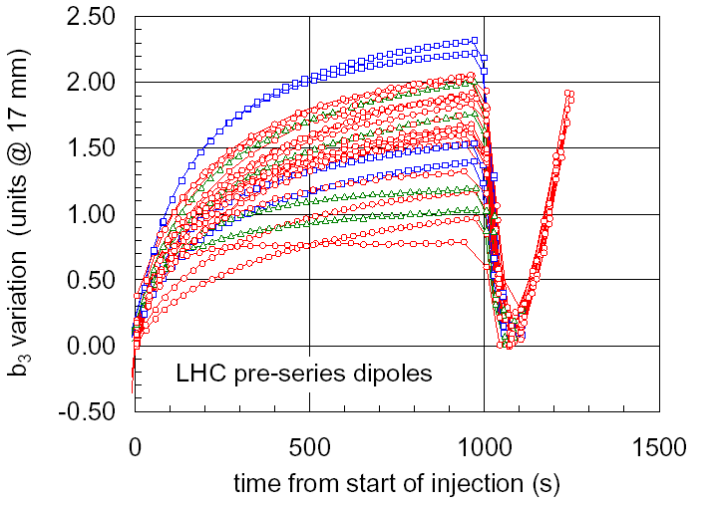
Measurement of b₃ decay
large spread both in:
dynamics, and
magnitude
decay is systematic in all magnets measured
Notes:
Expected decay and snap-back values have been estimated using an upper bound of 1/3 of the persistent current magnetization. Standard deviations for the MB dipoles has been estimated from measurements on a small series (approximately 10) of short model dipoles. As shown above the values measured on the latest 15 m long prototype dipoles are well within the expected values for series production.

Slide 14
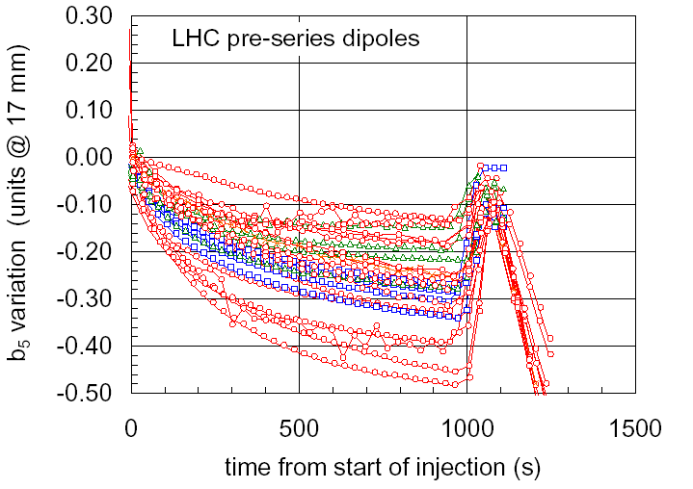
Measurement of b₅ decay
behavior similar to the one observed for b₃ (this holds for all allowed harmonics)
Notes:
Expected decay and snap-back values have been estimated using an upper bound of 1/3 of the persistent current magnetization. Standard deviations for the MB dipoles has been estimated from measurements on a small series (approximately 10) of short model dipoles. As shown above the values measured on the latest 15 m long prototype dipoles are well within the expected values for series production.

Slide 15
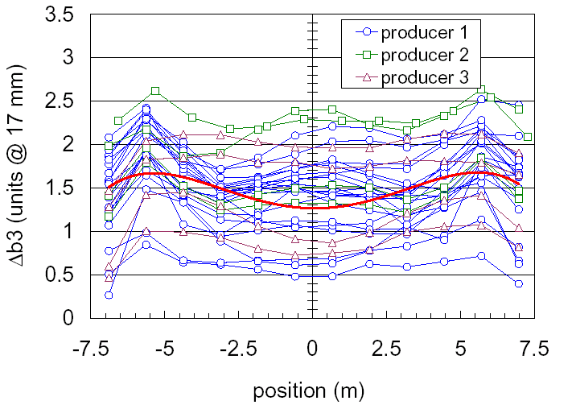
Dipole body and end behavior
visible end effects in the magnitude of the decay (see later…)
Notes:
Expected decay and snap-back values have been estimated using an upper bound of 1/3 of the persistent current magnetization. Standard deviations for the MB dipoles has been estimated from measurements on a small series (approximately 10) of short model dipoles. As shown above the values measured on the latest 15 m long prototype dipoles are well within the expected values for series production.

Slide 16
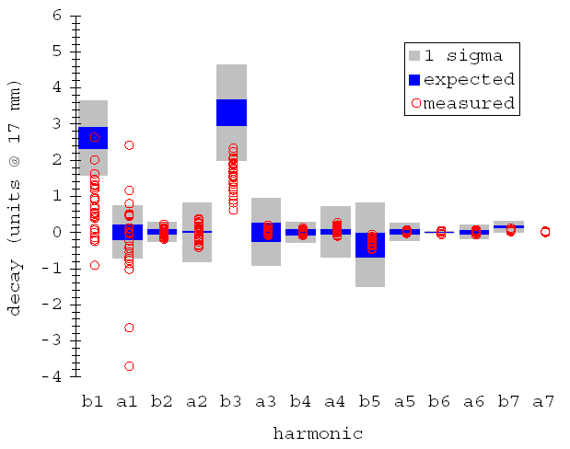
Decay and Snap-back statistics
expected values from Field Quality WG, MB-99-02,
based on decay = 1/3 persistent (see later why…)
first 13, 15-m long,
pre-series dipoles
Notes:
Expected decay and snap-back values have been estimated using an upper bound of 1/3 of the persistent current magnetization. Standard deviations for the MB dipoles has been estimated from measurements on a small series (approximately 10) of short model dipoles. As shown above the values measured on the latest 15 m long prototype dipoles are well within the expected values for series production.

Slide 17
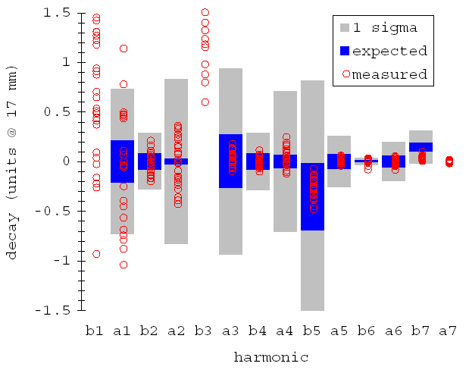
Decay and Snap-back statistics
a systematic decay is observed on allowed harmonics only
first 13, 15-m long,
pre-series dipoles
Notes:
Expected decay and snap-back values have been estimated using an upper bound of 1/3 of the persistent current magnetization. Standard deviations for the MB dipoles has been estimated from measurements on a small series (approximately 10) of short model dipoles. As shown above the values measured on the latest 15 m long prototype dipoles are well within the expected values for series production.

Slide 18
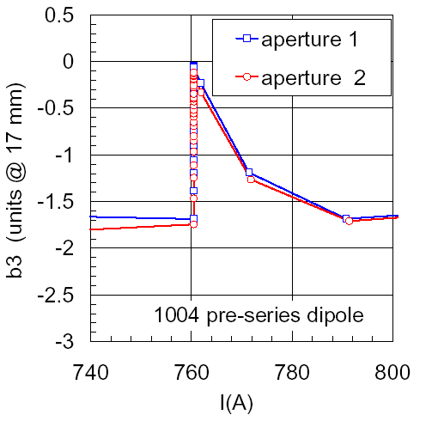
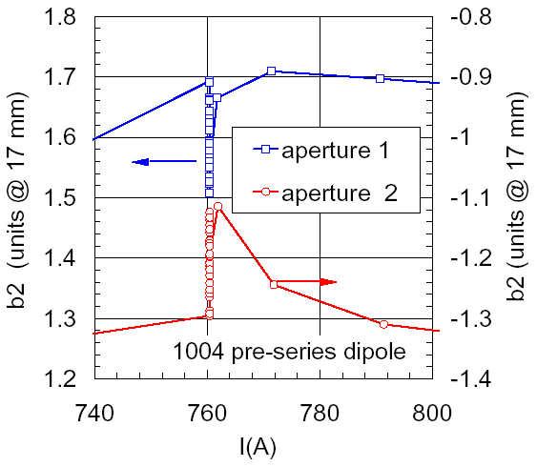
Is there a b₂ decay in the LHC ?
small decay observed on b2, changing in sign from aperture 1 to aperture 2
no systematic effect on the beam
Notes:
Expected decay and snap-back values have been estimated using an upper bound of 1/3 of the persistent current magnetization. Standard deviations for the MB dipoles has been estimated from measurements on a small series (approximately 10) of short model dipoles. As shown above the values measured on the latest 15 m long prototype dipoles are well within the expected values for series production.

Slide 19
Effect of Snap-back in LHC
An uncorrected snap-back (of the expected magnitude) will cause in LHC:
  Δb₁(MB)=2.6 → ΔQ = 0.026 vs. 0.003
  Δb₂(MQ)=1.7 → ΔQ = 5.4 10^{–3} Δb₂ =0.009 vs. 0.003
  Δb₃(MB)=3.3 → Δξ = 52 Δb₃ = 172 vs. 1
  (source: O. Bruening, CERN)

Slide 20
Definition of decay & SB
Decay & SB statistics on LHC dipoles
Operation, history and memory effects
Physics understanding
Fun ideas
  degaussing
  injection on-the-fly
The Multipoles Factory and other ideas for the LHC

Slide 21
Few important parameters
Pre-cycle maximum
current & time
Multiple pre-cycle
I
I
...
Snapback
Snapback
Q
Q
t
t
(Q, 1), (Q, 3), (Q, 6)
Pre-injection
current & time
Multiple operation cycles
I
I
...
Snapback
Snapback
Q
Q
t
t
(Q, 1,2,3,4)

Slide 22
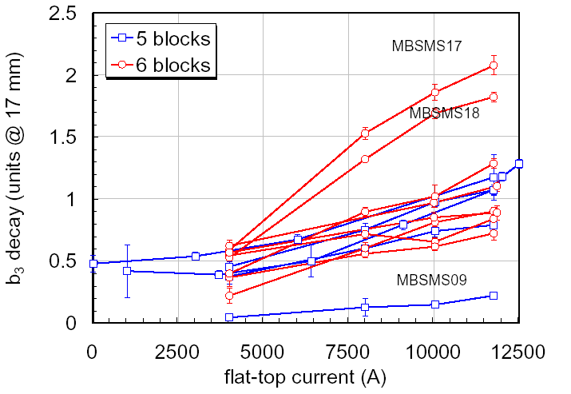
Effect of flat-top current
Pre-cycle maximum
current & time
I
Snapback
Q
t
short model dipoles
nearly linear growth of decay & SB as a function of the flat-top current

Slide 23
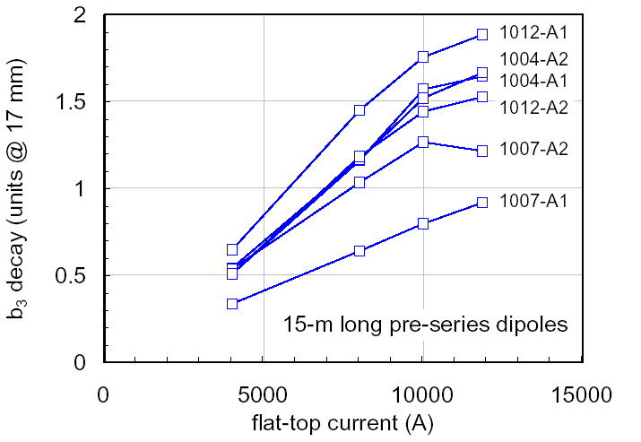
Effect of flat-top current
Pre-cycle maximum
current & time
I
Snapback
Q
t
scaling for long magnets similar to short models

Slide 24
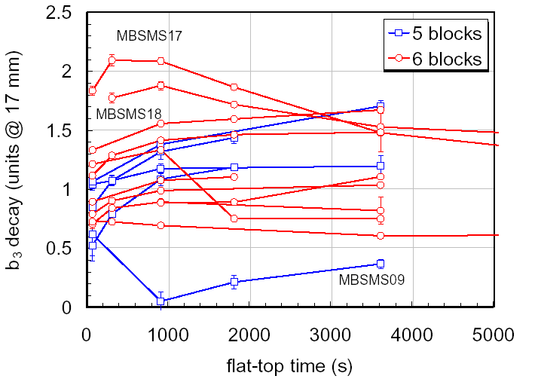
Effect of flat-top time
Pre-cycle maximum
current & time
I
Snapback
Q
t
short model dipoles
clear saturation of decay & SB for few magnets, peaks ?

Slide 25
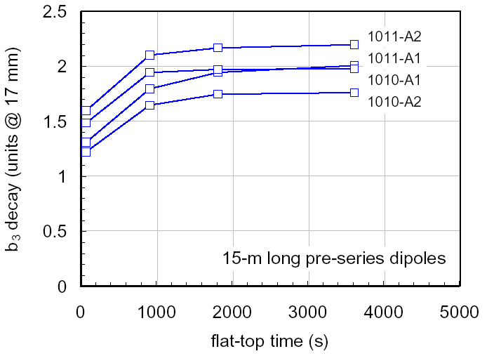
Effect of flat-top time
Pre-cycle maximum
current & time
I
Snapback
Q
t
saturation of decay & SB after < 1 hour flat-top

Slide 26
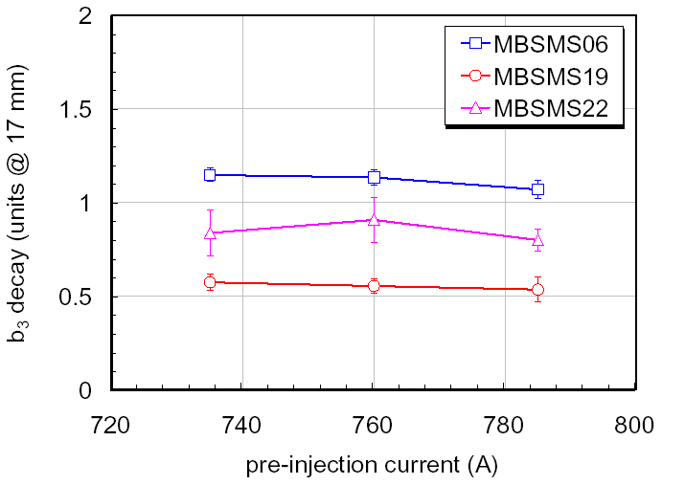
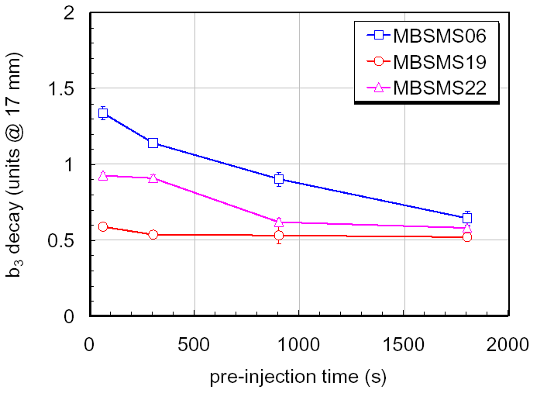
Effect of pre-injection
Pre-injection
current & time
I
Snapback
Q
t
it does not matter where one stops before injection…
… decay & SB decrease at increasing porch time !

Slide 27
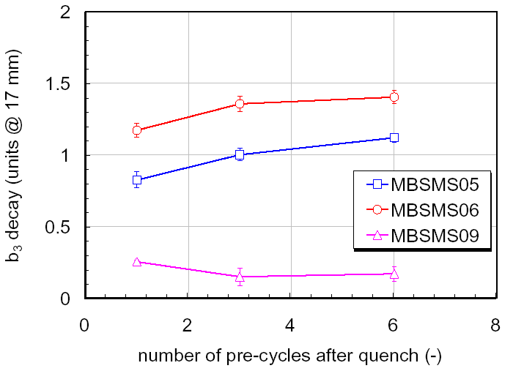
Multiple pre-cycles
Multiple pre-cycle
I
...
Snapback
Q
(Q, 1), (Q, 3), (Q, 6)
t
saturation observed after few cycles (> 3)

Slide 28
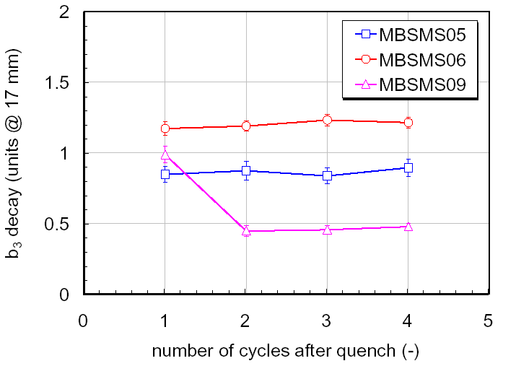
Run sequences
Multiple operation cycles
I
...
Snapback
Q
(Q, 1,2,3,4)
t
good repeatability already as of second cycle

Slide 29
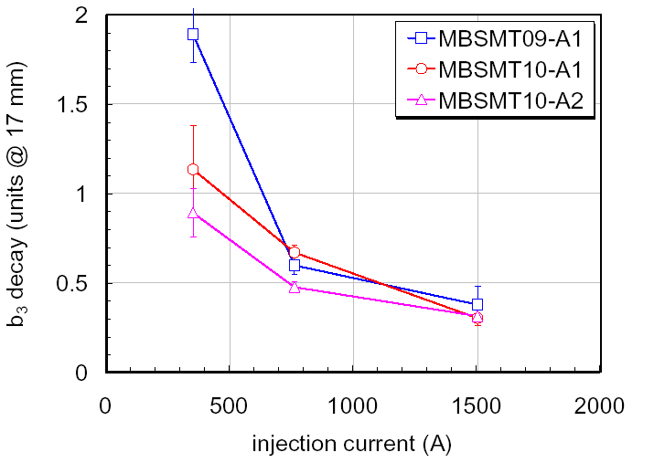
Injection current
Injection current
I
Snapback
1/I_{injection}
Q
t
approximate 1/B dependence as if decay were constant in field

Slide 30
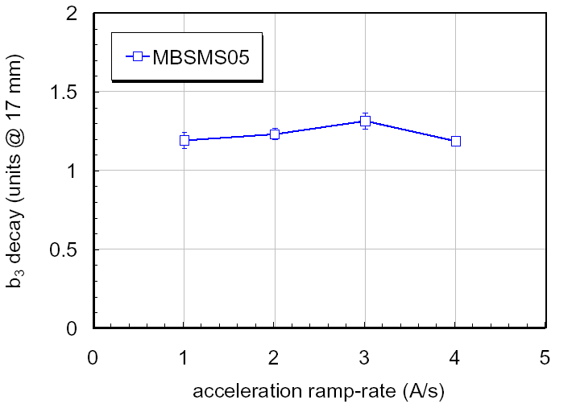
Acceleration ramp
Acceleration ramp
I
Snapback
Q
t
no dependence of SB on the acceleration ramp-rate

Slide 31
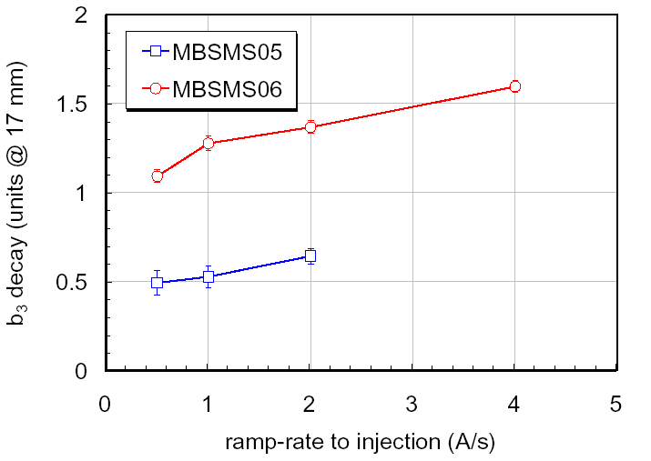
Injection ramp
Injection ramp
I
Snapback
Q
t
weak dependence on the ramp-rate to injection

Slide 32
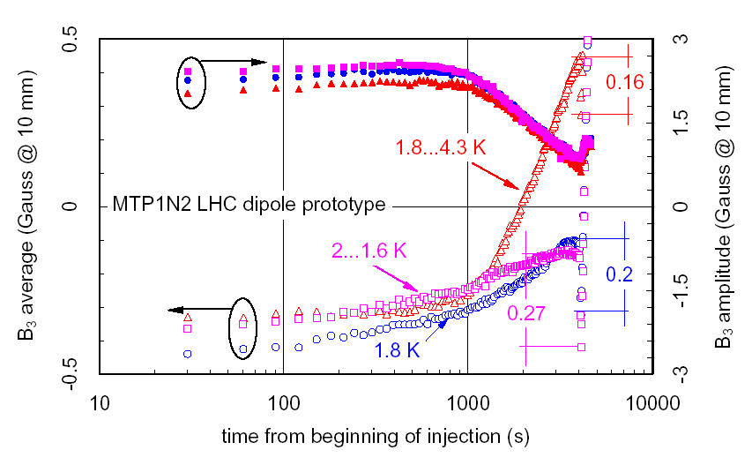
Temperature changes

Slide 33
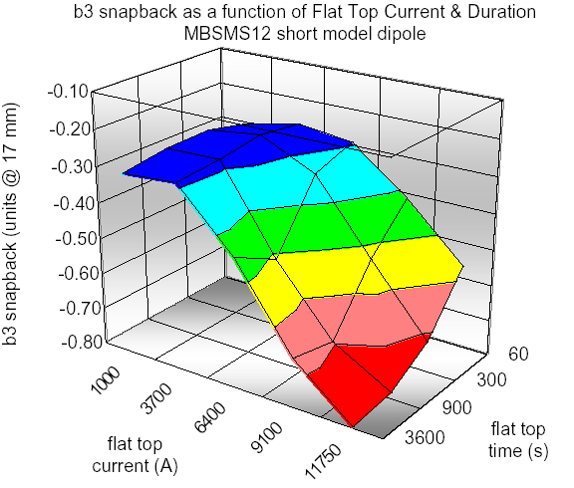
Measurements of Decay & SB
Space of parameters:
  flat-top current
  flat-top time
  pre-injection duration
  injection duration
  magnet temperature
  ramp-rates
  …
too large for series
measurements !

Slide 34
Definition of decay & SB
Decay & SB statistics on LHC dipoles
Operation, history and memory effects
Physics understanding
Fun ideas
  degaussing
  injection on-the-fly
The Multipoles Factory and other ideas for the LHC

Slide 35
One…
Current distribution is not uniform in the cables…
…and changes as a function of time generating a time-variable, alternating field along the strands…
(after the ideas of R. Stiening, SSC, and R. Wolf, CERN)

Slide 36
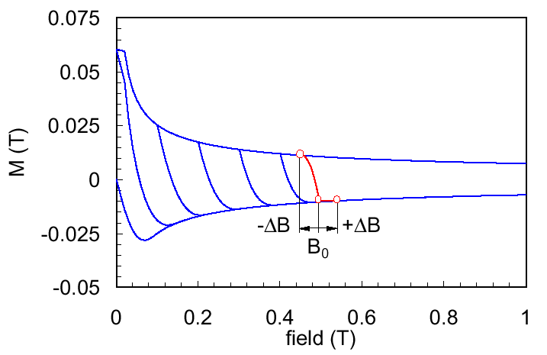
… two …
…the field change affects the magnetization of the super-conducting filaments...
-ΔB
+ΔB

Slide 37
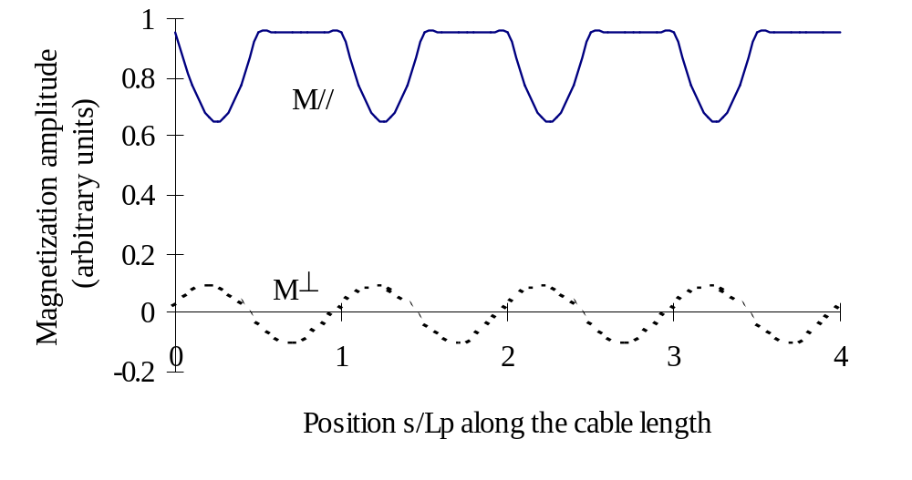
… three …
… and the magnetization change averages to a net decrease (rectifying effect) – the decay !
maximum decay is 1/π of M₀

Slide 38
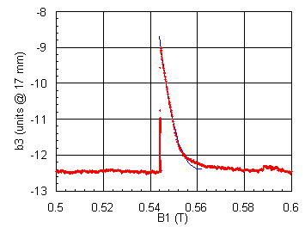
… et voilà !
The magnetization state is re-established as soon as the background field is increased by the same order of the internal field change in the cable (5 to 30 mT) – the snap-back !
-ΔB
+ΔB

Slide 39
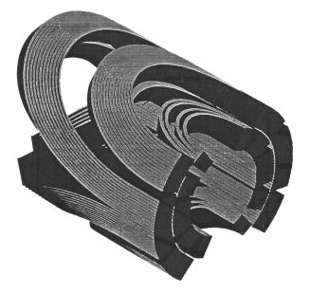
Checks
current distribution depends on powering history;
larger decay & SB observed close to the ends of long magnets, where current imbalance is larger;
current distribution saturates for times comparable (or longer) than the characteristic time;
the current distribution change at injection does not depend on temperature changes;
the SB does not depend on the acceleration ramp, quasi-DC process;

Slide 40
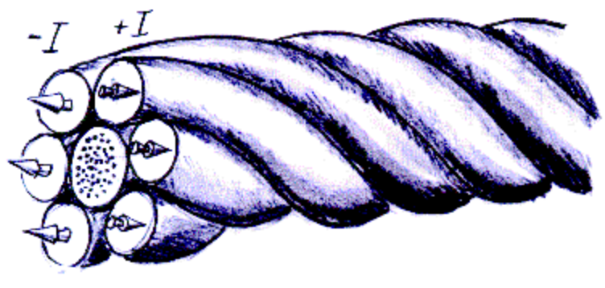
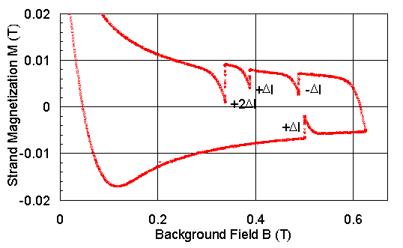
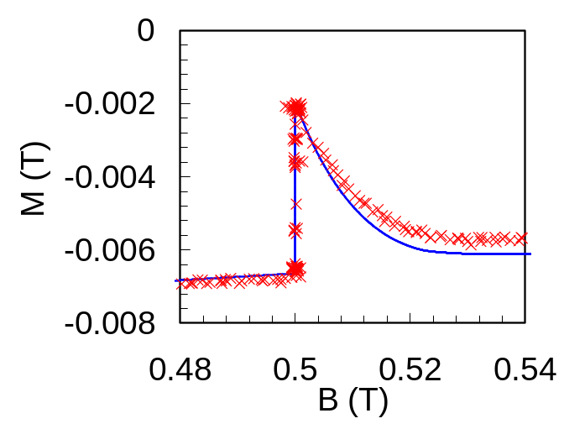
A demonstration experiment
NbTi strand
Cu strands
B
measured
computed
Courtesy of M. Haverkamp, CERN, experiment performed at U. Twente

Slide 41
Summary on physics status
basic understanding of physics principle available:
  interaction between cable transport current re-distribution and filaments magnetization
    L. Bottura, et al., Field Errors Decay and "Snap-Back" in LHC Model Dipoles, IEEE Trans. Appl Sup., 7(2), 602, 1997
    R. Wolf, The Decay of the Field Integral in SC Accelerator Magnets Wound with Rutherford Cables, Proc. of 15th Mag. Techn. Conf., Beijing, Oct. 20-24, 1997
  flux-creep not important (at most 10 % … 30 % of effect)
but cannot be controlled at production
  Rc, Ra, joints, n-value not in the control set

Slide 42
Modelling approaches
Empirical scalings:
  analytical model based on a charging and discharging R-L analogy
  neural network training based on measured magnets
  (M. Schneider, CERN)
Direct simulation
  (M. Haverkamp, CERN and Twente University)

Slide 43
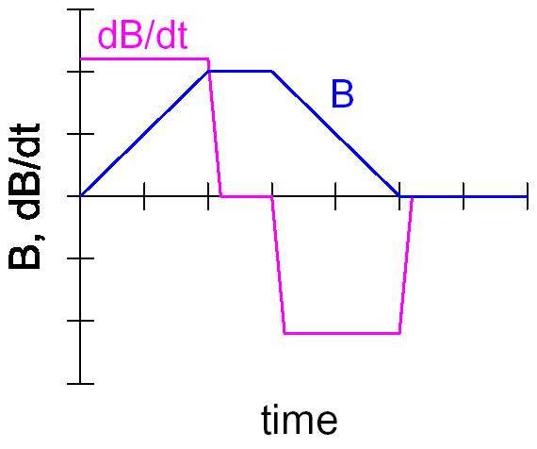
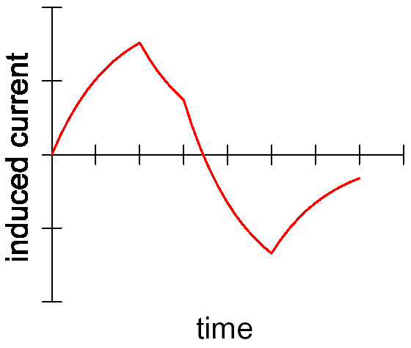
R-L circuit analogy
charging
discharging
R-L circuit simulates the response of the induced currents in the cable
The scaling assumes a linear relation:
I(x,y,z,t) → B → M → b₃
R
L
R
L
I
I
dB/dt
idea borrowed from A. Gosh and W. Sampson, BNL

Slide 44
Biological and digital neurons
dendrites
biological
input channels to the neuron
soma
process input to activity or rest
axon
transmit state of neuron activity
synapse
transmit activation to other neurons
digital
transfer
function
neuron model
summing
output
ω₁
ω₁
Σ
Τ
ω
Σ
+
Τ
ω
inputs
+
+
=
ω₂
ω₂
courtesy of M. Schneider, CERN

Slide 45
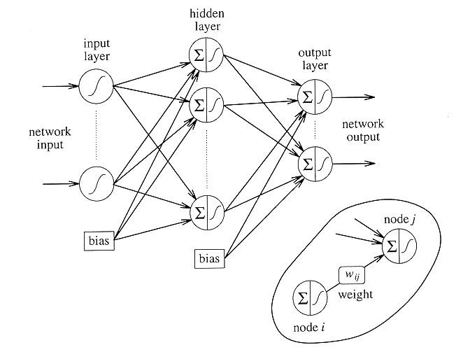
Artificial neural network (ANN)
three layer perceptron
training achieved by matching expected response (e.g. b₃ decay) to input (e.g. powering history)
courtesy of M. Schneider, CERN

Slide 46
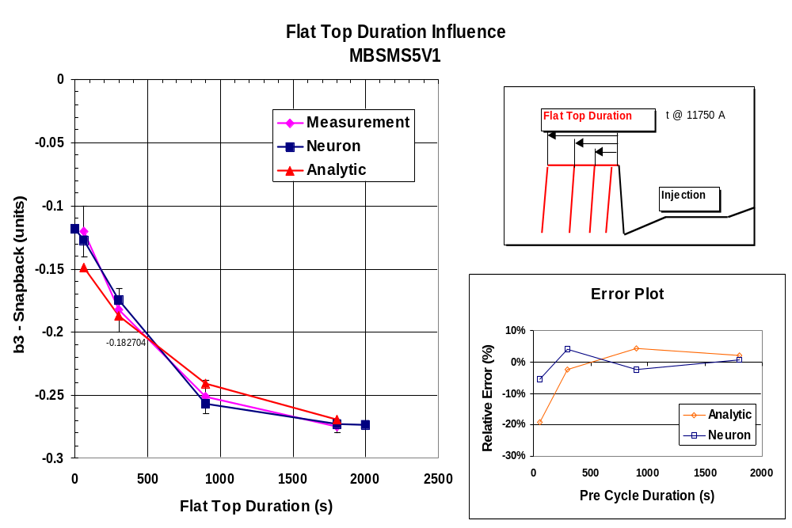
Modelling of Decay and SB
Analytical model accurate to 30 %
Neural network accurate to 5 %

Slide 47
Modelling results
R-L analogy:
  based on parameters with (some) physical analogy ✓
  lacks adaptivity ✗
Artificial neural network:
  lacks physical insight ✗
  adaptive ✓
Direct simulation:
  tantalizing task ✗

Slide 48
Definition of decay & SB
Decay & SB statistics on LHC dipoles
Operation, history and memory effects
Physics understanding
Fun ideas
  degaussing
  injection on-the-fly
The Multipoles Factory and other ideas for the LHC

Slide 49
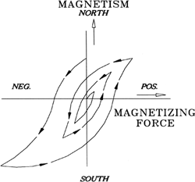
What is degaussing ?
Degaussing removes permanent magnetization by introducing an alternating magnetic field that is stronger than the offending permanent magnetization…
… if the amplitude of the alternating magnetic field is gradually reduced to zero, the material will be demagnetized…
… degaussing restores focus, image sharpness (tune) and color purity (chromaticity)…
…on video screens ☹

Slide 50
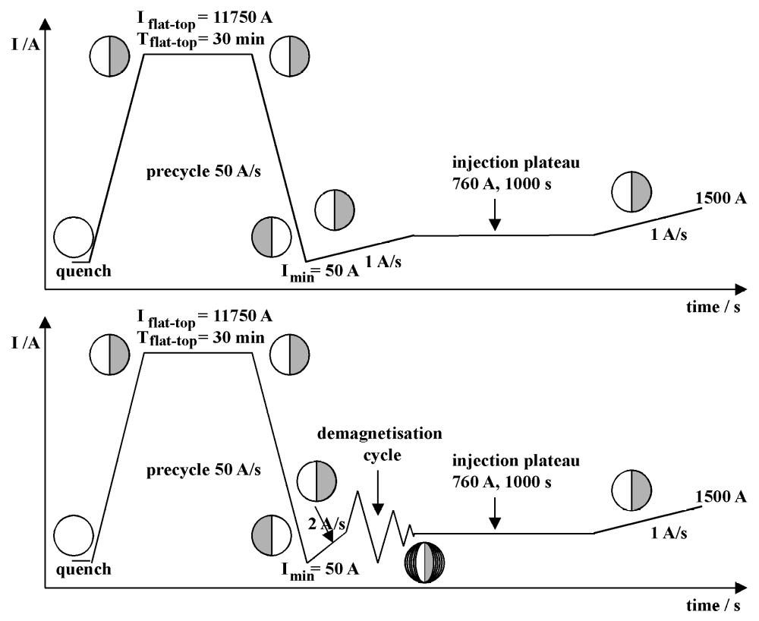
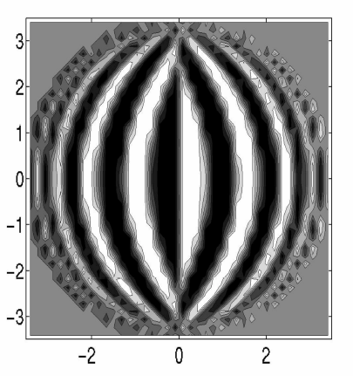
How is it achieved ?
degaussing cycle
a suitable AC current modulation is added before injection

Slide 51
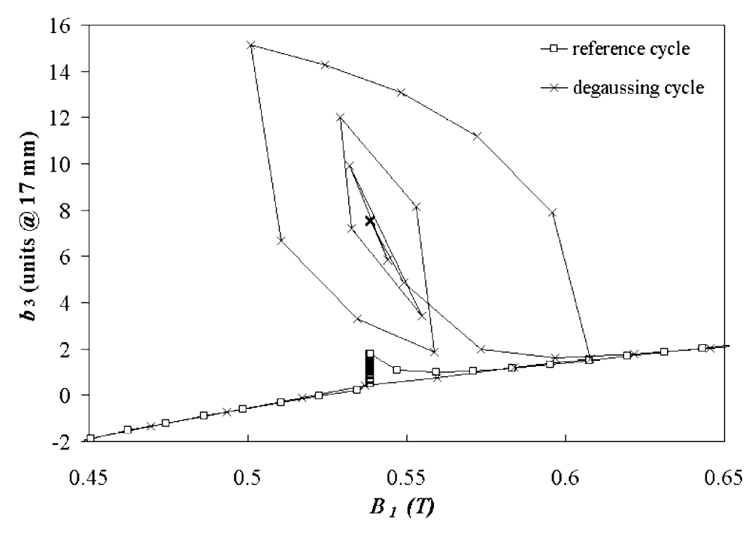
Degaussed state (1/3)…
b₃^{geom}
all multipoles tend to the geometric value after de-gaussing

Slide 52
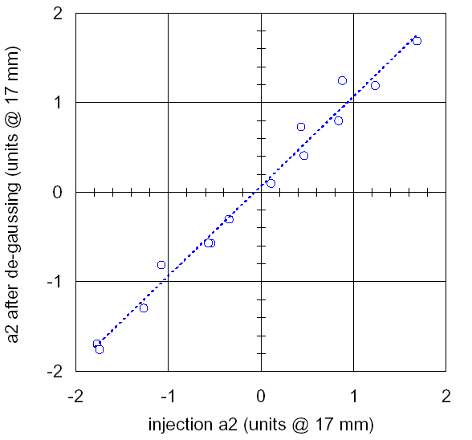
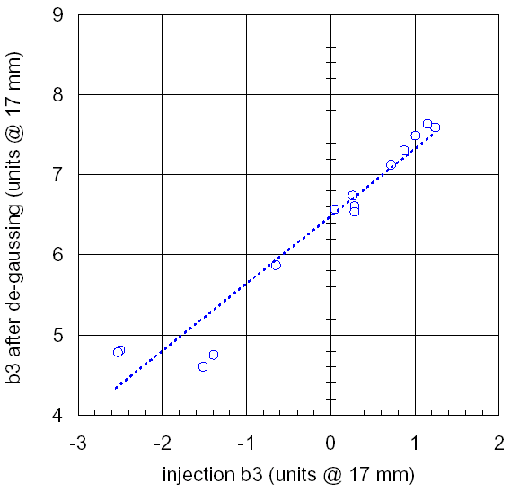
Degaussed state (2/3)…
zero offset
large offset
scatter in persistent currents
only allowed multipoles are largely affected by de-gaussing

Slide 53
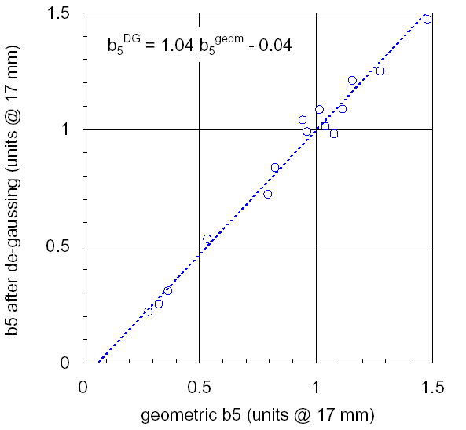
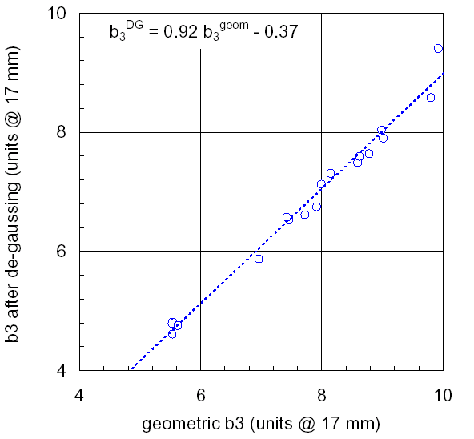
Degaussed state (3/3)…
allowed multipoles are brought close to geometric value

Slide 54
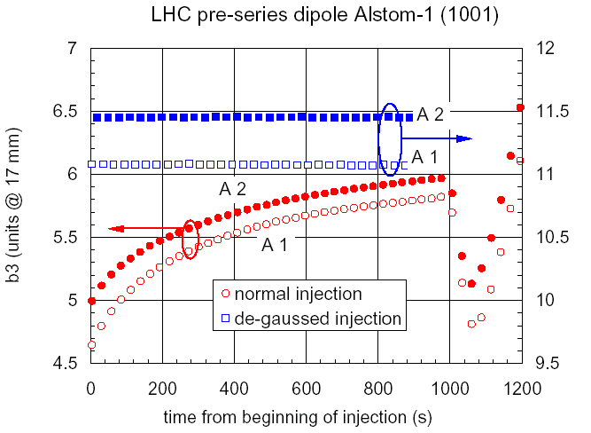
…injection (1/2)…
allowed multipoles have negligible decay after de-gaussing

Slide 55

…injection (2/2)…
non allowed multipoles also show no decay after de-gaussing

Slide 56
…and snap-back ☹
multipole change equals the full persistent current effect (giant SB)

Slide 57


A (yet) more efficient way !
degaussing blip
standard cycle

Slide 58


Easy and cheap…
http://www.periphman.com/degausser.html

Slide 59

Injection on-the-fly
Continuous injection ramp, 20 mT in 20 min
standard decay and SB
continuous ramp

Slide 60

Injection on-the-fly
standard decay and SB
continuous ramp with negligible decay and SB…
… but is difficult for operation (injection energy tracking)

Slide 61
Definition of decay & SB
Decay & SB statistics on LHC dipoles
Operation, history and memory effects
Physics understanding
Fun ideas
  degaussing
  injection on-the-fly
The Multipoles Factory and other ideas for the LHC

Slide 62
Correction magnets in the LHC
LHC half-cell 53.5 m
BPM
MQ
MBA
MCS
MBB
MCS
MBA
MCS
MSCB
MCDO
MCDO
MO, MQT, MQS

Slide 63
Control strategy for decay & SB
Optimized ramp to minimize effects
Cycling policy to guarantee reproducibility
Feed-forward from the LHC magnetic reference
Feed-forward from previous operating cycles
Feed-back from on-line (BI) measurements

Slide 64


Optimized ramp
A. Faus-Golfe, LHC Project Note 9, 1995.
L. Bottura, P. Burla, R. Wolf, LHC Project Report 172, 1998.
coast
coast
I ≈ t
injection
beam dump
energy ramp
I ≈ e^{t}
pre-injection
I ≈ t²
preparation and access
injection phase

Slide 65
Additional cycling policy
A pre-cycle before injection (≈1 hour) to condition magnets is foreseen at present
Pre-injection stop to decrease magnitude of decay/snap-back (if mandatory)
grace time limits for pre-injection stops and injection (re-cycle magnets if violated)
TBD based on results of series measurements !

Slide 66

The LHC magnetic reference
Multipoles
Factory
Machine
Operating
Conditions:
I, dI/dt, T
B1, B2,
angle,
multipoles
Machine
Operating
History:
I(-t), dI/dt(-t), T(-t)
Courtesy of Q. King

Slide 67

Inside the Multipoles Factory
linear physical model of reproducible effects
non linear model of decay and snap back
dataBase tables from series measurements on 100 % of magnets
dataBase tables from series measurements on 10 % of magnets
machine operating conditions:
Ι, dΙ/dt, T
machine powering history:
Ι(-t), dΙ/dt(-t), T(-t)
non linear adjustment for actual powering conditions
multipoles from reference magnets
multipoles from BI:
tune (b2),
chromaticity (b3)
B1, B2, angle, multipoles

Slide 68
Database generation
Cold measurements on 100 % of MB and MQ
  …
  ramp-rate harmonics
  decay and snap-back for standard measurement cycle
Extended measurements on ≈ 10 % of MB and MQ
  decay and snap-back as a function of operating parameters for training of non-linear scaling

Slide 69

Database growth
projected database size
expected growth rate (10 m/week)
present growth rate (1 m/week)
I know, we are late…

Slide 70

Reference magnets layout
use existing test benches (12) for the reference magnets
wide spread in magnet properties:
- 5 cable producers
- 3 (2?) dipole producers
open questions:
- how many magnets ?
- selection criterion ?

Slide 71

Equipment: NMR for slow B₁ calibration
SC cable
magnet bore
NMR signal = NMR-1 + NMR-2

Slide 72


Equipment: rotating coils for slow harmonics measurement
≈16 m
36
Rotating snakes: 0.1 μT, 0.05 mrad resolution, 100 ppm accuracy, 3 Hz maximum bandwidth

Slide 73


Equipment: Hall plates for fast b₃/b₅ mesurement
6 x b3 rings, 2 x b5 rings: 0.1 units resolution, 10 Hz maximum bandwidth

Slide 74
Reference Magnets Control Interface
Instrumented Magnet
SM18 Magnet
Test Benches
WorldFIP
fieldbus
C
Power
Converter
FB
I
Gateway
DB
Multipoles
Factory
3-10Hz
Real-Time
LHC Control
System
Real-time LHC controls network
Courtesy of Q. King

Slide 75
Feed-back from BI
b₁
  500 H and V beam position monitors (each ring)
  10 Hz
b₂
  R&D on tune-loop running in the 1 Hz range (0.2 Hz possibly enough for snap-back correction)
b₃
  R&D on chromaticity measurement at ≤ 1 Hz
  (source: A. Burns, LHC-SL-BI)

Slide 76
WG’s, Workshops, Research
Working and study groups:
      Dynamic Effects Working Group (dormant)
      LHC Controls Project
      LHC Machine Commissioning Committee
International Workshops and seminars:
      Dynamic Effects in Super-Conducting Magnets and their Impact on Machine Operation, CERN, October 6th, 1995.
      LHC Workshop on Dynamic Effects and their Control, CERN, February 5th to 7th, 1997.
      LHC Controls-Operation Forum, CERN, December 1st-2nd, 1999.
      Mini-workshop on Decay and Snapback in Superconducting Magnets, FNAL, November 8th, 2002
Students and Ph.D.’s
      M. Schneider: Decay and Snapback Studies on the LHC Dipole Model Magnets. A Scaling Law, Ph.D. Thesis, Technical University of Vienna, 1998.
      L. Larsson, Sextupole Snapback Detector, Master Thesis, University of Luleå, 2000.
      E. Benedico-Mora: A Fast Sextupole and Decapole Probe for Chromaticity Corrections, Master Thesis, Universitat Politècnica de Catalunya, 2002.
      M. Haverkamp: Ph.D., in progress, Twente University, 2003.
      T. Pieloni: Master Thesis, in progress, Universita’ di Milano, 2003.

Slide 77
Summary - 1
We do not know everything…
How reproducible will be the machine ?
How well will we predict these variations ?
  assume 80 % for the moment, 20 % residual error
What will be the spread among octants/magnets ?
How long will be the learning curve between commissioning and high performance ?
A deterministic model of decay and snap-back seems to be out of reach (for the moment) ...

Slide 78
Summary - 2
NOTE: this slide shown “as is” at MAC-8, February 2000
… but, 5 years before the first p in LHC,
we already know a lot !
Treasured TeV and HERA experience
Physics principle behind decay and snap-back assessed
Phenomenology and working empirical scaling available
Plans for 100 % cold measurements
Involvement of machine control and operation teams for early integration
Sector test could provide early vital information !

Slide 79
Acknowledgements
I am grateful to (at least) the following people for
the ideas, results, analyses presented here:
A. Akhmetov, E. Benedico-Mora, M. Breschi, A. Den Ouden,
A. Devred, M. Haverkamp, A. Kuijpers, L. Larsson, S. Sanfilippo, M. Schneider, N. Smirnov, B. Ten Haken, H. Ten Kate,
A. Tikhov, W. Venturini, L. Walckiers, R. Wolf, and the LHC-MTA measurement teams in the test stations of Block-4 and SM-18
special thanks to P. Bauer and M. Lamm for the
invitation and organization of this mini-workshop

